Slide 1
CLUB HISTORY
The Ankeny Wrestling Club (AWC) is a volunteer ran, non-profit, wrestling club with a goal of encouraging participation in the sport of wrestling, keep kids excited and interested in the sport while developing proper technique and training methods, allowing each kid to reach their fullest potential as a wrestler and member of the Ankeny community.
Our Ankeny Wrestling Club currently represents over 250 kids. We host practice in the Ankeny School Buildings for boys and girls from Kindergarten to 8th Grade.
Many of the national qualifiers/state qualifiers/place winners/champions produced by the Ankeny High School and Ankeny Centennial High School Wrestling programs began their career through the Ankeny Wrestling Club.
We are an AAU Wrestling and USA Wrestling sanctioned club, our members participate in both AAU and USA sanctioned events.
We develop kids to be good members of the community and wrestlers!

Slide 2
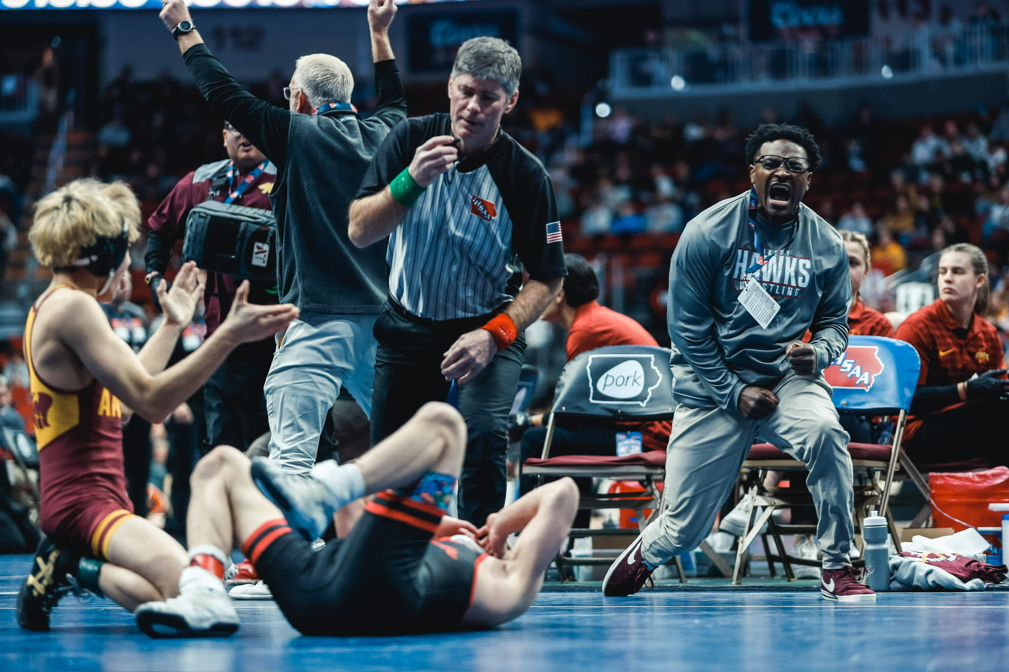
ANKENY WRESTLING

Slide 3
ANKENY WRESTLING
Ankeny Wrestling Club
Parents Night
September 25th, 2025

Slide 4
AGENDA
Club History
Admin Notes
Store Front
Picture Plan
Introductions
Philosophy
Practice Plan
Coaching Plan
Competition Plan
Clinic Plan
Meet Your Coach

Slide 5
ADMIN NOTES
AAU Card MUST be registered to: Ankeny Wrestling Club (UKK562STD)
Athletes will only go to their appropriate age group room. Bump ups are only for weight safety.
Door Monitor Sign Up: Both Open and Close
Room Parent – See Danielle
Tournament Volunteers – We need better help, younger support older | older supports younger
App and Communication, Door Number on the Calendar and App
TrackWrestling.com
IAWrestle.com
Athletes shower after practice
Shoes are highly recommended; some are here tonight | Donate Table in the back
Practice in snug shirt and shorts – Warm Clothes
Pick Up Plan for Kids – Can’t wonder around facilities
Notes:
Thanks for All you did last season, and for what we will do this season
2. Key Dates:
First Practice, October 2nd
Ankeny Helmkamp Tournament, December 10th
Christmas Break: No practice December 22 – January 2nd, Start January 3rd
Iowa State University club night for AWC, January 12th
Ankeny Classic Tournament, January 14th
State Prep Begins, January 22nd
AAU Districts, February 4th
AAU State, February 24th – 25th
Pee Wee State, March 2nd – 3rd
3. Tentative Tournament Schedule:
Shoes (No street shoes on the mat, including parents); shower after practice.
Form Friendships
Follow instructions from coaches, to include staying in the room and on breaks
Wrestlers cannot wait outside the school for parents to pick them up.
High School wrestlers will attend practices to help.
Sportsmanship matters all the time. It is the only reason you will be asked to leave the club.
Tournaments are recommended, they are not required.
Stay off the equipment in the rooms.
Be respectful of the equipment.
Get better at wrestling.
Expectations of Parents
Positive encouragement for all the kids.
Volunteer as Door Holder, Tournaments, Fundraising, Room Parents (Jenn Beal), and event leads.
Room Parent is a great way to get started on leadership in the club.
Door Holder is school safety policy.
Talk to your room coach about helping…you must help all kids…only coach in the room – not tourney.
Pick up kids in a timely manner.
Be ambassadors for wrestling in your circle of influence.
Fees cover club shirt, memory mat, practice

Slide 6
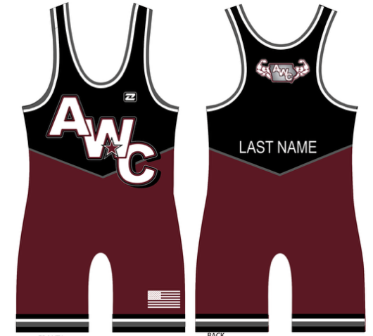

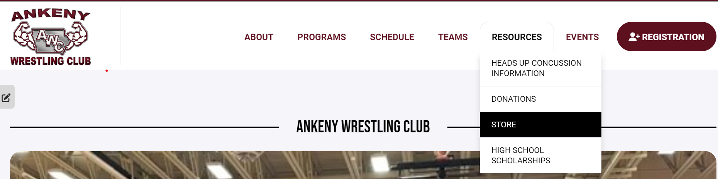
STORE FRONT
T-Shirt Design and Plan
Singlet Design
Store Plan - Direct Ship

Slide 7
Lori
PICTURE PLAN
Not During Practice!!!!
Sandeen Photography
2825 S Ankeny Blvd Suite 105,
Ankeny, IA 50023
Sign-Up Posted on the Website
November 3rd & November 4th
Athletes
Coaches
Board Members

Slide 8
INTRODUCTIONS
Executive Leadership
Director of AWC, Matthew Stephenson
Treasurer, C.T. Hammond
Secretary, Lori Staples
Director of Competition, Jared Gledhill
Director of Events, James Sparks
Board Members
Head AWC Coach, Anthony Smith
Head Girls Coach, Dustin Roland
Head Jags Coach, Jay Groth
Head Hawks Coach, Jack Wignall
Room Coaches
Kindergarten = Justin Mendenhall
1st – 2nd = Nick Lawrence
3rd – 4th = Jason Krohn
5th – 12th = Anthony Smith
Kurt Backes
Mitch Mueller
Executive Staff
Apparel Director, Mallory Odendahl
Communications Director, Danielle Welch
Marketing Director, Tori Sorensen
Coaches will be introduced as part of the coaching plan

Slide 9
PHILOSOPHY
Board Members
Head AWC Coach, Anthony Smith
Head Girls Coach, Dustin Roland
Head Jags Coach, Jay Groth
Head Hawks Coach, Jack Wignall
Philosophy
Goals
Training
Sportsmanship
Notes:
Coaching Philosophy
Goals
Training Objectives
Sportsmanship

Slide 10
PRACTICE PLAN
Regular Season
Post Season
Kindergarten | M
(Boys & Girls)
K – 1st – 2nd | M – T – Th
(Boys & Girls)
1st Grade – 2nd Grade | T – Th
(Boys & Girls)
3rd Grade – 4th Grade | M - W
3rd Grade – 8th Grade | M – T – Th
(Boys & Girls)
5th Grade – 7th Grade | M – T – Th
3rd Grade – 7th Grade | M – W
(Girls)
October 6th – December 22nd
NOTE: 3rd – 8th in same room until October 22nd
December 27th – March 8th

Slide 11
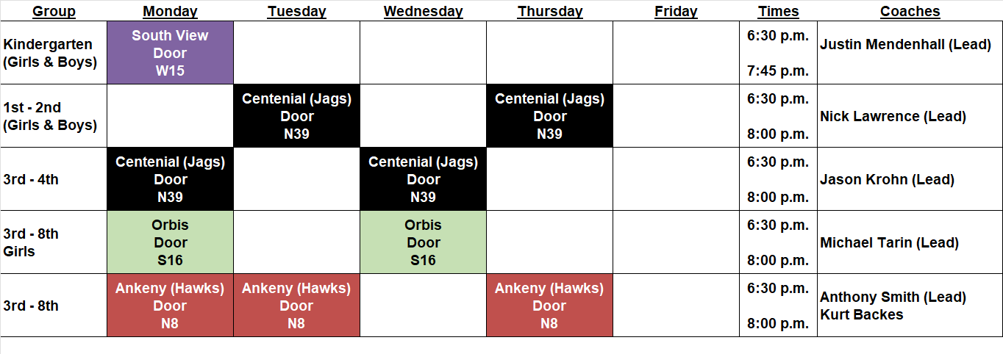
COACHING PLAN
Coaches come up for Introduction
Notes:
Advanced Room is Closed: New Wrestlers in this Room will have special development for ~45 days
Bumping up to the next level will be handled by the coaches: we will look at bumping up wrestlers after the beginner’s tournament: past state level place winners will be partnered up in Advanced Room on non-conflicting days: some Dad’s are in the room with their kids as a volunteer coach, their kids will be allowed in the room and can bring a partner.

Slide 12
COMPETITION PLAN
Tournament AWC is attending as a team
Comet Wrestling Youth Tournament, Intermediate
  November 22, 2025
ADM Tournament, Beginners
  December 7th, 2025
* Ankeny Duals Helmkamp, Invitational
  December 14th, 2025
* Ankeny Wrestling Club Classic, Advanced
  January 18th, 2026
Additional Future Adds:
  Girl’s Tournament x 1
  Beginner’s Tournament x 1
  Intermediate Tournament x 1
Dual Plans
Weight Specific
Wrestle-Offs Required
Run a Dual Tournament
Coordinate a Dual Tournament
Age Groups Tentative Design
Rules
* Hosted by the AWC

Slide 13
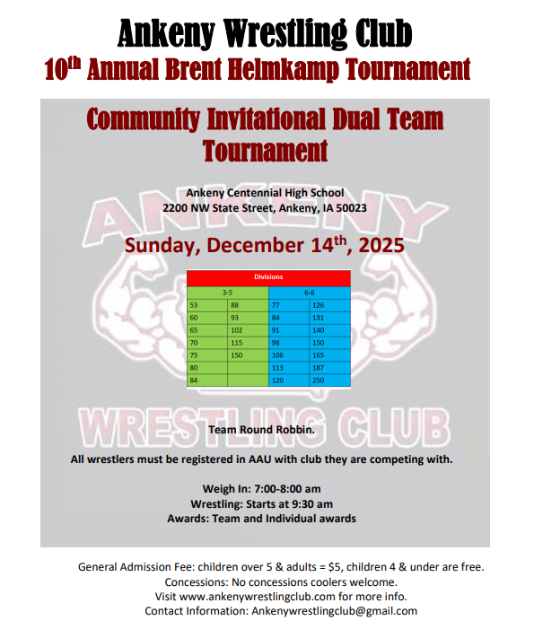
DUAL PLAN

Slide 14
CLINICS PLAN
Tentative Clinic Dates
October 25th, 2025 (Girl)
November 8th, 2025 (Boy)
December 28^{th,} 2025 (ISU)
Concept of Clinics
2 hours long
Conducted by high level guest athletes
Registered AWC Athletes 3rd – 7th
All Ankeny Wresters 8th – 12th
Iowa State University Practice
December 28th, 2025
Open to All Post Season Registered Wrestlers
Ankeny H.S. 8th – 12th that aren’t at risk of recruiting violation

Slide 15
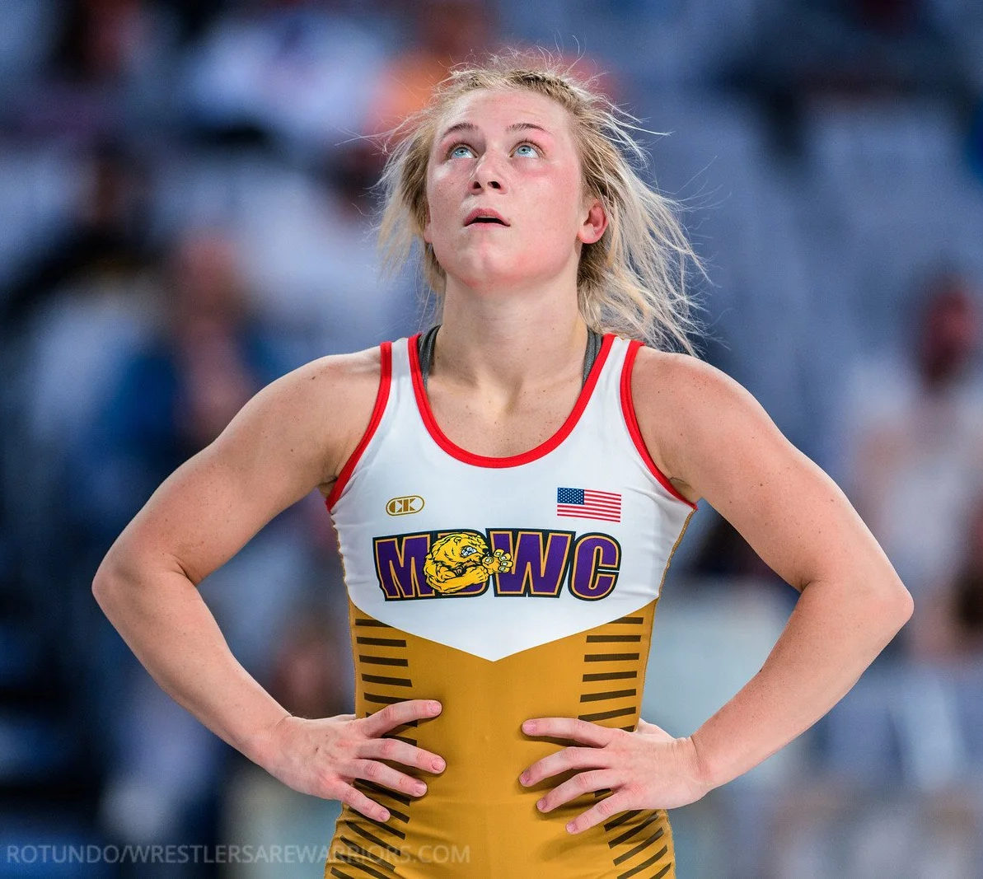
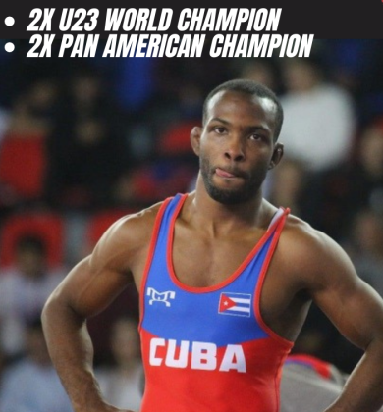
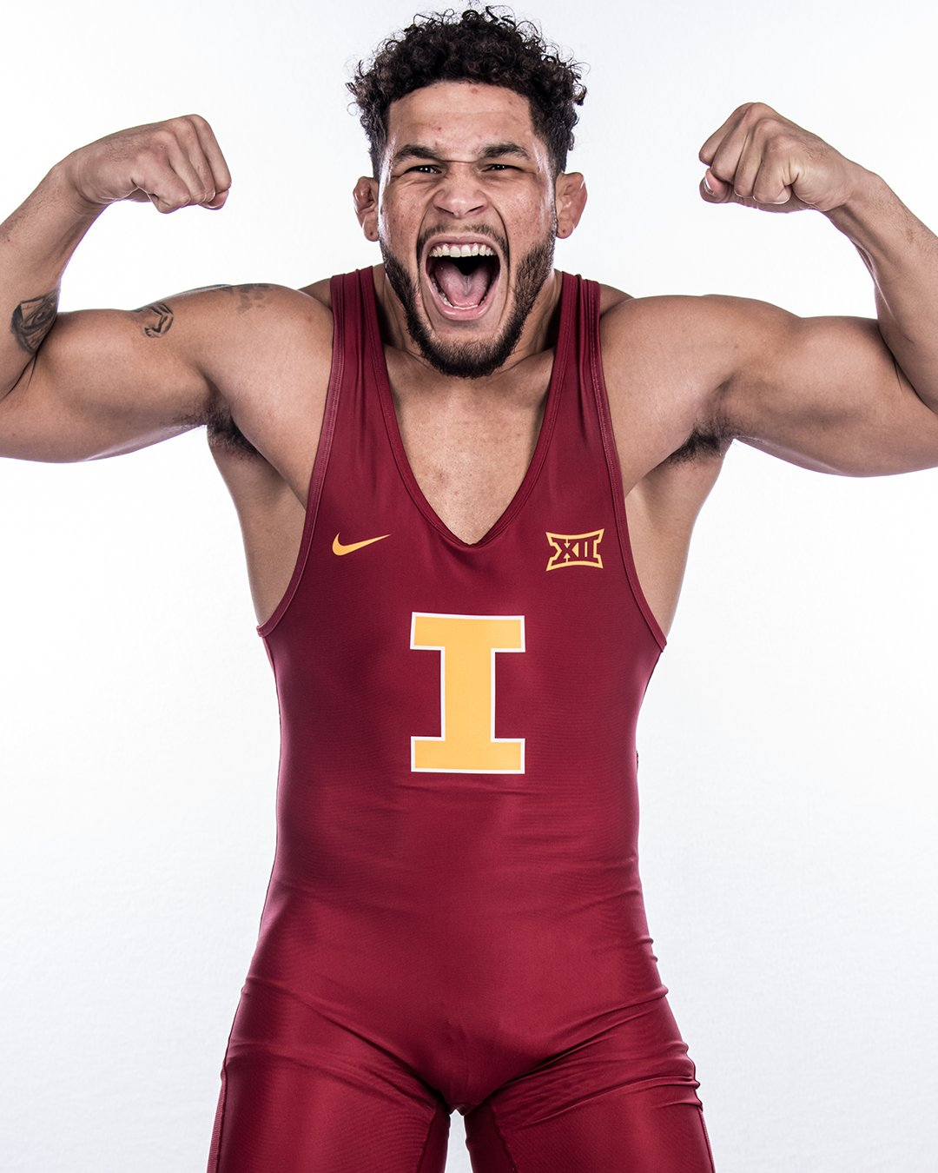
CLINICS
Felicity Taylor
Reineri Ortega
Yonger Bastida
October 8th, 2025
November 8th, 2025
December 28^{th,} 2025

Slide 16
MEET YOUR COACH
Thanks for being part of the Ankeny Wrestling Community (AWC)!

