Slide 1




October 2025 Newsletter
Irish News
Coyote News
Irish is currently 1-2-0 in league play, and 2-2-0 for overall play.
Sleep in Heavenly Peace has been rescheduled for October 18. Information was shared on Crossbar.
Registration for the South Bend Leprechaun Lash Out tournament, November 28-30th, isn’t looking promising for our division. There is an alternative option, also in South Bend for that weekend. More details to come.
We also plan to register for another tournament February 27-March 1 to end the season.
7th and 8th grade Skate with the Irish will be held Thursday November 13th during the Irish practice. This will be open to any and all 7th and 8th graders that will be attending one of our combined team schools for high school. More information and sign-ups coming.
Senior Night has been set for January 24^{th.} Parents, please let Lisa or Crystal know if you are interested in helping plan.
We will be wearing the kelly-green CCM shells for this season. The board will discuss adding a new shell to the uniform for next season.
Picture Day is October 23rd. All players should wear their dark jerseys and socks, no helmets needed for pictures. Picture galleries will be sent out within a week from picture day, orders can be placed through the gallery.
Pre-tier play has begun!
Peewees are 1-0 after their first game.
Mites, Squirts and Peewees play this Saturday!
Bantams have their first game Oct 18.
Reminder that picture day for mites and squirts is Oct 22. Peewees and bantams are Oct 23. All players should wear their maroon jerseys and socks, no helmets needed for pictures. Picture galleries will be sent out within a week from picture day, orders can be placed through the gallery.
NWHL is having a 2026 spring season! We’re hoping to have teams at all levels again, managers will send out spring surveys closer to the end of the season so we can plan.
We have a few things closing soon, fundraisers and spirit wear/decal orders both will be ending this month. Check the family calendar or your team schedule on Crossbar for those dates!
Check it out!
Head to the parent tab on the web site to find all the important documents and dates for club wide happenings!
https://www.kankakeehockey.com/parent-resources/2025-2026-parent-resources/126707
Head to the volunteer tab on the web site to find volunteer opportunities!
https://www.kankakeehockey.com/dashboard/volunteer

Slide 2


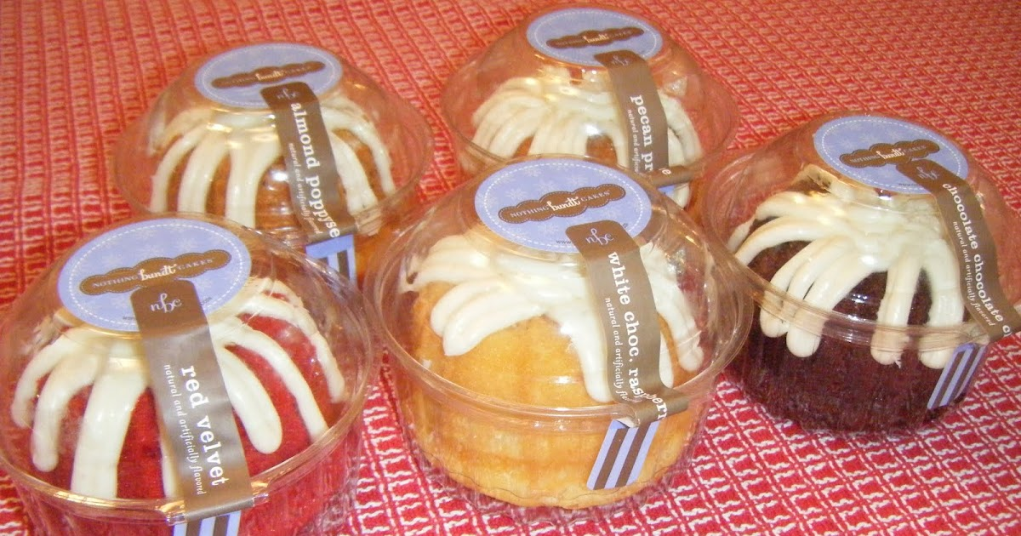
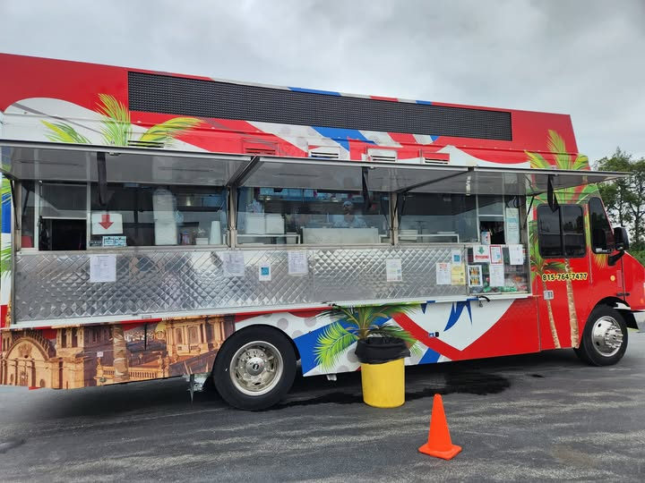
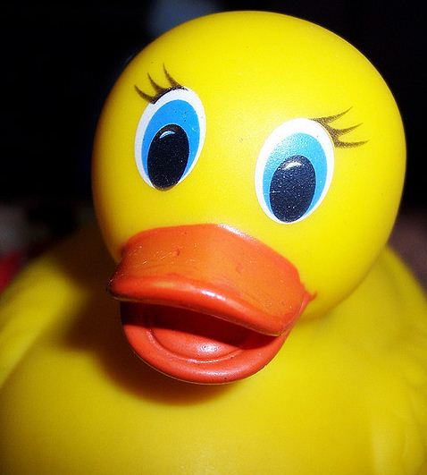

KYHC Day
November 1, 2025
Let’s celebrate KYHC and all of our teams!
Stay to watch some of our other teams play!
Enjoy the extra events happening!
Invite your family and friends!
Game Times
● Bantam: 2:00pm
● Mite: 3:15pm
● Squirt: 4:30pm
● Peewee: 5:45pm
● Irish: 7:00pm
Details
Chuck-a-Duck
Food
Chuck-a-duck profits will go to the teams. Sign-ups will be included with the main
volunteer options
on the website.
Tacos El Guadalajara will be set up in the parking lot from 1:30-7:00.
Ice Valley Concessions will have pulled pork sandwiches in addition to their regular offerings.
Nothing Bunt Cakes will be back.
Split the Pot
Will be sold throughout the day and the winning ticket will be drawn during the Irish game
Raffle Baskets
Families are encouraged to get donated baskets from the community. (You may still create your own baskets.) Basket donations will count towards volunteer hours. (every $20 in value = 1 credit hour).
Please reach out to Kristi Porter (815-914-3529) with questions about baskets, help with ideas, and to turn baskets in. see attached form.
All baskets are due by October 30!
Help Needed
Volunteers will be needed throughout the day. Parents are asked to volunteer for a time slot on the website under the volunteer tab.
WE NEED YOU!
Tickets for raffle baskets will be sold during all games. The drawing for winners will happen during the Irish game. Winners need not be present to win.

Slide 3

Ad Book
Little Ceasars Fundraiser
Dine and Donate Day
Submissions Extension: Due 10/30/2025
See the Flyer for details.
Questions? Email KYHCAdBook@hotmail.com
Help raise funds for the club. Money raised during dine and donate days is used to supplement KYHC’s operating budget.
Sales Close 10/12/25
https://fundraising.littlecaesars.com/login/join-fundraiser/4c315643-75cc-41eb-85fe-4d8faea697ae
Picture Day
Wreath Fundraiser
October 22nd – Mite & Squirt
October 23rd – Peewee & Bantam
October 23rd – Irish
Wear dark jersey and socks
No helmets
What: 20% of all sales will be donated to the club
Where: Panda Express in Bradley
When: Thursday October 30th all day
How: Use the code 3847258 or show the flyer
See attached Flyer.
Information coming!
Did you forget a piece of gear?
HELP NEEDED!
There is shelf of used donated gear in the Ice Valley storage closet. This gear was donated by KYHC families. Just ask at the front desk.
Highschool Partnership Committee
Marketing and Promotions
Lisa Paschall is stepping down from the Marketing and Promotions Chair. The club thanks her work as in this role over the past few years. She will continue to be involved with the committee.
The committee chair person is responsible for organizing, managing, and delegating tasks related to marketing our club. Please consider volunteering to lead this committee. They have already done some great things for the year!
We are also looking for a volunteer to focus on recruitment of new players/families.
Please reach out to Corinne at Volunteer@kankakeehockey.com
We are hoping to partner with area schools. This year our initiative will be to reach out to high schools in an effort to get our players recognized! They continue to look for volunteers for the unrepresented schools.
The committee has sample messages, emails, and talking points for volunteers. Plus, you have the support of the committee to bounce ideas off of!
We currently have representation at Bishop McNamara, St. Anne, Herscher, and Manteno.
Please consider signing up on the volunteer tab to represent our other schools!
Follow us on Facebook
https://www.facebook.com/kankakee.coyotes
https://www.facebook.com/KankakeeIrishHockey

