Slide 1


BPBA Parent Meeting 2025-26

Slide 2

Season Overview:
BPBA overview
Registration and Fee information outline
Practice and Tournament Information
Volunteer/Dibs
Coaches
Parent and Player Expectations

Slide 3

About BPBA
Belle Plaine Basketball Association (BPBA) was founded in 2006.
Is a proud member of the Mn Youth Athletic Services (MYAS). This is who helps to support and host a lot of the tournaments and leagues through the state for basketball, including the Mn state tournament.
Board Members:
Shelly Williams (President) Tom Endres (Volunteer Coordinator)
Peter Klaverkamp(Vice President) Rebecca Tanner (Website/Social Media)
Andy Holiday (Tournament Director) Brady Wohler (non-voting member)
Tara Henke (Facilites Coordinator) Elliot Rudd (non-voting member)
Terry Schmidt/ Brady Hartmann (Uniform/ Player Experience)

Slide 4
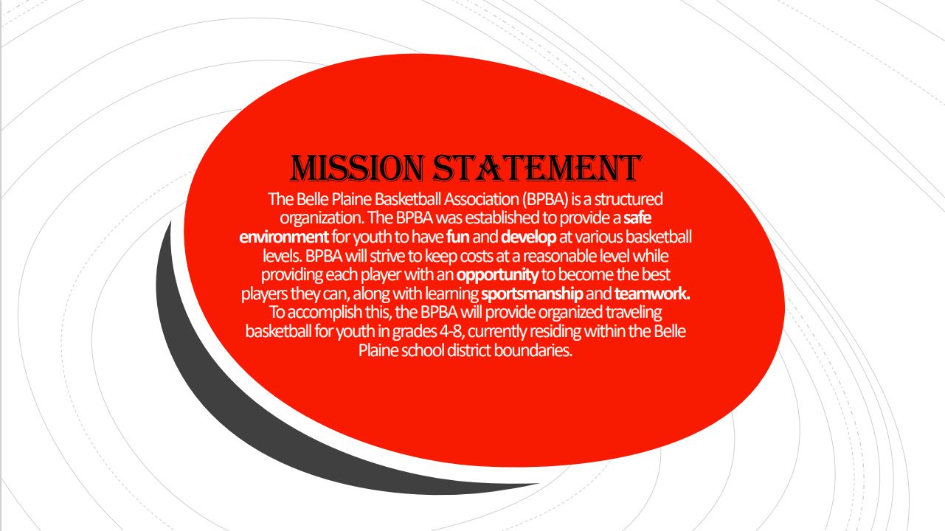

Slide 5

Tiger Paw Challenge Tournament
Tentatively Jan18 or 19th 2026
Includes both Boys and Girls 3 /4 -8th Grade
This will be the opportunity to get volunteer hours (set up/concessions/gate)
(Change from the previous years, which had two tournaments)

Slide 6
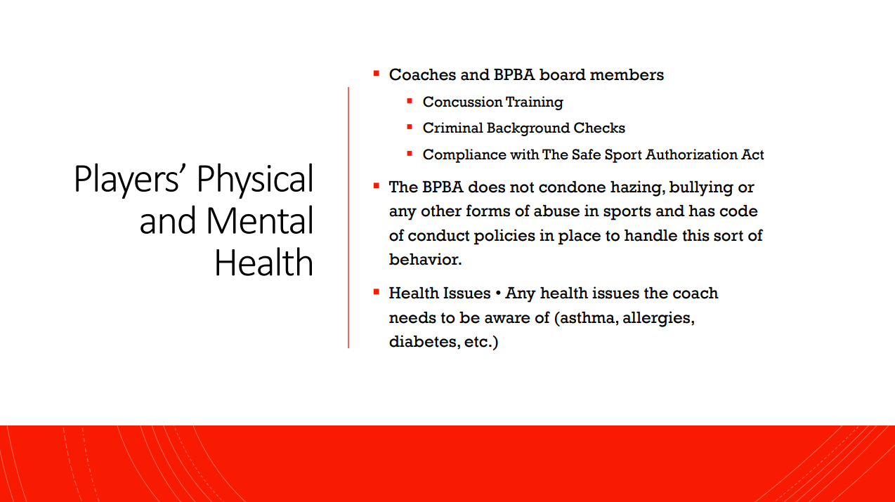

Slide 7
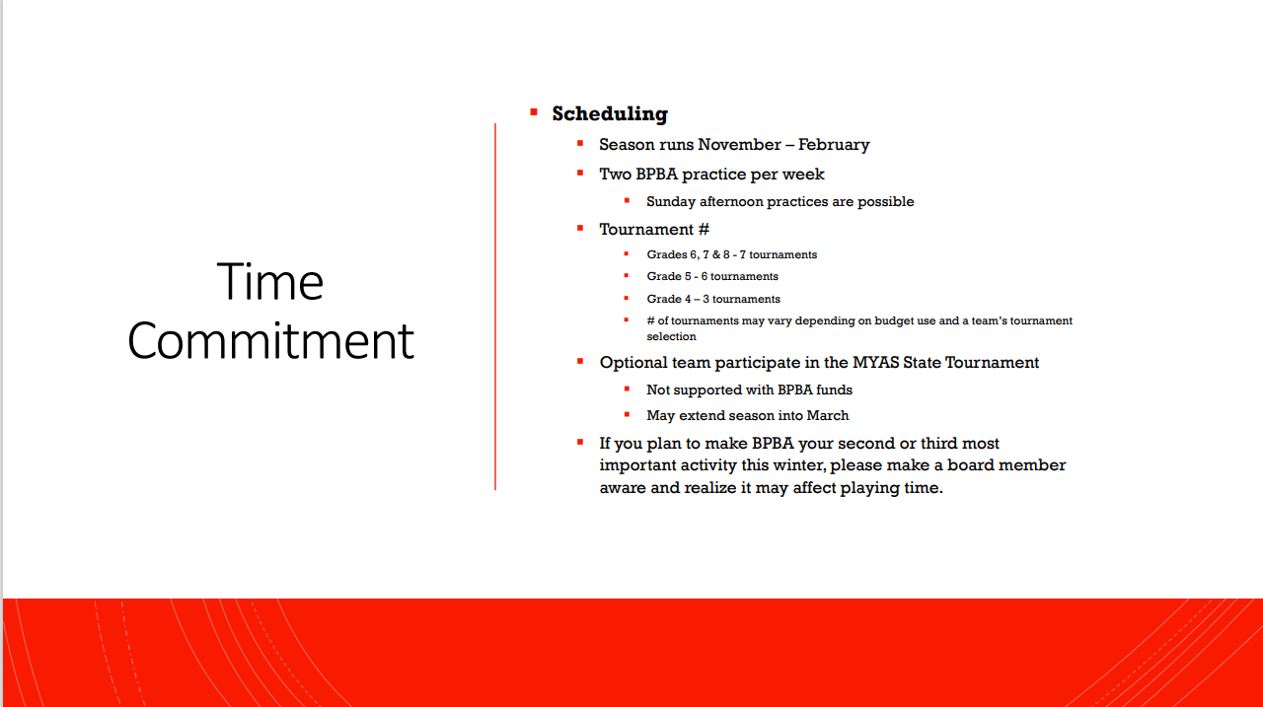

Slide 8
Financial and Volunteer Commitment
Uniform Fees
Same Uniform as 2024-25
Full Uniform cost is approx. $110 (jersey and shorts are $55 each)
Tournament/ Facilities Fee
4th Grade
5th Grade
6-8th Grade
This covers insurnace, tournament fees, facility fees, equipment etc.
Shooting shirts will be provided to players at no charge
Volunteer Commitment
6 hours per player
$300 check due at time of tryouts/evaluations as a deposit for volunteer hours (Max cap of 12 hour per family with $300 check)
Checks are shred when hours are complete or in the event child is not placed on a team.

Slide 9
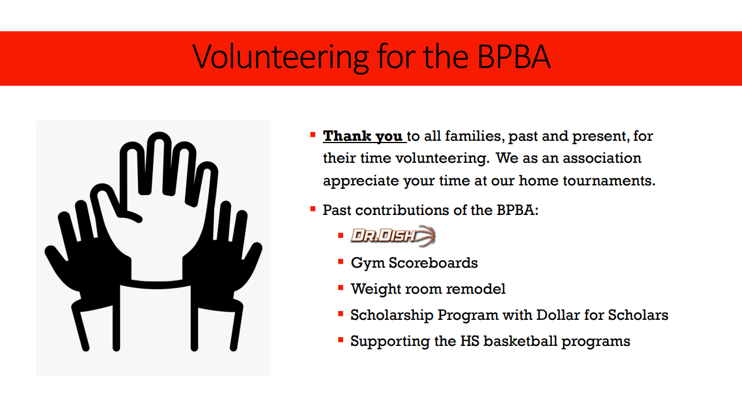

Slide 10
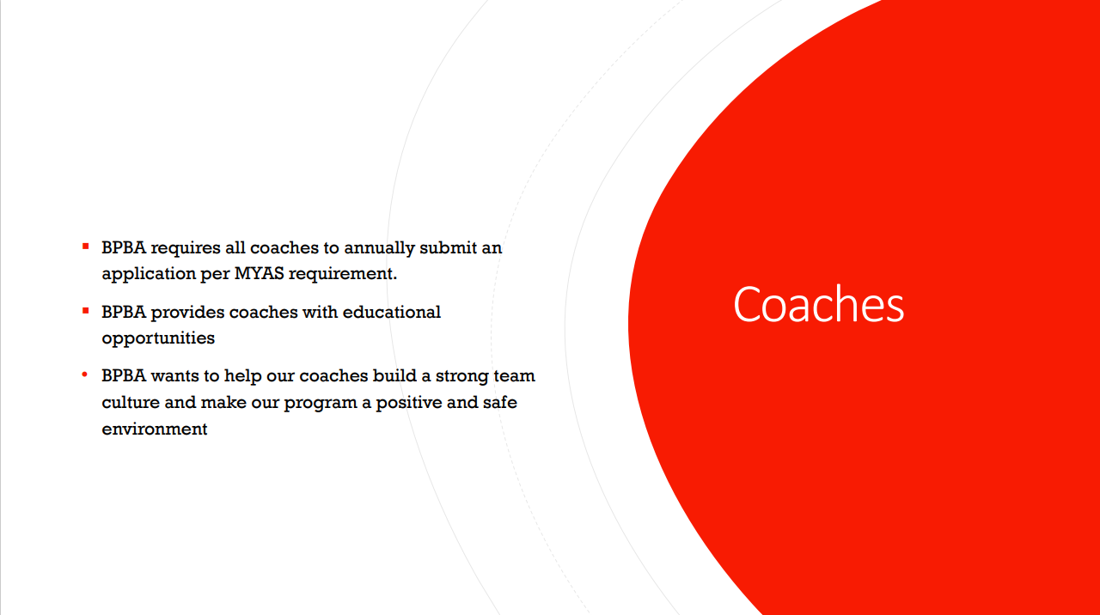

Slide 11
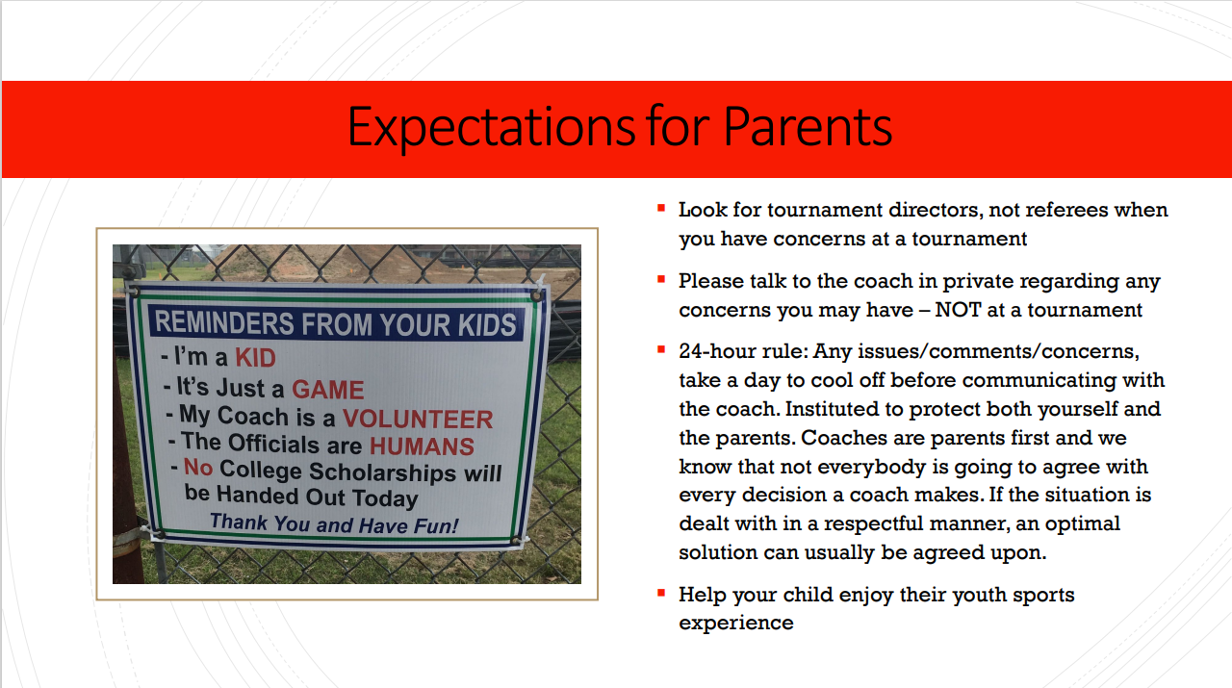

Slide 12
Player Expectations
1. Effort and Attitude
Always give your best effort.
Stay positive.
Support teammates.
2. Learning and Development
Focus on fundamentals.
Be coachable.
Ask questions.
3. Teamwork and Sportsmanship
Play as a team. uccess.
Respect everyone.
Celebrate effort, not just wins.
4. Practice and Attendance
Be on time and ready.
Practice consistently.
Communicate.
5. Game Day Behavior
Follow the game plan.
Stay focused.
Handle wins and losses with grace.
6. Academic and Personal Balance
School comes first.
Balance sports with rest and fun.

Slide 13
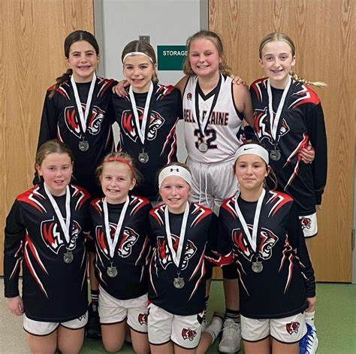
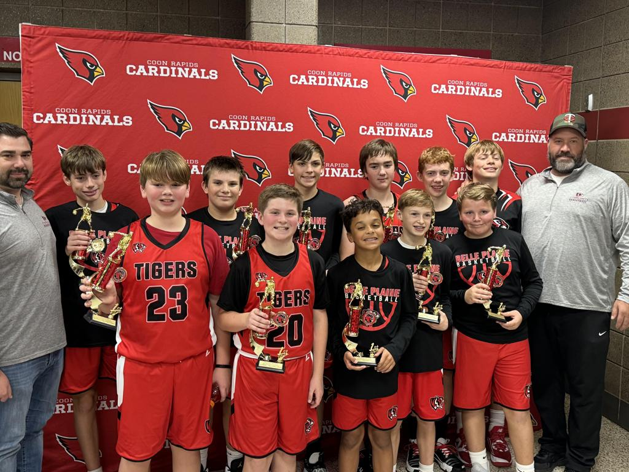
Thank you...
BPBA

