Slide 1

2025-26 Coaches Meeting
September 8, 2025

Slide 2

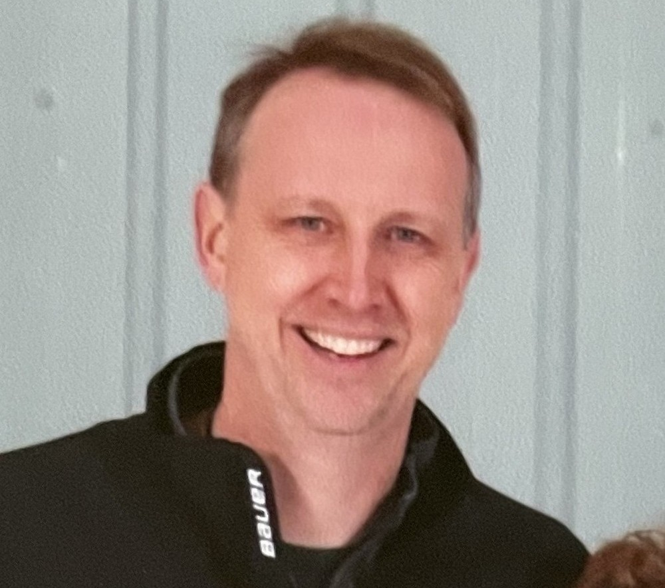
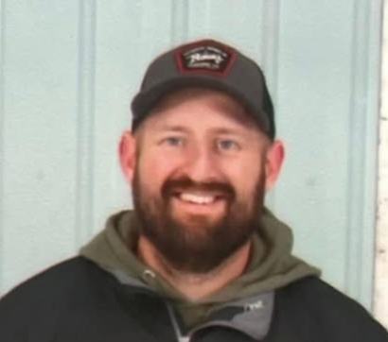
NIHA Leadership Team
Jeff Laird
Hockey Director
USA Hockey ACE Coordinator
Brad Cook
President
Mike Eckhardt
VP

Slide 3
Housekeeping
Coaching Requirements
Background check - every 2 years
SafeSport - yearly
Concussion Training - every 3 years
  CDC “HEADS UP to Youth Sports Coaches”
  National Federation of State High School Associations (NFHS) “Concussion in Sports”
Appropriate USA Hockey courses and Age Specific Modules

Slide 4
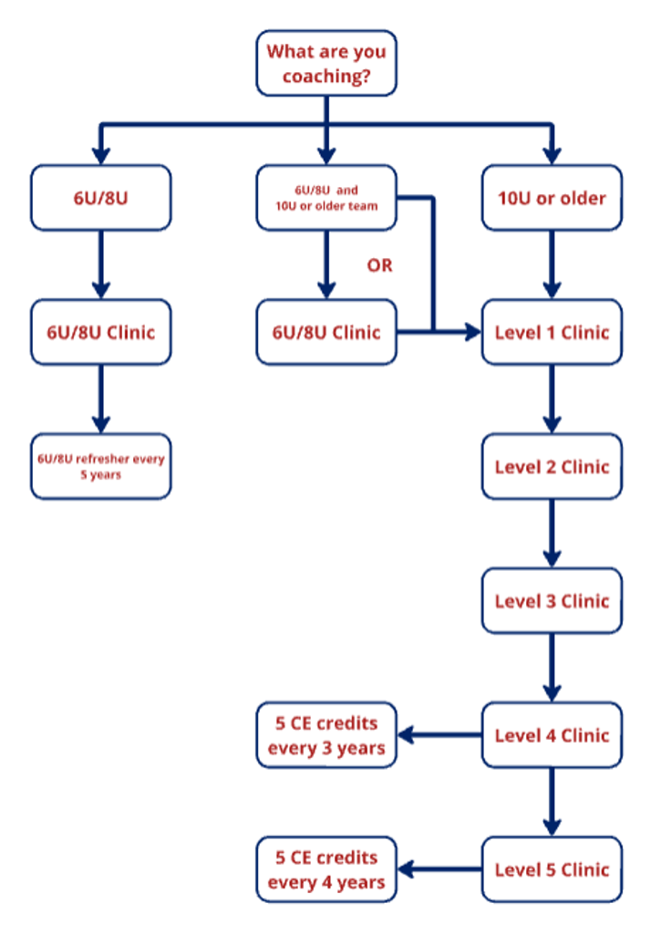

Slide 5

Thank You For Coaching!
Strength Through Community
Volunteers are the life blood of the organization
Your time, effort, and energy are appreciated!
You make a huge difference in teaching young people how to interact, bond, grow, and learn how to overcome adversity

Slide 6
Coaching Introductions
Name?
What level you will be coaching this year?
How many years have you been coaching?

Slide 7
Practice Schedules
House and travel teams will have 2 practices a week
Fundamentals night will return
  Combined house and travel practices working on skills
  House and travel coaches should mix in stations and share ideas
  Plan will come from members of the coaching committee

Slide 8
Games
Travel Teams will play in MCHL
12U and 14U House will play in the B division of BTHL
Both of these leagues will have a seeding tournament to try to evenly match teams
  Each team will be given allotted home game ice slots. It will be up to coaches or team managers to work out a schedule with opponents using your allotted team home ice slots and what opponents offer for away games
10U will play in the CBJ House league
At the time this slide is created, there are 32 players registered at 8U. 8U can divide into house teams and scrimmage each other or arrange for outside games if they can find willing opponents
8U Select

Slide 9
BTHL
Why????
Play with similar size, community based organizations
We won’t be the one team that sticks out in the different jersey
Allow more flexibility in scheduling out of league games
This year is a trial run and it will be reevaluated at the end of the season

Slide 10
General Structure of a Practice
Plan ahead, give definitive assignments, keep a general schedule
Make sure someone puts a plan together before arriving at the rink
Delegate drills and set up to assistant coaches before practice
Make sure all coaches know and have a chance to review their assigned drills several hours before practice starts
Ice time is really tight. Make sure from the second you hit the ice, there is a plan for every minute of it. Its okay to be flexible if a certain drill isn’t working.
Make sure everyone knows when the next set of drills need set up and what their responsibilities are
Consider sending practice plans to players

Slide 11
General Structure of a Practice
You will have flexibility in how you structure practices based on the needs of your team, your assistant coaching staff, and your personal preferences
Suggested flow:
  General Warm Up
  Skills based stations
  Some form of game play in each practice
  End with a positive statement
Make sure you fully utilize skills and student coaches at your practice
High school players have a lot of experience and knowledge they don’t know how to communicate .

Slide 12
General Structure of Practice
Drill Selection
It is easy to get overwhelmed with the catalog of drills that are out there
Build your season plan
  Planning ahead helps keep you and the team on task
  Plan what skills you want to improve through the season
  Kids gain confidence by repetition
  Select 10 or so core drills you will do regularly all season
  Think about how you can progress those drills to meet the goals of your season plan

Slide 13
General Structure of Practice
Skills Coaches
Rob Sangster
  Professional hockey player, high school coach, trained NHL players
  Likes coaching here because he believes our kids are grittier, more resilient than suburban Columbus kids
  He needs to be noticed and used. You can ask him about how to work on about anything and he will have a drill or station for it.
  At a minimum, give him space for a station and have kids rotate through with him.
  He is pretty self sufficient, but expects some recognition he is there
You also can bring in skating or goalie coaches. Any other skills coaching must be approved by the coaching committee

Slide 14
General Structure of Practice
Student Coaches
High school players have a lot of experience and knowledge they don’t know how to communicate
  Know when they will be at your practice. It is your responsibility to know and tell what you want them to teach
  Do not tolerate them standing by and socializing. They love the game and they will help you a lot if you help guide them.
  Your diligence on this will help them become better by helping them understand what they know
    It will exponentially benefit your players

Slide 15
General Structure of Practice
Know Your Absolutes
Have a list and clearly communicate 3-5 simple, absolute expectations
Be consistent and demanding on those. Have consequences for violations.
Examples
  Everyone in, focused and ready to listen within 3 seconds after a whistle
  3 hard strides after gaining puck possession
  Look up before every pass
  Communicate before every pass

Slide 16
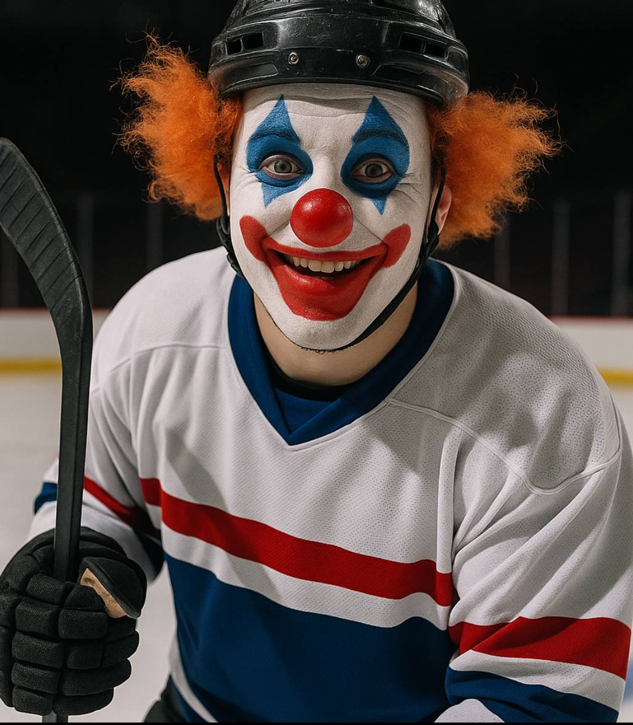
General Practice Structure
Make Sure To Keep It Fun!!!

Slide 17
Benefits of Positivity
Attitude Is Everything
Seeing mistakes is the easy part
  Don’t make it the focus
“Try it this way next time”
Tell kids how much better they are getting or will be as they gain the skill you are working on
Grows confidence
Builds enthusiasm
Try to always end with a positive or aspirational statement
  We want them excited to come back out

Slide 18
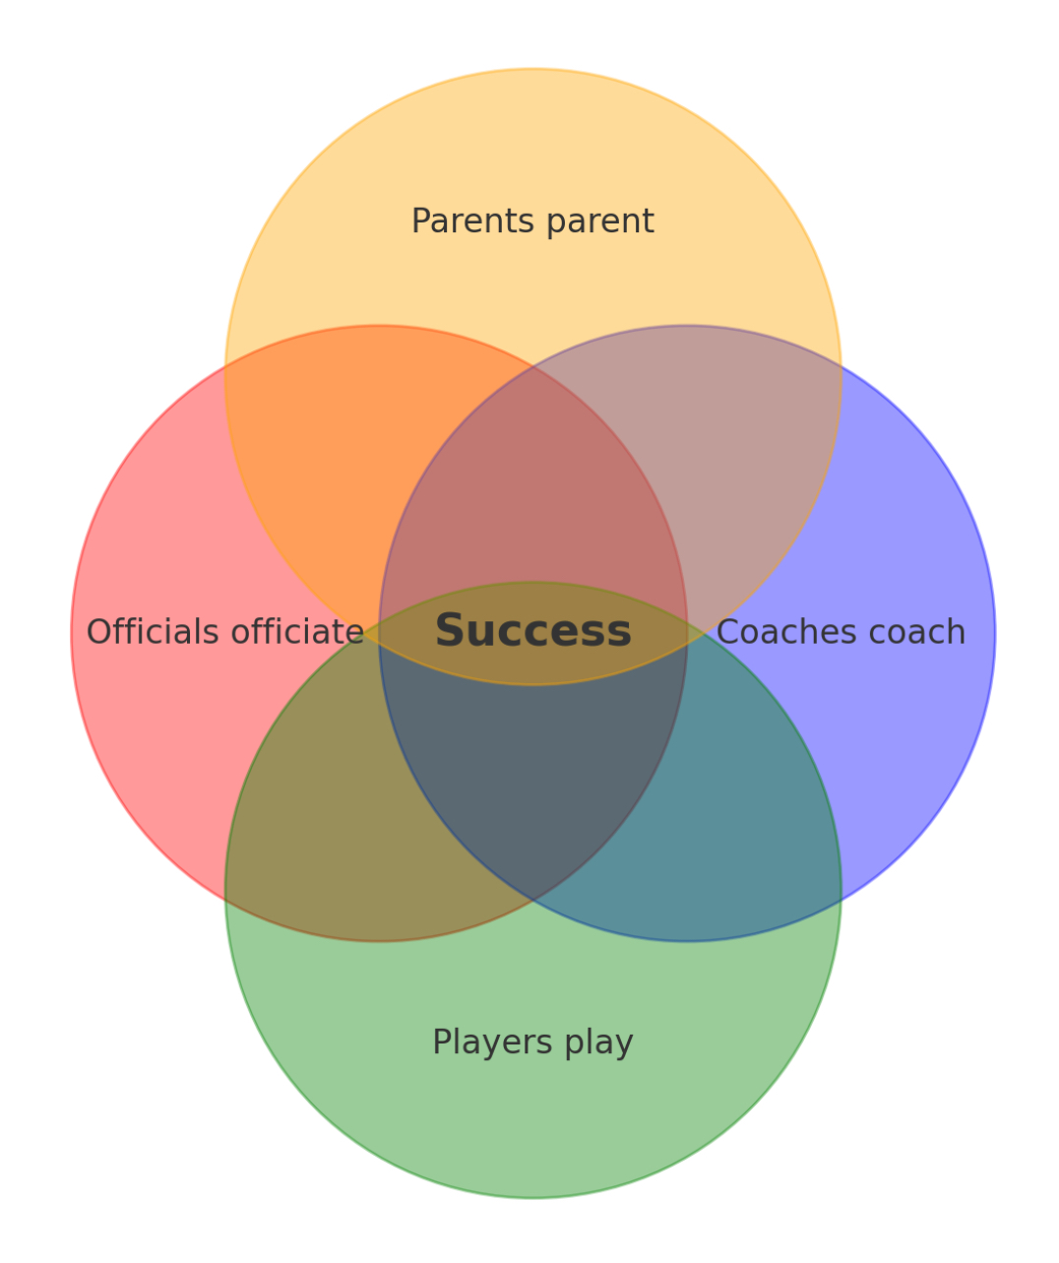
Game Day Experience
Best results when everyone stays within their boundaries

Slide 19
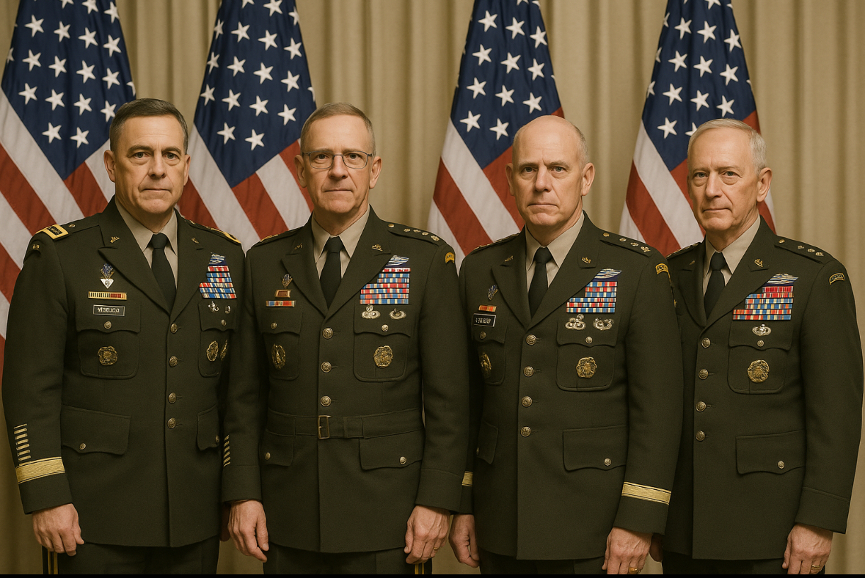
Coaching
Game Day Expectations
You represent all Generals
Do not yell at refs
Asking for explanations followed by a thank you is okay
Players should not interact with officials

Slide 20
Officials
Official for home games are assigned by 614 Refs
If there are any issues or feedback, put it in writing so I can address it with their leadership
  Some home games may have only 1 ref
  Please deal with it and coach around it
Refs are low paid employees/volunteers doing it because they love the game
Most are in some phase of learning
The only way we get better refs is by having more people wanting to do it!
Bench minors suck and 99% of the time hurt your team and your messaging

Slide 21

Parent Engagement
They spend a lot of time and energy on the game to
They will get involved whether you try to engage them or not
Outlining expectations early prevents future problems
  Parent meeting(s)

Slide 22
Parent Engagement
Find ways to positively engage them
  Team manager
  Locker Room Monitor
  Scorekeeper
  Penalty Box
  Statistician
  Social Coordinator (birthdays, etc)
  Social media engager

Slide 23
Locker Room Monitor
Every team needs to have an assigned locker room monitor(s)
  Need to be SafeSport certified
  Responsible for making sure the locker room stays SafeSport compliant
  Ensure players treat the facility respectfully and leave locker rooms the way the entered
  Can be in the locker room or immediately outside

Slide 24
Parent Engagement
Help them gain perspective
  Car ride home
    “I enjoy watching you play”
    Avoid discussing the game or practice unless the player brings it up
    Their attitudes and perspective affects the kids
      Blaming refs, coaches, other players breeds excuse making
  Kids are here to grow through adversity. Mistakes, including discipline issues, are learning moments.
    Defensiveness interferes with learning opportunities

Slide 25
Discipline Issues
Most issues should be dealt with within the team
Major Issues, including SafeSport violations should go to the board’s discipline committee
Leadership is here to help
  If you don’t know, ask

