Slide 1

2025 Coaches Q and A
Date: Sept 10,2025
Officials Coordinators: Ben Franson, Travor Silbernagel, Ryan Weiser
Ben Franson: Bfranson@midco.net
Traver Silbernagel:twsilber2@gmail.com
Ryan Weiser- MRIbuddyweiser@msn.com
Notes:
Welcome to 2025 coaches Q and A session #2. Thanks for joining and this is an opportunity to answer any questions you may have; however, we are not here to debate any rules or officials decisions.

Slide 2

Agenda
  Welcome first Q and A
  Meeting expectations-etiquette, not a dispute
  What are your questions?
  Why?

Slide 3
Common Questions
  Can we double team, reach block, pull linemen, crack back block? No, heads up blocking, safety issue
  Can my backfield player play TE or WR second half? Yes, but no player can play more than 6 total quarters in a game, unless injuries or roster issues.
  Do I replace my backfield out when we score td or after extra point? Extra point
  Can weight restricted player play Defensive end? If you have too many weight restricted players, can, however, can’t carry or catch pass.
  What do I do if my QB 2 gets hurt? Hopefully, you have QB 3, if not QB#1 can come back in because of injury, however, can’t run ball. Safety reason. Please communicate with officials and other team.
  Can player wear dark visor with doctor note? No, HS national rule, safety.
  Can linebackers and defensive back move up at goal line? No, they must be 5 yards, no matter where on field.
  Can QB run directly up zero hole? No, must move laterally 2 steps to each side with would be guard/center hole.
Notes:
We will go over the 2025 rules for FM again, as this was discussed with coaches back in July. Not many changes, other than clarifying things and cleaning up language.

Slide 4
2025 Rules
Notes:
Now that we have gone over the FM rules and changes, we will discuss some common things that have been shouted by coaches, and or fans. We will discuss illegal blocks in back. As you can see in this picture the player pushes him with 2 hands in back.

Slide 5
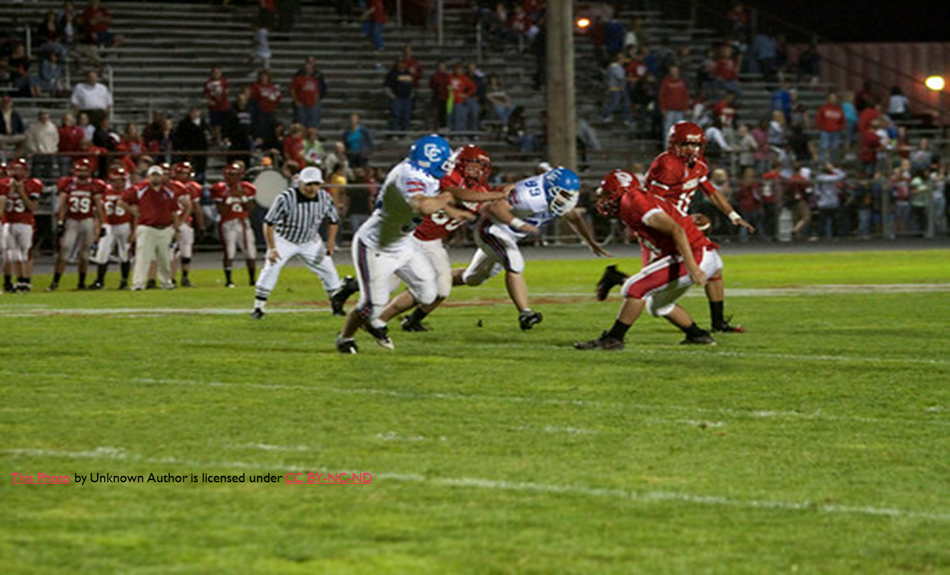
Illegal block in Back
Notes:
Notice the definition does not mention blocking on the side.

Slide 6
Illegal block in back BY Rule 9-5 High school rule book page 29 definition
Blocking in the back is a block against an opponent when the initial contact is in the opponents back, inside the shoulders and below the helmet and above the waist, and not against a player who is a runner or pretending to be a runner.
Notes:
Please note that initial contact is in the back. So, if a player starts on side and continues to block and now ends in back, this is not blocking in the back.

Slide 7
Illegal block in back BY Rule 9-5 High school rule book page 73 penalty
A player shall not block an opponent in the back except:
In the free blocking zone when contact meets requirements of 2-17.
Using hands or arms to contact an opponent above the waist in warding of a blocker, or when attempting to reach a runner, or catch or recover a loose ball which he may legally touch
To tackle a runner or player pretending to be a runner

Slide 8
Illegal block in back BY Rule 9-5 High school rule book page 73 penalty
In the free blocking zone when contact meets requirements of 2-17.
  Blocking in back permitted in free blocking zone when offensive players involved in blocking are on the line of scrimmage and in zone at snap.
  The contact occurs in the zone.
  Against defensive players who are in zone at the snap.

Slide 9
Casebook 9.3.4 page 79
Offensive lineman A1 is on his line of scrimmage and in free blocking zone at the snap. Immediately after the snap he drops back on step and move 3 steps to inside and while still in free blocking zone contacts B1 in back
Penalty or Not?

Slide 10
Casebook 9.3.4 page 79
Legal block by A1. Blocking in back does not have to be immediate.
A9 is approaching B10 in open field and at angle and pushes him in back with one hand and the other hand on the shoulder.
Penalty or not?

Slide 11
Casebook 9.3.4 page 79
This is an illegal block in back per rule 9-3-5.
https://www.youtube.com/watch?v=XAIfXpo9Gqk

Slide 12

Questions

