Slide 1

2026-2026 SEASON INFORMATION
River City Hockey Travel Association, LLC
d.b.a., San Antonio Youth Hockey Association

Slide 2
2025-2026
Board of Directors
Lindsey LeBlanc: President
Eric Helstedt: Commissioner
Chris Hill: Vice-President
Clint Hooker: Assistant Commissioner
Jesse Feragen: Treasurer
Shawn Thepuatrakul: Secretary

Slide 3
2025-2026
Jr Rampage Head Coaches
  10U:
  12U:
  14U:
  16U:
  18U:
  H/S:

Slide 4
2025-2026
DSTHL Season
  Leveling tournament will be played _____________
  The THL season consists of a regular season with approximately twenty (20) games played against teams from Austin, Dallas-Fort Worth, Houston, Odessa, Amarillo, Oklahoma City and/or Tulsa.
  Schedules are finalized and communicated 2-3 weeks after leveling. Games are scheduled on weekends between late September and late February.
  Playoffs take place at the end of the season and are scheduled Late February/Early March. For awareness, playoffs start on a Friday

Slide 5
2025-2026
Association Tournaments
  All players are expected to play in Association selected tournaments, and additional tournaments selected by your Head Coach
    THL Leveling Tournament is covered by your season dues
    Two additional tournaments are covered by your season dues

Slide 6
Tryout Facts:
Who’s Eligible
  Any child wanting to participate in Travel Hockey and who resides in/near San Antonio is eligible to try out for the Jr. Rampage.
  USA Hockey and the Texas Amateur Hockey Association (TAHA) establish the rules and regulations governing youth hockey on all levels including Tier I (AAA), Tier II (AA) and House/Rec (A / A2).
  In San Antonio, our association fields teams in Tier II (AA) and House/Rec (A / A2) divisions. As such, our association and players must follow the Community Based Rule.

Slide 7
Tryout Facts:
The Community Based Rule
  USA hockey mandates that Tier II and House/Rec players are community based. All players must reside in –state and the family’s domicile / permanent residence must be located within the same local community as the registered TAHA member association’s home rink.
    Residency must be THE PLAYER’S PRIMARY domicile
    Utility bills or additional documentation for proof of residency may be required
    Merely having a residence in a city is NOT sufficient
    If you want to play in another city in Texas, you will have to move your family to that location
    Further information regarding the community-based rule is available on the TAHA website (TAHA- OOC)

Slide 8
Tryout Facts:
What to expect during tryouts
  Tryouts are closed to all non Jr. Rampage Officials
  Each Age Division Head Coach is responsible for organizing and conducting the tryouts for their respective age groups. They will be responsible for creation of rosters and selection of additional coaches.
  Drills are designed to test the player’s understanding of the game, ability to take and apply direction, and to evaluate player work ethic and overall skill set.
  Scrimmages help evaluate application of the player’s skills to the game play.

Slide 9
Tryout Facts:
Cannot make tryouts?
  All players must be registered for tryouts to be considered for a Jr. Rampage team roster, regardless of ability to attend tryouts
  Coaches may be available to evaluate a player outside of the tryout session via local camps, house sessions, or other means.
    In order to qualify for a rostered position, players must be registered for tryouts
    Evaluation can be coordinated by reaching out to the commissioner and/or the assistant commissioner

Slide 10
Tryout Facts:
Results
  Coaches will contact ALL players when tryouts have completed in order to provide feedback.
  Due to the amount of time our coaches spend coordinating tryouts and planning for the upcoming year, we ask that you review the outlined SAYHA protocol for initiating contact.
    After the official rosters have been posted to the website, questions or concerns should be directed to the commissioner and the assistant commissioner. They are responsible for coordinating communication with the coaches.
    Please do not directly reach out to the coaches directly.

Slide 11
2025-2026
Rostering Information
  Texas Hockey League (THL) has established minimum & maximum roster sizes for each age division
  Coaches must follow the THL requirement regarding team size. However, coaches may choose to carry fewer or more players based upon multiple factors
  In accordance with USA Hockey rules and regulations governing age division, the Texas Hockey League (THL) restricts players from participating outside of their age-level. Exceptions for single market areas and for goalie situations require THL and SAYHA approval
  All Rosters and Coaches will be certified by the Board of Directors

Slide 12
2025-2026
Rostering Announcement
  Official Team rosters will be posted on the association website following tryout completion and player contact
  Roster “offers” will be sent to parents via Crossbar. Acceptance of the offer will include:
    Organization contract, Parent/Player codes of conduct, liability releases, information regarding fees and payment, among other things
  New players to USA Hockey will be required to provide proof of age (birth certificate)
  Non-permanent residents (ie. Non-US citizens) are required to obtain an annual transfer from USAH

Slide 13
2025-2026
Player Contracts
  THL requires all member associations to have player contracts
  The contract will be completed as part of the accepting the roster offer. The contract contains forms from Jr Rampage, THL and USAH to include releases and authorizations.
  Registration must be completed prior to participating in any Jr. Rampage activity, including the pre-season clinics

Slide 14
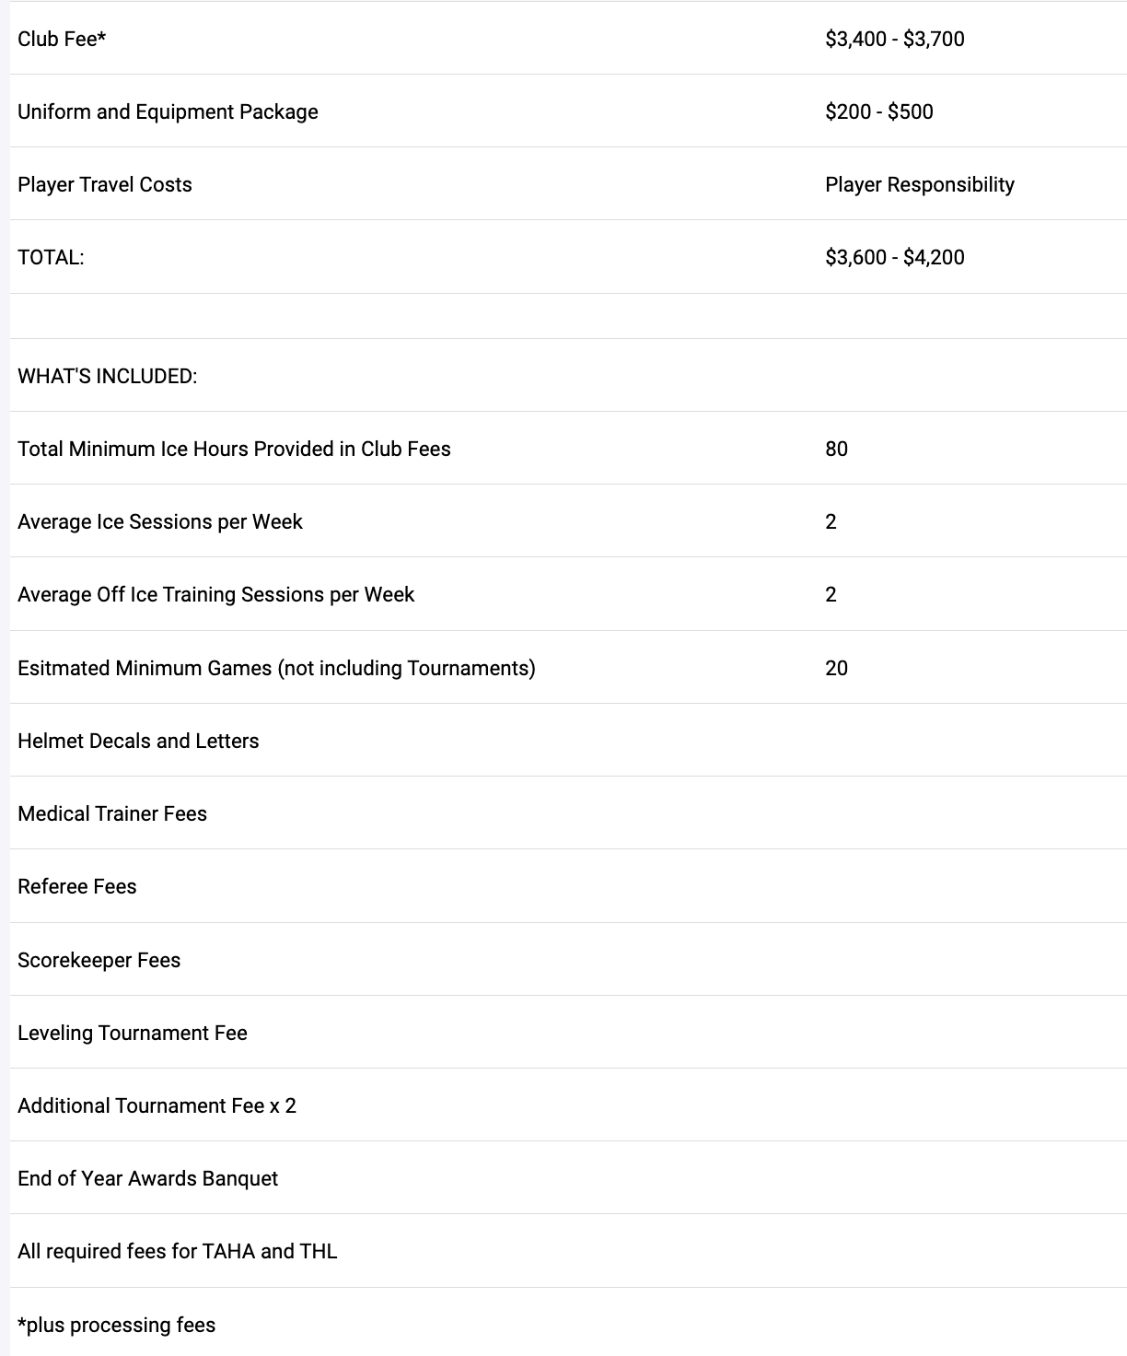
2025-2026
Season Fee’s & Scholarship
  Deadline for scholarship Application is June 15th
  Applications are reviewed by an independent committee, and all submitted information remains confidential
  Last year, we awarded $10,000 in scholarship
  The scholarship application can be found on our website

Slide 15
2025-2026
Other Expenses
  There are two options for purchasing optional swag items (Shirts, Hats, Jackets, etc.)
    The SquadLocker store at www.sanantonioyouthhockey.com
    The X-Jersey store at https://xjerseys.us/collections/san-antonio-rampage
  Coaches may request additional practice ice which will result in that cost being shared by the players.
  Teams may choose to play in additional tournaments which will result in that cost being shared by the players.
  Travel expenses (gas, hotel, food) will vary according to scheduling and personal travel arrangements.
  Any additional costs detailed in your player contract.

Slide 16
2025-2026
Payments, Insurance & Refunds
  PAYMENT
  Credit cards will be accepted as payment method, for an additional Crossbar fee
    You may pay in full, or…
    You may put $500 down, and split the remaining balance into 2, 3, or 4 equal payments. The same payment method will be used for each
  Offline payments will also be accepted (cash or check)
    Your full payment must be in the treasurer’s hands by July 9th, or your roster spot will be released.
    No payment plans are available for this option
    There is a $50 fee for returned checks.
  REGISTRATION INSURANCE
  You will see this option when accepting your roster offer through Crossbar; please take time to consider it
  REFUNDS
  No refund will be issued once a player contract has been submitted; again, please take time to consider registration insurance

Slide 17
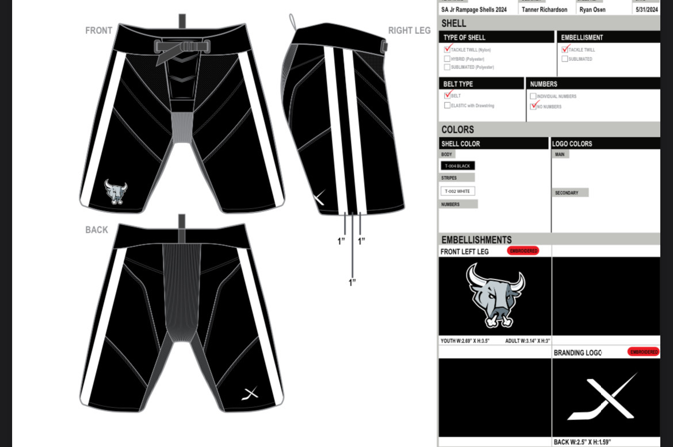
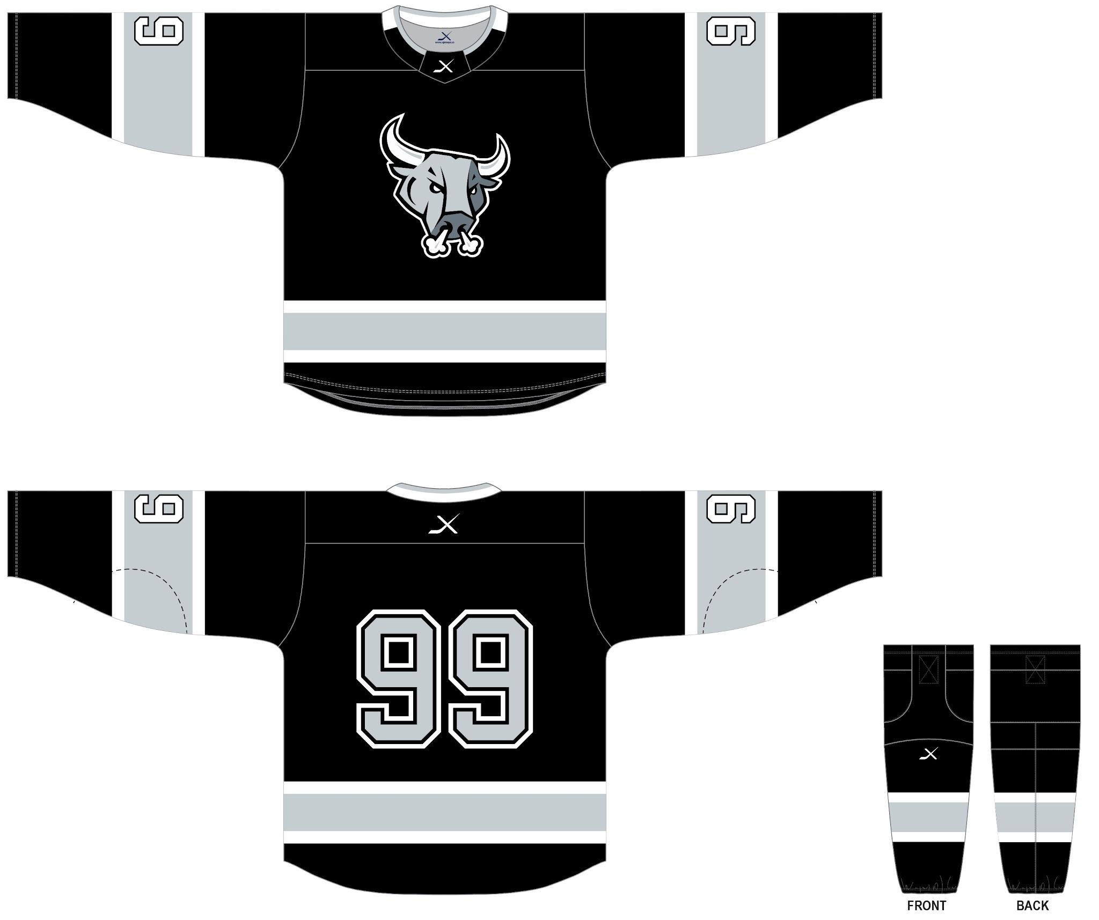
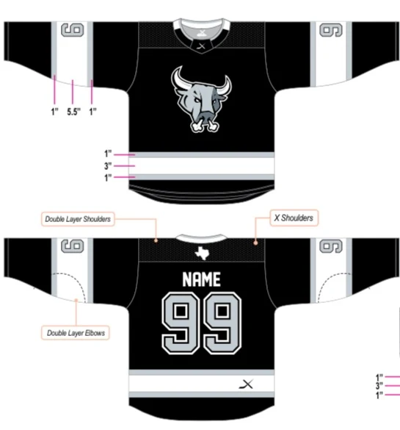
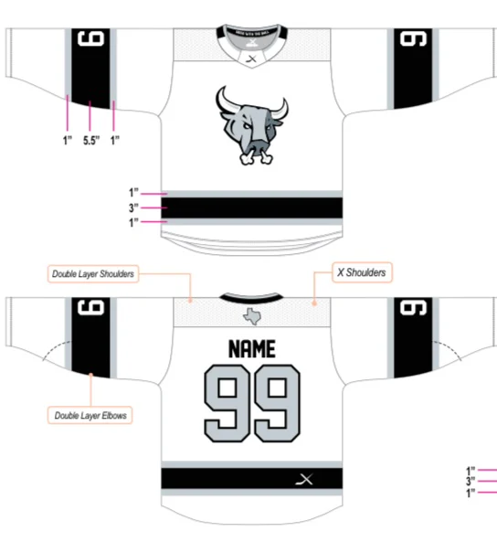
2025-2026
X-Jerseys – Official Supplier

Slide 18
2025-2026
Team Wear & Uniforms
  Jersey and Apparel sizing
  June 11th, 18th and 23rd during tryouts between 6:00pm – 8:30pm
  Required new player package ($255-$355)
  Jerseys (Home & Away)
  Game Shells
  Game Socks (Home & Away)
  Hockey Bag (if you do not currently have a Rampage bag)
  Optional Player Items (Check with coaches on what may be require)
  Dryland Set (3-piece)
  Warm-up Set (2-piece)
  Polo Shirt
  * All a carte ordering information will be released later

Slide 19
2025-2026
Uniform & Equipment Rules
  Jr. Rampage players must comply with these rules during all THL games.
  Helmets: Black color
  Helmet Logos: Player helmets must have Jr. Rampage approved logos and player number prominently displayed. No non-approved logos will be allowed.
  Gloves: Primary black color with minimal white or gray piping
  Pants: Shells with the embroidered Jr. Rampage logo and number.
  Skate Laces: White, black or grey.
  Stick Tape: Black or white on the blade and knob
  Practice Jersey: Jr. Rampage issued practice jersey must be worn during practice. Socks may be any color unless other noted by your coach.
  Exceptions: Teams may elect to utilize laces and tape of another color for events or causes as long as the team remains uniform (breast cancer awareness, hockey fights cancer, etc). The Head coach and Team Manager are responsible for such a decision and team compliance.

Slide 20
2025-2026
Communication
  Crossbar is the Jr. Rampage sport management platform of choice. It is mandatory for teams to use the Crossbar messaging application as their primary means of communication
  The SAYHA webpage will contain the most up to date information for the Jr. Rampage
    www.sanantonioyouthhockey.com, or
    www.jrrampage.com
  Organization emails and social media platforms will also be utilized to disseminate information.
  Team Managers represent the primary liaison between the teams and the Board of Directors. They have a direct line of communication at all times to facilitate fast responses to the needs of your team. However, as a small market organization, the board hosts an open forum/virtual hall as well as time permits.
  The Board of Directors has an open-door policy. Reach the entire board here.

Slide 21
2025-2026
Expectations
  All players, parents and coaches are expected to act in accordance with the USA Hockey Code of Conduct.
  All players, parents and coaches are to adhere to the player code of Conduct and Parent Code of Conduct signed as part of the player/parent contract. This includes commitments regarding the use of social media.
  Players, parents, & coaches can be disciplined by the Disciplinary Committee if any formal complaint or incident is witnessed and reported by anyone in the Association.

Slide 22
2025-2026
Respect for Officials
  Without our on-ice and off-ice officials, we have no games. Remember, officials are human, too.
  There are formal evaluation protocols for all Coaches and Team Managers
  Officials, like coaches, have annual certification exams that vary by experience level
  Disagreements happen and should include reasonable expectations, discussion, and perspective
  If a spectator is kicked out of a facility by an official it is an automatic 30-day suspension from all hockey activities including practices.

Slide 23
2025-2026
Disciplinary Committee
  All Discipline matters will be heard through a formal process by the Discipline Committee.
  All discipline matters must be formally brought forth by contacting the President who serves as the Discipline Committee Chairperson: president@sanantonioyouthhockey.com
  The discipline committee is made up of all current board members. For all events, the committee will gather evidence, obtain statements of involved parties, and administer disciplinary actions as detailed in the player, parent, and coaches code of conduct and the USA Hockey Code of Conduct.

Slide 24
2025-2026
Fundraising
  The association fundraising policy is located on our website.
  For donations to be 501(c)(3) tax deductible, they must funnel through the Association Treasurer, who will provide a receipt to the donor.
  Team fundraising is allowed but should not conflict with fundraising events or sponsorships meant to support the entire organization.
  The Association Treasurer can maintain cash flow records for a team’s finances
  The organization is setup with The Big Give, Benevity, Paypal’s giving fund, Zelle, and other methods for receiving donations
  Use of the SAYHA and Jr. Rampage logos for fundraising purposes requires board approval

Slide 25
2025-2026
Volunteer Opportunities
  The Jr. Rampage cannot operate without the assistance of our volunteers. As a small market association, we rely on volunteers to maintain operations.
  A support and volunteer section has been added to the SAYHA webpage with links to sign up as an Association volunteer. Available roles include the following -
    Team Manager
    Scorekeeper
    Scoreboard operator
    Game music
    Committee chairs and members (fundraising, equipment locker, social media, etc)
    Special event volunteers
  Team volunteers are managed at the team level

Slide 26
2025-2026 SEASON INFORMATION
** Questions **
Please visit our website at
www.sanantonioyouthhockey.com
www.jrrampage.com
Or Email
board@sanantonioyouthhockey.com

