Slide 1
Cheyenne Capitals
Bantams 2025-2026

Slide 2


Welcome to Cheyenne Capitals
Assistant: Shawn Ramage
Head Coach: Camden Ward
Phone Number: 253-389-5180
Email: camden1999@gmail.com
Assistant: Jayden Erickson
Notes:
This opening slide introduces the presenter and provides essential contact information. You can customize the placeholders with your name, email, phone number, and LinkedIn profile to make it easy for your audience to reach out after the presentation.

Slide 3
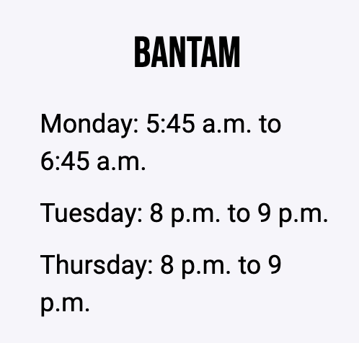
Practice Times and Expectations
Dry land: will be once a week. Time and location still to be determined
Attendance: will be recorded and will help determine ice time. Flexible with good communication.
Player preparedness: Players are expected to read the drills sent out via email every Sunday night. Be there at least 15 min early to go over drills
Give 100% effort every drill, every rep
Listen attentively and respect coaches and teammates
Maintain a positive attitude, even when making mistakes
Support teammates, encourage one another, and build team culture
Take care of equipment and leave the locker room/bench clean
Notes:
This opening slide introduces the presenter and provides essential contact information. You can customize the placeholders with your name, email, phone number, and LinkedIn profile to make it easy for your audience to reach out after the presentation.

Slide 4
Game expectations
Roster
19 skates and 1 goalie
4 lines of offense and 3 lines of defense
1 player will be a practice player
Games
Team warmups are mandatory 45 minutes before games. Goalies to stretch 10 minutes before getting on the ice.
Players dress up for home games
Every player will participate in team on ice warmups
No players coaching on the bench
Parents
24 hour rule post games for communication
No communicating with refs from the bleachers
Only approved “locker room monitors” are allowed in the locker rooms
Notes:
This opening slide introduces the presenter and provides essential contact information. You can customize the placeholders with your name, email, phone number, and LinkedIn profile to make it easy for your audience to reach out after the presentation.

Slide 5
Tryouts
Tuesday 9/23 Wednesday 9/24 Saturday 9/27
8-9 PM 8-9 PM 8-9AM (exact time tbd)
Notes:
This opening slide introduces the presenter and provides essential contact information. You can customize the placeholders with your name, email, phone number, and LinkedIn profile to make it easy for your audience to reach out after the presentation.

Slide 6
Volunteers
Locker Room Monitors:
(Safesport) For ALL games and ALL practices
14 and up – same sex monitors
Gamesheet:
1 per home game, electronic scoring
Scoreboard:
open to all only home games
Penalty Box:
open to all at home and away games
Game Music:
open to all only home games
Parent on bench:
Needed for away games
Team Manager:
These include coordinating travel arrangements for the team, scheduling volunteers for home games, tournament sign-ups and travel plans, and most importantly, being the liaison between coaches and parents as well as the board to the coaches and parents.
Notes:
This opening slide introduces the presenter and provides essential contact information. You can customize the placeholders with your name, email, phone number, and LinkedIn profile to make it easy for your audience to reach out after the presentation.

Slide 7
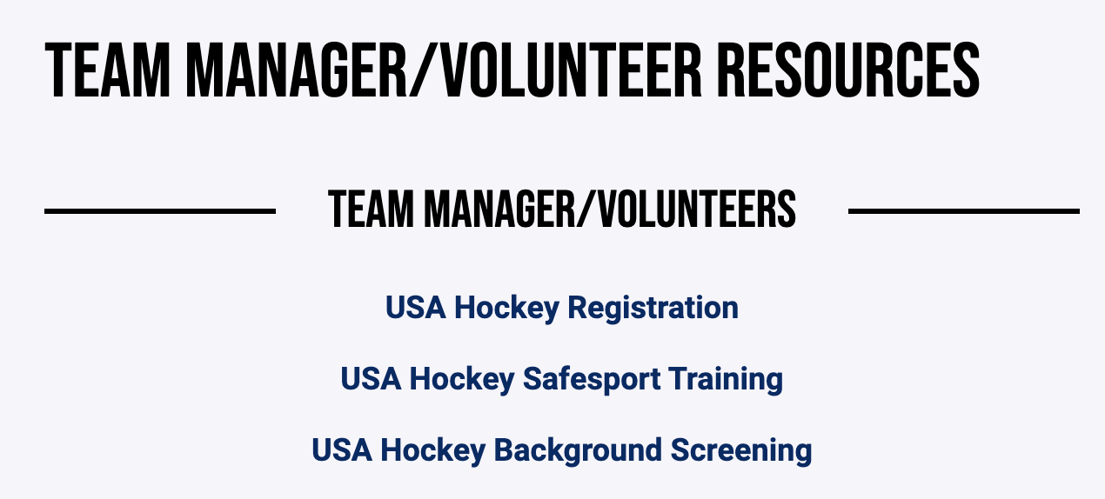
Volunteers
Notes:
This opening slide introduces the presenter and provides essential contact information. You can customize the placeholders with your name, email, phone number, and LinkedIn profile to make it easy for your audience to reach out after the presentation.

Slide 8
Questions
Notes:
This opening slide introduces the presenter and provides essential contact information. You can customize the placeholders with your name, email, phone number, and LinkedIn profile to make it easy for your audience to reach out after the presentation.

