Slide 1
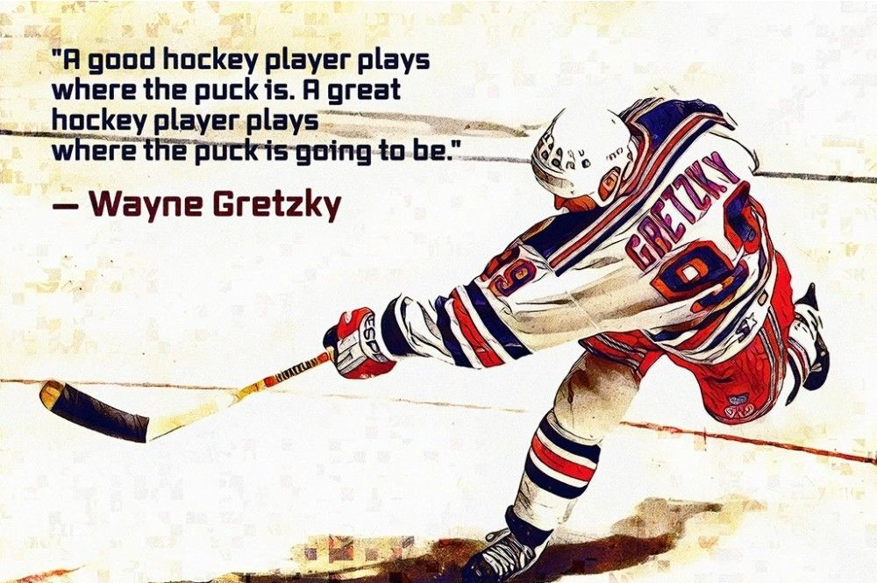
Mites
2025-2026

Slide 2
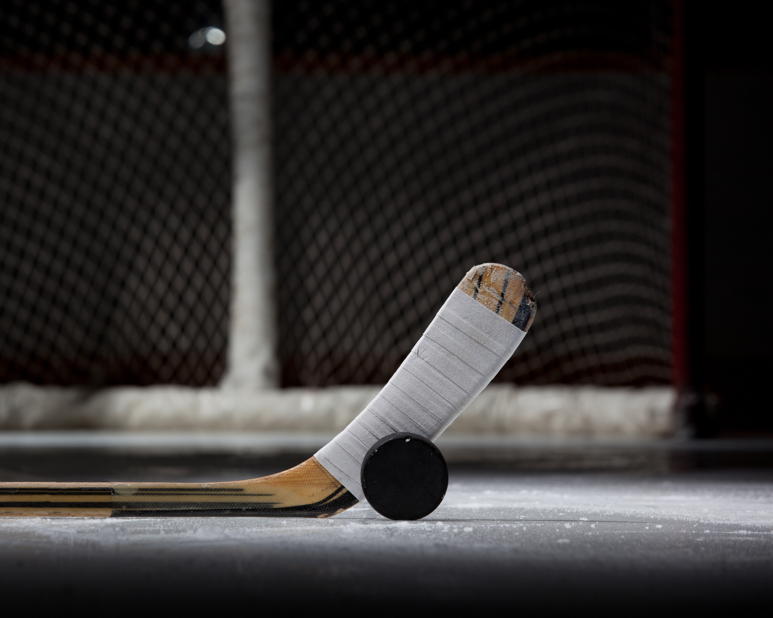
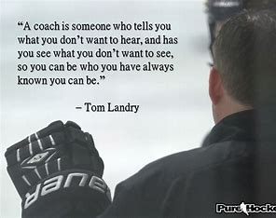
Meet Your Coaches
Brandon Hammack
Brice Jacobson
Assistants Coaches
Mini Mites
Head Coach
Justin Muir, Justin Watt, Max Silver, Jamie Popovich, Greg Bonazinga, Jared Terfehr, Nate Everett, Matt Humphreys, Richie Houdek

Slide 3
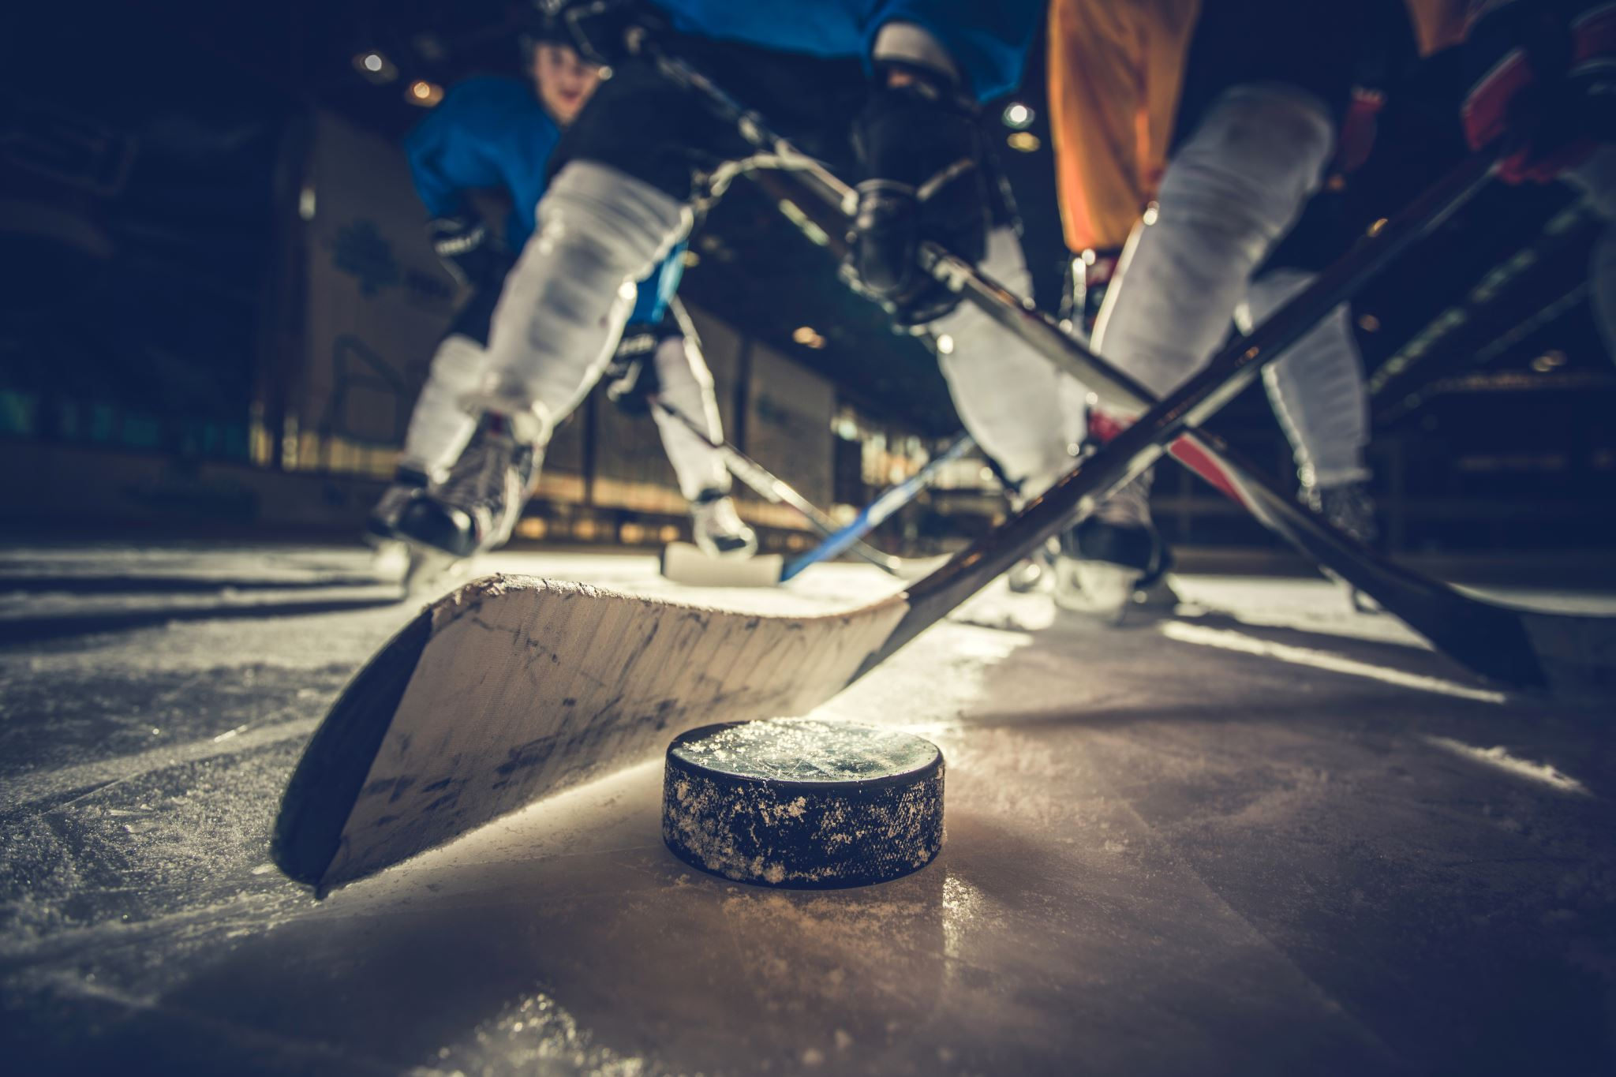
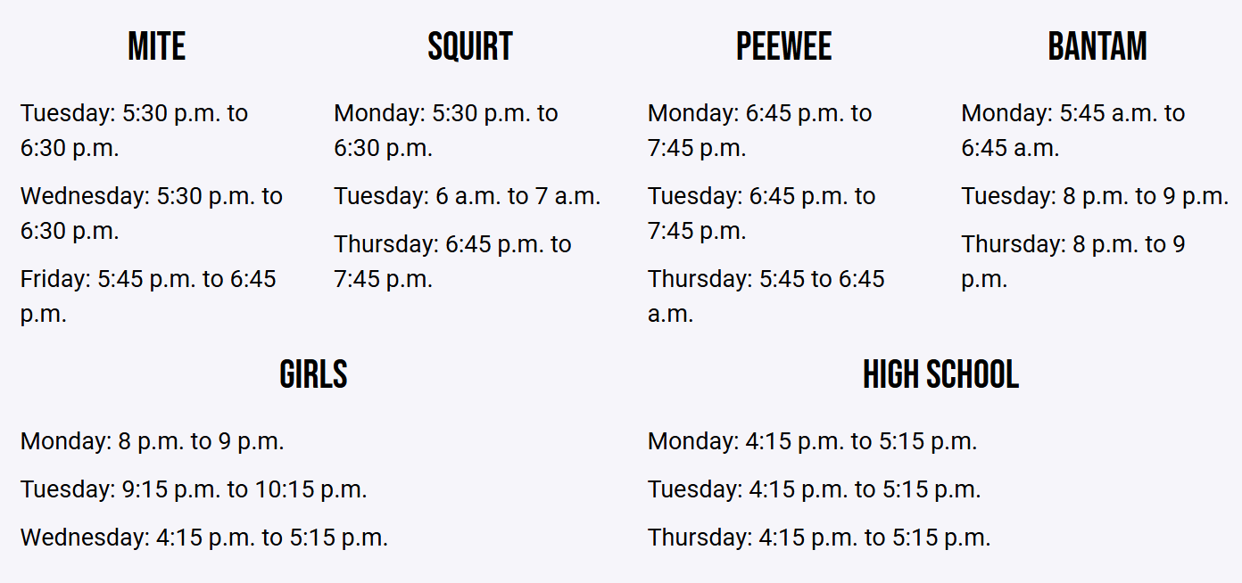

Practice Schedule
Dryland Training- hoping to do once a week – be more athletic all around.
First month of practice discipline & expectations will be high.
Limit wait times – keep players moving.
Drills
Get up or get off – no laying on the ice will be tolerated – major safety hazard.
Mites & Mini-Mites

Slide 4
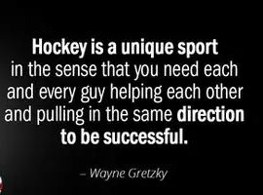
Player Expectations
Be on time for practice and games
On time is late, early is on time
Act Appropriately
Show up ready to work hard.
Be kind, be kind, be kind.
Treat coaches, players, & opponents with respect.
TEAM
We are going to emphasize TEAM this season – what it means, what it takes, and the importance of being a good teammate on and off the ice.
ACE (Attitude, Coachable, Effort)
Don’t be afraid to fail.
Don’t take criticism personal.
Positive “I can attitude.”
You get out, what you put in.

Slide 5
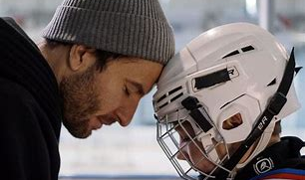
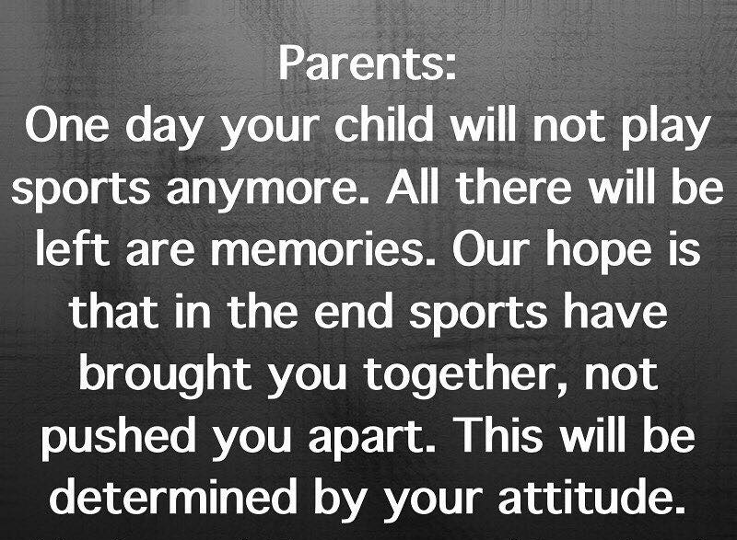
Parent Expectations
I will have my child wear properly fitting equipment.
Sharpen your player’s skates regularly.
I will respect and recognize the role of the coaches.
I will not coach from the sides.
I will promote a growth mindset.
I will encourage my player to try to resolve issues and talk to coach before I get involved.
I will respect the 24-hour rule.

Slide 6

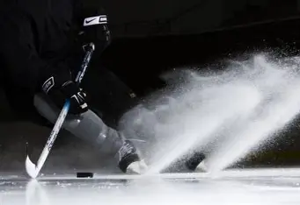
Coaching Expectations
  At the Mite level we focus on skill development and fundamentals.
  We are here to have fun and learn the game of hockey.
  We will foster a learning/development environment for all players.
  We will treat players, referees, rink staff, parents, and opponents with respect.
  Every player who wants to try goalie – will get the opportunity to do so.
  Every player will get equal playing time.
  No HERO hockey – every kid will touch the puck and hopefully get a goal by the end of the season.

Slide 7
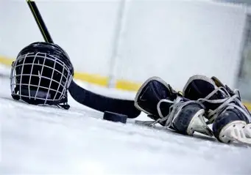
Equipment
Skates
Gear
If you don’t know how to put on any of the gear or have questions – ask!
Water Bottle
Bring a water bottle to EVERY practice and game. Having water bottles on the ice saves time.
Tie skates tight – if you need help/tips please ask.

Slide 8
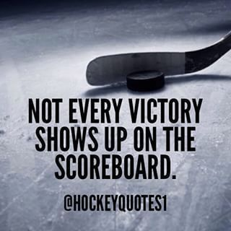
Season Goals
Develop quality hockey players/people
  Development is #1. Far above winning
  Being good teammates, showing good sportsmanship, and being respectful is pivotal
Play hard, play for each other, and be creative!
Have some fun ☺

Slide 9
Communication
Crossbar
Download app
Social Media
There will be a lot of information posted on social media as well. It will show other teams schedules which is a great opportunity for younger players to watch our older teams.
Questions
Please ask! We are here to help and make this season a success!
Schedule
Practices
Saturday Sept 27 & Sunday Sept 28 10:45am-11:45am

Slide 10

Volunteers Please!!
The most under appreciated, yet most important part of any program are the parents. You are our biggest fans, the ubers, and the financial backers. Your help is always encouraged and most definitely appreciated. In the Capitals hockey program, the following areas need assistance every season:
Locker Room Monitors
(Safesport) For ALL games and ALL practices
Scoreboard
every Friday scrimmage
Mites Boards
Mites Tournament

Slide 11
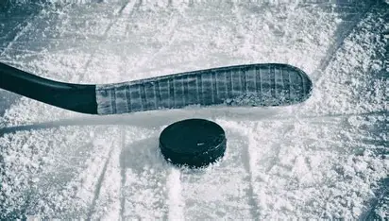
Tournaments
One tournament a month.
Extra expense.
Optional.
Room blocks.
All listed on paper – waiting on dates for some.
Birth certificates.

