Slide 1

Team Managers Meeting
September 3, 2025 @ 7:30PM
VIA ZOOM

Slide 2
CSDHL Website and GameSheet
Central States Development Hockey League
All declaration games and regular season games MUST be scored using GameSheet
Central States Development Hockey League | Game Sheet Training
IPAD Access Key: ipad-csdhl
CSDHL Assigns Referees for Games

Slide 3
2025-2026 CSDHL Prospects Divisions
Squirt: Red 1, Red 2, White 1, White 2,
White 3, Blue 1, Blue 2 & Blue 3
Peewee: Red 1, Red 2, Red 3, White 1, White 2,
White 3, Blue 1 & Blue 2
Bantam: Red 1, Red 2, Red 3, White 1, White 2,
White 3 and Blue 1
U16: 2 Divisions
U18: 1 Division

Slide 4
CSDHL Important Dates
Start of Regular Season : September 18, 2025
PROSPECTS DECLARATION END DATE: October 19, 2025
PROSPECTS REGULAR SEASON START DATE: November 1, 2025
End of Regular Season Prospects: January 25, 2026
End of Regular Season Major / Minor: February 1, 2026
Playoffs Prospects: January 29 - February 1, 2026
Playoffs Major / Minor: February 5-8, 2026
All rosters are due to Jeff Cesarone by 10/31/25. Please send only your portal link to: jeffcesarone@gmail.com. Please indicate in your email: Team name & Division playing in (i.e., Hawks Bantam Prospects Red 1).

Slide 5
Peoria Rule: CSDHL Prospects Division Only
The Peoria Rule means that certain teams competing at certain levels of the Prospects Division will be required to play their home games at an opposing team’s rink if the opposing team does not wish to travel to their home rink. If the Peoria Rule is invoked, the opposing team provides and pays for ice, referees and athletic trainers (if applicable).
Prospects RED (all tiers): No Peoria Rule. Play home games at a club’s home rink.
Prospects WHITE (all tiers, Squirt – Bantam): Peoria Rule (if invoked) for clubs subject to Peoria Rule (see list below).
Prospects BLUE (all tiers, Squirt – Bantam): Peoria Rule (if invoked) for clubs subject to Peoria Rule (see list below).
Clubs subject to the Peoria Rule (if accepted into the Prospects Division):
Affton, Bloomington, Champaign, Chesterfield Knights, Eagles, Garden Hockey Club, Highland Hills, Indy Fuel, Kansas City, Madison, Omaha, Pekin, Peoria, South Bend, Southern Ice Hawks, Sharks, Sting, Quad Cities, and any other club designated by the league.
Games between two teams subject to the Peoria Rule will be played at the respective home rinks as designated by declaration games grid and season games grid published by the league.

Slide 6
CSDHL Scheduling:
Declaration Round Games
Squirt, Peewee & Bantam
TEAMS IN EACH PROSPECTS DIVISION ANNOUNCED 9/1/25.
PROSPECTS DECLARATION ROUND GRIDS WILL BE RELEASED TO PRESIDENTS AND CSDHL REPS ON 9/5/25 (OPEN GOOGLE DOC TO SHARE WITH MANAGERS).
PROSPECTS MANAGERS SCHEDULING WINDOW FOR 6-GAME DECLARATION ROUND: 9/5/25 – 9/11/25.
HOME GAMES MUST BE ENTERED INTO CSDHL GOOGLE DOC SPREADSHEET BY 9/11/25.
MANAGERS CAN SCHEDULE GAMES BY CREATING A SIGN-UP GENIUS, PHONE OR EMAIL.
IF YOU RESCHEDULE A HOME GAME, MUST NOTIFY CSDHL VIA EMAIL AT: CSDHLVP@GMAIL.COM. PROVIDE GAME ASSIGNED IN GAMESHEET, DATE OF GAME AND HOME/AWAY TEAMS.

Slide 7
CSDHL Scheduling:
Regular
Season Games
Squirt, Peewee & Bantam
PROSPECTS REGULAR SEASON GAME GRIDS WILL BE RELEASED TO PRESIDENTS AND CSDHL REPS ON 10/22/25 (OPEN GOOGLE DOC TO BE SHARED WITH MANAGERS).
PROSPECTS MANAGERS SCHEDULING WINDOW FOR 20-GAME REGULAR SEASON: 10/22/25 – 10/28/25.
HOME GAMES MUST BE ENTERED INTO CSDHL GOOGLE DOC SPREADSHEET BY 10/28/25.
MANAGERS CAN SCHEDULE GAMES BY CREATING A SIGN-UP GENIUS, PHONE OR EMAIL.
IF YOU RESCHEDULE A HOME GAME, MUST NOTIFY CSDHL VIA EMAIL AT: CSDHLVP@GMAIL.COM. PROVIDE GAME ASSIGNED IN GAMESHEET, DATE OF GAME AND HOME/AWAY TEAMS

Slide 8
CSDHL Scheduling:
Regular Season
Midget Teams
MIDGET TEAMS ANNOUNCED 9/1/25.
NO DECLARATION GAMES FOR MIDGETS.
PROSPECTS MIDGET TEAM GRIDS WILL BE RELEASED TO PRESIDENTS AND CSDHL REPS ON 9/5/25 (OPEN GOOGLE DOC TO BE SHARED WITH MANAGERS).
PROSPECTS u16 MANAGERS SCHEDULING WINDOW FOR 24-GAME REGULAR SEASON: 9/5/25 – 9/11/25.
PROSPECTS u18 MANAGERS SCHEDULING WINDOW FOR 26-GAME REGULAR SEASON: 9/5/25 – 9/11/25.
HOME GAMES MUST BE ENTERED INTO CSDHL GOOGLE DOC SPREADSHEET BY 9/11/25.
MANAGERS CAN SCHEDULE GAMES BY CREATING A SIGN-UP GENIUS, PHONE OR EMAIL.
IF YOU RESCHEDULE A HOME GAME, MUST NOTIFY CSDHL VIA EMAIL AT: CSDHLVP@GMAIL.COM. PROVIDE GAME ASSIGNED IN GAMESHEET, DATE OF GAME AND HOME/AWAY TEAMS.

Slide 9
Game Time Rules, Athletic Trainers and Handshake Line
What are the time rules for games played in the Prospects Division? Visit the CSDHL website at https://www.csdhl.org/ for information on times for periods, penalties, overtime, ice cuts (for Midget level) and referees.
Are clubs required to have athletic trainers for home games at the Bantam and Midget levels of the Prospects Division? Athletic trainers are required for the Midget level for the Prospects Division. Athletic trainers are strongly encouraged for the Bantam level in the Prospects Division.
Coaches should NOT be in handshake line with players.

Slide 10
PENALTIES THAT RESULT IN GAME SUSPENSIONS
Fighting is an automatic (at least 3 game suspension) by CSDHL.
Coaches are expected to review their scoresheets after each game and note MAJOR penalties.
If a player receives a penalty which would require them to sit 1 or more games for suspension, do not play the player in the next game -- additional penalties may be assessed by CSDHL if you do.
If a player receives a penalty in a CSDHL game which would require them to sit 1 or more games for suspension, the suspension MUST be served in a CSDHL game (different than USA Hockey rules).
For example, if a player has a 1 game suspension from a major penalty in a CSDHL game and the next game is an out-of-town tournament, the player must sit the 1st game in tournament to satisfy USA Hockey rules, but that does not satisfy CSDHL. The player will also be suspended from the next CSDHL game to satisfy CSDHL. If a player gets a 1 game suspension at a tournament, just make sure they sit the next game whatever it is (not additional CSDHL game).

Slide 11
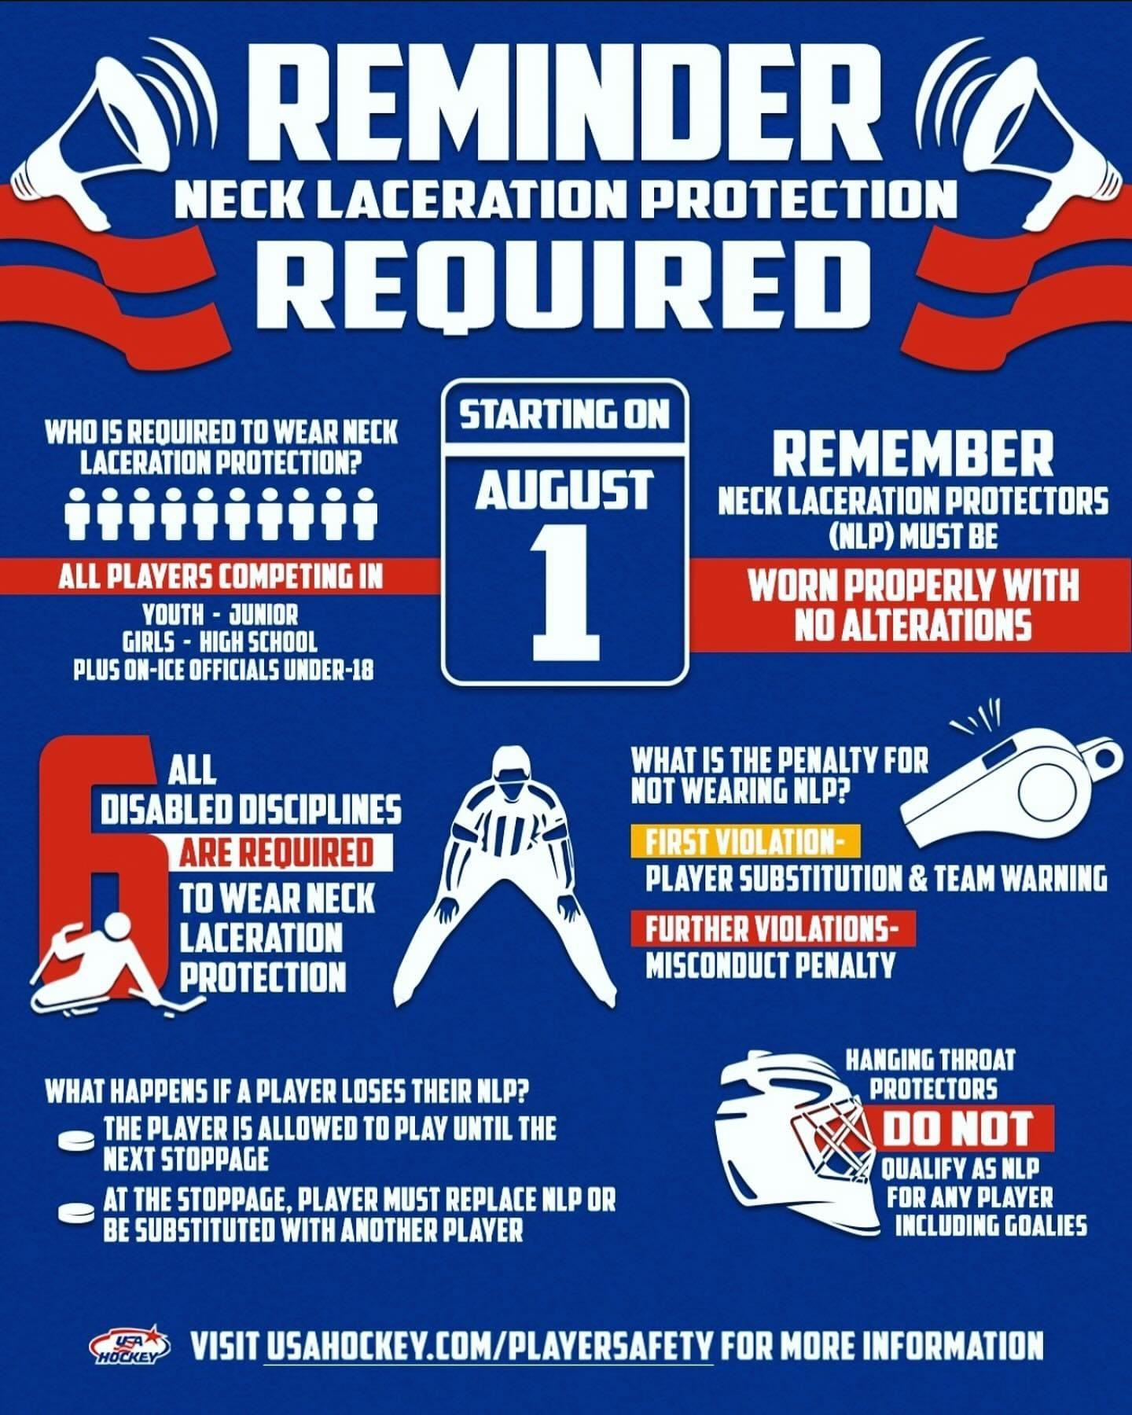
Neckguards!

Slide 12
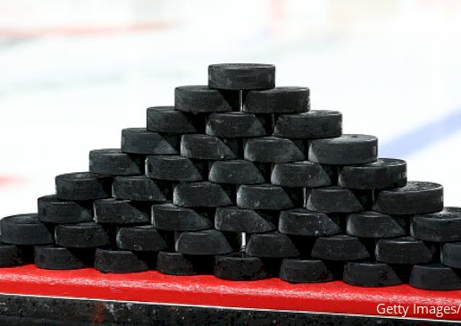
PUCKS FOR WARM-UPS
The Home Team provides pucks for warm-ups. Should provide 20 pucks.
If a Team invokes the Peoria Rule, they provide the pucks for warm-ups to the traveling team.

Slide 13


