Slide 1
Locker Room Monitor Policy
Locker Room Safety Matters

Slide 2
Why Monitoring Matter
"At USA Hockey, the locker room is more than just a place to change — it's where team culture begins. That’s why we require responsible adult supervision at all times. Protecting our athletes' physical and emotional safety isn't optional; it's a standard we hold ourselves to, on and off the ice.”
Protect athlete dignity
Prevent misconduct and bullying
Ensure privacy and boundaries
Build trust in your team and organization

Slide 3

Policy Overview
Key Rules to Know:
✅ Two Deep Rule: Two screened adults present
✅ Same-Gender Monitoring whenever possible
🚫 No cell phones or recording devices
✅ Monitors must be SafeSport trained and background checked

Slide 4


Common Pittfalls
Unscreened adults in locker areas
Only coaches as locker room monitors
Locker room monitors not listed on rosters
Misuse of phones or cameras
Players in locker rooms before any adults
Lack of gender consideration
Incidents not properly documented or reported
Locker room monitors outside of ear-shot and sight
Mixed gender locker rooms with out proper locker room monitors and base layers

Slide 5

Your Role
Complete SafeSport training annually
Complete your background screening
Understand locker room monitor policies
Monitor with discretion, professionalism, and respect
Keep everyone safe in the locker room
Get rostered as a locker room monitor
Speak up and report concerns
Make sure everyone knows and follows the rules

Slide 6
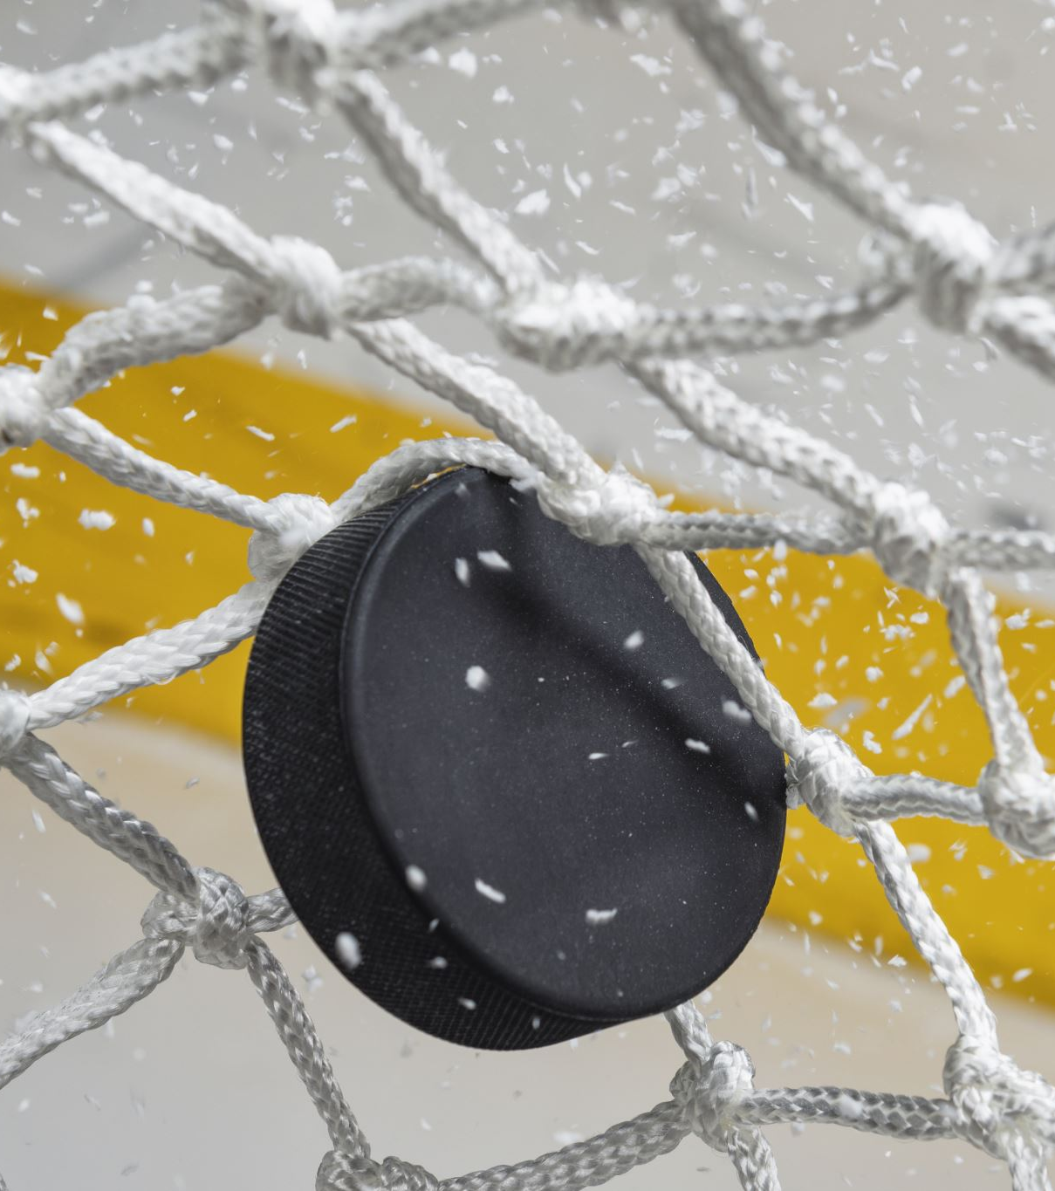
Resources and Support
USA Hockey SafeSport Portal
📧 safesport1@coloradohockey.org
Contact your Club SafeSport Coordinator

Slide 7



Questions

