Slide 1
REGISTRAR UPDATE
2025-2026 SEASON
Welcome and thank you
for taking on the registrar job!

Slide 2

TOP PRIORITIES
Background checks for coaches, managers, locker room monitors, board members.
CAHA Membership documents submitted for approval. Due prior to roster approval but no later than 9/30.
Portal set up for 2025-26 season.
Board roster submitted prior to any team rosters. Must include a minimum of President, VP, Secretary, Treasurer, Hockey Director, Registrar, SafeSport Coordinator.

Slide 3
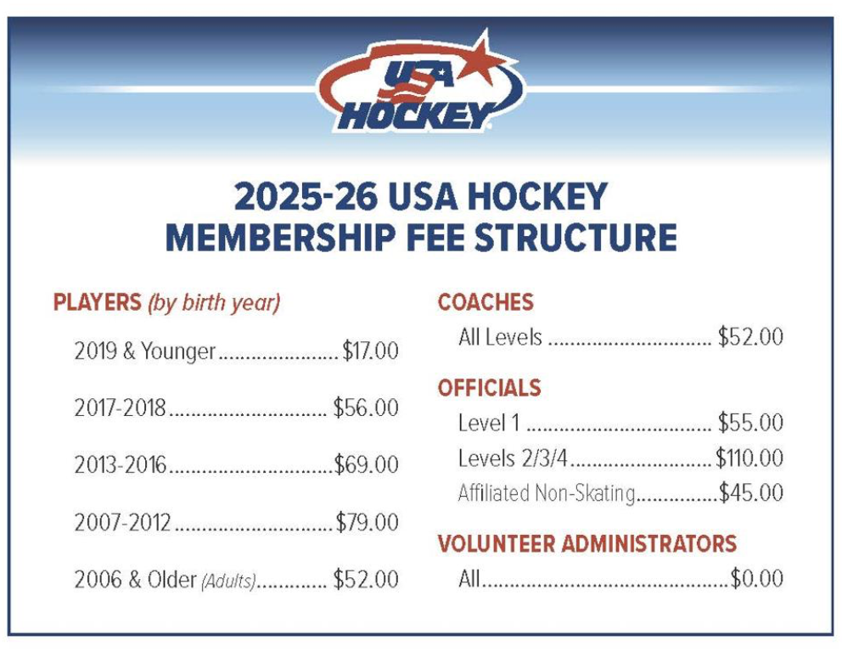
Fees paid at time of USAH registration.
USAH fee for coach and player registrations.
Players might also have a CAHA fee.
  $0 for 6U
  $5 for ages 7 and 8
  $20 for ages 9 – 18
  $0 for age 19+
Volunteers are free, but no ice participation.

Slide 4
CREDENTIALS
SAFESPORT
SCREENING
MODULES
DOB AND CITIZENSHIP VERIFICATION
NON-US CITIZEN TRANSFER
CEP & CONTINUING ED CREDITS

Slide 5
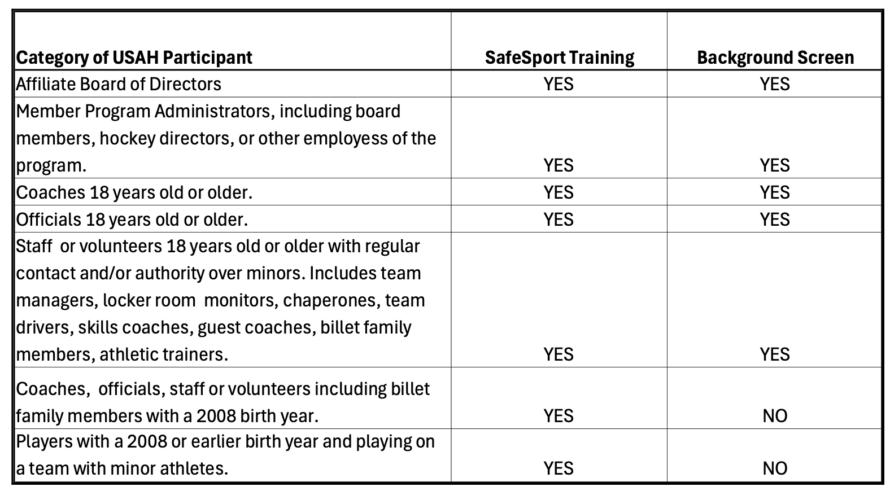
Who needs SafeSport and Screening?

Slide 6
SAFESPORT
Expires 12 months to the day after last taken.
Email reminders.
Coaches use their SSO (single sign on) code to access through their Learning Management System.
Volunteers and players use their SSO code to access via the SafeSport launch pad.
The SSO code is being emailed by USAH. Do NOT access SS courses without the code.
Players do NOT take the Youth Athlete course.
Course is free. If being charged, accessing in wrong place.
No certificate. Shows up in portal within few hours.
When claiming players, SS will show up, but it might take a few hours.
Use the expiration date and do not rely on the “complete”.
Automatically redlines if expires mid-season. Does NOT automatically add back.
It is possible to use SafeSport taken for another organization. Must call the Center to merge.

Slide 7
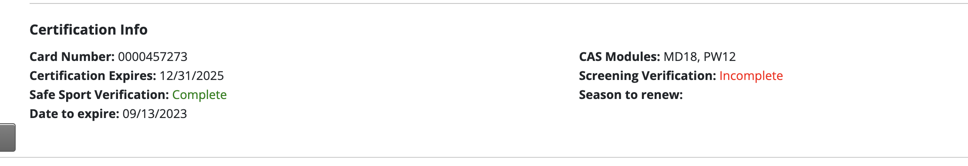
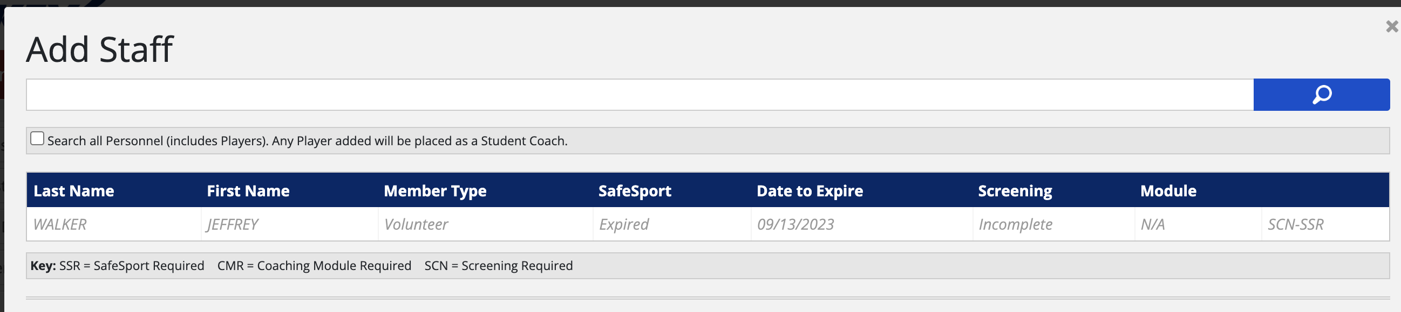
Incorrectly states SafeSport is complete. Look at expiration date.
Correctly shows SafeSport has expired

Slide 8
Due every two seasons (not years).
Fee.
Out of US/Canada for 6 consecutive months in any one country during the last 7 years will need an international screen.
Only screens taken through USAH will be accepted.
Receive email confirmation once register. This is not confirmation that cleared.
Flagged, check email and spam as often just need to provide additional information.
The requested “self registration number” is already populated!
SCREENING

Slide 9
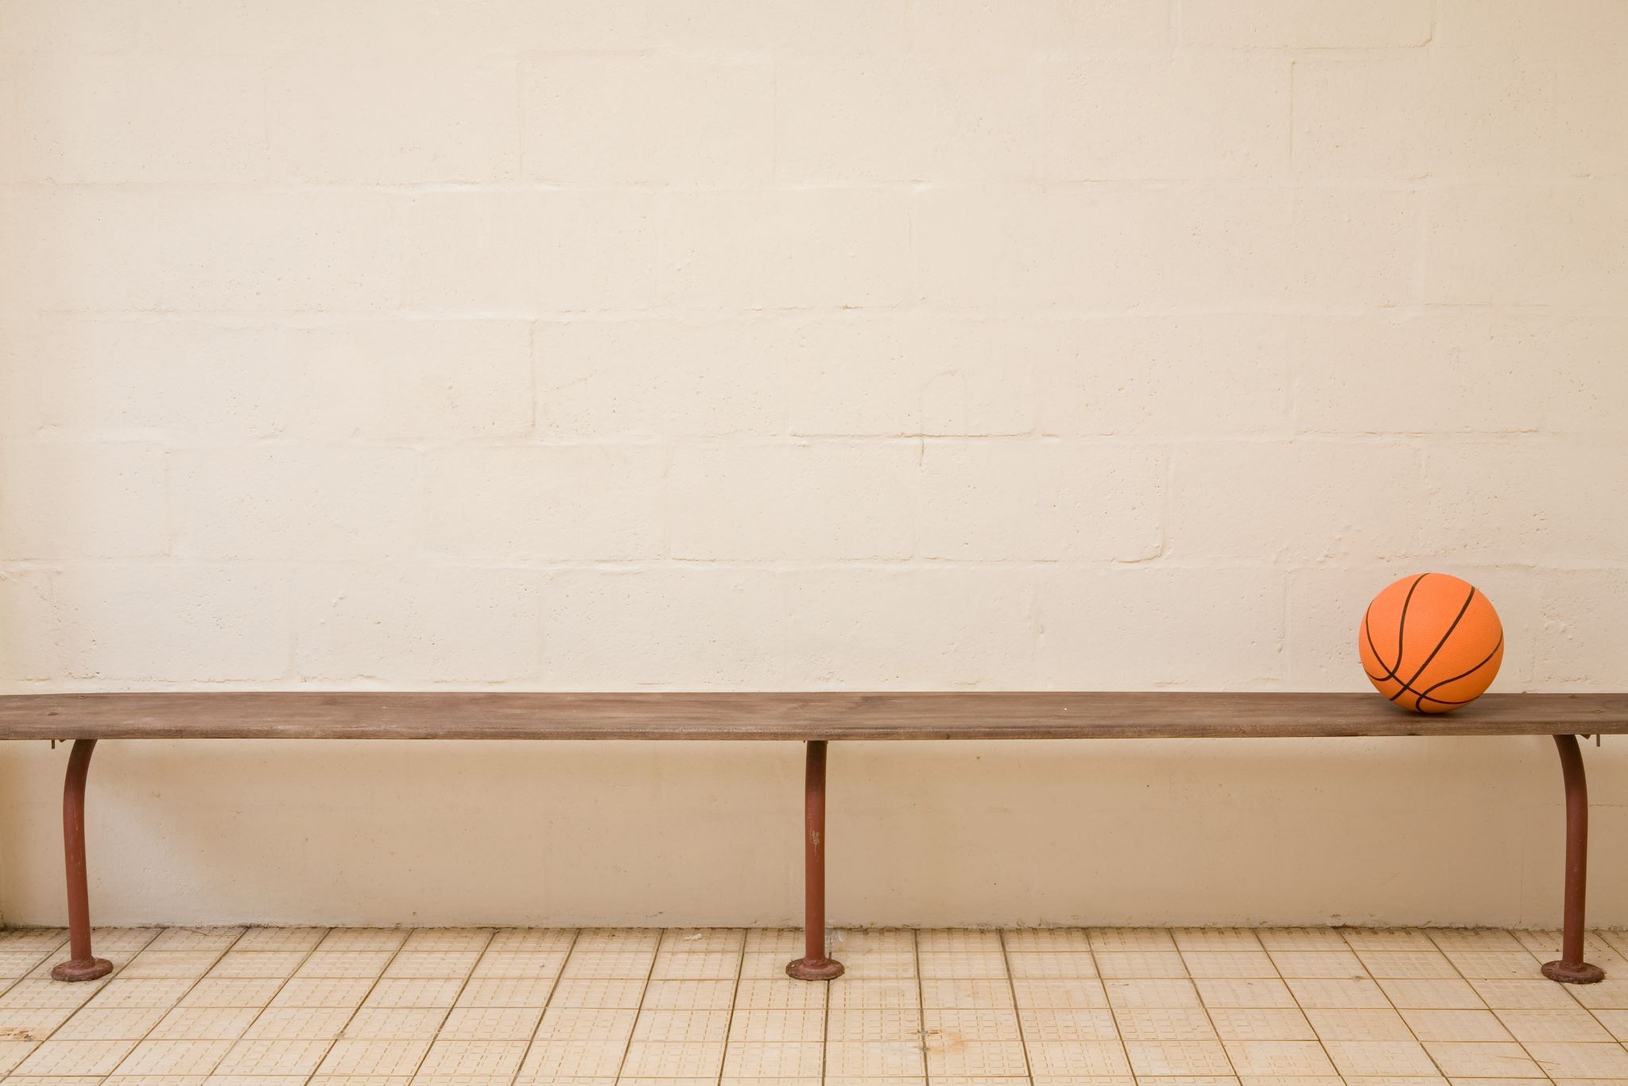
LOCKER ROOM POLICIES
All teams must have at least two designated non-coach locker room monitor (LRMs) on their roster. A team manager can fill one of these roles. Must be designated on the roster.
A coach can be a LRM, but each team must also have 2 non- coach LRMs.
Coaches added as LRM only are not allowed on the bench.
Best practices include 2 responsible, screened, SafeSport trained adults inside the locker room any time players are present.
If only one monitor is present, the LRM can be outside of the locker room, close enough to hear inside the room. Within arms reach, with door propped open an inch or so. They should be communicating with the players inside the room frequently.
LRMs must be present any time a player goes to the locker room during a game or practice.
Any time only one player is present, there must be at least 2 LRMs.
If only one LRM is available in the above situation must wait until multiple players are present before allowing anyone in the locker room.
Use of cell phones is prohibited in locker rooms.

Slide 10
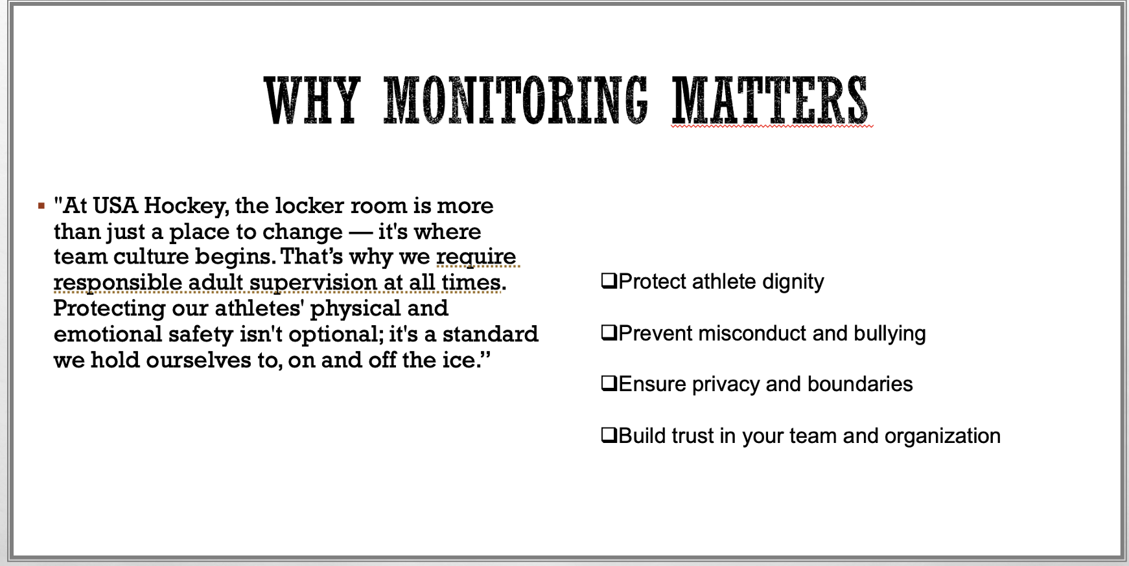

Slide 11
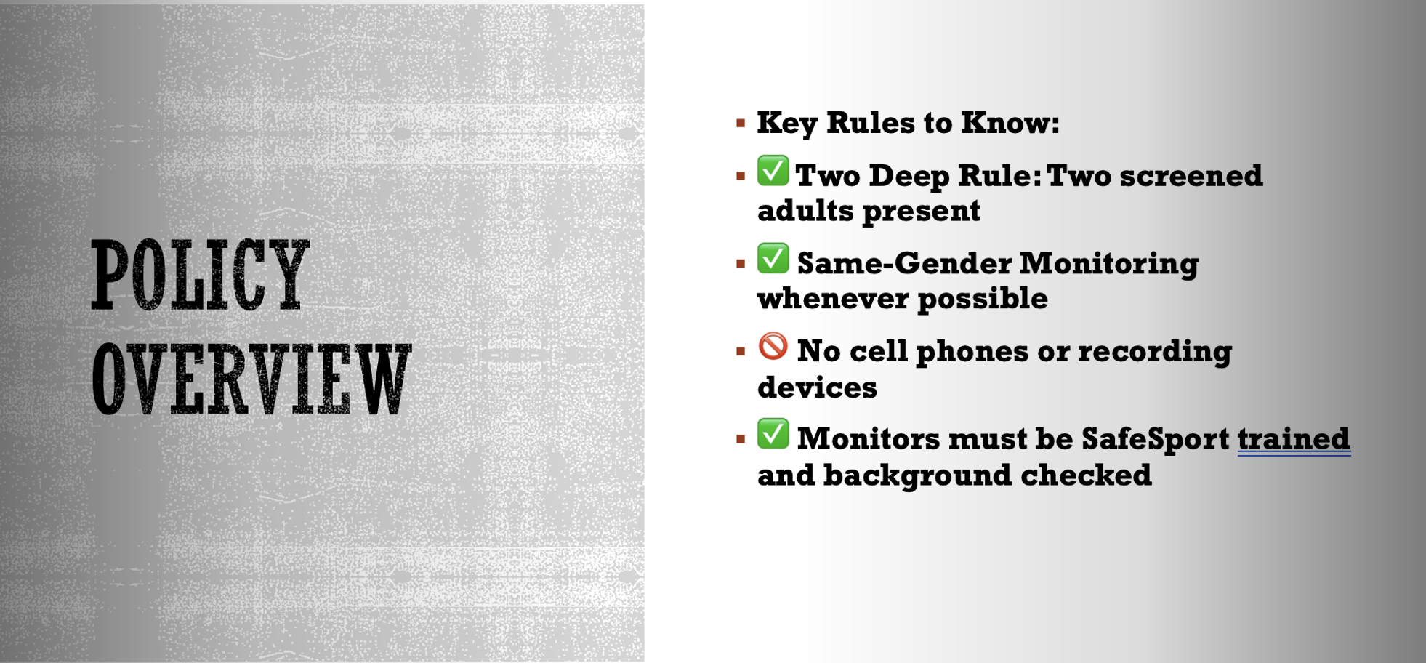

Slide 12
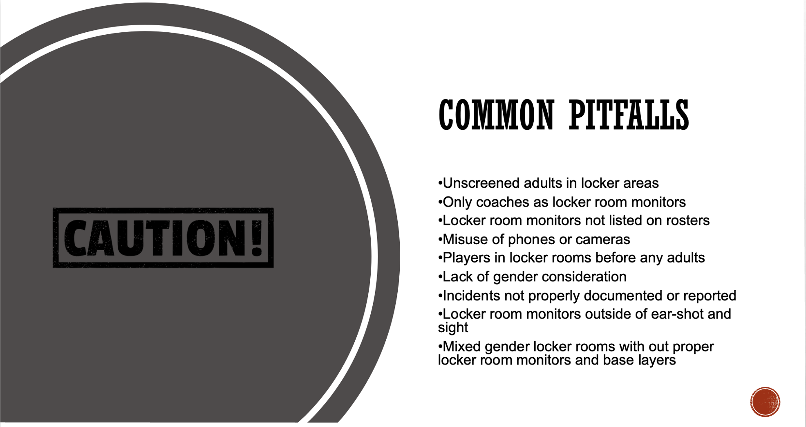

Slide 13
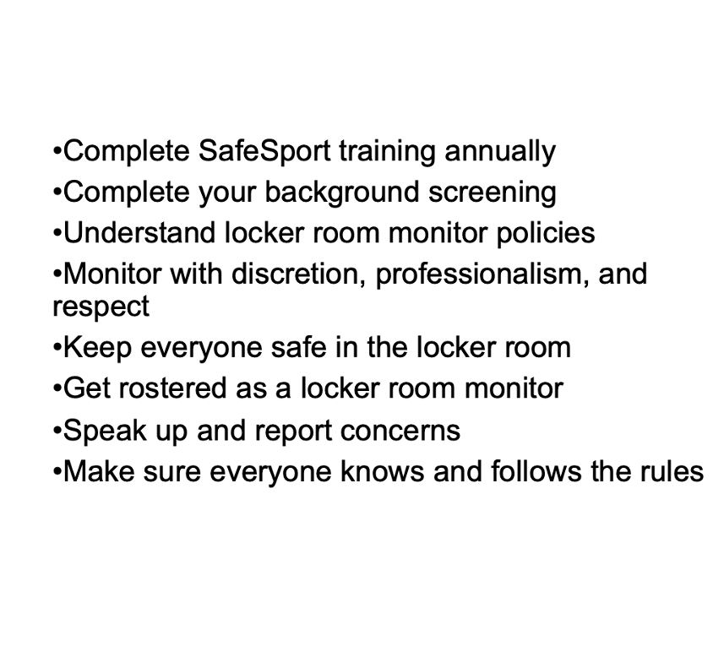
THE LRM’s Role

Slide 14
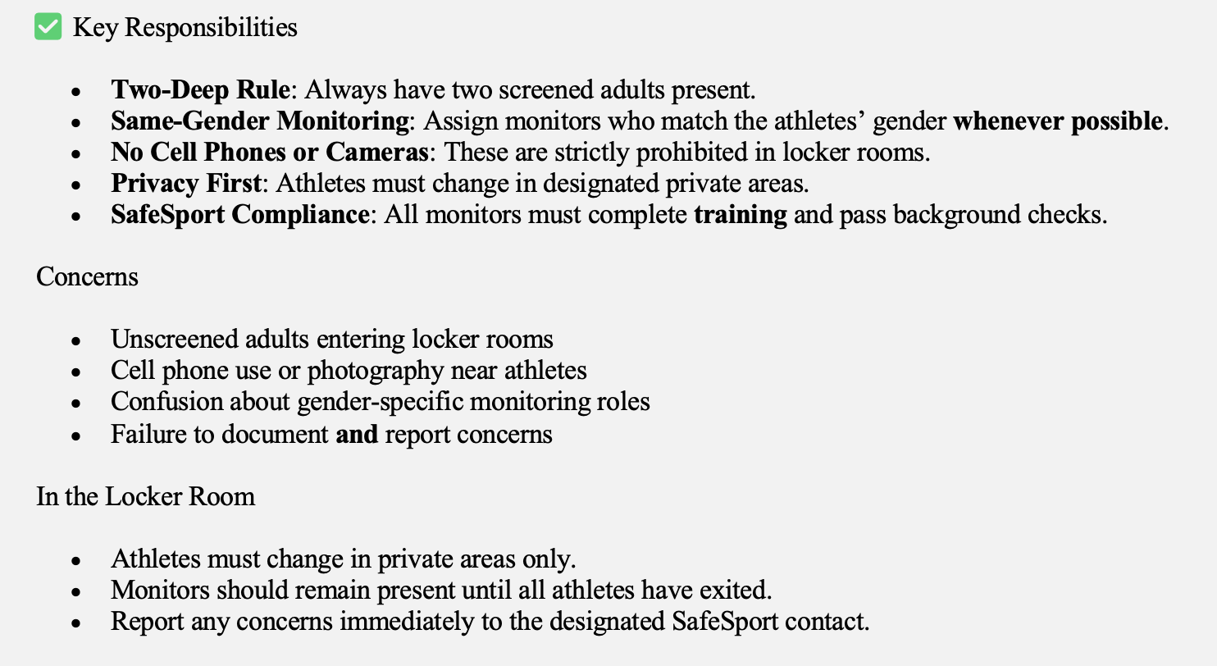
RECAP

Slide 15


Slide 16
6U/8U, 10U/12U, and 13+.
Old single age group modules still valid as long as coaching the correct age group.
$20 for 6U/8U module and $25 for all other age modules.
Fundamental module first if taking a newer module for first time. Free.
Must be done prior to adding coach to roster.
MODULES

Slide 17
COACHING EDUCATION PROGRAM (CEP) 6U/8U COURSE
Brand new coaches at the 6U/8U level, coaching Learn To Skate, or Learn To Play without ANY CEP will now begin with the new 6U/8U CEP course.
It is good for 5 years and can be renewed if still only coaching at 6U/8U, Learn to Play, or Learn to Skate levels.
Once move to an older age group, the coach would need to begin the CEP progression by taking a Level One course.
6U/8U course is shorter than the others.
Coaches who have already completed Level One should NOT take the 6U/8U CEP course.
A 6U/8U coach who has already completed Level One can continue to coach at the 6U/8U level with expired CEP. Once that coach moves to an older age group, the coach would need to take Level 2 and continue with the CEP progression.

Slide 18
Can add coach without CEP and in some instances with expired CEP. Have until 12/31 to meet requirements.
Clinics offered mid June through December 15th.
Must have current CEP with expiration of 2026 or later by 12/31.
L1, L2, L3, L4 in first 4 years of coaching 10U and older.
One level per year. L1 – L3 are good for one year only.
L4 is good for 3 years, 5 continuing education credits needed to renew.
L5 is good for 4 years, 5 continuing education credits needed to renew.
The first set of CEUs for L4 and L5 renewals are due 12/2025.
Grandfathered coaches had L4 or L5 prior to 2021 and have not coached a Tier One or Tier Two team. Expiration date shows as 20**.
Out of coaching for a while – start where left off.
One Temp Card per coach per lifetime of coaching.
COACHING EDUCATION PROGRAM (CEP) LEVELS 1-5

Slide 19
CEP REQUIREMENTS FOR NTB TIER COACHES
All NTB Tier One coaches must obtain a minimum of Level 4 designation by 12/31.
A Tier One association may apply for a waiver for one head coach with a Level 3 designation by 12/31.
A Tier One association may apply for a total of 3 waivers for assistant coaches who will be at a level 2 designation by 12/31.
All NTB Girls Tier Two head coaches must obtain a minimum of Level 3 designation by 12/31.
ADDING A COACH AFTER 12/10
Will require the email confirmation of CEP course completion/registration.
CEP NOT IN COMPLIANCE BY 12/31
Coach will be redlined.
Not eligible to participate with team at games or practices if redlined.
Can apply for Temp Card if has not had one previously.
Coaches removed from rosters in December, redlined for failure to comply with CEP requirements, or those that receive a Temp Card will be required to COMPLETE CEP prior to being added to a roster the next time they wish to coach. Applies to coaches removed/redlined last time they coached or received a Temp Card last season.

Slide 20
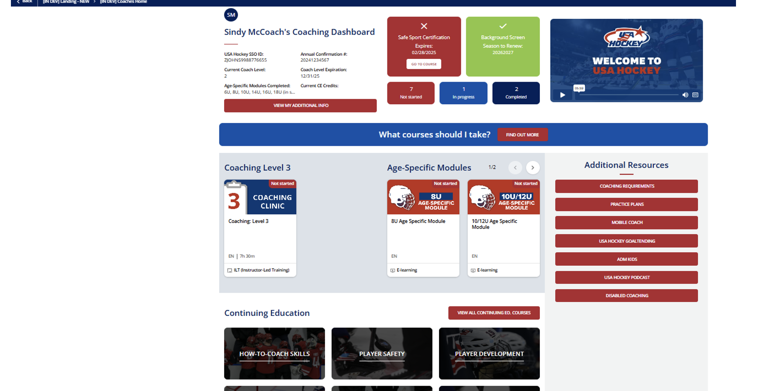
SAMPLE LEARNING MANAGEMENT SYSTEM FOR COACHES

Slide 21
CONCUSSION AWARENESS TRAINING
State law.
Not reflected on roster.
Turned into association only.
All teams should be using a Return to Play form after injuries.
COACHING CODE OF ETHICS
All coaches are required to sign the USAH Coaching Code of Ethics each year.
Signed Codes of Ethics should be collected and kept by the Association Registrar or a delegate.
CODE OF CONDUCT
New Code of Conduct templates on the new website.
Colorado Safer Youth Sports Act went into affect July 1st.

Slide 22
NON-US CITIZEN TRANSFERS
Must be approved by USAH before adding to a roster.
Student visas.
Unlimited transfer if green card.
Yearly transfer for all others.
DELINQUENT PLAYER LIST (DPL) AND PLAYER RELEASES
Per new policies can add players to DPL throughout season up to 7 days after the conclusion of USAH Nationals.
Beginning next season, check the DPL prior to adding a player from another association mid season.
Make sure the player provides a release even if not on DPL.
DOB AND CITIZENSHIP VERIFICATION
Required for all 10U players prior to being added to a roster
Required for all NTB players prior to being added to a roster.
Required for all players that will participate in CAHA state rec playoffs. Please do this prior to 12/15.
Birth certificate, passport, real ID drivers license if US citizen.
Player must be claimed to have DOB verified.

Slide 23
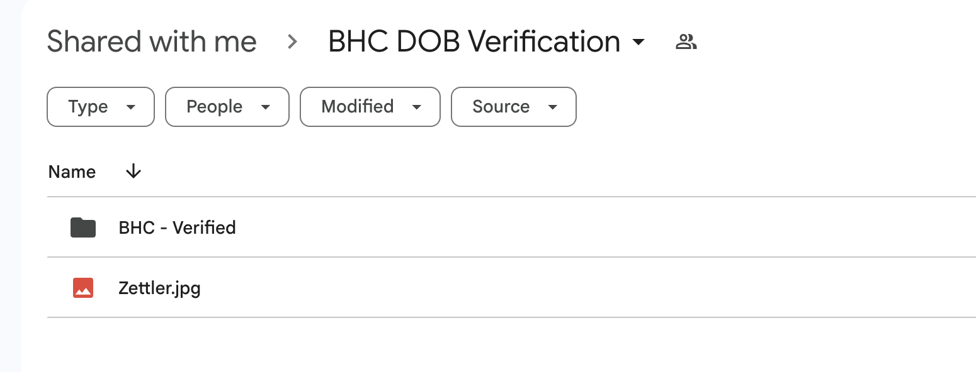
DOB AND CITIZENSHIP VERIFICATION PROCESS
Create a folder for your association on google docs. Title it ”[name of association] DOB Verification”
Share with your Affiliate Registrar – editor privileges.
Create a subfolder titled “Verified”.
Add documents for verification in your main folder. Rename the doc with the player's last name.
Once the Affiliate Registrar verifies the document, she will move it to the “Verified” subfolder.

Slide 24
ROSTERS
Association documents approved.
Board roster approved.
Naming policies.
Dual leagues.
Tournament rosters.
Play ups and play downs.
Flex rosters.
Dual rostering.
Roster notes.
Redlines.
Roster link.

Slide 25
BOARD ROSTER
Submitted and approved prior to team roster approvals.
Requires President, VP, Secretary, Treasurer, Hockey Director, Registrar, SafeSport Coordinator.
Will be able to add other board members, association volunteers, skills coaches, guest coaches, billet families, employees, etc.
Name as “[your association name] board”.
Season = Regular; Team Type = Board.
Can edit volunteers/coaches to list their roles.
If claimed as coach will need to use the “custom” option to enter the role.
If claimed as volunteer will have options in the drop down. If option is not listed (secretary), or multiple roles use board volunteer or one applicable role and let your Affiliate Registrar know what the role or additional roles are.

Slide 26
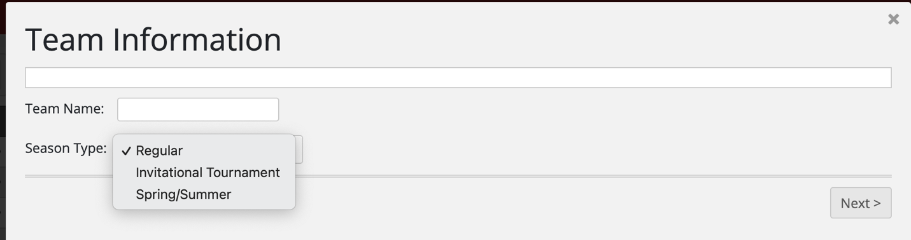
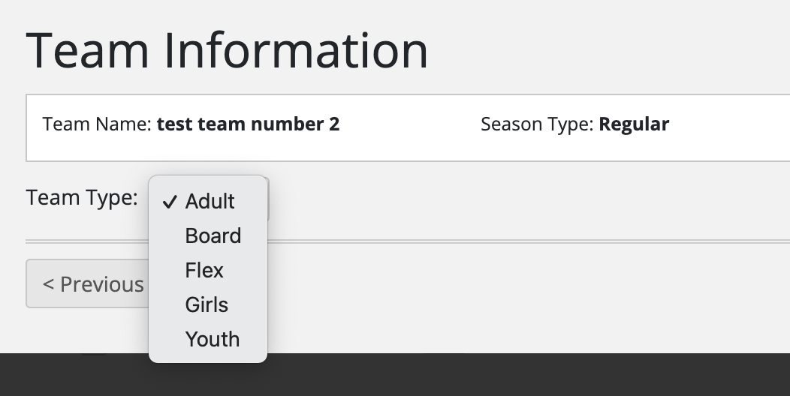
Name your team.
3 options for season type.
Select the team type.

Slide 27
Team Names for Youth/Girls rosters:
League
  No league for T1, or for 6/8U.
  Non NTB teams not in a league use IND.
Association.
Classification – age level. Do NOT use peewee, squirt, etc. U AFTER the age!
Division – AAA, AA, A, or B (omit if rec).
Identifier if more than one team in same class and division – Red, Black, etc.
*RMHF Arvada 16U A Black
*Colorado Thunderbirds 18U AAA
*CGHL Foothills 12U Girls
*IND Pikes Peak 14U B
*Woodland Park 8U
Team Names for High School rosters:
League – CPHL, IND, HPHL.
Team name – Hawks, Eagles, Coyotes, etc.
CPHL Tier as applicable.
CPHL Division as applicable.
Identifier if more than one team from same school in same CPHL Tier and Division.
If IND HS team add “HS” and either “Varsity” or “JV” to the team name instead of tier and division.
All CPHL teams are Varsity.
*CPHL Eagles Tier 1 Makar
*CPHL Coyotes Gold Tier 1 MacKinnon
*CPHL Lady Sabercats
*IND Durango HS Varsity

Slide 28

HIGH SCHOOL VS 16U AND 18U TEAM NAMES:
Do NOT use 18U or 16U in the team name for HS teams.
Do NOT use HS, JV, or Varsity in the team name for 18U or 16U teams.
  18U and HS rosters have different requirements and are NOT interchangeable.
TEAM NAME ON DUAL LEAGUE ROSTER:
RMHF Arvada 16U AA/CPHL Mustangs Tier 2 Makar.
CGHL/CRHL LHA 14ers 16U.
Cannot use a dual league roster if team is NTB in both leagues.
TEAM NAME ON TOURNAMENT ROSTER:
In state tournaments -add tournament name.
  TT Aspen 14U A Fall Face Off.
Out of state tournaments – add tournament name and dates.
  TT NCYH 10U AA Omaha MLK Jan 14 – 17

Slide 29
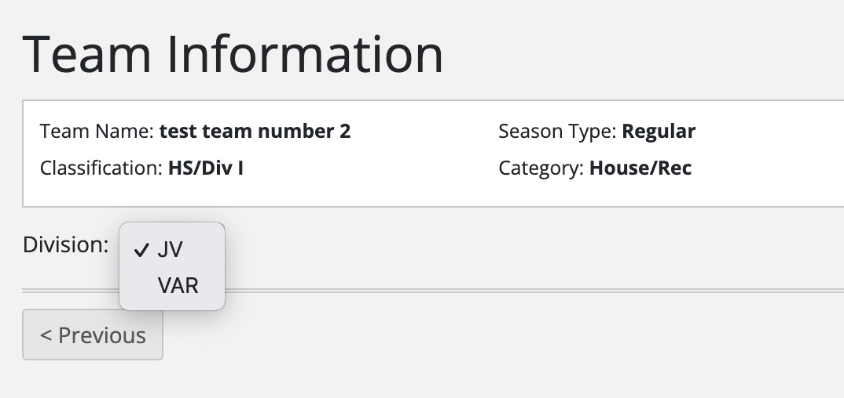
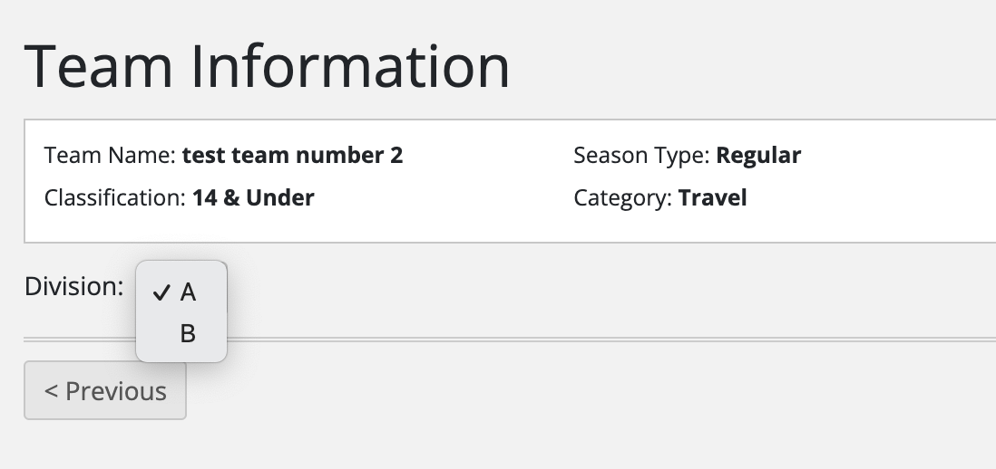
Classification.
Age group or High School. The U goes AFTER the age.
HS and 18U/16U rosters have different requirements so do NOT use a HS classification for an 16U or 18U roster or a 16U or 18U class for a HS roster.
Category.
Tier One and Tier Two categories are NOT related to CPHL T1 and T2 designations.
RMHF, WCHL, WGHL, any A or B teams use Travel.
CRHL, CGHL use house/rec.
HS categories are D1, D2, Prep.
  D1 = all players attend the same high school.
  D2 = players represent more than one high school.
Division.
All Tier I = AAA.
All Tier II = AA.
  12U AA use Tier II and AA, but this is considered a travel rec team.
Travel:
  Select A or B for division.
    Youth 10U AA – use A and add AA to team name.
    Not all of Girls travel categories have A or B options. Add A or B to the team name if needed.
Youth and Girls House/Rec = NA
High School and 8U only have House/Rec options.
  Defaults to JV, change all CPHL rosters to V. They do not have JV.

Slide 30
All NTB teams must check “yes” for NTB status.
Tier One and Tier Two 13/14U and up is only for those teams that applied for Tier NTB status and were approved.
  All Tier One and Tier Two 13/14U and up must be NTB.
12U AA and 10U AA require CAHA approval, regular season teams must participate in a league, must participate in CAHA State Rec Playoffs.
Teams wishing to participate in the Quebec Qualifier, or the CAHA State Rec playoff must use a regular season roster and participate in a CAHA league.
Tournament rosters require CAHA approval.
No out of state players or 8U to 10U and 12U to 14U play ups unless already approved on the regular season roster.
Players from regular season roster participating must be 12 or less.
No Tier One or Tier Two tournament rosters.

Slide 31
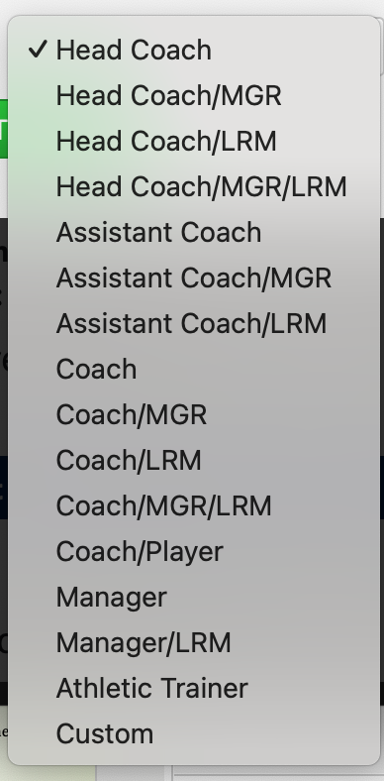
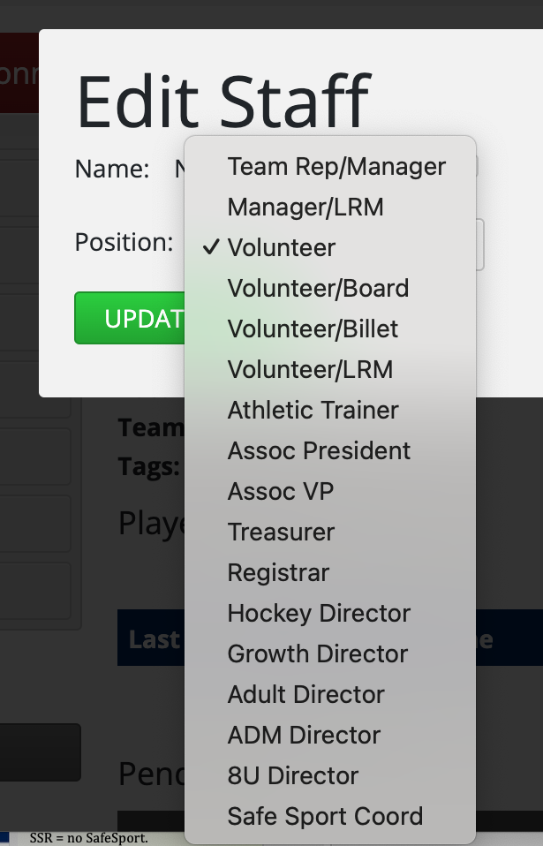
Add players, then add staff.
Must designate a head coach.
Designate a manager.
  Each 10U and older roster must include a manager.
  Manager must be aware they have been designated as manager.
Designate locker room monitors.
  Minimum of 2 non-coach LRMs.
Submit.

Slide 32
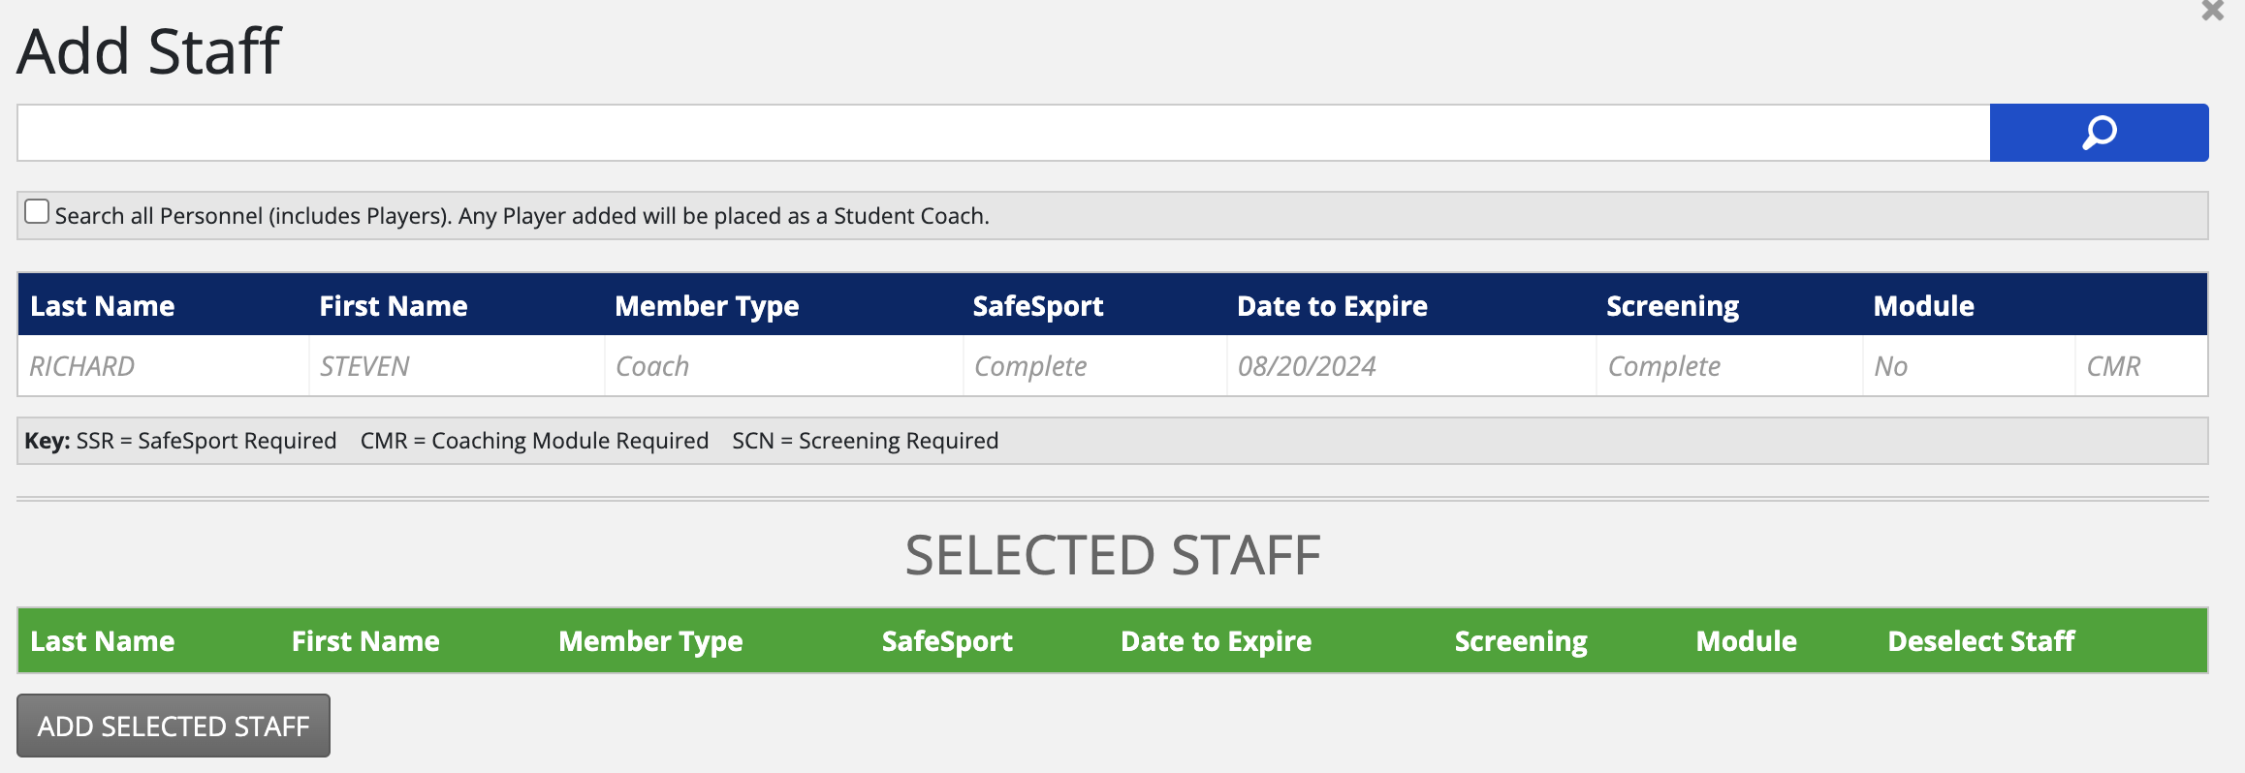
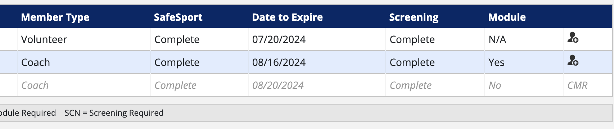
Can’t find – clear filter. Applies to student coaches, out of age range players, and females on youth rosters.
Grayed out = missing requirement
SSR = no SafeSport.
SCN = screening not done.
CMR = missing module.
Players might be grayed out if missing their SS requirement or if non-US citizen and transfer has not been completed.

Slide 33
FLEX ROSTERS
Up to 100 players.
Mixed age groups.
No check.
  Can use to roster 8Us or in house only players. Please let your Affiliate Registrar know the purpose of the roster.
  8Us will need to have regular rosters created for jamborees.
Might be able to use Flex roster if brand new player needs to start one year down.
  CAHA pre-approval required. Contact your Affiliate Registrar.
  Approval from opposing teams, league, tournaments required.
  Petition required for participation in CAHA year end tournaments – no guarantee.
Coaches would follow requirements of roster’s competition age level.

Slide 34
PLAY UPS:
CAHA pre- approval required for 8U to 10U and 12U to 14U.
Max of 3 boys and 3 girls per association allowed to move from 8U to 10U.
Last year 8U or last year 12U only.
Max of 2 players per association allowed to move from 12U to 14U.
  12U move ups must be to non-check teams.
No play ups from 12U to a NTB team.
No play ups from 12U to a 15U team (girls).
Hockey Director should be the one submitting requests to the appropriate VP.
Jeff Walker approves girls and the VP of Rec approves boys.
PLAY DOWNS:
USAH only allows play downs for documented medical reasons.
Paperwork involved.
House/rec, no check only.

Slide 35
USAH DUAL ROSTERING RULES:
Cannot be on 2 Youth NTB rosters at the same time.
Cannot be on 2 Girls NTB rosters at the same time.
Cannot be on 2 HS NTB rosters at the same time.
Can be on Girls and Youth NTB roster.
  Must declare which team will go through playoffs with by 12/31.
Can be on HS NTB and Girls or Youth NTB roster.
  Able to go through playoffs and play in both Nationals.
CAHA DUAL ROSTERING RULES:
Cannot roster on two travel teams or a Tier Two and travel team.
  May substitute in an emergency only.
  This includes goalies.
Rostering on more than one CPHL or CRHL team is allowed as long as approved by league.
Can roster on CPHL AND tier, travel, or CRHL as long as league rules allow.
Can roster on CRHL AND tier, travel, or CPHL as long as league rules allow.
May only participate in CAHA State Rec playoffs with the highest team rostered on.

Slide 36
ROSTER LIMITS
BENCH LIMITS
Youth T1 15O, 16U, 18U and Girls T1 19U – 22 players
High School rosters – 30 players
8U – 25 players
All other youth and girls’ rosters – 20 players
Flex – 100 players
Staff - unlimited
Youth T1 15O, 16U, 18U and Girls T1 19U – 22 players; no more than 20 skaters.
All other youth and girls’ teams – 20 players; no more than 18 skaters
High School teams – 20 players; no more than 18 skaters.
Staff – no more than 4 staff that are registered and rostered as a coach. This includes student coaches.

Slide 37
No 12U on NTB rosters.
No 8th graders, 5th year HS players, or post grads on NTB HS rosters.
Must check “yes” for NTB status.
Student Visas.
    Max of 4 on youth T1/T2 roster.
    Max of 2 on girls T1/T2 roster.
    Max still applies while using Vertical Movement.
Tier One youth and girls have limits on out of state players – refer to Tier Policies.
No out of state players on Tier Two rosters.
Can request exception for Tier Two if player does not live within 250 miles of a Tier Two association in their home affiliate.
NTB ROSTER RULES

Slide 38
OUT OF STATE PLAYERS
Aside from NTB Tier One teams, out-of-state players are not allowed on CAHA teams.
  Exceptions will be made for players whose address on record is within 100 miles of the CAHA association rostering him/her.
  Tier Two players can apply for an exception if they do not have a Tier Two association within 250 miles in their home affiliate.
No out of state players added to Tournament Rosters unless also on regular season roster.
$300/player fee due to CAHA within 21 days of rostering an out of state player on a Tier team.
  Up to association to monitor this and submit payment to the CAHA bookkeeper, bookkeeper@coloradohockey.org. Copy the CAHA Treasurer, treasurer@coloradohockey.org.

Slide 39
ROSTER NOTES:
At top of roster.
CEP and SS reminders.
Approved play up or play down.
Various other approvals.
REDLINES:
At bottom of roster.
Not eligible to participate.
Wrong age group.
DOB not verified for 10U and NTB teams.
Mid Season SafeSport expiration.
After 12/31 will see coaches without current CEP.
MUST be added back to roster to be eligible for participation.
  Association registrar resubmits the member, so we can approve.
ROSTER TAGS:
Approved, submitted, supplemented tags.
NTB tag.
Roster note tag.
Issues found tag.
ROSTER LINKS:
Sent to association registrar, and designated head coach at time roster first approved.

Slide 40
DEADLINES
NTB Tier players
12/31 Rosters lock to player changes.
All other players
No deadline per USAH, CAHA.
Staff
No changes to NTB Tier staff as of ten days prior to playoffs.
Check with league, association.
NTB HS players
No player changes on NTB coed teams once CPHL playoffs begin.
All others can add/drop staff at anytime during season.
Tier 1 player drops are permanent.
Vertical movement for Youth T1 15O and up and Girls T1 16U and up 9/1 - 2/1.
Tier 2 youth rosters are due no later than 9/15.
Girls’ teams may change players up to book due date. If adding a new player after 12/31 will need to demonstrate how the player will meet game counts prior to book due date.
No changes to NTB HS staff after 2/1.
DEADLINES

Slide 41
PLAYOFFS
NTB State, District, National Playoffs.
20/10 game count for youth; 14/10 for girls; 10/5 for HS.
DOB, citizenship verified.
Manager and locker room monitors on roster.
Positions and jersey #’s added to roster.
CVS form – updated, auto-populated, and sent to Manager to complete.
USAH Nationals Consent to Treat if advance to Districts or Nationals.
State Rec Playoffs.
Each player must have played in a minimum of 14 games with the team.
DOB, citizenship verified.
Manager and locker room monitors on roster.
Ebugs are for playoffs only.
Mandatory credentialing meeting December 3rd for all other NTB Team Managers.
Mandatory credentialing meeting October 15th for coed HS NTB Team Managers.
If rostered on more than one regular season team player is only eligible for state rec playoffs with the higher level team.

Slide 42
Association Registrar responsibilities related to NTB team credential checks.
Provide the team manager with a Credential Verification Sheet (CVS).
Prior to doing so:
Ensure all players and staff are listed.
At least 2 non-coach LRMs are listed.
At least 1 team manager is listed.
Enter all player positions in portal.
Enter all player jersey numbers, home and away even if the same, in the portal.
Ensure that all CEP is showing an expiration of 2026 or later.
Ensure all dob/citizenships show as verified.
Do NOT drop any players after the roster lock deadlines.

Slide 43
NTB Youth Tier One state playoffs begin 1/30 and end 2/8.
NTB Girls Tier Two state playoffs 2/6 – 2/9.
Districts in Denver, 2/26 – 3/1.
CAHA State Rec Playoffs first weekend in March.
Youth Tier Two state playoffs 2/20 - 2/22.
CPHL Tier 1 coed playoffs 10/29 - 11/2.
CHPL Tier 2 coed playoffs 11/4 – 11/9.
RMHF, WCHL A and B playoffs 2/20 – 2/22.
RMHF, WCHL A and B playoffs 2/20 – 2/22.
Girls HS (CPHL) state playoffs: 2/27 - 3/1.
PLAY OFF DATES

Slide 44
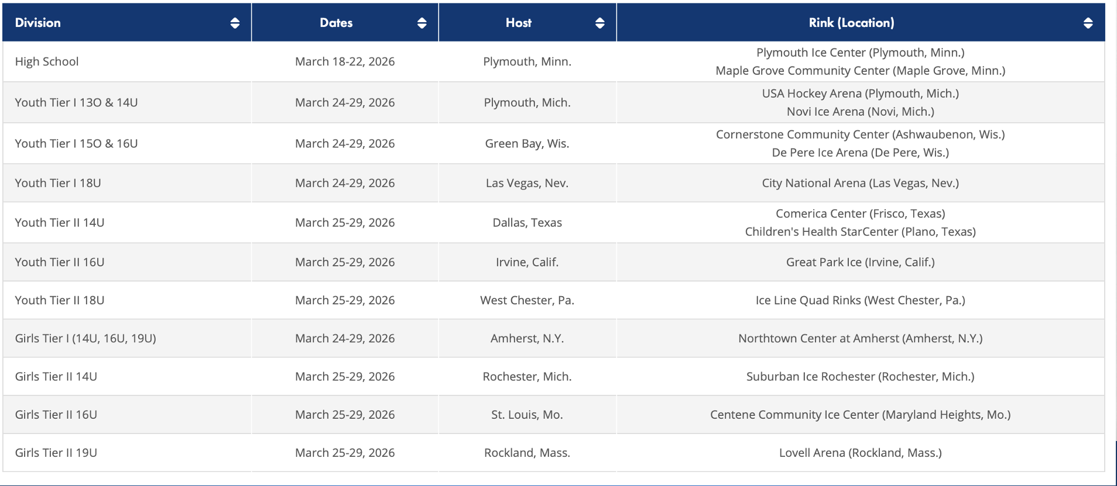
NATIONALS

Slide 45
SPORTS GAMESHEETSROSTERS
Players and coaches listed.
Goalies and head coach identified.
Use same names as on USAH roster if adding additional members manually.
Max of 18 skaters, 20 total players on bench.
Max of 4 coaches on bench.
Must be registered and on USAH roster as player or coach to be on bench.
Need jersey #'s listed on USAH roster for all NTB teams.
All positions listed for NTB teams. A minimum of goalies identified for all others.
Max of 20 skaters, 22 total players on bench for Tier One Youth 15O, 16U, 18U, and Tier One Girls 19U.
Do NOT input roster manually at start of the season. It MUST be imported from USAH the first time.
All members marked as active/playing on Gamesheet must be on USAH 1-T roster (with exception for vertically moving players).

Slide 46
How to score on Game Sheets.
How to direct link to a team’s schedule.
How to direct link to tournament standings.
How to set up and use MyHockey Rankings.
Jen Bosier
Scoring@coloradohockey.org.

Slide 47
TRAVEL PERMITS
Travel permit required anytime playing out of state including league, non-league, tournament games.
Only exceptions are for Districts or Nationals.
US and Canadian permits submitted online. Under Forms, Docs, and Links on Cross Bar site. Be sure to select the correct permit. Tournament Travel. League/Non-League Travel. Travel to Canada.
Submit travel permits AT LEAST TWO WEEKS ahead of travel.
HC and Manager are responsible for verifying that tournaments are sanctioned and non-league games are against USAH, Hockey Canada or other IIHF approved teams.

Slide 48

Unsanctioned Games
Do NOT participate in unsanctioned games/events during the regular season.
Only sanctioned games count towards game counts.
No USAH insurance in place for unsanctioned play/events.
Waivers required.
Abide by USAH policies
Off season unsanctioned play with your USAH association requires different team names, different jerseys and a waiver from each participating member. Team collects waivers and association registrar keeps on file.
Summer events not being held under your USAH/CAHA member association are not sanctioned. These are under a different organization’s name, have different jersey’s, etc. No waiver needed.

Slide 49
Who is Responsible for What?
Affiliate Registrars are responsible to make sure rosters meet USAH standards. Players in correct age group, CEP requirements met.
The Association and/or the team is ultimately responsible for monitoring the following, with our assistance as needed: number of out of state players and student visas, dual rostered players, mid season SafeSport expirations and completions, vertical movement game counts.
The Association and/or the team is solely accountable for: accuracy of scoresheet and USAH rosters, T1 player agreements, concussion training for coaches, billet and other volunteer credentials (unless on submitted roster), suspensions received and served, player eligibility for specific rosters.

Slide 50
RESOURCES
USAH - Annual Guide, portal, reports, forms.
CAHA website – policies, manager resources, coaches’ corner, tournament pages.
League, Association.
Try Hockey for Free – use the USAH platform.
Event Sanctions for on ice and off ice activities.
ESS (electronic scoring) – Jen Bosier, scoring@coloradohockey.org.
VP Rec (play ups, play downs)- TBD, vpofrec@coloradohockey.org
Disciplinary Chair – Alan McLean, discipline@coloradohockey.org
VP of Girls (play ups, play downs) - Jeff Walker, jhwalker1776@gmail.com.
.
VP of Tier - Shawn Vecellio, vpoftier@coloradohockey.org
Bookkeeper – Claire Graham McDonnell, bookkeeper@coloradohockey.org

Slide 51
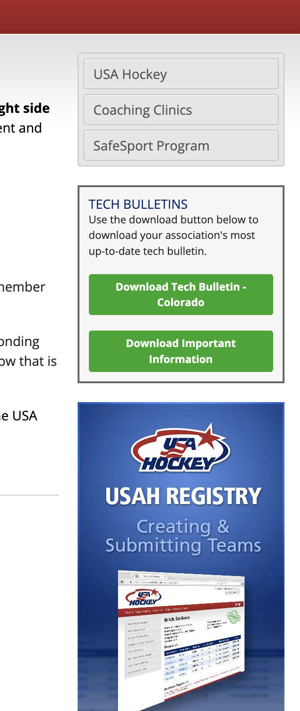
Resources found on home page of portal.
Links to useful pages.
Tech bulletin and USAH important information.
Tutorial on submitting rosters.

Slide 52
YOUR AFFILIATE REGISTRArS
ANDA CRAVEN
anda.craven@usahockey.org
970-481-2773
STACEY ZIS
stacey.zis@usahockey.org
720-308-8748
Award patches available upon request at END of season.
Hat Trick, Play Maker, Shut Out.
One per player per category, available at season’s end with scoresheet documentation
We send to team manager or registrar. They distribute to players.

