Slide 1

2026 SPONSORSHIP
OPPORTUNITIES

Slide 2
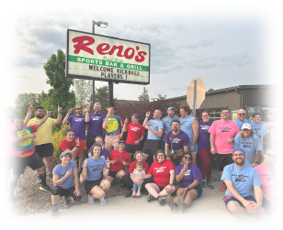
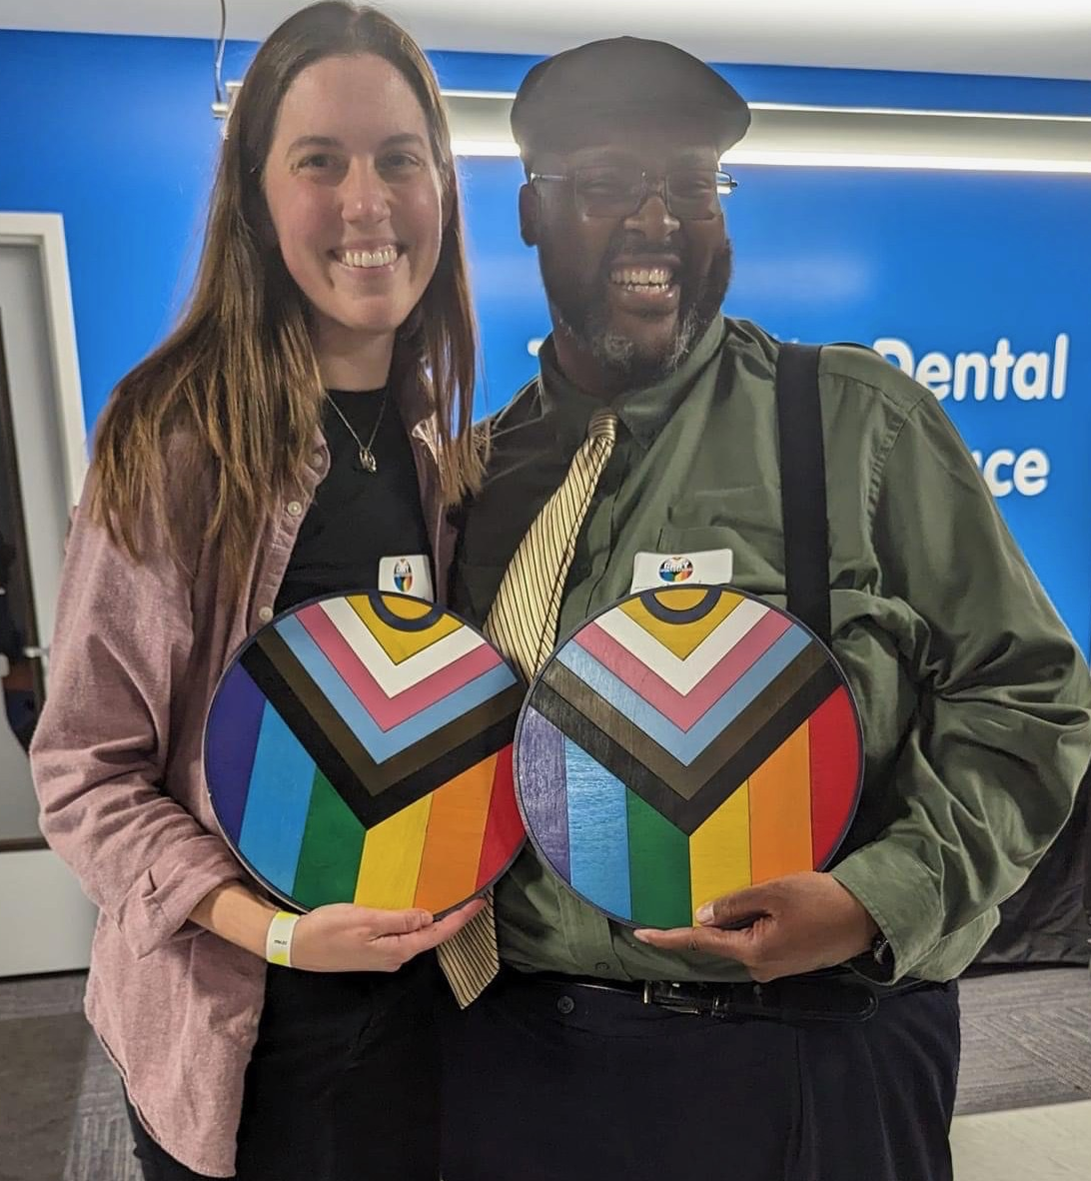
ABOUT GAAY SPORTS
Not-for-profit recreational sports league
Mission – to provide safe spaces for members of the LGBTQIA+ Community to recreate with one another in organized sports.
Started in June 2022 with a 44-person kickball league in Lansing. In 2025, over 2,000 participants played in eight different sports across four cities in Michigan!
We also offer organize other social activities for the LGBTQIA+ Community, including a family potluck BBQ, one day learn to play sport days, one-day tournaments, fantasy football, March Madness challenge, and an annual Holiday Extravaganza.

Slide 3
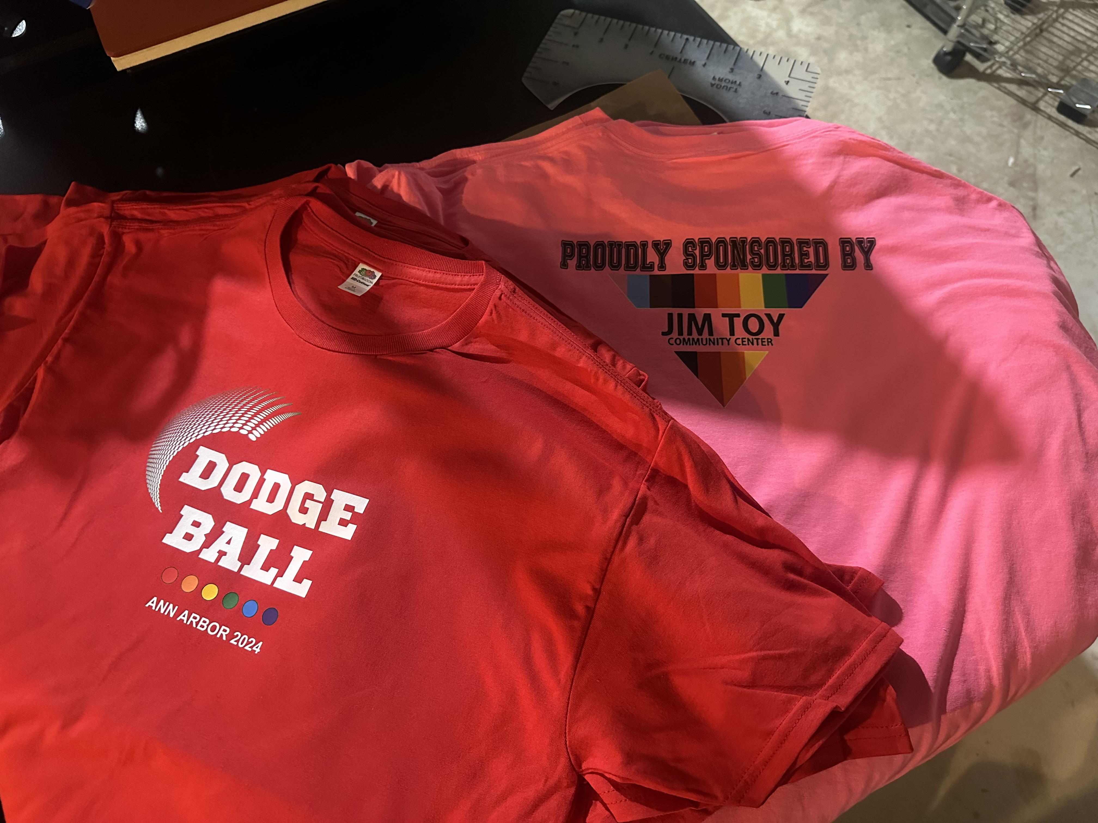
SPONSORSHIP INCLUDES
LOGO ON TEAM SHIRT FOR THE SEASON
RECOGNITION ON GAAYSPORTS.ORG FOR 2026 CALENDAR YEAR
IF EARLY ENOUGH, YOUR LOGO WILL BE ON ALL PRINT MATERIALS PROMOTING THE LEAGUE 10-8 WEEKS IN ADVANCE OF THE LEAGUE START DATE
DURING THE SEASON, WEEKLY RECOGNITION ON FACEBOOK AND INSTAGRAM WHEN STANDINGS ARE POSTED
  FACEBOOK IMPRESSIONS ARE OVER 10,000 PER MONTH!
DURING THE LEAGUE YOU SPONSOR, WE WILL SHARE SOCIAL MEDIA POSTS FOR EVENTS YOU ARE DOING ONCE PER WEEK ON REQUEST
THOUGH WE CANNOT GURANTEE ANY BUSINESS, WE DO EVERYTHING WE CAN TO ENCOURAGE PARTICIPANTS TO SUPPORT OUR SPONSORS WHENEVER POSSIBLE AND TRY TO ORGANIZE TEAM EVENTS AFTER GAMES
THE CHANCE TO DISPLAY THE LEAGUE TROPHY AT YOUR BUSINESS IF THE TEAM YOU SPONSOR WINS THE LEAGUE
THE INTRINSIC FEELING OF GOOD WILL FOR HELPING A MARGINALIZED COMMUNITY
ALL SPONSORSHIPS ARE 100% TAX DEDUCTIBLE (TAX ID: 88-2435086)
PLEASE NOTE: A SPONSORSHIP DOES NOT PAY FOR ANYONE’S REGISTRATION! IT DOES, HOWEVER, KEEP THE COST LOW FOR ALL PARTICIPANTS!

Slide 4
GRAND RAPIDS 2026
SPORT | SEASON | LENGTH | # OF PEOPLE | SPONSORSHIP
BOWLING 4-5 PER TEAM | JAN – APR OCT - DEC | 9 WEEKS 8 WEEKS | 50-70 50-70 | $100/TEAM
DODGEBALL 8/9 PER TEAM | FEB - MAR OCT - DEC | 8 WEEKS 8 WEEKS | 48-64 48-64 | $250/TEAM
KICKBALL 12-15 PER TEAM | APRIL – JUNE AUG-OCT | 8 WEEKS 8 WEEKS | 125-150 | $500/TEAM
SAND VOLLEYBALL 8/9 PER TEAM | JUNE-JULY | 8 WEEKS | 48-64 | $150/TEAM
2026 ALL GR TEAM SPORTS SPONSOR |  |  |  | $1,000

Slide 5
LANSING 2025
SPORT | SEASON | LENGTH | # OF PEOPLE | SPONSORSHIP
BOWLING 4-5 PER TEAM | JAN– APRIL SEPT – DEC | 12-16 WEEKS (10 PIN) 10-12 WEEKS (9 PIN) | 48-64 36-48 | $100/TEAM
DODGEBALL 8/9 PER TEAM | OCT - DEC | 8 WEEKS | 48-64 | $150/TEAM
KICKBALL 12-15 PER TEAM | APRIL – JUNE AUG - OCT | 8 WEEKS 8 WEEKS | 100+ 100+ | $500/TEAM
PICKLEBALL 4-6 PER TEAM | JAN – MAR JULY - AUG | 8 WEEKS 8 WEEKS | 24-36 | $100/TEAM
VOLLEYBALL (INDOOR) 8/9 PER TEAM | JAN - MAR | 8 WEEKS | 64+ | $150/TEAM
VOLLEYBALL (SAND) 5-9 PER TEAM | MAY – JULY (MON) AUG – OCT (MON) MAY – JULY (TUE) AUG – OCT ((TUE) | 10 WEEKS (SOCIAL BYOT) 6 WEEK (RANDOM TEAM) 8 WEEK (COMPETITIVE/RANOM) 8 WEEK (COMPETITIVE/BYOT) | 64-90 48-64 36-50 36-50 | $400/TEAM
GOLF SCRAMBLE 4-6 PER TEAM | FEB MAY | 1 DAY INDOOR OUTING 1 DAY 12 HOLE SCRAMBLE | 36 48-64 | $400/HOLE
2026 ALL LANSING TEAM SPORTS SPONSOR & GOLF OUTING HOLE SPONSOR SPECIAL PACKAGE |  |  |  | $1,500 SAVE $300

Slide 6
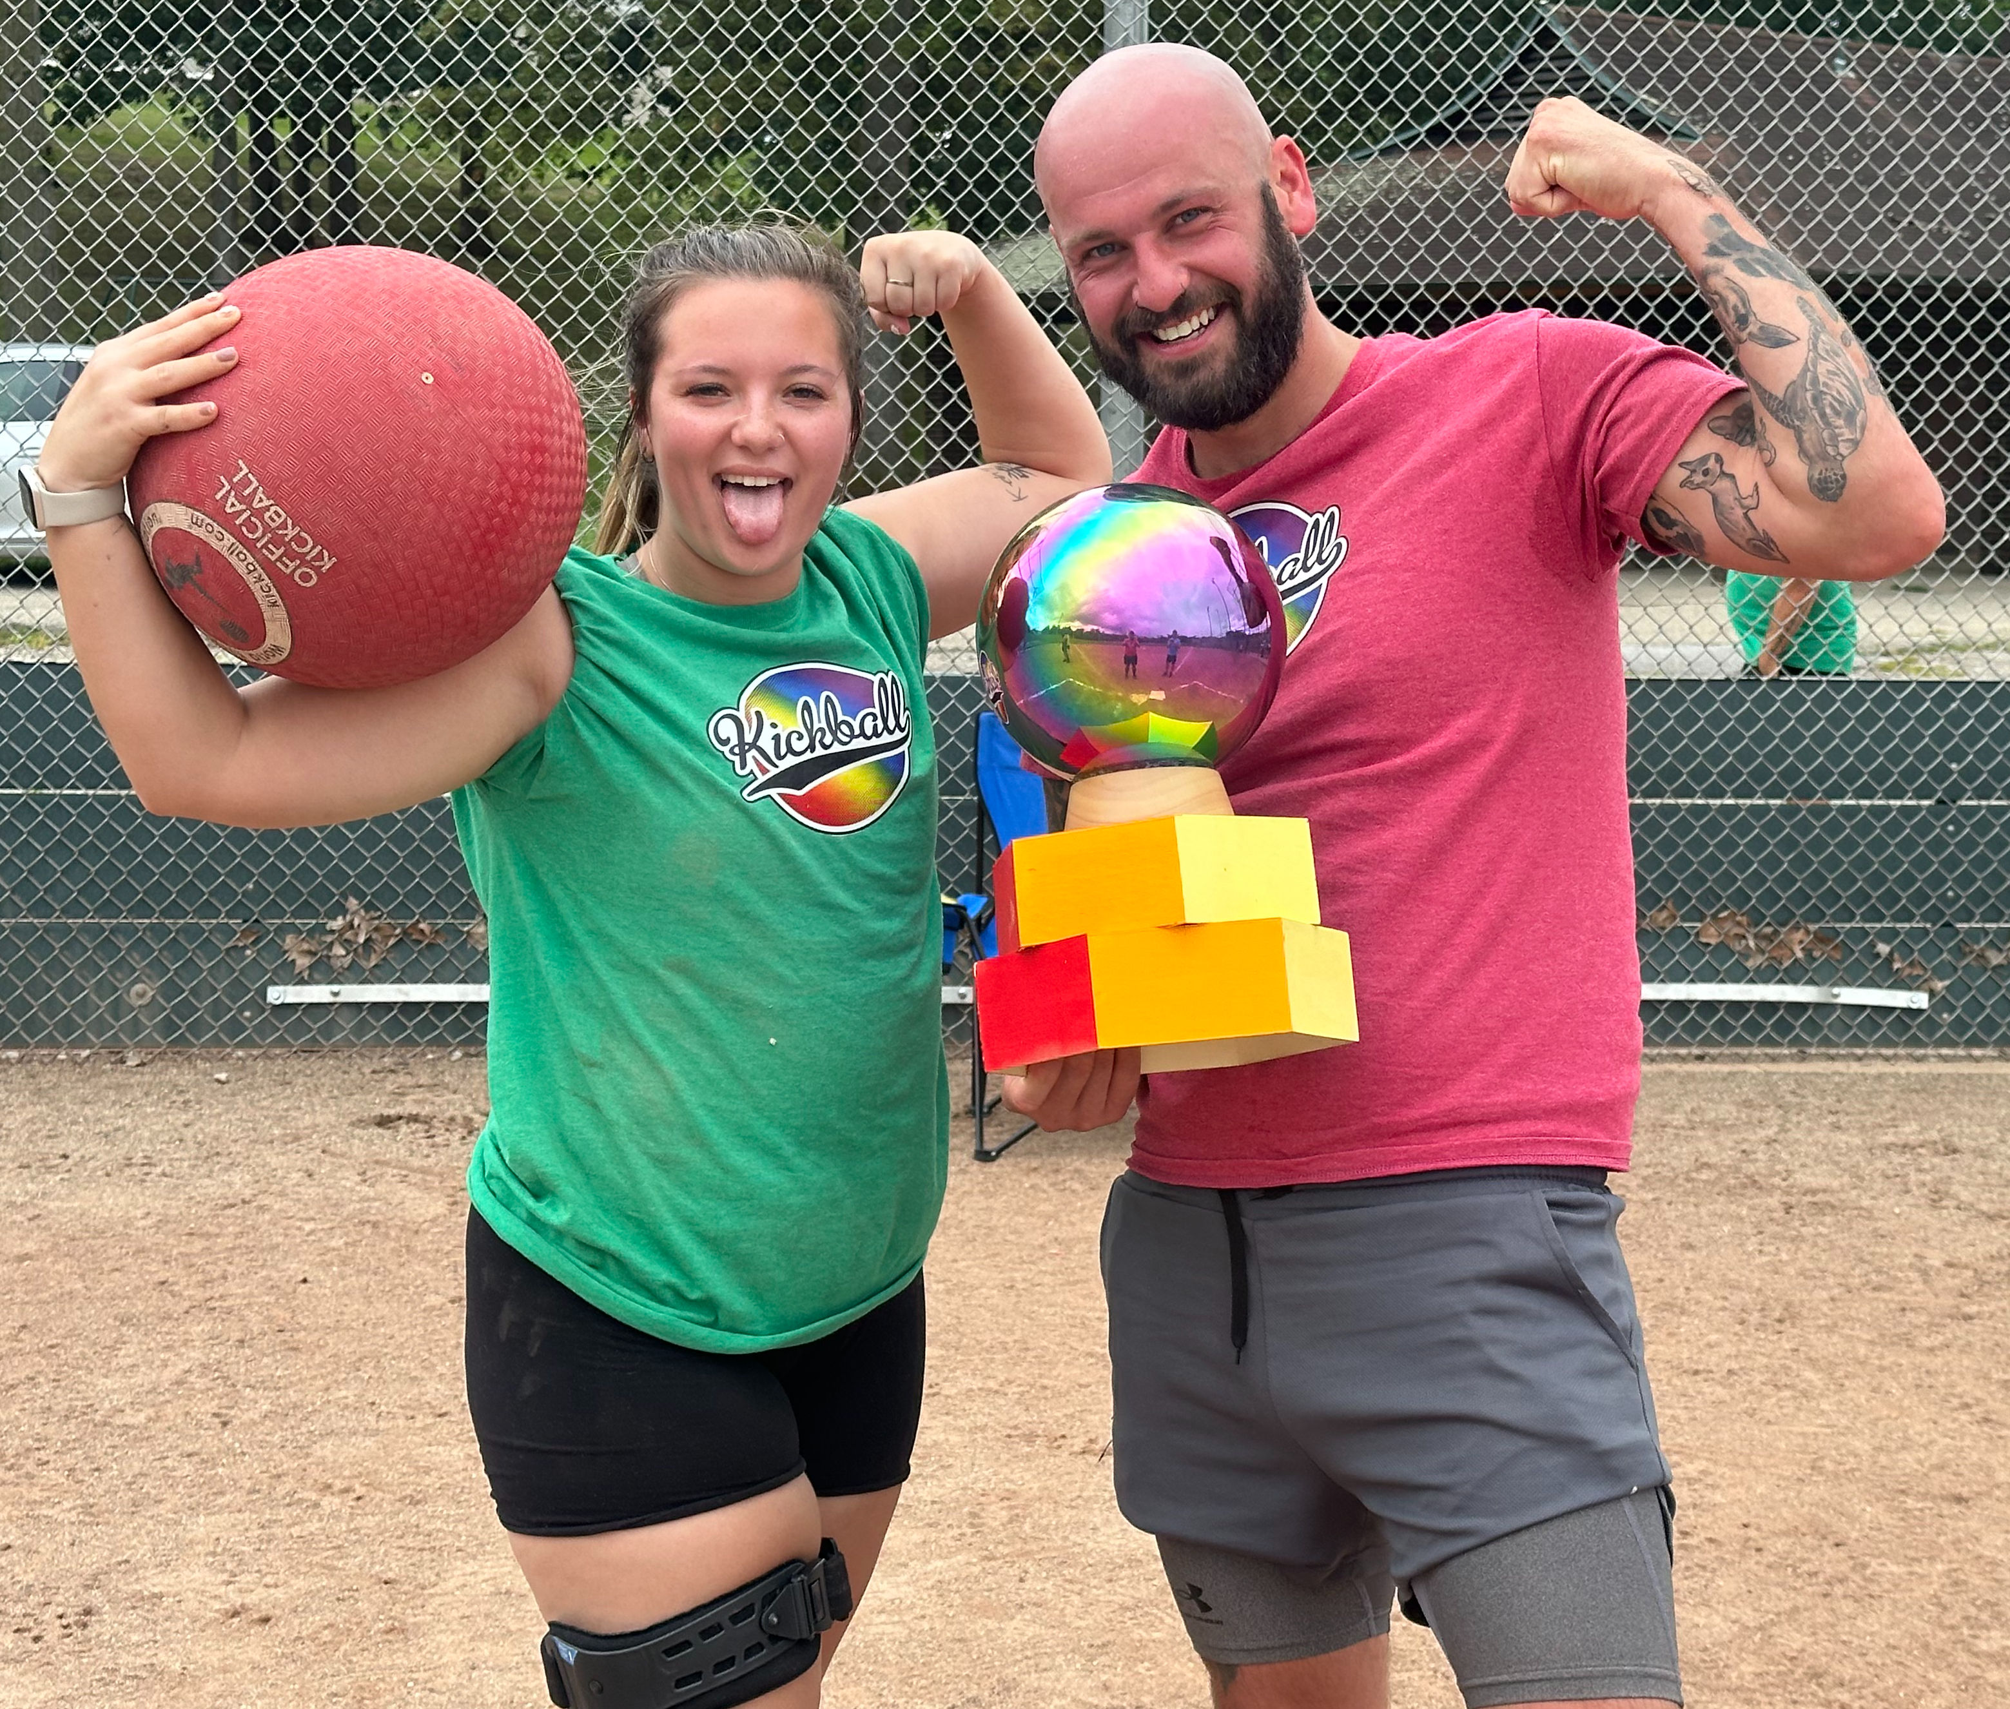
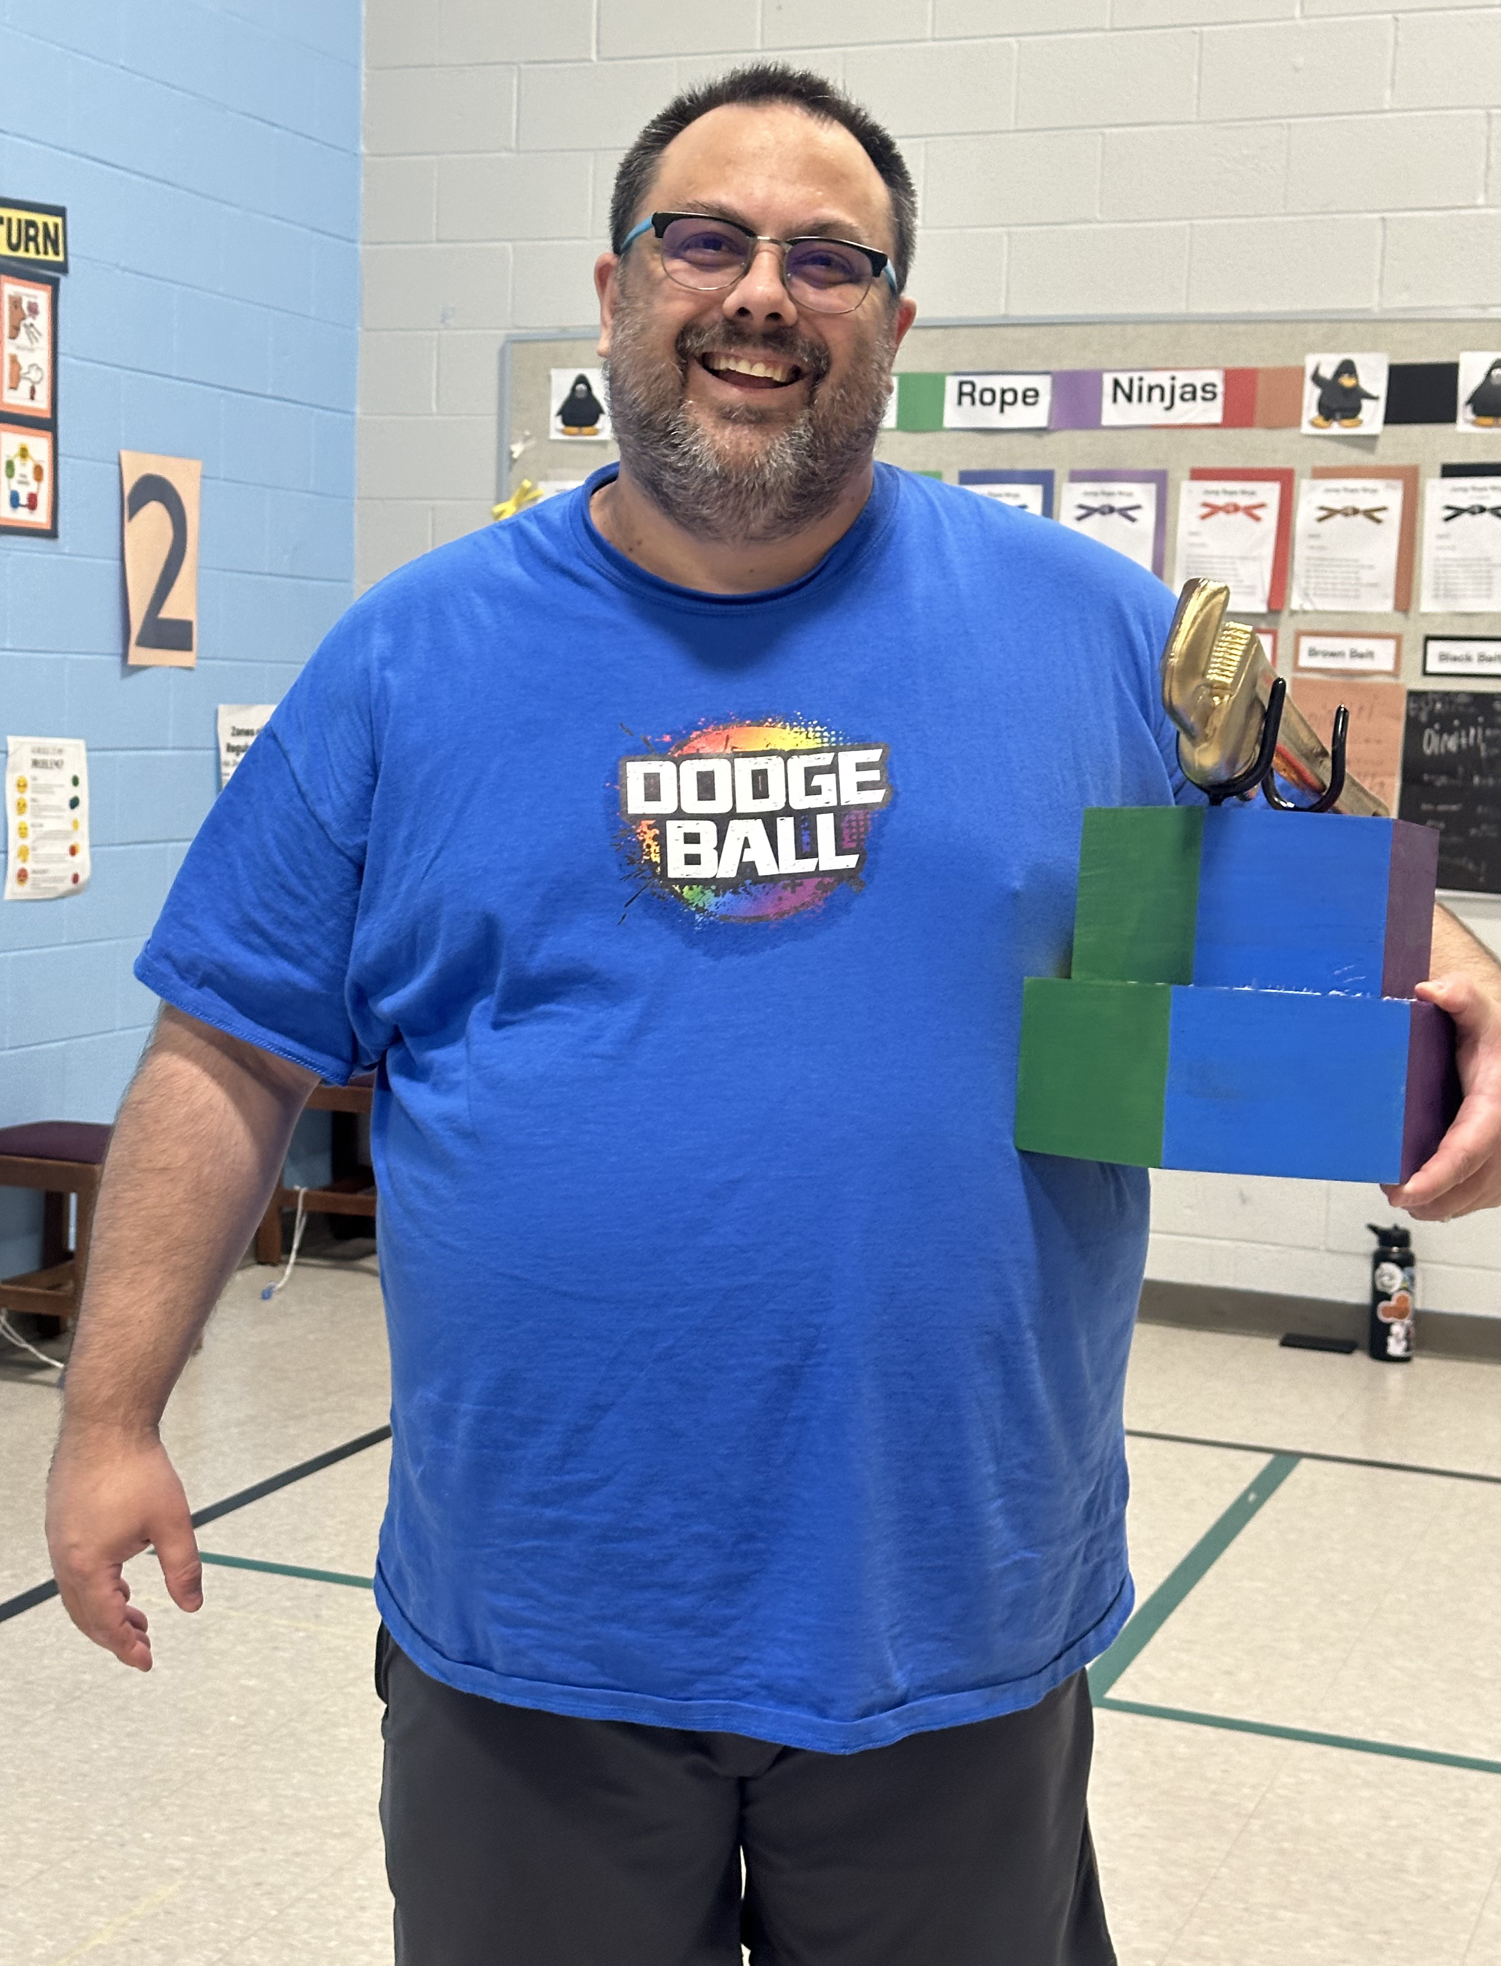
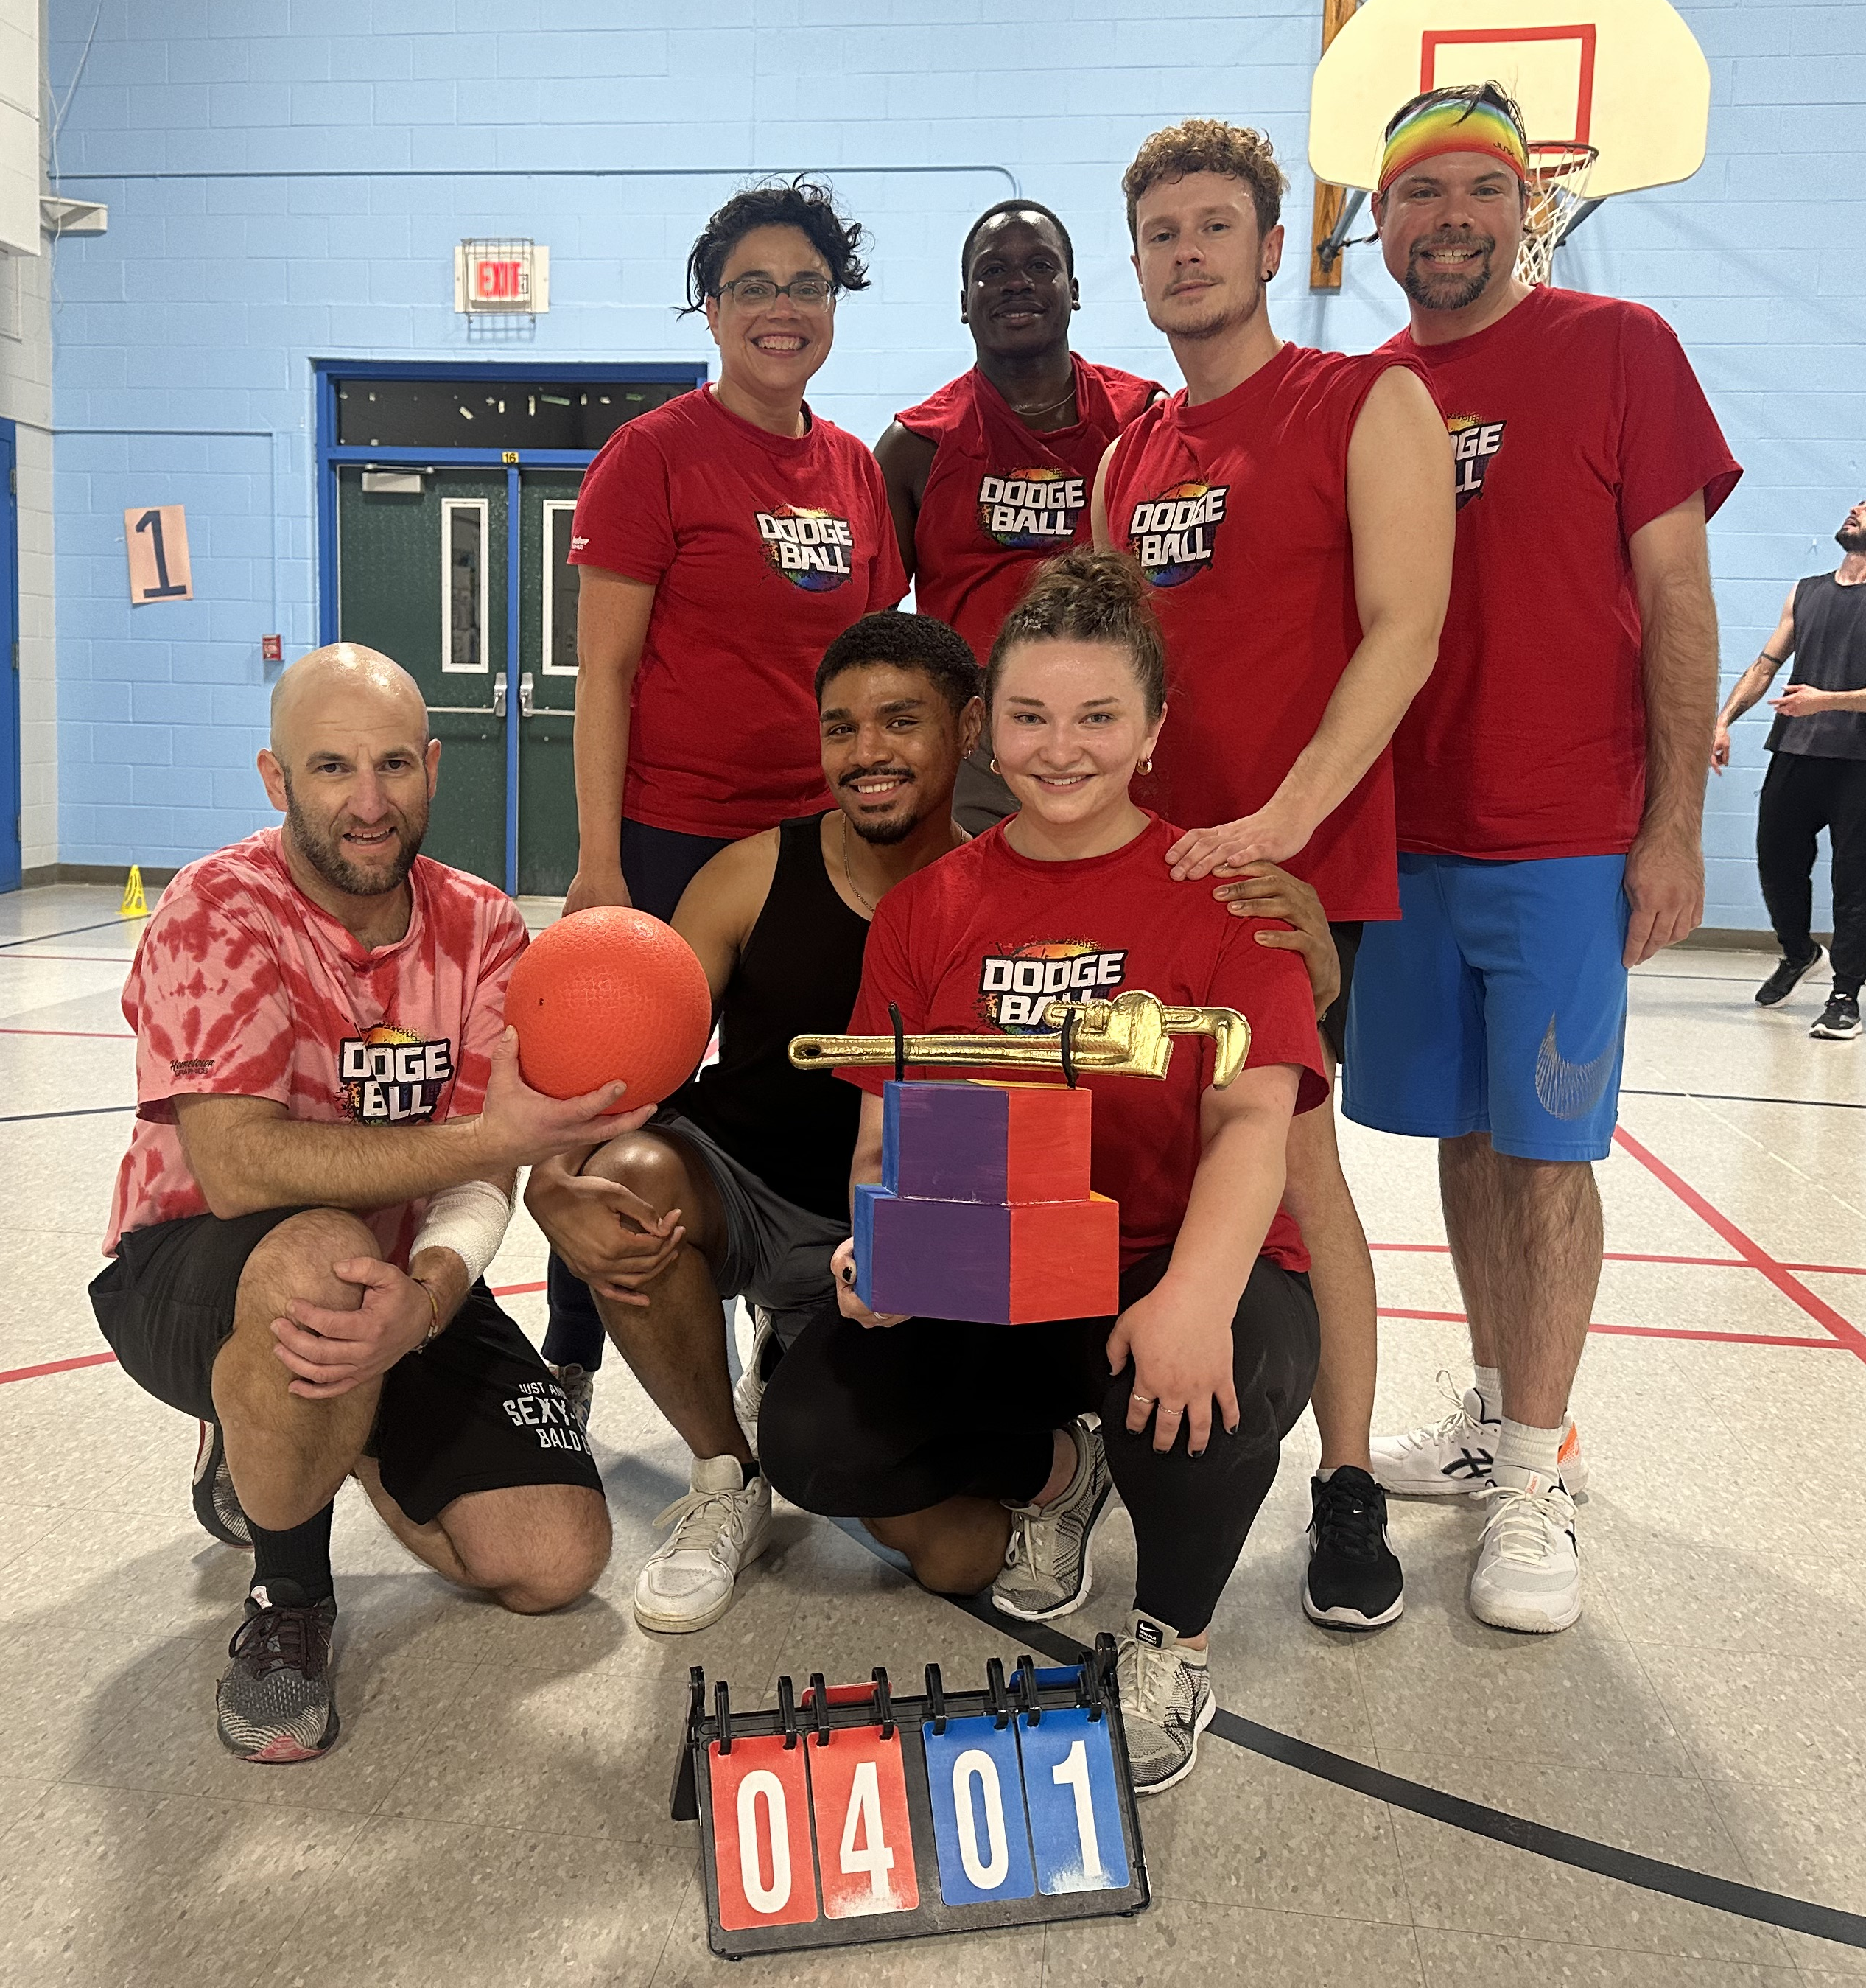
ANN ARBOR 2026
SPORT | SEASON | LENGTH | # OF PEOPLE | SPONSORSHIP
DODGEBALL 8/9 PER TEAM | FEB - APR OCT - DEC | 8 WEEKS 8 WEEKS | 48-64 48-64 | $250/TEAM
PICKLEBALL 4-6 PER TEAM | JAN – MAR JULY - AUG | 8 WEEKS 8 WEEKS | 24-36 | $100/TEAM
SAND VOLLEYBALL 8/9 PER TEAM | JUNE-JULY | 8 WEEKS | 48-64 | $150/TEAM
2026 ALL ANN ARBOR TEAM SPORTS SPONSOR |  |  |  | $500

Slide 7
501c3 status

Slide 8
DONATION RESPONSE FORM
BUSINESS NAME: __________________ PHONE: _______________
CONTACT NAME: __________________EMAIL: ________________
ADDRESS: _________________________________________________
Please email this form to Nicholas@gaaysports.org along with your business logo and we will promptly send you an invoice so you have a record for your tax deduction.
Yes! I want to support GAAY Sports in 2026! I would like to sponsor a team(s) in the following league(s):
LANSING
BOWLING ($100)
DODGEBALL ($150)
KICKBALL ($500)
VOLLEYBALL – INDOOR ($150)
VOLLEYBALL - SAND ($400)
PICKLEBALL ($100)
GOLF OUTINGS ($400)
ALL LANSING ($1,500)
GRAND RAPIDS
BOWLING ($100)
DODGEBALL ($250)
KICKBALL ($500)
SAND VOLLEYBALL ($150)
ALL GRAND RAPIDS ($1,000)
ANN ARBOR
DODGEBALL ($250)
PICKLEBALL ($100)
SAND VOLLEYBALL ($150)
ALL ANN ARBOR ($500)
I’D LIKE TO DONATE FOUR PRIZES FOR LEAGUE AWARDS (MVP, MOST IMPROVED, BEST ROOKIE, AND CONGENIALITY)
I’D LIKE TO BE A STATE-WIDE SPONSOR IN ALL LEAGUES ($3,000) FOR THE DISCOUNTED PRICE OF $2,500.
Please make checks payable to GAAY Sports

