Slide 1

DE PERE CENTRAL LACROSSE 2025

Slide 2
De Pere Central Lacrosse: Board
President: Eric Zeise
Vice President: Tamara Brockington
Communications Director: Nicole Van Helden Treasurer: Jason Sinkula
Volunteer Coordinator: Mark Wafle
Apparel Chair: Matt Smith
Fundraising Director: Bill Frank

Slide 3
De Pere Lacrosse: Housekeeping Items
• Registration (Girls and Boys)
Student-athletes must register at deperelax.com
Necessary forms that MUST be completed prior to the season
-Code of Conduct (for your high school)
-Concussion Form
-Athletic Physical
Forms may be picked up from Mrs. Guyette at De Pere HS, from the Activities Office at West De Pere HS, or online.
Note: Physicals MUST be renewed every two years
• Fees (Girls and Boys)
2025 Fees are $275
De Pere HS families may pay fees via the portal or deliver a check to Kerry Guyette in the Athletics Department.
West De Pere families should deliver a check to Kerry Guyette in the De Pere Athletics Department.
Check should be made out to “De Pere High School.”

Slide 4
De Pere Lacrosse: Facilities
Practices Facilities
• Pre-Season: West De Pere High School Indoor Turf Facility
• In-Season: De Pere and West De Pere High School Stadiums
Practice sites determined based upon field availability
• Strength and Conditioning Training:
ALL players (girls and boys) should attend speed and strength training at their respective high school. Sessions occur after school each day.
Game Facilities
• Home games played at De Pere High School’s Nowak Field and
West De Pere High School Football Field.
• Concessions available at West De Pere High School ONLY
• Game day operations managed by each team (volunteers needed)

Slide 5
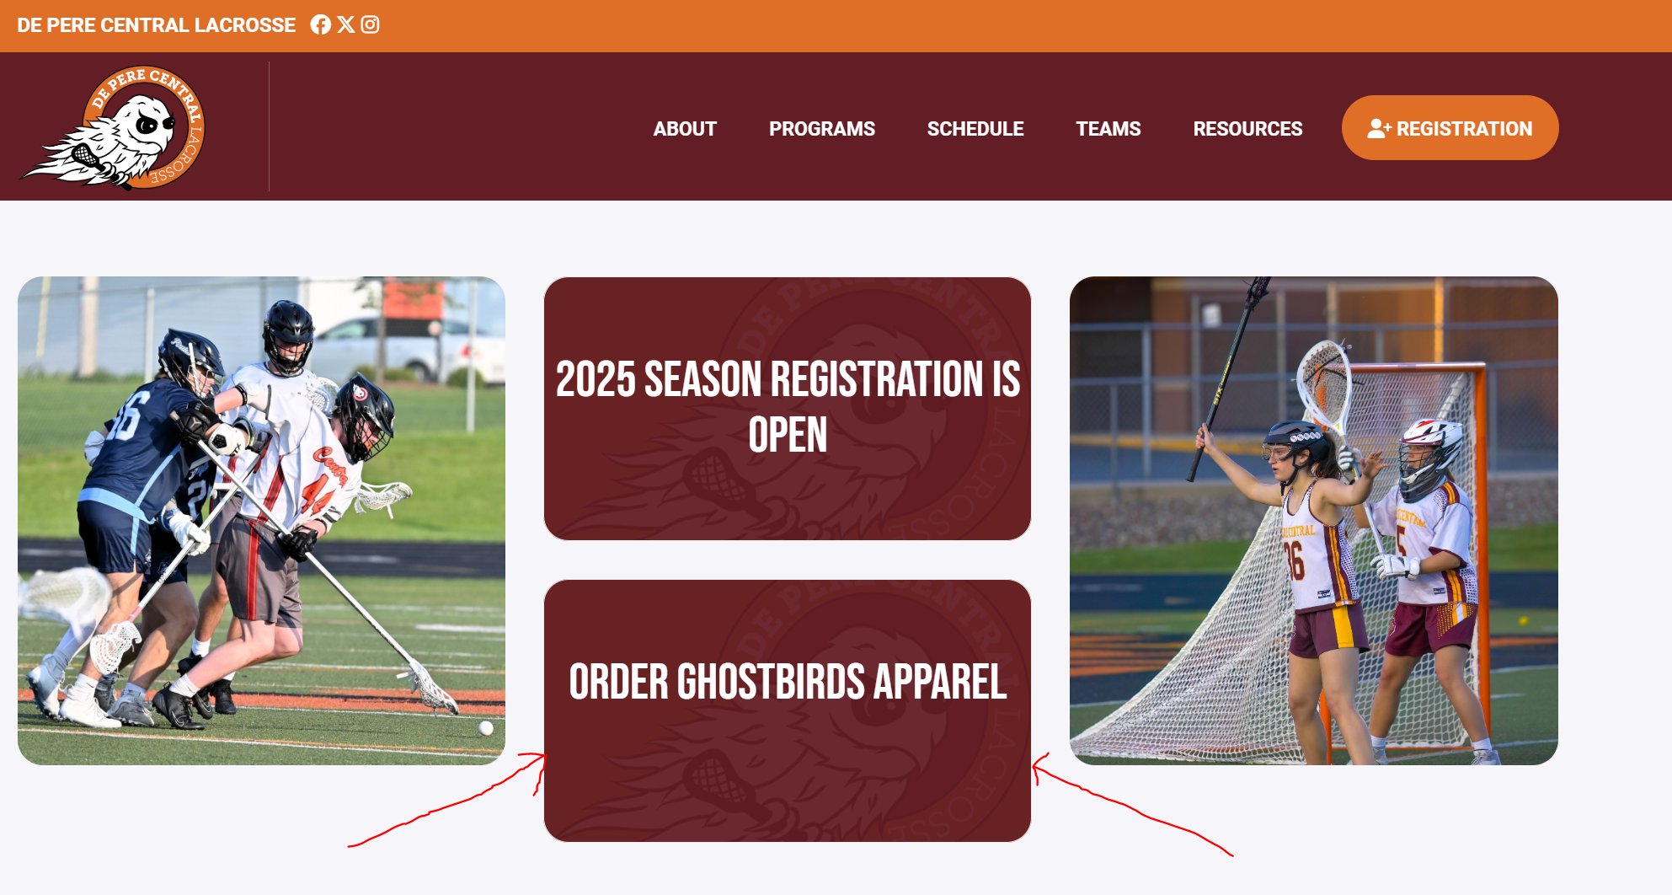
De Pere Lacrosse: Apparel
https://graciedesigns.com/collections/de-pere-central-lacrosse
You may access this link at deperelax.com on the landing page

Slide 6
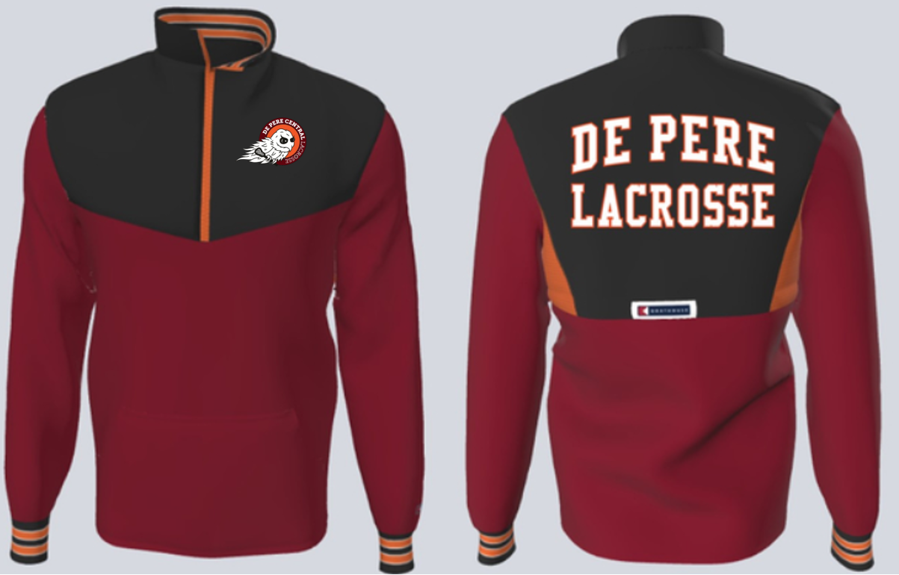
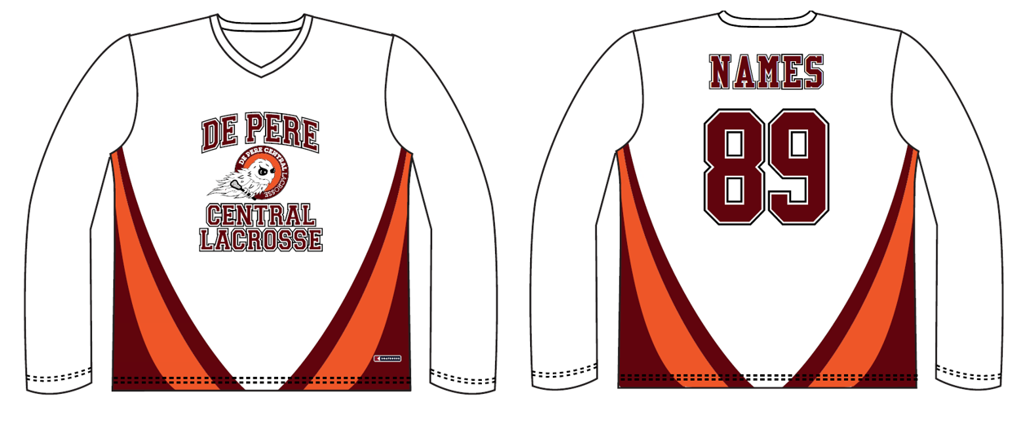
De Pere Lacrosse: Apparel
Boathouse:
Optional Items
Team Jacket: $107
Shooter Shirt: $57
Online ordering will be available soon!

Slide 7
De Pere Lacrosse: Fundraising
Goal is to raise $8,000 via Sponsorships.
Sponsorship Flyer explains different levels.
Players/Families will earn back 10% of the value of each sponsorship they sell.
Each player is required to “solicit” (not necessarily sell) to a minimum of 2 businesses.
Last year’s sponsors will be approached by same players or coaches that obtained their sponsorship last year.
For any new businesses, please connect with Eric Zeise to confirm the additional sponsorships for this year.

Slide 8
De Pere Lacrosse: Volunteering
New website will further describe duties
Likely to use Sign Up Genius for actual sign up
2 shifts for boys plus 1 Brat Barn in Summer
3 shifts for girls plus 1 Brat Barn in Summer
People filling season-long positions will not be required to sign up for any game-to-game shift duties

Slide 9
DP Lacrosse: Girls Volunteering
Girls season–long positions:
Public address (filled), team photographer (1), banquet organizers (2), social media specialist (1)
Girls game-by-game needs:
Pre-game set up (2), scorer’s table (1 JV, 1 V), stats/spotters (2 JV, 2 V), scoreboard (1 JV, 1 V), video board (@WDP HS only), post-game clean up (2), 50/50 raffle (2), team dinners (1 on eve of home games)
Play Day will require a number of each of these

Slide 10
DP Lacrosse: Boys Volunteering
Boys season-long positions:
Scorer’s table (filled), stats/spotters (filled), public address (filled), scoreboard (filled), team photographer (1), social media specialist (1)
Boys game-by-game needs:
Pre-game set up (2), post-game clean up (2), 50/50 raffle (2)

Slide 11
De Pere Lacrosse: Girls Team
Coaching Staff:
John Uhl (joined in 2018)
Jon Zawlocki (joined in 2021)
Lily Uhl(joined in 2025)
Captains…..

Slide 12
De Pere Lacrosse Girls
Optional Open Turf Sessions
Tuesdays and Thursdays 7 - 8:30pm
West De Pere High School Indoor Turf
Enter Thru Door 4
Practices Start March 17th
Typically Monday thru Friday
Times yet to be determined

Slide 13
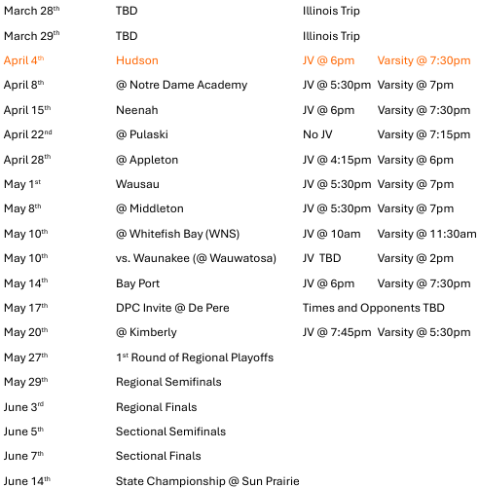
DPLAX: Girls Tenative Schedule

Slide 14
De Pere Lacrosse: Girls Budget
Refs
Hudson 405
Neenah 405
Wausau 405
Bayport 405
Oregon 405
Playday 1,215
Total $3,240
Other
Awards 550
Banquet 600
Gameday Snacks 800
Balls 375
Equipment 800
Misc 575
Total $3,700

Slide 15
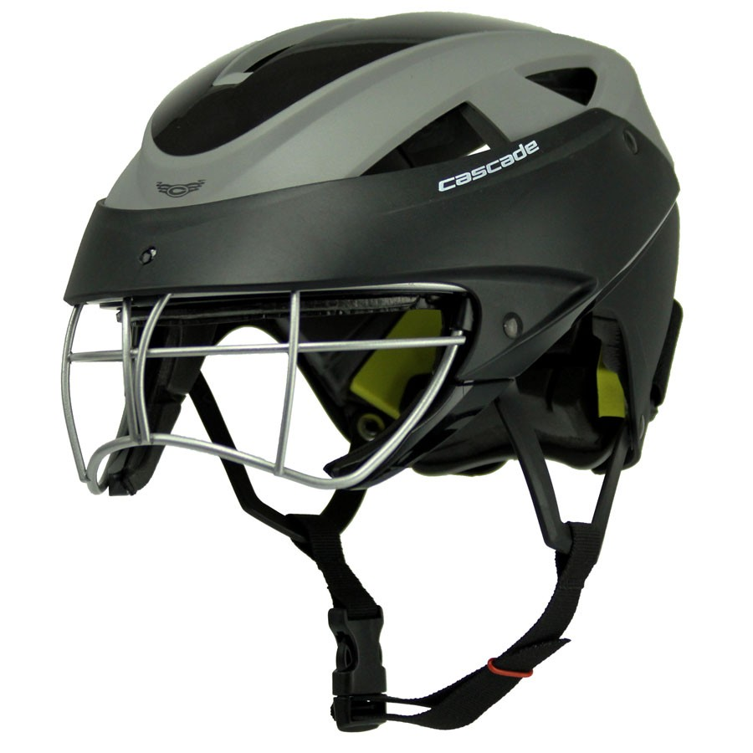
DP Lacrosse: Girls Equipment
• Required Helmet
Cascade Women's LX Lacrosse Headgear ($160)
HELMET MUST BE BLACK
Rental option available
• Additional Equipment
Cleats
Mouthguard (including a backup)
Stick

Slide 16
De Pere Lacrosse: Boys Team
Coaching Staff:
Charley Jacobs (joined in 2015)
Bill Nusbaum (joined in 2022)
Ben Graves (joined in 2023)
Marc Dempsey (joined in 2023)
Masen Powless (joined in 2025)
Captains:
Ben Nusbaum, Senior goalie
Aidan Curtis, Senior midfielder
Cade Brockington, Junior defenseman
Will Jacobs, Junior attackman

Slide 17
De Pere Lacrosse: Boys Team
Mission:
De Pere Central Ghostbirds Lacrosse seeks to employ the sport of lacrosse to teach life lessons that build stronger individuals and communities both on and off the field while developing a life-long love of lacrosse and its rich history among our players.
Vision:
De Pere Central Ghostbird Lacrosse strives to become the best high school lacrosse program in the region through the development of the physical and intellectual skills of the boys who play the game, supported by a community of administrators, parents, and community members who value a vibrant athletic experience that supports the improvement of our youth.

Slide 18
De Pere Lacrosse: Boys Team
The De Pere Central Ghostbirds Lacrosse coaching staff will base its approach to practices, games, and the development of our players on the core values of C⁴ described below.
COMMUNITY
A dedication to support those with whom you share the classroom and the field.
CHARACTER
Resolve to treat everyone with respect, equity, and dignity both on and off the field.
COMMITMENT
Devote yourself to developing your intellectual and physical skills every day.
CAMRADERIE
Build and maintain trust and respect with teammates, opponents, coaches, teachers, and school staff.

Slide 19
De Pere Lacrosse: Boys Team
Hazing
Hazing is defined as any humiliating or dangerous activity expected of a student to belong to a group, regardless of their willingness to participate.
Some practices associated with high school hazing carry the potential for serious bodily harm or even death. These practices may include: tattooing, piercing, head-shaving, branding, sleep deprivation, physical punishment (paddling and "red-bellying"), "kidnapping," consuming unreasonable/unacceptable foods or beverages, such as alcohol. Coerced sexual activity, in addition to being classified as sexual assault and/or rape, is another form of hazing.

Slide 20
DP Lacrosse: Boys Equipment
• Required Equipment (Handout available on table)
Recommended Helmet
Warrior Burn ($250)
Cascade XRS ($320)
HELMET SHOULD BE GLOSS BLACK
Additional Equipment
Shoulder pads ($125)
MUST be NOSCAE certified with rigid chest plate
Elbow pads ($50-$150)
Gloves: White or Black ($50-$150)
Mouthguard (2): ($10-$20)
Athletic cup: required by rule ($15-$25)
Stick: ($50-$200)
visit stringking.com and receive a 20% discount

Slide 21
De Pere Lacrosse - Boys Budget
Other
Defensive Coach 1,250
Team Helmets 1,000
Awards/Gifts 550
Team Dinner 350
Helmet Stickers 300
Supplies/Pinnies 1,550
Total $5,000
Refs
Neenah 600
Oneida 250
Wausau 600
NDA 250
Pulaski 250
Bay Port 600
Total $2,550

Slide 22
De Pere Lacrosse: Boys Practice
IMPORTANT DATES
Pre-Season Practice
Voluntary pre-season practices will be held each Tuesday and Thursday through March 13. Practices will be conducted from 7-8:30 pm at the West De Pere High School indoor turf facility.
Regular Season Practice (Tentative Schedule)
March 16 Team Meeting TBA
March 17 Begin on-field practice TBA
March 22-30 Spring Break: De Pere and West De Pere High Schools
Players should plan on attending practice through March 21
Players who are in town for spring break are expected to attend
practices.
Note: All early-season practice dates and times are tentative.
Weather may cause changes.

Slide 23
De Pere Lacrosse
Conference Alignment 2025
Bay Valley Lacrosse Conference:
Appleton United
Bay Port Pirates
De Pere Central Ghostbirds
Kimberly Papermakers
Neenah Rockets
Notre Dame Academy Tritons
Oneida Thunderhawks
Pulaski Red Raiders
Wausau Wild

Slide 24
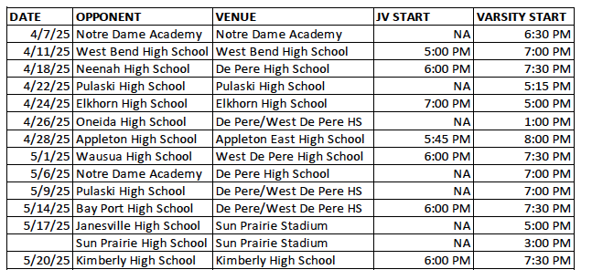
DPLAX: Boys Tentative Schedule

Slide 25
De Pere Lacrosse:
Practice Expectations
• Gear on and ready to go 5 minutes prior to practice
• Jog and dynamic warm-ups led by captains
• Competition at every practice
• Practice will be challenging, but fun
Game Expectations
• Attendance at all games
• Take the field with the expectation to win
• Play with intensity but respect for the game, opponents, and
officials
Note: Today, all players will be receiving a handbook outlining these expectation and consequences for missing practice or games.

Slide 26
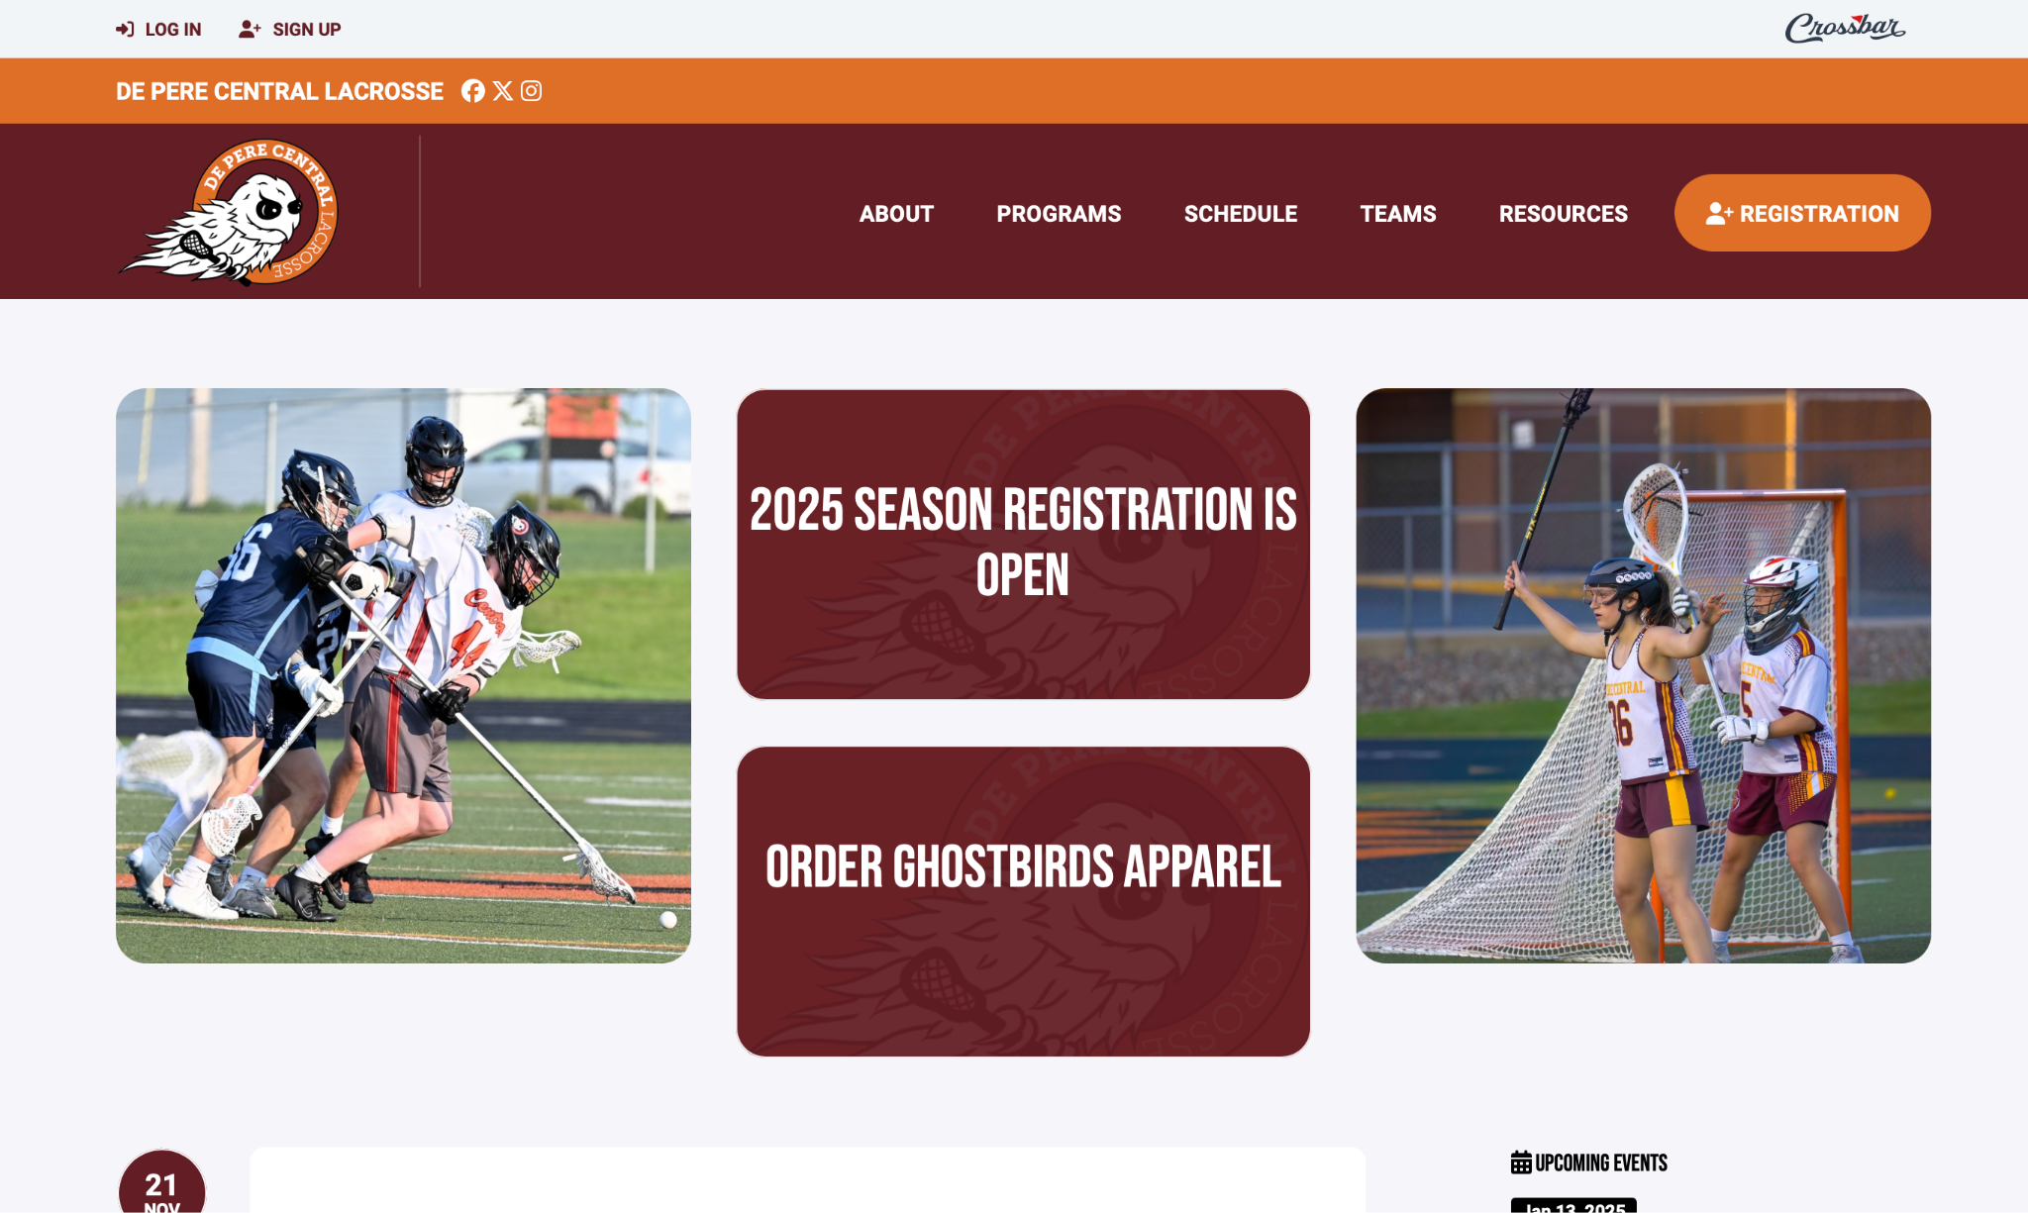
De Pere Lacrosse: Website
deperelax.com
-Register
-Apparel link
-Coach contact info
-Resources & more

Slide 27

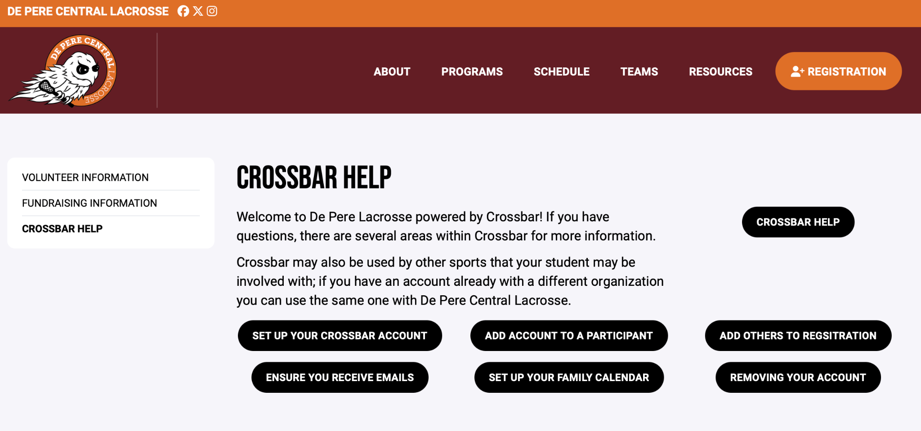
De Pere Lacrosse: Crossbar app
Crossbar mobile app
-Calendar sync
-Notifications
-Chat
Need Crossbar help?
See “Resources” tab
on our website

Slide 28
QUESTIONS??

