Slide 1

2025 Parent/Guardian Meeting

Slide 2
Our sponsors
Harker Heating and Cooling
Edward Jones - Matt Miron
Omni Technologies
Shackelford Heating & Cooling
Brothers HVAC
General Beverage
Comedy on State
Madison Mallards
Madison Capitols
Madison Forward
Global Sight and Sound
Main Tap
Vortex
Raw Graphic Expression
Headquarters
Bella Reis
E Clips Hair Design
Badger Tavern
Pizza Pit
Culvers
Notes:
Lets make sure we get this updated from Tom. Also include Pizza Pit as they are helping.

Slide 3

Agenda
Oregon Lacrosse Club
Welcome and Introductions
About us / OLC Board / Contacts
Makeup of Teams
Parent/Player Expectations
Player Development
Practices and Games
Health and Safety
Q& A / Closing

Slide 4
Introduction
Rob Carlon – Boys Youth Director
Joel Malak – Girls Youth Director
Boys Coaches
8U: Looking for volunteers
10U: Paul, Jim (tentatively Dan and Chad)
12U: Looking for volunteers
14U:Hunter, Aiden, and Max
Girls Coaches
Cheris Congo
Emily Podgorni

Slide 5
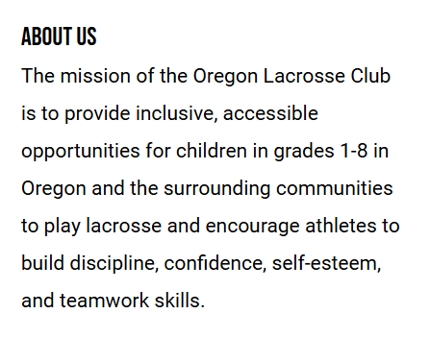

Slide 6
Oregon Youth Lacrosse
We are a program made up of players, coaches, volunteers, parent/guardians
Designed to create consistent experience for everyone in the
program
Developmental program emphasis, more than winning or losing
Players participate for various reasons
  Learn lacrosse
  Love lacrosse
  Want to hang out with friends
  Favorite new spring sport

Slide 7
Oregon Lacrosse Club Board
President – Amy Cameron
Vice President – Laura Shtaida
Secretary – Becky Rothering
Treasurer – Tom Grice
Boys Youth Director - Rob Carlon
Girls Youth Director - Joel Malak
Communications Coordinator – Joe Mueller

Slide 8
Important Links
Oregon Lacrosse Club:
  https://www.oregonlacrosseclub.com/
Club Facebook Page:
  https://www.facebook.com/oregonyouthlacrosse/
Badgerland Lacrosse:
  https://www.badgerlandlacrosse.com/

Slide 9
Current Makeup of OLC Teams
Boys
U8 - 5 registered players
U10 - 20 registered players
U12 - 19 registered players
U14 - 11 registered players
Girls
U10 – 9 registered players
U14 – 6 registered players

Slide 10
Parent/Player Expectations

Slide 11
Parent Code of Conduct
For your child to get the most out of playing lacrosse, it is important that you do the following:
1) Be supportive of your child
2) Attend games whenever possible
3) Be a positive role model
4) Let your child set his own goals
5) Let the coach be the coach. If you want to coach, volunteer!
6) Respect the decisions of the referee
7) Read the rule book
8) Get to know who is in charge
9) Get involved!
10) Sit back and enjoy the game

Slide 12
Player Expectations
Players are representing OLC – respect those around you in buildings, gyms, and at events.
– Officials, coaches, parents, spectators, and opponents
Support all your teammates, encourage
Someone talks, everyone listens, eye contact
Listen, learn, & work hard
Practice like you play!
Have fun!!!
Notes:
I like to remind kids that not only are they wearing our team name, they are also wearing an easy to read number. If you are doing something you shouldn’t it will get reported and it’s really easy to be identified.

Slide 13
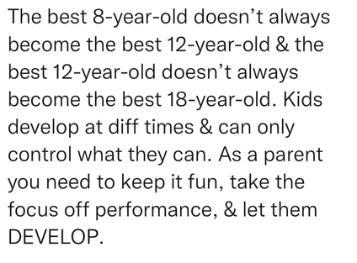
Player development

Slide 14

Best practices for developing youth athletes
Notes:
Also mention the 24 hour rule for parents and kids.

Slide 15
Playing Time
Coaches work to maintain equitable playing time
  Equal opportunity doesn’t always mean equal outcomes
Four main factors
  Show up to practice
  Work hard and listen at practice
  Understand offense, defense, out of bounds, etc.
  Quality of play in games, game situations
24-hour rule – timing of communication or questions for coaches

Slide 16
Practice/Game Conduct
Three Strike Rule
1) Coach talks with parent/player and sends a note via email.
2) Oregon Lacrosse Club President talks with parent/player and sends a note via email.
3) Parent/player will be told they are no longer welcome to attend any OLC events for the year, school district will be notified.

Slide 17
Additional help needed

Slide 18
Coaches
Selected from parent/guardian showing interest as well as non-parent/guardian applicants
Reviewed/approved by OLC Board
Lacrosse coaching experience and past performance is reviewed
Background checks are required/performed
Additional training is required

Slide 19
Managers
Selected from parent/guardian applicants as well as non-parent/guardian applicants.
The role is to be the primary organizer of daily operations:
  Collaborate with coaches to send out a weekly email that contains important information for the upcoming week
  Also, send last-minute communications (such as time changes or rainouts)
  Help facilitate volunteer hours, opportunities, and schedules.

Slide 20
Culture Keeper
Badgerland Lacrosse has a renewed focus on sportsmanship, as there has been a noticeable lapse in fan behavior.
Both teams will assign a Culture Keeper for each game to ensure their team fans act in accordance with our Code of Conduct and represent our team respectably and appropriately for a youth sporting event.

Slide 21
Other Volunteers
Home games require extra help, and every family is expected to help by serving in at least one of these volunteer roles during the season
These roles include Field prep and set up, field tear down and ball chaser, Score keeper, Game timer, Penalty box timer, Culture keeper, and Equipment manager

Slide 22
Practice schedules

Slide 23
Boys Practice Schedule
Brooklyn Fields M-F 4:30-7:30
Goal of March 17th start week, we cannot start earlier per conference and state rules
Coaches are volunteers and set schedules
  8U: 2 days a week, 1 hour each
  10U: 2 days a week, 1-1.5 hours a week
    Coaches are planning for M & W 5:30
  12U: 2-3 days a week, 1-1.5 hours a week.
  14U: 3-4 days a week 1.5-2 hours a day
    Planning for M,T,R 5-7 and F 5-6:30
Indoor practices vary based on gym availability
Currently waiting on Basketball to end so we can secure indoor space
Notes:
Remind them that the downside to starting practices early is that things are not finalized yet, but schedules will come out around the same time as prior years. Also starting early may mean an odd schedule for spring break.

Slide 24
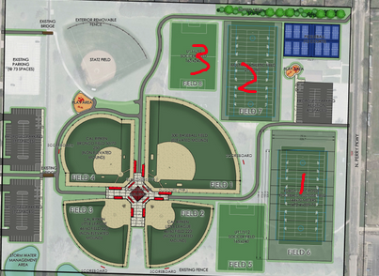
Girls Practice Schedule
Practices begin
  Monday, March 17
  Mon/Thur/Fri at OMS from 6-730
  Once weather permits (mid-April?) we anticipate moving outdoors to Bergamont Park or Brooklyn Elementary

Slide 25
Season Schedule

Slide 26
Boys Schedule
Goal of three tournaments for 10,12,14. Two tournaments for 8U. Those are still being finalized, but likely contenders are
  4/13: Badger Spring Invite (Wis Dells)
  5/10-5/11: Top Cheese (Kettle Moraine)
  6/7: Norski Invite (8/10Us - DeForest)
  6/8: Norski Invite (12/14Us - DeForest)
Badgerland Games
  Schedule drafted by 3/22, Finalized by 4/1
  8U/10U on Saturdays, 12U/14U Sundays on non-tournament weekends
  Schedule will be added to Crossbar as we finalize it

Slide 27
Girls Schedule
Potential tournaments
  Sat. 4/12: Badger Spring Invite (Wis Dells)
  5/10 or 5/11: Top Cheese (Kettle Moraine)
  6/7 or 6/8: Norski Invite (DeForest)
  6/14 or 6/15: Blue Ox (Blaine, MN)*
Badgerland Conference Games
  Schedule drafted by 3/22, Finalized by 4/1
  8U on Saturdays, 14U Sundays on non-tourney weekends
  The schedule will be added to Crossbar when finalized

Slide 28
Game day procedures and expectations
Games - Watch Crossbar app for changes - Crossbar link
Tournaments - Look for the tournament bracket board for the time/location of games
Before the game:
1. Arrive at least 30 minutes before game time to meet & warm-up
2. Equipment check to ensure all gear is on and adjusted as needed
3. Look around to help coach and players with gear, left behind gear

Slide 29
Equipment and rules vary by gender and age

Slide 30
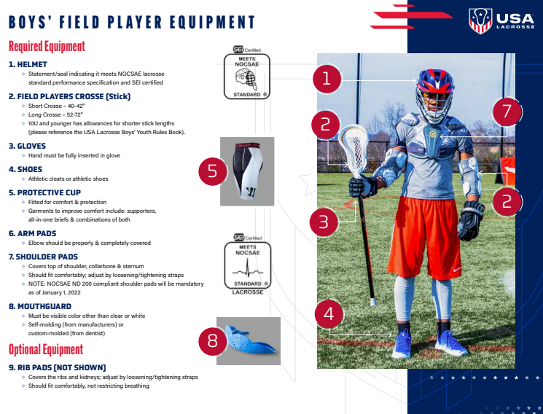
Boys Equipment
OLC provides all recommended Goalie equipment

Slide 31
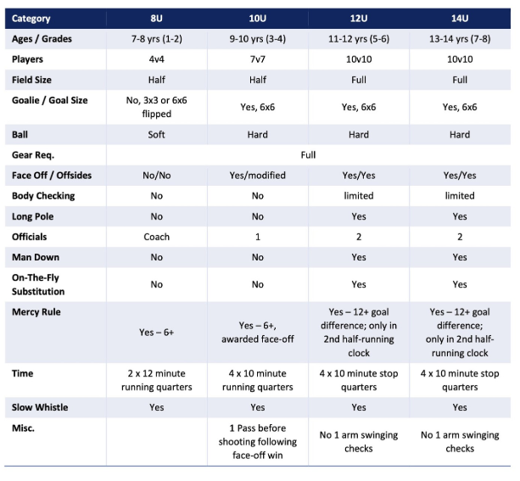
Boys rules

Slide 32
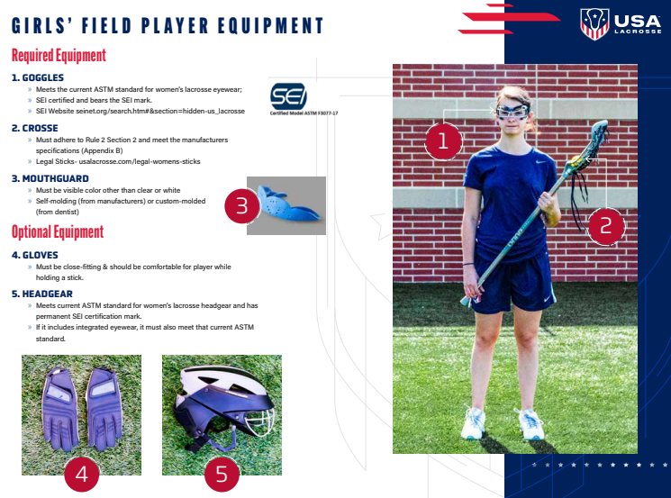
Girls Equipment
OLC provides all recommended Goalie equipment

Slide 33
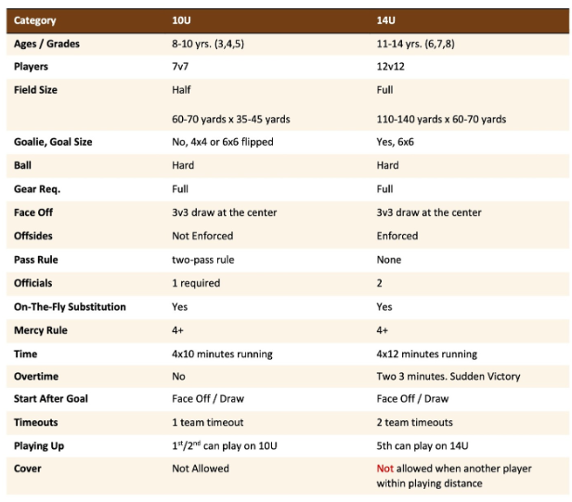
Girls rules

Slide 34
Health and Safety

Slide 35
Injury Prevention
Proper Warm-Up and Conditioning:
  Structured warm-up routine with dynamic stretching
Protective Gear:
  All players must wear all appropriate protective equipment at all times when on the field
Technique Training:
  Athletes will be taught proper checking, shooting, and passing techniques to reduce the risk of injury.
Hydration and Nutrition:
  Coaches encourage players to stay hydrated
Notes:
Ensuring the safety of youth lacrosse players involves a combination of preventive measures and effective management strategies. Here are some best practices:
Injury Prevention
Proper Warm-Up and Conditioning:
Implement a structured warm-up routine that includes dynamic stretching and sport-specific drills.
Focus on strength training, particularly for the lower extremities, to prevent ACL injuries[1].
Protective Gear:
Ensure all players wear appropriate protective equipment, including helmets, mouthguards, gloves, and pads[2].
Regularly check and maintain equipment to ensure it meets safety standards.
Technique Training:
Teach proper techniques for checking, shooting, and passing to reduce the risk of injury.
Emphasize the importance of playing within the rules to avoid unnecessary contact.
Hydration and Nutrition:
Encourage players to stay hydrated and maintain a balanced diet to support overall health and performance.
Injury Management
Emergency Action Plan (EAP):
Develop and communicate an EAP that includes protocols for handling injuries, sudden cardiac arrest, and other emergencies[3].
Ensure all coaches and staff are trained in CPR, AED use, and first aid[1].
Concussion Management:
Implement a concussion management plan that includes education on signs and symptoms, removal from play, and a return-to-play protocol[2].
Require written clearance from a healthcare professional before allowing a player to return to activity.
Heat Illness Prevention:
Establish guidelines for practice and game modifications during extreme heat conditions.
Educate players and coaches on the signs of heat-related illnesses and appropriate responses[1].
Incident Reporting:
Maintain detailed records of all injuries and incidents to identify patterns and areas for improvement[3].
By following these guidelines, you can help create a safer environment for youth lacrosse players. Do you have any specific concerns or questions about injury prevention or management?
References
[1] League Standards - Safety and Risk Management | USA Lacrosse
[2] Health & Safety Guidelines - USA Lacrosse
[3] US Lacrosse Emergency Action Plan Guidelines for Youth Lacrosse ...

Slide 36
Injury Management
Concussion Management:
  Coaches receive specific concussion training that includes education on signs and symptoms, removal from play, and a return-to-play protocol.
Heat Illness Prevention:
  Coaches receive guidelines for practice and game modifications during extreme heat conditions.
Incident Reporting:
  Coaches will discuss identified injuries and incidents with parents
Notes:
Ensuring the safety of youth lacrosse players involves a combination of preventive measures and effective management strategies. Here are some best practices:
Injury Prevention
Proper Warm-Up and Conditioning:
Implement a structured warm-up routine that includes dynamic stretching and sport-specific drills.
Focus on strength training, particularly for the lower extremities, to prevent ACL injuries[1].
Protective Gear:
Ensure all players wear appropriate protective equipment, including helmets, mouthguards, gloves, and pads[2].
Regularly check and maintain equipment to ensure it meets safety standards.
Technique Training:
Teach proper techniques for checking, shooting, and passing to reduce the risk of injury.
Emphasize the importance of playing within the rules to avoid unnecessary contact.
Hydration and Nutrition:
Encourage players to stay hydrated and maintain a balanced diet to support overall health and performance.
Injury Management
Emergency Action Plan (EAP):
Develop and communicate an EAP that includes protocols for handling injuries, sudden cardiac arrest, and other emergencies[3].
Ensure all coaches and staff are trained in CPR, AED use, and first aid[1].
Concussion Management:
Implement a concussion management plan that includes education on signs and symptoms, removal from play, and a return-to-play protocol[2].
Require written clearance from a healthcare professional before allowing a player to return to activity.
Heat Illness Prevention:
Establish guidelines for practice and game modifications during extreme heat conditions.
Educate players and coaches on the signs of heat-related illnesses and appropriate responses[1].
Incident Reporting:
Maintain detailed records of all injuries and incidents to identify patterns and areas for improvement[3].
By following these guidelines, you can help create a safer environment for youth lacrosse players. Do you have any specific concerns or questions about injury prevention or management?
References
[1] League Standards - Safety and Risk Management | USA Lacrosse
[2] Health & Safety Guidelines - USA Lacrosse
[3] US Lacrosse Emergency Action Plan Guidelines for Youth Lacrosse ...

Slide 37
Concussion Form
Wisconsin State Law
Recognize signs, symptoms, and behaviors of concussions
  Player is removed for practice/play if concussion is suspected
  Parent/guardian’s responsibility to seek medical treatment if a suspected concussion is reported
  Player can return only after a written clearance from a health care provider is submitted to coach
    Coaches are not qualified to make medical decisions to return athlete to the game
Coaches, parent/guardian and players need to review and acknowledge concussion awareness document

Slide 38

Clothing Orders
Merchandise orders are fulfilled locally and offer local pickup
https://rge-store.com/collections/oregon-lacrosse
Portion of profits go back to the club
Preseason sale going on now. Use code OLAXPreseason10

Slide 39

Questions/Comments

Slide 40
THANK YOU

