Slide 1


Parent Open House
2025/26 Season
May 21, 2025
6:00 PM
Notes:
© Copyright Showeet.com – Free PowerPoint Templates

Slide 2
Welcome & Introductions
Luke Fulghum – Hockey Director
Notes:
© Copyright Showeet.com – Free PowerPoint Templates

Slide 3
Welcome & Introductions
Purpose
To inform membership about the coming season.
Introduce new support structure, set expectations, provide opportunities to get involved.
Gratitude
Families for continued membership, players for their commitment
Coaches/staff for dedication on and off the ice.
Volunteers for vital contributions and being the heartbeat of LHA.
Notes:
© Copyright Showeet.com – Free PowerPoint Templates

Slide 4
Our Mission
“We are an athlete-centered organization that places the needs of children first. The Littleton Hockey Association provides a safe, rewarding, and fair competitive environment that will have a positive impact upon the long-term development of participants as individuals, hockey players and members of their communities. We give each athlete the opportunity to participate to the best of their ability and to develop as a hockey player.”
Notes:
© Copyright Showeet.com – Free PowerPoint Templates

Slide 5
LHA Staff
Luke Fulghum – Hockey Director
Hannah Westbrook - 14ers Hockey Director
Beth Lindemann – Administrative Director
Jason Gour - Programs Director
Harry Golden - 8U Director
Jesse Shelton - Rec/Grow the Game Director
Notes:
© Copyright Showeet.com – Free PowerPoint Templates

Slide 6
Board of Directors
Phil Heinrich - President
Mike Crawford - Vice President
Jessie Gallant - Secretary
Jen Thompson - Treasurer
Keith Oxenreider - Membership Director
Stuart Logan - Coaching Director
Todd Barrs - Operations Director
Notes:
© Copyright Showeet.com – Free PowerPoint Templates

Slide 7
LHA Coaches (Tier II)
Team | Coach | Type
18U AA | Lee Edleman | Team Travel
16U AA | Alec Orme | Team Travel
15U AA | Jesse Shelton | Team Travel
16U Prosp | Nick Leitz | Team Travel
14U AA | Jason Gour | Team Travel
13U AA | Shawn Rafferty | Team Travel
12U AA | Corey Wagner | Parent Travel
11U AA | Danny Perez | Parent Travel
10U AA | Jason Tejchma | Parent Travel
9U AA | Stuart Logan | Parent Travel
Notes:
© Copyright Showeet.com – Free PowerPoint Templates

Slide 8
14ers Coaches (All Levels)
Team | Coach
19U Tier II | Kerry Mayhew, Eric Mayhew and Kylie Fitzgerald
16U Tier II | Sasha Maslowski and Maura McKeown
15U Comp | Erika Von Den Benken and Bryce Jankowski
15U Dev | Charles Oese and Jeff Craven
14U Tier II | Frank Roberts, Pat Kilbride and Vince Arena
12U Comp | Brian McConnell and Dana Valletti
12U Dev | TBD
10U | Reece Diener, Lindsey Solberg
Notes:
© Copyright Showeet.com – Free PowerPoint Templates

Slide 9
Agenda
Luke Fulghum – Hockey Director
Notes:
© Copyright Showeet.com – Free PowerPoint Templates

Slide 10
Agenda Overview & Goals
Season Recap and moving into next Season
Organizational Announcements
New LHA Organizational Structure
Player Registration
Teams Structure
League and Affiliate Updates
Looking Ahead
Closing Q&A
Notes:
© Copyright Showeet.com – Free PowerPoint Templates

Slide 11
Season Recap
(2024/25)
Phil Heinrich – President BOD
Notes:
© Copyright Showeet.com – Free PowerPoint Templates

Slide 12
Season Recap: 2024-2025
18U AA - State Champs 8 seasons in a row and going to Nationals.
16U AA - State Champs 8 seasons in a row and going to Nationals.
  16U AA contributed a ton to the Affton player who tragically lost his life in an honor game in St. Louis.
14U Programming - 11 championship banners
12U Programming - 9 championship banners
  12U AA - State Champs & Silver Sticks Regional Champions
10U Programming - 8 championship banners.
  10U AA - Black Silver Stick Regional Champs
  10U B - Silver Stick Regional Champs
Notes:
© Copyright Showeet.com – Free PowerPoint Templates

Slide 13
Exciting Announcements for 2025-2026
Michael Crawford – Vice President BOD
Notes:
© Copyright Showeet.com – Free PowerPoint Templates

Slide 14
New Partnerships
Contracts for both dryland and soft goods providers ended following the conclusion of the 2024-2025 season.
LHA Submitted RFPs for both contracts to numerous vendors.
A minimum of three vendors were selected as finalists.
LHA Staff and LHA Board were integral in the decision-making process.
Notes:
© Copyright Showeet.com – Free PowerPoint Templates

Slide 15

Dryland Partnership –
Team Speed
Team Speed is a premier sports performance training facility in the south metro Denver area for young hockey athletes that want to take their game to the next level.
They have been able to help hundreds of local athletes improve their core skills, build mental toughness, secure Division 1 college commitments, and in some cases ascend to the level of Olympic or professional competition.
Notes:
© Copyright Showeet.com – Free PowerPoint Templates

Slide 16
Dryland Partnership –
Team Speed
Each session is geared toward improving:
  Speed and agility
  Strength
  Endurance and conditioning
  Injury prevention
  Flexibility
  Focus
  Mental toughness
  The Team Speed facility is located at
  311 E County Line Rd A19,
  Littleton, CO 80122.
Notes:
© Copyright Showeet.com – Free PowerPoint Templates

Slide 17

Soft Goods Partnership –
Total Team Sales - Centre Ice
For over 20 years, Total Team Sales has been servicing athletic clubs across the region to provide families and directors with a plethora of buying options all while working toward saving and earning money for their individual clubs.
Located in the back of Centre Ice Hockey in Centennial, CO, TTS includes Connor Halbert, Jeff Mielnicki, Nevan Costello and Mike Wolfe (Owner).
They have over 40+ years of Hockey Team Sales Experience.
Notes:
© Copyright Showeet.com – Free PowerPoint Templates

Slide 18
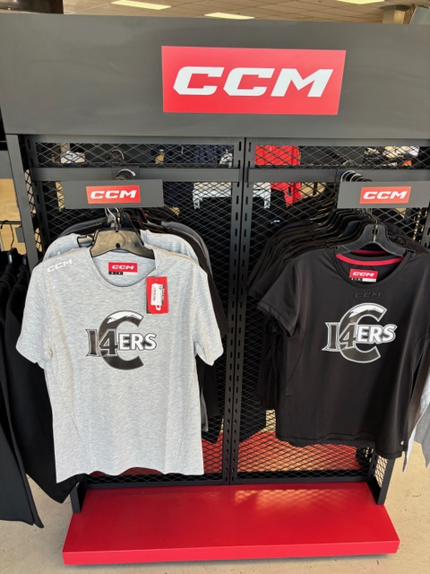
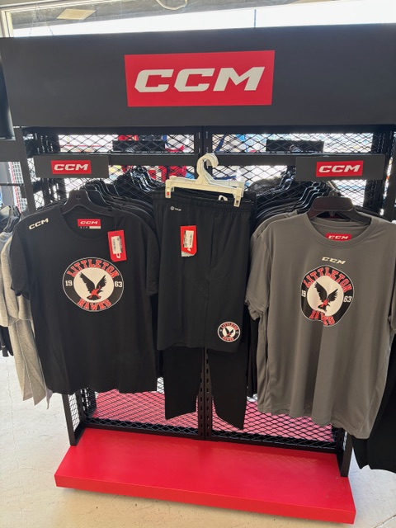
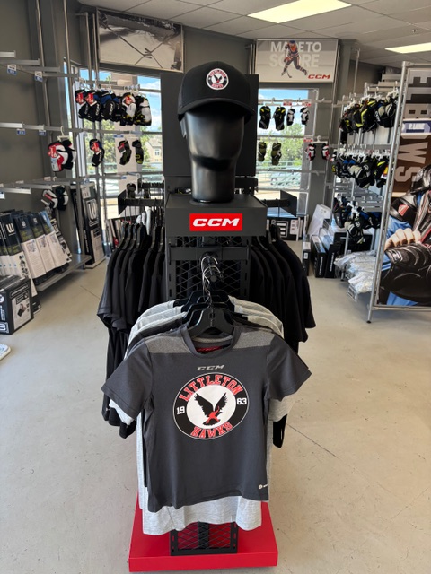
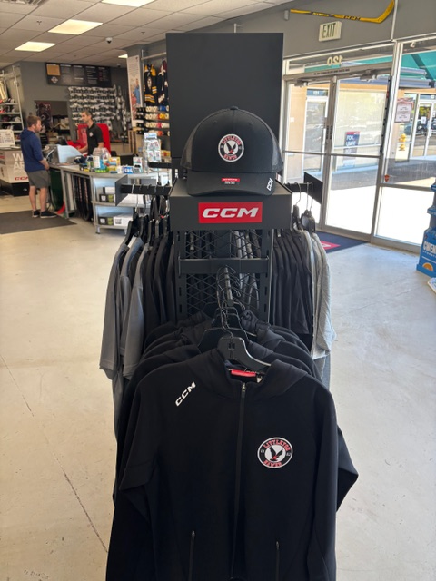
Soft Goods Partnership –
Total Team Sales - Centre Ice
Exclusive LHA pricing on CCM products in-season.
LHA & 14ERS Apparel & Gloves available in-store.
Exclusive shopping opportunities throughout the season for LHA families
Team Manager order pickup available in-store
Notes:
© Copyright Showeet.com – Free PowerPoint Templates

Slide 19
Continuing Initiatives for 2025-2026
Todd Barrs – Operations Director
Notes:
© Copyright Showeet.com – Free PowerPoint Templates

Slide 20
Player Development -
Build From Within
The cultivation of young talent through a robust development program stands as a cornerstone for the future success of our hockey association.
These initiatives serve as incubators for talent, character development, and athletic excellence, molding young players into skilled, disciplined, and resilient individuals poised for success on and off the ice.
Notes:
© Copyright Showeet.com – Free PowerPoint Templates

Slide 21

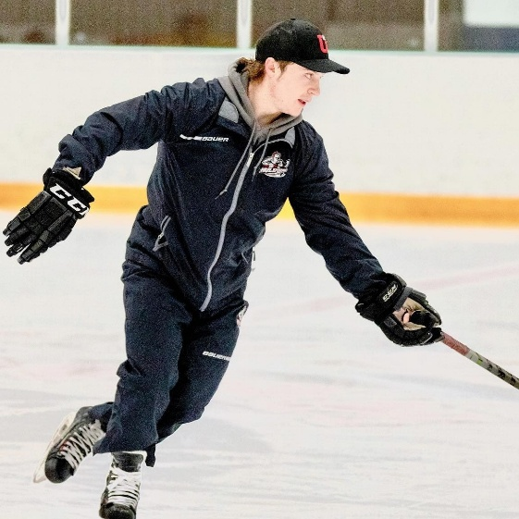
Hull Hockey
Program overview
Skill Development:
Conduct up to 2 skills practices per month, depending on team.
Focus on individual skills
Coach Development:
Age-specific drill library
Monthly coaching seminar
On-ice “teach the teacher” skills session for coaches
Open line of communication to respond to coach questions, etc
Notes:
© Copyright Showeet.com – Free PowerPoint Templates

Slide 22

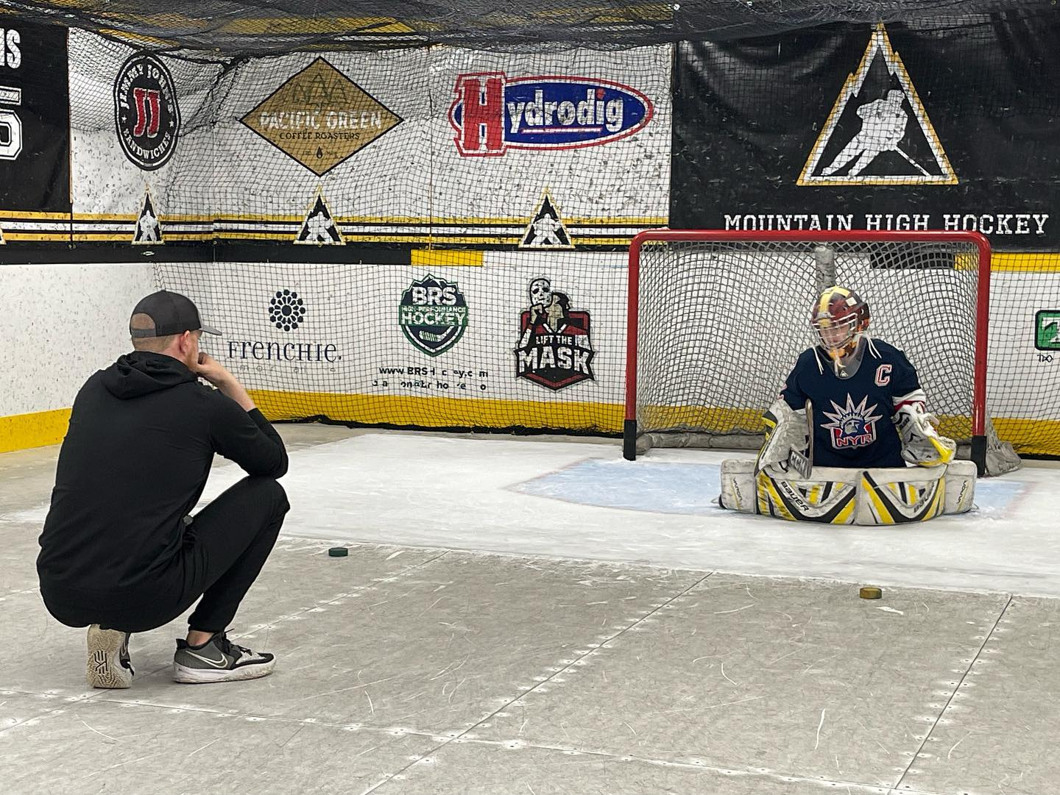
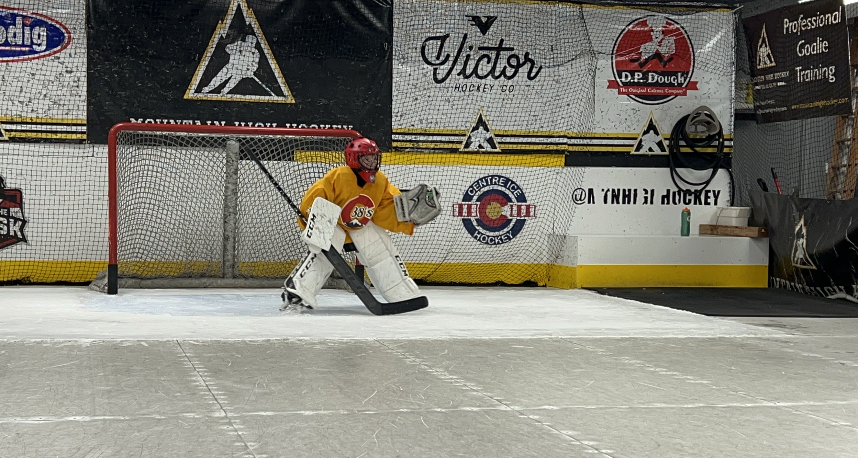
Mountain High Hockey Goalie Club Partnership
LHA will utilize MHHGC’s training facility, providing real ice lessons for goaltenders.
Goalies will receive 2 off-ice coaching sessions per month with MHHGC.
Hawks Nest Sessions with coaches.
Monthly goalie Zoom training sessions with all goalies.
Notes:
© Copyright Showeet.com – Free PowerPoint Templates

Slide 23
Disciplinary Committee Overview
Todd Barrs – Director of Operations
Tom Burke – Legal Counsel
Notes:
© Copyright Showeet.com – Free PowerPoint Templates

Slide 24
Disciplinary Committee
Process Improvements
Better coordination with HDOC and both Hockey Directors to preemptively identify situations before they become disciplinary problems.
More active Disciplinary Committee input to HDOC and both Hockey Directors regarding coaching policies and “standard” coach-parent communications.
Better coordination with HDOC and both Hockey Directors after discipline has been imposed to address potential Pattern of Conduct behavior.
Notes:
© Copyright Showeet.com – Free PowerPoint Templates

Slide 25
LHA Community Outreach & Giving Back
Keith Oxenreider – Membership Director
Jeanette Gurolnick – Fundraising Director
Notes:
© Copyright Showeet.com – Free PowerPoint Templates

Slide 26
Ongoing Scholarship & Community Initiatives
Fundraising and Community Building Efforts
  Golf Tournament
  LHA Day
  CO Gives Day / Team Programs
Offset to Registration Fees & Hockey Community Support
Four graduate scholarships for 14-ers/Hawks ascending to college over the past two seasons.
Notes:
© Copyright Showeet.com – Free PowerPoint Templates

Slide 27
Giving Back – LHA Day
We have raised almost $15k over the last two LHA Days, along with other organization-wide and team-level fundraising efforts.
Additionally, we will have awarded four $1500 graduate scholarships for 14ers/Hawks players ascending to college over the past two seasons.
Notes:
© Copyright Showeet.com – Free PowerPoint Templates

Slide 28
Giving Back – Scholarships
The Association sets aside a percentage of registration fees for member scholarships.
These efforts help offset the costs associated with registration fees, including providing full or partial scholarships/financial aid for 20-25 players per year.
Financial Aid scholarships awarded last year:
  $ 29,979.10
Notes:
© Copyright Showeet.com – Free PowerPoint Templates

Slide 29
New LHA Organizational Structure
Stuart Logan – Coaching Director BOD
Notes:
© Copyright Showeet.com – Free PowerPoint Templates

Slide 30





The challenge of managing one of the biggest youth hockey associations in the U.S.
Opportunity to enhance structure to improve the LHA hockey experience
Even quicker response to team and coach questions/concerns
Increased visibility into Association decisions
Improved connectivity between teams, coaches, and leadership
More member involvement
LHA Staff
~1,000 players & ~2,000 adult stakeholders
~70+ teams (8U, 14ers, Hawks Travel, Rec/IHHL)
~350 coaches, managers, treasurers
Notes:
© Copyright Showeet.com – Free PowerPoint Templates

Slide 31













15 Months of
Research and Discussion
LHA Deep Dive
Member Survey ‘23-’24 season
Member discussions
Member Survey ‘24-’25 season
Coach Feedback Meetings
How can WE make a large association feel small
Peer Associations
Add’l People & Resources
Notes:
© Copyright Showeet.com – Free PowerPoint Templates

Slide 32



Hockey Development & Operations Council (HDOC)
HDOC Chair (Luke)
14ers Segment Leader (Hannah)
8U Segment Leader (Harry)
BOD Coaching Director
Co-ed Travel Segment Leader (Jason)
Rec/IHHL Segment Leader (Jesse)
14-18U Level Rep
Beginner Level Rep
Intermediate Level Rep
Advanced Level Rep
10U Level Rep
12U Level Rep
14U Level Rep
15-18U Level Rep
10U Level Rep
12U Level Rep
14-18U Level Rep
10U-12U Level Rep
New Layer of support: each level of play (8U-18U) gets a dedicated representative
Broader ownership: Council includes mix of Staff and Member volunteers – diverse input, shared responsibility
Repeatable process: Council meetings formalize discussion of programming and operational issues
Improved experience: faster response to team issues, better planning for development, more connection across the association
Staff
Non-Staff
Notes:
© Copyright Showeet.com – Free PowerPoint Templates

Slide 33
Join the Hockey Council –
Be a Level Representative
What: Represent your age group, connect with families and coaches, provide insights to LHA leadership.
Who: Parents, coaches, or volunteers who want to positively shape the hockey experience at their level.
Time commitment: Attend monthly council meetings and stay engaged with your level’s coaches and managers through the month.
Notes:
© Copyright Showeet.com – Free PowerPoint Templates

Slide 34
Join the Hockey Council –
Be a Level Representative
Remuneration: $700 - $1,500 off player dues; amount based on the level you support
How to apply:
  Complete the application
  Application due: June 5th
Questions? Contact Stuart Logan: coaching@littletonhockey.org
Notes:
© Copyright Showeet.com – Free PowerPoint Templates

Slide 35
Registration, Team Declarations and League Updates
Beth Lindemann – Administrative Director
Notes:
© Copyright Showeet.com – Free PowerPoint Templates

Slide 36
Player Registration
June 1, 2025 - Current Member Registration Opens
July 1, 2025 - New Member Registration Opens:
Reminder: Membership holds benefits and priority registration is one of them – Don’t Delay
Anticipated team structure within each segment of our programming (8U, Travel, 14ers, Rec) and expected game and practice count (in a range)- Luke Fulghum(LHA) Hannah Westbrook(14ers)
Notes:
© Copyright Showeet.com – Free PowerPoint Templates

Slide 37
Player Registration
June 1, 2025 - Current Member Registration Opens
July 1, 2025 - New Member Registration Opens:
Reminder: Membership holds benefits and priority registration is one of them – Don’t Delay
Anticipated team structure within each segment of our programming (8U, Travel, 14ers, Rec) and expected game and practice count (in a range)- Luke Fulghum(LHA) Hannah Westbrook(14ers)
Notes:
© Copyright Showeet.com – Free PowerPoint Templates

Slide 38
What Do My Fees Cover?
Registration Fees
  Ice budget and Referee fees
  Apparel/Dryland package/Team uniform
  League fees
  Dryland for RMHF/ Tier II teams
  Name bars for RMHF/ Tier II teams
  Gloves for Tier II teams
Team fees
  Tournament entry fees
  Coach travel
  Team party
  Additional team apparel & select team equipment
Notes:
© Copyright Showeet.com – Free PowerPoint Templates

Slide 39
Tryouts and Start of the Season
Hannah Westbrook – Hockey Director - 14ers
Luke Fulghum – Hockey Director - Hawks
Notes:
© Copyright Showeet.com – Free PowerPoint Templates

Slide 40



Tryout Process - Overview
Process transparency
  Open communication on process, structure and objectives
Accountable evaluators
  8–10-member group to evaluate each player group.
  3 staff, 3-4 HDOC, 2 TPH; pre-meeting before each session to ensure proper expectation-setting.
Well vetted evaluation metrics
  Re-anchor on critical metrics and standardize definition of those metrics.
Notes:
© Copyright Showeet.com – Free PowerPoint Templates

Slide 41


Tryout Process - Overview
Trusted assessment tool
  Leverage Team Genius platform to ensure all parameters are captured, archived and factored.
Streamlined evaluation discussions
  Drive out post-session evaluation inefficiencies and resulting error with Team Genius automation.
Dependable post-tryout assessments
  Timely and repeatable feedback process for parents who want tryout input
Notes:
© Copyright Showeet.com – Free PowerPoint Templates

Slide 42
Tryout Dates – 14ers
19U & 16U (Tier II only) – July 15th-17th
14U (Tier II only) – July 15th-17th
14ers Tryouts – TBD
15U (Competitive) – August 18th – 20th
12U (Competitive) – August 18th – 20th
Haven’t skated yet?
  Pre-tryout skates for on 7/12 – All are welcome…!
Notes:
© Copyright Showeet.com – Free PowerPoint Templates

Slide 43
Tryout Dates – Hawks
Midget 15U-18U (AA only) - August 1st-3rd
Bantam 14U (AA/A/B) - August 14th-17th
Peewee 12U (AA/A/B) - August 21st-24th
  Skills and Drills Start August 18th
Squirt 10U (AA/A/B) - September 11th- 14th
  Skills and Drills Start September 2nd
Mites 8U Skills and Evaluations - October 1st
  Games Start November 1st
CRHL (18U through 12U) - games start Sept 20/21
CRHL (10U) - games start September 26
Notes:
© Copyright Showeet.com – Free PowerPoint Templates

Slide 44
Rule Changes & League Updates
Hannah Westbrook – Hockey Director - 14ers
Luke Fulghum – Hockey Director - Hawks
Notes:
© Copyright Showeet.com – Free PowerPoint Templates

Slide 45
CAHA Updates
CAHA has set forth rules that help to control the number of games that hockey players can play by age:
  10U - 50 Games
  12U - 55 Games
  14U - 60 Games
  16U-18U - 65 Games
League Playoffs, Silver Stick qualifiers, CAHA Member Tournaments, and Quebec qualifiers do not count towards game count total.
Notes:
© Copyright Showeet.com – Free PowerPoint Templates

Slide 46
RMHF Updates
RMHF AA Showcase #1 - September 26-28
  5 games for 10U AA, 12U AA, 14U AA, 16U AA
RMHF AA Showcase #2 - January 2-5, 2026
  5 games for 10U AA, 12U AA, 14U AA, 16U AA
RMHF Destination Showcase
  4 games for 10U AA, 12U AA, 14U AA, 16U AA
    November 14-16 -10U AA
    November 20-23, 2025 - 14U AA, 16U AA
    December 4-7, 2025 - 12U AA
Notes:
© Copyright Showeet.com – Free PowerPoint Templates

Slide 47
RMHF Updates
RMHF A/B Games - One central individual scheduler
Playoff Dates:
  RMHF AA Playoffs - February 6-8, 2026
  RMHF A/B Playoffs - February 20-22, 2026
  CRHL Playoffs - February 20-22, 2026
  Centennial Cup CRHL - February 27-March 1, 2026
  Centennial Cup RMHF - March 6-8, 2025
  2017’s Graduation Tournament March 27-29, 2026
RMHF Game count limits: (14-16 games)
  14U A/B: 16 games
  12U All Levels: 16 games
  10U All Levels: 14 games
Notes:
© Copyright Showeet.com – Free PowerPoint Templates

Slide 48
Looking Ahead
Phil Heinrich – President, Board of Directors
Notes:
© Copyright Showeet.com – Free PowerPoint Templates

Slide 49

Annual LHA Golf Tournament
Friday, July 18, 2025, at Raccoon Creek Golf Course.
All proceeds from the tournament go directly toward providing financial assistance to LHA players in need, ensuring every child can play the game they love; regardless of financial circumstances.
What to Expect:
  A fun-filled day on the course with fellow LHA supporters
  Great food, drinks, and raffle prizes
  Contests, giveaways, and community spirit
  And most importantly—the chance to give back to the hockey community
Notes:
© Copyright Showeet.com – Free PowerPoint Templates

Slide 50
Annual LHA Golf Tournament
How You Can Help:
  Register to play – individually or as a foursome
  Sponsor a hole or become a featured event sponsor
  Donate raffle items or services
  Spread the word to friends, families, and local businesses
Register to play or become a sponsor today: https://zurl.co/rKFuV
Notes:
© Copyright Showeet.com – Free PowerPoint Templates

Slide 51
Annual Meeting
Tryouts & Start of the Season
2025-2025 – Survey Initiatives
What’s New for 2025-2026?
Coaching Standards Updates
Player Development Initiatives
New Partnerships
Disciplinary Committee
Treasurers Report
Election of Open Board Positions
Notes:
© Copyright Showeet.com – Free PowerPoint Templates

Slide 52
LHA - Annual Meeting
Phil Heinrich
President
Mike Crawford Vice President
Jen Thompson
Board Treasurer
Jessie Gallant
Board Secretary
Todd Barrs
Director of Operations
Stuart Logan
Director of Coaching
Keith Oxenreider
Director of Membership
Up for Election
Up for Election
Up for Election
Notes:
© Copyright Showeet.com – Free PowerPoint Templates

Slide 53
LHA - Annual Meeting
Election for Open Board Positions
Procedure for Voting to Appoint New Board Members
  Must have at least 30 LHA Members present for vote.
  Members are given one voting ballot per registered hockey player.
  Members receive voting ballots at sign-in desk
  Ballots will be collected, and votes counted at the meeting.
  Announcements will be made once all meetings are concluded.
Notes:
© Copyright Showeet.com – Free PowerPoint Templates

Slide 54
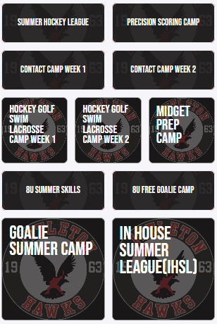

LHA Summer Camps
Looking to get the kids out of the house?
  Be sure to check out our summer camp offerings on the LHA website.
  Registration information and pricing can be found in the LHA Summer Program sections.
Notes:
© Copyright Showeet.com – Free PowerPoint Templates

Slide 55
Q&A
Phil Heinrich – President, Board of Directors
Notes:
© Copyright Showeet.com – Free PowerPoint Templates

Slide 56
Thank You !
We appreciate your attendance at the 2025 Open House
Please contact us with any questions:
luke@littletonhockey.com
Hannah@14ershockey.com
Notes:
© Copyright Showeet.com – Free PowerPoint Templates

