Slide 1
Spring League 2025
Survey results
(n=14)

Slide 2
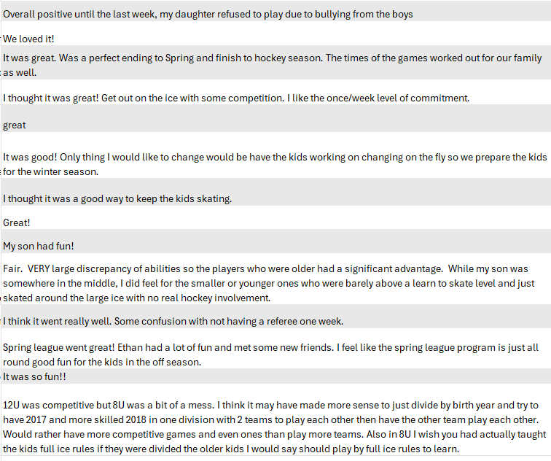
How was your experience overall?

Slide 3
STOP
Our little guy requested no music being played while playing. Said it was distracting and made it hard to hear coaches.
2 minutes horns
I would recommend doing face offs not just thronging the puck all over the place each time there is a line change.
Playing music during the games. It is too loud and obnoxious for the spectators
Pre-picking teams by birth year prior to seeing ability, birth year is not a good judge of ability all the time.
I think it can be cheaper with no jersey and just do light and darks or use pinneys.
I don't think anything should stop just maybe have an Eval day to set teams.

Slide 4
START
Reaching out to potential coaches ahead of the start of the spring league to verify their availability and willingness to help.
Maybe getting parents involved to volunteer to help with clock/scoreboard to prep for tournament volunteering?"
Changes on the fly. More than 2 teams
I would recommend changing on the fly the blowing the horn and changing lines just takes away from the game time. And makes no sense, Most kids and parents dislike the horn situation.
Have an evaluation to divide teams by ability. The 8U level was difficult this year with the significant difference in ability levels. It would have been more beneficial for all to allow the stronger players to have their own teams and play against each other. This would have allowed the younger players to be able to touch the puck more and have more opportunities to work on their skills
Have all the kids skate night one and let the coaches make the teams off of their ability so they're more even.
Perhaps divide by ability so it’s fair for the competitive kids and the developmental ones… not to say that they all aren’t developing.
Do half ice for mites with the black dividers so you can save money on the extra sheet or offer an extra week or two.
I would love to see a program like this continue the whole off season!

Slide 5
CONTINUE
The jerseys were a huge hit!! And please continue offering the spring league.
splitting up the lines based on ability
Letting the kids have fun!
Continue to keep the teams as small as you can so each child gets a lot of playing time
Continue offering the spring league! We are also not opposed to lengthening it
Having spring league!
"Loved the music at the last game.
Great opportunity to offer more time on the ice. Thank you!"
Having it. Such an improvement from when Craig ran it.
I loved how the kids were given matching jerseys. The game times were do-able for the working families.

Slide 6
GENERAL
Due to the number of spring sports, it was hard to commit to the spring league prior to knowing what nights it would actually be on. It would have been nice to know the dates and times when it started being advertised.
"I personally thought the price point was great. I realize ice is expensive so getting 5 games for $100 and a jersey was a win.
Like I stated above just getting parents involved to assist coaches and run the clock/scoreboard. Tournaments take volunteers so this would be a great teaching experience.
Maybe do 1/2 ice for the mite level? Could potentially double the amount of games played.
Overall I would just like to thank PYH for being such a great organization. Our little guy loves being a Roadrunner"
I thought it was great and hope to have the opportunity for Nathan to participate again next year.
Thank you to everyone who set it up, skated, ran the clock. My son had a blast so did I!
"We really enjoyed it. I would recommend it to all kids.
I would recommend making changes to teams after the first game you can usually tell who the better players are on the first night.
Moving a few players here or there if need be.
The 8u coyotes were very weak compared to the other teams."
Thank you for this opportunity
The kids being introduced to their team and coach night one all in the locker room would probably be beneficial. Assign each a locker room.
Thank you! It was great to have the kids on the ice and it was really fun! It was laid back and I'm glad it was offered.
I know this is difficult sometimes, but releasing the days and times makes it so much easier for families to commit. Especially since it is when all the spring sports typically start. I did hear that one family was unhappy with the team they were on, I think they lost every game, but not much you can do about that. Another thing I heard was families thought if you did the teams again next year (Canadians, Bruins, etc.) You should ask when they sign up if their child has a favorite team so they get that jersey and are playing for that team. That was not something that crossed my mind, but thought I would share. We really hope you offer it again next year!!!

