Slide 1

Parents Meeting 2026
Spring League

Slide 2
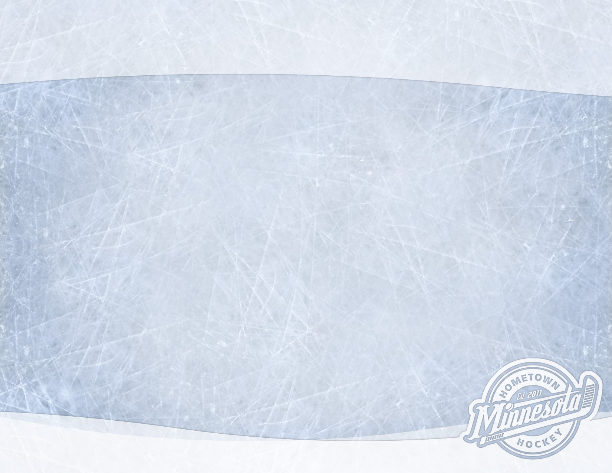
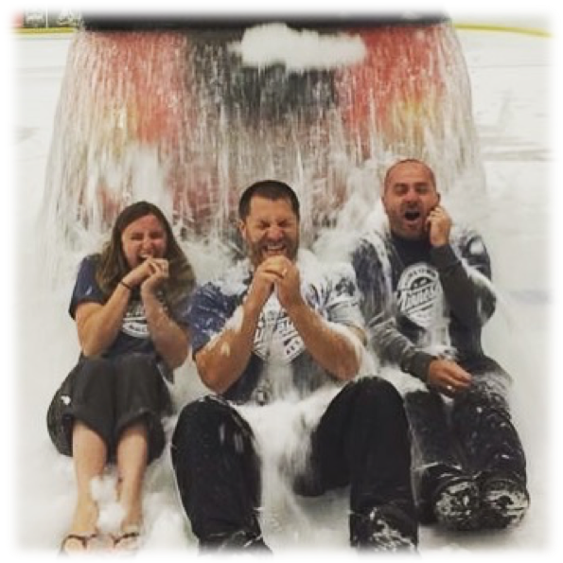
Agenda
Program Staff Introductions
Program Information
Fundraisers
Spring League Player Cards
Product Offerings
Introduce Coaches and Teams
Apparel
Questions and Answers

Slide 3
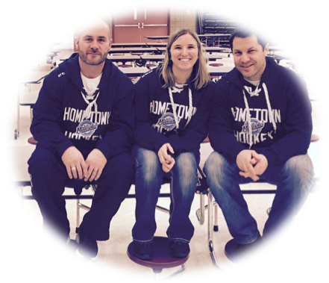
Program Staff Introduction
Bernie Knox - Operations Director bernie@hometownhockeymn.com
Jeff Martin - Hockey Director jeff@hometownhockeymn.com
Laura Lazan - Admin Director laura@hometownhockeymn.com
Ryan Olson – Goalie Director ryan@hometownhockeymn.com
Josh Kozak – Girls Director josh@hometownhockeymn.com
Jensine Knox – Apparel Director
jensine@hometownhockeymn.com

Slide 4
Program Information
Crossbar App
  You can download this app which functions the same as Sports Engine. From the app, you will be able to RSVP for events as well as upload your schedule to your phone. Please make sure to RSVP for ALL events, especially games!
Schedules
  Practice and Game Schedules will be uploaded this week!
  Each team will have their own page on our website where roster info, coach info and the schedules will be kept. Everything will also be available on the app.
Games/Practices
  Game jerseys and socks are expected to be worn at EVERY practice and game.
  Practices are run at a level of high-intensity and are focused on individual skills.
  If you aren’t able to make it to a game, please make sure and let your coach know ASAP.
  We give out “Player of the Game” pucks to one kid from each team after every game. We try to choose a new kid every game until the start of the Playoffs.
  We keep stats for both skaters and goalies and all of that information will be live on our Spring League Page.
  There will be playoffs at the end of the season and the final games
  will all be live-streamed with live commentary!
  The Champion team is awarded with the Hometown Hockey Cup –
  Every player gets a week with the Cup!

Slide 5
Fundraising
Pastry Puffins
Fundraiser starts TODAY!
Offering Frozen Pastry’s that go straight from freezer to oven
$6/profit PER pack sold!
Online sales available – emails for the online store will be sent
Your total amount earned will be applied to any open balance or added as a credit for future use if you have already paid in full
Orders due March 31st / Delivery April 21st
All Fundraising information is available on our website under the “Resources” tab

Slide 6
HTH Player Cards
  My name is Lexi Sanburg
  I am 19 and a sophomore at Minnesota State
  My brother Flynn is a goalie and played with HTH for 6 years
  I’ve been photographing hockey for 11 years and creating hockey cards for 8. During those 8 years, I have made hockey cards for various regular season teams, AAA Teams and Spring League.
  This will be my 7th year designing cards for Spring League kids

Slide 7
HTH Player Cards
Each pack of cards consists of the following
  A team card
  A 2-sided card of each kid on the team (action photo and individual posed )
  A card of the head coach
Card stock is made just like cards from the NHL
Cards will be delivered towards the end of the season
Cost per pack: $20
Option to add a screwdown case for your child’s card for $10
Extra cards of your child are available –
5 extra cards for $10 or 10 extra cards for $15
Payments will be collected online through Hometown Hockey website – Laura will send out an email when this is ready
Generally, we will have extra packs and screwdowns available but it is best that you pre-order to ensure that you get a pack. Once the kids see them in person, they ALL want them!

Slide 8
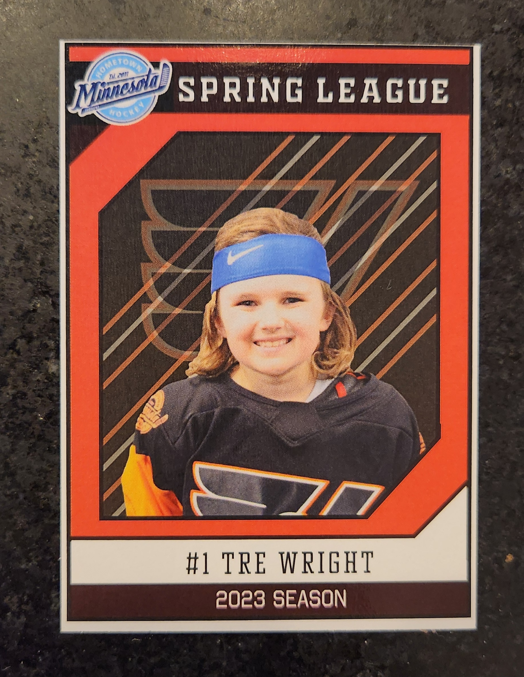
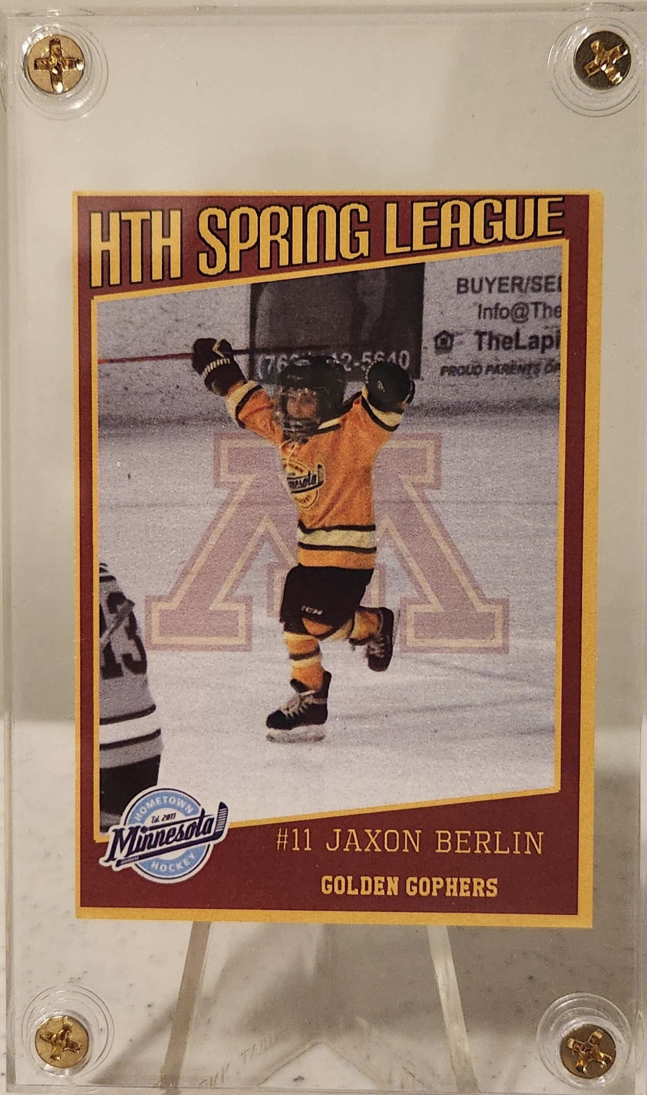
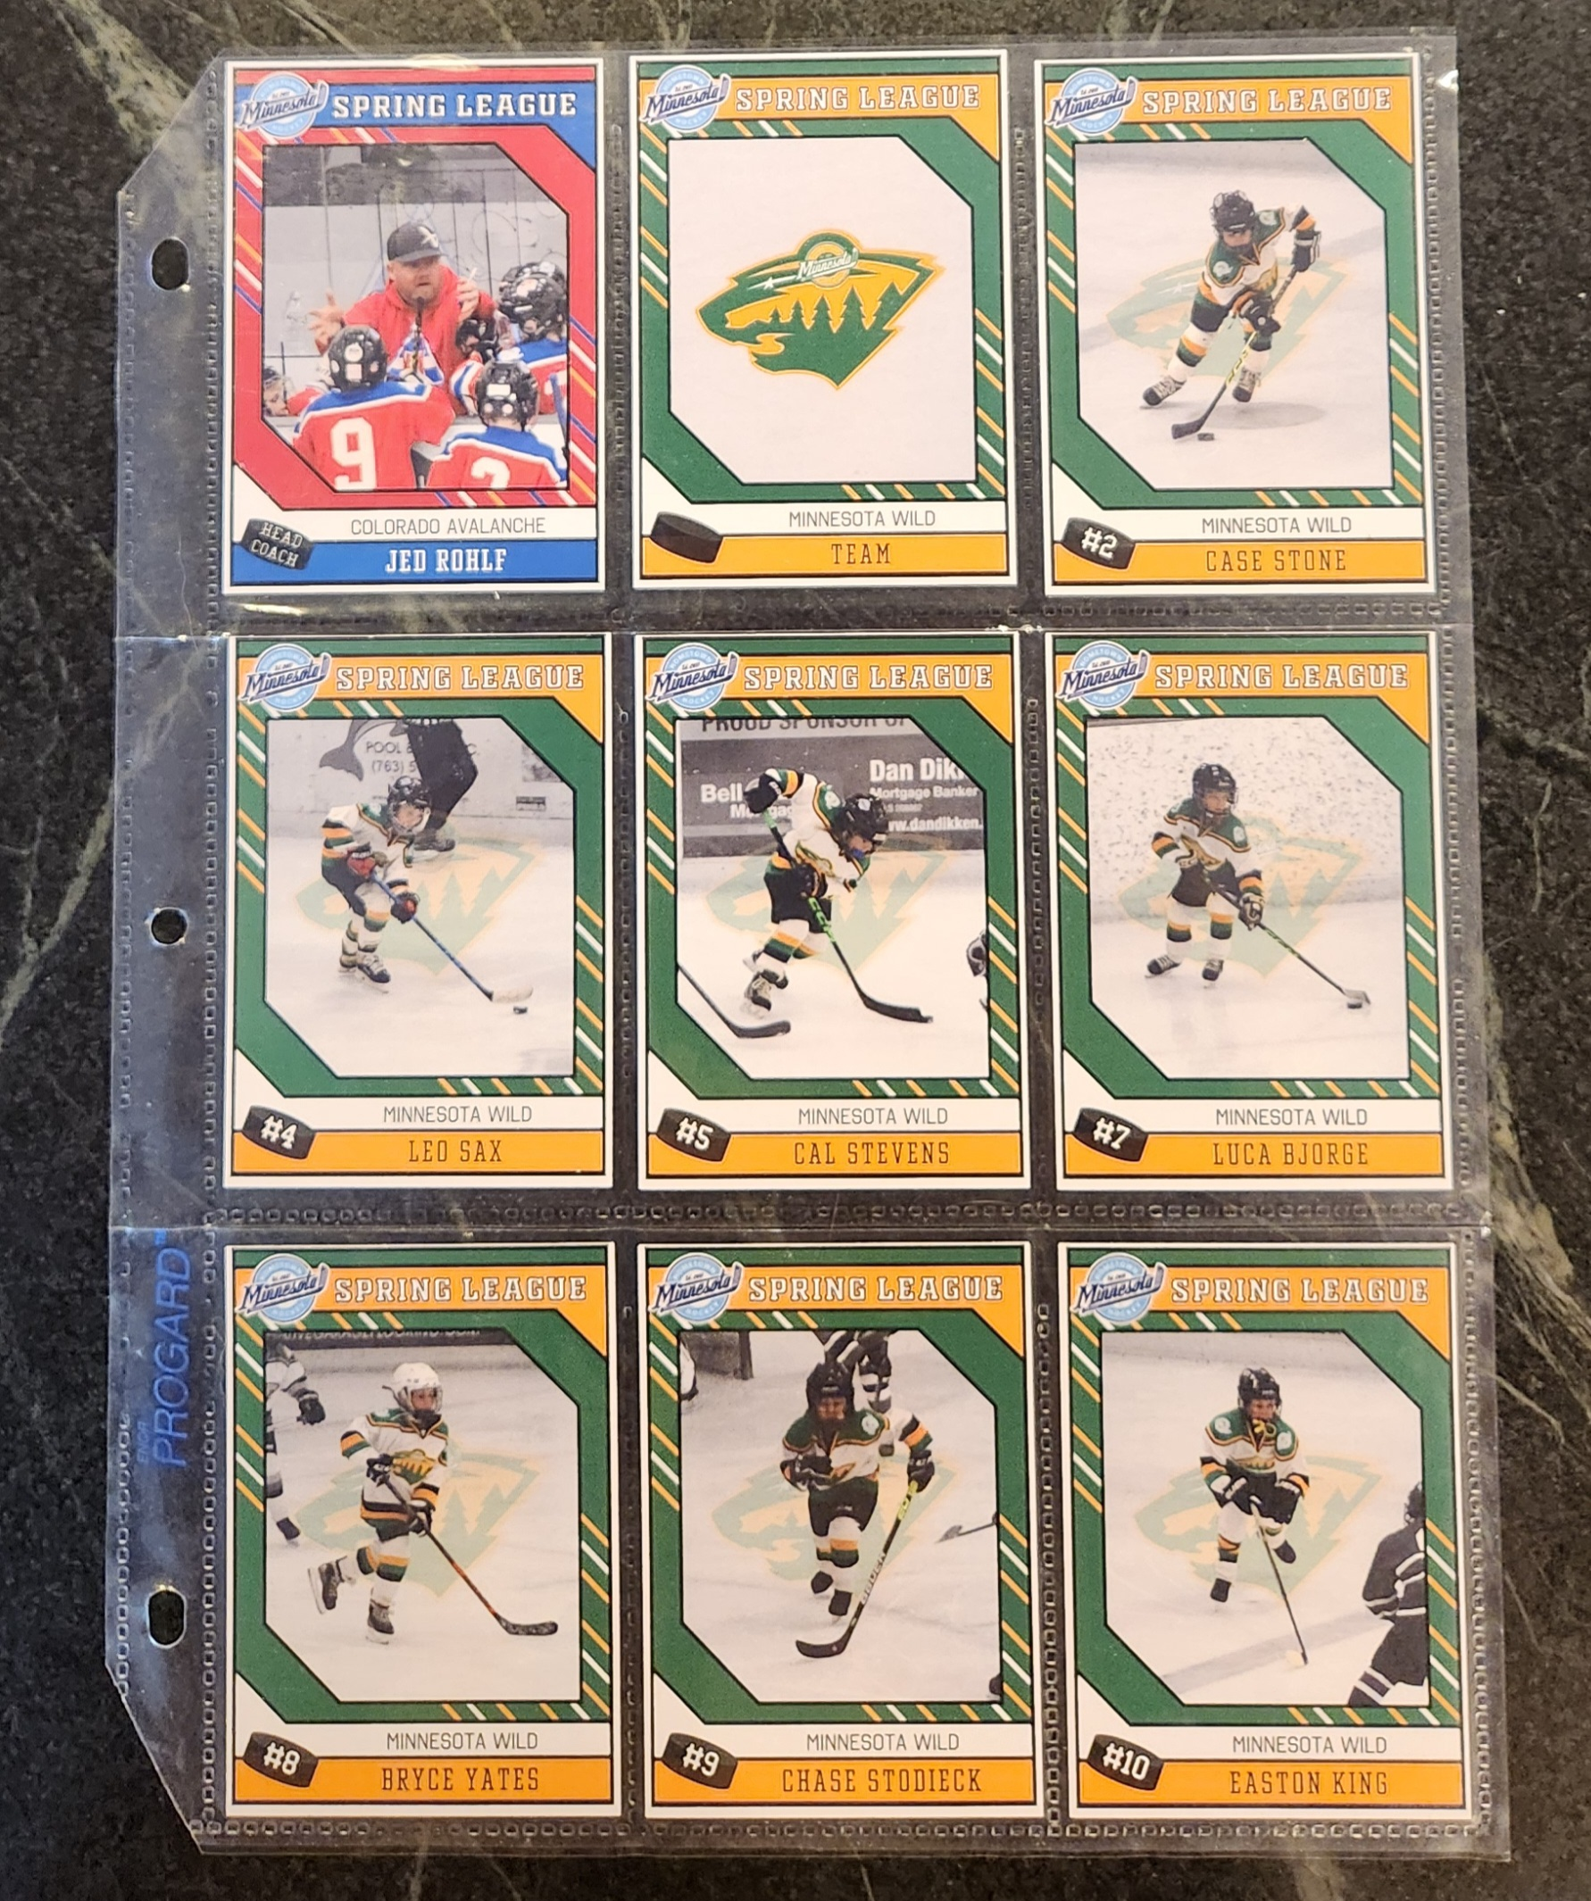
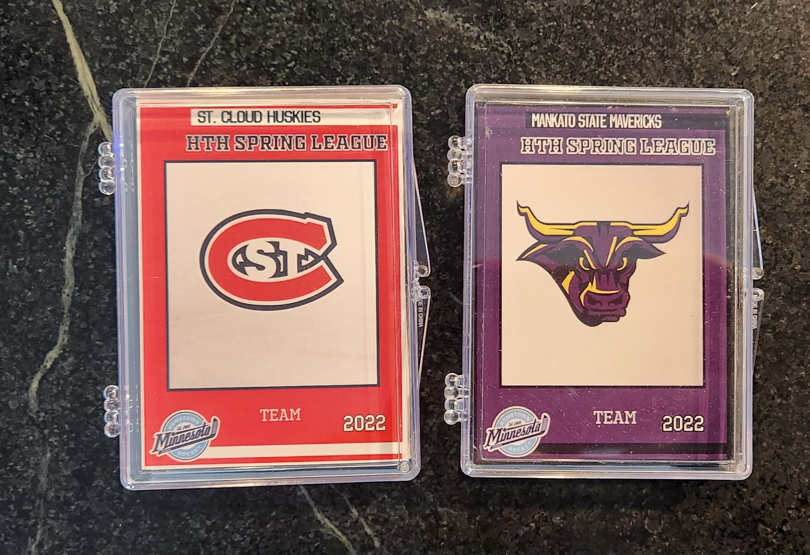
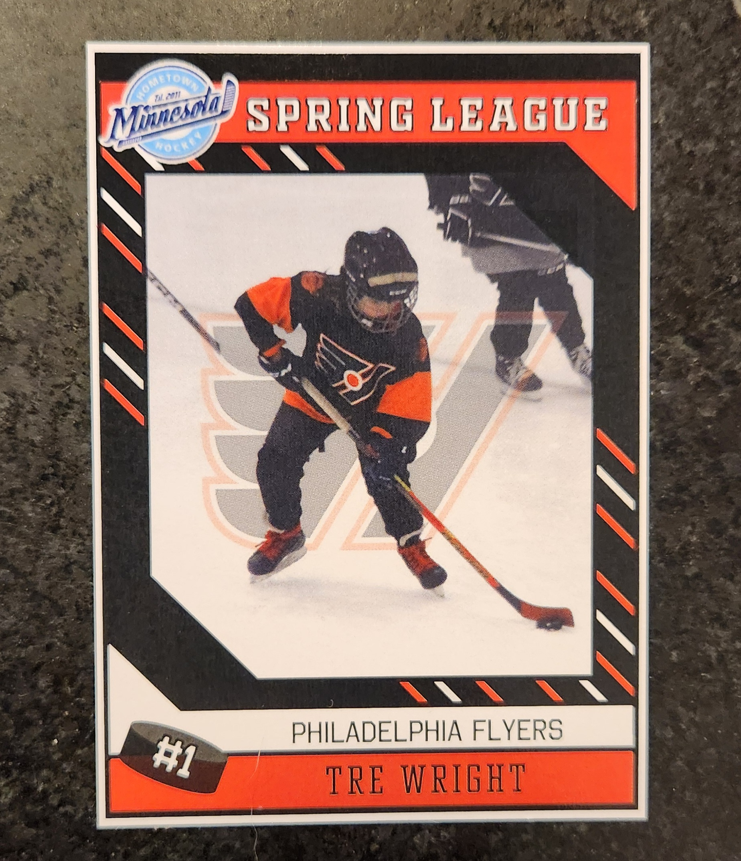
HTH Player Cards

Slide 9
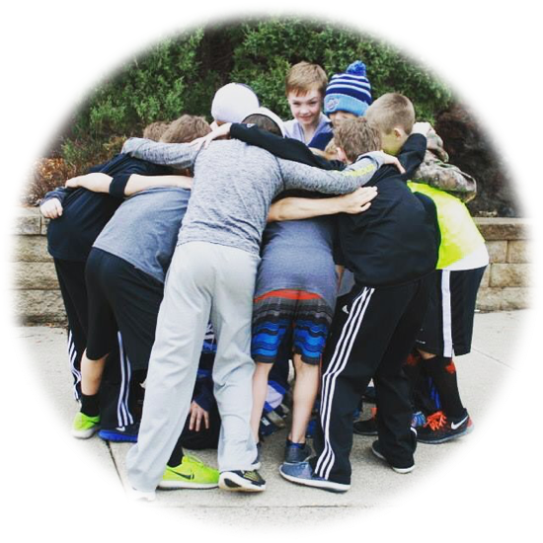
2026 Product Offerings
AAA Hockey Boys and Girls
  Competitive Teams formed by birth year
  Tryouts for the 2027 Season are Sept 11th-13th
Spring League
3 v 3 Summer League– Full for Mites, Some Squirt openings
  Wednesday evenings in June/July – Mite & Squirt Levels
Girls Prep League – Aug/Sept
  U8/U10 Development Program for Girls
Mite Fall League – Aug/Sept
  Condensed version of Spring League
  4 Teams instead of 6
  6 practices/8 games

Slide 10
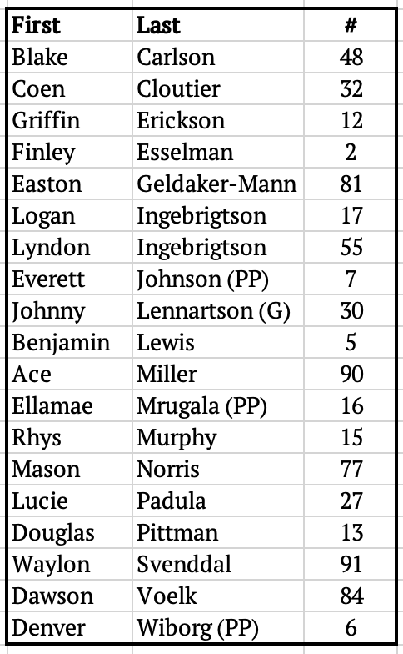
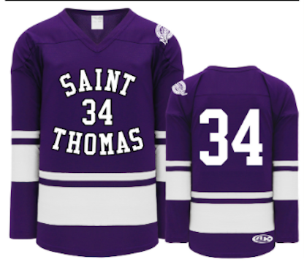
St Thomas Tommies
Coach Nick Svenddal

Slide 11
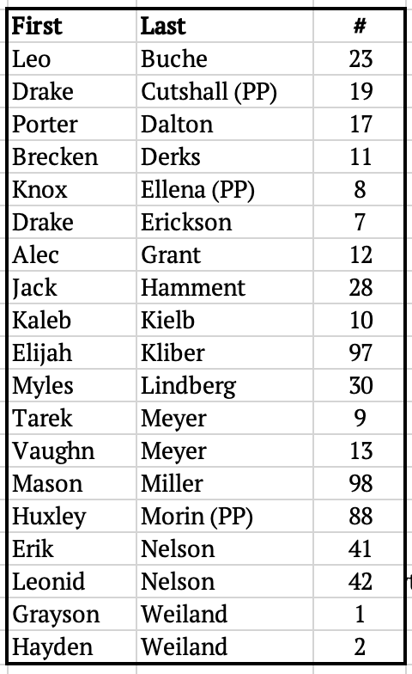
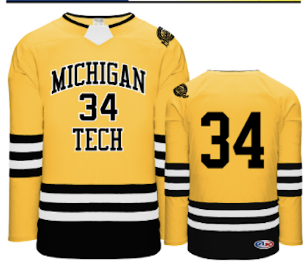
Michigan Tech Huskies
Coach Jason Lindberg

Slide 12
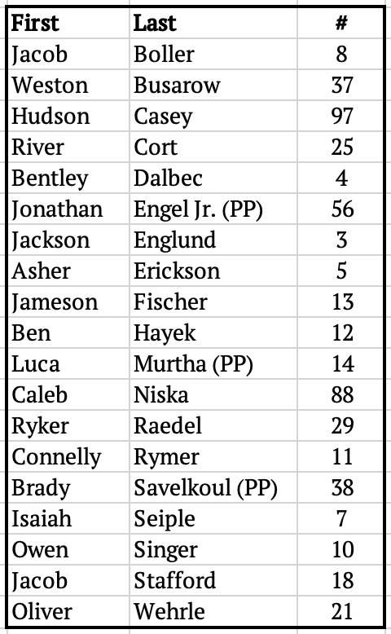
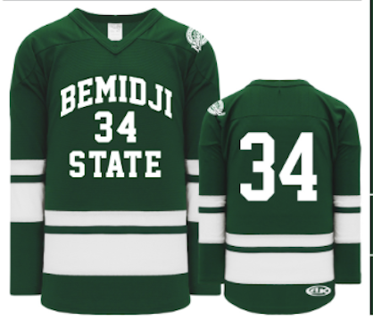
Bemidji State Beavers
Coach Nick Boller

Slide 13
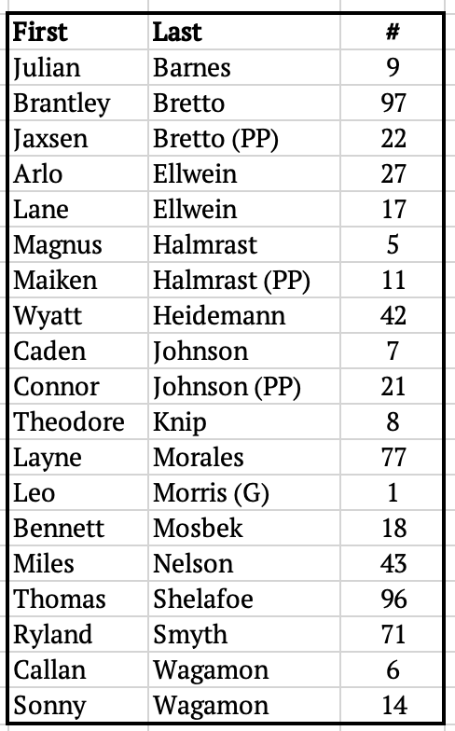
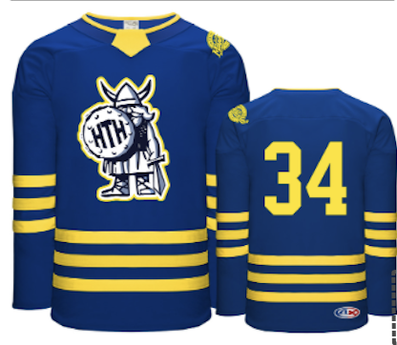
Augustana Vikings
Coach Jake Ellwein

Slide 14
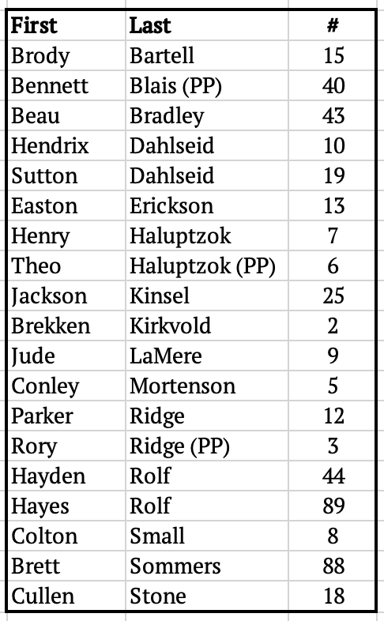
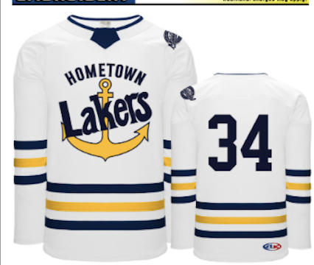
LSSU Lakers
Coach Tim Mortenson

Slide 15
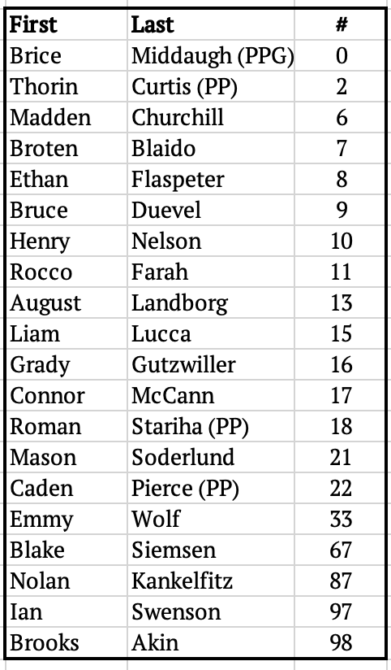
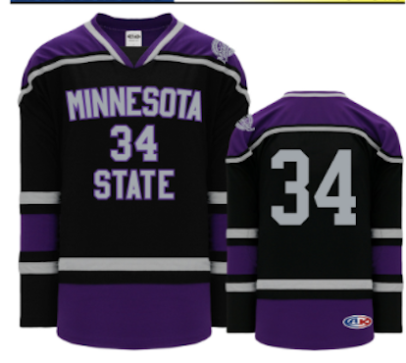
Minnesota State Mavericks
Coach Rich Blaido

Slide 16
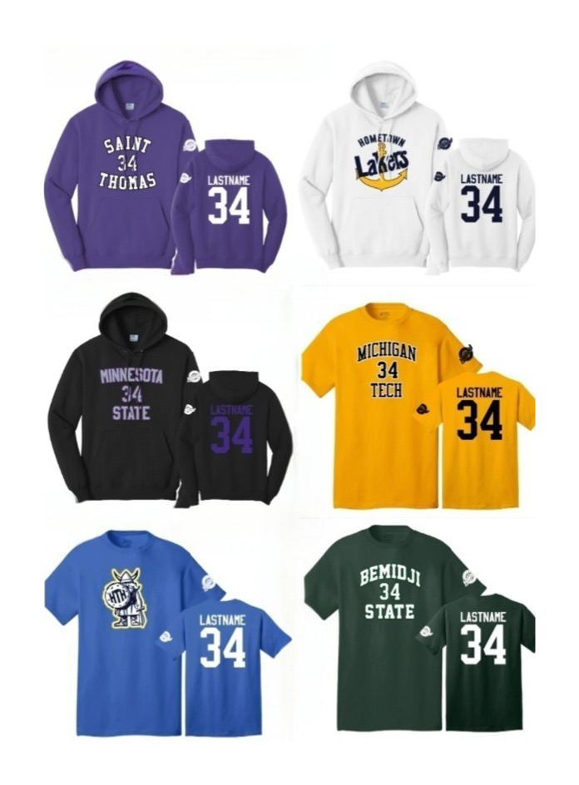
Spring League Apparel
Sweatshirts $30
T-Shirts $15
Personalization Available!

Slide 17
Questions and Answers

