Slide 1

Parents Meeting 2025
AAA

Slide 2
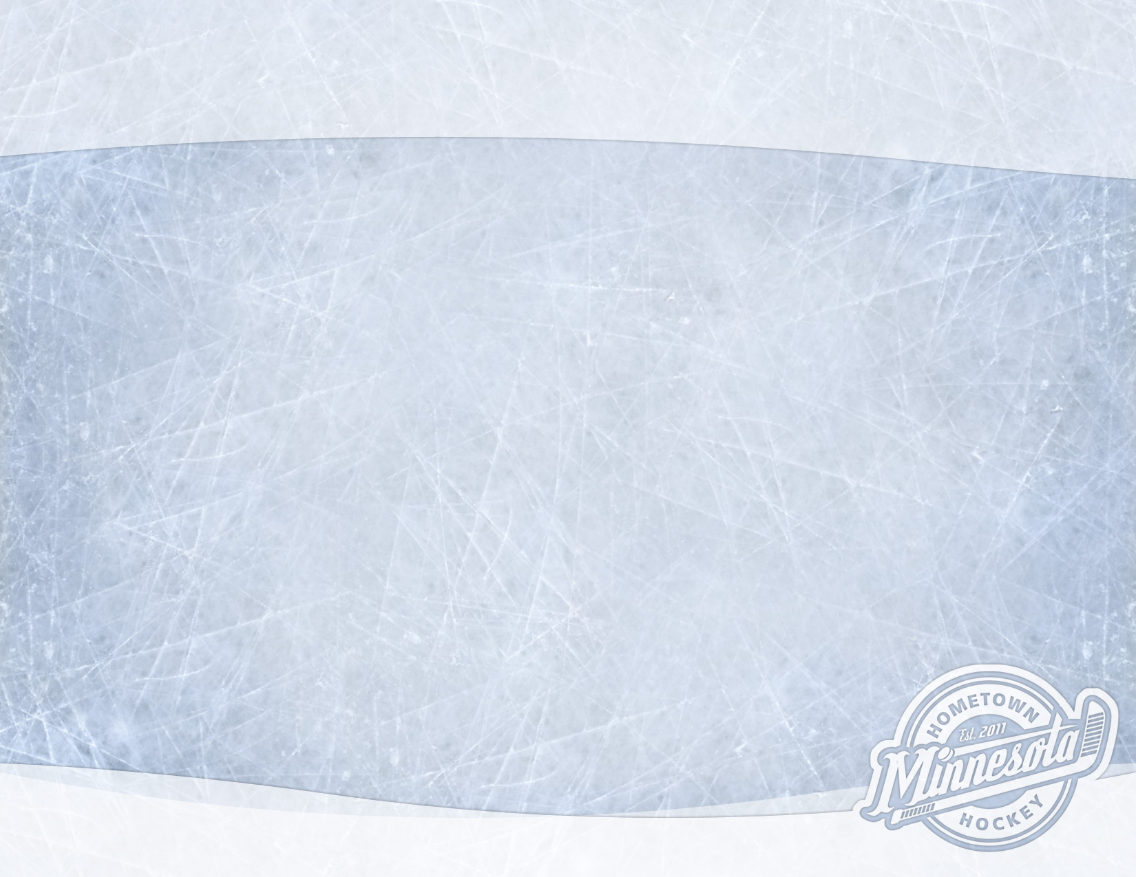
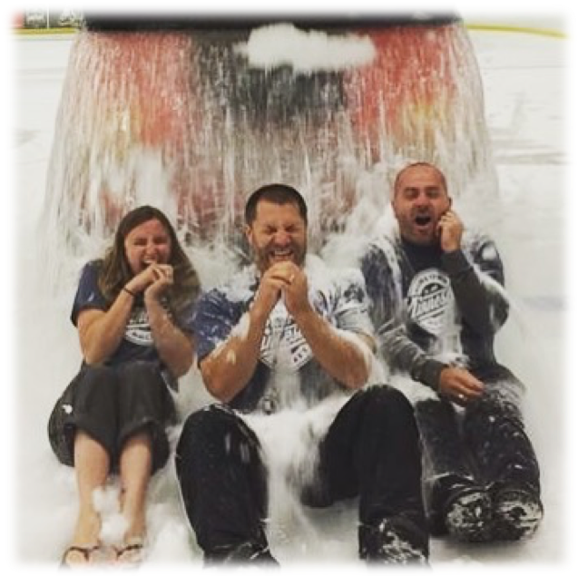
Agenda
Program Staff Introductions
Program Information
Jerseys
Apparel
Fundraisers
Product Offerings
Summer Classic Tournament
Introduce Coaches and Teams
Questions and Answers

Slide 3
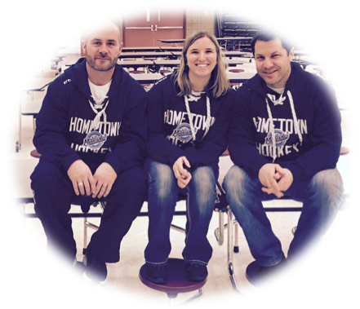
Program Staff Introduction
Bernie Knox - Operations Director bernie@hometownhockeymn.com
Jeff Martin - Hockey Director jeff@hometownhockeymn.com
Laura Lazan - Admin Director laura@hometownhockeymn.com
Ryan Olson – Goalie Director ryan@hometownhockeymn.com
Josh Kozak – Girls Director josh@hometownhockeymn.com
Jensine Knox – Apparel Director
jensine@hometownhockeymn.com

Slide 4
Program Information
Crossbar App
  You can download this app which functions the same as Sports Engine. From the app, you will be able to RSVP for events as well as upload your schedule to your phone. Please make sure to RSVP for ALL events, especially games!
Schedules
  Practice schedules will be uploaded soon!
  Each team will have their own page on our website where roster info, coach info and the schedules will be kept. Everything will also be available on the app.
  PLEASE check your team’s schedule DAILY as practice times do change sometimes!!
  Tournament schedules typically come out 2 weeks prior to the start of the tournament but may be even later than that. Your manager will communicate that information.
Jerseys
  Practice jerseys will be provided and players should wear them to every practice
  We will have ONE reversible game jersey/socks this year and players should wear them to all tournaments, scrimmages, etc. (pictured on next slide)

Slide 5
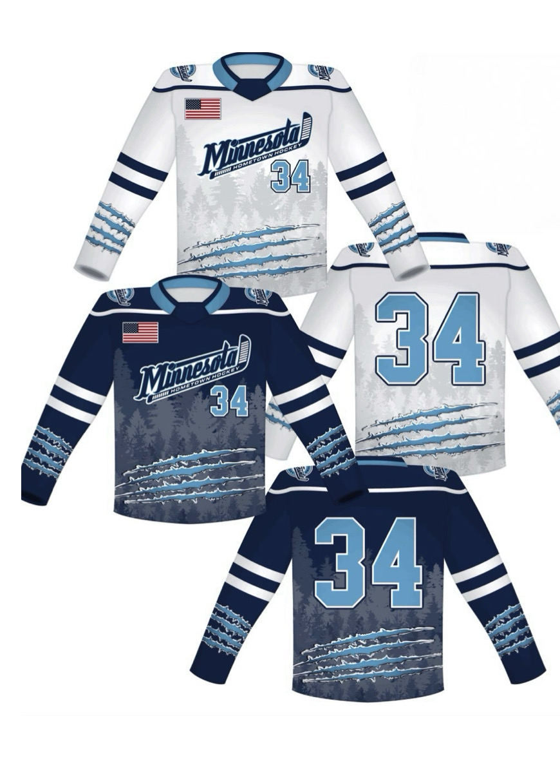
2025 AAA Game Jersey
Practice Jerseys will be handed out during the first couple of weeks
Game jerseys and socks handed out before your 1st tourney

Slide 6

2025 Apparel
Online Order Windows for HTH Apparel
Lettermen Sports and Number 1zie
Now – March 9th
March 21st – 30th

Slide 7
Fundraising
Shelton Pizza/Brats/Beef Sticks
  Fundraiser starts TODAY!
  Offering Frozen Pizzas, Brats/Beef Sticks, etc
  $5/credit PER pizza sold, $4/credit per brat/beef sticks pack sold
  Credit will be applied to any open balance or refunded back if you have already paid in full
  Orders due March 24th/Delivery April 14th
Pastry Puffins
  Fundraiser starts TODAY!
  Offering Frozen Pastry’s that go straight from freezer to oven
  $5/credit PER pack sold!
  Online sales available – emails for the online store have been sent
  Credit will be applied to any open balance or refunded back if you have already paid in full
  Orders due March 24th/Delivery April 14th
All Fundraising information is available on our website under the “Resources” tab

Slide 8
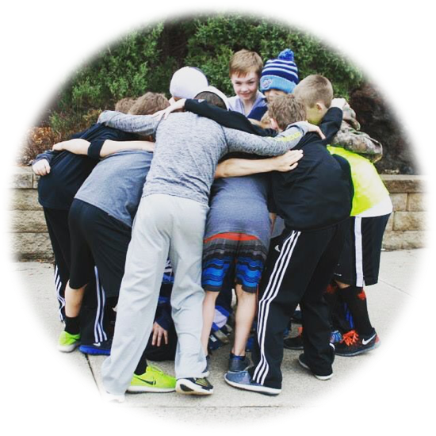
2025 Product Offerings
AAA Hockey Boys and Girls
  Competitive Teams formed by birth year
  Tryouts for the 2026 Season: Sept 5th-7th
Spring League
  In-House league for Mites (full-ice games)
Girls Prep League– spots still available!
  U8/U10 Development Program for Girls
  Spring and Early fall
3 v 3 Summer League– spots still available!
  Wed nights in June/July – Mite & Squirt Levels
Summer Camp – spots still available! SKATERS ONLY
  Kids going into grades 1-5
    Aug 4th – 8th
    Aug 11th – 15th
Mite Fall League – Aug/Sept
  Condensed version of Spring League
  4 Teams/6 practices, 8 games

Slide 9
2025 Summer Classic Tournament
July 11th–13th in Andover
Same weekend as Andover FunFest
5-Game Tournament
Custom Themed Jerseys!
Eligible Players: 2012’s – 2016’s
2 Levels of Play – we mix the kids from our AAA teams together and then draft them onto new teams just for this tournament
Email coming out soon to sign up and it will be first come, first serve!
We may add an older level as well!

Slide 10
2025 AAA Coaches
Boys AAA
2011 Elite Josh Kozak
2011 Black Tony Peterson
2012 Elite Corey McKinnon
2012 Blue Nick Manney
2012 Black Matt Olson
2013 Elite Aaron Lewicki
2013 Blue Jason Hehir
2014 Elite Grant Ellena
2014 Blue Mike Possin
2015 Elite Jeff Cogswell
2015 Blue Jason Bjorge
2016 Elite Brian Fritch
2016 Blue Tom Akers
2017 Elite Jeff Martin
2017/18 Blue Mike Knop
2018 Elite Rich Blaido
Girls AAA
U19 Ryan Olson
U14 Elite Bryan Shortridge
U14 Blue Jake Geisler
U12 Elite Bernie Knox
U12 Blue Nate Gist
U10 Elite Aaron Lewicki
U8 Ryan Allen

Slide 11
Questions and Answers

