Slide 1


Parent & Player Meeting
August 27, 2024

Slide 2

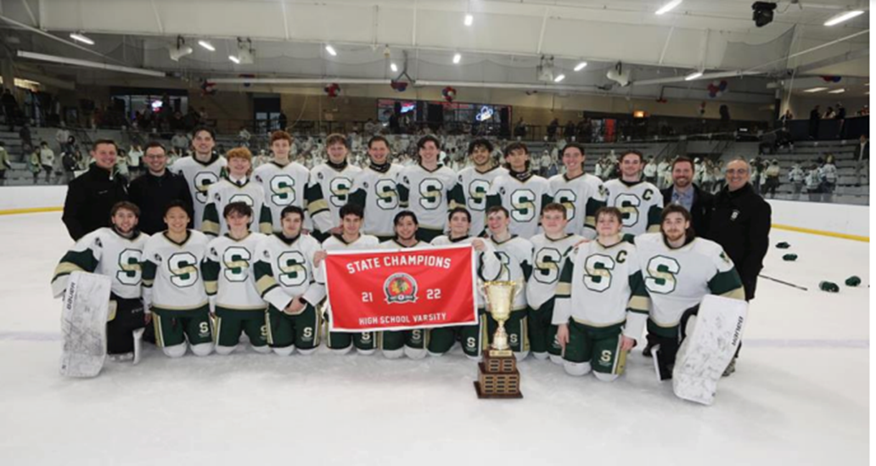
10 mons
Agenda
  Introduction to Stevenson High School Hockey Association
  (“SHSHA”)
  2. Hockey Program Overview
  3. Parent & Player Volunteering

Slide 3
10 mons
Introduction to SHSHA
Scholastic Hockey League (“SHL”)
  Scholastic Hockey League Teams
  Carmel
  Fenwick
  Glenbrook North
  Glenbrook South
  Lake Forest
  Lake Forest Academy
  Loyola Academy
  New Trier Green
  St. Ignatius
  St. Viator
  Stevenson
  York
  Illinois Red Varsity State Champions
  2010: St Rita
  2011: New Trier Green *
  2012: St Rita
  2013: New Trier Green *
  2014: New Trier Green *
  2015: Glenbrook North *
  2016: New Trier Green *
  2017: New Trier Green *
  2018: Loyola Academy - Gold *
  2019: New Trier Green *
  2020: Cancelled - COVID
  2021: New Trier Green *
  2022: Stevenson *
  2023: New Trier Green *
  2024: New Trier Green *
  * Scholastic Hockey League

Slide 4
10 mons
Coaching
  Varsity Green
  Head Coach & Hockey Director: Dan Wood (12th Year with Stevenson Hockey) –Former Stevenson Hockey Player
  Assistant Coaches:
    Marc Shellist (7th Year with Stevenson Hockey) – Parent of 3 Former Stevenson Hockey Players
    Brian Murtha (7th Year with Stevenson Hockey) –Former Stevenson Hockey Player
    Sean Hammond (2nd Year with Stevenson Hockey) –Former Stevenson Hockey Player
  Varsity Gold
  Head Coach: Marc Shellist (7th Year with Stevenson Hockey)
  Assistant Coaches:
    Billy Kopka: (1st Year with Stevenson Hockey) –Former Stevenson Hockey Player
    Trevor Hilt (2nd Year with Stevenson Hockey) –Former Stevenson Hockey Player
    Sam Shellist (1st Year with Stevenson Hockey) –Former Stevenson Hockey Player
  JV White
  Head Coach: Don Howard (1st year with Stevenson Hockey)
    Assistant Coach: Sam Spector (1st Year with Stevenson Hockey) –Former Stevenson Hockey Player
    Assistant Coach: Nico Moulakelis (1st Year with Stevenson Hockey) –Stevenson Alumni

Slide 5
10 mons
SHSHA Board of Directors
  David Smoller
  President
  Dan Wood
  Hockey Director
  Matt Collins
  Vice President
  Katie Wood
  Treasurer, Scheduler, Program Manager
  John Fredin
  Secretary, Webmaster
  Mark Hemphill
  Director / Registrar
  Veronica Woolson
  Director / Equipment Manager
  Rebecca Schnulle
  Director / Philanthropy
  Jim Brown
  Director / Rules & Ethics
  Gary Greenberg
  Director / Tournament Chair
  Bob Wojdelko
  Director
  Greta Tchernikov
  Director
  Greg Wiener
  Director
  Dean Outschoorn
  Director
Final season on the SHSHA BOD – Player Graduating

Slide 6
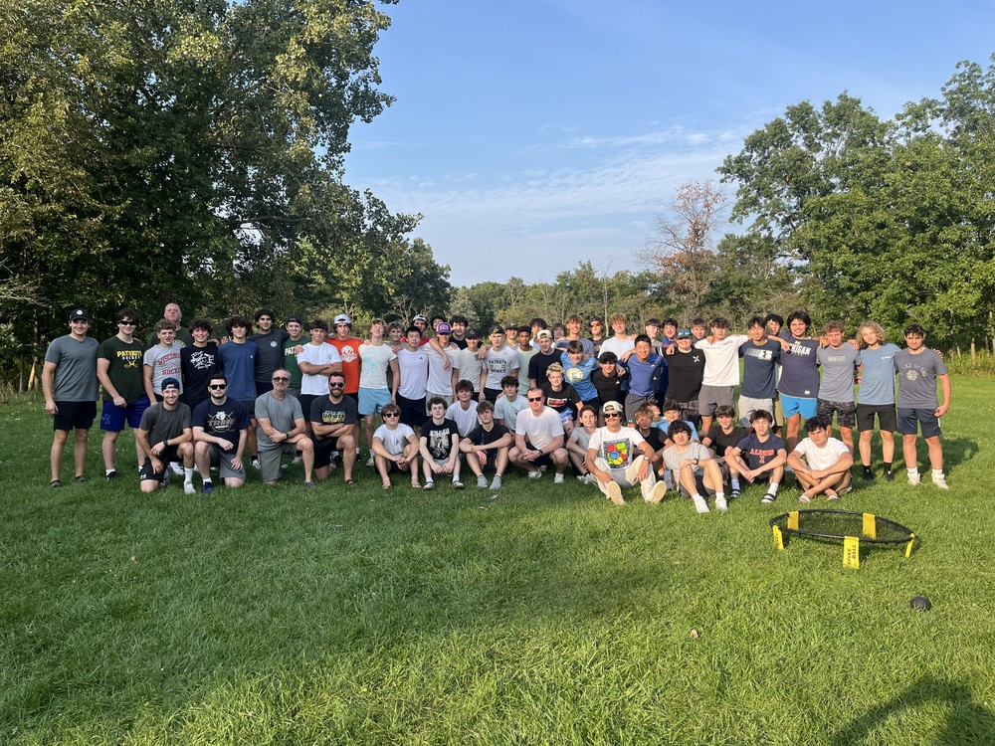
10 mons
SHSHA Board Priorities
Provide the Players with the Best High School Hockey Experience
Maintain Connection with the School
  Stevenson Athletics
  Boosters
  Student Outreach
Establish Committees and Volunteering to drive success of the program
  Philanthropy - Stevenson Foundation, GLASA, Reading Power
  Fund Raising – Tournaments, Sponsorships, Community Events
  Marketing – Raise profile of organization with community, feeder programs and fans
  Special Events – Alumni Game, Fan Appreciation, Recruiting Events
Establish Board Consistency and Processes
  Succession plan for the Board of Directors
  Continuity in program quality

Slide 7
10 mons
SHSHA Program Philosophy
The Stevenson Hockey Program is committed to balancing excellence in hockey with promoting the development of its players as leaders both academically and within the Stevenson community.
The program establishes an environment in which all our players can grow as students, athletes and teammates. We take pride in the way we play and present ourselves both internally as a team and externally to our opponents and the Stevenson community we represent both on and off the ice.

Slide 8
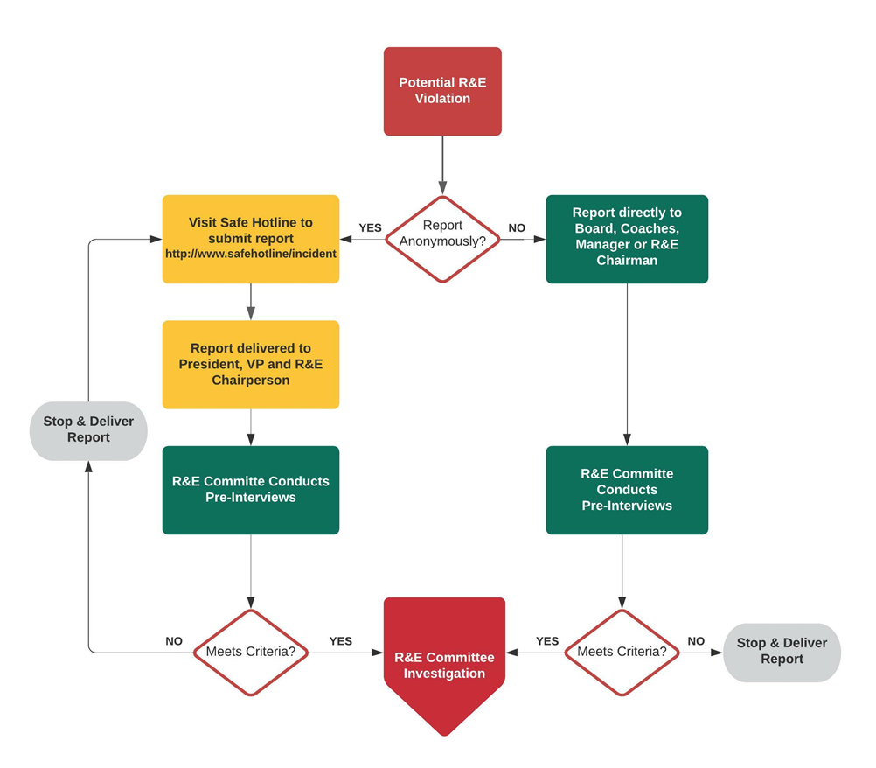
10 mons
Rules & Ethics Committee
  Overview
  The SHSHA Hockey Rules and Ethics Committee is responsible for investigating reports of inappropriate player behavior that take place outside of game situations. Player offenses committed during games are first escalated directly to AHAI by the game referees. AHAI has the right to reassign the investigation back to the club level. The SHSHA Rules and Ethics Committee shall also conduct investigation into complaints lodged against parents, spectators and coaches.
  Committee Members
  Jim Brown- Rules & Ethics Committee Chair
  Robert Wojdelko
  Greg Wiener
  Lidia Vysotskyy
  Jon Corteen
  Safe Hotline Anonymous Reporting Category
  1-855-662-SAFE (1-855-662-7233)
  Code: 5360406426

Slide 9

10 mons
Player Handbook
  www.stevensonhockey.org
    Resources
      For Parents
        Player Handbook
          Player_Parent Handbook.docx
          Parents and Players are responsible for reviewing and understanding the contents.

Slide 10

10 mons
Cell Phones
    USA Hockey & Safe Sport Cell Phones
    All cell phones must remain put away while in the locker room.
    You may NOT take your cell phone out and use it while in the locker room.
    If a player needs to use their cell phone, they must do so out of the locker room.

Slide 11
10 mons
SHSHA Program Changes
Scholastic Hockey League has expanded to include an AHL Division (Varsity 2 Division).
All but 2 teams have their 2nd teams, playing in the AHL this year.
First fall season where the second team is playing as a Varsity 2 team.
Consistent video sessions integrating all three teams
Goalie specific sessions added throughout the season
Workouts at PWC – Already added for all three teams on Tuesday. These will be mandatory. Starting mid November, the workouts will switch to being offered twice per week (Tuesdays and Thursdays), pending game schedule
Due to several family requests, Coach Wood will be adding informational sessions about playing opportunities after high school – what does the ACHA and Juniors landscape look like for players should they want to continue playing. This will be a multiple presentation series. Topics will include overview of the college/juniors landscape, how the recruiting process works, suggestions for putting together reel videos to send coaches for recruiting purposes, benefits of fully funded vs non fully funded programs and how that impacts whether a coach is involved in the admissions process and suggestions for coach outreach

Slide 12
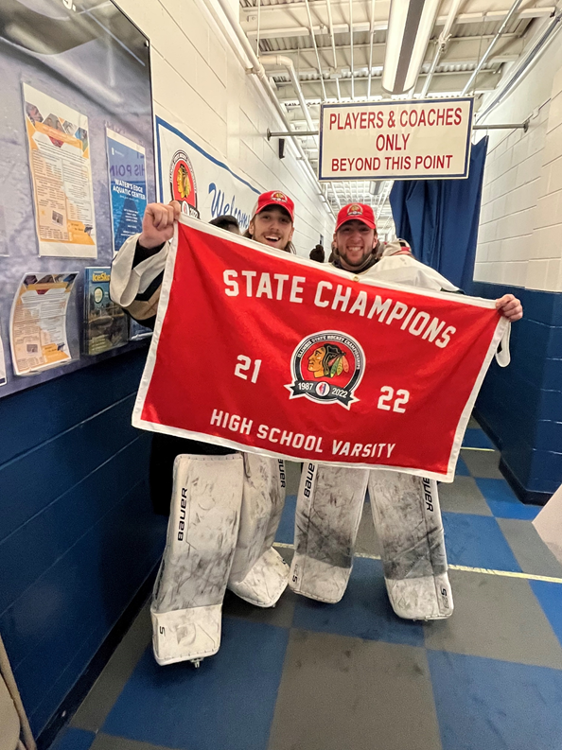
10 mons
Varsity Green
Total Game Target: 60-65
  30 SHL Regular Season Games
  16 Tournament Games – Tournament Minimum
  League Playoffs
  State Playoffs
  Exhibition Games
Opponents
  Scholastic Hockey League Varsity Division
  Catholic League Teams
  Prep Schools
Tournaments
  Wheaton West Pre-Season Invitational
  High School Showcase – November 20-22nd at Mount Prospect
    10 SHL Teams
    10 Non-SHL Teams (2 MI, 2 CO, 2 WI, 1 CT, 1 AZ, 1 IN, 1 PA)
  SHS Thanksgiving Tournament
  Las Vegas Halloween Bash

Slide 13
10 mons
Varsity Gold
Total Game Target: 60-65
  27 SHL Regular Season Games
  16 Tournament Games – Tournament Minimum
  League Playoffs
  State Playoffs
  Exhibition Games
Opponents
  Scholastic Hockey League AHL Division (Varsity 2 Teams)
  Catholic League Teams
  Central States Teams
Tournaments
  Kings Kup Pre-Season Tournament
  SHS Thanksgiving Tournament
  Las Vegas Halloween Bash
  MLK Weekend Tournament

Slide 14
10 mons
JV White
Total Game Target: 50-55
  30 Regular Season League Games in JV
  12 Tournament Games – Tournament Minimum
  League Playoffs
  State Playoffs
  Exhibition Games
Opponents
  Scholastic Hockey League JV Division
  Catholic League Teams
Tournaments
  Kings Kup Pre-Season Tournament
  SHS Thanksgiving Tournament
  MLK Weekend Tournament (Hybrid Indoor/Outdoor)

Slide 15
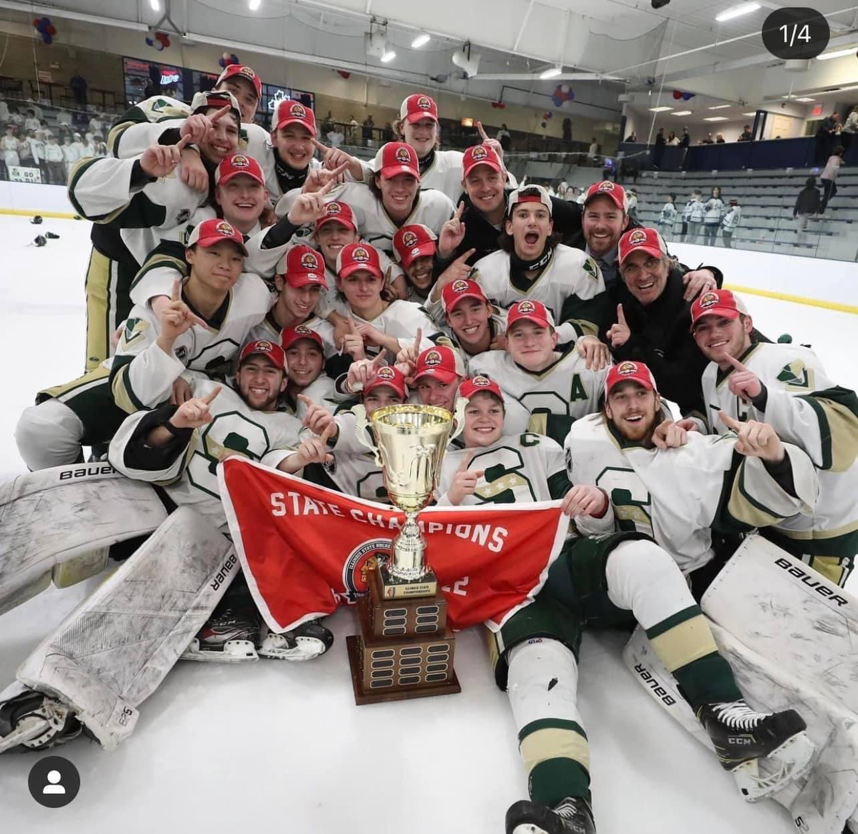
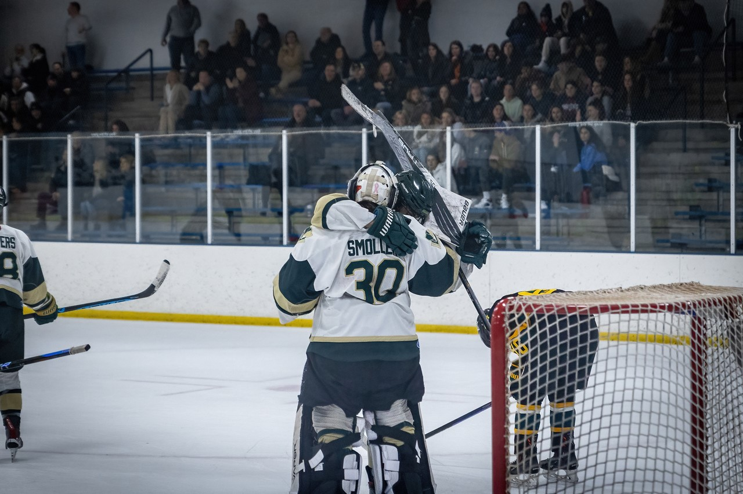
10 mons
Why Family Volunteering & Committees are Important to the Success of SHSHA
    We operate the program
    Stevenson High School Supports in Many Ways
    IHSA Emerging Sport
    Showcase a Top Program in the Top Illinois High School Hockey League – The Scholastic Hockey League (“SHL”)
    Drive the Most Memorable Experience for the Players

Slide 16
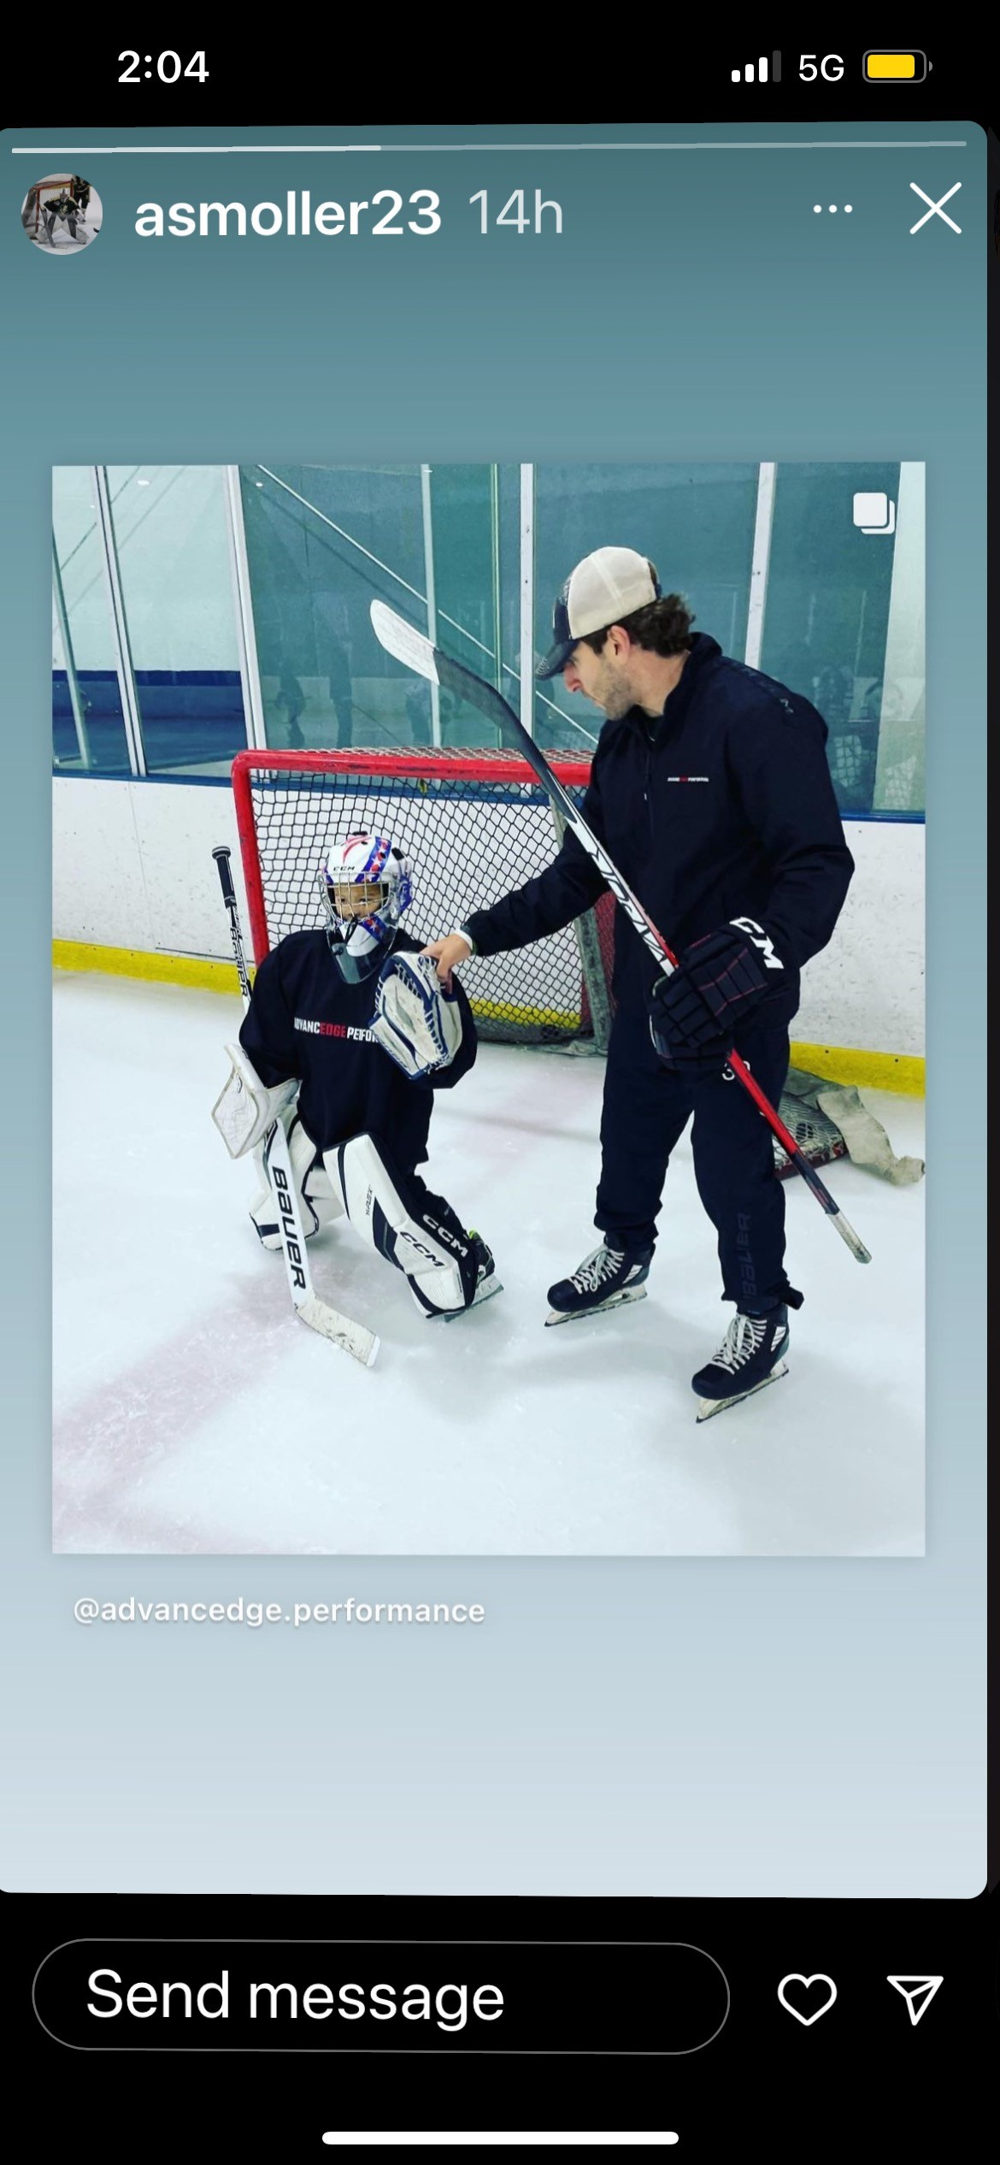
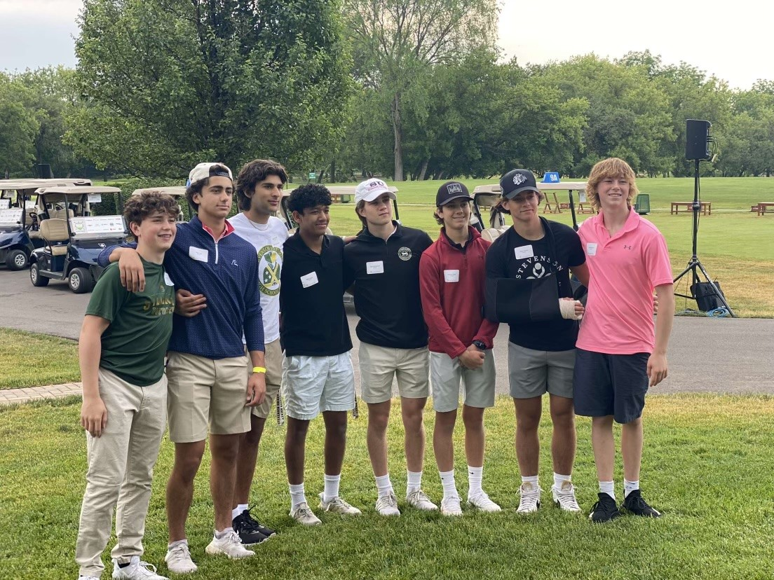
10 mons
Player Volunteering
    SHSHA – 3 Consecutive Community Service Awards from SHS
    Youth Program Opportunities

Slide 17
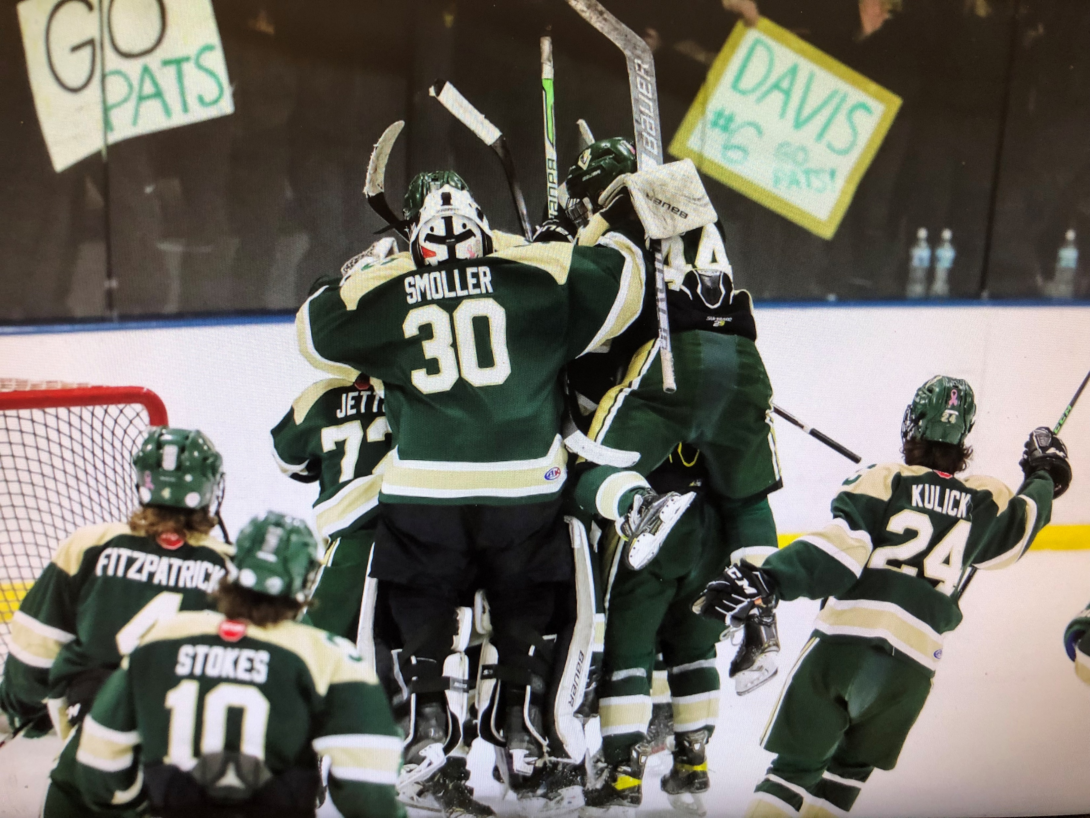
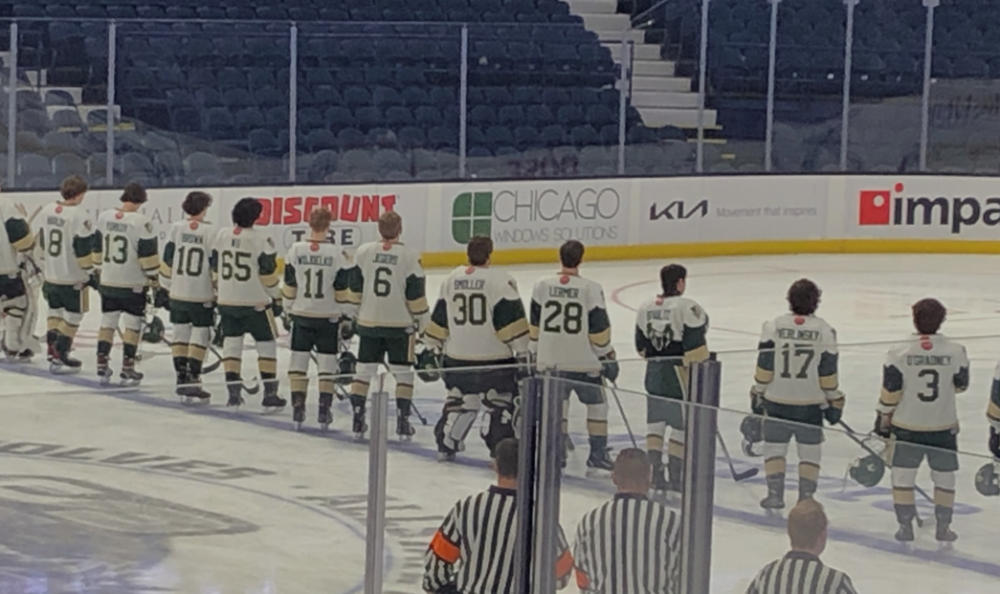
10 mons
Family Volunteering Details
    27 General Hours Required
    7 Additional Hours During Thanksgiving Tournament (Parents and/or Players)
      Board Members and Managers automatically satisfy this requirement with their roles
      Other exemptions will not be granted
    Buyout Option
      General Season: $1,500
      Thanksgiving: $525

Slide 18
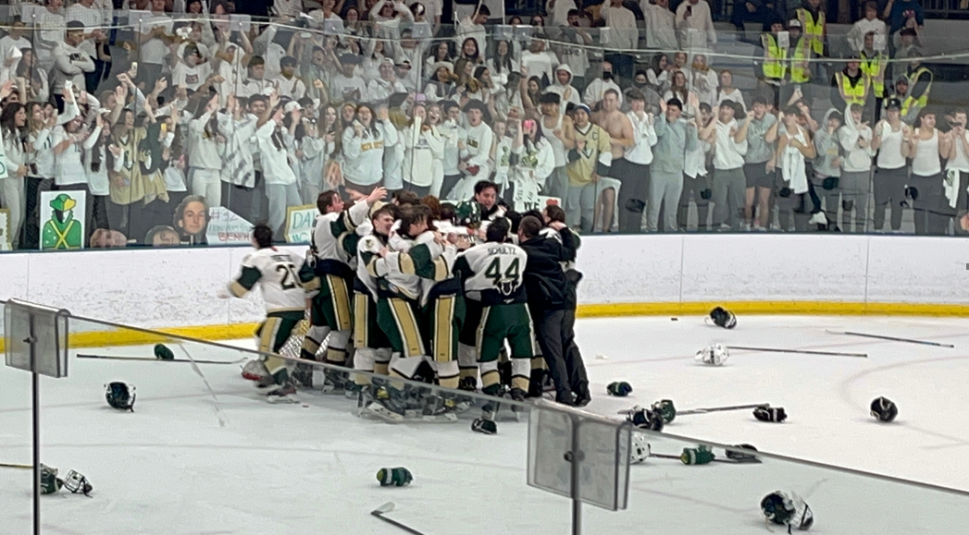
10 mons
Game Duty Volunteering Opportunities
    Scorekeeping
      Done via Game Sheets on iPad – Training Provided
    Clock / Scoreboard
    Security
      2-4 volunteers needed per game, depending on team, opponent and event
      Professional police security hired for high profile games to assist
    Music
    Penalty Box
    Special Event Assistants
      Used typically during fan/charity nights to help provide additional on-site assistance to committee through game promotion activities

Slide 19
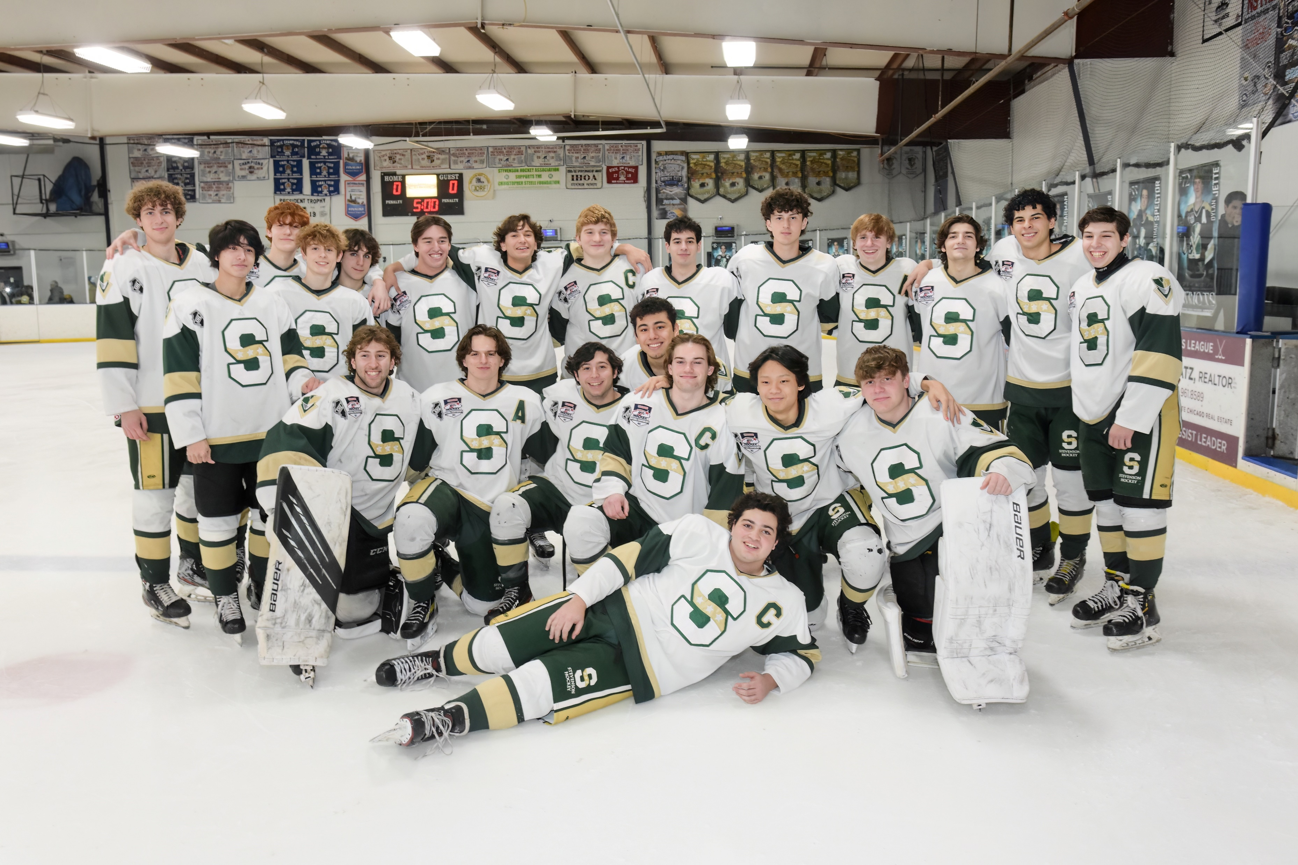
10 mons
Committee List
    Philanthropy
    Fan Appreciation & Special Events
    Fund Raising
    Marketing /Graphics
    Ad Book
    Senior Night
    Alumni Night
    Stevenson High School Liaison / Media Liaison
    Booster Club Representative
    Thanksgiving Tournament
    Social Media
    Statistics

Slide 20
10 mons
Ad Book – New This Year
    Families have the opportunity to sell ad space to offset their dues via a 60/40 split.
    Email will be sent by end of the week with details
    Ads will run in the Thanksgiving Program book as well as the Year Book
    Player Ads will also be available for sale in the Year Book
    Sponsorships (larger than just Ad book placement) also adhere to the same split
    Rebates will be issued after all dues have been paid / used to offset the last payment in a payment plan (up to the families) – They can also be pulled forward and credited against Spring

