Slide 1

Arapahoe Warriors 8U
Parent Meeting – 10/18/2025

Slide 2
Program Overview
Team Levels
Advanced 1 and 2
Intermediate 1 and 2
Beginner 1 and 2
Practice Schedules
Team Selection Date: 11/1

Slide 3

Staff Introductions
Dillon Whalen
  8U Hockey Director
  On-Ice Lead: Intermediate 2, Beginner 1 and Beginner 2
Alex Wegienka
  On-Ice Director
  On-Ice Lead: Advanced 1 and Intermediate 1
Alex Beckman
  On-Ice Lead: Advanced 2
Amidon Miche
  SSPRD Hockey Manager
Susan Pfieffer
  Registrar

Slide 4

Jamborees/Friendlies
Jamborees (Tournaments)
Number determined by team level
Everyone will participate in Frozen 8’s
Friendlies (Scrimmages)
Monthly
Both Home and Away Friendlies should be expected
Denver Metro Area Primarily (LHA, Arvada, Foothills, Hyland Hills, etc)

Slide 5
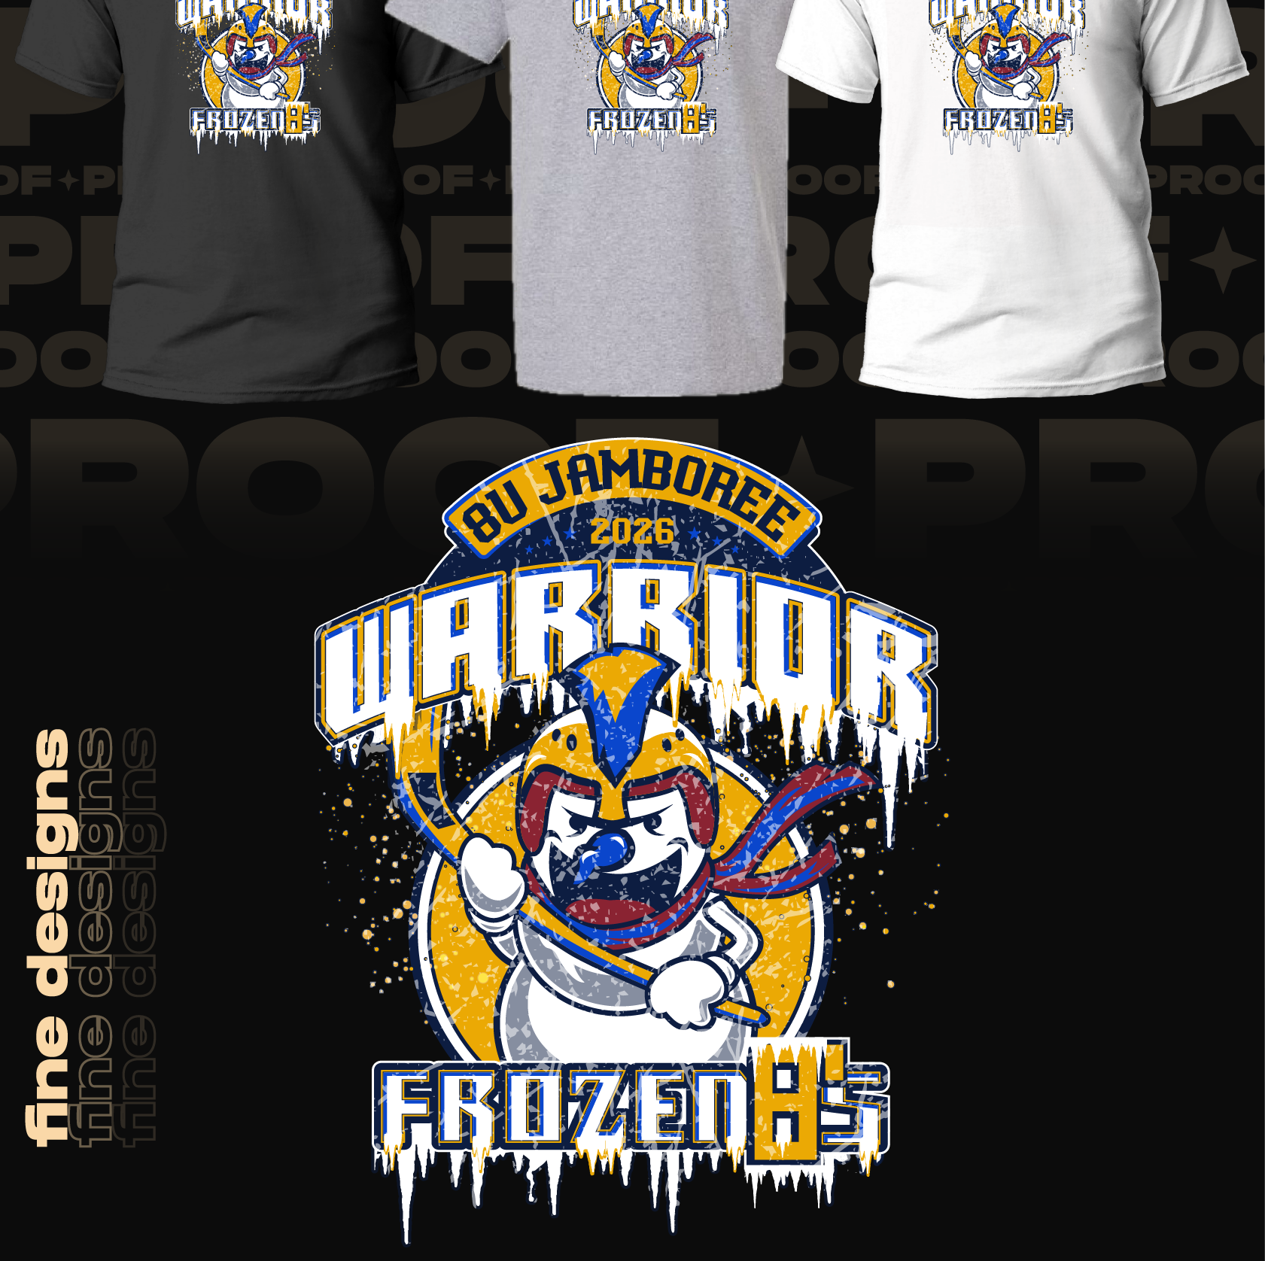
Frozen 8’s Jamboree
Friday, January 16th – Sunday, January 18th, 2026
Silent Auction
Fine Designs Apparel
Rink 1 – Beginner
Rink 2/3 – Intermediate and Advanced

Slide 6

Mite Nights
Fundraising events
Restaurant Nights
First one of the season – 11/1 and 11/2
  Hippops Ice Cream at South Suburban Sports Complex

Slide 7
Team Managers/Culture Coordinators
Every team is required to have one of each
Manager Responsibilities
Communication
Schedule, Questions, etc
Culture Coordinator Responsibilities
Team Events
Silent Auction Basket
Fundraising Opportunities

Slide 8
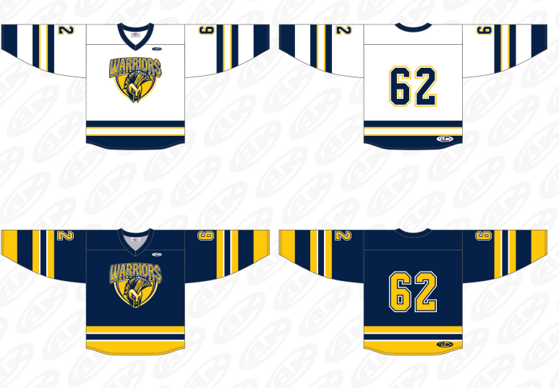
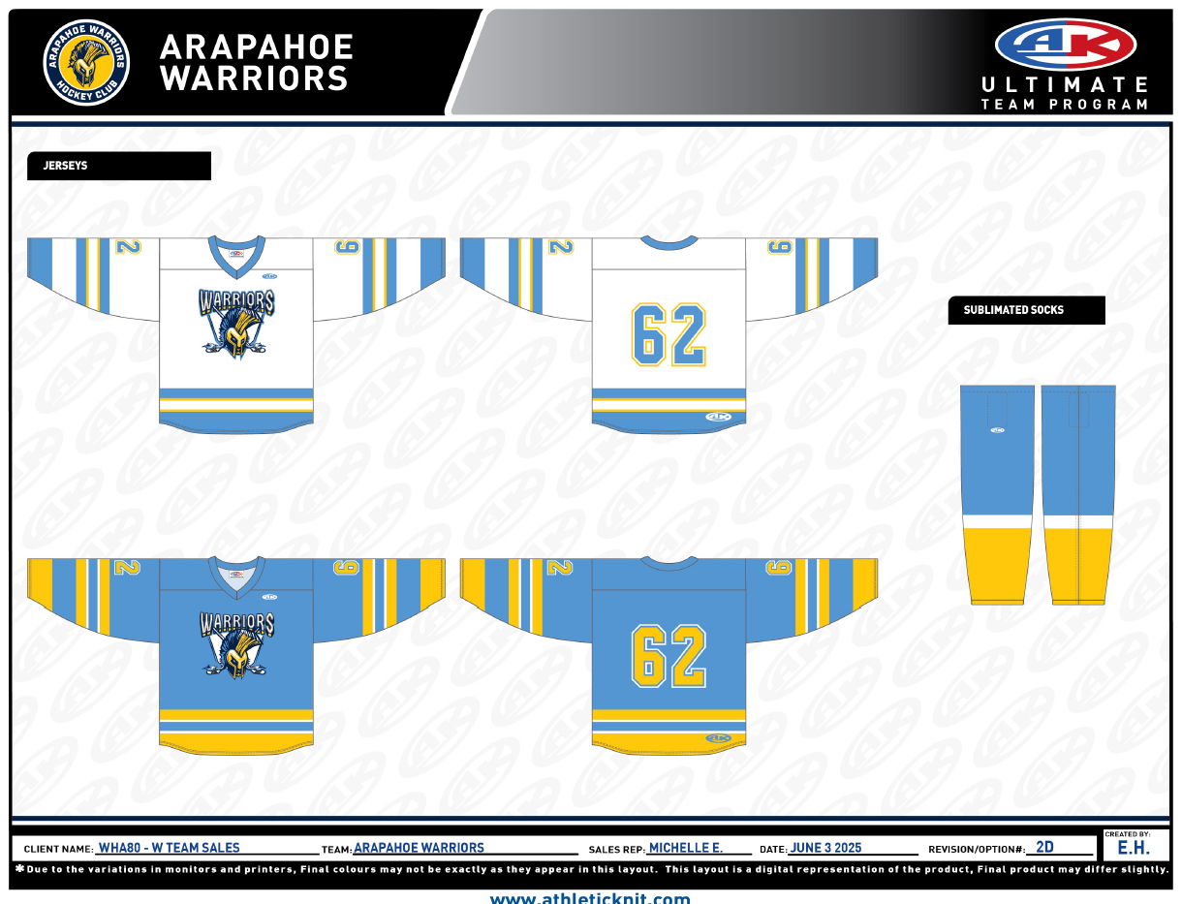
Uniforms
Jerseys
Nameplates
  $25 per player
  Covers both sides of the jersey
  Will provide team managers with dates to collect jerseys for printing
Hockey Socks
  Will be given to players after team selections

Slide 9
Questions?

