Slide 1

SYBA In-House Evaluation Parent Meeting
2026

Slide 2

2026 SYBA BOARD
PRESIDENT: Shane Hofmann
VICE PRESIDENT: Kyle Rice
TREASURER: Rob Deuth
SECRETARY: Sean Dolan
TRAVEL DIRECTORS: Jason Lenz & Blake Grefe
IN-HOUSE DIRECTORS: Jason Mousel & Trevor Jones
FIELD & FACILITIES DIRECTOR: Christina Tibbetts
COMMUNICATIONS DIRECTOR: Mark Amundson
SOCIAL MEDIA DIRECTORS: Sara Lewis & Tracey Domke
TOURNAMENT DIRECTOR: Katie Johnson
ASSISTANT TOURNAMENT DIRECTOR: Tatum Heil
EQUIPMENT DIRECTOR: Tyler Menden
UMPIRE COORDINATOR: Brent Vannier
COMMUNITY LEAGUE COORDINATOR: Ryan Schmitz
ASSISTANT EQUIPMENT DIRECTOR: Sean LaCoste
FUNDRAISING COORDINATOR: Billy Wermerskirchen

Slide 3
MISSION STATEMENT
The mission of the Shakopee Youth Baseball Association is to serve young athletes of all skill levels and experience, from beginner and recreational players, to the highest competitive levels. We are committed to the development of strong baseball skills and competitive excellence within a safe, fun, and inclusive community, allowing players to succeed both on and off the diamond.

Slide 4


SYBA CORE VALUES
TEAM:
Work together toward a common goal, put our teammates first, trust and support each other.
RESPECT:
Value your teammates, coaches, umpires, opponents, the game, and the fields we play on. We listen, show sportsmanship, appreciate everyone's role, and leave the field better than we arrived.
HUSTLE:
Bring max effort and energy every play. We sprint out onto the field, run hard to first base, get dirty to make plays, take the extra base and fight for every run.
HEART:
Play with passion, courage, and determination. We keep going when the game gets tough, lift each other up, and never give up.
FUN:
Enjoy playing the game and your teammates. Baseball is competitive, but we will create memories, celebrate wins, and learn from losses together.

Slide 5

Evaluations
Evaluations conducted on hitting (close range front toss), playing catch/throwing, ground balls, and flyballs for 8U/9U only
Players evaluated on a 1-3 scale
Total points will be accumulated and used when assigning players to teams or addressing safety concerns

Slide 6
Team Announcements
In-House Directors will assemble the teams in the days following the evaluations.
Coaches will be assigned based on interest indicated during registration. If there aren’t enough head coaches for every team, Directors will reach out to team members asking for volunteers. Reminder that the head coach and 2 assistant coaches receive DIBS credit. Head coaches will select their assistant coaches.
Teams are constructed by looking at overall evaluation scores. Teams will be created as equally as possible. Special requests will be taken into consideration, but they are not guaranteed.
Team rosters will be input to Crossbar by Directors

Slide 7
Season Outlook
7U will have 10 teams. Practice and games will be from 5:30-6:45 on Tuesdays and Thursdays on Pearson 1 & 2, Sweeney 1 & 2, and Jackson (2 teams per field). Teams will rotate between fields throughout the season.
8U/9U will have 6 teams. Practice and games will be on Tuesdays and Thursdays at Red Oak from 5:30-6:45 and 6:45-8:00 (2 teams per field).
Season will start the week of May 4th (assuming the City has opened the fields)
The first couple weeks will be practices only. After that it will be 1 practice a week and 1 game a week.
Season concludes with a Jamboree on July 25-26. 7U will be on Saturday only.

Slide 8
In-House Baseball Goals
7U Baseball:
* Introduction to pitch baseball
* Learn the fundamentals of hitting and throwing
* Learn basic rules of the game
* Learn to become good and supportive teammates
* Have FUN!
* Ultimate success is the kids want to play again next year
8U/9U:
* Introduction to kid pitch baseball
* Introduction to playing the catcher position
* Prepare kids to move up levels in their baseball progression whether it is
to travel or community league
* Continue to work on the fundamentals of hitting and throwing
* Have FUN!
* Ultimate success is the kids want to play again next year

Slide 9
Coaches Resources
SYBA Website:
* Travel Directors are in the process of putting drills and practice
plans on the website
YouTube and the Internet:
* Countless options on-line to find drills and practice plan ideas
* Coach Ballgame (especially good for 7U)
* Dominate the Diamond
* Legends Baseball & Softball Camps
End each game or practice with something fun:
* Team relay race
* One team starts at home plate, the other at second. 1 player from each team runs around the bases and then hands a baseball to the next player to complete their lap. Fun & competitive way to cap practice or a game and you can work on base running skills.

Slide 10
Volunteering (DIBS)
Shakopee Tournament June 12-14 (Main source of DIBS opportunities)
In-House Jamboree July 25-26 (Limited DIBS availability, but we do need help)
Travel: 6 hours required per players family
In House/ Community League: 2 hours required per players family (NEW)
Max 12 for multi-player families
Partial shifts are not allowed
If your DIBS are not met, the credit card on file will be charged: $500 (Travel), $250 (In-House/Community league)
Email will be sent out to signup for volunteer shifts on www.shakopeeyouthbaseball.com
Volunteering Credits:
  Head Coach
  3 (Travel) & 2 (In-House/Community League)
    Assistant Coaches, Team Manager, Grounds Crew
    Head Coach has final selection of credits awarded
Tournament proceeds
are re-invested back into
the baseball association-
field improvements,
equipment, etc.

Slide 11

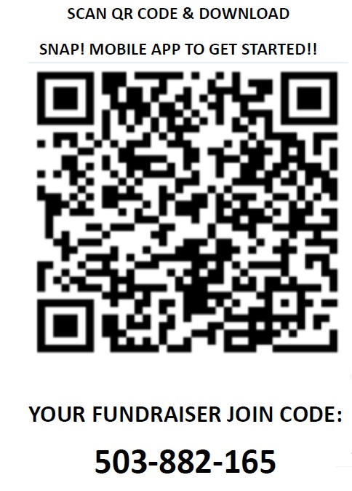
Follow these steps to get logged in!
  Scan QR Code, Download & Open Snap! Mobile App
  Click “I’m joining are accessing my fundraiser”
  Click “I’m a student or participant in a fundraiser
  **If you are new to Snap! Raise click Create Account”
  If you are returning to Snap! Raise simply log back in. You previously uploaded contacts should be saved
  Enter your 9-digit Fundraiser Join Code: 503-882-165
  Create the profile with your player’s name and your contact information
  Finish the profile by adding your player's photo
  Upload your supporter emails and phone numbers and SAVE!

Slide 12
QUESTIONS?

