Slide 1

2026 SYBA Travel Coaches Presentation
March 23, 2026

Slide 2
Important SYBA Contacts
SYBA Travel Directors
Blake Grefe
  sybatraveldirectors22@gmail.com
  612.462.2399
Jason Lenz
  jasonlenz463@gmail.com
  612.387.1005
SYBA Equipment Coordinator
Tyler Menden
  tylermenden@gmail.com
  612.281.2253
SYBA President
Shane Hofmann
  kylejrice@gmail.com
  952.484.4319
SYBA Vice President
Kyle Rice
  kylejrice@gmail.com
  612.749.5910
SYBA Umpire Coordinator
Brent Vannier
  brentavannier@gmail.com
  636.248.1193

Slide 3

New Crossbar SYBA Website & App
SYBA launched a new Crossbar website and app this Spring
(No longer use Sports Engine)
All SYBA travel teams, rosters, and head coaches will be loaded on Crossbar for you.
Head coaches have admin access and will need to input your assistant coaches once they are determined.
Utilize Crossbar for practices and games, etc.
It will be the head coaches (or team manager) responsibility to input practices, games, tournaments into Crossbar.
Encourage your parents to register for Crossbar if they are not registered already and to download the app.

Slide 4

Game Changer
Game Changer is an app that can be utilized by each team to
stream your games, score the game, and allow others to connect
that may not be able to be there in person.
Utilizing Game Changer is the easiest way to keep an accurate pitch count for your team.
If you do not want to utilize game changer the SYBA can provide your team with a scorebook so that you can score your game and manage pitch counts manually.
Metro Baseball League does expect that during games each team either uses a scorebook or game changer to ensure accuracy. You do not have to use both.
Many SYBA teams have a designated coach, team manager, or a volunteer parent that will manage this app for their team during the season.

Slide 5
Metro Baseball League (MBL) & Minnesota Baseball Tournament (MBT)
MBL and MBT is a non-profit organization created and existing solely to serve youth baseball in Minnesota.
Shakopee Youth Baseball Association uses MBL for all our league games and league playoffs.
The goal of MBL/MBT is to grow the game of baseball, while always focusing the programming, education, training, and resources back to the youth baseball organizations in each community.
Website: www.MBL.bz

Slide 6
MBL Scheduling
Scheduling for league games starts Tuesday, April 7th at 6:00 PM.
Use your team’s assigned home field dates for scheduling your games from the master schedule that will be sent out to all head coaches.
Head coaches will be notified by the MBL of their regions along with coaching contacts prior to Friday morning.
Schedules need to be completed by Tuesday, April 7th but can be edited later if times or locations happen to change.
Monday, April 13th is the first eligible MBL game date for league play.
MBL game scheduling instructions:
  Click here for a scheduling tutorial: https://www.mbl.bz/pages/faq-scheduling
Notes:
We likely won’t have jerseys until April 27th

Slide 7
MBL Scheduling Cont…
Total of 14 league games within your assigned region – 7 home and 7 away.
Double headers can be scheduled if you start early enough, or the host city has lights. Scheduling double headers are a great way to free up more time for practices.
Shakopee MBL games trump any practice that is scheduled on the main field for each age level.
Game schedule changes for whatever reason need to be adjusted on the MBL site to ensure that umpires can be assigned to the games.
Avoid scheduling any home games in April. The city of Shakopee has traditionally always been the last city in the metro to release fields for play.
Away games can be scheduled in April.
Monday, June 29th is the last day for reg. season game results to be recorded that will count for playoff seeding.

Slide 8
Adding players to MBL
Head coaches must add all players and coaches to their roster on their team home page on the MBL site.
For coaches to add players, asst coaches, and managers to a roster, those players must be registered in the MBL system.
The links below will explain the process of having parents register their player(s) and how coaches can then add players to their rosters. Parents only need to register one time, but all players must have their own individual usernames/registrations.
For returning coaches, most of your players are most likely already in the system. (Double registrations will cause issues)
How to Register: https://www.mbl.bz/pages/faq-how-to-register
How to Add Players to Roster: https://www.mbl.bz/pages/faq-adding-players
How to Add Coaches/Managers to Roster: https://www.mbl.bz/pages/faq-adding-coaches

Slide 9
Reporting an MBL Game
MBL games must be reported the day following a game by 10:00 am.
Log on to MBL and click the game that you wish to report.
Enter the number of pitches each player pitched and click “save”
Enter the final score of each game and click “save”.
If the game was not complete, you can report more innings when the game is played again.
Once entered click “report innings”. Enter the number of innings played, the date, if the umpire showed, and if the game is complete and then click “Save”.

Slide 10
SYBA Field Assignments
9’s - Tahpah 8, Tahpah 5
10’s - Westminster 1
11’s - Westminster 2
12’s - Green Meadow and Sacs (practice field)
13’s - Jackson and Sacs (practice field)
14’s – Riverview and Tahpah West

Slide 11
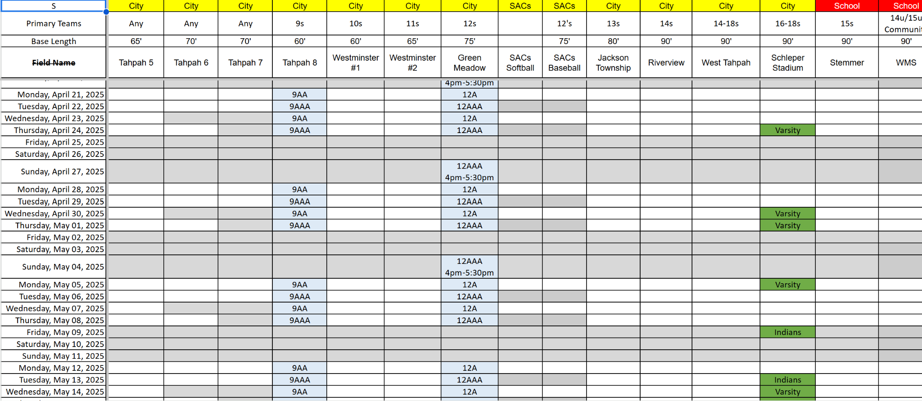

Master Field Schedule
Field Scheduler: Chrstina Tibbets

Slide 12
2026 Travel Tournaments
Total of 4 tournaments for each team that are covered by SYBA.
Additional tournaments may be scheduled at the cost of each individual team.
Most teams have one overnight tournament (depending on tournament availability at each level).
Head coach or the team manager are responsible for finding a hotel block for those overnight tournaments if needed.
MBL/GSTC/MSF State Tournaments – Each individual team that qualifies for state is responsible to cover the costs to participate.
EACH TEAM THAT QUALIFIES FOR A STATE TOURNAMENT IS REQUIRED TO PARTICIPATE IN AT LEAST ONE OF THE STATE TOURNAMENTS.
If you have not earned a state bid before the Shakopee Tournament, please submit your at large bids through MBL/GSTC if your team is interested in playing in one of these state tournaments.

Slide 13
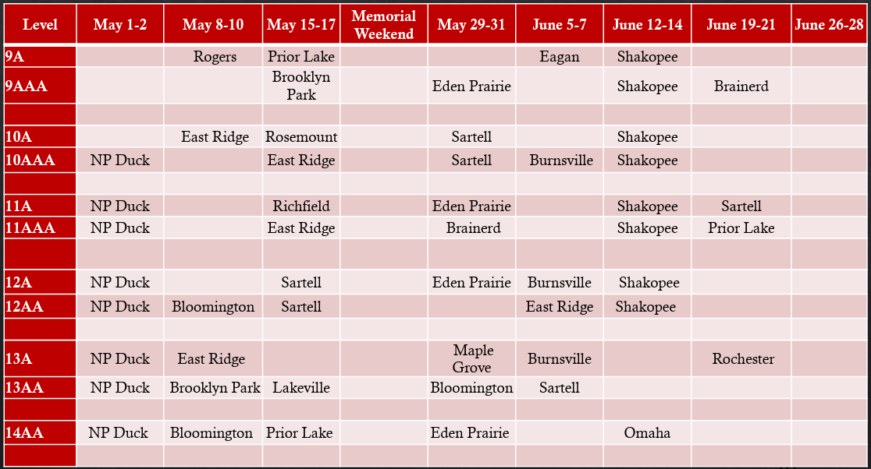
2026 Tournament Schedule

Slide 14
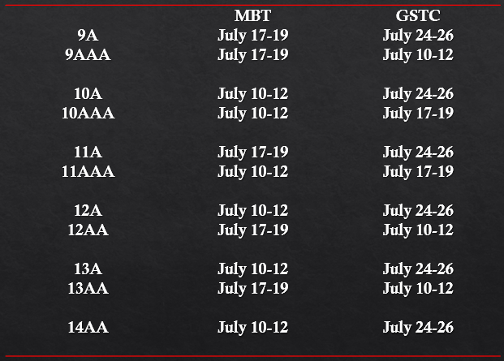
2026 MBT / Gopher State - State Tournaments

Slide 15
MBL Playoffs / August Classic
MBL Playoffs:
Emphasis on one game per week (when possible).
Geography will play a bigger factor in creating brackets
MBL League Playoffs begin week of July 6th.
MBL playoff championship games at neutral site:
  Tuesday, July 21st – Thursday, July 23rd
August Classic:
This fun tournament takes 2-4 players from every MBL team and groups those players with 3 to 4 other MBL teams to create an August Classic team. August Classic teams play four games against other August Classic teams in their age level.
Friday, July 31st – Sunday, August 2nd
Volunteer head coaches are generally allowed to select more kids from their own team.

Slide 16
Coaching Checklist
Collect each player's birth certificates and bring it with to all games.
Ensure all coaches have completed required coaching trainings. Have these completed certifications with you at all games and tournaments. ***Coaches can not participate in games until completed***
Make sure rosters, including coaches, are inputted into the MBL site.
Review the MBL rules specific to your age level. Print off the rules and have them handy at all tournaments and games.
Review all tournament rules prior to the start of a tournament. These will change with every tournament. (Pitch counts, time limits, tie breakers, etc.)
Do not hold any outdoor practices on your assigned field until after we get the green light from the city.

Slide 17
Coaching Checklist Cont.
Conduct a pre-season parent meeting (usually after a practice):
  Set expectations for the season
  Discuss SYBA team values
  Cover field maintenance expectations
  Collect / plan for any additional fees (“slush fund”)
  Plan for any alternative pants/ jerseys

Slide 18
Miscellaneous
Reminder: Alcohol prohibited at games, practices.
The MBL is fine with music for pregame warmups but it should not be utilized during the actual game.
17th Avenue batting cages – We will post time slots on sign up genius with available times during the week (this will be available the week following spring break). Weekends will remain first come first serve.
  1-hour slots on weekdays from 5pm to 8pm. First to sign up gets priority.
  High School teams will trump any sign up. Generally, HS are done with these cages by 5:00 pm.
  Don’t sign up unless you plan on using them.

Slide 19
Miscellaneous Cont.
Coaching resources are available on the SYBA website for tools and practice ideas.
  Reach out to Blake or Jason if you need additional assistance with practice plans.
We will have some fieldhouse / gym times available after spring break that each age level will be assigned to.
Equipment check out: Baseball equipment shed behind West Middle School – March 22 after tryouts.

Slide 20
Umpires (MBL rules)
Bad calls WILL happen; Exercise Self-Control and Respect the Umps.
Before each game remind the umpire what age level your team is. He might have just umped a different age level so it nice to remind him of some of your age specific rules just so he remembers them.
Any coach, player or spectator who confronts, abuses, or follows an umpire outside the fenced area or otherwise demarked area of an individual baseball field will be suspended from their affiliated team’s games indefinitely.
Said suspension may be lifted after a hearing with the MBL Supplemental Discipline Committee.
If a coach, player or spectator is ejected from a league or tournament game, they are suspended for the next MBL league/playoff game or MBT qualifying or state tournament game on the team’s schedule at the time of the ejection.
Suspension can carry over to the following season.
If a spectator who has previously been warned by an umpire regarding unsportsmanlike or disruptive behavior during a game is subsequently ejected from said game, the head coach of that team is also ejected, and subject to suspension rules regarding coach/player ejections.

Slide 21
Shakopee Umpires
9U and 10U Shakopee home games (also our Shakopee Tournament) are umpired by Shakopee kids many of whom played in the SYBA or are currently playing.
SYBA provides umpire training and support for these kids during the season.
We want to keep the SYBA kids as umpires, so as head coaches engage with the umpires during games to make sure everything is going well.
If other coaches or fans become a problem, please step in to address the issues and to show support.
Umpire scheduling for 9U and 10U games is done by Brent Vannier so any changes to home games that may occur for any reason need to be sent to him as well as updated on the MBL site.
  Brent Vannier - brentavannier@gmail.com / 636.248.1193
The MBL schedules umpires for all other Shakopee home games for 11U-14U so make sure you enter field locations and start times accurately.
Any updates to field changes or game times should be done through the MBL site to ensure umpires are assigned.

Slide 22
Field Maintenance
After games and practices, players are expected to help coaches with field maintenance.
Ensure that dirt is filled in and level around the bases, home plate and mound (with clay in sheds) after use with the rakes or portable drag that are provided at each field.
The portable mounds need to be removed and placed flat outside the field of play after games/practices so the city can drag and water. (We destroyed a few sprinklers last season by not removing the mounds and it create a lot of extra work and money for the city)
Pick up any trash in the dugouts, stands, or on the field.
The players should not leave until the team is finished cleaning up the field and dugouts.
Leave the field better than when you arrived. (“Respect” Team Value)
This is part of being on the team, especially once players begin on fields with more maintenance (clay mounds, tarps, dugouts).

Slide 23
Field Maintenance Cont…
Each field will have a storage bin or shed that will contain all the supplies needed to maintain and get the field ready for games. Please make sure that the equipment is put away and locked up after each use.
Storage lock codes at all SYBA fields is: 1357
If you need more chalk, mound clay, dirt dry, string line, etc. for your assigned field please contact Tyler Menden (612.281.2253 / tylermenden@gmail.com).
Tyler does a great job of monitoring supplies during the season so this shouldn’t be an issue.
City will drag the fields prior to the games and most practices, but the coaches are responsible for getting the field chalked and ready for each home game.

Slide 24
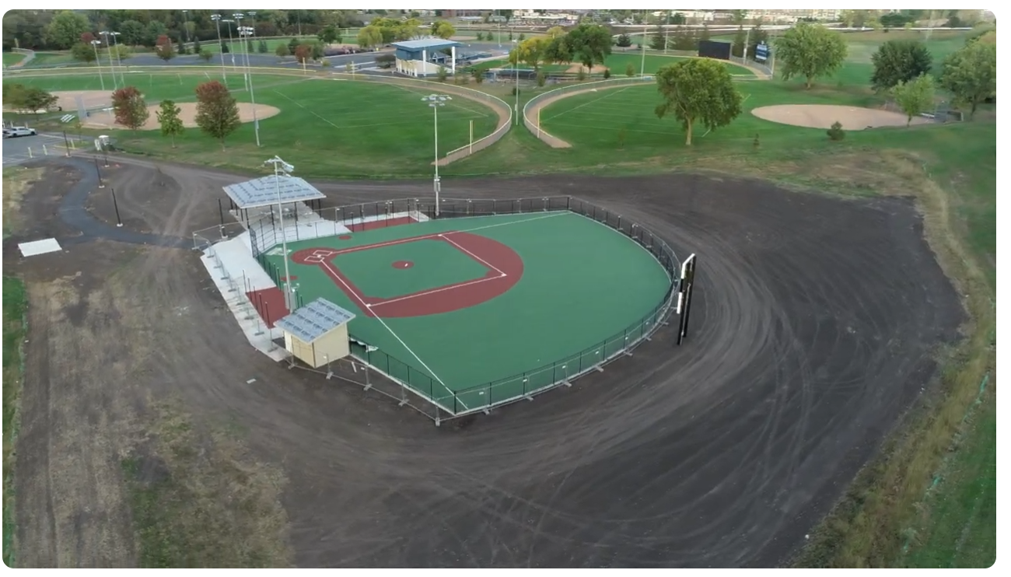
Miracle League – SYBA Buddies
The new Miracle League field at Tahpah Park has been completed.
Our first season of miracle league will start mid-May and run through the end of July.
Goal is to have every travel team assist
with one of their games or practices
throughout the summer.

Slide 25
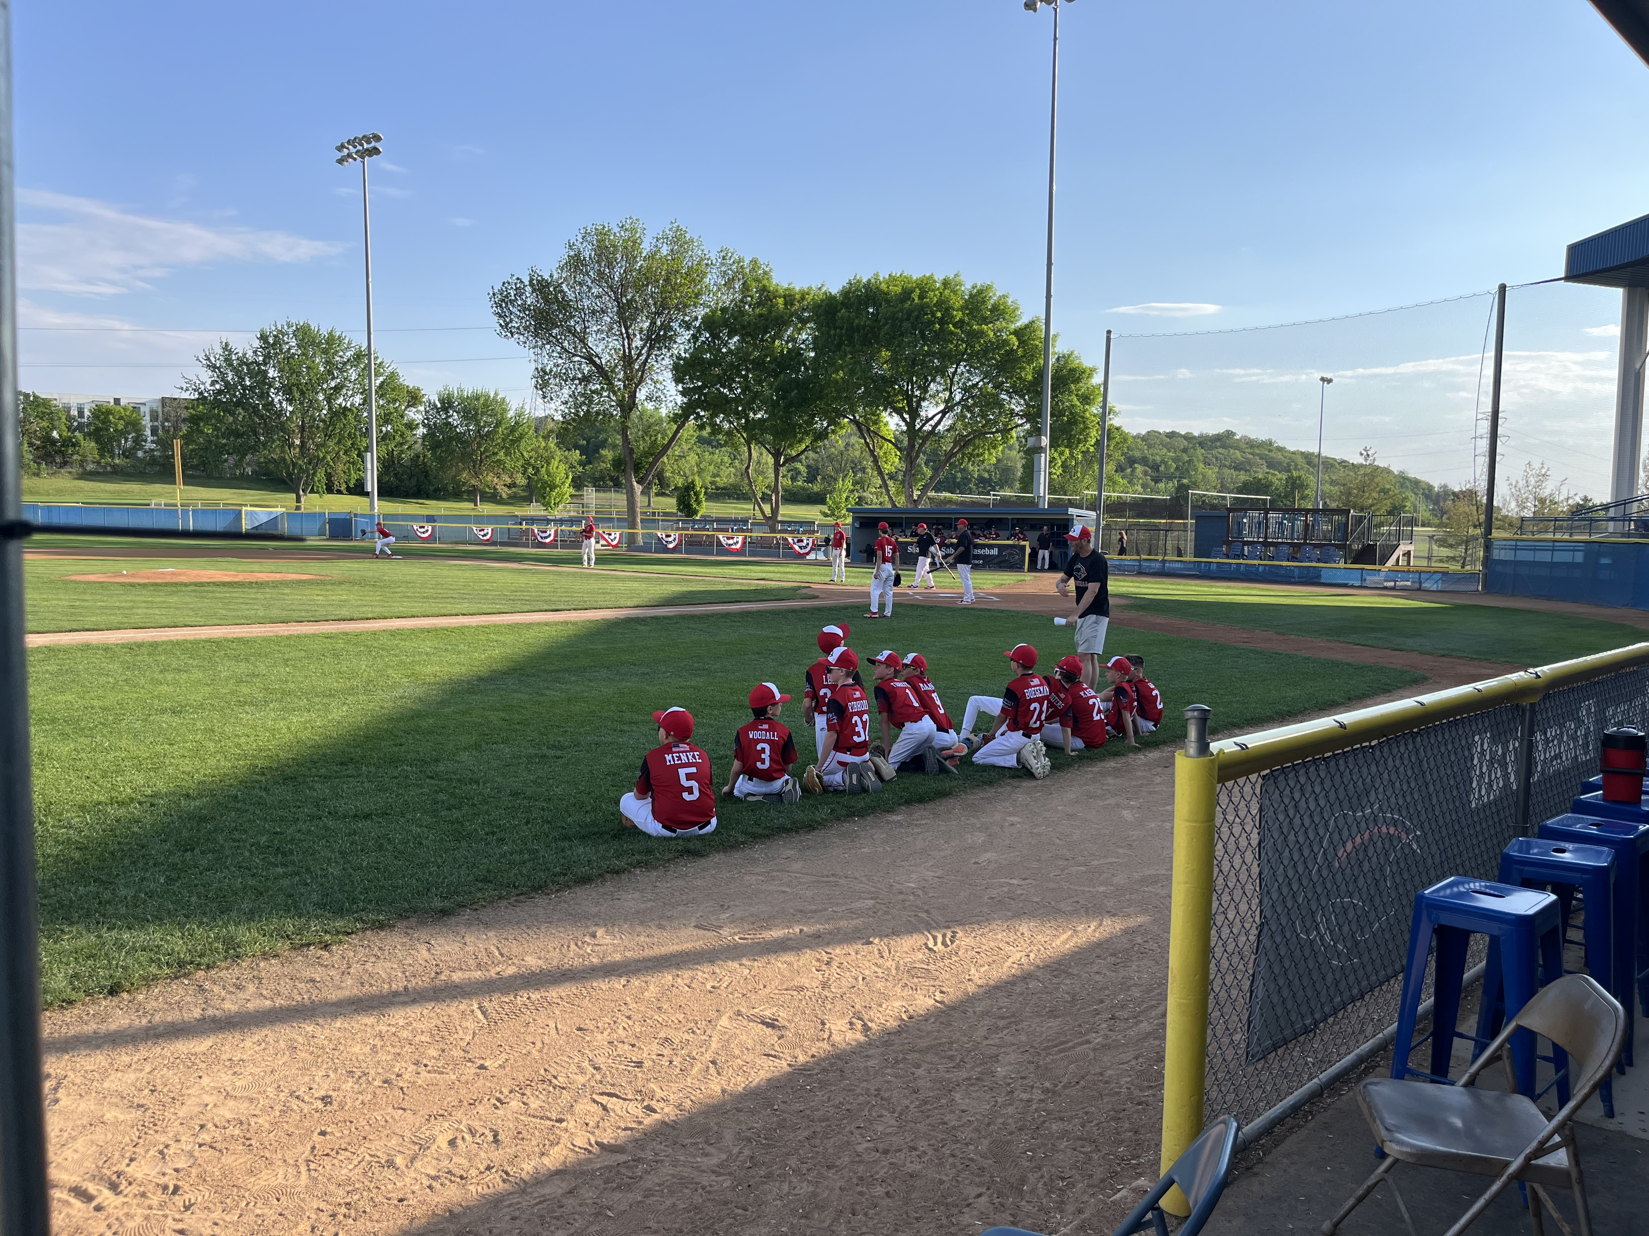
SYBA – Varsity Game Nights
9A – April 27th @ 7:00
9AAA – April 29th @ 7:00
10A – April 30th @ 7:00
10AAA – May 2nd @ 7:00 (SYBA Night)
11A – May 4th @ 7:00
11AAA – May 6th @ 7:00
12A – May 7th @ 7:00
12AA – May 13th @ 7:00

Slide 26

SYBA Team Values
TEAM
Work together toward a common goal, put our teammates first, trust and support each other.
RESPECT
Value your teammates, coaches, umpires, opponents, the game, and the fields we play on. We listen, show sportsmanship, appreciate everyone’s role and leave the field better than when we came.
HUSTLE
Bring max effort and energy every play. We sprint out onto the field, run hard to first base, get dirty to make plays, take the extra base and fight for every run.
HEART
Play with passion, courage, and determination. We keep going when the game gets tough, lift each other up, and never give up.
FUN
Enjoy playing the game and your teammates. Baseball is competitive, but we will create memories, celebrate wins, and learn from losses together.

Slide 27
Questions?

