Slide 1



MAPLE GROVE WRESTLING CLUB
2025-2026 Season Update

Slide 2


AGENDA
Welcome by Board
Introductions : Who’s Who
Coaches’ Philosophy
Season Schedule
Tournament Schedule + Dual Team
Our Wrestling Family
Volunteer Opportunities
Wrap Up

Slide 3



WHO’S WHO
BOARD:
COACHES:
COORDINATORS:
Christina Fox- President
Brittany Clark- Vice President
Lynsey Seubert – Secretary *
Lindsey Renken – Treasurer
Donnie Leuer- Head Coach
Dan Williams - Assistant Coach
Brad Griffore- Assistant Coach
David Zilverberg- Assistant Coach
Thomas Schlangen- Assistant Coach
Troy Seubert - MGHS Head Coach
Kyle Palmer- Social Media
Ryan Bielat– Volunteer Coordinator
Open Position - Equipment Manager
Open Position - Photographer
Open Position – Fun Coordinator(Team Manager)
* Open for next season

Slide 4


COACHES’ PHILOSOPHY
Code of Conduct and Discipline – Wrestler and Parent
Individual Goal Sheets
FAQ’s + Wrestling 101
Overarching season goals for each group
Practice Format (Beginners + Experienced)
Parent help during practice
Tournaments
Dual Team opportunity

Slide 5


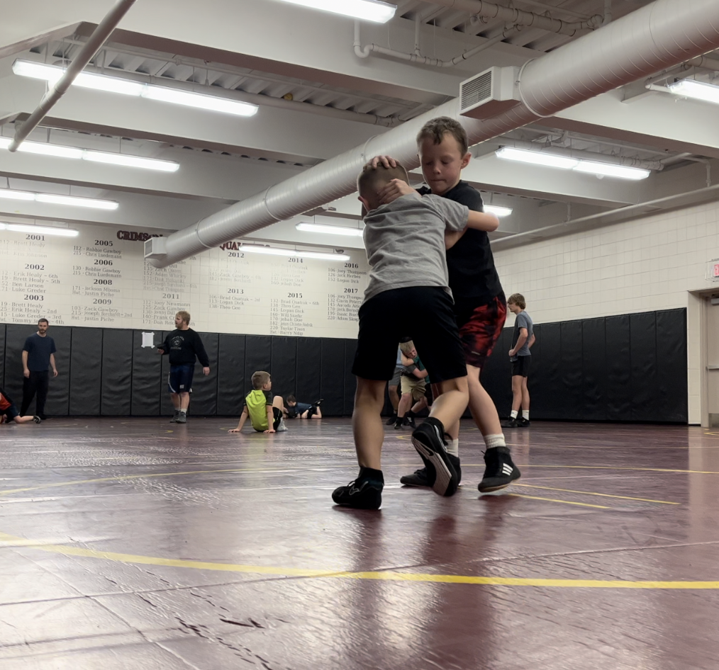
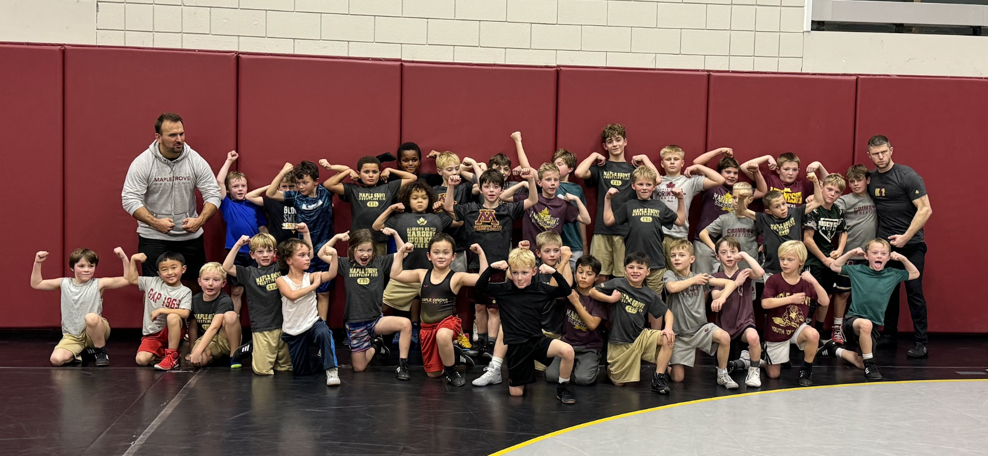
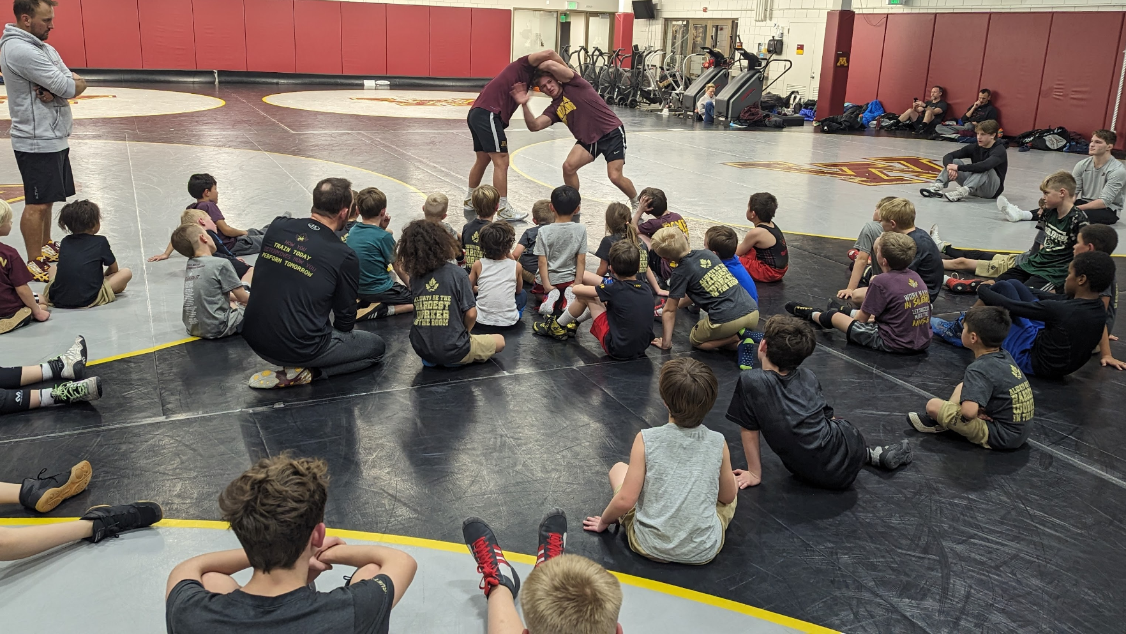
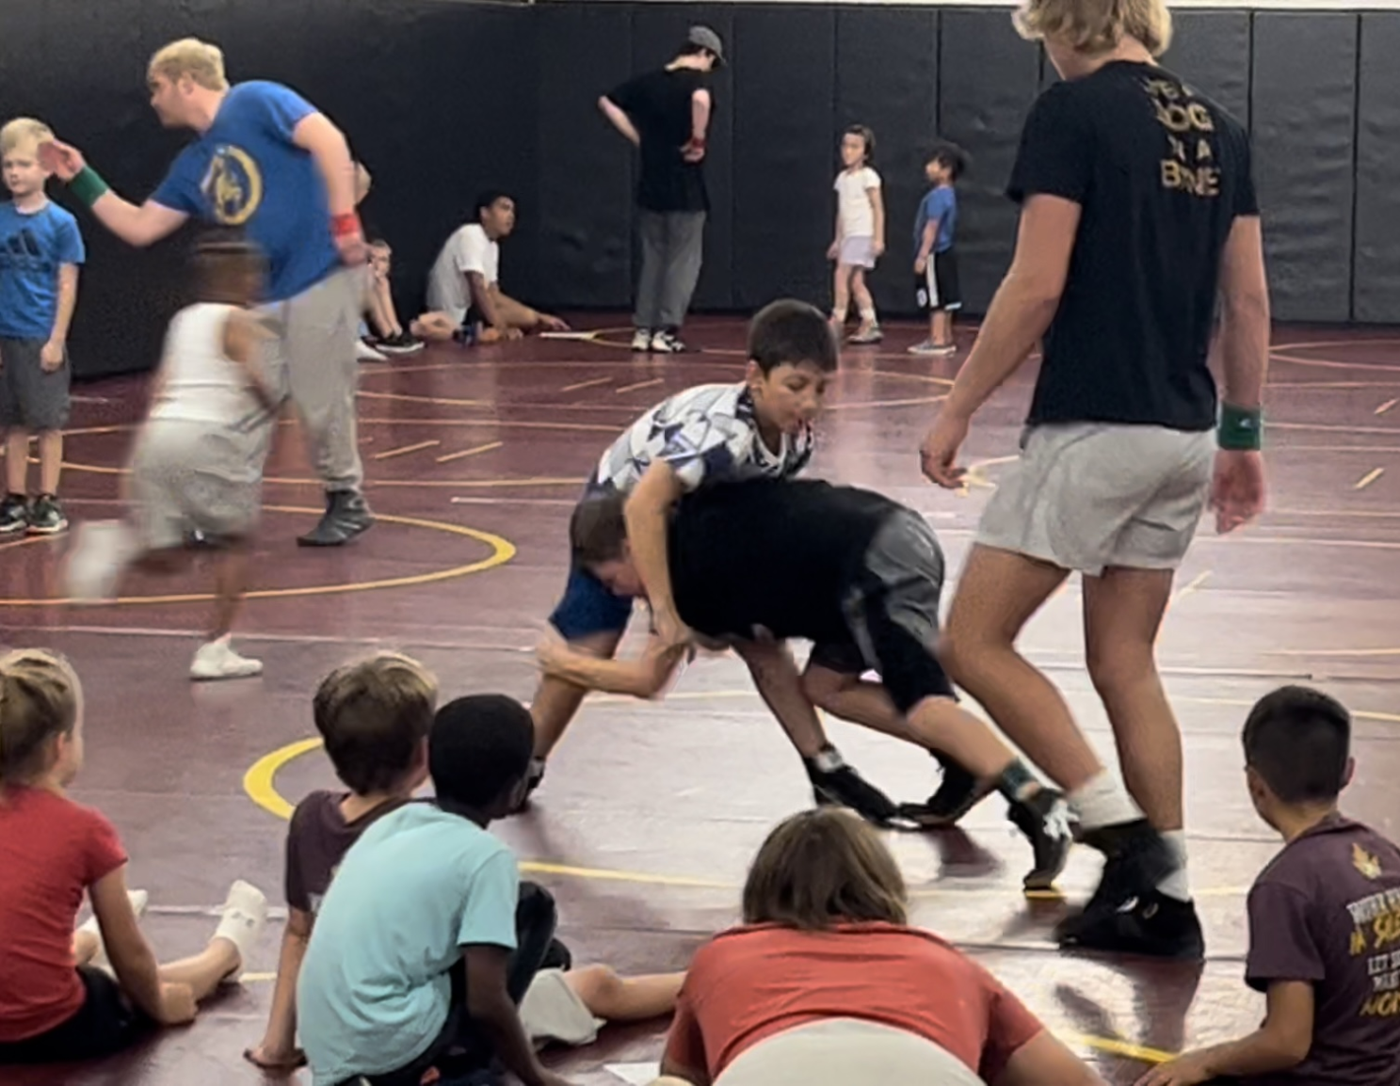
Wrestling Practice Expectations
Respect
  Coaches
    Volume
  Teammates
  Wrestling Room
Suggested Practice Attire
  Athletic Shorts, Sweatpants, Singlet, Compression Bottoms
  T-shirt or Long Sleeve
  Wrestling Shoes and Headgear
  Water Bottle
Wrestling Partners
  Weight
  Age
  Skill
Supportive and Fun!
Practice schedule will be posted on CrossBar App- You will be assigned and should see practices in the app.
Full Season- we will be slotting kids into groups:
Team Crimson (Monday-7p; Wed- 6p) *2026 will change
Team Gold (Check schedule; Time varies)
Ankle Biters–
Monday’s 6:00 – 6:50PM from Nov 10th through Dec 15th
Look for email tomorrow for group assignment
**We will use CrossBar to communicate (via Chat function) which tournaments folks may be going to and any changes to schedule which may happen last minute (weather, etc)**

Slide 6
ANKLE BITERS
OUR NEWEST CRIMSON WRESTLING FAMILY!
Pre-K through 1st grade only and beginner wrestlers
Nov 10th through Dec 15th
Monday’s 6-6:50p
Option to continue on for full season

Slide 7
TOURNAMENT
OPPORTUNITIES
BEGINNER BASH
OPENS
MNUSA TOURNAMENTS
DUAL TOURNAMENTS
The Guillotine
MNUSA Membership
Notes:
7

Slide 8
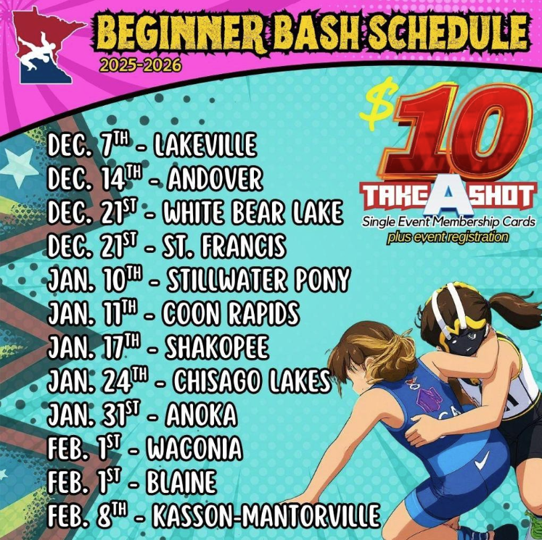

Beginner Bash
To Participate:
1st or 2nd year wrestlers (not winning any state titles).
3rd year wrestlers are welcome if they haven’t competed in any regional, state or national tournaments in the past.
KEY POINTS~
MNUSA CARD NOT REQUIRED- CAN PURCHASE DAY OF
“TAKE A SHOT” FOR $10 PER TOURNAMENT
PRE-REGISTRATION REQUIRED IN ADDITION TO COST OF “TAKE A SHOT” FEE
https://www.mnusawrestling.org/page/show/8890035-beginners-bash

Slide 9
TOURNAMENT
SCHEDULE
Tournaments
11/30 Maple Grove Wrestling Club Tournament
12/7 STMA (paid)
12/21 St. Francis (MNUSA)
1/11 Buffalo Open
1/11 Coon Rapids (MNUSA)
1/18 Rockford (paid)
1/31 Anoka (MNUSA)
2/1 Blaine (MNUSA)
2/8 Centennial (MNUSA)
2/14 Edina (paid)
MNUSA Regionals
2/15 Waconia
2/22 Blaine and Brainerd
3/7 Forest Lake
3/8 Owatonna
MNUSA State - Rochester
3/13– 3/15
  * Weekly emails and chats will be source of truth for tournaments Coaches will be at each week
The Guillotine
MNUSA Membership
Notes:
7

Slide 10
DUAL TEAM
Dual Tournaments
12/14 Maple Grove Dual ​
1/2 Champlin Park Dual
1/4 Lakeville K-3 + Duals
1/11 Mounds View K-3 Duals​
1/25 The Brawl ​
Wrestle-offs *
Week of 12/2 Maple Grove Duals
Week of 12/16 The Brawl
* Wrestle off dates are subject to change and at coaches' discretion. If your wrestler is interested, please let Coach Donnie or Coach Dan know.
* If you wrestle off for a spot, you are committing to being there for the team for all meets.
Weight Classes
Weigh-ins vary by tournament (K-3 tournament vs K-6th tournament)
10ths allowed (ex. 45.9lbs)
Can move up one weight class from weigh-in weight
Most tournaments allow alternates to roster
Coaches’ discretion for who is sent out to wrestle based upon matchups and team needs
ONE Mat
ONE Team
ONE Goal
Communicate to Coaches if interested in Duals

Slide 11
OUR WRESTLING FAMILY
When you come to practice, put down the phones if you can and watch and learn- this is an easy way to learn how to wrestle. This could be beneficial for tournaments where you may be mat side without a coach.
After tournaments or dual tournaments- meet after for food/ice cream whatever that looks like.
Social events- Dad’s night and Mom’s night and Parent’s night
Sit together at a tournament that you attend→ continuing to build the program and easier for coaches to find you
Experienced families, make yourselves available to newcomers- whether that be through answering questions or helping them through first tournaments.
Encourage your kids throughout the season- this sport is challenging and could be frustrating or exciting! Through thick and thin, stick with it!
Ask to be part of planning or board positions; there will be one open in the next season (Secretary)

Slide 12
SEASON SCHEDULE
Wrestling 101 Night for parents- 11/19 in the HS Forum Room 6p-6:45p
Picture Night – 12/3
  All athletes will get a MG Shirt and shorts, Please wear to pictures
Gopher’s Practice – 12/11-6:30p
Youth Night (MGHS) – 12/4
Family Socials
  Dad’s Night Out – TBD
  Mom’s Day Out – Bingo at Pints and Paddles 11/18
  Bowling – 1/18 5-7pm
  Parent’s Night Out w/HS parents- TBD
End of Year Banquet –3/18 week after State Tournament
As always, please be mindful as we head into winter, if your child is sick at all, please keep them home.
If you notice anything from skin perspective, reach out to a coach and ask!
Practice and other Fun events will be posted on CrossBar App
**Use CrossBar to communicate (via Chat function) which tournaments folks may be going to throughout the season and any changes to schedule which may happen last minute (weather, etc) will be communicated in the app as well**
Best way to learn as a new parent is to watch the practice!

Slide 13
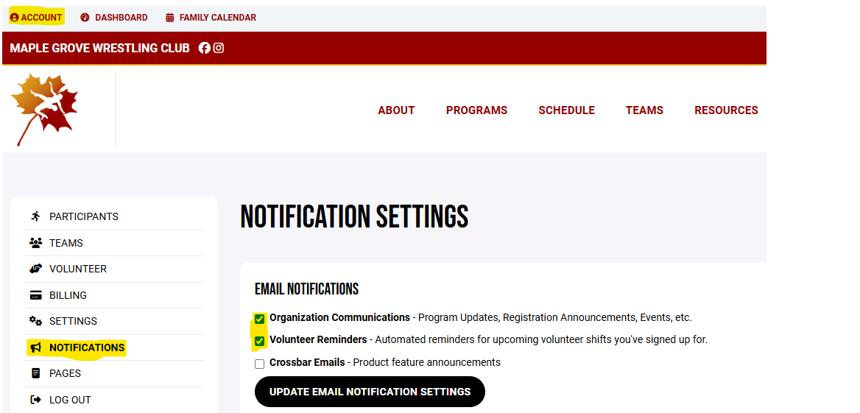
CROSSBAR
DON’T MISS INFORMATION- Adjust your settings in your profile so you stay connected throughout the season.
Email Notifications
DIBS

Slide 14
VOLUNTEER OPPORTUNITIES
No experience needed
Volunteer Hours- 4 hours per family/ $150 check
Sign up Genius posted on website to find a shift and we will manually mark complete in CrossBar after shift.
Opportunities
  MG Youth Tournament: 11/30 Most needed!
  Youth Dual Tournament MGWC Hosts: 12/14
  HS Opportunities: 12/12 and 12/13 tournaments and Concessions for home duals
**Please plan accordingly and look to get these done with the dates listed above. If you do not volunteer, we will be cashing checks at the end of the season**

Slide 15
WRAP UP COMMENTS
Scholarship Opportunities - See Lynsey or email Club directly for more information
“Like” and share us on Facebook and Instagram
Fan Gear
  1st Round open through 11/9 (delivery by Thanksgiving)
    2nd store reopens 11/23 through 11/30 (delivery by Christmas)
Tables in back: (Cash, Check, or Venmo)
    Opportunities to buy past year compression gear/Singlets $15 - $20
    Maple Grove Wrestling Club singlets/misc available for sale $45
      Need to place order by 11/11 (Bring check to 1st night of practice if you haven’t paid yet)
    Car Decals $5
    Stickers $2
    Backpacks $52
    Attic Stock Apparel (shorts, t-shirts, etc…) $2
THANK YOU FOR YOUR CONTINUED SUPPORT - SEE YOU ON THE MAT!

