Slide 1


Maple Grove Crimson HS Wrestling
Parent FAQ and Resource Guide

Slide 2
Wrestler Code of Conduct:
Expect success by staying confident and positive.
Correct errors promptly to avoid mistakes.
Be a role model on and off the mat for younger wrestlers.
Accept both praise and criticism as opportunities to grow.
Avoid making excuses and arguing with officials.
Focus on improving, not past achievements.
Set goals based on wrestling skills, not weight class.
Attend all school sessions; unexcused absences mean no wrestling.
Maintain good grades and behavior.
Remember, your actions reflect on the entire wrestling program.
Review MSHSL Student Athlete Code of Conduct

Slide 3
Wrestling – What makes it great
Fun
Challenging
Compete and succeed as an individual and as a team
Improved Athleticism/Physical Fitness
Be part of a success bigger than any individual – where every athlete makes a difference
Create lifelong friendships with a great group of like-minded athletes.
Character Building and Life Skills…

Slide 4
How will wrestling help me???
Character Building and Life Skills:
  Improved priorities/academics
  Develop (or improve on) a strong work ethic and experience the relationship between effort and success
  Improve accountability and commitment skills
  Learn to handle adversity and be an overcomer
  Develop teamwork skills as well as respect for others (opponents, referees, etc.)
  Spend time in a positive atmosphere as part of the Crimson Wrestling Family

Slide 5
I’m new to wrestling…What to expect
To challenge yourself and work toward self-improvement
To build friendships within a supportive team environment
To stay fit and enhance athletic skills throughout the season
To develop physical and mental resilience applicable beyond sports
To learn and improve in the sport over time
To achieve personal successes regardless of outcomes
To enjoy the experience
To take part in unique opportunities with the team

Slide 6
Practice Schedule
Practice is Daily (Monday-Friday) unless there is a meet. There can be some Saturday AM practices as well throughout the season.
Wrestling practice starts at 3:10p
    Monday – Wednesday we’ll often be lifting at 2:10p on school days. Non-school days are typically at 9am or 3p (check calendar on this).
Be ready to go when practice starts unless you have contacted Coach Troy via text or call (763-913-0601).
Any wrestler missing practice or a meet should inform Coach Troy prior to missing the event (via text or call).
If you need to take the activity bus home let a coach know so that we can make sure you get out of practice with enough time to shower before catching the bus.

Slide 7

HYGIENE REQUIREMENTS
Shower after all practices and meets.
01
Only wrestle in clean clothes. Wash daily. (Parents)
02
Don’t wear your wrestling shoes outside.
03
Follow additional coaches' instruction in regard to proper hygiene.
04

Slide 8
Meet Procedure and Expectations
Home dual meets:
  JV and Varsity set up after weigh-ins and put mats away after the meet.
Crimson Invitational:
  All wrestlers help with setup and takedown (details TBD).
Away events:
  Bus departure info announced at practice and posted in the wrestling room; also emailed.
All wrestlers must ride the bus to and from away meets unless pre-excused by a parent or guardian using the coaches' form.

Slide 9
Weight Classes
High School (Varsity/JV) *107 lbs. *114 lbs. *121 lbs. *127 lbs. *133 lbs. *139 lbs. *145 lbs. *152 lbs. *160 lbs. *172 lbs. *189lbs. *215 lbs. *Hwt. (285 lbs).
9th grade team (7th/8th/9th) *88 lbs, *94 lbs. *100 lbs. *107 lbs. *114 lbs. *121 lbs. *127 lbs. *133 lbs. *139 lbs. *145 lbs. *152 lbs. *160lbs. *172 lbs. *189 lbs. *Hwt. (188 min. lbs).
No wrestler will be required to make a certain weight.
They will need to choose a weight for most events. Once THEY commit to a weight they are expected to make the weight.
There is no need to commit to a weight that you aren’t sure you’ll make.

Slide 10
Wrestle Offs
Wrestle offs will take place when two wrestlers are so close it is deemed necessary and before big tournaments/Individual Sections. Wrestle offs will work as follows:
The first wrestle-off to establish the varsity wrestler will be best of three unless the first match is won by five or more points – in which case it will be best of one.
107 – 127 must be within four pounds of weight to wrestle off. 133 – 152 within five pounds. 160 – Hwt. within six pounds.
Once the varsity wrestler has been established (I.E. Beaten his opponent) for a weight class, in future matches the challenger must defeat the varsity wrestler in the first match to earn a best two out of three scenario. (A challenger must win the first tryout match or it’s over).
Coaches reserve the right to make decisions without or despite the tryouts – as they feel is best for the team.

Slide 11
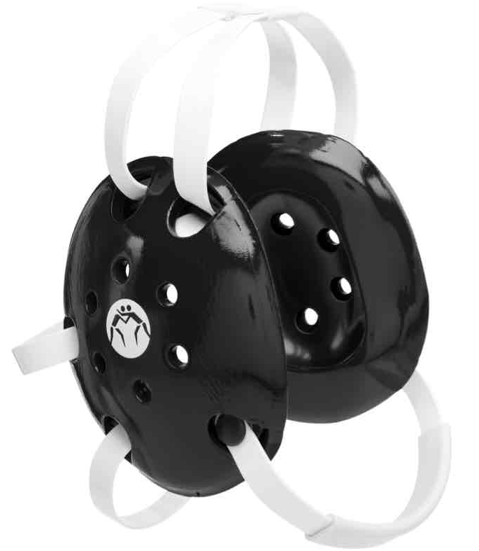
Common Questions
Q: Do I have to cut weight?
A: You will not be asked or encouraged to cut weight. We do encourage you to eat healthy to perform at your best. “Fueling the Tank with Premium” is an important aspect of reaching your potential.
Q: Do a lot of wrestlers get cauliflower ear?
A: This is not a concern if you wear your head gear. Head Gear are available to check out.

Slide 12
MGSH Varsity Letter Criteria
EXPECTATIONS
Varsity letter-winners must finish the season to the State Tournament.
If a wrestler has more than 5 unexcused absences during the season they will not be eligible to letter.
All Wrestlers are expected to volunteer at least two youth practices throughout the course of the season.
CRITERIA
  18 varsity team points (not to include more than six points received via forfeits) = Varsity Letter.
  Or ‘Top Six’ (Medalist) finisher in section individuals = Varsity Letter.
  Or seniors out for (2) consecutive seasons = Varsity Letter.
  Wrestlers who wrestle at least 20 varsity matches AND give up less than six team points in half of their matches = Varsity Letter.
  Student Managers = coaches discretion.
  *Coaches reserve the right to letter or not letter any individual.

Slide 13

MGHS Banquet Awards
*Hardest worker (V/JV)
*Most Outstanding Wrestler (V/JV)
*Most Improved Wrestler (V/JV)
*Rookie of the Year (V/JV)
MR. Crimson (Best Teammate – V/JV)
*All Conference
*Section Champ (V/9th grade)
*State Tournament qualifier (9th grade or senior high)
*Senior state qualifiers to get career plaques
*State Place winners (Senior High and 9th grade)
*Season or Career Maple Grove records
*Captain
*Most Falls (Varsity/JV)
*Most Takedowns (Varsity/JV)
*Most Near Falls (Varsity/JV)
*100% practice/meet attendance
*Senior ~ Highest GPA
*Most Team Points (Varsity/JV)

Slide 14
Maple Grove Poster Picture Requirements
The Poster Picture is earned based on the previous season. It is NOT the team picture.
Here are the requirements to earn being in the poster:
  Must have finished through the completion of the previous season (through the state tournament) to be considered for the poster.
  Must also meet at least one of the following criteria:
    Varsity Letter Winner
    Competed at Varsity Sections
    Wrestled 5 or more Varsity matches
    9th grade individual state tournament competitor
    Seniors who wrestled as Juniors.
    Considered: Wrestlers who won 10 or more matches (any level).

