Slide 1


MAPLE GROVE WRESTLING
2025-2026 Season Update

Slide 2


AGENDA
Welcome by Board
Introductions: Who’s Who
Mission and Vision of MG Wrestling
Why Wrestle
Key Details for the Wrestling Season
MG Values and Wrestler expectations
Practice Philosophy
Injuries
Match Count and Varsity Line Up
Communication apps
Volunteer Opportunities
Key Dates for the season
Wrap Up

Slide 3
Who’s Who
Booster Club:
Christina Fox – President (Ryan Bielat in training)
Brittany Clark– Vice President (Youth Parent)
Lindsey Renken – Treasurer (Youth Parent)
Jenae Hubbard and Lynsey Seubert–Secretary
Chris Thompson – Concessions Coordinator
Christina Fox- Manager Coordinator
Kyle Palmer- Social Media Coordinator
OPEN POSITIONS: Fun Coordinator/Team Manager/Trip Coordinator

Slide 4
Meet your Captains
Boys:
Connor Peterson, 12 – 5x State Entrant/2x All-State (finished 5th is 2023 and 3rd in 2025), 5x All-Conference. Fourth year captain.
Grady Mandle, 12 – 1X letter winner. 1st year Captain
Jaeden Hubbard, 12 – 3X letter winner. 1st year Captain.
Ethan Hong, 11 – 4X letter winner. 2025 State Entrant. Second year Captain.
Girls:
Liz Ofuasia, 12 - 1X Maple Grove letter winner. 1st year Captain.
Kathrine Melton, 12 - 2X letter winner. 1st year Captain.
Russo Capel, 12 - 2X letter winner. 1st year Captain.

Slide 5
2025 - 2026 Coaching Staff
Troy Seubert – Head Coach (20t^{h} yr. as Head Coach – 22nd total)
Ron Seubert – Assistant Coach (20th consecutive yr.)
Brad Holzerland – Assistant Coach (8th yr.)
Eddie Kilgard – Assistant Coach (5th yr.)
Carl Leuer – Assistant Coach (4th yr.)
Daniel Polanco – Assistant Coach (4th yr.)
Donnie Leuer (4th yr.)
Jake Olmstead – Assistant Coach (3^{4d} yr.)
Josh Barzowski – Assistant Coach (3rd yr.)
Dylan Schultz – Assistant Coach (2nd yr.
William Gamble (2nd yr))
Mason Carter – Assistant Coach (2nd yr.)
Aedon Oferdorfer (1st yr.)
Carter Focht (1st yr.)
Michael Maston (1st yr.)
Ireland Meade (1st yr.)
Rufus Bartee – Assistant Coach (1st yr.)

Slide 6
Maple Grove Wrestling
MISSION STATEMENT
To help each wrestler develop a “can do” attitude, a strong sense of self-worth, confidence, and the mindset needed to work as part of the team. To teach wrestlers the skills that will make them successful in wrestling, in school, and in life.
VISION STATEMENT
To develop a team that consistently competes with the top programs in the state of Minnesota.

Slide 7
Why choose Wrestling
Fun and challenging
Compete and succeed as an individual and as a team
Improved Athleticism/Physical Fitness
Be part of a success bigger than any individual – where every athlete makes a difference
Create lifelong friendships with a great group of like-minded athletes.
Character Building and Life Skills…

Slide 8
How will wrestling help me???
WRESTLING IMPACT OFF THE MAT (CHARACTER)
  Improve priorities/academics
  Develop (or improve on) a strong work ethic and experience the relationship between effort and success
  Improve accountability and commitment skills
  Learn to handle adversity and be an overcomer
  Grow Confidence
  Develop teamwork skills as well as respect for others (opponents, referees, etc.)
  Spend time in a positive atmosphere as part of the Crimson Wrestling Family

Slide 9
ATHLETIC IMPACT AS A WRESTLER
  To be challenged and work hard to be the best version of yourself
  To develop new friendships as part of a team in a family atmosphere
  To get in a great workout daily and finish the season in great shape – improving your athleticism that will apply to all athletics
  To gain/improve physical and mental toughness that can be applied to all areas of life
  To learn the sport and steadily improve as the season goes on
  To have successes to be proud of (regardless of record)
  To have fun
  To experience opportunities unique to our sport and our team

Slide 10
Celebrating Recent Success
WE ARE CRIMSON WRESTLING
Academic Progress
  2019 - 2025 Recognized as a Gold Standard Academic Team with a GPA between 3.5 and 4.0
  Athletic Achievements
On the mat, 38 state qualifiers (avg team gets about 3 per year) and 49 All Conference the last 10 years.
Supportive Learning Environment
  Dedication and a positive attitude, fostered by a supportive environment, fuel both academic and athletic growth.
Notes:
Image source: Microsoft 365 content library
Students have shown remarkable progress in the classroom, excelling in assessments and active participation. On the mat, achievements include improved teamwork, discipline, and mastery of skills during practice sessions. These combined successes reflect dedication, positive attitude, and a supportive learning environment encouraging growth both academically and athletically.

Slide 11
Key Details for Wrestling Season
Equipment
Wrestling Shoes, head gear, knee pad (optional), mouth guard (optional), clean shorts and t-shirt daily.
Register
Registration can only be done through Edutrak.com. A current physical will have to be completed and submitted before it will allow you to complete the process. The rest is as easy as putting money on a lunch account. Register on CrossBar as well for in season schedule and communication. www.crimson-wrestling.com
Bussing
Junior high to the high schoo - MGMS Bus #270 and 276; OMS Bus #373l
Activity bus after practice
Hygiene
Shower after every practice and meets
9th Grade, JV, and Varsity structure
What’s the 9th grade league all about? How does that work in relation to J.V. or Varsity meets?
Academics
School comes before wrestling! If you are having trouble in school talk to a coach.

Slide 12
Maple Grove Wrestling Values
Work ethic
Team work
Dedication
Accountability
Commitment
Self sacrifice
Respect for teammates and opponents
Ability to overcome adversity/challenges

Slide 13
Wrestler Expectations:
Expect success by staying confident and positive.
Correct errors promptly to avoid mistakes.
Be a role model on and off the mat for younger wrestlers.
Accept both praise and criticism as opportunities to grow.
Avoid making excuses and arguing with officials.
Focus on improving, not past achievements.
Set goals based on wrestling skills, not weight class.
Attend all school sessions; unexcused absences mean no wrestling.
Maintain good grades and behavior.
Remember, your actions reflect on the entire wrestling program.
MSHSL Code of Conduct reviewed during Winter Sports Meeting

Slide 14
Wrestling Room Guidelines
Show respect to coaches and teammates.
Listen when the coach is speaking (Learn the why not just the how)
No horseplay during practice; keep any off-practice fun positive.
Motivational music is allowed if appropriate; managers/coaches will handle music.
Disruptions will be warned; repeated offenses lead to removal from practice and meeting with the coach before returning.

Slide 15
HYGIENE
  Shower after all practices and meets.
  Only wrestle in clean clothes. Wash daily. (Parents)
  Never wear your wrestling shoes outside.
  Follow additional coaches' instruction regarding proper hygiene.

Slide 16
Practice Philosophy
Each wrestler can achieve great things. How talented you are matters but what matters most is how you practice.
  Do you attend practices daily?
  Do you take the time to really learn the sport and the details of the technique?
  How dedicated are you in your efforts? If you put forth your best effort daily - you will see considerable improvement throughout the season.
  Are you a good practice partner? Do you seek out good practice partners?
  Are you actively listening with your eyes and ears to the coaches?
If you get injured– we take these seriously and you need to talk to Coach Troy and the trainer (meets and practices)
If you can’t make it to practice for some reason, please connect with Coach Troy and your personal coach directly, not the Team Chat in the CrossBar or Hello Teams app.

Slide 17
Wrestling Injuries: WE TAKE INJURIES SERIOUSLY
If hurt, you will need to see the trainer and talk to Coach Troy.
Wrestlers are expected to participate in all parts of practice unless they have a note from a doctor or unless the trainer has excused them. Once excused the wrestler can’t come back to practice or competition until a coach verifies that the doctor or trainer has lifted the restrictions.
Coach Troy/your personal coach will work with you to set up a practice routine that is within your restrictions and will make final decision as to when a wrestler can compete.
Hurt wrestlers should not be in the wrestling room unless they are working out or strictly paying attention to the practice.
The risk of injury is typically greater in a competition than in a practice. In general hurt wrestlers will be held out of competition if any of the following apply:
  You don’t wrestle the overwhelming majority of the practice the day before the match.
  You don’t wrestle at least half of the practices the week of the match (live and drills).

Slide 18
Match Count and Line Up
Match count rules:
  The MSHSL allows each wrestler up to 45 matches throughout the regular season. Our schedule will allow healthy wrestlers who consistently attend practices, duals, and tournaments to approach 45 matches. Wrestlers who are able to take advantage of match opportunities typically improve considerably faster than those who don’t.
Line Up Philosophy:
  There will be many opportunities for multiple wrestlers at each weight class to get varsity matches. Match Count, match ups, sickness, etc. will lead to many opportunities to see a variety of wrestlers meet the challenge of competing at the highest level.
  Depth has been and will be key to the successes we have! Some of our most vital members of our section championship teams WERE NOT Varsity wrestlers at the individual section tournament. Every wrestler has a role to play and contributes to the success of the team.

Slide 19
WRESTLE OFFS
AND VARSITY LINE UP
WRESTLE OFF PHILOSOPHY:
When possible, we will limit early season wrestle-offs. Regular season line-ups will be determined by a coaches’ decision based on the following factors:
  ~ Practice attendance/effort/results
  ~ Previous/recent match results
WRESTLE OFF PROCESS:
Wrestle offs will take place when two wrestlers are so close it is deemed necessary and before big tournaments/Individual Sections.
Wrestle offs will work as follows:
  The first wrestle-off to establish the varsity wrestler will be best of three unless the first match is won by five or more points – in which case it will be best of one.
  107 – 127 must be within four pounds of weight to wrestle off. 133 – 152 within five pounds. 160 – Hwt. within six pounds.
  NOTE: Head to Head matches at tournaments will function and count as a wrestle off.
Once the varsity wrestler has been established (I.E. One wrestler has won a head to head series) for a weight class, in future matches the challenger must defeat the varsity wrestler in the first match to earn a best two out of three scenario. (A challenger must win the first tryout match or it’s over).
VARSITY LINE-UP DETERMINATION:
All dual meet line-up decisions throughout the season will be made by the coaching staff as they see fit. This applies to Varsity, J.V., and 9th grade dual line-ups.
Coaches reserve the right to make decisions without or despite the tryouts – as they feel is best for the team.

Slide 20
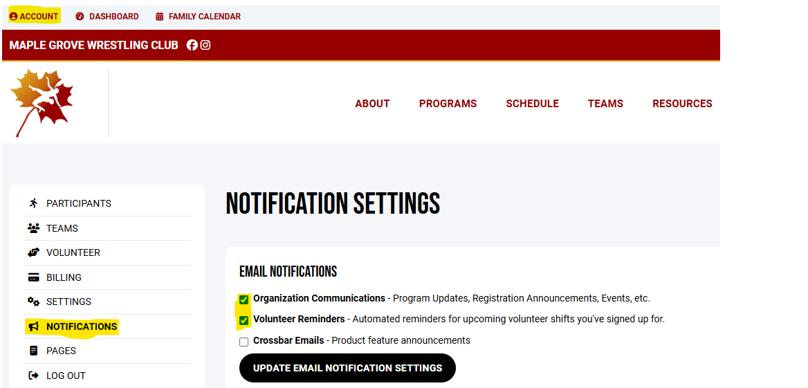
CROSSBAR
DON’T MISS INFORMATION
  Adjust your settings in your profile so you stay connected throughout the season.
  Register your athlete if you haven’t already
  Communicate schedule conflicts to Coach Troy and your assigned personal coach directly (not the Team app)
Email Notifications
Schedule
www.crimson-wrestling.com

Slide 21
HELLO TEAM
Communication from Coaches to athletes
www.crimson-wrestling.com

Slide 22
VOLUNTEER OPPORTUNITIES
No experience needed
Sign up Genius posted on website to find a shift!
  11/30 MG Youth Tournament
  12/12 Girls & JV dual tournament
  12/13 MG tournament- All wrestlers
  Concessions for home duals– Connect with Chris for shift opportunities

Slide 23
KEY WRESTLING EVENT DATES
First Tournament of the year (Need Weight Certifications by 11.26 in order to compete) - 11.29.25 at Minnetonka
MG Youth Tournament FUNDRAISER: 11.30.25
Youth Night: 12.4.25
MG Girls Tournament and JV Duals: 12.12.25
MG HS Individual Tournament: 12.13.25
Redwood Riot (Out of Town Tournament): 12.19.25 - 12.20.25
9th Grade Team State: 1.17.26
9th Grade Individual Sections: 1.24.26
9th Grade Individual State: 1.31.26
Girls Individual Sections: 2.6.26 - 2.7.26
Boys Team Sections: 2.13.26
Boys Individual Sections: 2.21.26
STATE TOURNAMENT: 2.25.26 - 2.28.26
As always, please be mindful as we head into winter, if your athlete is sick/contagious, please keep them home.
If you notice anything from skin perspective, reach out to a coach and ask!
Parent FAQ Resource Guide on the website- Under Resources for Parents
Practice and other Fun events will be posted on CrossBar App
**Will be used to communicate (via Chat function) any changes to schedule which may happen last minute (weather, etc) **

Slide 24
SEASON KEY DATES
EQUIPMENT CHECK-OUT - Nov 17th. Need to register prior to this date.
First Day of Practice: Mon. 11.17.25
Parent/Wrestler Kick off Potluck: 11.22.25 after practice in the MGSH Cafeteria
Weigh-in Certifications start: 11.17.25 - 11.19.25
Team Pictures: 11.24.25
Optional Thanksgiving Day Football Game (Alumni vs Current): 11.27.25
Alumni Night: 1.15.26
Parent/Senior Night: TBD
Teacher Appreciation Night: TBD
Family Socials:
  Mom’s Day Out: Bingo at Pints and Paddles 11.18.25
  Dad’s Night Out: TBD
  Parent’s Night Out w/Youth parents: TBD
Equipment Check In: 3.3.26.
End of Year Banquet: 3.16 at the Wellstead in Rogers
As always, please be mindful as we head into winter, if your athlete is sick/contagious, please keep them home.
If you notice anything from skin perspective, reach out to a coach and ask!
Parent FAQ Resource Guide on the website- Under Resources for Parents
NON- WRESTLING EVENTS

Slide 25


Crimson Wrestling Social Media
Website: www.crimson-wrestling.com
Offseason Wrestling Opportunities: www.crimson-wrestling.com
Facebook: Maple Grove High School Wrestling
Instagram: maplegrovewrestling
Email: info@crimson-wrestling.com

Slide 26
WRAP-UP
THANKS FOR COMING!

Slide 27

Any questions?
Specific situational questions I can answer after the meeting

