Slide 1


MAPLE GROVE WRESTLING CLUB
Wrestling Basics &
Tournament Essentials
Ryan Bielat
November 19, 2025

Slide 2
Objectives
Wrestling Styles
Gear
Match Basics
Tournaments
MN State Tournament
Odds & Ends
Wrap Up

Slide 3
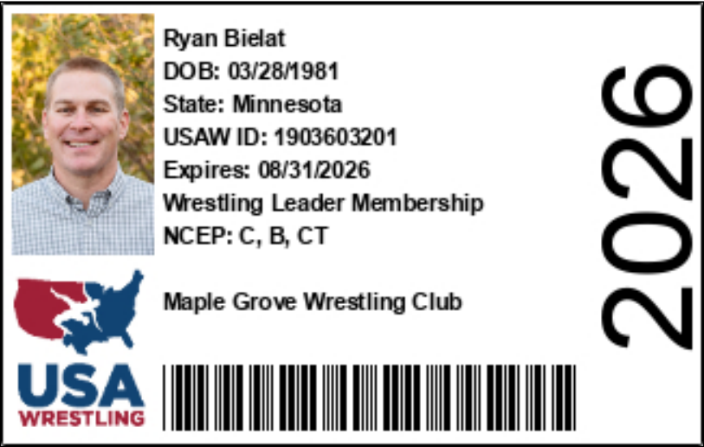
MN/USA Wrestling https://www.mnusawrestling.org/
One of the sanctioning bodies for amateur wrestling in Minnesota
MGWC is an affiliate club of MN/USA Wrestling
Certain tournaments require an annual USA Wrestling membership (also called a MN/USA card)
You may have purchased a MN/USA card with your MGWC registration (talk to me if you’re not sure or need help)
A MN/USA card can also be purchased at any time at https://www.usawmembership.com/
Our coaches are background-checked, trained, and certified through MN/USA Wrestling
Concussion training is available to members

Slide 4
Styles of Wrestling
Freestyle
Focuses on takedowns and back exposure
Greco Roman
Similar to freestyle except legs are off-limits
Folkstyle
More focus on mat wrestling
Freestyle and GR are considered “international” or “Olympic” styles.
Folkstyle is wrestled almost exclusively in the US (high school and collegiate). It’s MGWC’s focus for the winter season.

Slide 5
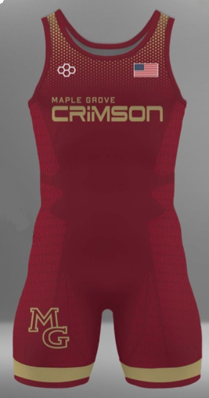
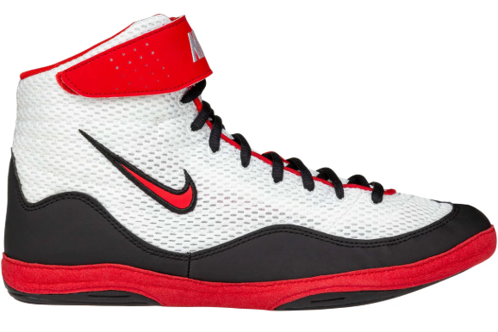
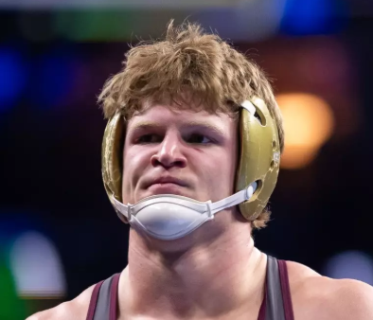
Gear/Uniforms
Wrestling shoes
Headgear (not required for youth)
Shirt & shorts for practice
Singlet or fight shorts/compression shirt for competitions
Tournaments frequently have gear vendors

Slide 6
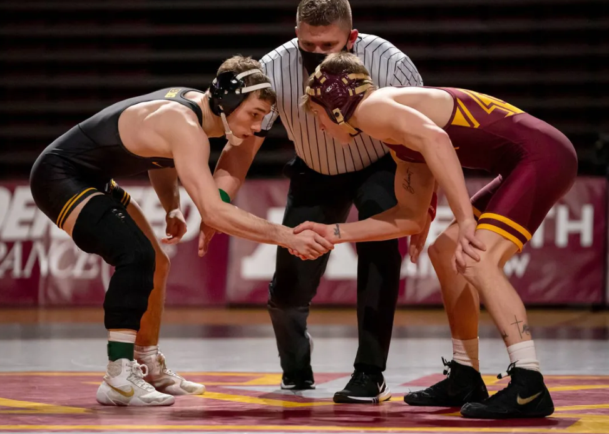
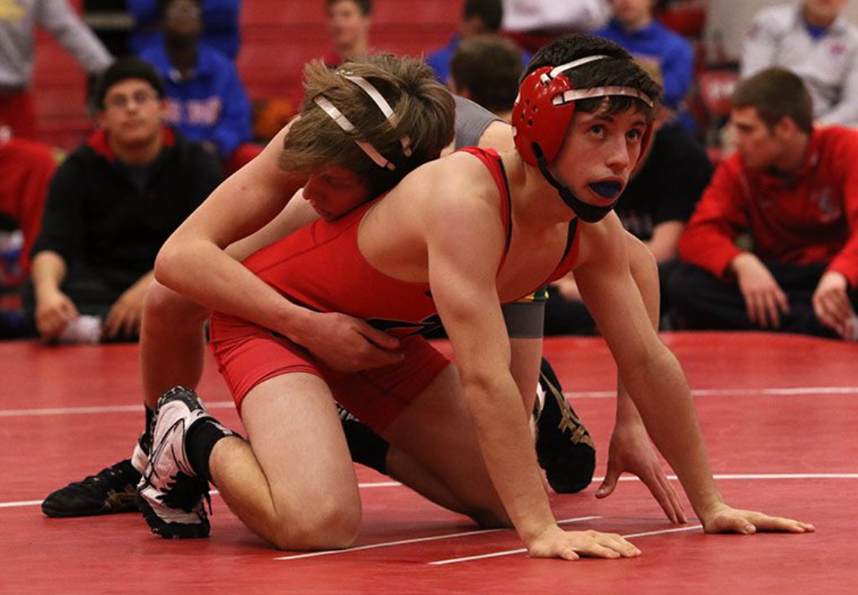
A Wrestling Match
Three periods: Normally 1:00 or 1:30 for youth, depending on age
  1st period – Both wrestlers begin on their feet (neutral position)
  2nd period – One wrestler has choice (top, bottom, neutral, or defer)
  3rd period – The other wrestler has choice (top, bottom, or neutral)
  Sudden victory overtime, if needed
Neutral Position
Referee’s Position

Slide 7
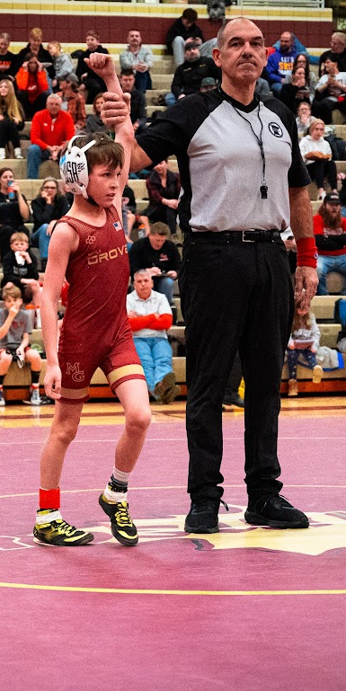
Scoring a match
In folkstyle wrestling, there are basically 5 ways to score:
  Takedown (3 pts): from neutral, a wrestler gains control of the opponent on the mat
  Escape (1 pt): from the bottom position, a wrestler gains the neutral position
  Reversal (2 pts): from the bottom position, a wrestler gains top position over the opponent
  Nearfall (2, 3 or 4 pts): from the top position, a wrestler exposes the opponent’s back/shoulder blades to the mat—scored once the hold is released
  Penalty (1+ pts): illegal holds, unsportsmanlike, stalling—sometimes warnings are issued
Scores are awarded by referee. The referee’s green/red wrist bands correspond to green/red ankle bands that the wrestlers wear.
Types of victories
Decision: win by 1-7 pts
Major Decision: win by 8-14 pts
Technical Fall: win by 15 pts (match is stopped)
Fall (aka Pin): opponents shoulder blades are “pinned” to the mat (match is stopped)

Slide 8
Tournaments: Individual vs. Dual Team
Individual
  Your wrestler is bracketed with 3 wrestlers of similar age/weight
  All 4 wrestlers will wrestle a match against each other
  Awards are given after all matches complete
Dual Team
  Our team full lineup wrestles other teams (K-3 or K-6)
  Coaches determine the team lineup through discretion and “wrestle-offs”
  Team points are awarded based on results of individual match results (3 pts for decision, 4 pts for major decision, 5 pts for tech fall, 6 pts for fall/forfeit)
  This is the type of match you often see at the high school and collegiate level

Slide 9
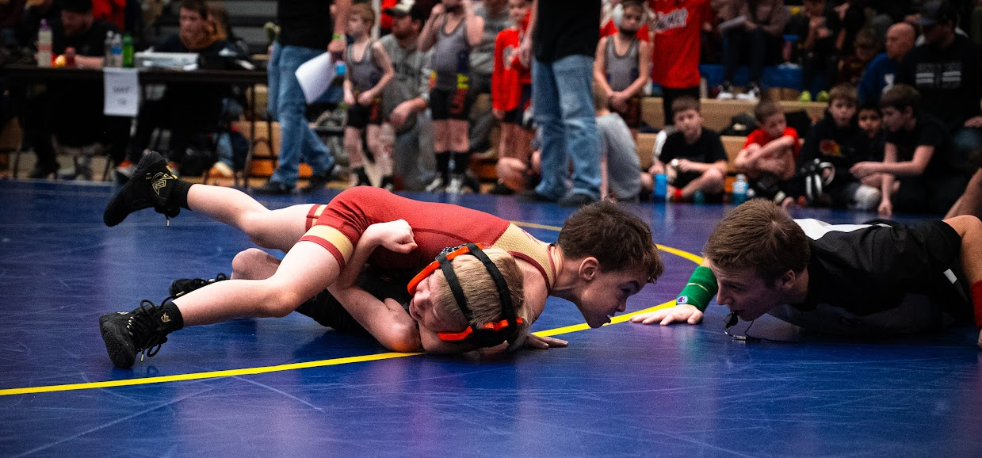
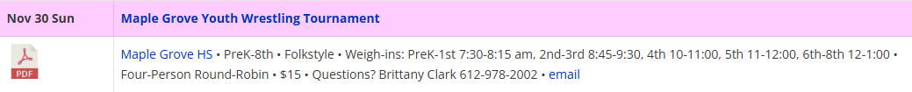
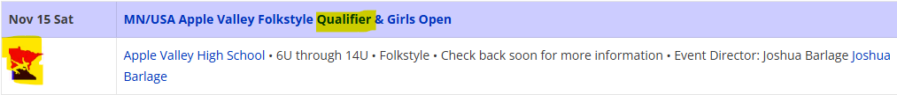
Individual Tournaments
Open Tournament
  No MN/USA membership required
  Often same-day registration/weigh-ins
  Often will pair by grade in school
  Often will try to pair by experience level
  Often use paper bracketing
MN/USA Qualifier Tournament
  Must have a MN/USA membership
  Must pre-register, honor system weights
  Use MN/USA age groups
  Wrestlers accumulate qualifying points for regional/state tournaments
  Online bracketing
  Generally stiffer competition
Age | Group | Birth Years
6U | Pee Wee | 2020-2021
8U | Bantam | 2018-2019
10U | Intermediate | 2016-2017
12U | Novice | 2014-2015
14U | Schoolboy/girl | 2012-2013

Slide 10
Let’s Wrestle!
Find a tournament
  The Guillotine: https://theguillotine.com/open-tournament-calendar/
  We’ll communicate where coaches/others will be via Crossbar and weekly e-mails
Pre-register, if required
Check-in
  Skin checks
  Weigh in, if required
Pay attention for your wrestler to be called to staging or to a mat
  Could be announced (e.g. all 3rd graders report to staging)
  MN/USA Qualifiers and some other tournaments are run on https://www.usabracketing.com/ (brackets/mat assignments are
  released shortly before the session begins)

Slide 11
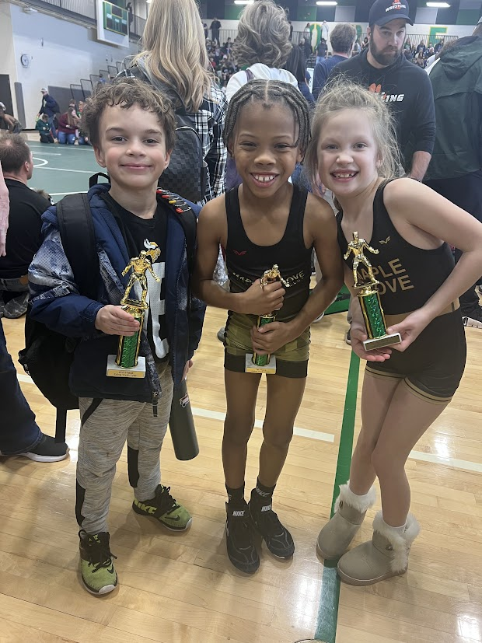
Let’s Wrestle! (continued)
Feel free to stick with your wrestler the entire time
Find and support other MGWC families (Crossbar chat)
Find a coach when your wrestler is up (Crossbar, text, etc.)
  It’s common to start with the youngest wrestlers, but that’s not always the case
  We’ll do our best to have a coach there for your wrestler, but don’t panic if you can’t find a coach
When your wrestler’s bracket is complete, head to awards with the other wrestlers from your bracket
Highly recommend connecting with an experienced family or two for your first tournament(s). Ask any board member or coach if you need a suggestion.

Slide 12
Qualifying for Regionals and State
Points are assigned based on results at MN/USA qualifier tournaments
  1st = 40 pts
  2nd = 25 pts
  3rd = 10 pts
  4th = 0 pts
Requirements are based on age:
 | 6U & 8U | 10U & 12U | 14U | Girls
Need 30 points accumulated from MN/USA Qualifier tournaments | Yes | Yes | No | No
Must register and compete at Regional | No | Yes | Yes | No
Must place top 4 in a Regional to qualify for State | No | Yes | Yes | No

Slide 13
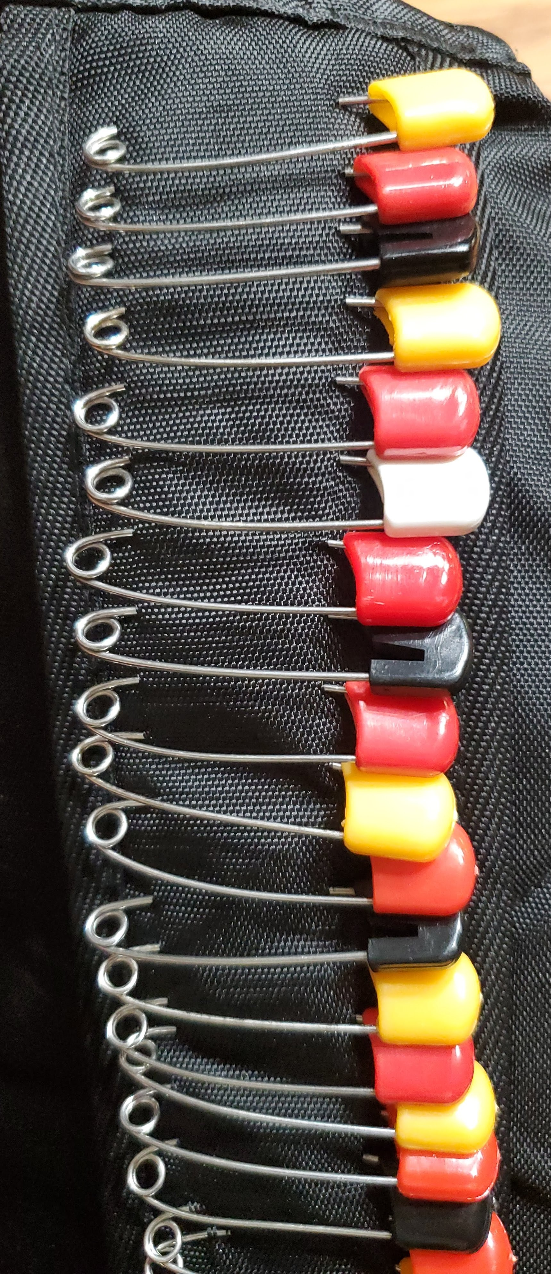
Odds & Ends
Our focus is on open tournaments early in the year. As we get into the new year, the focus will shift more to MN/USA qualifiers, regionals, and state.
USA Bracketing: Some tournaments (mainly MN/USA qualifiers) are run through USAbracketing.com. You must create an account to use this system. Ask for help--we’re here for you!
The chat function in Crossbar is your friend.
If you need help with MN/USA membership, tournament registrations, USA Bracketing, etc, you’re not alone. Reach out in person, via Crossbar, or email the club: mgwrestlingclub@gmail.com

Slide 14
Wrap up comments
Wrestling is difficult—be supportive! Let our coaches coach.
Wrestling is an emotional rollercoaster. Be prepared to see lots of tears at tournaments.
We’re here to grow the sport. Please reach out if you need anything.
Get involved! Even if you’re new to wrestling, your help is needed. A willingness to learn is all that is needed.
Please submit your DIBS checks and sign up to volunteer!
THANK YOU FOR YOUR CONTINUED SUPPORT!

