Slide 1

Girls Hockey
Growing Girls Hockey
Officiating
Michelle Lichterman
2022-2023 Girls Committee Educational Tutorials

Slide 2


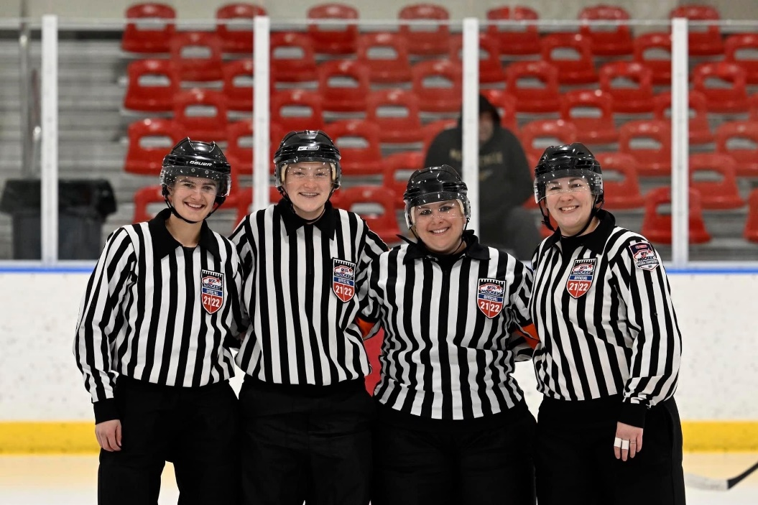
About Me
Started in 2002
Mentor
Supervisor/Evaluator
Certified Seminar Instructor
  2019 – Lake Placid
Accomplishments
  National Tournament 2013
  National Tournament 2022
Why do I love it?

Slide 3
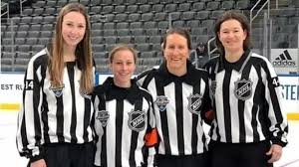
Why officiate?
Earn extra money
Start learning responsibility
College job
Meet new people – grow network
More ice time
  Improve skating skills
Learn life skills
  Communication
  Commitment
  Building relationships

Slide 4
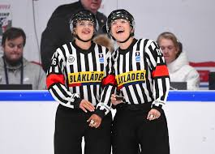
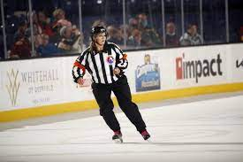
Where can this take you?
All over the world
IIHF
NCAA/NCHA
ECHL/AHL
Olympics

Slide 5


How Do I Sign Up?
Register with USAH as an official
Visit IHOA.com to register for seminar
Complete all certification requirements

Slide 6
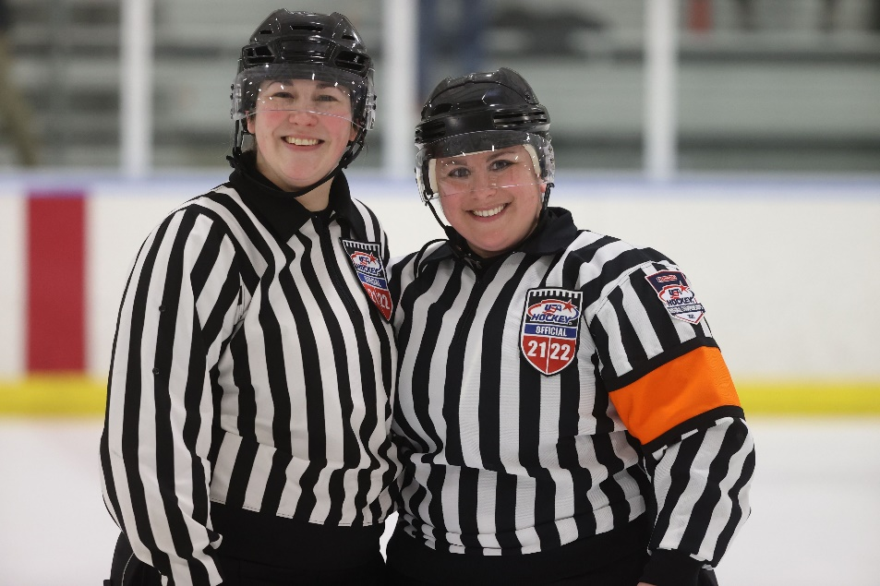
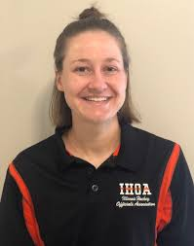
More Information
Michelle Lichterman
  C: 224-465-4378
  E: girlsbhc@ahai2.org
Samantha Cebulski
  C: 630-456-6621
  E: sgcebulski@gmail.com
Erika Greenen
  C: 630-301-2189
  E: egreenen3@gmail.com

Slide 7

AHAI Girls Committee
Thank you!

