Slide 1

Girls Hockey
Growing Girls Hockey
Sports Nutrition: Everyday Fueling
Tavierney Rogan MS, RD, CSSD
2022-2023 Girls Committee Educational Tutorials

Slide 2
Introduction
Tavierney Rogan MS, RD, LDN
  BS in Biology at Saint Mary’s College, Notre Dame, IN
  MS in Nutrition at Boston University, Boston MA
  Worked for Northwestern University Athletics
  Work with athletes from endurance athletes to MMA to Olympic hopefuls
Played fastpitch softball for 10 years
  4 years on Varsity at New Trier
Retired endurance runner
  Chicago Marathon x 1, Half Marathon x 5)
Love to lift and do yoga!

Slide 3
Overview
Why Fuel?
Macronutrients 101
Hydration
“Build Your Balanced Plate”
The 80:20 Rule

Slide 4
WHY FUEL?
Why Do You Practice/Train?
  Get better
  Become stronger, faster, more powerful
  Prevent injuries
Why Fuel?
  Get better
  Become stronger, faster, more powerful
  Prevent injuries

Slide 5
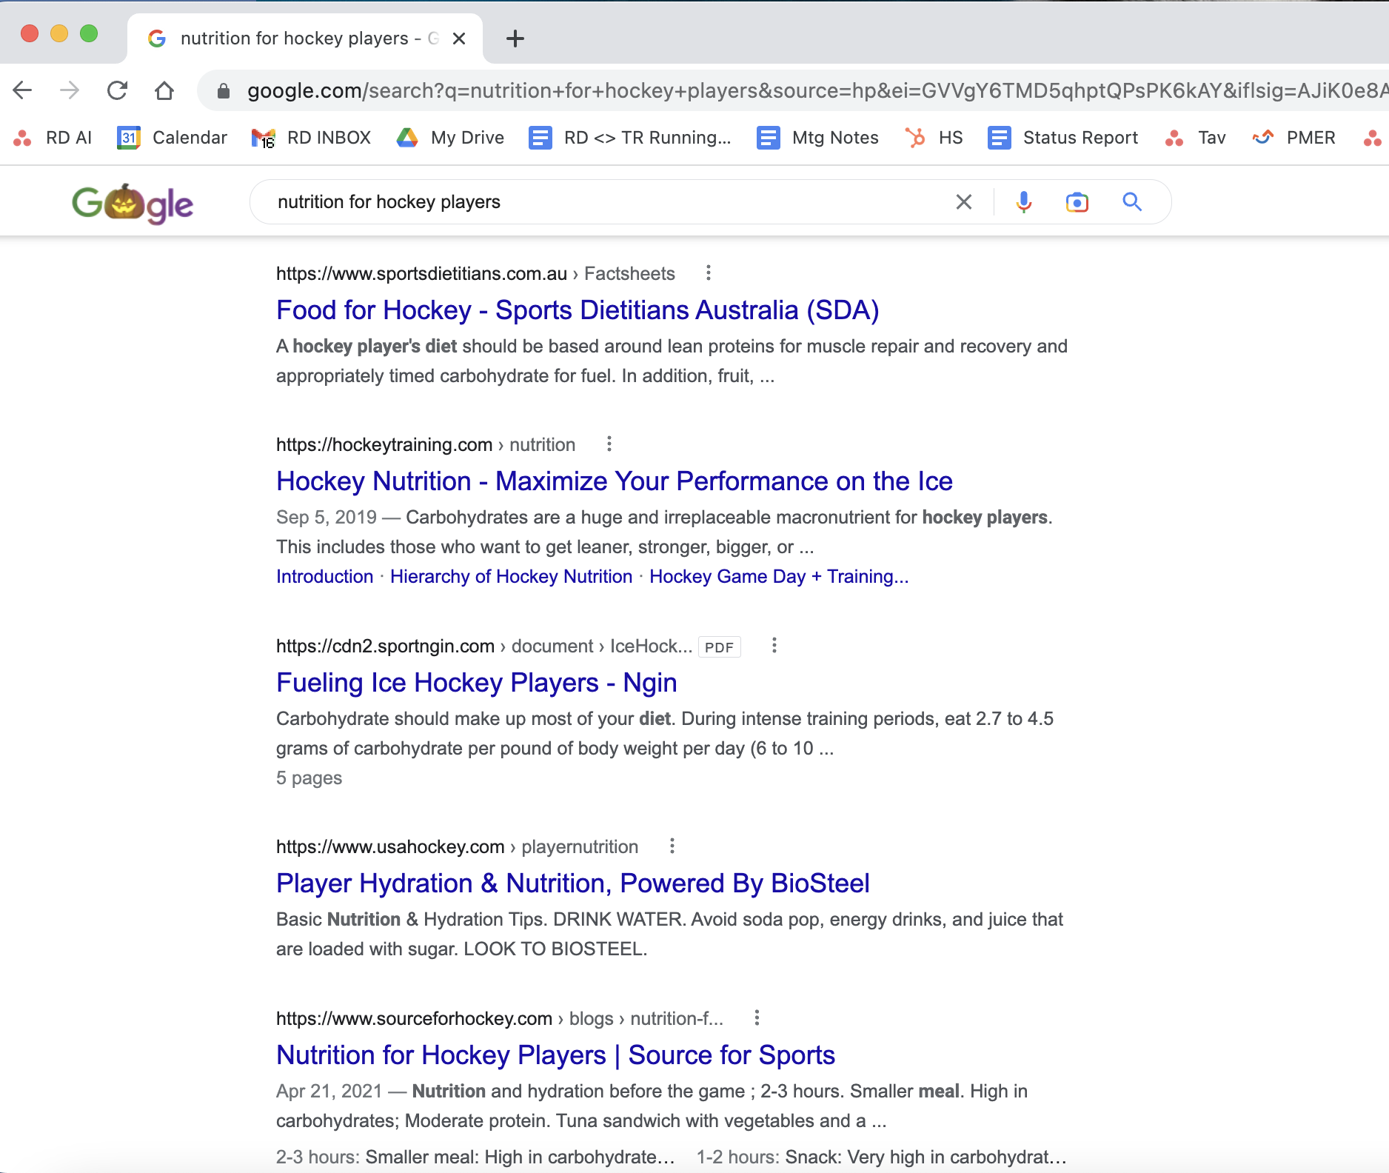
ESPECIALLY IMPORTANT FOR HOCKEY PLAYERS!!!

Slide 6
Macronutrients

Slide 7
Carbohydrates
Three types of carbohydrates:
  Sugar
    Simple→ made from 1-2 sugar units
    Found naturally in fruits, vegetables, milk and milk products.
    Added to processed foods.
  Starch
    Complex carbohydrate→ made from several sugar units
    Occurs naturally in vegetables, grains, and legumes.
  Fiber
    Complex carbohydrate.
    Occurs naturally in fruits, vegetables, whole grains, and legumes.
    The body cannot digest fiber completely

Slide 8
Carbohydrates
Main Fuel Source!!!!!!
Sugars + Starches → Glucose
Glucose is absorbed into your bloodstream then into cells for use by the body
Leftover glucose is stored in the liver and muscles as Glycogen → Energy available for later use
Your body depends on glucose/glycogen for EVERYTHING→ from walking, to digesting food, to breathing, to thinking, to…....
Notes:
Your body uses carbohydrates as its main fuel sources. All sugars and starches are broken down to glucose

Slide 9

Carbohydrates
Eat Carbs → Increase Performance!!!!
  Inadequate carb intake→ premature fatigue, muscle catabolism, and poor recovery
  Also provide a ton of vitamins, minerals, + antioxidants
When fueled properly, athletes get energy from:
  Blood Glucose (what you’ve eaten 1-2 hours before)
  Glycogen Stores (what you’ve eaten 3+ hours before)
How do you fuel properly?
  Eat complex and simple carbs at every meal and snack
  Especially before and after training/competition
Empty Glycogen Stores!!!

Slide 10
Carbohydrates
Potatoes
Whole grains
  Brown/Wild rice
  Quinoa
  Oatmeal
  Couscous
Air Popped Popcorn
Whole grain cereals
Chocolate Milk
Frozen, fresh, dried fruit
100% Fruit Juice
Fruit Smoothies
Granola + granola bars
Fig bars
Sports drinks and chews
Starchy Vegetables (corn, peas, squash)
Yogurt
  Legumes
    Beans, lentils, peas
  100% Whole Wheat
    Bread
    Crackers
    Pasta
    Tortillas
    English muffins
    Bagels

Slide 11
Protein
Several amino acids bonded together
FUNCTIONS:
  Those important to athletes:
    Provide structure to cells and the body
    Building blocks of muscle
    Support the structure of bones
    Contract muscles
Protein foods are typically good sources of B Vitamins, zinc, calcium, and iron

Slide 12
Protein
Protein Needs for Athletes
  Training creates stress on the body→ breaks down muscle and other tissues (ligaments, tendons etc.)
  Dietary protein repairs, maintains current, and helps build new muscle tissue:
    Increases strength, power, and speed
    Prevent injury
  Added Bonuses….
    Keeps you satiated
    Muscle increases metabolism

Slide 13
Protein
Chicken (grilled, baked, roasted, rotisserie, canned)
Chicken and turkey sausage
Lunch meat (chicken, turkey, roast beef, ham)
Lean ground turkey and beef
Fish
Lean cuts of steak
Tofu
Tempeh
Greek yogurt
Cottage cheese
Fairlife Milk
Beans and lentils
Edamame
Cheese
Nuts and nut butter
Eggs and egg whites
Soy Milk

Slide 14
Fat
Fats are an important part of a healthy, balanced diet.
FUNCTION:
  Provide taste and satiety
  Help with vitamin absorption
  Important for cell and heart health
Not all fats are created equal
  4 Types of fats

Slide 15
Fat
MUFAs (Monounsaturated Fatty Acids)
  Vegetable oils, nuts, seeds, olives and avocadoes.
  We want to increase these!!
PUFAS (Polyunsaturated Fatty Acids)
  Vegetable oils, fish and seafood.
  Omega 6s→ we already get a lot of these from canola oil
  Omega 3s→ We want to increase these….

Slide 16
Fat
Omega 3s
  Necessary for proper brain growth and development.
  Anti-inflammatory→ important for recovery from training, practice, and competition
  Important for the prevention and treatment of depression, heart disease, and cancer
  Found in fatty fish (salmon and sardines), walnuts, flax seeds, and chia seeds

Slide 17
Fat
Saturated Fat
  Found in animal foods like meat, and dairy products, like butter and cheese.
  We want to eat a low to moderate amount of these!
Trans Fats
  Liquid vegetable oils that have been chemically processed to become semisolid at room temperature
  Used in some margarines, fried foods, and process snack foods
  We want to avoid these!

Slide 18
Fat
Olive Oil/Olives
Coconut Oil/Full Fat Coconut milk
Nuts
Seeds
Avocado/Guacamole/Avocado Oil
Vinaigrettes
Fatty Fish
Cheese
Sour cream
Butter
Creamy dressings
Full fat dairy
Animal meat

Slide 19
Hydration

Slide 20
Hydration
60-75% of your body weight is water
Hydration is important for performance and overall health
Hydration Goals:
  Delay fatigue and maintain mental acuity
  Regulate body heat, especially in hot environments
  Satisfy thirst and prevent significant weight loss from sweating
  Improve ability to recover quickly from training and competition
  Drink 0.5-1 oz per pound body weight

Slide 21
Hydration
How to Drink More Fluid
  Track your intake using an App (Hydrate is a good one)
  Use a marked water bottle and mark down time goals
  Make it taste good→ Add frozen or fresh produce
    Berries, lemons, limes, melon
    Cucumber
  Drink at least 1 cup of fluid with every meal and snack
  Count your cups during a game/practice
  Never let your water bottle be empty

Slide 22
Build your balanced plate

Slide 23
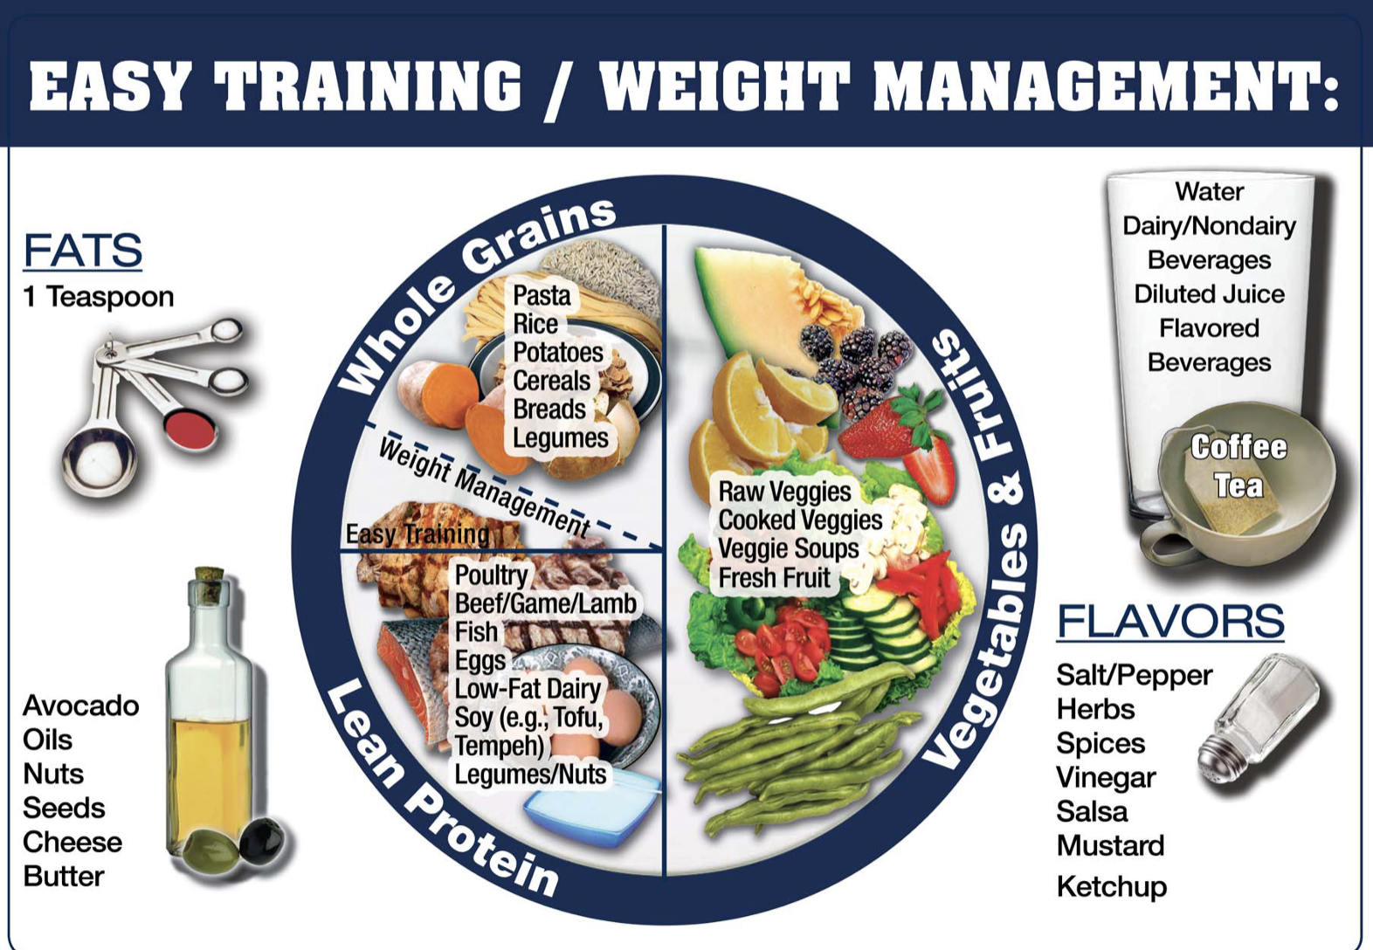
Build your balanced Plate
Light Training Day → Active Rest or Rest Day
  50% Fruits & Vegetables
    Full of vitamins, minerals, and antioxidants
    Vital to recovery from workouts, practices, and competition
  25% Complex Carbohydrates
  25% Lean Protein
  + Healthy Fats
  + Hydration

Slide 24
Build your balanced plate
Moderate Training Day → 1 Hard Workout
  25% Lean Protein (this stays consistent)
  Split the rest of the plate
    Complex Carbohydrates→ increased carbohydrate and energy needs throughout the day
    Fruits & Vegetables→ for recovery
  + Healthy Fats
  + Hydration

Slide 25
Build your balanced plate
Heavy Training/Competition Day → 2+ Workouts
  50% Complex Carbohydrates→ keep your glycogen stores topped off
  25% Fruits & Vegetables→ recovery
  25% Lean Protein (this stays consistent)
  + Healthy Fats
  + Hydration

Slide 26
80:20 rule

Slide 27
The 80:20 Rule
Healthy is a lifestyle, not a diet
DIETS DON’T WORK
Athletes need nutritious food…. but not 100% of the time
80%→ whole, natural, and nutrient dense foods
20%→ indulge in moderation, in whatever you want!!!
Food is meant to be Fuel AND Fun

