Slide 1


Denison 2022/23 Game Philosophy

Slide 2
Main Objective:
Force teams to play in their Zone as much as possible.

Slide 3
Key Component:
The precision and effort level must be “Constant and Unrelenting”

Slide 4
Basic Concept-Forecheck F1
The first forward, F1, enters the zone with speed. He wants to get in on the defenseman, take away his lanes, hands, and establish physical contact. Heavy forecheck! .

Slide 5
F2
F2, is barely trailing F1 and ready to support the puck immediately. F1 is either trying to force a reverse quickly, so the other defenseman is forced to receive an awkward pass, or force the puck carrying defenseman to chip it up to the strongside winger on the wall where the winger will be covered by our sitting Strongside D

Slide 6
F2 cont. anticipates the most obvious first move of the opponent with the puck. Read-react and attack quickly, there are no wrong decisions, your backside support has 3rd and 4th outlets. Corral any loose pucks. Win all 50/50 battles.

Slide 7
F3, remains cognizant of his responsibilities as the "high" guy and his responsibility to be an offensive threat in the high slot. His duties rest on being support for the D during wall sit or weakside pinch, and establish immediate pressure in the middle on the other side of the ice once the puck is reversed behind the net. Also first shooter.

Slide 8
F3 Once this pressure is established, F3, who is always above the slot, can either cut off the winger on the strong side with speed on the backcheck, or wall sitting defenseman can be stick on stick with the winger and be covered by F3 (like a hinge i.e. 2-3) .

Slide 9
F3 If we lose the zone, he's cutting off the winger, F3 is looking to funnel the winger into his defender so that the defender will have an opportunity to step up in the neutral zone. The key here is that all the parts are moving together and every player is moving with speed when they go to their positions.

Slide 10
System built on trust!

Slide 11
This system is based heavily on trust. Forwards are able to commit fully to pressure, and defensemen are able to commit fully to pinches because of what the system allows. The third man high and a system that has a built-in speed component (where player's legs are always moving) allow pressure, and its accompanying support comes fast and heavy.

Slide 12
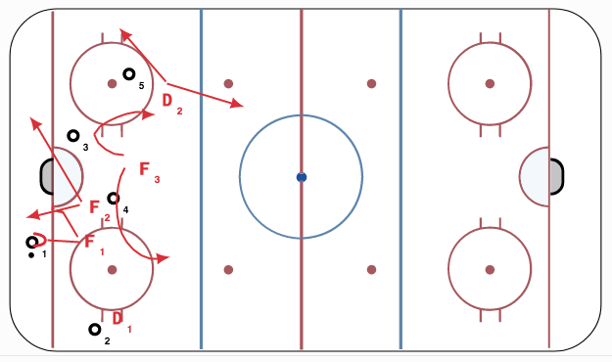
Basic Forecheck Structure

Slide 13
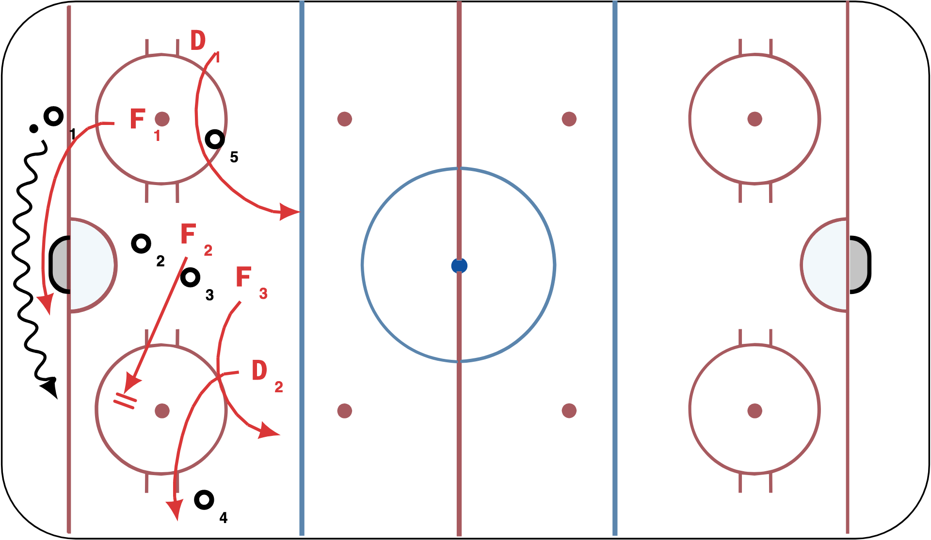
Wheel Route-Passive F2

Slide 14
Forecheck from possession

Slide 15
  Forwards
  Chip in when out numbered or we are changing-ALWAYS CHIP STRONG SIDE
  Same Side chip, two on puck (but not like a 2-1-2..be careful here).
    Forwards hunt their own puck. Don’t chip and watch!!!

Slide 16
  Sticks Take away next pass
  F1 Pursuit to create separation
  If they wheel, When the puck gets to the trapezoid, only one forward (F1) chases. The other (F2) plays passive. This is the only time we play passive is on a D wheel. F2 cut’s off their route so that one pass doesn’t beat two players.
  Stick on puck.

Slide 17
  Pressure D to D pass, F3 Takes away the middle pass
  Pressure and anticipate next obvious outlet. Especially F3 and Pinching D.
  Stick in the next lane!!!

Slide 18
  Defense
  Strongside Pinch (take 2nd pass) on boards (Either side pinch on D to D or Reverse)
  Pinch the puck not the man
  Strong puck side gap. Puck side D stay up tight
  Punch the puck back down
  If we lose the blue line, Defensive Dump back in Always to WEAK SIDE

Slide 19
Neutral Zone Forecheck..

Slide 20
  1-2-2 NZ All five guys working as one.
  Establish after we chip out from our D-zone
    F1 hard on Defense/stop opponent from setting up a counter
    Pressure D to D hard
    All 5 players up and into NZ fast
Lock guy is determined by whomever is in the middle when the first D to D pass is made. Once the lock is established, that player maintains middle lock. Force a dump in!

Slide 21
DZONE Philosophy

Slide 22
  Let 1 on 1 happen/if it’s not your guy, get away from the one on one and pick someone up
  Cut off top and bottom when puck is on the boards. Puck cannot go up the boards to the point man/Puck cannot reverse. NEVER.
  Winger and center switches if winger is 1st back

Slide 23
  Defense, box out if you have position on opponent and front pucks if opponent has position on you. Don’t turn your back to the puck!!!
  When puck goes to the top, play man on man = 5 one on ones
  Always exit through middle of the ice. No pucks on boards to chip and chase unless desperate.

Slide 24
  Dzone Exits

Slide 25
Defense - Low Support System. Wings will drop below hash marks when puck is below the goal line with possession and “swarm” to protect D when possession is won.

Slide 26
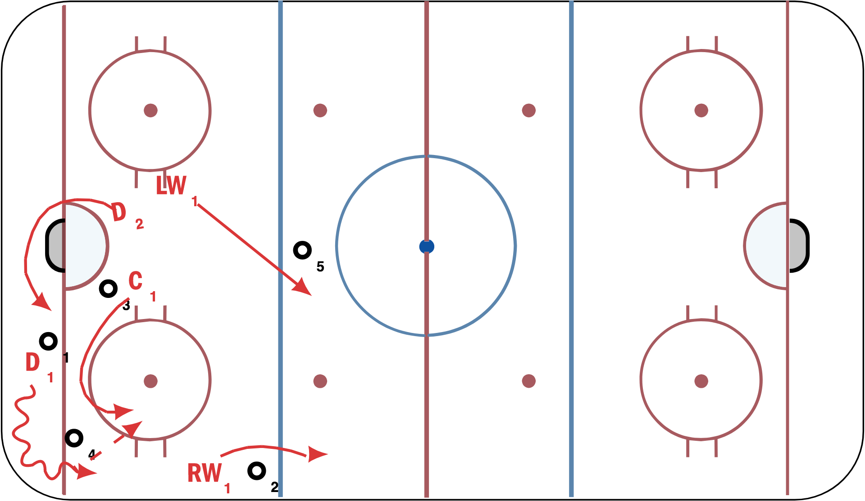

Slide 27
  3 back low on breakouts with close support.
  Create space/weakside winger splits the defensemen to create space. Send one and come out with 4.
  Weakside D joins rush every time.
  Low and slow for middle out.. Center can stay still for the middle out. Maintain front of net presence in case of turn over along the boards
  Note: On dump in exits, always have 4 back in the area of puck.

Slide 28
Counters, Regroups and ¾ ice game
  On a chip out, quick up to far side
  Forward fill 3 lanes quickly
  Weakside D Goes up
  Middle drive
  Only quick D to D
  If D Goes below own blue line, draw opponent down and trap them, then move it quick up to weakside stretch pass or D to D with stretch pass. Draw opponent down to the low circle.

Slide 29
With Possession, attack/Zone Entry
  Triple drive with 4 up Weakside D is late man/shooter
  Puck Carrier Outside with Speed/ Drive wide and low
  Middle lane drive always inside opponent weakside D
  Always attack with 4. 4th guy is always the trailer and shooter. DO NOT MISS THE NET. Must be first guy back if you do.
  Fill all 3 lanes
  Attack in waves with Tight turn delays and hit the late man

Slide 30
  If you gain the blue line. DO NOT DUMP. If they outnumber, then chip strongside and forecheck

Slide 31
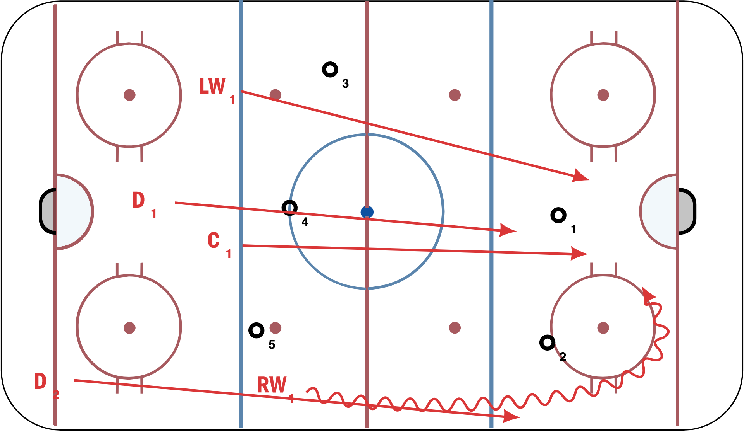

Slide 32
Offensive Zone Play
  2 man quick support.. F1 heavy, F2 very close to F1. read and react. Passive on a wheel.
  F3 shooter
  Quick (2 seconds) concise puck movement-NESN
    North to the net
    East/West on Possession
    South back to the D
    North back to the net. Keep repeating.

Slide 33
Offensive Zone Play
  Funnel pucks from low to high
  Constant movement in front of the net
  Rotate and force a switch
    F3 high
    F2 middle moving down
    F1 front of net moving out
    Strongside D on the wall
    Weakside D opposite side high with High Forward between

Slide 34
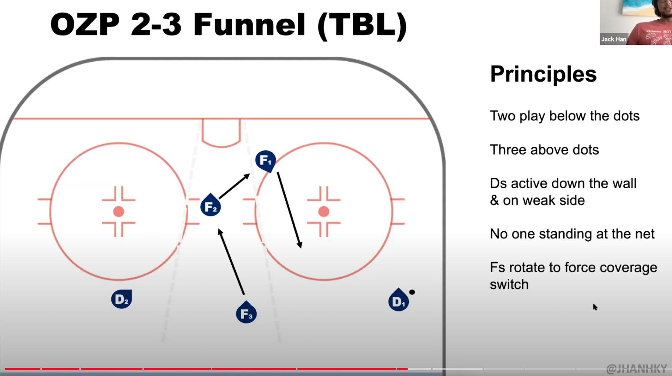
Denison OZ 1-1-3 Funnel

Slide 35
  Use both depth and width
  Cycle, and skate on the cycle. Two man cycle, third man is shooter
  Traffic in front of net before the shot..
  Every one v. one requires our guy to be the first second man.. Win the race
  Two on the cycle, third man shooter (again…still)
  Quick Decisions-Possession for 2 seconds or less-either move it or shoot it.
  Shoot, crash, kick rebounds outside and reload-NESN.

Slide 36
RANDOM KEY GAME POINTS!!!
  Track and Reload/ no gap between forwards and D. All 5 players on the same 40’ of ice. Come back hard. In other words, always play with 5 players within the puck zone.
  Backcheck Forwards-Five hard strides over top. Once puck is turned over, take 5 hard strides to catch play by center ice. Every player must transition to the backcheck every time.. NO GLIDING. Stay Above the puck and deflect, not below and chase.
  All five players on one half of ice (puck side)

Slide 37
RANDOM KEY GAME POINTS!!!
  Forwards chase all the way back
  Defense responsible 1 on 1 from our blue line back
  Dzone-Tracking forwards takes ladder, D-man takes tight turn (drop passes or cycles)
  Forwards responsible for all trailers
  Weakside D has middle drive. Engage physically
  Offensively-Attack in waves. Segmented attack, reload, attack again.

Slide 38
Seven Keys to Winning
  Attack
  Attack
  Attack
  Back-check
  Back-check
  Back-check
  We before Me

