Slide 1
Lateral Mobility (Dmen) at Blue Line
& Line Rush Against
https://www.nhl.com/video/bears-second-goal-of-the-period/t-309487934/c-69159003

Slide 2
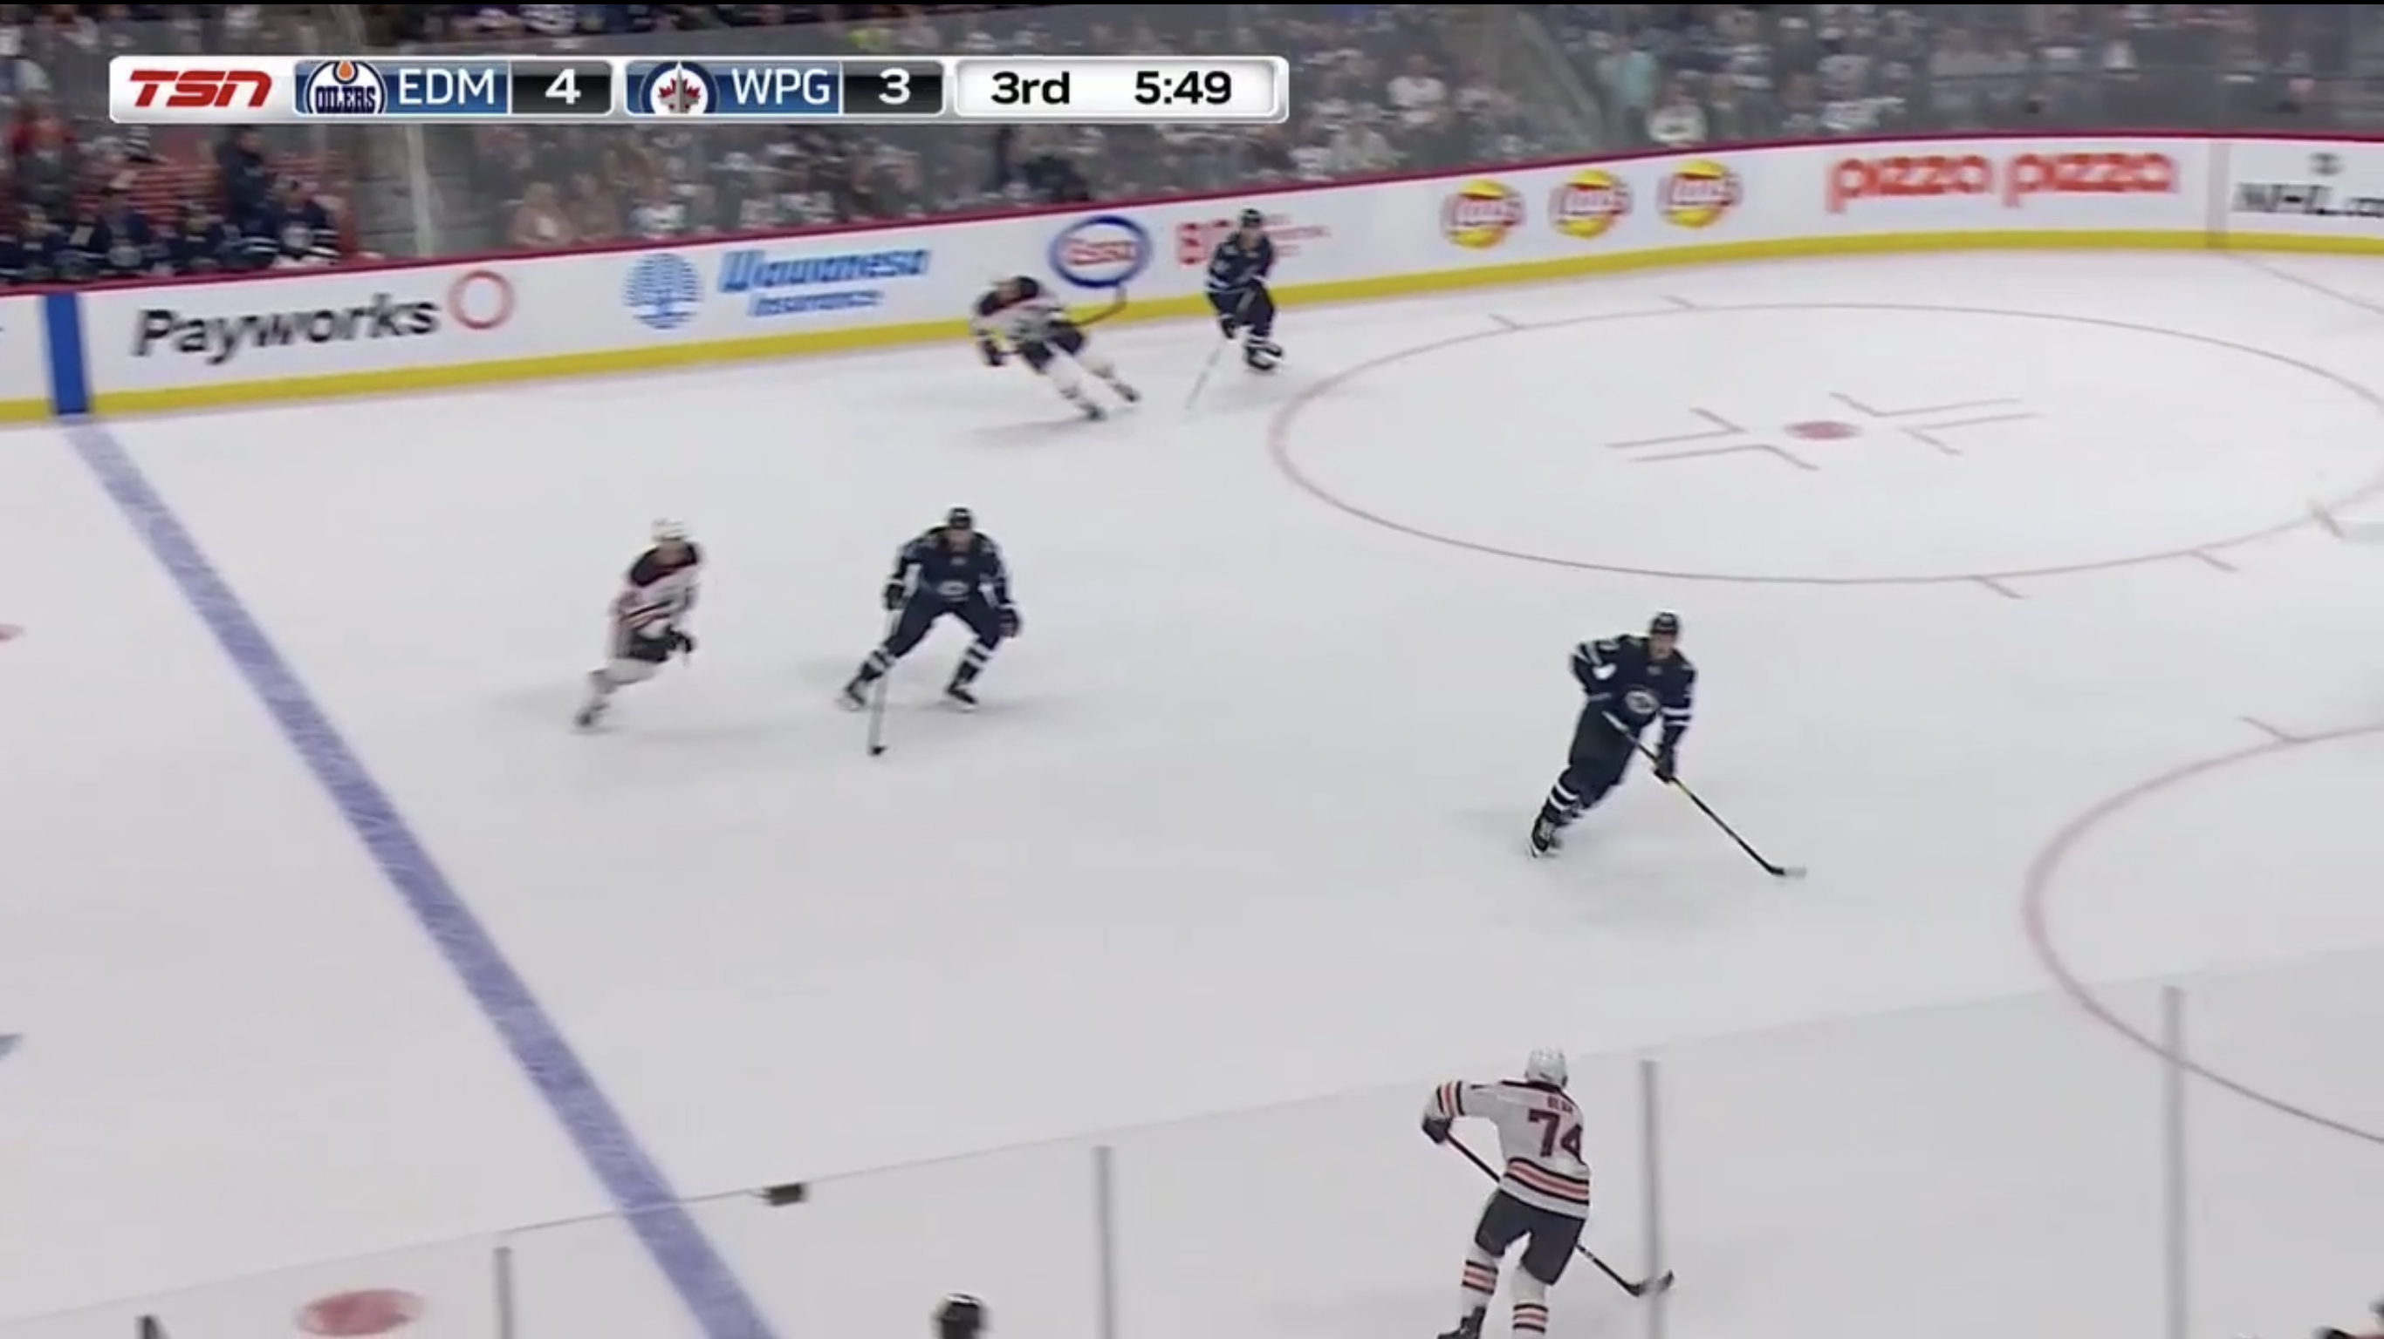

Slide 3
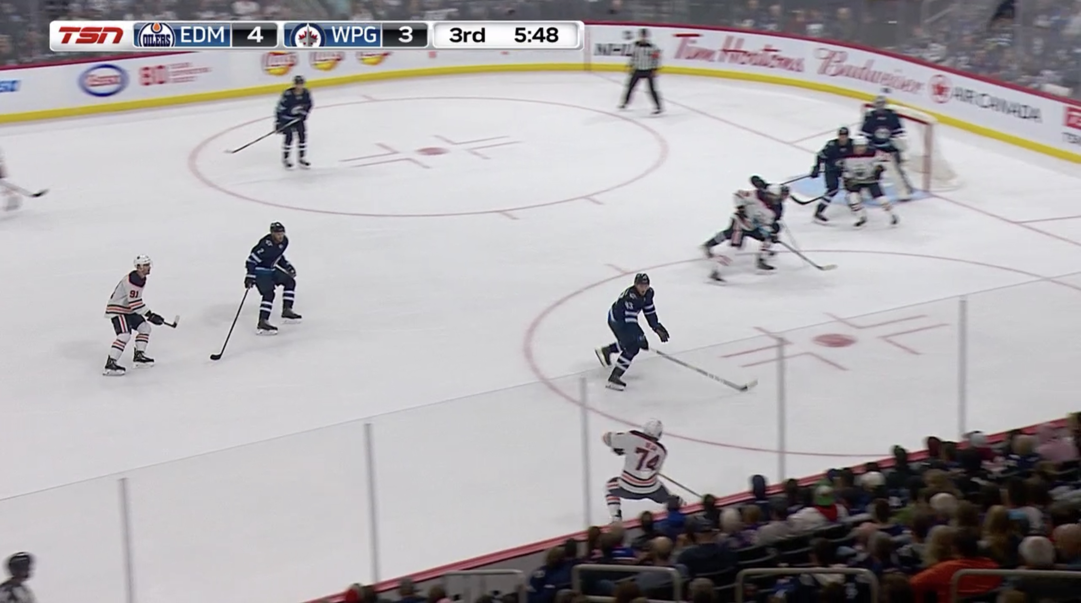

Slide 4
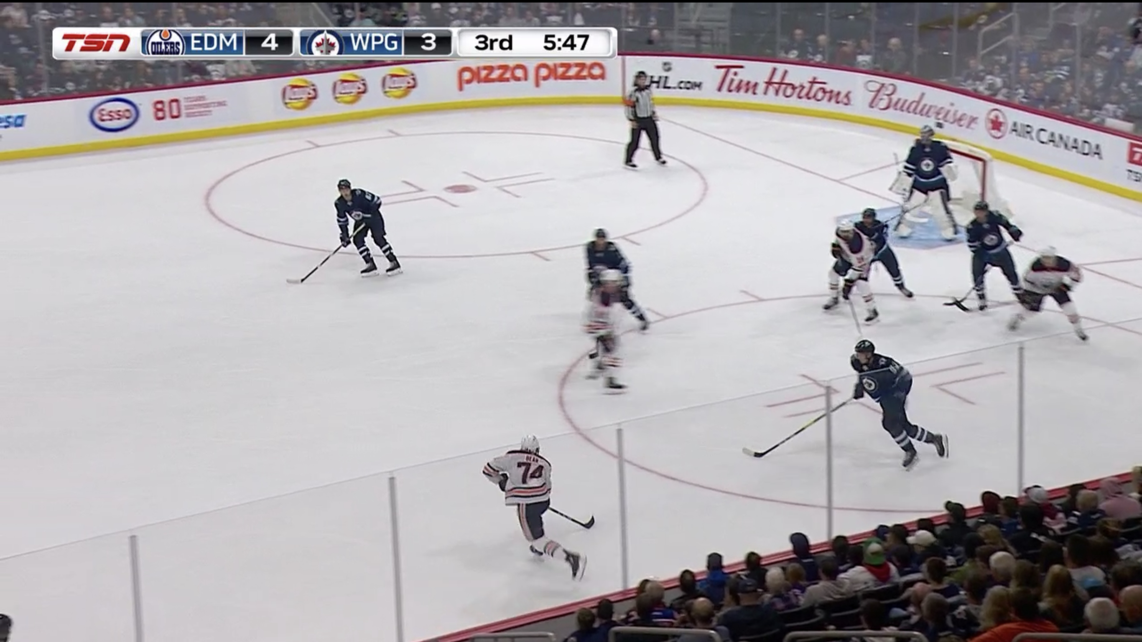

Slide 5
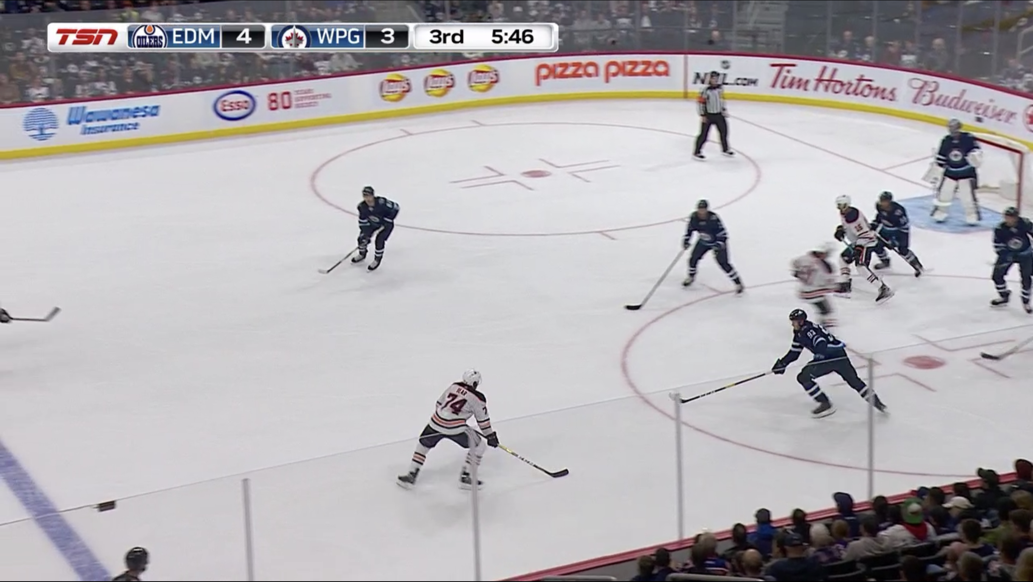

Slide 6
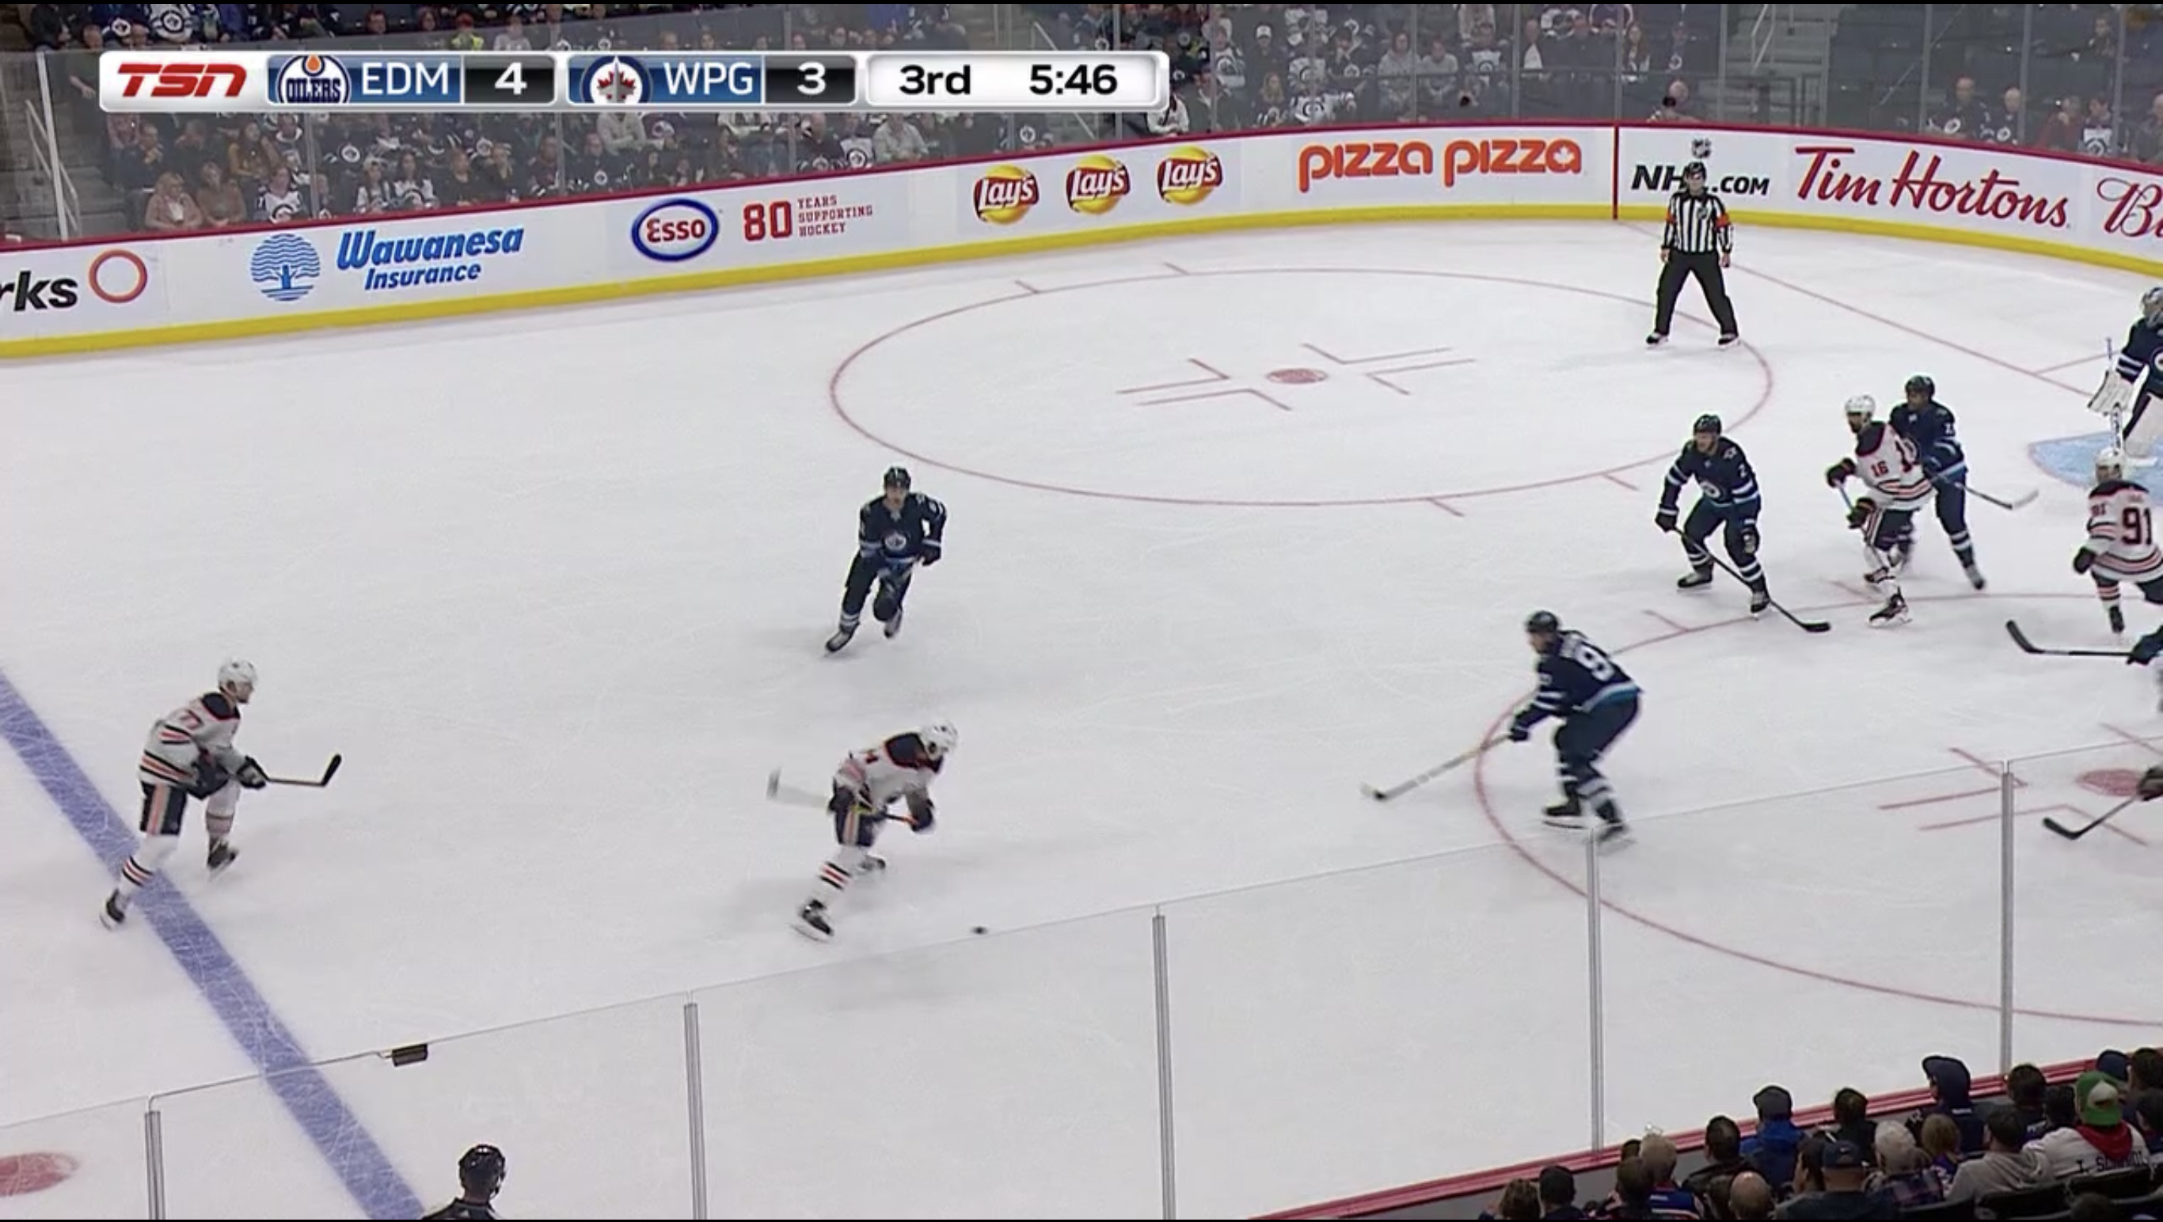
Notes:
https://www.nhl.com/video/bears-second-goal-of-the-period/t-309487934/c-69159003

Slide 7
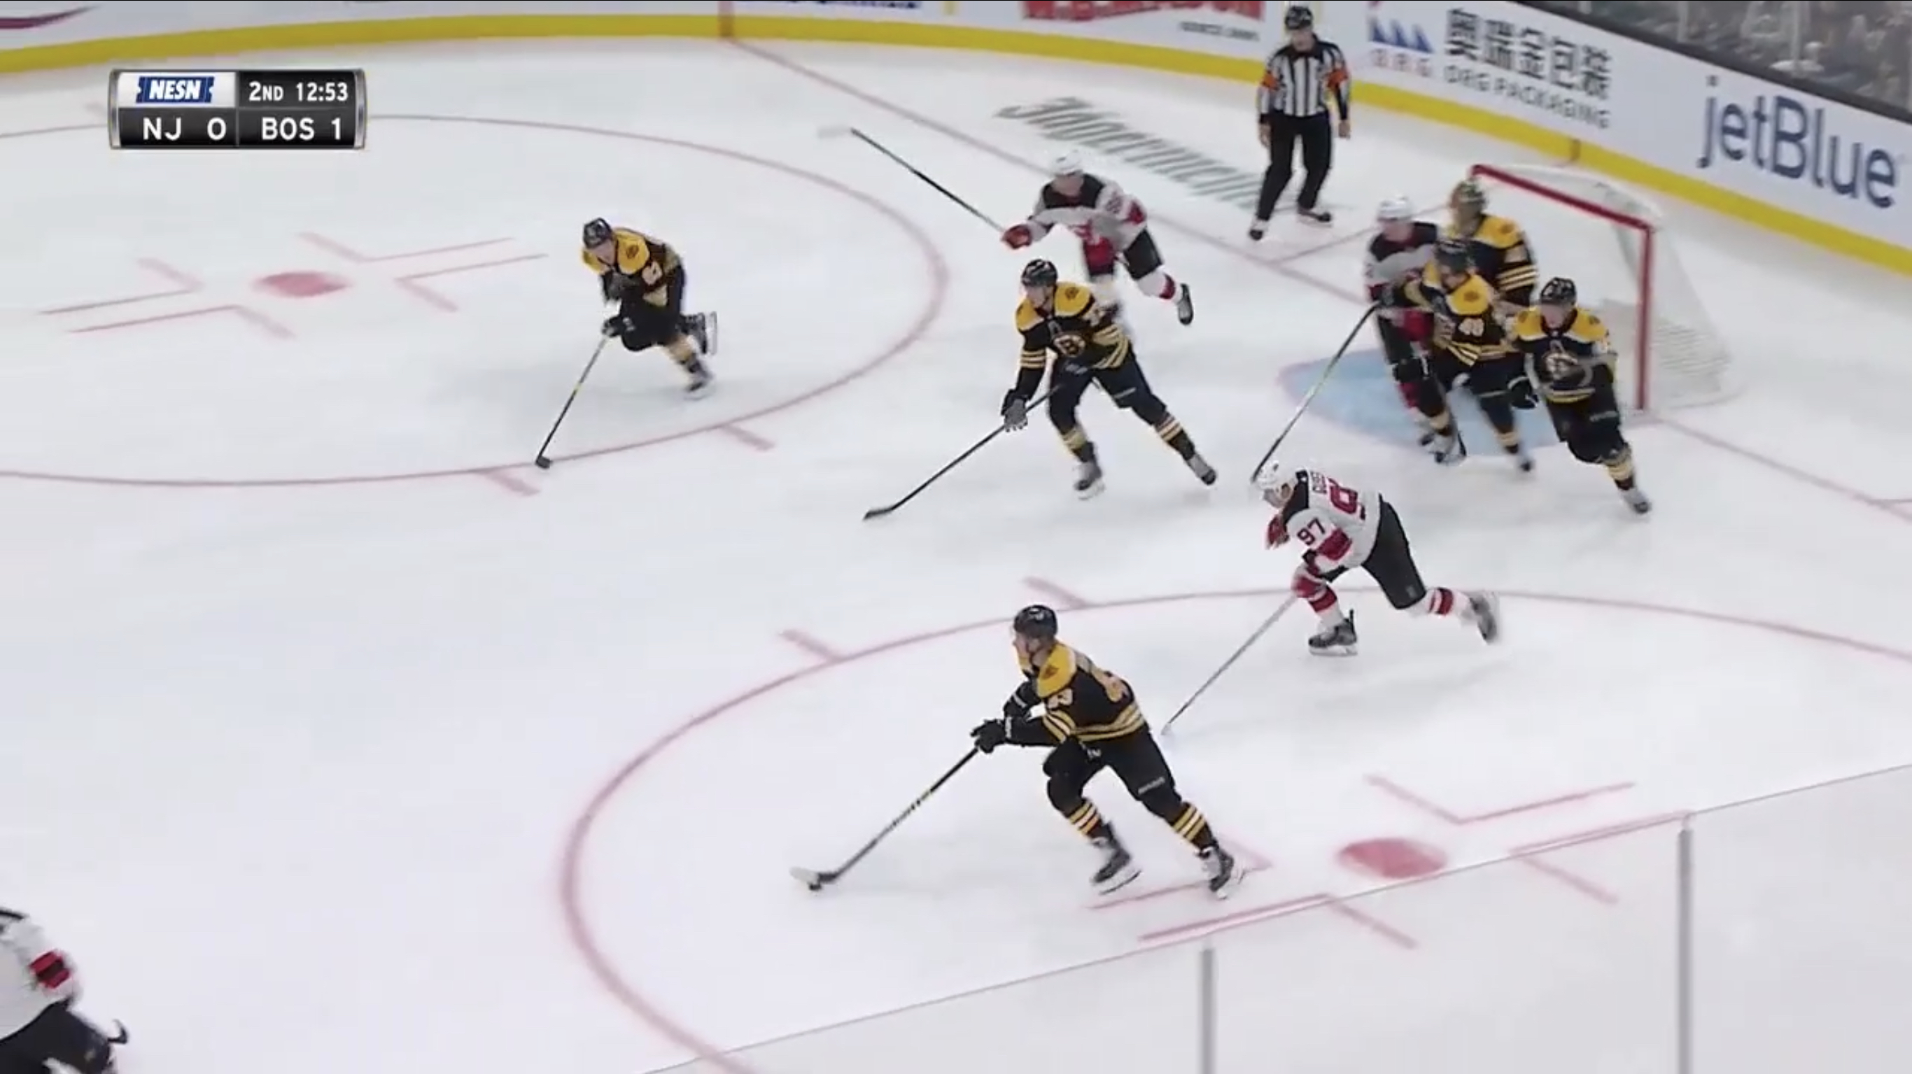
Line Rush Against (great gap & lateral movement)

Slide 8
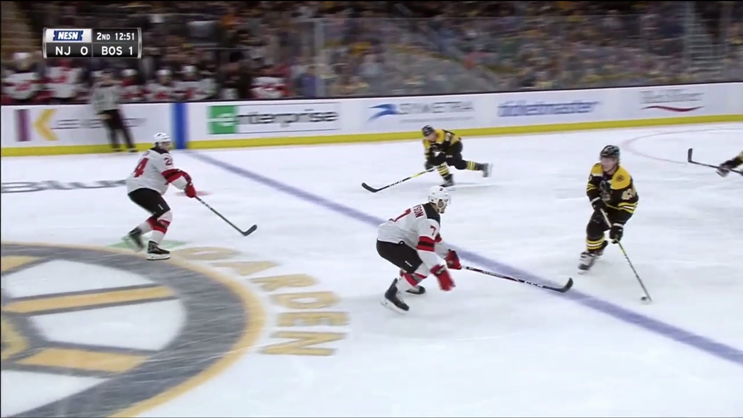

Slide 9
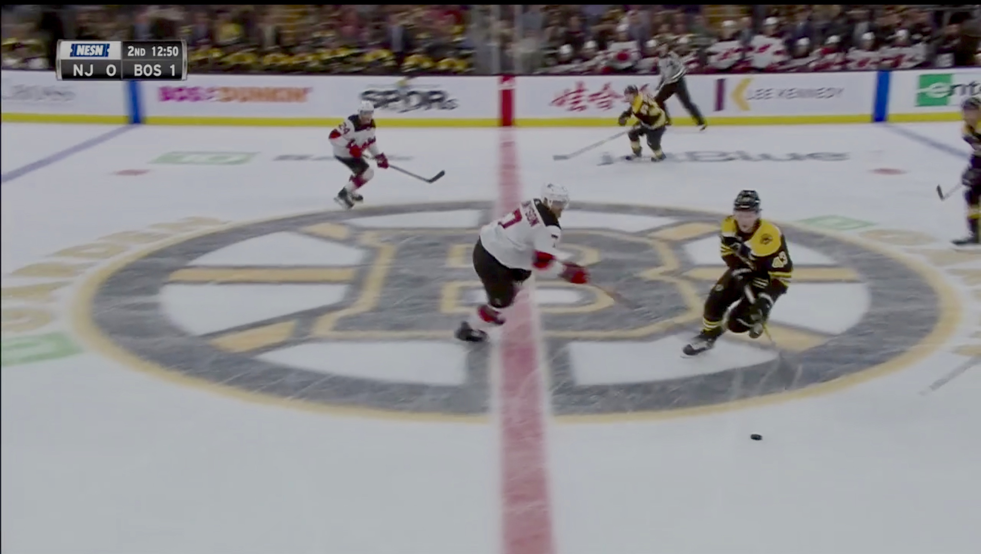

Slide 10
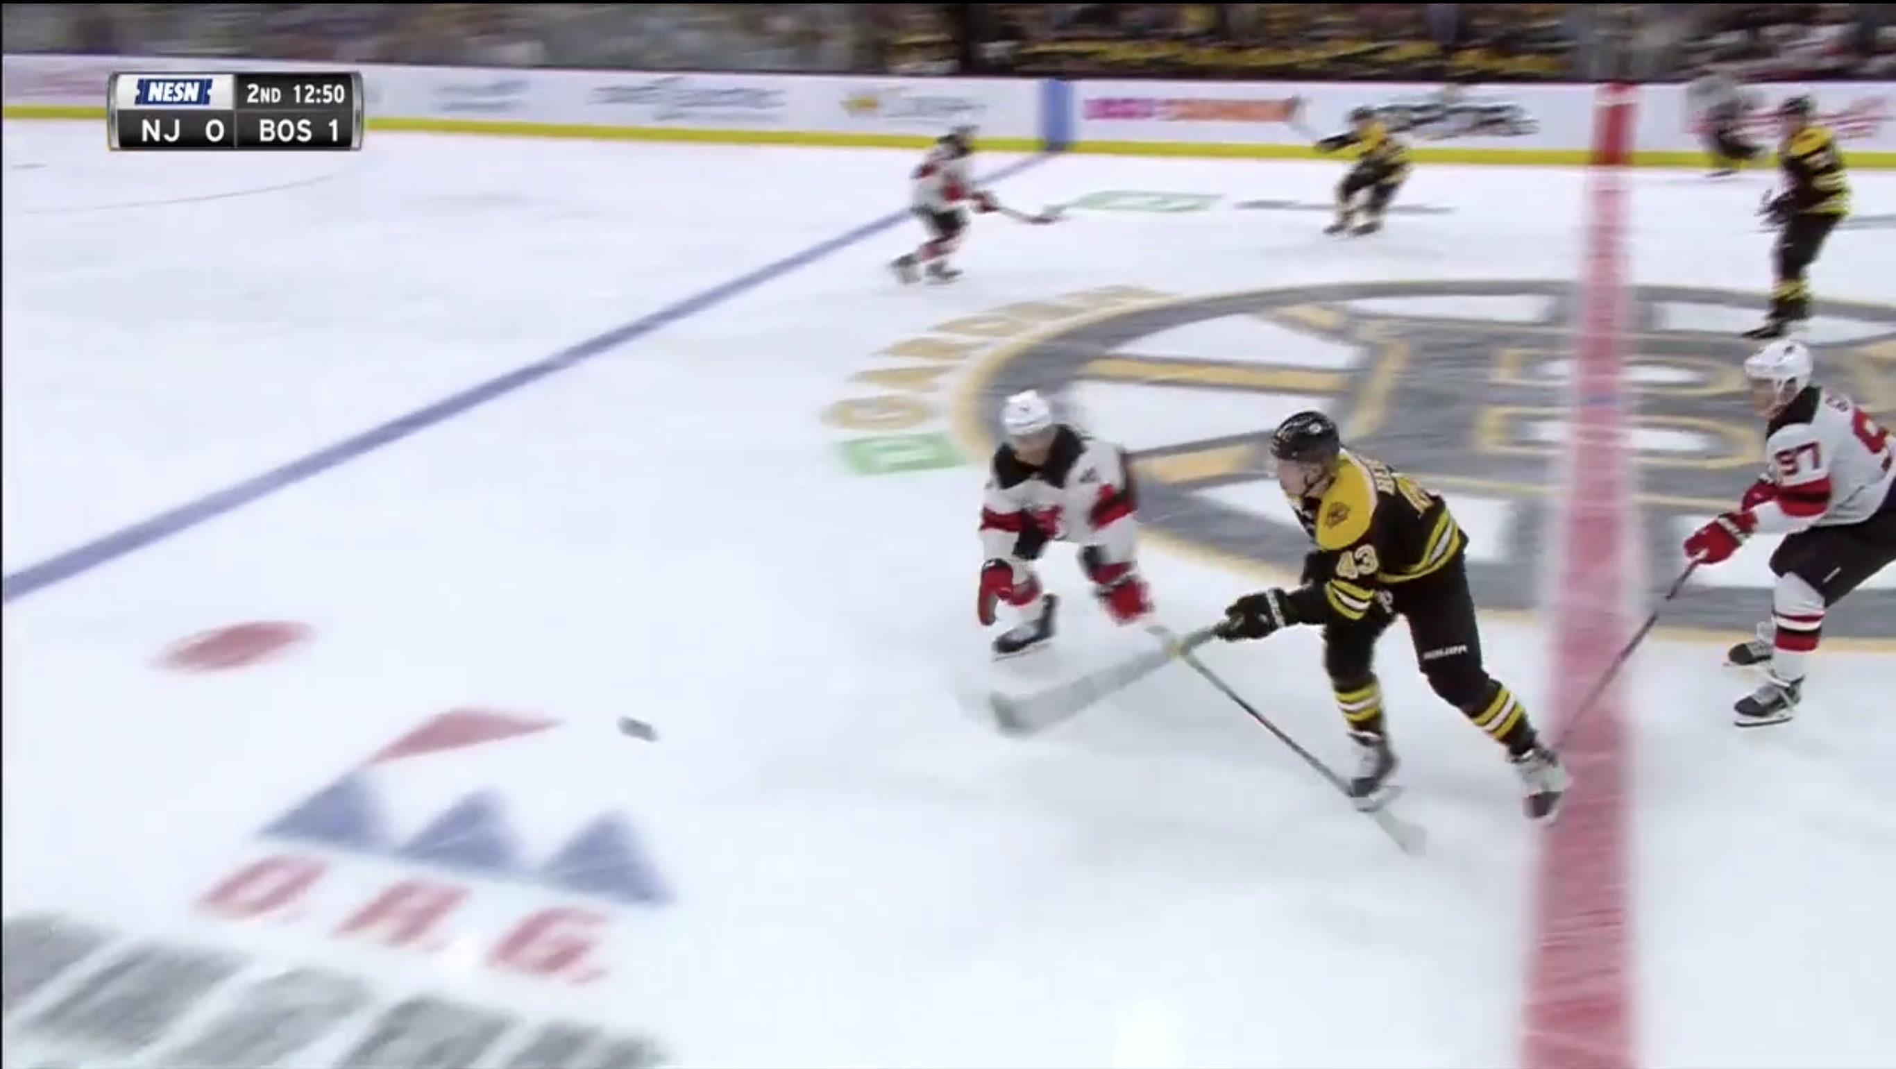

Slide 11
