Slide 1
Angling

Slide 2
Necessary Skills
There are a few keys elements to note when angling:
Stick awareness – Players should be using their stick to influence play.
Sticks on the ice give the best chance of disrupting the attack by intercepting the puck or deflecting any potential passes.
Second, when going for contact or stripping puck carriers of possession, they should lead with stick-on-puck.
Skating on arcs – Players that skate in straight lines are easy to get around. Those that arc their routes are highly effective. When done properly, players will pick up speed into the opponent.
Aim at their back shoulder/butt –
The aiming point for an angling player is the back shoulder/butt of the opposition. This is critical for stopping any cutbacks.

Slide 3


Slide 4
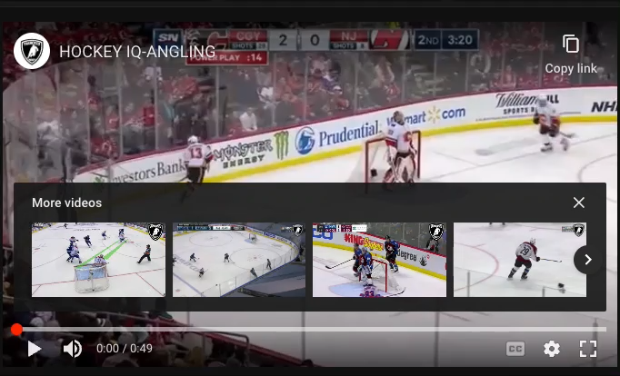

Slide 5
Surf and skate with
Not Surf and skate at.
Skate with allows for numerous attempts to stay with the player.

Slide 6
