Slide 1

Mite parent meeting
SYHA 2025-2026
October 26, 2026

Slide 2
Agenda
Introductions
Meet the Mite Team
Meet the Board
Hockey Development Committee
Let's Play Hockey
D6 Rules
Required equipment
Practices, Scrimmages & Jamborees
Registration update
Important Dates
Team recognition & Flag Bearers
Fundraising & Volunteering
DIBS
Fundraising
Supporting SYHA in the community
SYHA Events
Q&A

Slide 3
Introductions

Slide 4
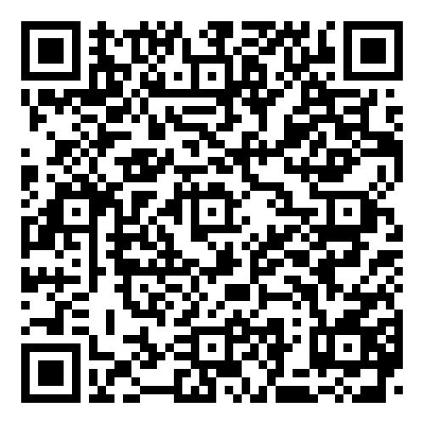
Mite Contacts
Off Ice Coordinators (mite-coordinator@shakopeehockey.com)
Cece Backman
Amanda Ungs
On Ice Coordinator
Mitch Benson
Board Liaisons
Vanessa Breimhorst
Alicia Waits
Mite information page

Slide 5
2025 – 26 board Members
President
Chris Johnson
Vice President
Jon Radmacher
Treasurer
Jenn Holzer
Secretary
Erik Peterson
Erik Peterson
Try Hockey For Free
Vanessa Breimhorst
Mite Liaison, Try Hockey For Free, Scott County Fair
Alicia Waits
Mite Liaison, Saber Sniper Club
Dan Woodall
Travel Tournament Director
Becky Benson
In House Tournament Director, Scott County Fair, Little Wild
Curt Zins
Coaching & Safe Sport Coordinator

Slide 6
Role of the board
Comprised of Association-elected members elected for a 3-year term
Responsible for Business Operations for the Association
  Preparation of budgets, reconciliation of budgets to ice bills at end of season and monthly financials
  Discipline or member grievances
  Gambling efforts and funding
  Public relations with the Association, rink personnel and community
  Recruitment, retention
  Fundraising
  SafeSport compliance
  Sponsorships
  Leadership of Volunteers, key committees, etc

Slide 7
Hockey development committee (HDC)
A Board-approved committee responsible for Hockey Operations, which includes:
  Athlete skill development
  Coaching selection and education – recruitment and development of coaches throughout the season and ongoing year-to-year
  Design and execution of the tryout process (Team Genius)
  Developing and implementing programs for players and coaches at all levels to develop athletes and continually improve the quality of hockey in Shakopee

Slide 8
Association Volunteers
THANK YOU Volunteers for all that you do!
Volunteers are vital to the success of our Association. Without the selfless dedication of our volunteers, we would not be able to run our programs
Apparel Committee - Laura Moon and Megan Menden
Golf Tournament - Jess Violette, Chris Schmieg
Concessions - Chris Johnson, Jesse Thomas, Wendy Raymaker, Jenny Lorenz, Ali Hemphill, Angie Ponce
SKATE Committee - Shana Meyers
Social Media - Tina Johnson - www.socialmedia@shakopeehockey.com
Fundraising - All
Sponsorships - All
Travel Manager Coordinator - Jackie Grumish
Dibs Coordinator - Jenny Kaufhold
THESE ARE A FEW BUT NOT ALL OF OUR AMAZING VOLUNTEERS! WE APPRECIATE EACH AND EVERYONE OF THEM.

Slide 9
Let’s play hockey

Slide 10
Required equipment
Certified Helmet with facemask/cage
Mouth guard (thanks Veil & Wild!) - Tethered
Neck guard - MUST WEAR WHEN ON THE ICE AT ALL TIMES!
Shoulder Pads
Elbow Pads
Gloves
Breezers/hockey pants
Pelvic protection (most have Velcro for socks)
Shin guards
Hockey socks and jerseys
Skates
Stick
= Items provided to you
Please put your child’s name on their helmet to help coaches identify who is who

Slide 11
D6 rules
Shakopee hockey is part of Minnesota’s 6th district for Youth Hockey, D6 covers the south and west metro area
D6 is our governing body and is responsible for rule enforcement of Minnesota and USA Hockey to all participating associations
Rules for Mite Hockey:
  Mouth guards and neck protection must be worn at all times on the ice
  Lower mite scrimmages/games must be played cross or half ice
  Upper mite scrimmages/games must be played cross/half ice prior to January 1st
    After Jan 1st upper mites are allowed to play up to 10 full ice games
  No scorekeeping, no stoppage time
  All mites play with intermediate nets

Slide 12
Practices
All practices are one hour in length and held at the Shakopee Ice Arena. Locker Room assignments are posted on the video monitors outside the entrance to the rinks.
Rookie Mites:
Season: January- March, 2 practices per weekend
• Optional preseason skates November – mid December, one hour per weekend
M1 & M2:
Season: November- March, two practices per weekend and one weeknight later in season
Upper Mites:
Season: October - March, two - three practices per week

Slide 13
Scrimmages
Lower Mites scrimmages will always be half or 1/3 ice, there is no full ice play allowed
Upper Mites scrimmages prior to January 1st will be half ice, after January 1 each team is allotted up to 10 full ice scrimmages (in house scrimmages do count towards the 10)
Intermediate nets ONLY, No goalies at M1 or rookies
Shifts are 60-90 seconds; the buzzer will sound to signal shift change. Each period is running time. At least 1 coach from each time will be on the ice with their team.
There is ABSOLUTELY NO SCOREKEEPING

Slide 14

Jamborees
All Shakopee teams M2 and above participate in the Saber Showdown
  December 26 – 28, 2025, 3 game guarantee
Teams M2 and above will attend the Elk River Mite Jamboree
  February 27 – March 1, 3 game guarantee
All Shakopee teams will participate in the year end Skate Spectacular
  March 13-14, in house scrimmages and other skating games

Slide 15
Registration & Teams
Level | Skaters
Rookie Mites | 23
Mite 1 | 35
Mite 2 | 24
Mite 3/4 | 23
8U | 22
Total | 127
M3 Black
Allison Zhao
Blake Breimhorst
Easton Freeman
Edison Rishel
Lincoln Hagaman
Lucas O'Keefe
Mac Strelow
Miles Vogel
Myles Hoppenstedt
Riley Daniel
Xander Joos
M4 Red
Brooks Bailey
Harrison McGuire
Jackson Westling
Jerry Schmidt
Keegan Beckett
Knox Radmacher
Landon Fischer
Logan Pherson
Luke Wexler
Mason Rife
Nicolas Reed
Owen Meemken
8U Black (Intermediate)
Annabelle Vance
Avni Srivastava
Blake Petersen
Bryce Niesche
Charlotte Vance
Elena Samuel
Emeline Hoover
Georgia Wiest
Lily Hawkins
Luca Buckentine
Lydia Janssen
8U Red (Advanced)
Amelia Munroe
Arianna Farwell
Avyn Halverson
Harper Boldt
Josie Benson
Nora Molencamp
Norah Mick
Norah Tschida
Norah Woodall
Paisley Pieper
Rosaria Pelant
Rookies, M1 and M2 have been rostered to high level teams
  Final Team rosters for M1 & M2 will be completed in early December

Slide 16
Important dates
Lower Mite Practices and Rookie Fall session start: 11/1
Lower Mite teams will be rostered by 12/1
Team Picture night Wednesday 12/3
  East Middle School
Saber Showdown 12/26 – 12/28
Elk River Mite Jamboree 2/27 – 3/1
Spring Social 3/13
Year End Skate Spectacular 3/14- 3/15
Mite information page

Slide 17
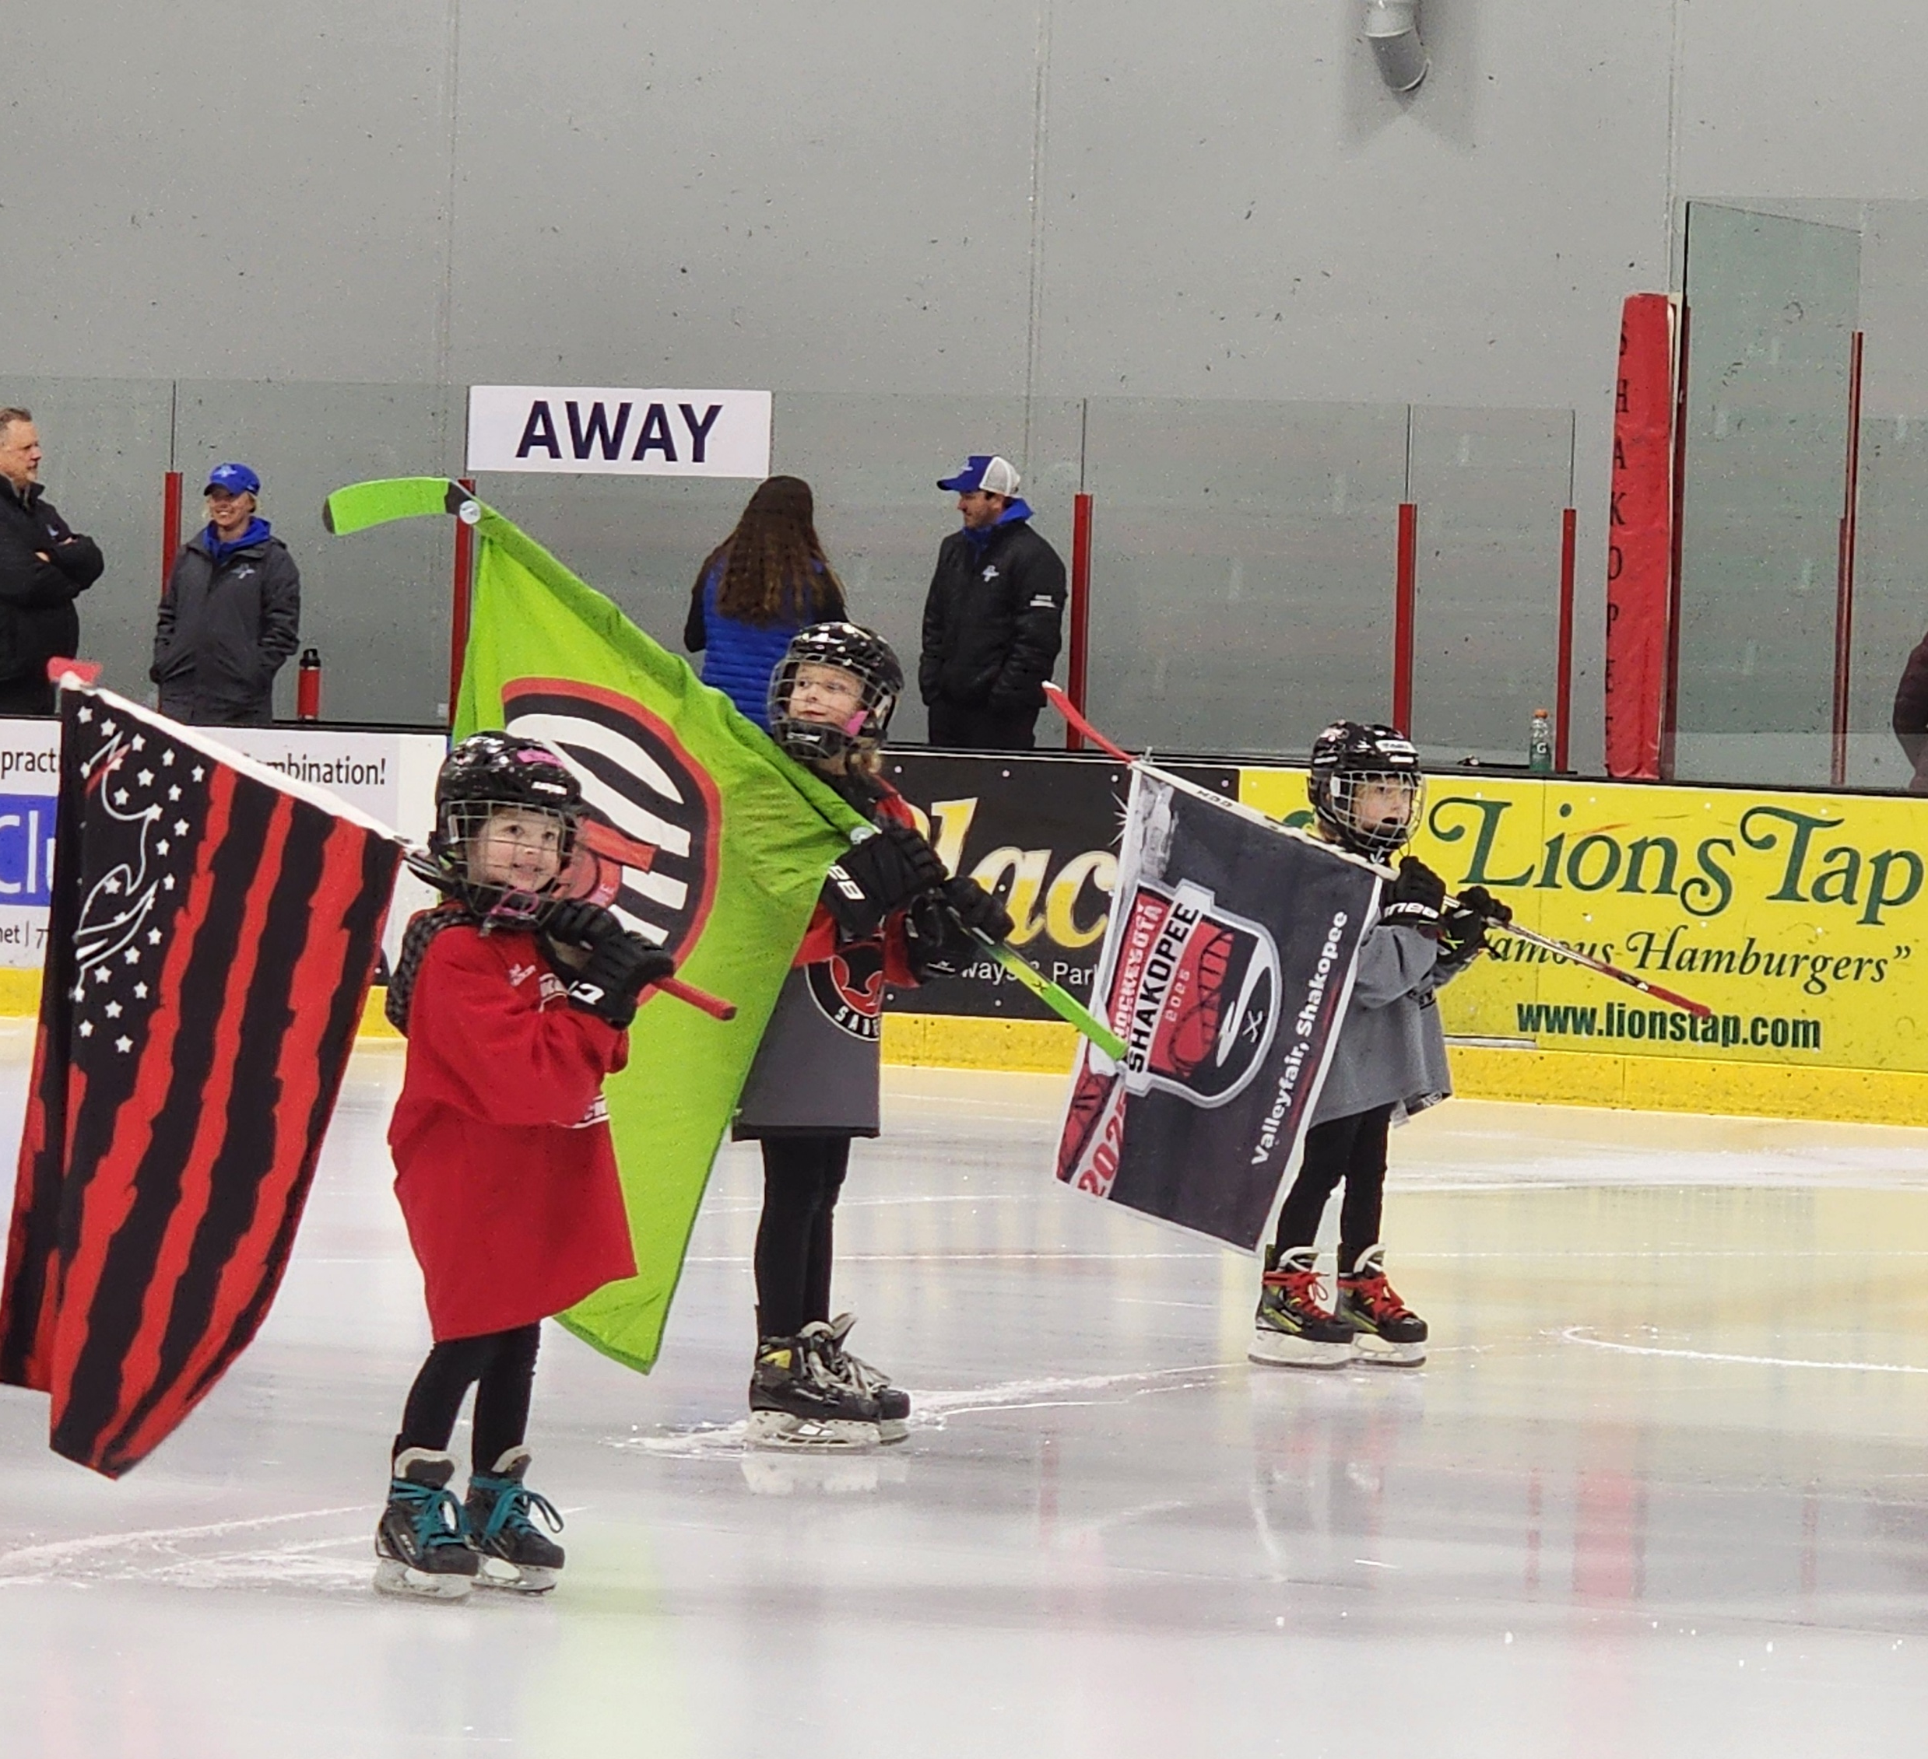
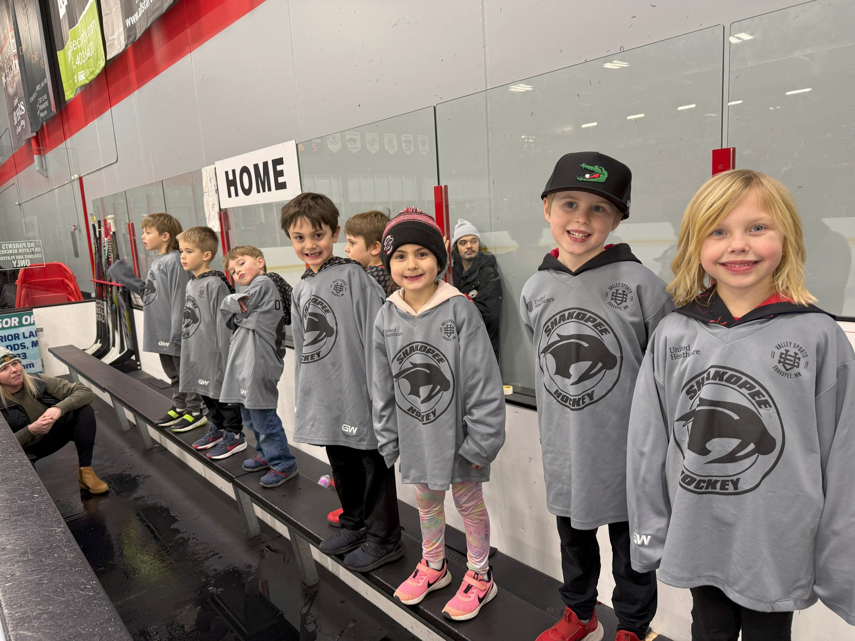
Team recognition & flag bearers
Each team will be recognized as one high school boy’s game and one high school girl’s game
Mite teams will be recognized during the first intermission
Players names will be announced individually, and they will waive to the crowd
At High School home games for both boys and girls, there are youth players that carry flags onto the ice prior to the players entering the ice
The flag bearers enter the ice carrying the flag from the home team entry tunnel, skate behind the home net, and to center ice
Players then stand at center ice while the team enters the ice and the national anthem is played

Slide 18
Dibs/volunteering
”Dibs” is the term that we use for mandatory volunteer hours that need to be completed by each family each year (examples include but not limited to: working the concession stand, helping with Try Hockey For Free, fundraiser pickup, etc.)
At the start of the season, every family needs to have a card on file in Crossbar, which we will charge if Dibs hours are not completed by the end of the season.
If Dibs are completed by the end of the season, and you are in good financial standing with the Association, your card will not be charged
Dibs fill up fast so sign up quickly when new hours are posted (you will receive an email when they are posted)
Dibs per family (18hrs), for new Mite families with their only player at this level (9hrs), for scholarship families (36hrs)

Slide 19
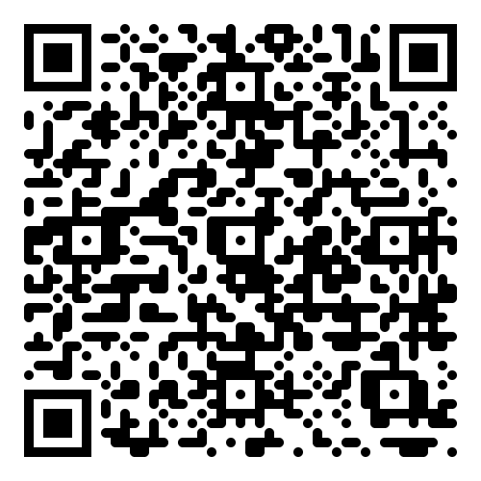
Mite Team Managers
M2 Needs Team Managers
USA Hockey registration and Safe Sport certification is required; this is a 90-minute time investment for initial certification and can be broken up and progress will not be lost through the program. A background check will also need to be completed.
For more information on Safe Sport please visit the Safe Sport Information page.
Scan the QR to visit our Manager Information Page and Register
Team Managers are credited 9 Dibs hours

Slide 20

fundraising
Fundraising is vital to the success of our Association to reduce the cost of hockey
What: Each player must sell at least $130 worth of fundraising products (max of $260 per family) When: Sales occur during the month of November, all orders are due the last week of Nov. final due date will be sent out shortly. Turn in packets at the concessions stand at the rink. Final pick-up date TBD in early December, pick up is in the lower lot of the rink/community center. Final details and logistics will be sent out prior to pick up. Payment: Payment(s) should be turned in with your order packet. If you do not submit payment, you will be billed through crossbar and will incur a processing fee. You will NOT receive your orders if payment is not received prior to pick up. Prizes/Swag: 20 -29 pizzas sold = Free Tshirt 30 + pizzas sold = Free Sweatshirt Valley Sports will open a Pizza Fundraiser Shop on their website and families who are eligible will receive a discount code for their t-shirt or sweatshirt. You may also purchase gear from this shop, if desired.
Pricing: $13 regardless of type/flavor | You must have freezer room! We will not be able to hold any products for anyone. | Top Sellers 1st place $250 gift card 2nd place $150 gift card 3rd place $75 gift card

Slide 21
Supporting syha in the community
Pull Tabs
Shakopee Bowl
Tin Shed
Turtle’s Bar and Grille
Buffalo Tap in Savage
Golf Garage
Shakopee Brewhall
Don Ramons
SYHA Golf Tournament (September)
Donations
Sponsorship opportunities available:
Rink dashers, jersey sponsorships, tournaments, apparel

Slide 22

Saber night with the wild
Shakopee Hockey Families are invited to attend a MN Wild hockey game together as an Association.
Sunday, October 26th
vs San Jose Sharks
5:00 PM
Blue Line Buddies & scrimmage players – wear your 2025/26 Jersey

Slide 23
questions, concerns & feedback
Reach out to the Mite Coordinators
Reach out to a Board Member
Attend a board meeting
  First Wednesday of the Month at 6pm, check website for location

