Slide 1

Team manager overview
Nashoba Youth Hockey Association
2025 - 2026 Season

Slide 2

WELCOME
Introductions
Your name
Team name
Years with NYHA
What are you looking forward to this season?

Slide 3
Season schedule at a glance
August: season starts
September: parity round begins / goalie clinics begin / shoot-a-thon starts
October: parity round ends / uml game
November: regular season / hs season ends / shoot-a-thon & picture night
February: registration opens
March: placements held / playoffs start
April: playoffs end / offers sent / 1st deposit due
May: uniform orders due

Slide 4

ROLE OF TEAM MANAGER
SUPPORT COACHES, PLAYERS, & PARENTS
HELP TEAM HAVE A SUCCESSFUL SEASON
SHARE IMPORTANT UPDATES WITH THE BOARD
AVG. 15-20 MINUTES / WEEK
TASKS MAY VARY BY COACH

Slide 5
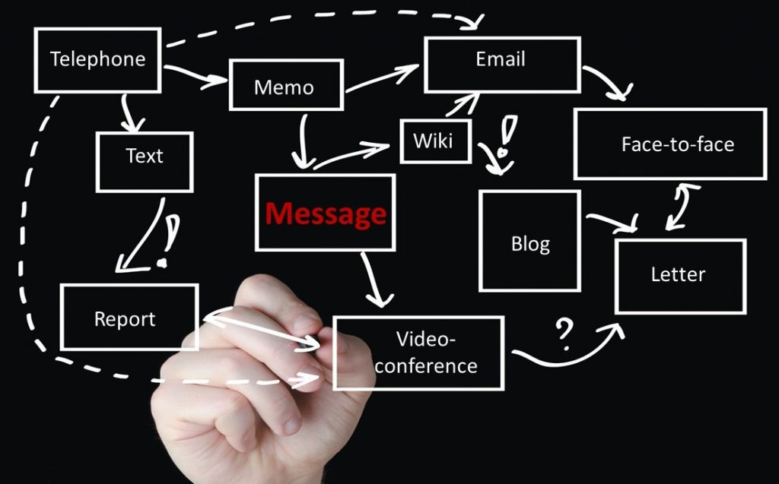
COMMUNICATE WITH COACHES
DISCUSS THE WEEK AHEAD
COACH MESSAGES TO TEAM
IDENTIFY GOALIE
COORDINATE CALLUPS
SCORE SHEET (COED) – EACH COACH DOES THIS DIFFERENTLY
This Photo by Unknown Author is licensed under CC BY

Slide 6

TEAM COMMUNICATION
HOW: Crossbar team chat or email
WHEN: weekly
WHAT:
jersey color, goalie, other related game info.Goalie
Other related game info
Schedule reminders
Goalie clinic sign up/schedule
Event reminders
Fundraising info
Registration & placements
This Photo by Unknown Author is licensed under CC BY-NC-ND

Slide 7
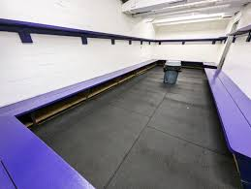
MONITOR LOCKER ROOM
COORDINATE WITH COACHES TO IDENTIFY MONITORS
  MUST COMPLETE REQUIREMENTS FIRST
  REGISTER WITH NYHA & USAH, BACKGROUND SCREEN, SAFESPORT
MONITORING LOCKER ROOMS: PRACTICE, SKILLS, GAMES
RECRUIT PARENT HELPERS
IMPORTANT: CELL PHONES USE NOT ALLOWED IN LOCKER ROOMS (BY ANYONE)
LOCKER ROOM POLICY → WEBSITE → ABOUT → POLICIES

Slide 8

TEAM SOCIAL EVENTS
SOCIAL ACTIVITIES ARE NOT REQUIRED BUT…THEY HELP PLAYERS TEAM BUILD AND HAVE FUN!
COORDINATE WITH YOUR COACHES
MANAGERS MAY BE RESPONSIBLE FOR:
  MAKING RESERVATIONS
  COLLECTING FEES & MAKING PAYMENTS
  SENDING INVITIATIONS
  ADDING EVENTS TO TEAM CALENDAR
  COMMUNICATING PLANS WITH FAMILIES
EXAMPLES:
END OF SEASON CELEBRATION
PIZZA PARTIES THROUGHOUT THE SEASON
ICE CREAM SOCIAL
FUN SKATES OR OTHER SPORTS ACTIVITIES
*NYHA DOES NOT COVER THE COSTS OF TEAM RELATED EVENTS

Slide 9

fundraising
fundraisers held annually
Help keep our costs down (including tuition)
Share info & reminders with teams
Assist at fundraising events (when you can)
Help organize:
  Collecting donated items
  Recruiting sponsors or donations
  Setting up & volunteering at events
This Photo by Unknown Author is licensed under CC BY-NC
Fundraisers this season:
Shoot-a-thon (fall)
Golf tournament (may)

Slide 10

Team updates
We want to hear how your team is doing!
Share exciting moments (ie. First goals, volunteering, social events, etc.)
Message director of marketing & communications:
  Email or slack message
  Summary of event/moment
  Photo
  Player name
  Team name

Slide 11

tournaments
MA Hockey state tournament: NYHA pays fees for teams that are eligible
Outside tournaments:
  Optional – discuss with coaches
  NYHA does not pay for any associated fees or costs
  Managers/coaches complete registration & payment, collect each team member’s share of fees, notify dir. of resources of game schedule, submit usah travel permit to district registrar (if necessary)

Slide 12
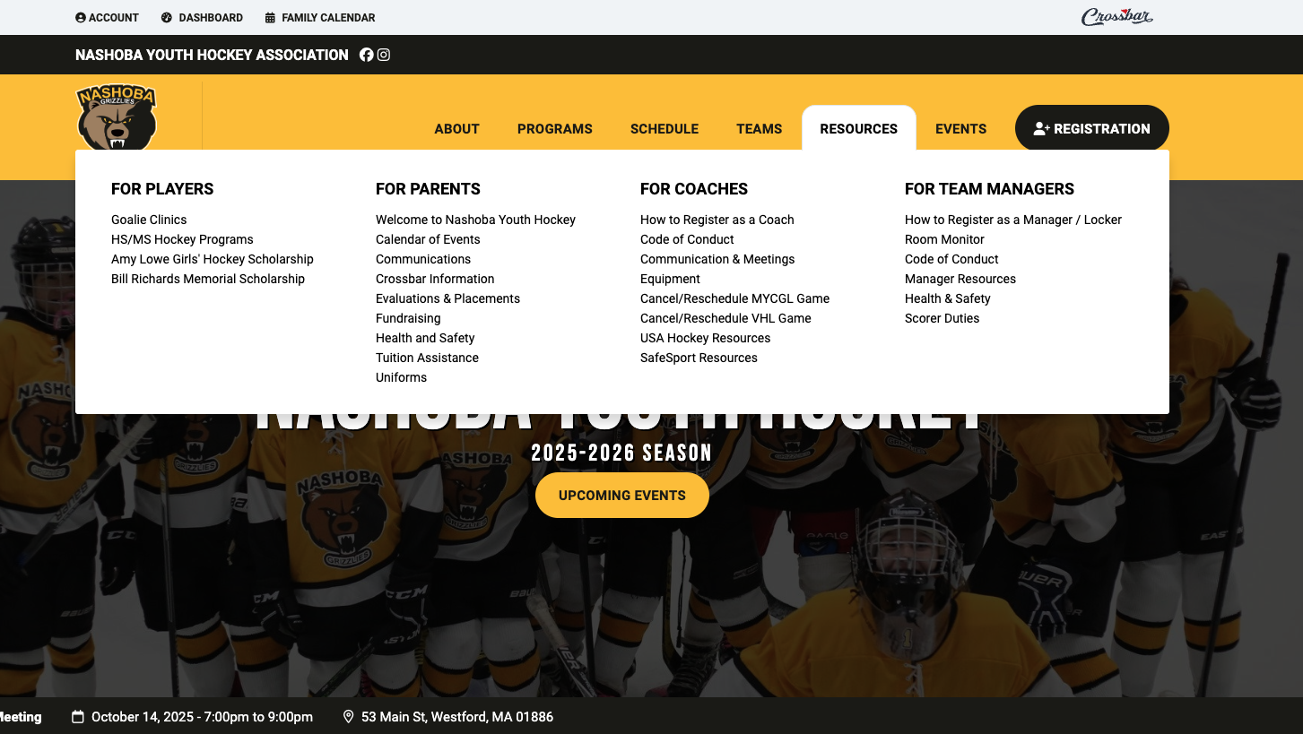
MANAGER RESOURCES
WEBSITE - https://www.nashobahockey.com/
RESOURCES → FOR TEAM MANAGERS → SEE MENU ITEMS
SLACK –
Coaches & Managers thread (https://nashobagrizzlies.slack.com/archives/C092Q8HBC91)
BOARD –
Meetings 2nd Tuesday of each month 7-9p
Slack direct message
Email
Events –
https://www.nashobahockey.com/events

Slide 13
Board of directors & appointees
Contact info: https://www.nashobahockey.com/about/board-of-directors/4758
MICAH O’MALLEY
PRESIDENT
AMY TESZ
DIRECTOR OF RESOURCES / VP
BRANT BERGLUND
DIRECTOR OF PLAYER DEVELOPMENT
SARA FALCONE
REGISTRAR
PAUL ARGIRO
DIRECTOR OF FUNDRAISING
KATIE CASH
SECRETARY
ERIC HAMILTON
TREASURER
JESS STOWE
DIRECTOR OF MARKETING & COMMUNICATIONS
JOE SAVIOLI
DIRECTOR OF GIRLS HOCKEY
MATT RESTUCCIA
INITIATIONS
KEVIN ROBITAILLE
EQUIPMENT MANAGER
RYAN GUERRERO
DIRECTOR OF MIDDLE SCHOOL HOCKEY
MIKE BONENFANT
MA HOCKEY REPRESENTATIVE
OPEN POSITION
DIRECTOR OF HEALTH & SAFETY

Slide 14

QUESTIONS?

