Slide 1

2025 PARENT KICKOFF MEETING

Slide 2
Introduction – Board Members
Ryan Peterson – Vice President
Chris Walker - Registrar
Heather Ballstadt – Dibs Manager
Laurissa Wendling – Concessions
Dustin Morgan – Board Member
Bob Pagel – Board Member
Maybe you…???

Slide 3
2025 PROGRAM
PRACTICE BEGINS APRIL 6th (Sunday)
MAY PRACTICES TUES / THURS
NORTHFIELD TOURNEY MAY 17TH
GAMES BEGIN FIRST WEEK OF JUNE
GAMES ARE ALL PLAYED DURING THE WEEK, EXCEPT FOR THE JESSE JAMES RAID TOURNAMENT AND END OF SEASON TOURNAMENT / JAMBOREE
TEAMS MAY CHOOSE TO REGISTER FOR ADDITIONAL TOURNAMENTS DURING THE SEASON
8 and 10U JAMBOREE JULY 19 OR 20
12U AND 14U STATE TOURNAMENT JULY 26TH AND 27TH

Slide 4
Scholarship Assistance
Financial assistance is available. Please contact the Community Action Center for more details.
Registration Fees:
Boys 12U & 14U: $345
Boys 10U: $345
Boys 8U: $270
First time player at any level: $200
A $400.00 ($600 family max) check for the volunteer fee must be given to coach before child can practice!!!!
Wondering what your registration fee covers?
Coaches & referees
Field maintenance
Goalie equipment, balls, and nets
Association membership & registration fees for YLM
Uniforms

Slide 5
Boys Planned Practice Schedule
***Typical but may change***
 | Monday | Tuesday | Wednesday | Thursday
U8 |  | 6:00-7:00 |  | 6:00-7:00
U10 |  | 6:00-7:30 |  | 6:00-7:30
U12 |  | 6:00-7:30 |  | 6:00-7:30
U14 |  | 6:00-7:30 |  | 6:00-7:30

Slide 6
A few notes about practice …
Practice times can change due to:
  Weather
  Field availability
  Coach schedules / Preference
  Games schedule changes
Please have your player on-time for practice. Arriving 5-10 minutes early is suggested. This allows your player time to get on his/her equipment.
Please be on-time picking your player up from practice. Our coaches can’t leave until all children have been picked up. Be respectful of their time.

Slide 7
Communications
All teams will use CROSSBAR for practice and game scheduling
Updates will be made by Head Coach/Team Manager
Please update availability!!!
All changes, additions, cancellations of practices & games will be communicated. Sometimes this takes up to 1 hour before event. Each family is to do what is best for their child.

Slide 8

USA Lacrosse Age Verification
USA Lacrosse is now requiring all players to complete Age Verification
Parents must complete this process by July 1
Log in to USA Lacrosse account and upload qualifying document, i.e. Birth Certificate
If process is not completed players will become ineligible

Slide 9
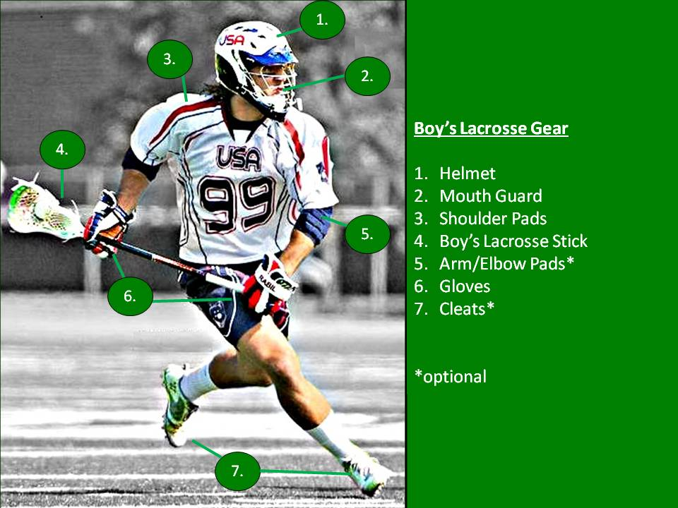
Equipment Requirements

Slide 10

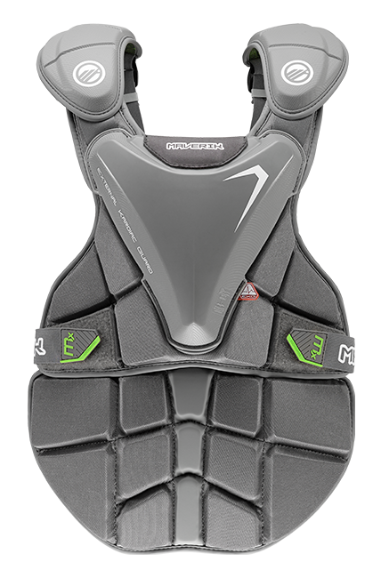
Chest Protector Requirements
USA Lacrosse requires NOCSAE standard ND200 chest protector
This applies to all levels of boys lacrosse
Multiple brands and products available
Equipment must have NOCSAE logo and SEI certification mark

Slide 11

FREE MOUTH GUARDS
Mouth Guards are required by USA Lacrosse
Referees check this through out the games
Mouth guards may not be clear
Thank you to Schieck Orthodontics for sponsoring FREE mouth guards for all NRL players
Complete Waiver and pick up your mouth guard tonight!

Slide 12
Volunteer Requirements
Volunteer Requirements / Opportunities
4 hours required per family
Team Manager
Score/Time Keepers
Tournament help
Field Maintenance
High School concessions
Dibs coming out soon
This WILL be enforced!!! 3 hours does not equal 4 hours!!!
We are looking for board members

Slide 13

Jesse James Raid Tournament
2025 Jesse James Raid
May 17th
Sponsors needed!
Volunteers needed!
  Volunteer requirements will be met by helping with tournament

Slide 14
Code of Conduct
  NEED Parents to push kids to:
Represent Northfield
Be good teammates
Respect EVERYONE on the field
Coaches coach, Officials officiate, Players play, and Parents WATCH!
All players required to sign conduct Policy

Slide 15
Sponsorships
2025 Sponsorship Opportunities
Booster: $100 - Logo on website
Raider: $250 - Above + signage @ fields (SC and HS)
Maroon: $500 - Above + hole sponsor at golf tourney
Gold: $1000 - Above + golf foursome
Field sign sponsorships!!! ***FULL***

Slide 16
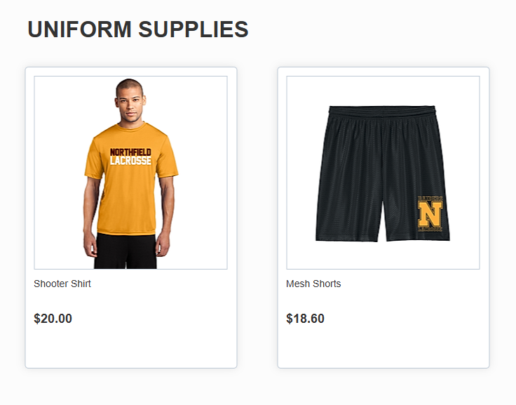
Team and Family Apparel Store
Larson’s Printing in Northfield supplying player and family apparel
  Closes on 4/7/25 @ 11:59pm
  Raiderlacrosse.com – family and player apparel

Slide 17

Heggies Pizza
Fundraiser
Closes 4/6 at 11:59 PM
Prizes for selling the most pizzas

Slide 18


