Slide 1
Woodbury United Lacrosse
2026 Kick-off Parent Meeting

Slide 2
Agenda
Board Introduction
Season Overview
Evaluation Process
Parent & Player Expectations
Black and Blue Tourney / DIBs
Community Night
Q&A

Slide 3
Board Members
Co-Presidents/Tourney Directors
Jeff Dansky
Kristine Glancy
Incoming Co-Presidents/Girls Director
Don Emery
Jaci Skiba
Treasurer
Jen Dardis
Boys Director
Pat Dardis
Boys Assist Director/Team Manager
Ezra King
Girls Assist Director/Team Manager
Wendy Peterson
Open Positions
Girls Director
Equipment/Scheduler
Tourney Director

Slide 4
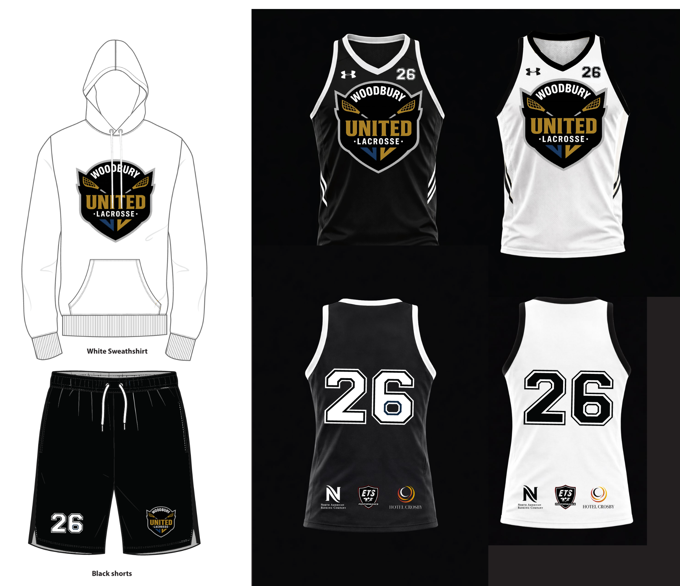
Season Overview
We reached a new season high registration in 2026……256 athletes!
156 Boys
100 Girls
NEW! Every athlete will receive a player pack, inclusive of:
Jersey
Shorts
Sweatshirt

Slide 5
Season Overview
Season starts April 7th (U10+) practice 1x per week (indoor practices)
Starting May 8th, (U8+) practice 2x per week (outdoors)
NEW this year is U6 program, 5/4-6/22, 1 practice/week + 4-6 games
U10+ includes 6 Spring Games (4/25-5/30) - weekend double headers (3 weekend days) as well as 2 Tourneys
  Note U14 Boys will have 1 additional day (2 games) due to Spring Team Size
All Teams include 8-10 Summer Games (weekdays) as well as 2 Tourneys (weekends)
All Families are required to complete 4hrs of DIBS (6hrs for 2+ Athletes) at BNB Tourney unless payment of $300 to opt out of hours was completed
Every team will have a minimum of 2 coaches + 1 Team Manager

Slide 6
Registered Players & Team Plan
 | # of Kids Registered Spring | # of Teams Planned Spring | Avg Kids Per Team Spring |  | # of Kids Registered Summer | # of Teams Planned Summer | Avg Kids Per Team Summer
U8 Boys | 0 | 0 | 0 |  | 32 | 2 | 16
U8 Girls | 0 | 0 | 0 |  | 14 | 1 | 14
U10 Boys | 40 | 3 | 13-14 |  | 40 | 3 | 13-14
U10 Girls | 25 | 2 | 12-13 |  | 25 | 2 | 12-13
U12 Boys | 45 | 2 | 22-23 |  | 45 | 2 | 22-23
U12 Girls | 30 | 1 | 23* |  | 30 | 1 | 23*
U14 Boys | 31 | 1 | 31 |  | 39 | 2 | 19-20
U14 Girls | 14 | 1 | 21 |  | 31 | 2 | 21
Total | 185 | 10 |  |  | 256 | 15

Slide 7
Season Overview - Girls
 | April | May | June | July
U8 | N/A | 2 practices/week (60min) | 2 practices/week (60min) In-Season Games 6/26-6/28 - BNB Tourney | 2 practices/week (60min) In-Season Games 7/25-7/26 - State Tourney
U10 | 1 practice/week (60min) 4/26 - Games | 2 practices/week (60min) 5/2-5/3 - Games 5/15-5/16 - Wayzata Tourney 5/29-5/31 - State Tourney | 2 practices/week (60min) In-Season Games 6/26-6/28 - BNB Tourney | 2 practices/week (60min) In-Season Games 7/25-7/26 - State Tourney
U12 | 1 practice/week (60min) 4/26 - Games | 2 practices/week (90min) 5/3 - Games 5/9 - Games 5/15-5/16 - Wayzata Tourney 5/29-5/31 - State Tourney | 2 practices/week (90min) In-Season Games 6/26-6/28 - BNB Tourney | 2 practices/week (90min) In-Season Games 7/25-7/26 - State Tourney
U14 | 1 practice/week (60min) 4/26 - Games | 2 practices/week (90min) 5/2-5/3 - Games 5/15-5/16 - Wayzata Tourney 5/29-5/31 - State Tourney | 2 practices/week (90min) In-Season Games 6/26-6/28 - BNB Tourney | 2 practices/week (90min) In-Season Games 7/25-7/26 - State Tourney

Slide 8
Season Overview - Boys
 | April | May | June | July
U8 | N/A | 2 practices/week (60min) | 2 practices/week (60min) In-Season Games 6/26-6/28 - BNB Tourney | 2 practices/week (60min) In-Season Games 7/18-7/19 - State Tourney
U10 | 1 practice/week (60min) 4/25-4/26 - Games | 2 practices/week (60min) 5/15-5/16 - Tourney 5/30 - Games | 2 practices/week (60min) In-Season Games 6/5-6/7 - State Tourney 6/26-6/28 - BNB Tourney | 2 practices/week (60min) In-Season Games 7/18-7/19 - State Tourney
U12 | 1 practice/week (60min) 4/25-4/26 - Games | 2 practices/week (90min) 5/9 - Games 5/10 - Games 5/15-5/16 - Tourney | 2 practices/week (90min) In-Season Games 6/5-6/7 - State Tourney 6/26-6/28 - BNB Tourney | 2 practices/week (90min) In-Season Games 7/25-7/26 -State Tourney
U14 | 1 practice/week (60min) 4/25-4/26 - Games | 2 practices/week (90min) 5/2 - Games 5/9 - Games 5/15-5/16 - Tourney | 2 practices/week (90min) In-Season Games 6/5-6/7 - State Tourney 6/26-6/28 - BNB Tourney | 2 practices/week (90min) In-Season Games 7/25-7/26 - State Tourney

Slide 9
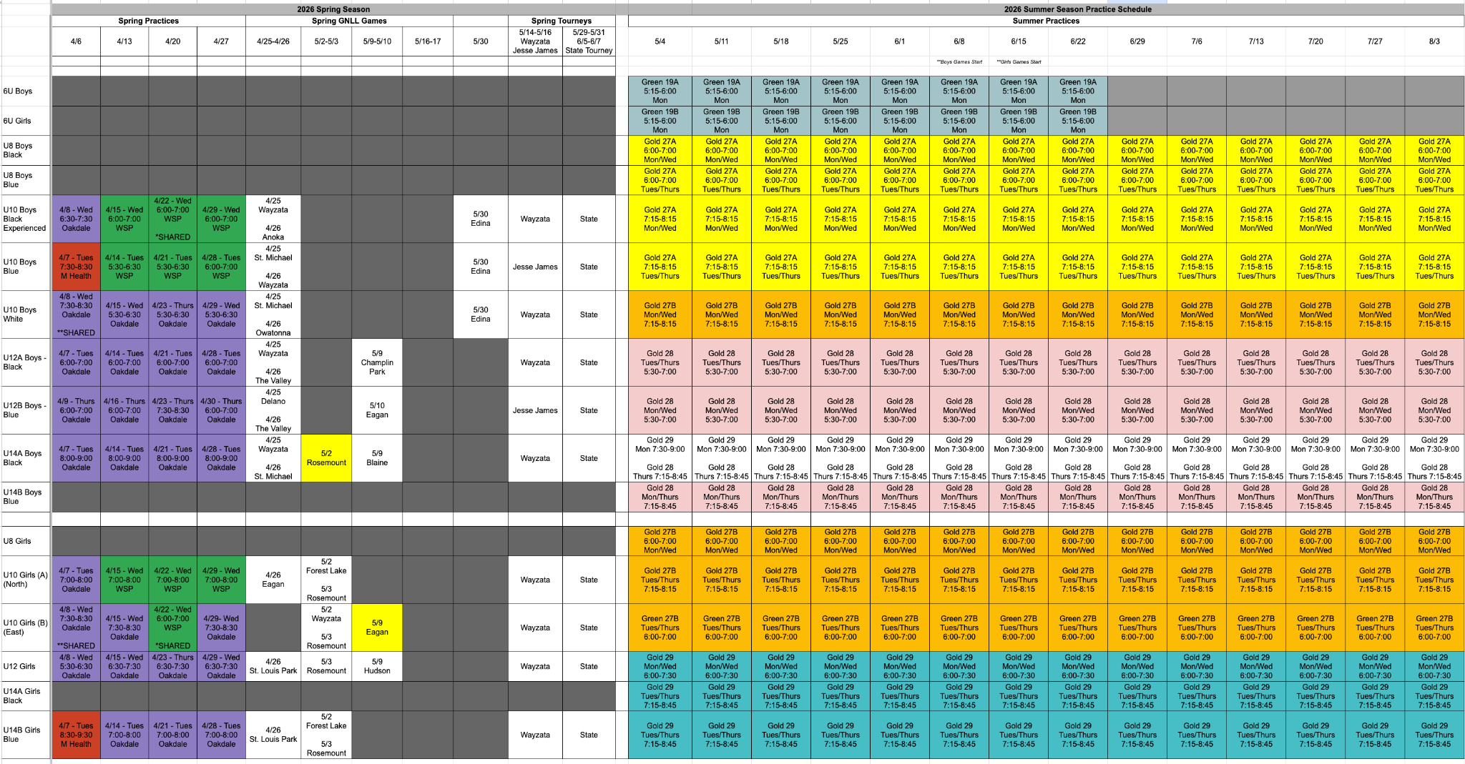
DRAFT: Practice Schedule
**Subject to change

Slide 10
Tourney Recap (Weekends)
Girls
Boys
 | May | June | July
U8 | N/A | 6/26-6/28 | TBD
U10 | 5/15-5/16 5/29-5/31 | 6/26-6/28 | 7/25-7/26
U12 | 5/15-5/16 5/29-5/31 | 6/26-6/28 | 7/25-7/26
U14 | 5/15-5/16 5/29-5/31 | 6/26-6/28 | 7/25-7/26
 | May | June | July
U8 | N/A | 6/26-6/28 | 7/18-7/19
U10 | 5/15-5/16 | 6/5-6/7 6/26-6/28 | 7/18-7/19
U12 | 5/15-5/16 | 6/5-6/7 6/26-6/28 | 7/25-7/26
U14 | 5/15-5/16 | 6/5-6/7 6/26-6/28 | 7/25-7/26

Slide 11


Team Pictures / Games / Sports Engine / Store
Team Pictures: in process of being scheduled. Planning on reserving ES Lacrosse so not weather dependent
Summer Game schedule will be released by end of May for both boys and girls. We will get loaded into Cross Bar once finalized. Please note games can be scheduled for any day of the week Mon-Thurs.
We utilize Crossbar to communicate rosters & schedules. Please utilize the RSVP function within Crossbar to inform your coaches when you will/won’t be at practice to allow them to better plan for practices and games.
If you are interested in getting any WULAX branded gear the store is open thru March 23rd, apparel will be ready 3 weeks after the store closes

Slide 12
What does it take to be a coach?
USA Lacrosse Certification (includes Bronze level)
  U12/U14 - Silver Certification
  Certifications are reimbursable from WULAX
Leverage existing coaches manuels created by WULAX
Will receive full season reimbursement for coaching entire season
$50 towards WULAX Branded Gear Store
Covers Season DIBS

Slide 13
Evaluation Process
The full Evaluations Policy is on the WULAX Website. Key Points are below:
Evaluation results will be used to form ‘A’ teams for Boys 12U/14U and Girls 10U/12U/14U and balanced teams across all other levels. Failure to attend will result in a lower draft ranking, except for an injury or excused.
Any player missing an evaluation will not be eligible for an ‘A’ team unless prior approval by WULAX Board.
If a player misses an evaluation day and has prior approval for an excused absence or injury, they will be evaluated based on past coaches recommendations.
If a player is more than 20 minutes late to an evaluation, they will not be allowed to participate in the evaluation.
If a player misses an evaluation day due to family obligations or other unexcused absence and does not let the WULAX Board know ahead of time the player will be placed on a B team.
Evaluations will be organized and coordinated by the WULAX Board in conjunction with the evaluation committee, coaches, and support from ERHS and WHS. Parent Coaches/Board Members are NOT permitted to evaluate their own child.
The evaluations committee shall not have the authorization to change player rankings and an audit trail is enabled.
Evaluators shall have no stake in the outcome.
Please observe the “24 Hour Cooling Off Period” for any grievances after teams are placed.

Slide 14
Evaluation Process
Evaluation Scoring Metric
Evaluators for all age levels and genders will evaluate athletes based on the following criteria:
Stick Skills - passing, catching, ground ball scooping, cradling, shooting
LAX IQ - does the athlete know position play, basic lacrosse movement on field
Athleticism - body control, strength, speed & agility
Hustle - always moving feet, never giving up - NO WALKING
Team Play - coachability, communication on field, positive attitude
NOTES - evaluators have option to add notes for any additional details
Metrics for criterias #1 - #5 above are on a 1 (needs work) - 2 (average) - 3 (excels) scale with the ability of the evaluation committee to weight any given score.

Slide 15
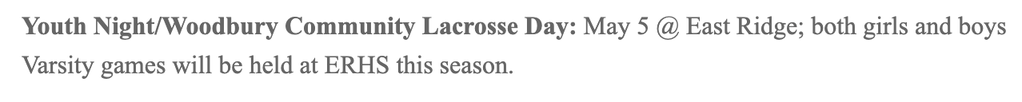
Community Night - 5/5/26

Slide 16
Black and Blue Tourney
We are hosting our annual BNB tourney 6/26-6/28 at MHealth Athletic fields
We have 140 teams registered (sold out in 1 month!)
DIBS will be shared out in advance for sign-ups. Will be CRITICAL to get full parent participation to help make the ensure the tourney is a success
  DIBS requirement = 4hrs/family with 1 player, 6hrs/family with 2+ players
  DIBS buyout is $300.00
We have food trucks and multiple food vendors
We will be utilizing all fields

Slide 17
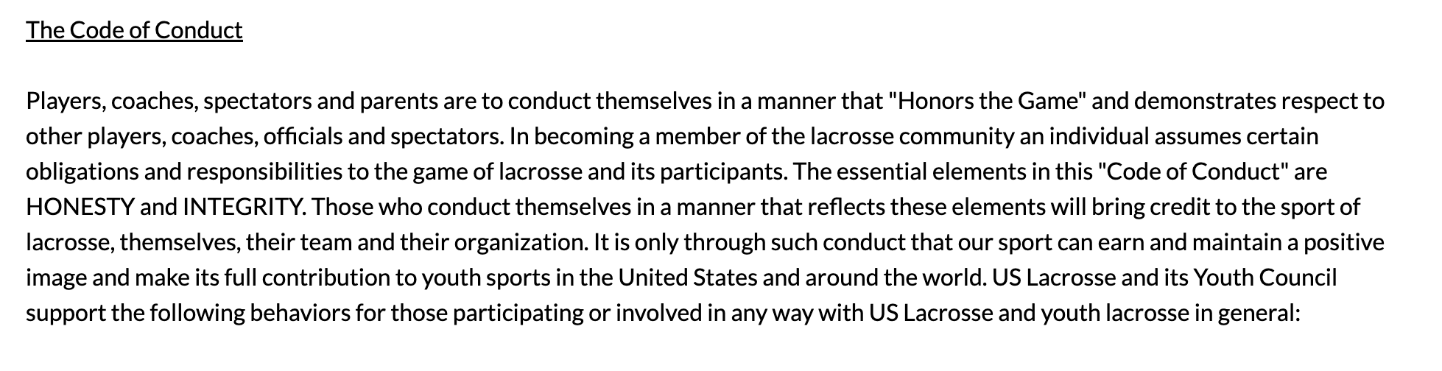
Sideline Expectations
We will not tolerate disrespectful behavior on the sidelines towards our coaches, players or the referees. Please be an example for our kids and enjoy watching your child play the sport of lacrosse. We encourage cheering the full team on. Please allow our coaches to coach your kids, they have been trained to do so.
Please allow 24hr cooling off period if you have concern!

