Slide 1
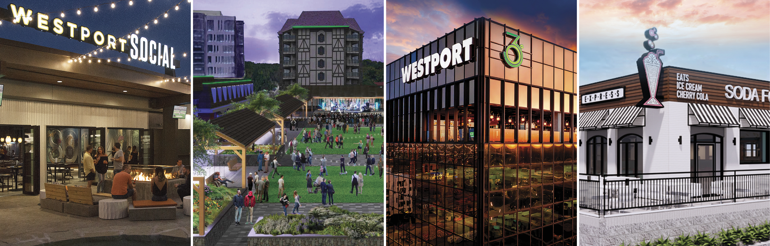
Comfortable
Westport Plaza
Entertainment and Dining
RESTAUARNTS
Drunken Fish Sushi and Japanese cuisine
Fuzzy Taco Shop Baja-style Mexican food
Jovick Brothers Deli Fresh subs and salads
Kobe Japanese Grill Hibachi Grill
Trainwreck Saloon Lunch, happy hour, dinner and late night menus, Live Music
Westport Social A classic bar and gaming lounge, offering bocce ball, shuffleboard,
ping pong, karaoke rooms, hoops, darts,
live music and great food
360 Westport Sip, See, and Savor at this restaurant on the 12th floor of the gold tower offering panoramic views of the surrounding area. Featuring high level cocktails, expansive wine list and enlightened small plates
Soda Fountain Express The sweetest place at Westport Plaza offering something for everyone to enjoy - from freak shakes and sundaes to sodas and sandwiches
Starbucks Fresh, Italian-style expresso beverages and a variety of pastries and confections
ENTERTAINMENT
Backstreet Jaz and Blues Club
Laid-back atmosphere with moody lighting
Funny Bone Comedy Club
Featuring professional comics and weekly open-mic nights
Westport Playhouse
Offering a variety of Broadway and
Off-Broadway entertainment
Rawlings Experience
A new immersive baseball experience, featuring commemorative baseballs, gold glove vault, batting cages and more
Westport Park 10,000 square feet of Green Space, yard games, movie nights, concerts and more

