Slide 1

2026 Club Packet

Slide 2
Agenda
Overview
Season Schedule
Field Coordination
Fees
Conduct/Sportsmanship
Website
Boys Rules
Girls Rules
Boys/Girls Schedules Questions
Misc. Items

Slide 3
Overview
Mission:
  Grow the game of lacrosse by promoting cooperation and coordination between recreational boys and girls’ youth lacrosse member clubs in south-central Wisconsin, in coordination with the Wisconsin Lacrosse Federation (WLF).
Badgerland has been helping provide opportunities since 2009
Last 4 Years:
Games | 2022 | 2023 | 2024 | 2025
Boys Games | 235 | 192 | 209 | 263
Girls Games | 96 | 84 | 101 | 125
Total Games | 331 | 276 | 310 | 388
Participants | 2022 | 2023 | 2024 | 2025
Boys | - | - | 735 | 845
Girls | - | - | 321 | 355
Total Kids | - | - | 1,056 | 1190

Slide 4
Board
Role | Person | Member Club | Next Election | Contact
President | Brian King | Waunakee Boys | 2027 | presidentbadgerlandlax@gmail.com
Vice President (Boys) | Russ Coley | Middleton | 2026 | blaboysyouth@gmail.com
Vice President (Girls) | Cassidy Dabs | Waunakee Girls | 2027 | blavpofgirls@gmail.com
Treasurer | Chad Leatherman | Waunakee Boys | 2027 | blatreasurerlax@gmail.com
Secretary | Kate Spitek | Waunakee Boys | 2026 | secretarybadgerlandlax@gmail.com
Director of Marketing | Ava Kenny | Capitol City | 2027 | avajkenny22@gmail.com
Director of Sportsmanship | Nicholas Lambert | Janesville | 2026 | nlambert0617@gmail.com
Other Key People
Role | Person | Club | Contact
Boys Scheduler | Jeff Reuter | Janesville | jeffreuter0202@gmail.com
Girls Scheduler | Jeff Reuter | Janesville | jeffreuter0202@gmail.com
Boys Officials Assignor and Trainer | Jeremy Sullivan | n/a | malabyoc@gmail.com
Girls Officials Assignor | Scott Saunders | n/a | saunders.lax@gmail.com
Girls Officials Trainer | Jack Long | n/a | jlong21@wi.rr.com

Slide 5
Season Schedule
March
Note: No March Board Meeting
Sun March 1st, 2028 Request for Initial Club Team Counts
Sun., March 8th, 2026 Girls Officials – Virtual Training 1
Sun., March 15th 2026 Girls Officials – Virtual Training 2
Mon., March 16th 2026 Earliest Start of Practice
Fri., March 20th, 2026 Provide Team Counts and Field Information to BLA
Tue., March 24th, 2026 8U/10U - Badgerland All Clubs Coaches Meeting
                Separate dial ins for girls and boys
Wed., March 25th, 2026 12U/14U -Badgerland All Clubs Coaches Meeting
                Separate dial ins for girls and boys
Sun., March 30th, 2026 Publish Draft BLA Season Schedule
April
Sun., April 5th, 2026 Easter Weekend (No Games)
Mon., April 7th, 2026 Publish Final BLA Season Schedule
Sun. April 12th, 2026 - Morning Girls Officials – Field Rating Day (Waunakee Warrior Stadium)
Sun., April 12th, 2026 - Afternoon Boys Officials – Field Rating Day (Waunakee Warrior Stadium)
Sat., April 18-19th, 2026 First Weekend of BLA Games
Tue., April 21st, 2026 April BLA Board Meeting
Sat, April 25, 2026 Badger Invite (Dells) - Boys Youth (Optional BLA Games)
Sun, April 26, 2026 Badger Invite (Dells) - Girls Youth (Optional BLA Games)
Feb
Boys Official Virtual Trainings
February 15th: 11:30-3:30
February 22nd: 11:30-3:30

Slide 6
Season Schedule
May
Note: No May Board Meeting
Sat/Sunday., May 2nd 2026 Kettle Moraine Tournament - Girls
Sat/Sunday., May 9-10^{th,} 2026 Mother Day Weekend (Kettle Moraine Tournament) - Boys
Sat/Sunday, May 24-25^{th,} 2026 Memorial Day Weekend (No BLA Games)
Sat/Sunday, May 30-31^{h} Deforest Norski Tournament (Optional BLA Games)
June
Sat/Sun, June 6-7th WLF State Tournament
Wed., June 10th Badgerland All-Star Game(s)
                Tentative Location – Middleton High School
Wed., June 24th, 2026 End of Year BLA Club Meeting

Slide 7
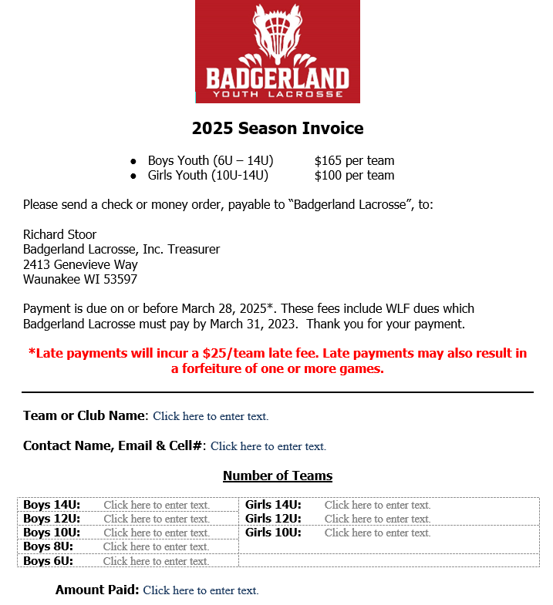
BLA Team Fees
Type | Amount
Boys Youth | $165
Girls Youth | $100
2026 Season Invoice
Chad Leatherman
1106 Waterwheel Drive
Waunakee, WI 53597
Chad Leatherman - blatreasurerlax@gmail.com
Chad Leatherman,
1106 Waterwheel Drive,
Waunakee WI 53597
March 28 2026
March 31 2026

Slide 8
Boys/Girls Schedule
Days
Boys 8U/10U – Saturdays
Boys 12/14U – Sundays
Girls 10U/12/14U – Saturdays and Sunday
2026 Game Day Weekends
Sat/Sun, April 18-19th, 2026 First Weekend of BLA Games
April 25th and 26th Badger Spring Invite (No BLA Games)
May 2nd and 3rd
May 9th and 10th
May 16th and 17th
May 23rd and 24th No BLA Games - Memorial Day Weekend
May 30th and 31st
Jun 6th and 7th Norski Invitational – Deforest (No BLA Games)
June 10th 14U Girls and Boys All Star Games (tentatively Middleton)
Scheduler (girls and boys)
Jeff Reuter
jeffreuter0202@gmail.com

Slide 9
Field Coordination
Field maintenance and requirements
  Goals
  Painted lines
  Mowed
  Scoreboard
  Horn and Timer
Rain and cancellations
  Coordination is home team’s responsibility for cancellations
  Contact:
    Opposing Coach(es)
    Ref Scheduler(s)
      Boys: Jeremy Sullivan - malabyoc@gmail.com
      Girls: Scott Saunders - saunders.lax@gmail.com
  Coach contact information is available on Badgerland.com
    https://www.badgerlandlacrosse.com/coaching-resources/2026-coach-contact-list/149960

Slide 10
Field Coordination
2025 Fields Below: Email sent to clubs confirm on 12/22
Red Text = Indicates change from 2025
Town | Teams | Field Location | Address
Capitol City | Boys/Girls | Garner Park | 381 S Rosa Rd, Madison, WI 53705
Deforest | Boys/Girls | Windsor Sport Complex | 4198 Mueller Rd, Deforest, WI 53532
Janesville | Boys/Girls | JVL Youth Sports Complex | 100 S Wuthering Hills Dr, Janesville, WI 53546
Middleton | Boys | West Middleton Elementary School 1/2 | 7627 W. Mineral Point Rd., Verona, WI 53593
Middleton | Boys | Airport Road Field 1/2 | 8424 Airport Rd., Middleton, WI 53562
Middleton | Girls | Taylor Park Field 1 and 2 | 5280 Bishops Bay Pkwy, Middleton, WI 53562
Monona Grove | Boys | Ahuska Park | 400 E Broadway, Monona, WI 53716
Oregon | Boys | Brooklyn Elementary School | 204 Division St, Brooklyn, WI 53521
Oregon | Girls | Oregon Jaycee Park | 275 N. Perry Parkway. Oregon, WI 53575
Sauk Prairie | Boys/Girls | Culver Community Park | 340 21st St, Prairie du Sac, WI 53578
Sun Prairie | Boys | Prairie View Middle School | 400 N Thompson Rd, Sun Prairie, WI 53590
Sun Prairie | Boys | Ashley Field | 220 Kroncke Drive, Sun Prairie
Verona | Boys | Badger Ridge | 700 N. Main St. Verona, WI 535893
Verona | Boys/Girls | Sugar Creek Elementary | 700 N. Main St. Verona, WI 535893
Waunakee | Boys | Tierney Park | 2111 Peaceful Valley Parkway, Waunakee, WI 53597
Waunakee | Girls | Tierney Park | 2111 Peaceful Valley Parkway, Waunakee, WI 53597
Waunakee | Boys/Girls | Waunakee High School (Warrior Stadium) | 301 Community Drive, Waunakee, WI 53597

Slide 11
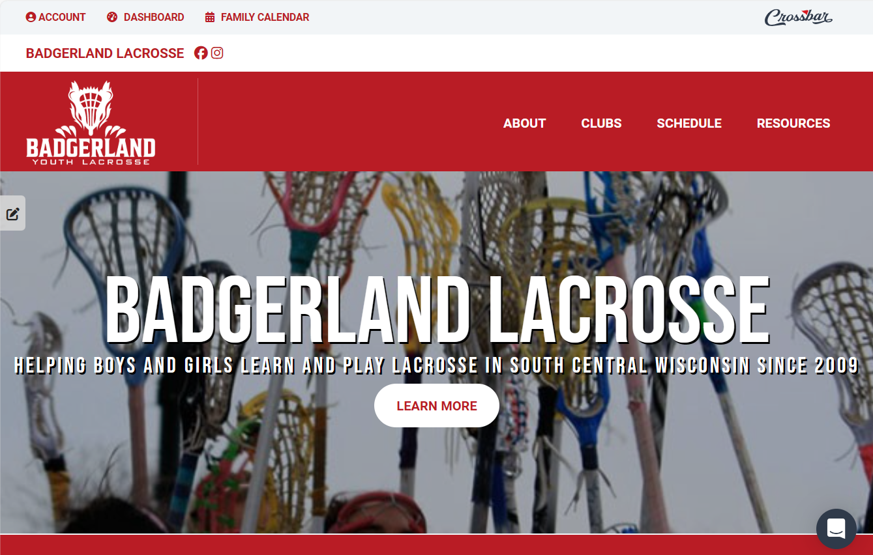
Website
https://www.badgerlandlacrosse.com/

Slide 12
Conduct/Sportsmanship
Consequences for Violations
First Offense: Verbal warning
Second Offense: Removal from game or field.
Repeated Offenses: Possible suspension from future games or events.
BLA Youth Lacrosse Sportsmanship Rules
For Players
Respect Everyone – Treat teammates, opponents, coaches, and officials with courtesy.
Play Fair – Follow the rules of lacrosse; no cheating, taunting, or unsportsmanlike conduct.
Positive Attitude – Encourage teammates and stay calm under pressure.
No Trash Talk – Avoid negative comments toward opponents or officials.
Safety First – No intentional rough play or actions that could cause injury.
For Coaches
Lead by Example – Model respect and integrity for players and parents.
Encourage Effort Over Outcome – Focus on improvement and teamwork, not just winning.
Respect Officials – Disagree respectfully; never argue calls during games.
Promote Inclusion – Ensure all players feel valued and supported.
Zero Tolerance for Abuse – No yelling, intimidation, or negative behavior toward players or referees.
For Parents & Spectators
Cheer Positively – Support all players, not just your child.
Respect Officials & Coaches – Do not confront referees or coaches during games.
Set the Right Example – Show good sportsmanship from the sidelines.
Keep Perspective – Remember: It’s about fun, learning, and growth—not just winning.
No Sideline Coaching – Allow coaches to do their job.

Slide 13
Officials and Rules
Clubs are responsible for paying officials before or after the game.
Fees shall be split between the two clubs involved in the game
Type | Amount
10U | 1 Official - $60.00 per game
12U/14U | 2 Officials - $60.00 per official per game or 1 Official - $90.00 per game
    Note: If you cancel a game, and officials don’t know and show up, hosts are still responsible for paying them

Slide 14
Boys Rules
Badgerland follows USA Lacrosse rules unless otherwise noted below.
Category | 8U | 10U | 12U | 14U
Ages / Grades | 7-8 yrs. (1-2) | 9-10 yrs. (3-4) | 11-12 yrs. (5-6) | 13-14 yrs. (7-8)
Players | 4v4 | 7v7 | 10v10 | 10v10
Field Size | Half | Half | Full | Full
Goalie, Goal Size | No, 3x3 or 6x6 flipped | Yes, 4x4 or 6x6 flipped | Yes, 6x6 | Yes, 6x6
Ball | Soft* | Hard | Hard | Hard
Face Off / Offsides | No+ | Yes | Yes | Yes
Body Checking | No | No | Yes | Yes
Long Pole | No | No | Yes | Yes
Officials | Coach | 1 | 2 | 2
Man Down | No | No | Yes | Yes
On-The-Fly Substitution | No | No | Yes | Yes
Mercy Rule | Yes – 6+ | Yes – 6+ | Yes – 12+ | Yes – 12+
Time | 2x12 minutes (run) ¥ | 4x10 minutes (run) | 4x12 minutes running | 4x12 minutes running
Slow Whistle | Yes | Yes | Yes | Yes
Misc. | 1 pass attempt before shot | 1 pass attempt before shot | No one-arm stick checks | No one-arm stick checks
* Ball: If the teams practice with regular/real balls and are comfortable with them, they are allowed if both teams/coaches agree
+ Face-offs: If the teams have practiced face-offs (especially towards the end of the season or as the kids are getting ready for 10U), it is allowed if agreed to by coaches
¥ Game time: Depending on team size and coach's discretion, longer games are allowed as long as it doesn't interfere with upcoming games and coaches agree

Slide 15
Girls Rules
All ages:
Use hard balls and require full head gear (goggles or helmets) and mouth guards, players may also wear close fitting gloves if desired
Mercy rule at 4+ goal differential, the losing team starts with the ball at center field, all players are 4M away
The sphere for 14U and under is 12”
On the fly substitution allowed for all ages
Stick check may be requested at any time
Deputy goalkeeper is a defensive player entering the circle to tend goal if the goalie steps out
All games are run time, clock only stops for team timeouts and injury timeouts
Teams may call a timeout when they have possession, all players must drop sticks where they are, at end of timeout player pauses before self start
Game pauses, player must go back behind the restraining line but not turnover. Offside for 12U and 14U requires turnover.
Closely guarded rule states that a player may not hold the ball for more than 3 seconds if they are closely guarded, defense has both hands on the stick and if they player could be checked if checking is allowed. This is only applicable in the midfield and is used when a player is no longer progressing down the field.

Slide 16
Girls Rules
Badgerland follows USA Lacrosse rules unless otherwise noted below
New 12U Division in 2024 (dependent on Teams available)
Category | 10U | 12U | 14U
Grade Level | 3rd-4th | 5th-6th | 7th-8th
Number of Players | 8v8 w/goalkeeper; 7v7 w/o goalkeeper | 12v12 w/goalkeeper | 12v12 w/goalkeeper; (deputy permitted) (1)
Goal Size | Full, flipped if no goalkeeper | Full | Full
Field Size | Half | Full | Full
Length of Game (2) | 10min quarters, 5min half time, 2min between quarters | 10min quarters, 5min half time, 2min between quarters | 12min quarters, 5min half time, 2min between quarters
Timeouts (3) | 1 (60sec) | 2 (60 sec ea) | 2 (60 sec ea)
Start of Game and Quarters | Draw at center | Draw at center | Draw at center
Start After Goal | Goalkeeper: Goalkeeper clears, all players outside of 8M; No Goalkeeper: Ball to defender at side of goal, all players 4M away, player self starts | Draw at center, unless Mercy Rule is in play | Draw at center, unless Mercy Rule is in play
Offsides(4) | Not Enforced, 2 behind restraining line | Enforced, 3 behind restraining line | Enforced, 3 behind restraining line
Covering | Not allowed | Not allowed if another player is within a sticks distance | Not allowed if another player is within a sticks distance
Checking | No Checking | Modified Checking (below the shoulder, away from the body) | Transitional Checking (away from body, below shoulder if from behind)
3sec 8M rule | Not applicable | Yes | Yes
3sec Closely Guarded (5) | Yes | Yes | Not Applicable
Officials | 1 Required | 2 (1 Required) | 2 Required

Slide 17
Girls Program Evolution
Our goal is to move away from only having 10U and 14U teams. This is heavily dependent on numbers across clubs, coordination, and getting girls involved earlier in lacrosse
8U:
Players receive a stick, goggles and pinnie from BLA per the $25 registration fee
Program runs April 20th- June 1st, with two 1.5 hour practices per week and scrimmages as appropriate.
Suggested minimum group is 10 players
if a club has 10+ players, they can have their own team, but we may still ask them to accept players from neighboring clubs
Any questions please reach out to blavpofgirls@gmail.com
12U:
As lacrosse grows in Dane County we need to expand our age group options for girls
Last year we had our first year of 12U and we would like to expand it this year.
We understand not every club will be able to have each age group but encourage you to put the most kids in the correct age group as possible.
If your club does not have a 12U team we would be happy to assist in creating a co-op team with another club.

Slide 18
Officials and Rules
Officials Coordinators
Boys
Jeremy Sullivan
Email: malabyoc@gmail.com
Phone: 1-708-269-2700
Girls
Scott Saunders
Email: saunders.lax@gmail.com
Phone: 1-847-217-9030

Slide 19
Appendix

Slide 20
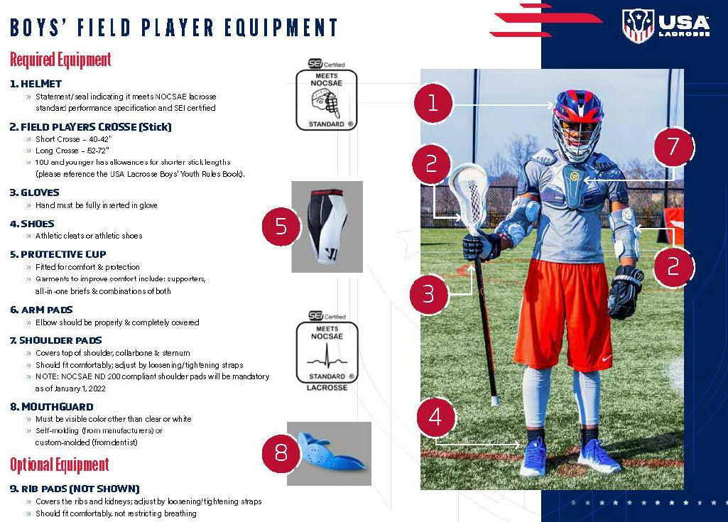

Slide 21
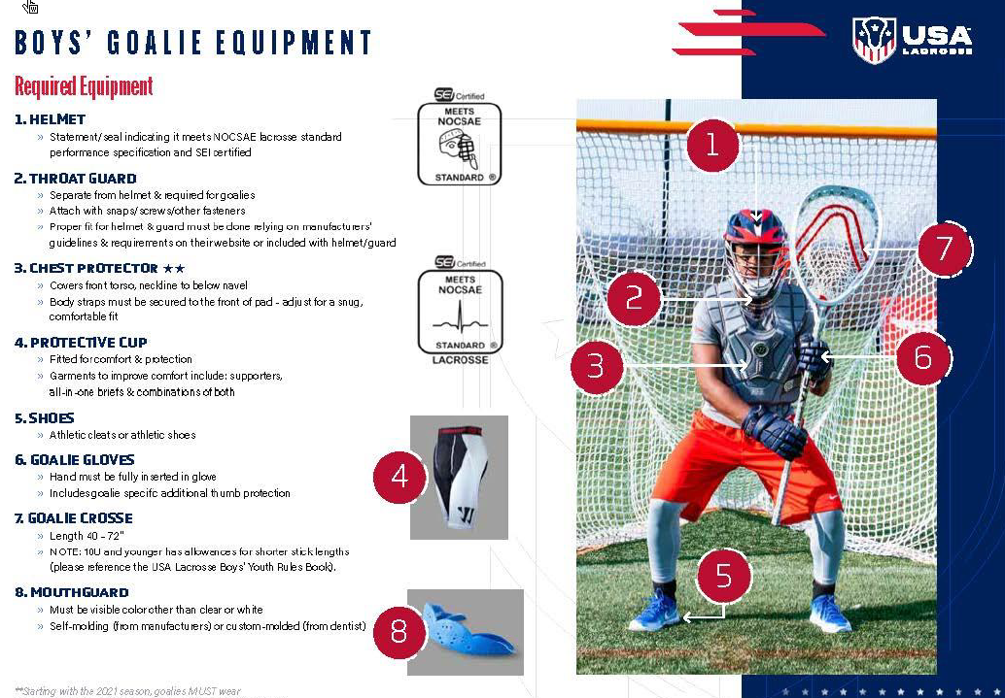

Slide 22
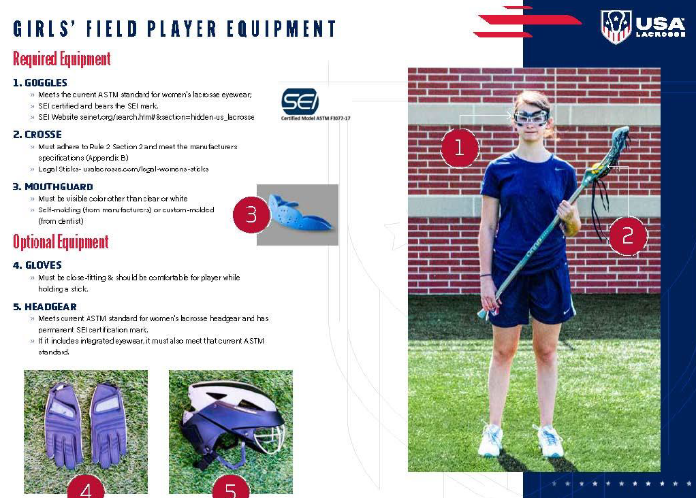

Slide 23
