Slide 1


WSLA Scorer & Timer Clinic
Feb 26th, 7pm

Slide 2
Table Personnel Reminder
ALL TABLE PERSONNEL MUST REMAIN NEUTRAL...
You cannot cheer, coach, yell, etc. from the table
The scorers and timekeepers have official status. They are neutral and should not cheer, call fouls or make comments from the table area.

Slide 3
Scorer & Timer Resources
USA Lacrosse Rulebook
WSLAX.org – Resources – Scorer & Timer
Procedure and Terminology Handouts
Score Sheets
Stats Guide
Notes:
Is there an update for the USA lacrosse rulebook?

Slide 4
Table Personnel
Official Scorer & Timer – HOME team
Spotters
Visiting Team Statistician

Slide 5
HOME TEAM Equipment
Air horns
Digital clocks or Lacrosse timing app
Extra batteries
Stat sheets, pencils and eraser
Canopy, table and chairs
Flip-A-Score or use of Scoreboard
Alternate Possession indicator (cone)
NOCSAE stamped lacrosse balls (4)
10 soft or flexible cones, pylons or flags

Slide 6

Pre-Game Set Up
Arrive early
1
Set up table
2
Meet with Officials
3

Slide 7
Timer Duties – Running Clock vs Stop Clock
Youth = Running Clock
High School = Stop Clock

Slide 8
Running Clock-Youth
Clock continues to run after goals and in the last minute of each quarter unless a time-out is signaled.
10 min quarters 8U-12U
12 min quarters 14U

Slide 9
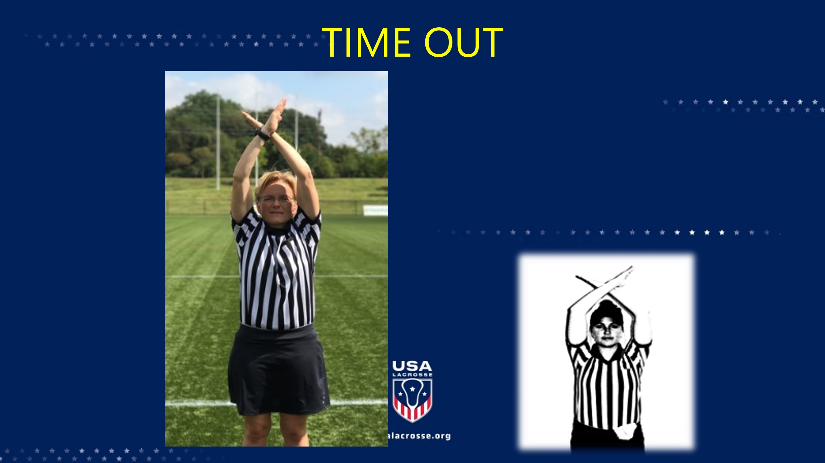

Slide 10
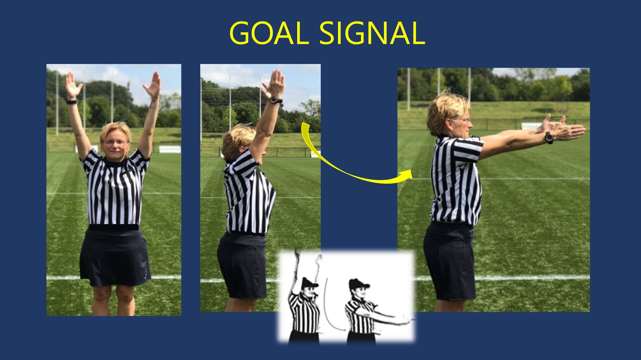

Slide 11
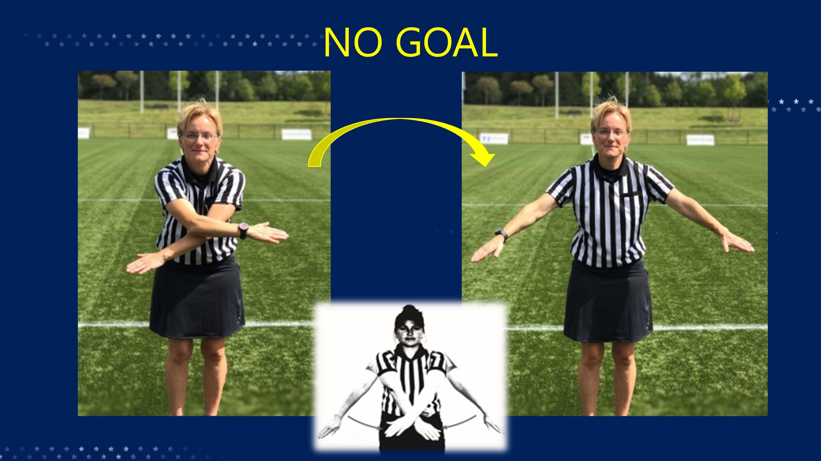

Slide 12
Stop Clock - HS
Clock starts on the whistle at each draw
Stops at official’s whistle and arm signal after each goal
Stops/Starts at whistle for Time-Outs
Stops in the last minute of EVERY quarter when there is a foul in the Critical Scoring Area
10-Goal differential = Running Clock
Notes:
HIGHLIGHTED IS RULE CHANGE

Slide 13
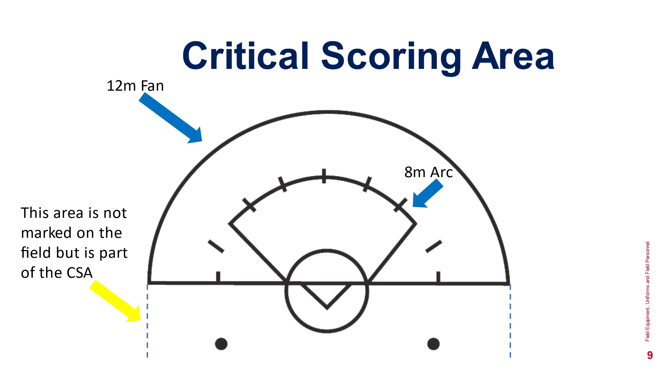

Slide 14
Timer Duties
Time Penalty Cards, Time-Outs, Half Time
1
Notify Official when there are 2 minutes remaining in all quarters
2
Sound horn to end each quarter
3
Watch for fouls in the CSA
Stop time at official’s signal

Slide 15
Timer Tips
Time matters in close games. Count down last 10 sec aloud.
A goal is scored IF the ball leaves the crosse BEFORE the horn sounds.
Don't get carried away watching the game.
Notes:
STEP ONTO THE FIELD

Slide 16
Scorer Duties – Youth & HS
Record team rosters, confirm player numbers
Record goals scored
Record the issuance of cards
Record ALL team timeouts
Maintain an accurate record for alternate possession

Slide 17
WSLA Required Statistics – High School
Goals (G)
Assists (A)
Ground Balls (GB)
Caused Turnover (CT)
Draw Control (DC)
Goalkeeper Saves, Game Score and yellow/red cards

Slide 18
Scorer Tips
Talk to Coach about what stats they would like taken beyond the 5 required.
Stat sheets are customizable. Prepare sheets ahead.
Rite in the Rain paper
List players on your score sheet by player number.

Slide 19
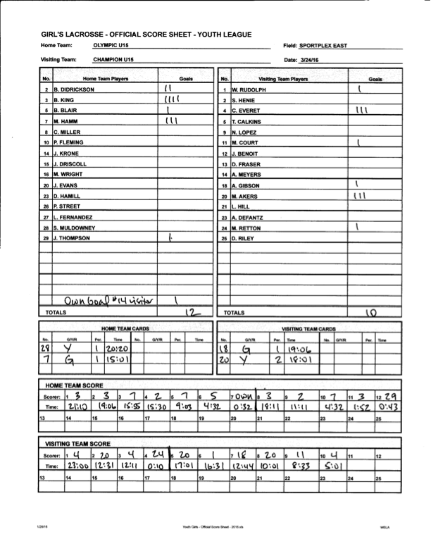
Youth Sample Score Sheet

Slide 20
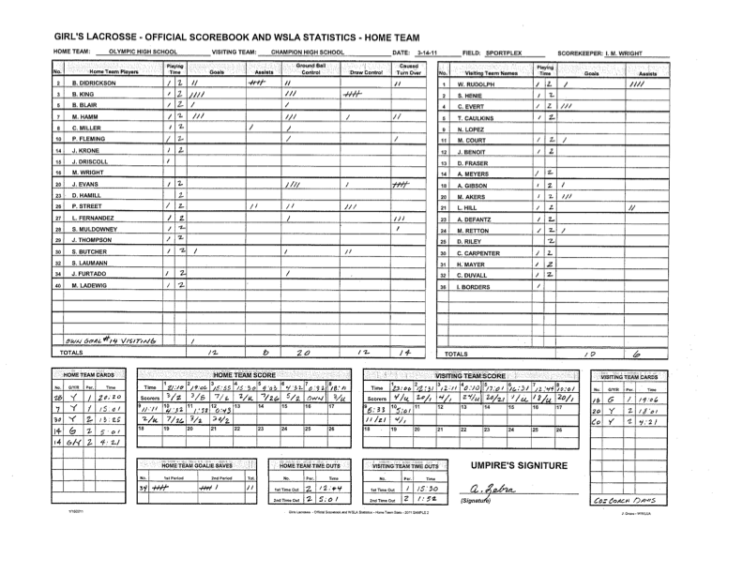
HS Sample Score Sheet

Slide 21
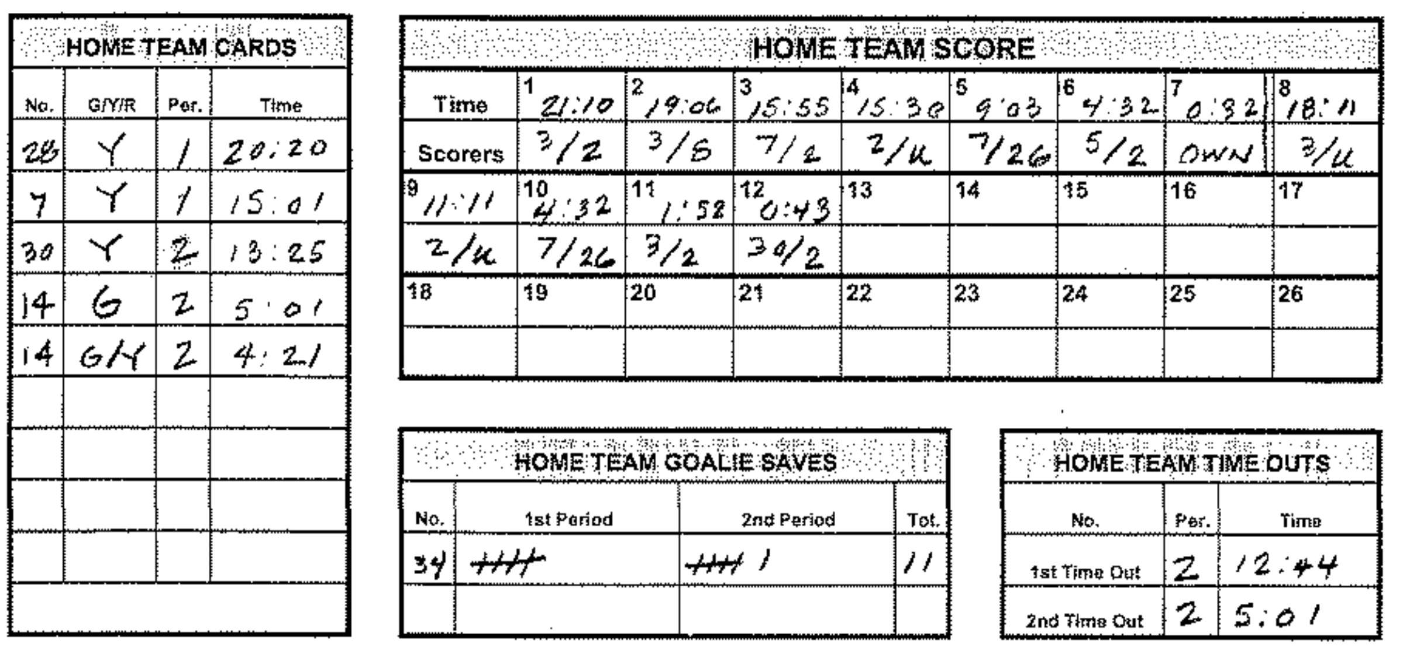

Slide 22
Goal
A goal occurs when the whole ball passes completely over the goal line and should only be recorded if the signal for such has been given by the official.

Slide 23
Assist (A)
An assist is a play made by a player to her teammate who then scores a goal without having to evade excessive defensive pressure other than the goalkeeper. Only one assist per goal may be recorded.
Pass contributes directly to goal.

Slide 24
Ground Ball (GB)
A GB is recorded when a ball changes possession during live-ball play or when the ball hits the ground (due to check, drop, errant pass, or shot) and retrieval of the loose ball is directly contested (within a sticks length) by the opposing team.

Slide 25
Caused Turnover (CT)
This statistic is defensive-minded and is designed to give a player credit for disrupting play which results in her team’s gaining control of the ball resulting in a change of possession. A CT may be awarded to the player if she performs any of the following actions resulting in a change of possession: stick check, interception, blocked pass or shot, drawn charge.
There is often a 2nd stat associated with a CT.

Slide 26
Draw Control (DC)
A draw control is awarded to the player who controls the ball following the taking of a draw; i.e., gains possession following the draw.

Slide 27
Save
A save is recorded each time a goalie stops a ball from going into her goal that, if she did not stop, might result in a goal for the opponent.
If a goalie stops a shot, either by catching it in the goal circle or deflecting it away from the mouth of the goal with her crosse or body, it is a save.

