Slide 1
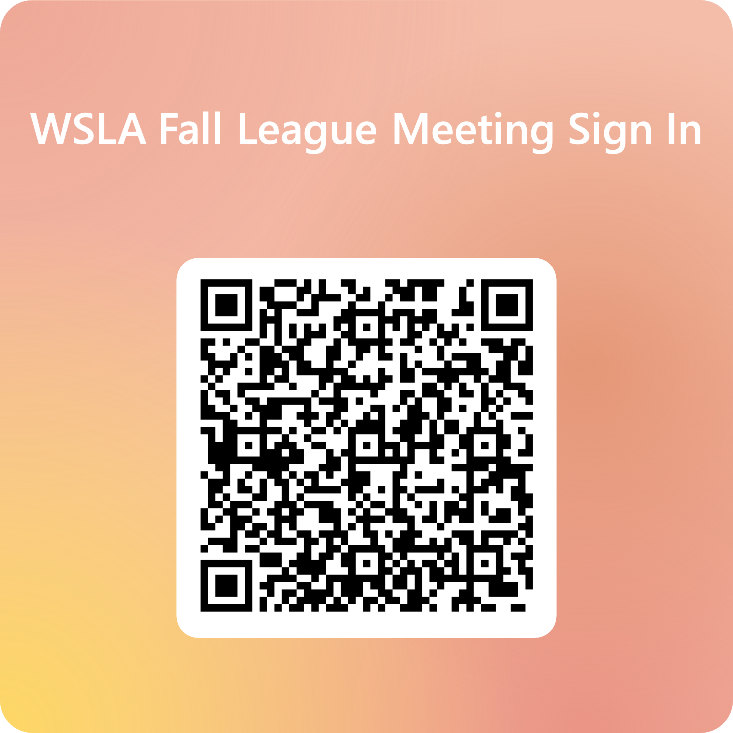

Slide 2

WSLA
October 26, 2024
Fall League Meeting

Slide 3

WSLA Fall League meeting
Lyn Porterfield | October 26, 2024

Slide 4
COACH CERTIFICATION REMINDERS FOR 2024
Bronze level certification required for ALL coaches
  Entry level coach certification included with USA Lacrosse membership
    Requirements:
      Valid membership for duration of season
      Background check (good for 2 years)
      Abuse Prevention course (good for 2 years)
      Concussion Education course
      Sudden Cardiac Arrest (SCA) course
      Cultural Competency course (take once)
      Annual Rules test – no
Silver level certification takes place of former WSLA Level 1 certification requirement.
  If you’re currently Level 1 certified you were transitioned to Silver, Level 2 to Gold, Level 3 to Platinum.
More information on certification changes is here: https://www.usalacrosse.com/new-coach-development-faq
WSLA Fall meeting

Slide 5
2025 Spring season reminders
Member Organization Agreements required again for 2025.
  Submit and you’ll receive the link to request Certificates of Insurance (COI) for field rentals.
  Available first week of December 2024.
Program Leader membership – introduced July 2024:
  Each member program must have a minimum of one Program Leader member starting 1/1/2025.
  Requires Background check + Abuse Prevention (similar to coaches)
  Access to Resource Library and webinars.
Don’t forget (see Lyn for details):
  Discounted memberships for players needing financial assistance
  Non-member event insurance for introductory clinics
WSLA Fall meeting

Slide 6
National Celebrate Lacrosse Week 2024
FIVE host sites in Washington state this year!
  November 2, 9:00AM: Kamiakin Lacrosse hosting @ Desert Hills MS (Kennewick)
  November 3, 12Noon: Kitsap Youth Lacrosse hosting @ Bremerton Sports Center
  November 10, 10:30am: WSLA hosting @ Brighton Playfield (Seattle)
  November 10, 12Noon: Bainbridge Lacrosse hosting @ Battle Point Park
  November 10, 1:00pm: Valley Lacrosse Alliance hosting @ Rogers HS (Puyallup)
More information on National Celebrate Lacrosse Week is here:
  https://www.usalacrosse.com/national-celebrate-lacrosse-week
WSLA Fall meeting

Slide 7

410-316-6105
Lyn Porterfield
Regional Director – Pacific + Mountain
lporterfield@usalacrosse.com
Work: 443-645-0919
Cell: 206-972-8610
Kate Macintyre
Regional Coordinator – Pacific + Mountain
kmacintyre@usalacrosse.com
Work: 410-316-6105

Slide 8
2024 September Board Planning & Updates
WWLOA Chair: David Almond
NEW WEBSITE: Crossbar
8U additional game – Playing 5 instead of 4
8v8 at 12U
Mercy Rule – Point of Emphasis with WWLOA
Co-President: Sara Towner & Jamie Asaka​
Notes:
Edith has stepped down, and David Almond will be the new WWLOA Board Chair
New website – Crossbar. Very easy to use. Show on the next slide

Slide 9
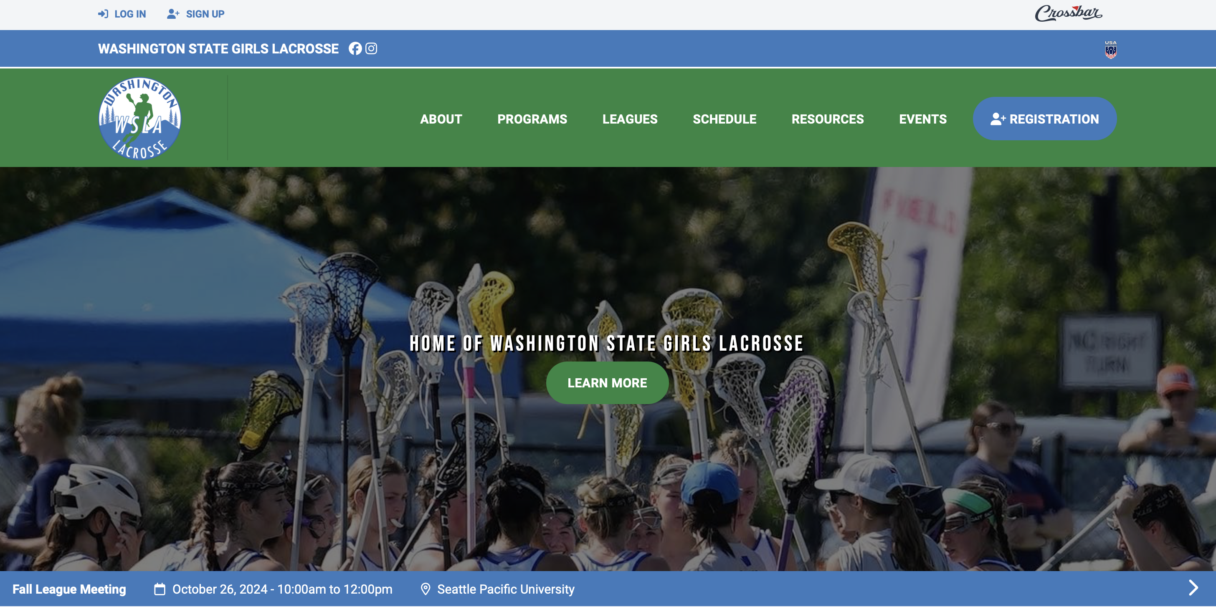
NEW WEBSITE!

Slide 10
12U > 8v8 Format - Shift from Full Field Play
More touches and involvement for all players = Increased Development
A vast majority of 12U players are new and/or beginners to the sport. Full field play minimizes individual growth as teams tend to rely on a select few to carry and move the ball to advance game play. The 8v8 format will increase player skill and involvement as there is ‘no where to hide.’
Fast paced and Fun!
With increased touches and involvement the games will move fast! Similar to basketball, players will run the field more often with less play stoppage.
Increase in Program Participation
8v8 format will increase program participation from 26 to 33 (if not more) & more programs will compete as their program
In 2019, WSLA had 38 12U teams - various programs with multiple 12U teams. In 2024, WSLA carried 26 12U teams - only 3 programs had two 12U teams and multiple neighboring programs combined to field a 12U team.
Roster size recommendations > WSLA recommends 14-18 players per team
2024 spring season brought some woes relative to 12U full-field rosters sizes and game scenarios. Many teams played with little to no subs or even played ‘woman down’ consistently. The 8v8 format allows for more program involvement given the need for slightly less players to register a team.
Programs with larger numbers can field more than 1 team if applicable - MORE ON THIS LATER….
The pace of 8v8 format at the 12U level will be fast paced. Players will tire quickly given the back and forth format, thus the need for substitutions (on the fly during offensive transition). 10U teams get by with fewer players due to the slower nature of the game.

Slide 11
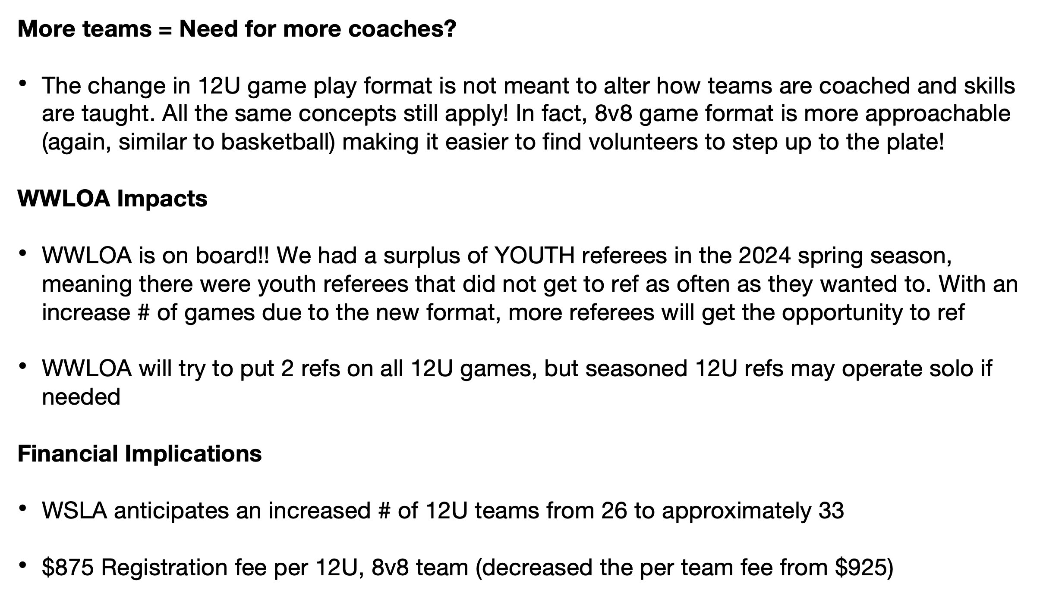
12U > 8v8 Format - shift from full field play (cont.)

Slide 12
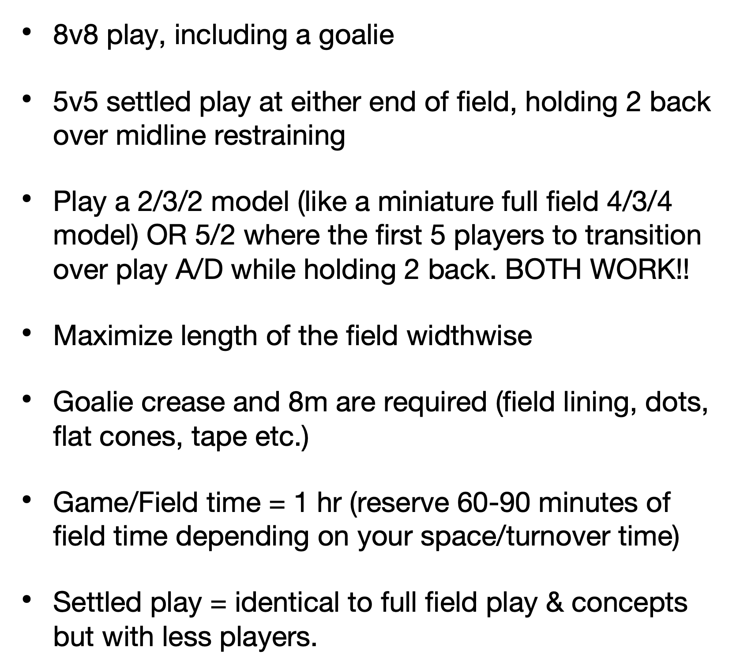
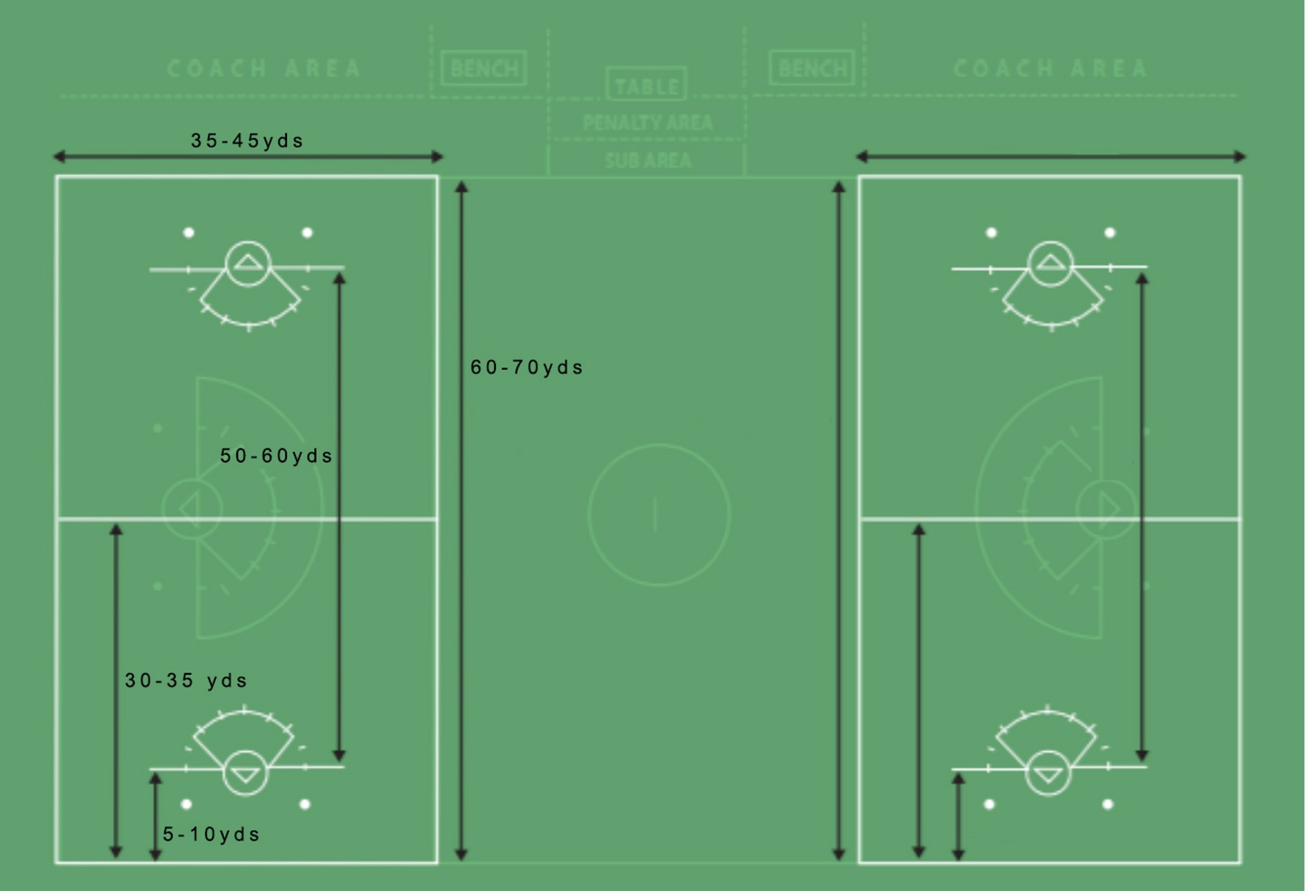
12U > 8v8 Field Setup & Play

Slide 13
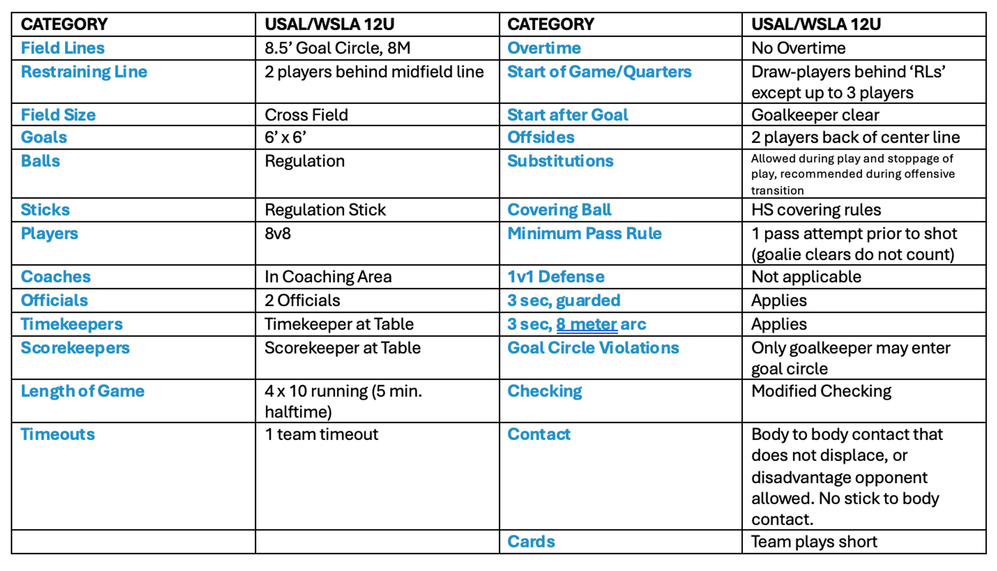
12U > 8v8 Rules
Attack, midfield and defensive concepts should be taught the same in the new format given the use of the mid-line as a restraining line

Slide 14
12U > 8v8 Scenarios & Guide
Practice & Coaching Strategies with 12U Shift
•Keep things as they are! Practice all of your 12U players together with your typical coach(es) and make a plan for game coverage.
•Coaching is more approachable under these circumstances. To some/most of these 12U players, it will feel like a continuation of 10U play w/ slightly advanced rules.
•Home games can be scheduled simultaneously or back to back - this will be indicated on your scheduling form (same as 10U scheduling).
•Away games - if your program has 2 teams and they are playing in different locations, split coaches and bring HS player helpers! Game management and subbing is easier with 8v8 play.
•Adult volunteer coaches, HS player coaching assistants, HS Player Coaches, Paid coaches - we don’t want you to change what is already working for your program.
12U Scenarios and WSLA Recommendations
•12-18 players > 1 team, 1-2 coaches
•18-24 players > consider 2 teams OR 1 team with 3 pods - assign 2 pods to each game & practice all players together
•24-36 players > 2 teams, 2-3 coaches
•36-45 players > consider 3 teams or 2 teams with pod rotation
•Multiple 12U teams? > create even, skill based teams (recreational lacrosse, not A and B teams)
•You know your program best relative to practice and game attendance. Pick a solution that works for your program.

Slide 15
Registration Fees 2025
Fee | 2022 | 2023 | 2024 | 2025 | Change 24-25
V | 1500 | 1500 | 1630 | 1850 | 13%
JV | 1400 | 1400 | 1520 | 1700 | 12%
14U | 900 | 900 | 980 | 1100 | 12%
12U | 700 | 700 | 765 | 875 | 14%
10U | 400 | 400 | 445 | 525 | 18%
8U | 100 | 100 | 115 | 150 | 30%

Slide 16
Out of Season Reminders
In-Season Coaches CANNOT coach their in-season players Labor Day – MLK Day unless…
Open to ALL WSLA players
Posted on the WSLA website AT LEAST 7 days before the practices/clinic begins
HS Coaches CAN coach the youth players that feed into their HS program
Post MLK Day – Beginning of Season is HS Coaching Dead Period
Captain’s Practices OK
Year-Round Conditioning OK
Youth Recruitment OK

Slide 17
2025 Season Dates
Youth and HS Calendar Dates are available under About -> Important Dates
Season Begins February 24, 2025

Slide 18
Officials & Recruitment
Year | New Adult | Total Adult | New Juniors | Total Juniors
2021 | 7 | 46 | 21 | 44
2022 | 6 | 49 | 37 | 50
2023 | 17 | 68 | 46 | 75
2024 | 7 | 59 | 30 | 78
HS teams are responsible for recruiting adult officials for the HS league (1 per year)
$200 Fine for not meeting recruitment requirements (details on next slide)
Recruitment of adult officials is essential so that games will not be cancelled

Slide 19
Official Recruitment Requirements
Requirement is proportional to the number of teams fielded
  1-3 teams = 1 requirement
  4-6 teams = 2 requirements
  7-9 teams = 3 requirements
  10 teams = 4 requirements
  Each 10U team counts as ½ a team for these purposes
IND Youth | ADULT | COACH | 2nd Year Adult
Rated + 10 | Rated + 5 | Rated + Jamb | Rated + 8

Slide 20

WWLOA Training Dates
January 11th (Saturday) in Spokane
January 26th (Sunday) location TBD
February 8th (Saturday) location TBD
February 23rd (Sunday) location TBD
March 1st (Saturday) location TBD
Tentative Locations:
Archbishop Murphy (North Sound)
Bellarmine Prep (South Sound)
East side catholic (Central)
Lakeside (Central)

Slide 21
Rating Jamborees
8 Mar. and 9 Mar.
High School – March 8 & 9, 2025 (More to come on locations)
15 Mar. and 16 Mar.
Youth – March 15 & 16, 2025 (More to come on locations)

Slide 22
Boundaries & Player Assignments
Know your boundaries/Know your players
Post boundaries on homepage of program website
Boundaries should be clear within registration
Verify participant addresses long before practices start
Youth & HS assignment charts on WSLAX.org
Player assignment rules in the handbook – questions ask MK

Slide 23
Youth Scheduling
Be sure to be reserving fields now
14U, 12U, 10U will be scheduled 8 games; 8U will be scheduled 5 games (an increase from 4 last year). This does mean 8U MAY start before spring break – based on teams availability.
Teams will be scheduled regionally
May potentially play the same team more than once

Slide 24
Youth Scheduling Dates
11/20/2024 Scheduling Point of Contact due to admin@wslax.org
1/15/2025 Registration Opens
Schedule Forms should be filled out WITH coaches
ONLY 2 BLACKOUT weekends allowed, more than that reduces the # of games you will be scheduled
1/27/2025 DEADLINE for Registration, Fees in FULL & Scheduling Forms
Programs pay in FULL at time of registration with credit card or e- check.
Schedule Change Deadlines – if they are not met games will not be rescheduled, NO EXCEPTIONS. Programs are responsible for knowing the deadlines

Slide 25
Youth Program Leader Summit
Discussing Recruitment
8v8 for 12U continued discussion
Today in this room after the meeting
Even if you didn’t RSVP you are welcome to join if you have the time

Slide 26
Varsity Scheduling
Play Everyone in your Conference
Eastern conference 2x
Out of Conference games will consider
Power Rankings
Availability and Travel
Requests – Both teams need to make request to have it placed on the schedule
Reserve field time for playoffs (games must be 5:30pm or later)
1st Round May 5 & 6 | 2nd Round May 8 & 9th
Rainier Cup May 10 & 11th | Neutral Site | 2 games Saturday, 3rd place & Championship game Sunday
More to come for location
Semi-Finals May 13, State Championships May 16 - Starfire

Slide 27
HS Scheduling Dates
JV 10 games
Varsity 12 games
11/1/2024 JV & Varsity Registration Opens
11/15/2024 JV & Varsity Registration Deadline
12/15/2024 HS Registration League Fees Due in Full
1/28/2025 Last Day to Drop a JV team for a refund less the $350 deposit
Notes:
We did move the date to drop a JV team back... we can't give people until season but this should give people a full month back at school and we understand SOME HS programs don't open registration until january based on how some schools run

Slide 28
WSLA Winter League Meeting
January 25, 2025
Seattle Pacific University
Otto Miller Hall room 109
Youth Meetings 9-10:30am
HS Meeting 10:30am – Noon
HS New rules Interpretation 9-10:30am
  https://www.nfhs.org/sports-resource-content/girls-lacrosse-rules-changes-2025/
Youth New rules will be virtual closer to the season start
Working to get a CPR class again – details coming
Coach mixer to follow – details coming
Notes:
REQUIRED IN PERSON

Slide 29
Communications
Website – wslax.org
Social Media
  Instagram – wa_glax
  Facebook – Washington Girls Lacrosse
Stories
  Successes, Players, College commitments
  Out of season, clinics
  We want them all!!

