Slide 1
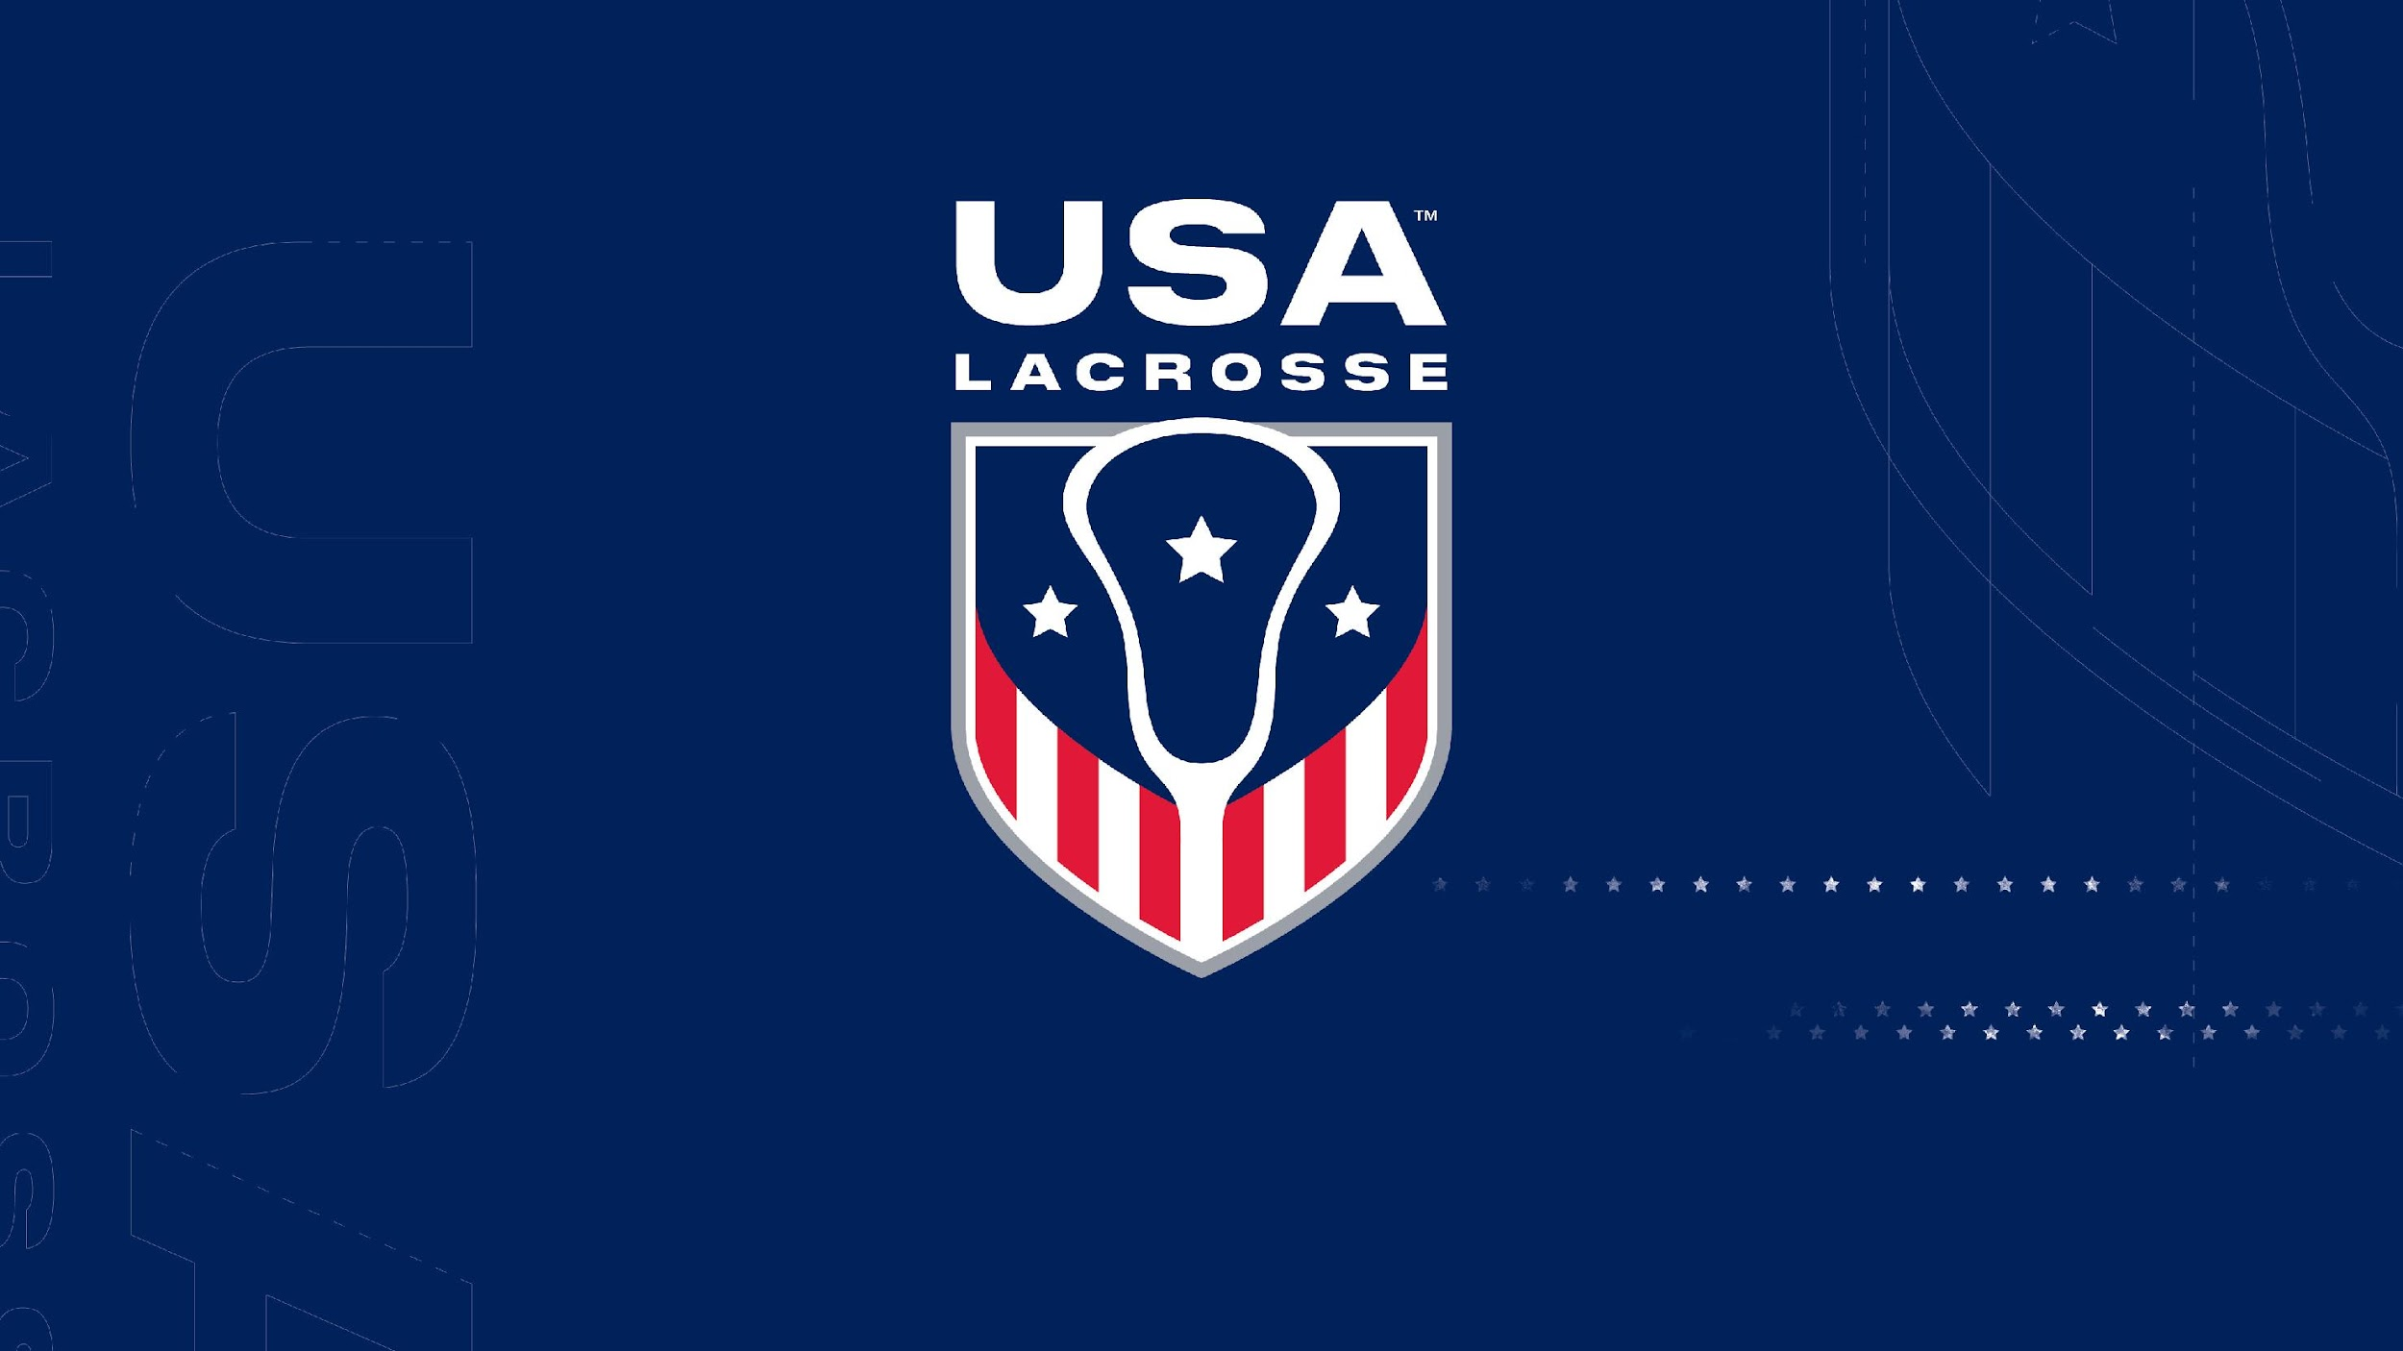
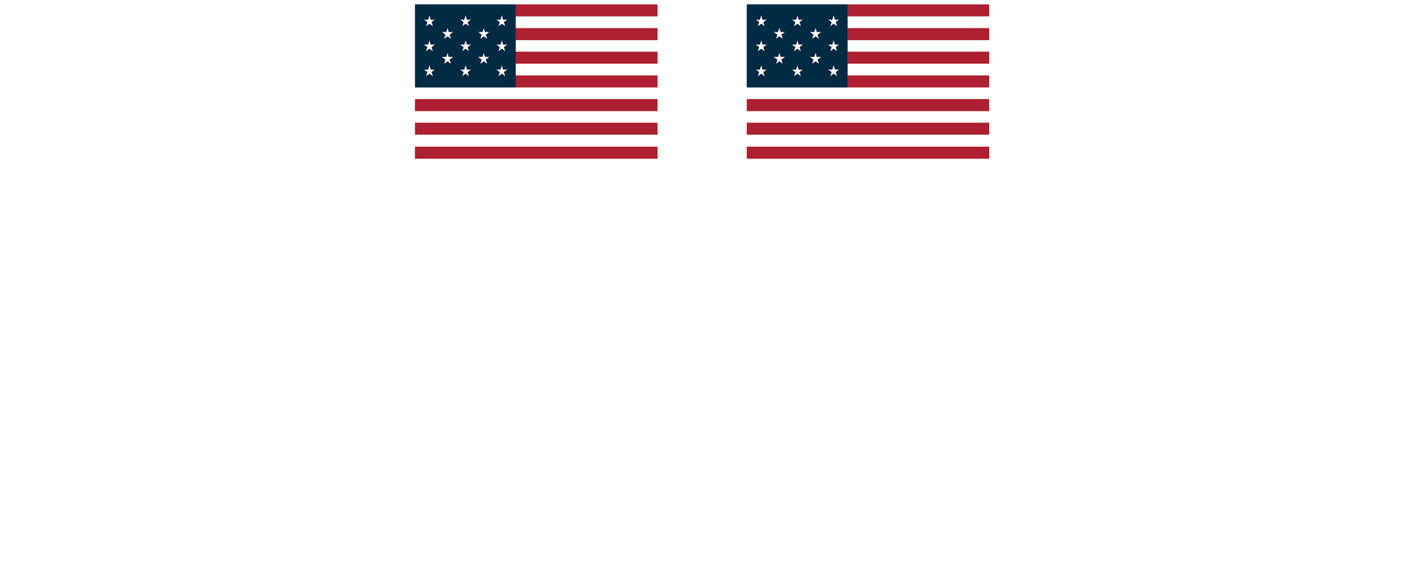
2026 Boy’s Youth Rules Interp
Jim Carboneau, Rick Lake, Mark Burnett, Caitlin Kelley | 2-26-26

Slide 2
Disclaimer
This PowerPoint presentation is intended solely for educational purposes and serves as a supplementary resource to facilitate understanding of the 2026 boys youth lacrosse rules. It is not a substitute for reading and studying the official rulebook.
Please be aware that the information presented here is subject to monthly updates, and revisions may occur. For the most accurate and current information, it is strongly recommended to consult the official rulebook and refer to any published memos provided by NFHS/USA Lacrosse.
Individuals seeking clarification or interpretation of rules are encouraged to reach out to their state or local rule interpreter for guidance. The content herein is not exhaustive, and any discrepancies should be resolved through reference to the official rulebook and relevant communications from the governing lacrosse authorities.
2

Slide 3
Agenda
Clarifications for 2026
  1-9-1B (4 & 5) Updates to Mouthguards
  4-3-3e Clarifications for Players Facing Off
  4-8 Clarifications for Goals Scored
  4-18-4 and 5-6-2 – Goal Crease Privileges and Updated Player Penalties
  4-22-1c Elimination of Goalie 5-second Rule on Restarts (14U and 12U Only)
  6-3-2c Clarifications to Holding Penalties
  6-5-2y Loss of Helmets Resulting in Technical Foul for Illegal Procedure
  7-3 Ball Location for Restarts when Fouls Occur in Attacking Area
8U/10U Penalty Administration
Loss of Helmet Questions
Questions Submitted
3

Slide 4

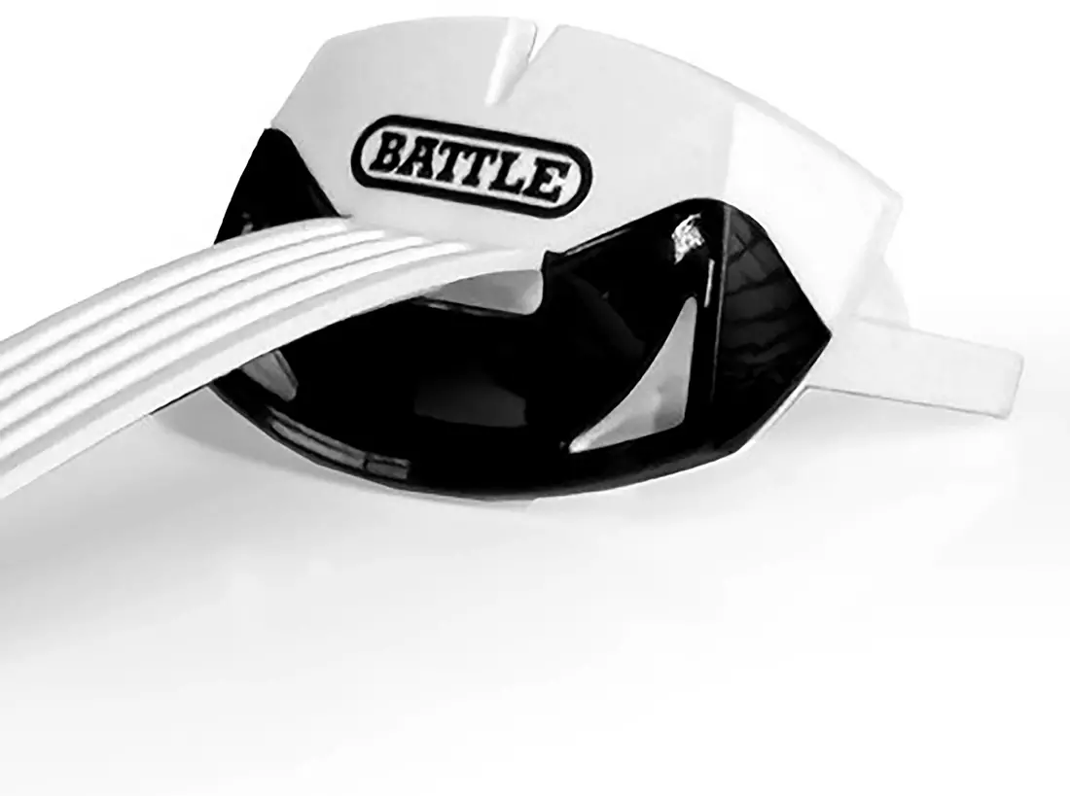
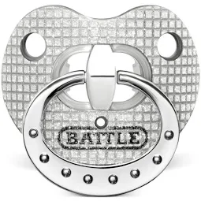
Mouthguards
There are no longer any color restrictions for mouthguards or a lack of color (White and Clear).
However, mouth attachments that serve no protective purpose or are purely decorative are prohibited.
Reminder: The penalty for an illegal mouthguard is a technical foul. This is an exception to Use of Illegal Equipment penalties.
4

Slide 5
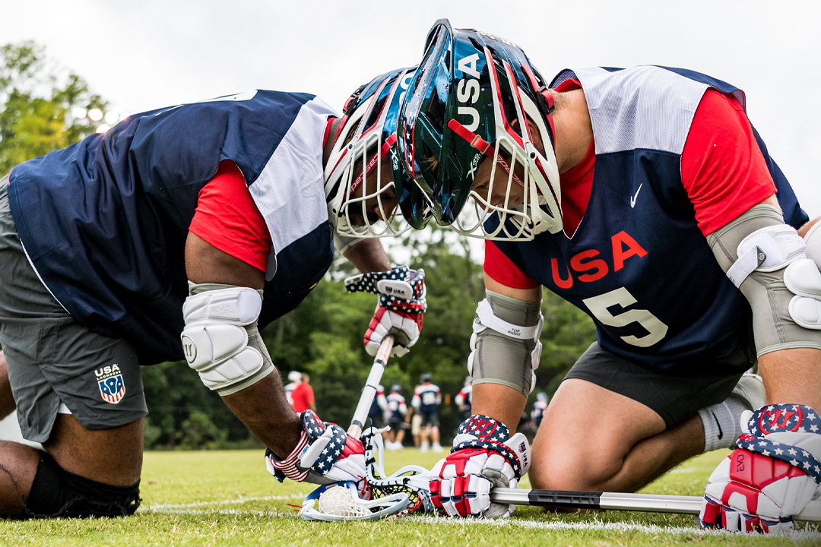
Clarifications for Players Facing Off
If faceoff players are not positioned properly during a faceoff, the official may adjust the players’ positioning or their crosses to ensure a fair faceoff.
If players must be repeatedly adjusted, the official may assess a delay-of-game penalty and award the ball to their opponent.
This is at the discretion of the officials and should be discussed with faceoff players and the coach before and during the game.
5

Slide 6
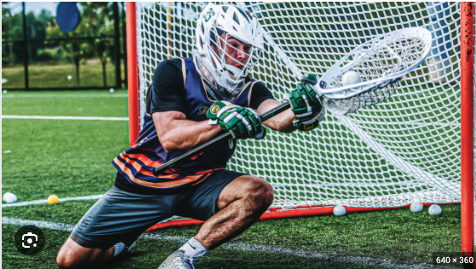
Clarifications for Goals Scored
A goal is defined as a loose ball that completely crosses the goal line
If a ball were to be in possession of the goalie or a defender while in their own crease and the stick was brought over the goal line and then dropped it would be a goal.
PRESENTATION TITLE HERE
6

Slide 7
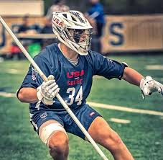
Goal Crease Privileges
In all cases, it is now a personal foul for illegal equipment when a defensive player, other than a properly equipped goalkeeper, enters their own crease with the perceived intent of blocking a shot or acting as a goalkeeper.
7

Slide 8
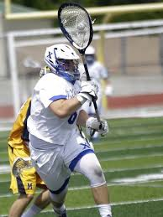
Elimination of Goalie 5-second Rule on Restarts (14U and 12U only)
Rule 4-22-1c was eliminated – The goalkeeper is no longer allowed up to 5 seconds to re-enter the goal crease to resume their position after leaving for a legitimate purpose.
If a goalie leaves the crease, they are a field player.
However, if a goalie leaves the crease and officials notice a goalie equipment issue during a dead ball, then by rule, we need a properly equipped goalie to resume play.
Not adopted at 10U and 8U
8

Slide 9
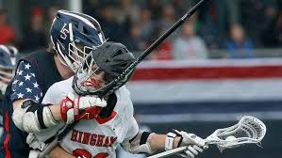
Clarifications to Holding Penalties
The penalty for holding has not changed
The added terms “hook,” “lift,” and “pin” further define holding and provide clearer guidance on illegal actions that have become more common in games.
This helps officials to officiate plays like the “Crowbar”.
9

Slide 10
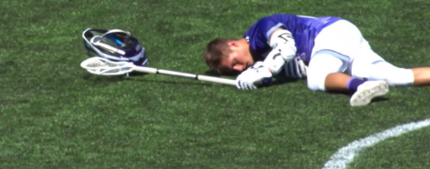
Loss of Helmets -Illegal Procedure
Loss of a helmet is an illegal procedure, unless the official determines that the helmet was dislodged due to direct contact with the player's head.
In any case, if a player’s helmet comes off as a part of play, that player must leave the field and may return after the next dead ball.
10

Slide 11
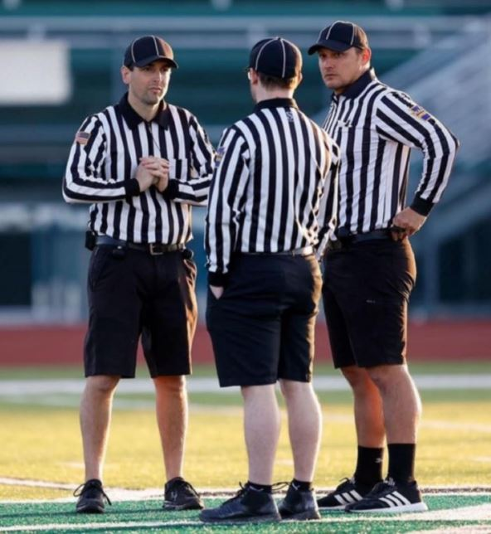
Ball Location for Restarts in Attacking Area
If the ball has crossed the end line before or after the penalty occurring, the ball shall be restarted laterally outside the goal area.
The only time a ball will be restarted in the attack area is on an out-of-bounds play.
PRESENTATION TITLE HERE
11

Slide 12
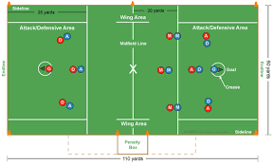
10 v 10 Allowable at 10U Level
7 v 7 or 10 v 10
Body Contact Rules: Legal Holds, Legal Pushes, Box Out, Riding, Some Incidental Contact is Allowable, but Body Checking is Prohibited.
Checking with Crosse: Lift/Poke Checks, Controlled Stick Checking at/below chest or downward stick checks below BOTH players’ shoulders. No one-handed checks permitted.
PRESENTATION TITLE HERE
12

Slide 13
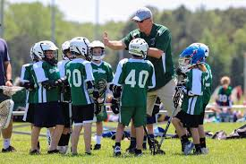
10U and 8U Penalty Enforcement
No Man-Down / Man-Up Penalties…… However
If a player commits a time-serving foul, they must leave the field immediately once play stops, and a substitute must take their place.
The player must stay off the field for the full penalty duration.
Fouling Out:
  A player fouls out if they commit 3 personal fouls.
  A player fouls out if they commit two of the following: multiple-minute personal fouls, or what would be considered a non-releasable foul at NFHS (Unsportsmanlike Conduct & High Hits, Defenseless Player).
    If a team has 3 players who foul out, the game is over, and that team forfeits the game.
PRESENTATION TITLE HERE
13

Slide 14
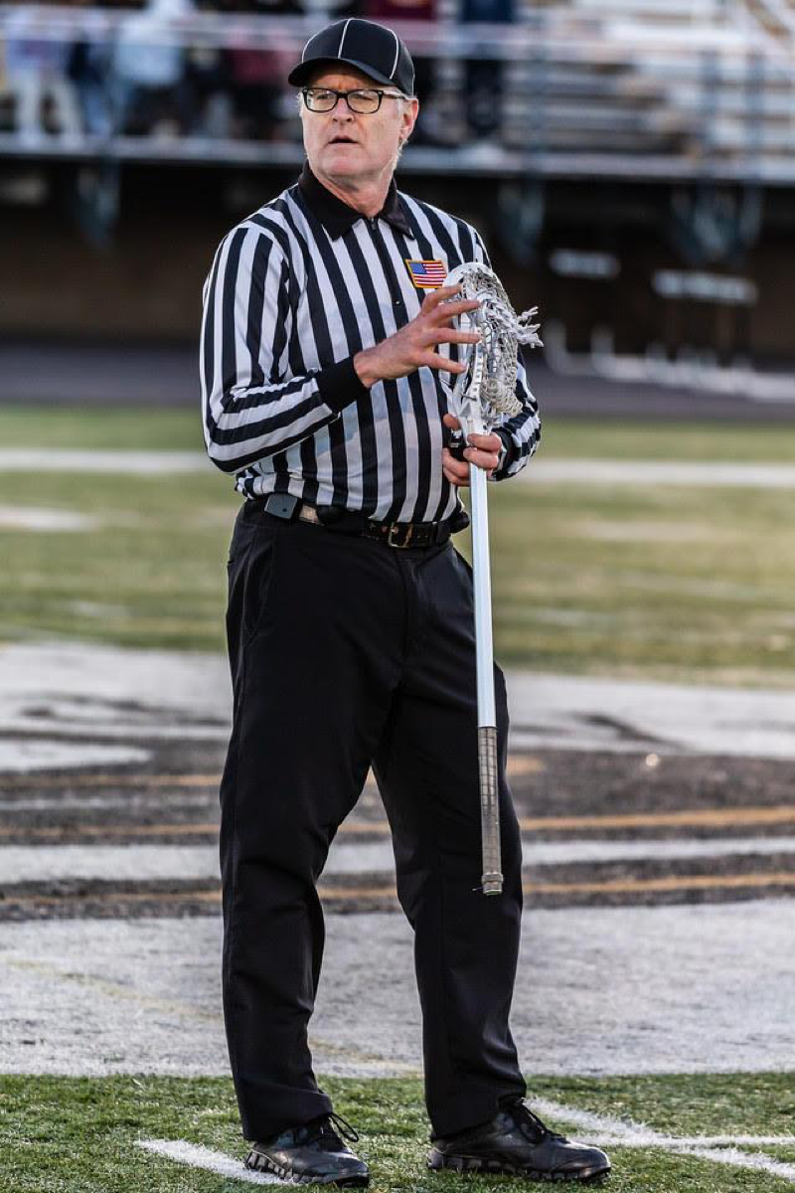
10U and 8U Penalty Situations
Situation 1: A1 is in possession of the ball when B1 commits a slash. A flag is thrown, resulting in a 1-minute personal foul on B1. B1 is substituted for by B2. Ten seconds into the ensuing play, Team B’s coach attempts to re-enter B1 into the game. Ruling: B1 may not re-enter the game. His penalty time has not expired.
Situation 2: B1 commits a 2-minute slash in the first half and a 2-minute illegal body check (Head/Neck) in the second half. Ruling: B1 has fouled out of the game for committing multiple-minute personal fouls and a hit to the head.
Situation 3:B1 commits a 2-minute non-releasable Illegal Body Check (contact to the head/neck) during the first half and later commits a 2-minute slashing foul in the same half. Ruling: B1 has fouled out of the game for committing a multiple minute personal fouls.
PRESENTATION TITLE HERE
14

Slide 15
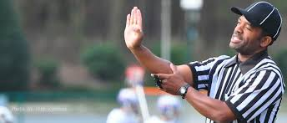
10U and 8U Penalty Situations
Situation 4: B1 commits what would be called at the NFHS level a 3-minute non-releasable Illegal Body Check (Targeting) in the first half. Later in the game, B1 commits a 1-minute non-releasable Unsportsmanlike Conduct penalty. Ruling: B1 has fouled out of the game for committing two non-releasable personal fouls.
PRESENTATION TITLE HERE
15

Slide 16
2026 Helmet FAQ
Rule 6-5 Illegal Procedure
  Page 75 6-5-2y – Loss of helmet, unless the official determines that the helmet was dislodged due to illegal contact.
Rule 7-6 Simultaneous Fouls
  Page 89
    ART. 2 . . . An immediate whistle shall occur when a foul is committed by the team in possession (or entitled to possession) during a flag-down slow whistle
    ART. 3 . . . Penalty Time:
      A. No penalty time is served if there is no play-on or flag down in effect, and all fouls are technical.
      b. No penalty time will be served by the team in possession (or entitled to possession) if that team commits only technical fouls.
16

Slide 17
What Does That Mean?
In All Cases
A player who loses a helmet during live play must leave the field and may not return until after the next dead ball.
During a Flag-Down Slow Whistle
If Team A commits a foul causing a flag‑down, slow‑whistle situation, and that foul causes a Team B player’s helmet to come off, immediately whistle, Team A serves their penalty time.
The Team B player whose helmet came off does not serve penalty time but must leave the field until and may return after the next dead ball.
Loose-Ball Personal Fouls
If a Team A player commits a personal foul during a loose ball situation, causing a Team B player’s helmet to come off, immediately whistle, Team A serves their penalty time.
The Team B player whose helmet came off does not serve penalty time but must leave the field until and may return after the next dead ball.
Loose-Ball Technical Fouls
If a Team A player commits a loose‑ball technical foul, causing a Team B player’s helmet to come off, the official will blow the whistle immediately.
Team B is awarded the ball, and the Team B player whose helmet came off must leave the field until the next dead ball.
17

Slide 18
Questions Submitted?
What is the difference between a Cross-Check and a Legal Hold with the Cross using equal pressure?
Cross Check - Checking an opponent with that part of the handle of the crosse that is between the player’s hands, either by thrusting away from the body or by holding it extended from the body and running forcibly into an opponent
Legal Hold - Holding is legal when applied with equal pressure and no thrusting, using two hands on the crosse, forearms, shoulder, or closed hand, against a ball carrier or an opponent within 3 yards of a loose ball, including legally holding the opponent’s crosse
Is it a penalty at 8U/10U to block a shot by contacting the opponent’s stick above the shoulders?
At the 8U/10U level, legally blocking or checking a stick during a shooting motion, without excessive force or a chopping wood action, is not considered a slash and is not a penalty.
18

Slide 19
