Slide 1

President’s Meeting
February 25, 2025
Notes:
Keelan to Open

Slide 2

Agenda
Thank you
Scheduling Housekeeping
Scheduling Template
Roster Template
Coach/Ref Meeting
Ref Costs
Upcoming Dates/Deadlines
Q & A
Notes:
Anthony to Review Agenda

Slide 3

THANK YOU KEELAN!
Notes:
Anthony

Slide 4
Reminders:
Board of 5 people
Respect for ALL- individuals and clubs
EVERYTHING is discussed as a Board
Have an issue/question→ EMAIL US
Notes:
Anthony

Slide 5

Scheduling Housekeeping:
Scheduler’s Meeting on 2/6/2025
League Contacts
  Contacts are listed on the WPYLA website
Email Responses
Conference Games- PRIORITY
Traveling to Games
Notes:
Kristen

Slide 6
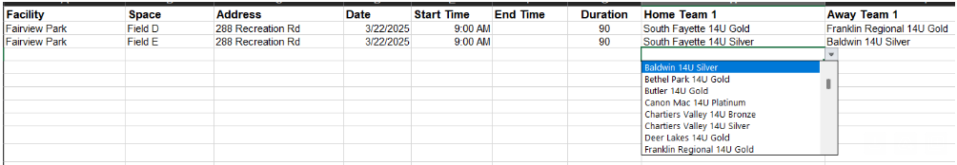
Scheduling Template
DUE 3/4/2025
HOME games only
Needs to be the form we send- other formats will be returned
Only the first submission will be accepted
Any schedule changes will need to be approved by Matt Martin
Notes:
Elene

Slide 7
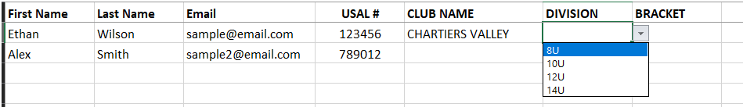
Coach Roster
DUE 3/6/2025
Send rosters early if they are done
Needs to be the form we send- other formats will be returned
Please verify information BEFORE sending to WPYLA
Coaches need to be Bronze certified, not just have a membership
Notes:
Elene

Slide 8
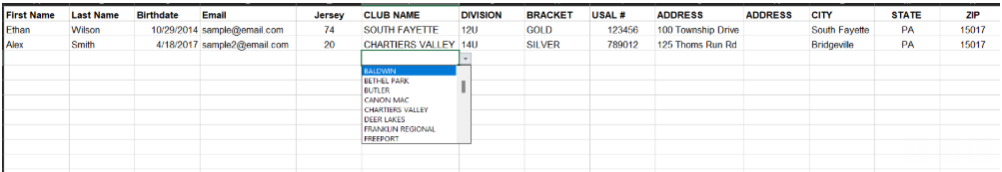
Player Roster
DUE 3/11/2025
One roster per team is needed
Send rosters once they are done
  The earlier the better
Needs to be the form we send- other formats will be returned
Please verify information BEFORE sending to WPYLA
Notes:
Elene

Slide 9

Coach/Ref Meeting
In-Person meeting on
  Sunday, March 9, 2025, at 4:30pm-5:30pm
Chartiers Valley High School Stadium
  Gym will be the back-up plan
Opportunity to ask questions
At least 1 coach from every club should attend
Notes:
Melissa

Slide 10

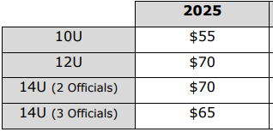
Ref Costs
Assigner Fee
Assigner’s Compensation in Arbiter
  10U, 12U, and 14U= $60 per team
  Late fee of $50 if no payment within 60 days of invoice
Per team
Ref Fees
Methods of Payment:
  Check at game site or Zelle
  Mailed check no later than 1 week after the game
Notes:
Melissa

Slide 11


Dates/Deadlines
2/26/2025- Player Eligibility Forms Due
  Age and District Forms available on the WPYLA website
3/4/2025- Season Game Schedules Due
3/6/2025- Coach Roster Due
3/11/2025- Player Rosters Due
3/12/2025- WPYLA to start validating USA Lacrosse Memberships
  Any player or coach will not be able to be on the field without a valid membership
3/22/2025- Start of Regular Season
Notes:
Kristen

Slide 12

Thank you!
Notes:
ALL

Slide 13

2025 WPYLA Board Members
Anthony Gumina (Vice President)
Melissa Taylor (Treasurer)
Elene Fornella (14U Director/Website)
Carllie Reck (12U Director)
Kristen Hernandez (Secretary)
THANK YOU FOR EVERYTHING!
Notes:
ALL

