Slide 1

President’s Meeting
February 3, 2026
Notes:
Melissa

Slide 2

Agenda
Follow Up from the January President meeting
Team Registration Update
Scheduling Meeting Info
Equipment Requirements
Roster Max, Call Ups, & Roster Checks
Penalties
Suspensions
Upcoming Dates & Deadlines
Q&A
Notes:
Anthony or Melissa

Slide 3
Follow Up from January
Payments via Arbiter will not be permitted. A file of referee payment options (Venmo, Zelle, etc.) will be created.
No-Show Fees
  If a team no-shows a scheduled game, that team will be responsible for 100% of the game fees (EMTs, field, & refs)
  If the away team no-shows, the home team is responsible for reporting the no-show to WPYLA and the away team must provide proof to WPYLA that the home team was reimbursed
  All fees must be paid before the next game
  No team with outstanding fees to WPYLA or another team will be permitted to play in the end of season tournament
Notes:
Anthony or Melissa

Slide 4
Team Registration Update
Registration closes on 2/6
15 of 32 programs have registered
Current Registration
  14U: 20 teams
  12U: 20 teams
  10U: 19 teams
  8U: 16 teams
Season registration fees due on 2/9
  $500/team if participating in the tournament
  $100/team for the regular season only
There will not be a placement appeal process this season. Please include all necessary details relative to your placement request in the registration form.
Notes:
Melissa

Slide 5
Scheduling Meeting
February 18th, 6:15 pm at Rival (1595 Washington Pike Bridgeville, PA)
Prepare in advance & bring a plan
  Know your blackout dates (dances, concerts, confirmation, other sport tryouts, etc.)
  Know your home field availability – remember to account for daylight
  Consider travel time
    Rush-hour, Pirates games, the NFL draft, concerts, etc.
    Know which opponents you want to play on the weekend
Bring a blank printed calendar & a pencil – it is time consuming to use a laptop in the moment
The meeting is limited to 2 people per program (due to space limitations)
Be efficient with your time – this event is for scheduling only
Schedules are due to WPYLA and Matt Martin on March 2
Scheduling instructions will be provided in advance
Notes:
Kristen

Slide 6
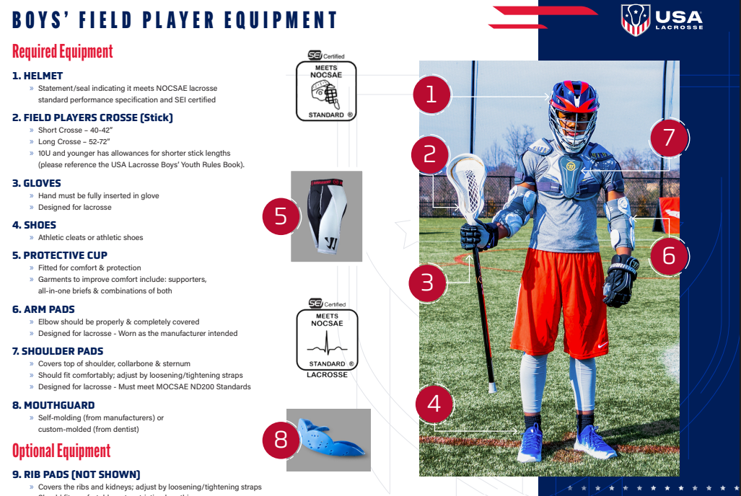
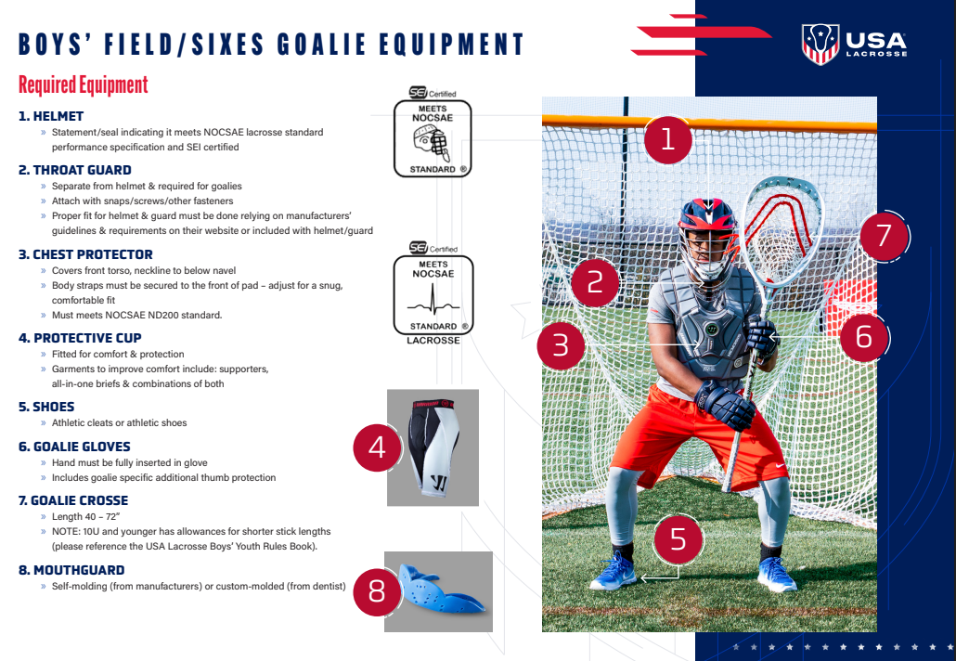
Equipment Requirements
https://www.usalacrosse.com/sites/default/files/documents/Safety/USAL-equipment-guide-2025b.pdf
Notes:
Matt or Kristen

Slide 7
Roster Max
Each Team will have a “MAX Roster #”. This number will be different for each team and will be determined by the roster you submit and WPYLA approves prior to the season.
For programs with 2 teams at the same age level, the minimum # of players is 15 per team. This prevents programs from stacking rosters in the lower division.
Max Roster Numbers
  Programs that have 20 players or less on the roster: max roster size on game day will be 20 players.
  Programs that have 21+ players on the roster: max roster size will be the same number of players as the approved WPYLA roster.
    Example 1: Bethel Park 12U Gold has 23 players on the approved roster. The game day max roster size is 23 players.
    Example 2: Chartiers Valley 14U Silver has 17 players on the approved roster. The game day max roster size is 20 players. They can call up 3 players from lower divisions or from 12U, if needed.
Notes:
Elene

Slide 8
Call Ups
No player can be forced to “Play up”. Parental consent must be given. Example: 12u player can’t be mandated to play on a 14u team.
Call up players should ONLY be used when there are injuries, illness, , significant absence for a game, or when a player’s skill has improved substantially since initial rostering. You can not go over your team’s max roster number.
If a goalie is needed on 2 teams at the same age level, that goalie should be rostered on the lower of the 2 teams.
A call up player from a younger age group can only be used at the same division or higher.
  Example: A 12U Gold player can only be called up to 14U Gold or 14U Platinum
Notes:
Elene

Slide 9
Roster Checks
Roster checks will continue to be at the request of either Head Coach
A roster check is REQUIRED if a player or coach from either team is suspended
If a program is found to have an un-rostered player or coach in a game, the official will notify WPYLA and the following will occur:
  Program will be fined $300
  The Head Coach will be suspended for 1 game minimum
If a program refuses to participate in the roster check, the game will be forfeited and the team that refused will receive a loss. The program will also receive a $300 fine.
The Roster Check process will be distributed before the start of the season.
  All fines must be paid before the next game. No one will be permitted to participate in the WPYLA tournament if money is owed.
Notes:
Elene

Slide 10
New 2026 Season Penalties
More than 5 coaches on the sideline – 3-minute non-releasable
Suspended player on the sideline – minimum 2-minute non-releasable & the player must leave the sideline
  The offending team will continue to be man-down past 2 minutes if the player is still present on the sideline
  Suspended players are permitted to watch from the stands, but may not be on the sideline
Suspended coach on the sideline – 3-minute non-releasable & the coach must leave the sideline (the program will also be fined)
  If the suspended coach refuses to leave the sideline, the game is over and that team will forfeit the game
  Suspended coaches are permitted to watch from the stands, but may not be on the sideline
Non-coaches or non-players on the sideline (this includes siblings, players from JV, Varsity, etc.) – 2 minute non-releasable
  The offending team will continue to be man-down past 2 minutes if the sideline has not been cleared.
Notes:
Anthony or Carllie

Slide 11
Penalty & Gameday Reminders
WPYLA has asked ALOA to prioritize enforcement of these infractions this season.
Illegal equipment – 3-minute non-releasable
Excessive or flagrant contact with an opponent’s head – 3-minute non-releasable and possible ejection
EMTs are REQUIRED at all games
  Home teams/programs are responsible for scheduling EMTs
  If an EMT is not present at the beginning of the game, the game must not begin.
  The game can begin once an EMT is present. Gametime will be reduced to account for the EMT’s late arrival.
  If an EMT fails to arrive, referees must be paid and the team responsible for EMT scheduling will forfeit the game.
Notes:
Anthony or Carllie

Slide 12
Suspensions
Player ejected from a game
  1st offense – 1 game suspension
  2nd offense – 3 game suspension
  3rd offense – suspended for the remainder of the season, including the end of season tournament
Head or Assistant Coach ejected from a game
  1st offense – 1 game suspension
  2nd offense – suspended for the remainder of the season, including the end of season tournament
Multiple players ejected from a game
  In addition to the player suspensions outlined above, the head coach will be suspended for 1 game
Multiple coaches suspended from a game or multiple coaches suspended in the season
  In addition to the coach suspensions outlined above, the head coach will be suspended for 1 game if any assistant coach is ejected from a game or has multiple ejections in a season
  WPYLA reserves the right to adjust suspensions and may require a meeting with the program president if concern over player or coach behavior exists
Notes:
Carllie

Slide 13


Key Dates/Deadlines
2/6 – Team Registration Closes
2/9 – 2026 WPYLA fees due
2/10 – Player age & district eligibility forms due – submit as players register, do not submit all at the deadline
2/18 – Schedulers Meeting
2/28 – Final Player Registration info due (not needed if there are no changes from 1/31)
3/2 – Team Schedules due to Matt Martin & WPYLA
3/7 – Team Rosters due with jersey numbers (can be updated from the 1/31 submission
3/8 – Coaches On Field Clinic hosted by ALOA (in person)
3/13 – Coaches Rosters due
3/15 – Youth Rules Review hosted by ALOA (virtual)
3/21 – Start of Regular Season
Notes:
Kristen

Slide 14

Thank you!
Notes:
ALL

