Slide 1

23-24 Season
Virtual Open House
Presented by 365 Director, Mario Puskarich

Slide 2
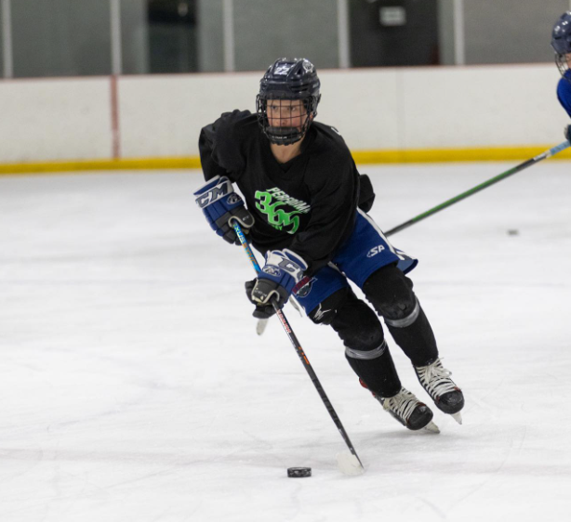
23-24 Performance Hockey Academy Season
August 15th, 2023 – May 17th, 2024
Monument Ice Rinks
Professional Coaching Staff
Flexible Academic Options
On Ice Training & Development
Off Ice Training & Fitness
Holistic Athlete Development
FUN!!
365 PHA Welcomes all Tier 1 & Tier 2 Skaters & Goalies from all organizations.
Elite Level
Training for
Players Who
Want More
YOU DO NOT NEED TO BE A RAMPAGE PLAYER
TO ATTEND

Slide 3
WHY 365 PERFORMANCE HOCKEY ACADEMY?
Purposeful reps and coaching needed to develop the entire athlete that many rinks/programs can’t offer.
We want to create a group of like-minded individuals who will thrive in a training environment like this and maximize their development path.
Enrichment
Athletics
Players will be educated on the latest nutrition, yoga, sleep, and recovery practices to optimize their development.
Players will receive today’s best training from professional coaches to help them maximize their training and develop the skills needed to move to the next level in their game.
Mental Game
Character Development
Players will spend time learning sports psychology techniques to better their mental game.
Players will have the opportunity to gain volunteer hours that will transfer to their schools required credits.

Slide 4

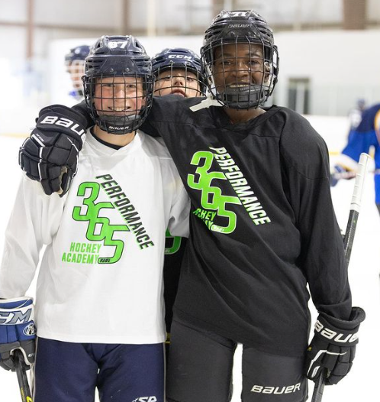
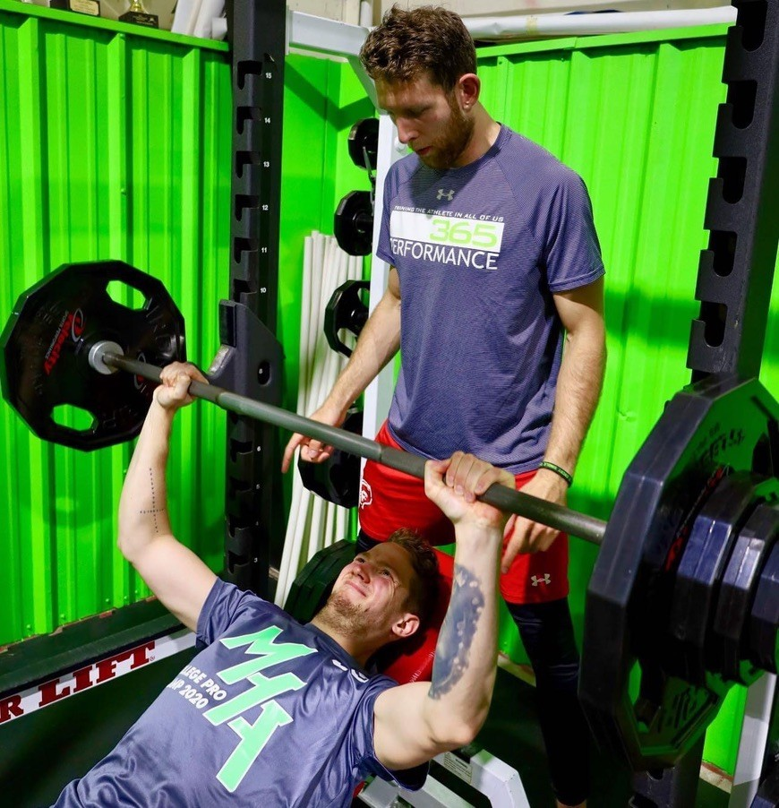
365 PHA 23-24 Season
What You’re Getting!
On & Off Ice Weekly Sessions
#1 - FLEXIBLE ACADEMIC OPTIONS
We offer a variety of academic options through D-20, D-38 and D-49 school districts
Our public school options range from fully online to hybrid to traditional brick and mortar schools
Our academic partnerships are local public schools and do not cost the family extra money
Our partner schools work with the players and families to create a schedule that will allow the player to maximize their training while also getting the academic attention/classes/requirements they need

Slide 5
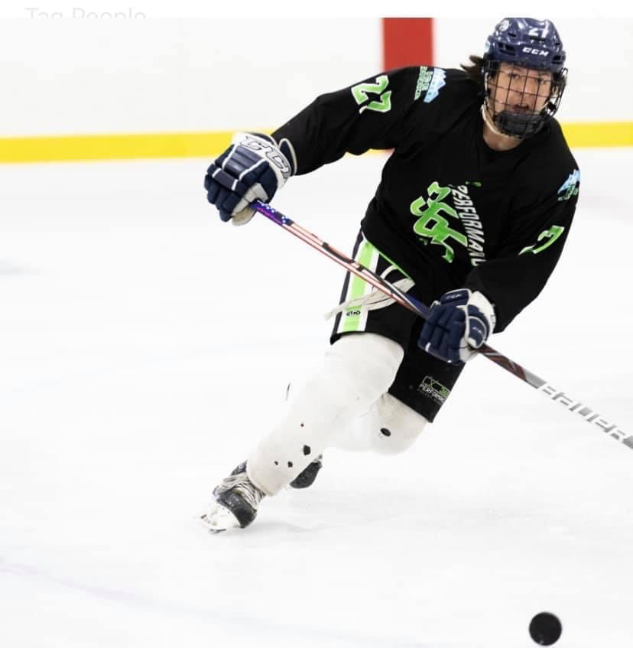
#2 - ON ICE TRAINING AND DEVELOPMENT
Players will have 10 ice sessions per week to choose from
Players may attend any session they would like based on their personal schedule
Sessions run Monday - Friday
7:30 AM - 9:00 AM
1:30 PM - 3:00 PM
Players will focus on skating, passing, puck handling, shooting, and other skills daily
Players will also work on game awareness and hockey IQ (learning the patterns of gameplay) and use the tactical skills to execute
Coaches design practices to be fun, high paced, and focused on proper movement and development to maximize each ice touch

Slide 6
#3 - OFF ICE TRAINING AND FITNESS
For maximum flexibility for players and their school schedules, there is access to off ice training multiple times a day
This offers every player the opportunity to also benefit from personalized workout plans with professional strength and conditioning coaches to maintain their fitness and increase power, strength, speed, and endurance throughout the season
Players will get the most up to date training methods to maximize their development in the program and stay ahead of their competition
#4 - HOLISTIC ATHLETE DEVELOPMENT
Character development
Mindset to become a RESILIENT ATHLETE and HUMAN
Proper Nutrition, Hydration, Sleep and Supplementation Habits
Team-building and leadership development
#5 – FUN
Take pride in your development
Enjoy the process of development in an environment of excellence... while having a great time in the process!

Slide 7
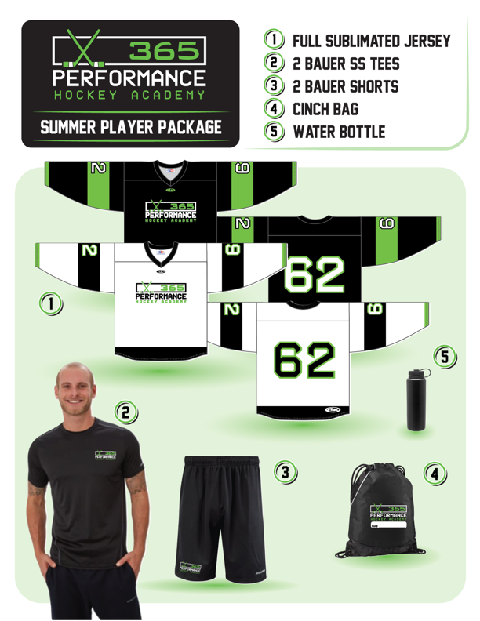
[365 PHA 23-24 Season]
Gear!!
We will be using the same gear as our Summer School 2023
If you were in summer school
YOU DO NOT HAVE TO ORDER AGAIN!

Slide 8
What are the total cost & savings of the 365 Academy?
The cost of the full program next season is $8,900 (pay in full) or $9,900 (installments).
When does the program start and end for the season?
The first day of school is Tuesday, August 15th, 2023, and the last day is Friday, May 17th, 2024.
What players are welcome to join the program?
365 Performance Hockey Academy welcomes Tier I and Tier II players from all organizations. You do not need to be a Colorado Rampage player to attend.
What age group(s) are welcome in the program?
The academy welcomes all competitive (10+) ages to join!
﻿Are pricing installments available?
Yes! As you go through the registration process, you will be able to select the payment installment option.
Are registrations fees refundable?
Registration fees for this program are non-refundable.
Is there an on-site study area for the athletes?
Yes! We have an on-site 365 Academic Center available for student athletes to work on their daily studies.
Where do the on and off-ice sessions take place?
On ice sessions take place in the West Rink of Monument Ice Rinks. All off ice sessions take place in the 365 Performance Training Center located in the East Rink.

Slide 9







365 PARTNERS

Slide 10
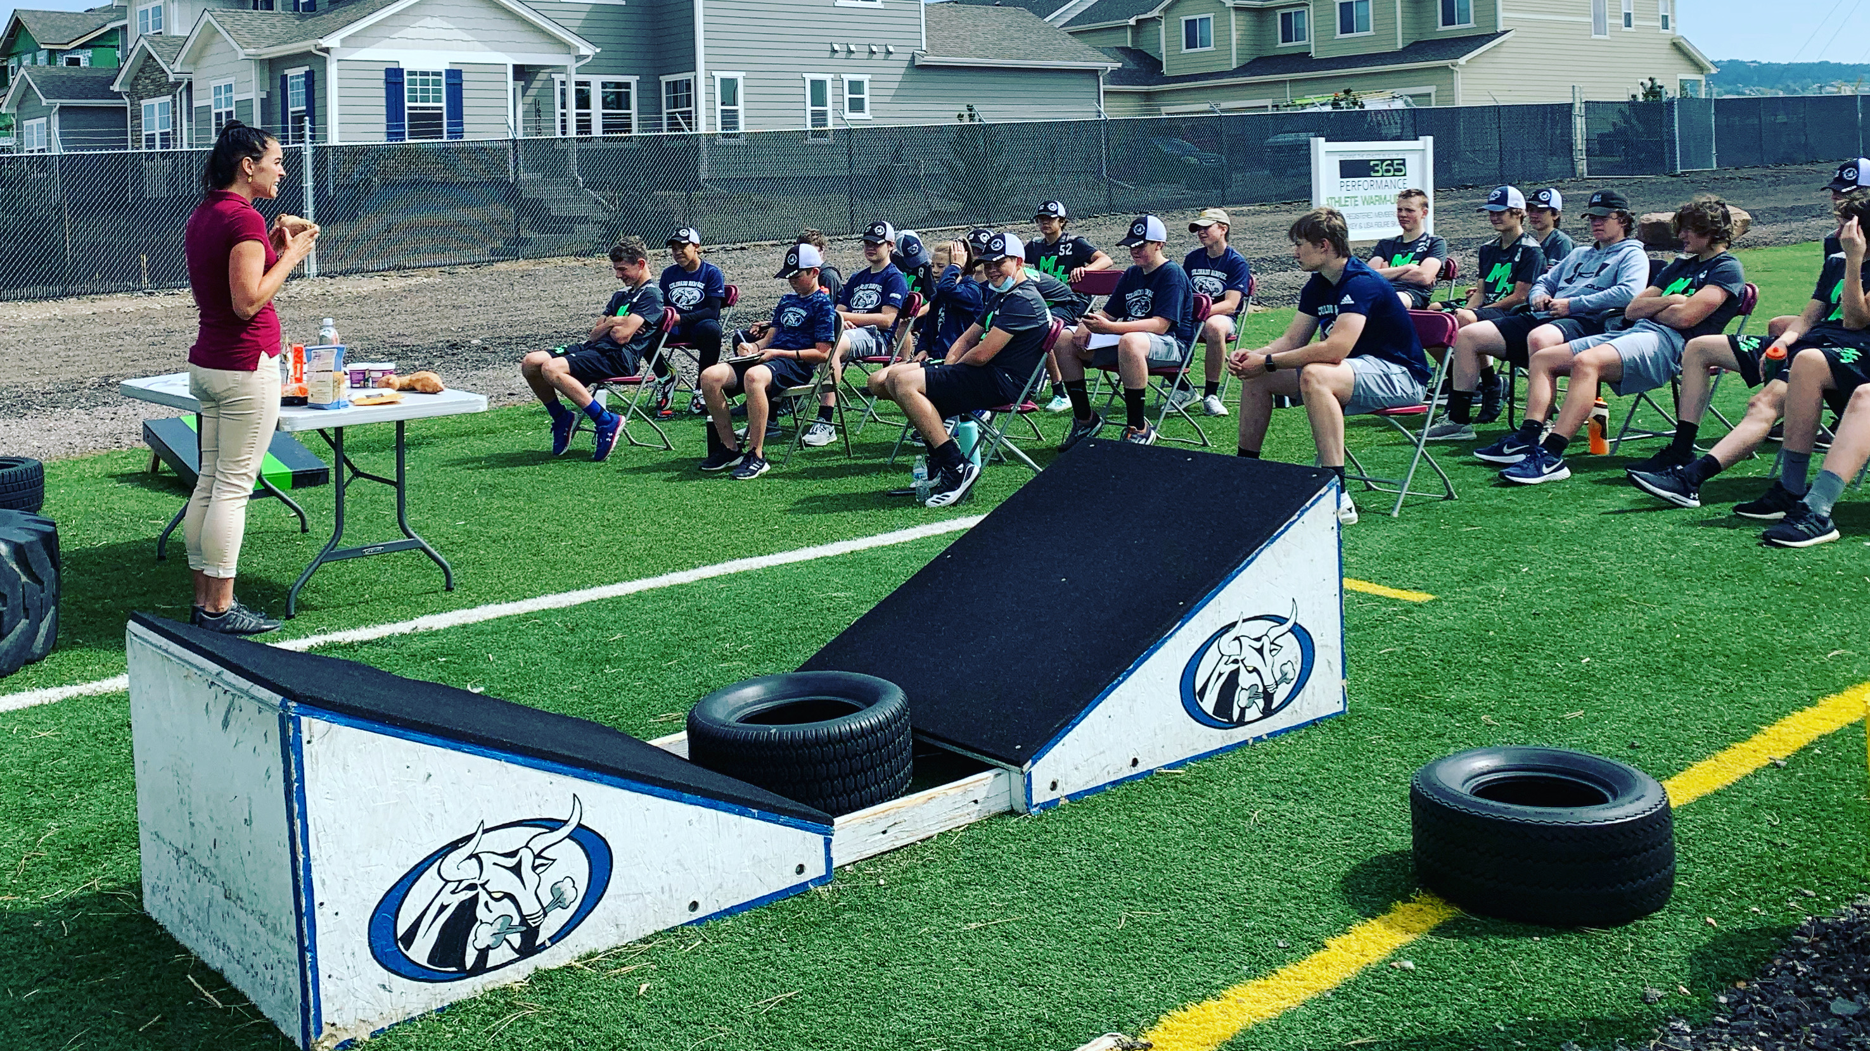
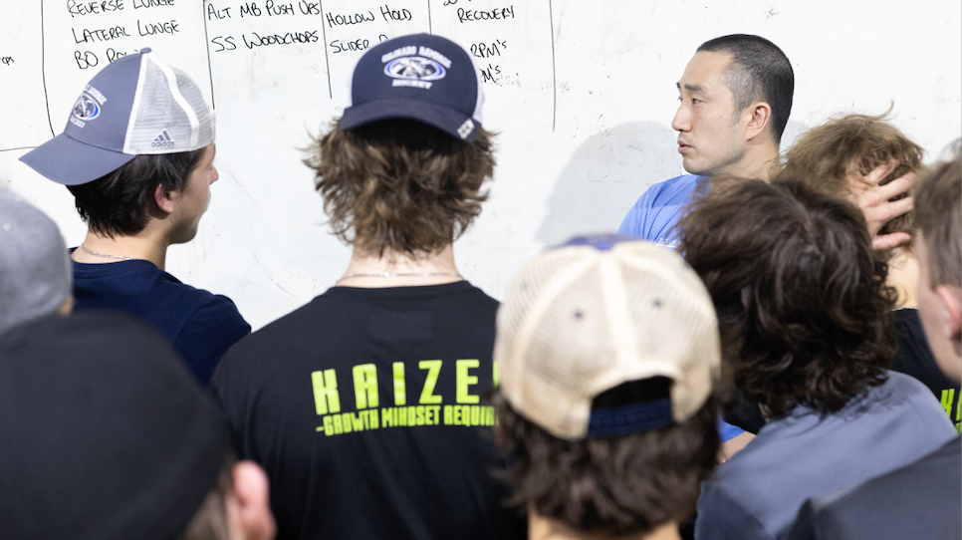
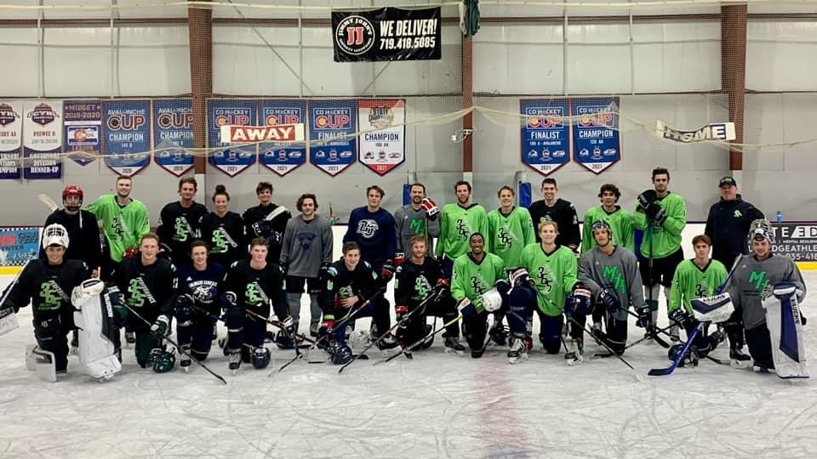
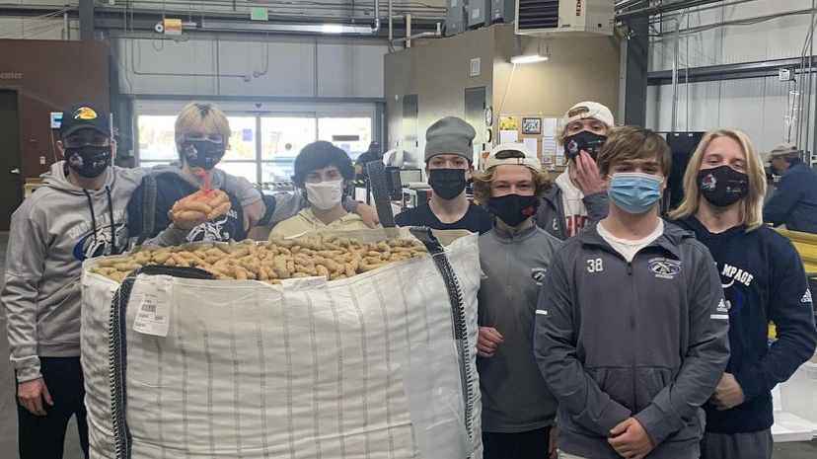
QUESTIONS?

