Slide 1

2025-2026 Season
October 20, 2025
Notes:
Kelle
1

Slide 2

Board Members
John Weber
Sam Meyer
Chad Stockmann
Emma Conrad
Jenny Merritt
Ashley Schneider
Kristie Fritz
Shelly Byers

Slide 3
MN CORE Values
Character – be the best person you can be, show good sportsmanship, and support and respect our opponents, officials, and each other.
Opportunity – take advantage of the opportunity to compete in this club, embrace the team aspect, and enjoy your time with teammates and coaches.
Resilience – overcome adversity, recover from setbacks, and compete.
Effort - nothing is given, and nothing is gained without putting forth maximum effort.
Notes:
3

Slide 4
WHY CHOOSE MINNESOTA CORE VOLLEYBALL?
Training: two 90-minute practices per week (approx. 36 practices) with two coaches per team.
Competitive Tournaments: teams of age 13 and older, will play in 9-10 in-state, single or two-day tournaments. Higher level teams will travel out of state for 1-2 tournaments and will typically play in 5-6 single-day tournaments and 3-4 two-day tournaments. Teams of age 12 and younger play a shorter season, so they will play in 5-6 in-state tournaments (typically 3-4 single-day tournaments and 2-3 two-day tournaments).
Apparel Package:
  First year players will receive two jerseys, a warm-up shirt and a backpack included in their season fees.
  Returning players will receive two jerseys, a warm-up shirt and a club sweatshirt included in their season fees.
Fundraising Opportunities: each player will receive raffle tickets, included with your season fees, that can be sold to put money back in your pocket or win prizes at our fundraiser event.
Value: as a non-profit organization, we can provide many of the same options as larger clubs, but at a lower price.
Notes:
4

Slide 5
Tryout Registration is OPEN!
We gladly accept players from any school or town.
To register for tryouts:
1) Review the Age Chart below (also on our website) to determine what age to tryout for
2) From the home page, click on the Club Season link and click on the 2025-2026 Tryout Registration link
3) Attend the tryout session for the age determined above (see tryout dates/times below or on our website)
Online registration is preferred prior to tryouts
In addition to club coaches, we will have outside evaluators present to score tryouts.
Tryout fee is due with online registration or at tryouts
This fee is non-refundable/non-transferable
Team Commitment fee is due upon acceptance of team offer
The commitment fee serves as the players commitment to play on a MN CORE Volleyball team.

Slide 6
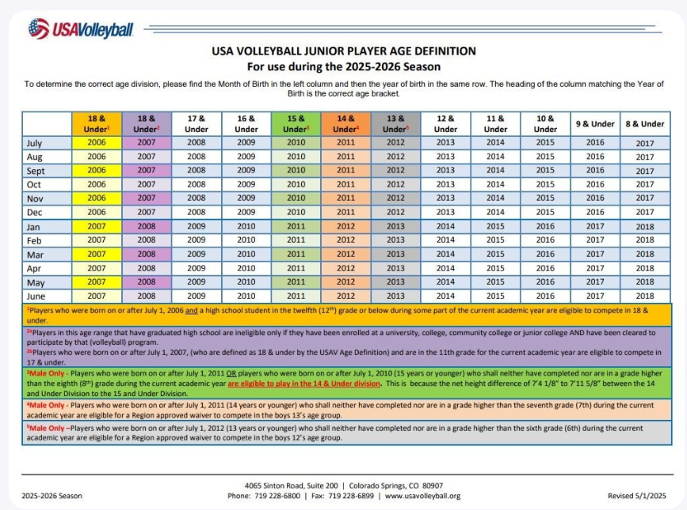
No athlete will be placed on a team at an age level below their defined age group
Notes:
6

Slide 7
Ages: 15 and above
Sunday, November 9, 2025
9:00 am – 9:30am Check-in
9:30am – 11:30am Tryouts
TRYOUT LOCATION
Waconia High School
1650 Community Dr Waconia, MN 55387
TRYOUT DATES AND TIMES
Ages: 11 & 12
Sunday, October 26, 2025
9:00am - 9:30am Check-in
9:30am – 11:30am Tryouts
Ages: 13 & 14
Sunday, October 26, 2024
12:00pm – 12:30 pm Check-in
12:30pm – 2:30 pm Tryouts
Notes:
7

Slide 8
WHAT TO BRING TO TRYOUTS
Appropriate footwear (volleyball shoes preferred, no street shoes)
Appropriate athletic wear
Water bottle
Knee-pads
Tryout fee $50 if not pre-registered
Notes:
8

Slide 9
PLACEMENTS AND COMMITMENT FEES
Tryouts are used to determine team size for each age level.
10/27/25 Players 11s-14s will be notified by Minnesota CORE Volleyball if they have secured a spot with the club via email through Crossbar.
11/11/25 Players 15s-17s will be notified by Minnesota CORE Volleyball if they have secured a spot with the club via email through Crossbar.
Families will have 24 hour to accept offer. Upon acceptance of the offer, the commitment fee will be charged. Online payment is preferred however other options may be available for offline payment.
  11s/12s Commitment fee $300
  13s + Commitment fee $500
There is a possibility that a subsequent tryout practice may be needed for 11s – 14s. This practice will be the 10/28/25 and will be used to determine placement on specific team (1s, 2s, etc.) Players will be notified of specific team placement after the completion of the practice tryout. We expect to do this on 10/30/25.
Commitment fees will be applied to season fees. If, after receiving their final placement, the family decides not to keep commitment to the club, the commitment fee will not be returned.

Slide 10
PRACTICES
Each team will have two 1.5-hour long practices per week
Due to limited gym availability- there may be times where practices are overlapped/combined with other teams based on court availability.
Locations (others may be added if they become available)
  All Waconia schools, Safari Island, Mayer Lutheran Field house
Typical Practice Times
  Mon – Fri, starting as early as 4:00 and might go as late at 9:30p
Practices Start in December for 13s – 17s.
Practices for the 11s/12s will start in January.
Notes:
10

Slide 11
TOURNAMENTS
Teams of age 13 and older, will play 9-10 tournaments beginning in January and finishing the end of April.
Higher level teams (1s) will travel to WI and/or IA for 1-2 tournaments and will typically play 5-6 single-day tournaments and 3-4 two-day tournaments.
Teams of age 12 and younger play a shorter season, so they will play 5-6 in-state tournaments beginning in February and finishing the end of April.
Most in-state tournaments are within a 1-hour drive from the Waconia area.
All tournaments are pre-selected by board. Tournament selection is based on previous experience, discussions with coaches and reputation of the tournament. While we do our best to select good, well-run events, we cannot guarantee the competitiveness of each tournament. This is dictated by the teams attending them.
Notes:
11

Slide 12
CORE BLOCK PARTY TOURNAMENT
We are excited to announce that we will be hosting three tournaments this season. We will host one tournament for 11s, 12s, and 13s teams.
Tentative CORE Tournament dates are:
  11s/12s Saturday, February 21, 2026
  13s Sunday, February 22, 2025
We will be requiring assistance to ensure that we are successful in hosting our tournaments, club families will be expected to help with the planning and the day-of tournament activities.
More information to follow
Notes:
12

Slide 13
Coaches
COACHING
We are fortunate to have many returning coaches committed to the club. There are opportunities for additional head coaches and assistant coaches for the upcoming season. If you know of anyone who may be interested, please contact a board member or ask them to fill out the application on the website.
We have had parent coaches in prior season for our younger teams (11s/12s).
Coaches are paid.
We will have coaches meeting prior to the start of the season to go over the goals of the club and get our coaches prepared for the upcoming season.
Notes:
13

Slide 14
Team Fees
Season FEES - 1'S TEAMS (AGES 15-17)
$1,700 per player
Fees Include:
  $150 Fundraiser Raffle Contribution/Tickets
  2 paid Coaches
  2 practices/week (approx. 36 practices)
  9-10 tournaments (including 2-3 out of state tournaments)
  2 team jerseys, 1 warm-up shirt, 1 team backpack or sweatshirt
  JVA registration fee
  Season runs December through April
Notes:
14

Slide 15
Team Fees
Season FEES - 2'S TEAMS (AGES 15 - 17)
$1,550 per player
Fees Include:
  $150 Fundraiser Raffle Contribution/Tickets
  2 paid Coaches
  2 practices/week (approx. 36 practices)
  9-10 tournaments 2 team jerseys, 1 warm-up shirt, 1 team backpack or sweatshirt
  JVA registration fee
  Season runs December through April
Notes:
15

Slide 16
Team Fees
Season FEES - 1'S TEAMS (AGES 13-14)
$1,650 per player
Fees Include:
  $150 Fundraiser Raffle Contribution/Tickets
  2 paid Coaches
  2 practices/week (approx. 36 practices)
  9-10 tournaments (including 1-2 out of state tournaments)
  2 team jerseys, 1 warm-up shirt, 1 team backpack or sweatshirt
  JVA registration fee
  Season runs December through April
Notes:
16

Slide 17
Team Fees
Season FEES - 2'S TEAMS (AGES 13-14)
$1,500 per player
Fees Include:
  $150 Fundraiser Raffle Contribution/Tickets
  2 paid Coaches
  2 practices/week (approx. 36 practices)
  9-10 tournaments 2 team jerseys, 1 warm-up shirt, 1 team backpack or sweatshirt
  JVA registration fee
  Season runs December through April
Notes:
17

Slide 18
Team Fees
Season FEES – AGES 11-12
* SHORTENED SEASON
$930 PER PLAYER
Fees Include:
  $100 Fundraiser Raffle Contribution/Tickets
  2 paid Coaches
  1-2 practices/week (approx. 30 practices)
  5-6 tournaments
  2 team jerseys, 1 pair warm-up shirt, 1 team backpack or sweatshirt
  JVA registration fee
  Season runs January through April
Notes:
18

Slide 19
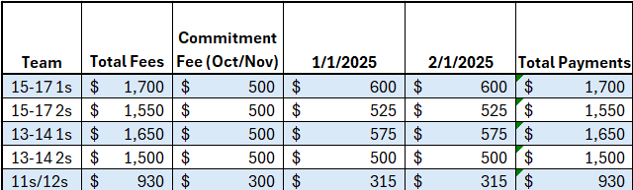
Payment Schedule
Fee Payment Schedule
Notes:
19

Slide 20
FUNDRAISING
As in prior years, we plan on having ONE primary fundraising source, the club raffle.
Included in your total fees, there is a fundraising fee of $150 (13s - 17s) or $100 (11s – 12s) that gets you raffle tickets.
You can sell your tickets, or you can enter your own name into the raffle.
Details of the date, time and place will be communicated at a later date.
We are contacting local businesses for raffle prize donations – we will let you know who donated to our club, let’s make sure to support these businesses who support our athletes!
If you know anyone who would be willing to support our athletes (items such as $25/50 gift cards, gift baskets, or other prizes), please contact anyone on the MN CORE Volleyball Board. We will accept donations up to the date of the raffle drawing.
Notes:
20

Slide 21

Communications
COMMUNICATIONS
Website – www.mncorevball.com
  Main source for up-to-date information
Club Email – mncorevball@gmail.com
Follow us on:
  Facebook – https://www.facebook.com/mncorevball
  Instagram - https://www.instagram.com/mncorevball
  Twitter – https://twitter.com/mncorevball
Notes:
21

Slide 22
Parent Reps
PARENT REPRESENTATIVE
Each Team needs to have a “Parent Representative”.
Some of the responsibilities of a Parent Rep include:
  Communicate team information via email, text or team apps.
  Coordinate collection and submission of fundraising tickets.
  Coordinate plans for away tournaments, if applicable. ie: hotel reservations, dinner plans, etc.
  Assist coaches as needed.
Notes:
22

Slide 23
Wrap Up
If you have any further questions, please feel free to contact us at MNCoreVball@gmail.com
For additional information visit the website at www.mncorevball.com
Notes:
23

