Slide 1

2025-2026 Team Meeting
November 13, 2025
Notes:
Kelle
1

Slide 2

CORE Values
Character – be the best person you can be, show good sportsmanship, and support and respect our opponents, officials, and each other.
Opportunity – take advantage of the opportunity to compete in this club, embrace the team aspect, and enjoy your time with teammates and coaches.
Resilience – overcome adversity, recover from setbacks, and compete.
Effort - nothing is given, and nothing is gained without putting forth maximum effort.
Notes:
2

Slide 3
JVA REGISTRATIONS
Now that you have been placed on a team, you will need to register for JVA.
Players will not be allowed to participate in club activities until they have registered for the JVA.
  Places the athlete on our club roster with JVA.
  Insurance waiver.
The JVA registration links are active on the website.
Notes:
3

Slide 4
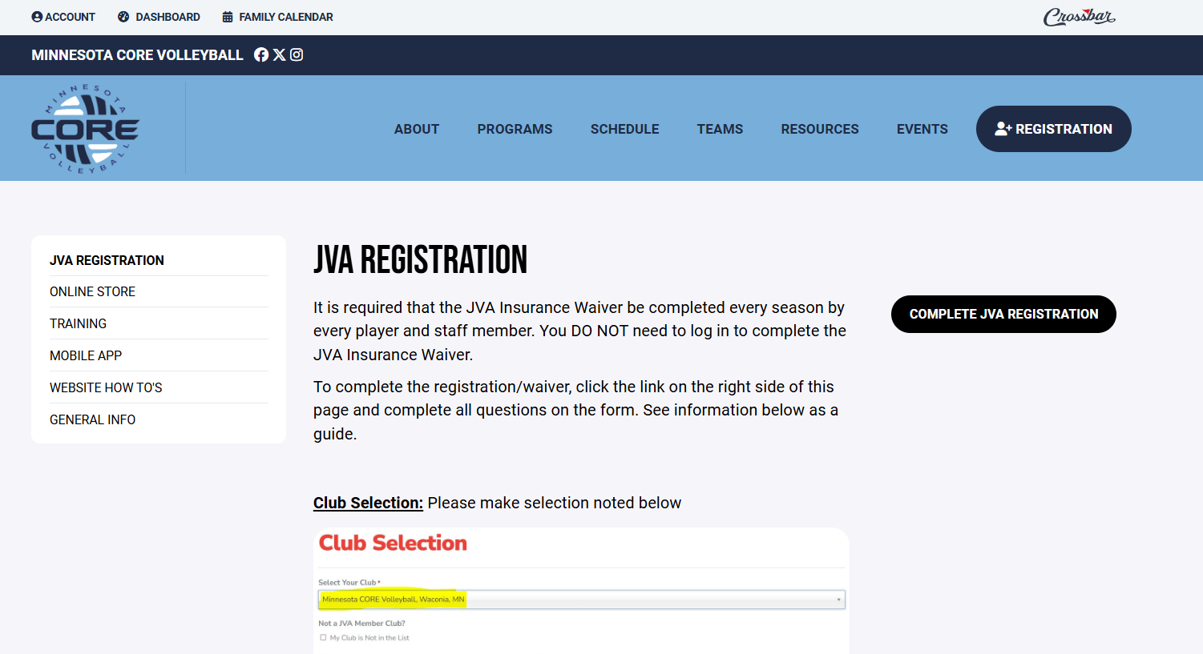
JVA REGISTRATION
Notes:
4

Slide 5
PLAYING TIME
Playing time is not a given, it is earned by what is observed by coaches at practices, how they are performing at a tournament, attitude, attendance and effort.
Coaches are expected to make sure that everyone plays, however, there will be occasions where time in the game will be limited due to how the set is going.
It is expected that our athletes attend all practices and tournaments.
  Exceptions – school teams/sports, family emergencies, religion/worship services
  If an athlete need to miss a practice or tournament, the athlete/parent needs to communicate to the coach as soon as possible.
  Unexcused absences may impact playing time.
Notes:
5

Slide 6
Player Responsibilities and Expectations
Be On Time
Give maximum effort in practice and at tournaments
Stay positive, support your teammates
Ask your coach questions if you don’t understand.
Embrace opportunities given to you
  It’s OK to play a new position
  Put the needs of the team first
Respect each other, your coaches, opponents, officials, etc.
Notes:
6

Slide 7
Parent Responsibilities and Expectations
Be On Time
Support all team members
Respect each other, your coaches, opponents, officials, etc.
Use the outcome of the results as a teaching moment, what went well, what didn’t, how did you support your teammates, etc.
Notes:
7

Slide 8
Coaches Responsibilities and Expectations
Be On Time
Coach in a positive manner
Push players to be their best
Use the outcome of the results as a teaching moment, what went well, what didn’t, how did you support your teammates, etc.
Respect each other, your players, opponents, officials, etc.
Notes:
8

Slide 9
PRACTICES
Each team will have two 1.5-hour long practices per week
Due to limited gym availability- there may be times where practices are overlapped/combined with other teams based on court availability.
Locations (others may be added if they become available)
  All Waconia schools, Safari Island, Mayer Lutheran, and the Victoria Rec Center
Typical Practice Times
  Mon – Fri, starting as early as 5:30pm and might go as late at 9:30pm
Practices Start in December for 13s – 17s.
Practices for the 11s/12s will start in January.
Notes:
9

Slide 10
TOURNAMENTS
Teams of age 13 and older, will play 9-10 in-state tournaments beginning in January and finishing the end of April.
Higher level teams will travel to WI and/or IA for 1-2 tournaments and will typically play 5-6 single-day tournaments and 3-4 two-day tournaments.
Teams of age 12 and younger play a shorter season, so they will play 5-6 in-state tournaments beginning in February and finishing the end of April.
Most in-state tournaments are within a 1-hour drive from the Waconia area.
All tournaments are pre-selected by board. Tournament selection is based on previous experience, discussions with coaches and reputation of the tournament. While we do our best to select good, well-run events, we cannot guarantee the competitiveness of each tournament. This is dictated by the teams attending them.
Notes:
10

Slide 11
CORE BLOCK PARTY TOURNAMENT
We are excited to announce that we will be hosting three tournaments this season. We will host one tournament for 11s, 12s, and 13s teams.
Tentative CORE Tournament dates are:
  11s/12s Saturday, February 21, 2026
  13s Sunday, February 22, 2025
We will be requiring assistance to ensure that we are successful in hosting our tournaments, club families will be expected to help with the planning and the day-of tournament activities.
More information to follow
Notes:
11

Slide 12
CANCELLATION POLICY
In the event of bad weather, MN CORE Volleyball follows the Waconia School District school closing policy. If the Waconia School District cancels school, or has an early release due to bad weather, MN CORE Volleyball will cancel practice.
Tournaments seldom cancel tournaments. They will occasionally push the start time back. MN CORE Volleyball will only attend if we feel that conditions are such where travel is not a safety concern.
In the event that MN CORE Volleyball chooses not to attend a tournament, a replacement tournament may be considered but not guaranteed.
Notes:
12

Slide 13
FUNDRAISING
As in prior years, we plan on having ONE primary fundraising source, the club raffle.
Included in your total fees, there is a fundraising fee of $150 (13s - 17s) or $100 (11s – 12s) that gets you raffle tickets.
You can sell your tickets, or you can enter your own name into the raffle.
Details of the date, time and place will be communicated at a later date.
We are contacting local businesses for raffle prize donations – we will let you know who donated to our club, let’s make sure to support these businesses who support our athletes!
If you know anyone who would be willing to support our athletes (items such as $25/50 gift cards, gift baskets, or other prizes), please contact anyone on the MN CORE Volleyball Board. We will accept donations up to the date of the raffle drawing.
Notes:
13

Slide 14
WEBSITE
https://www.mncorevball.com/
Crossbar is the app used for communications and club information.
You are the owner of your account. You can add/delete members to/from your account, change names, address changes, etc. We do not have access to maintain your accounts.
The calendar tab contains activities for all teams and can be filtered. Scheduling on individual team pages will contain activities specific to that team.
  Practices will be scheduled on the calendar.
  You can link this calendar to your Google calendar.
  Tournament dates will be listed on the calendar.
Team Gear Store
Notes:
14

Slide 15

COMMUNICATIONS
JO Website – www.mncorevball.com
  Main source for up-to-date information
Club Email – mncorevball@gmail.com
Follow us on:
  Facebook – https://www.facebook.com/mncorevball
  Instagram - https://www.instagram.com/mncorevball
  Twitter – https://twitter.com/mncorevball
Notes:
15

Slide 16
PARENT REPRESENTATIVE
Each Team needs to have a “Parent Representative”.
Some of the responsibilities of a Parent Rep include:
  Communicate team information via email, text or team apps.
  Coordinate collection and submission of fundraising tickets.
  Coordinate plans for away tournaments, if applicable. ie: hotel reservations, dinner plans, etc.
  Assist coaches as needed.
Parent rep duties will take the place of Block Party volunteer commitment.
Each team needs to come out of the meeting tonight with a parent rep.
Notes:
16

Slide 17
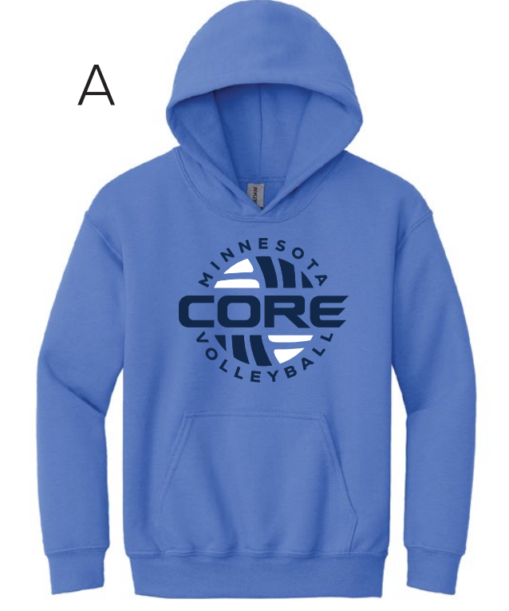
BACKPACKS/SWEATSHIRTS
Season fee includes a team backpack for new players and an additional sweatshirt for returning players.
Sweatshirts are available for purchase by new players
  You can use Venmo to pay for your sweatshirt, please indicate last name and size in the comments/memo
Notes:
17

Slide 18
Wrap Up
If you have any further questions, please feel free to contact us at MNCoreVball@gmail.com
For additional information visit the website at www.mncorevball.com
Notes:
18

