Slide 1
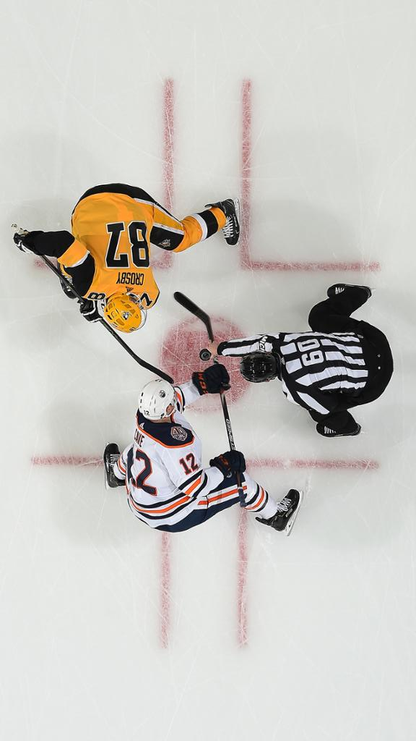
2025-2026 RYHA Season
Nate Moen, President
Ryan Johnson, Hockey Director

Slide 2

AGENDA
Welcome
Board and Coordinator Roles
DIBS Information
Fundraising & Booster Club
President Updates
Hockey Development & Tryouts
Questions

Slide 3
WELCOME
On behalf of RYHA, thank you for taking time to meet tonight. We want this to be a great experience for everybody, as this goes by quickly!

Slide 4
AGENDA
Welcome
Board and Coordinator Roles
DIBS Information
Fundraising & Booster Club
President Updates
Hockey Development & Tryouts
Questions

Slide 5

ASSOCIATION BOARD MEMBERS
  President – Nate Moen
  Vice President – Dan Ritter
  Secretary – Amanda Spilde
  Treasurer – Christian Grams
  Registration – Emily Barnacle
  Ice Schedule – Tim Hanson
  Gambling Manager – Mike Johnston
  Fundraising – Zach Jans
  Growth Director – Becky Chrisinger
Development Director – Ryan Johnson
Coaching Director – Dan Miller
Girls Director – Andy Pohl
Boys Director – Matt Kleinbrook
Mite Director – John Groebner

Slide 6
ASSOCIATION COORDINATORS
CATEGORIES
Web Master
Communications Coordinator
Manager Coordinator
S.K.A.T.E Coordinator
Hockey Fights Cancer
Volunteer Coordinator
Finance Manager
U10 Coordinator
U12 Coordinator
Goalie Coordinator Travel
Goalie Coordinator Mite
Dryland Coordinator
Jr Gold Director
Ice Scheduler
D10 Rep
Growth Coordinators
Equipment Manager
SafeSport Coordinator
*All coordinators for RYHA Need to have all their registration/sport done by 9/30
Notes:
all coordinators for RYHA Need to have all their registration/sport done by 9:30

Slide 7
BOARD POSITIONS
All Voting Positions are currently filled!
This has not been the case in the past, so we want to keep this momentum going and thank you for your support.
RYHA is growing and with growth comes the need for more opportunities to divide and conquer. We will be adding supporting roles in the future with coordinator positions.
Communication is Key – If you feel there are areas that seem to have gaps or could be improved, please communicate with your board members, remember this is a volunteer organization and there are over 400 kids in our association now!
Our goal is to make this experience a good one for your son/daughter and your family!

Slide 8
AGENDA
Welcome
Board and Coordinator Roles
DIBS Information
Fundraising & Booster Club
President Updates
Hockey Development & Tryouts
Questions

Slide 9
REGISTRATION / DIBS
Families are required to work ten (10) hours of volunteer time during the season regardless of the number of registered players. A minimum of three (3) hours must be completed at one of the RYHA hosted tournaments.
If the volunteer requirements are not fulfilled, you will be charged at a rate of $50 per hour, up to $500.00 (per family) against your payment method on file.
RYHA Travel and Coaches (4 per team), Travel Team Managers (maximum of 2 per team), Mite Coaches (4 per team) and one Mite Team Manager per team will have their volunteer hours fulfilled.

Slide 10
AGENDA
Welcome
Board and Coordinator Roles
DIBS Information
Fundraising & Booster Club
President Updates
Hockey Development & Tryouts
Questions

Slide 11

FUNDRAISING
Zach Jans, Fundraising Director
Personal fundraising
  Not required
  Heggies Pizza
    Selling Pizza to help cover Personal Cost
    Great for family and friends
    If Interested, contact Zach Jans!
Notes:
Zach Jans Speak - Just make sure to ensure that they keep the balance of any sales they make over the cost of the pizza. In most cases its about 3 dollars per pizza.

Slide 12
FUNDRAISING & SPONSORSHIPS
  Tiered “Packaged” Advertising Opportunities
  $1,000/$500/$350
    Mite Team Sponsor/Sponsor Daughter or Sons team.
    Bar Down Classic Tournament Sponsor
Title Sponsor for Squirt-Pee Wee-Mite Jamboree
    Annual Golf Event Sponsor.
      Hole Sponsorship, Meal Sponsorship
Great way to showcase your brand name!
Contact Zach Jans for any sponsorship details,
questions, or ideas!!
ryhafundraising@rogershockey.com
Notes:
Always open to different levels of sponsorships, Try to highlight our large sponsors. Make sure they know that Maynards, Clives, Rockwoods, Boondocks, Cowboy jacks are large supporters so continue to support the groups that support our association. Mite team sponsors are on the jersey in tournament flyers, posted on Tournament Web pages, and on our tournament banners. Tournaments are always a great spot to highlight your businesses as we see many different areas of the metro come to Rogers for those tournaments.

Slide 13

Sa
HIGH SCHOOL BOOSTER CLUB
Rogers Royals Face-Off Booster Club
Sara Weis, President
Provides support to our Rogers Royals Boys & Girls Hockey Programs through fundraising events, sponsorship opportunities, and memberships.
Contact Sara Weis for more information:
rrfobcpresident@gmail.com

Slide 14
AGENDA
Welcome
Board and Coordinator Roles
DIBS Information
Fundraising
President Updates
Hockey Development & Tryouts
Questions

Slide 15
PRESIDENT TOPICS
New this year
SafeSport
Cell Phone Policy
Association Apparel Guidelines
Budget
Ice
Pictures
Future Facility Updates

Slide 16
PRESIDENT TOPICS: NEW THIS YEAR
No girls coop (Informal @ 15U, with Blaine)
ETS and Skills Status
Budgeting towards expansion
District 10 Updates (LRM, Cell Phone Violations, EJ Rule)

Slide 17
PRESIDENT TOPICS: SAFESPORT
All team coaches, volunteers and Locker Room Monitors must be current with SafeSport certification and the Background screening. These items are required.
*One adult male per family Needs to complete registration/safe sport to be a room monitor. This needs to be completed by 9/30
Emphasis on electronic communication and locker rooms
Safe Sport Training: https://www.usahockey.com/safesporttraining
Background Check: https://www.minnesotahockey.org/page/show/96281-screening

Slide 18
PRESIDENT TOPICS: CELL PHONE POLICY
The use of cell phones in locker rooms is strictly forbidden. RYHA understands players may need to have a cell phone in their presence for personal reasons for rides and other communication purposes.
Violations will be reported to D10 and the players family will be responsible for any fines.

Slide 19
PRESIDENT TOPICS: APPAREL
Team warm-up costs are included in registration cost this season. Please make sure your order has been placed with Hat Trick.

Slide 20
PRESIDENT TOPICS: CONT.
Ice
Game scheduling is done through a scheduling app. We block home games for them to schedule around. Each team will be allocated the same amount of game times at SR and RAC. More games at RAC have been scheduled but one team might have more at SR than others. This is out of our control.
The game scheduling process will be done by the end of October.
Once practice schedules are posted to team calendars, any movement of ice is done by the team. The board does not adjust any ice once it is allocated.
Bantams typically are the only teams that can start a practice after 9:15 PM. Due to ice restrictions this season, Peewee/12U may have later start times than in years past.
Teams will have practices this year at the RAC, SR, Anoka, and possibly a few hours at Brooklyn Park.

Slide 21
PRESIDENT TOPICS: UPDATES
Budget
RYHA is in a strong financial position
Planning and forecasting around 2nd sheet
Equipment
Mouth Guards - Must be attached
Neck Guards – Must be worn
Crossbar
Used for registering, calendars, dibs, etc.
Each parent needs a login to receive updates
Future Facility
Progressing with City
New Capital Campaign
Updates

Slide 22
RYHA Rink Drive
Expand the RAC

Slide 23
How are we doing this?
To make this vision a reality, we need support from large donors and the community.
RYHA is organizing a team of skilled salespeople, marketers, and grant writers.

Slide 24
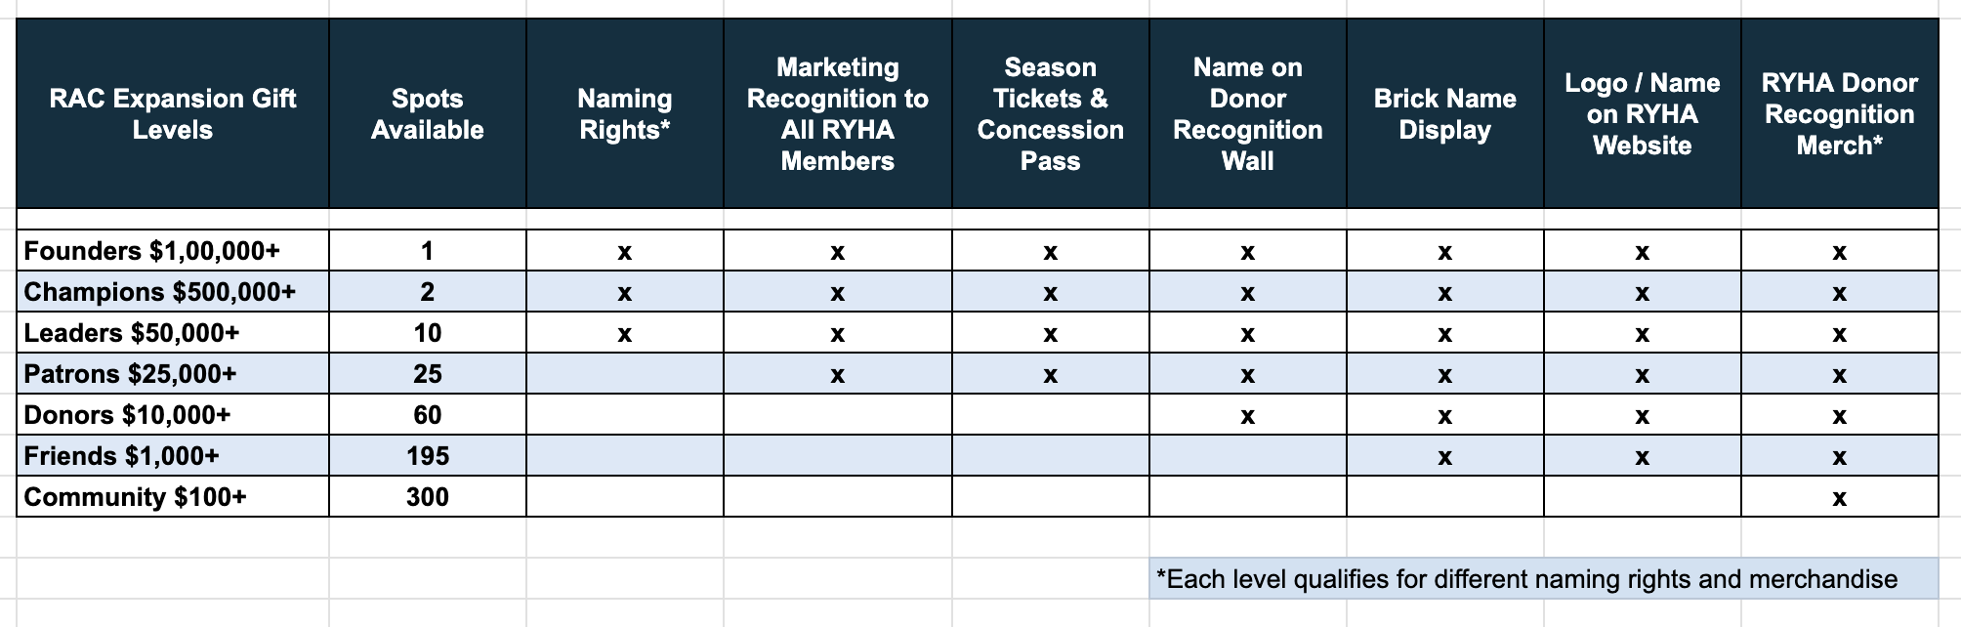
What are we offering large donor sponsors?
Donors contributing $10,000 and over will be honored on the Donor Recognition Wall inside the new rink. Donors choosing a naming opportunity will be recognized on both the Donor Recognition Wall and at the selected naming opportunity.
Contributions of $1,000 will receive a customizable brick for the donor brick wall.

Slide 25
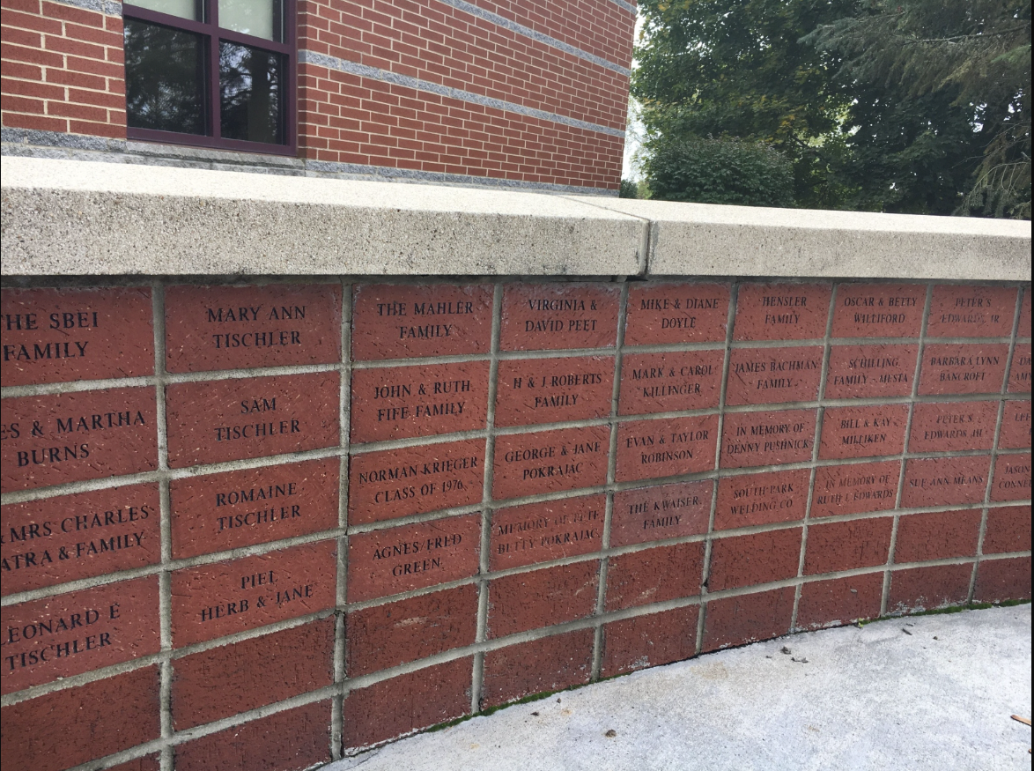
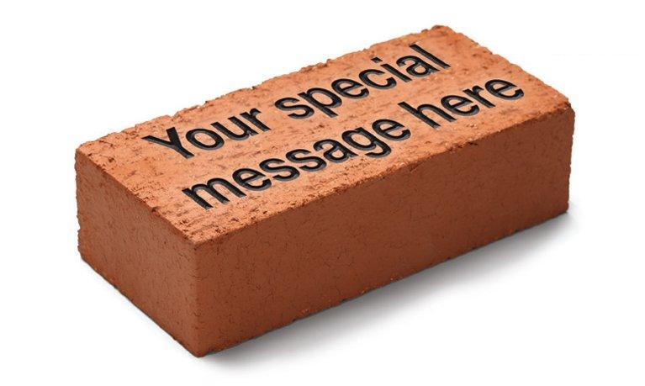
Brick Donations, $1,000 over 40 months
We need 200 donations of $1,000 to hit our goal
Get a brick to get your name, or a loved one's name in the rink forever
We have monthly payment options at $25 a month for 40 months
When RYHA members donate it shows the community just how much this rink matters to us

Slide 26
How can you help?
If you want to help e-mail rinkdrive@rogershockey.com
If you want to pledge money for the future, scan the “Pledge” QR code on the front tables
If you want to donate today, scan the “Donate Now” QR codes on the front tables

Slide 27
AGENDA
Welcome
Board and Coordinator Roles
DIBS Information
Fundraising
President Updates
Hockey Development & Tryouts
Questions

Slide 28

DEVELOPMENT & TRYOUTS 2025-2026
*All items are subject to change
Notes:
* Please note all items are subject to change

Slide 29
WHAT IS THE
ROLE OF HOCKEY DEVELOPMENT?
Oversee and implement player development of on and off-ice training using the principles of Long Term Athletic Development and age appropriate training.
Notes:
The Role of the Hockey Development team is to oversee player development and implement strategies to maximize all players’ development. Though things like Edge boss, USA Hockey ADM models, breathing training, Practice planning, and off ice training.

Slide 30
WHAT DO THEY DO AND WHO ARE THEY?
Hockey Development Group is a Team of volunteers who focus on development of our players
Skaters and goaltenders are equally important
The team meets throughout the year to plan hockey development activities
  Summer training (i.e. 10,000 shot challenge)
  Skills sessions
  Goalie Development
  Coaching Recruitment / Training
  Resource for Parents & Players for ALL Levels
Notes:
The hockey development group is made up of individuals with strong hockey backgrounds and or level directors. All members have extensive playing and or coaching backgrounds.

Slide 31

HOCKEY DEVELOPMENT TEAM 2025 - 2026
Ryan Johnson
Gino Guyer
John Groebner
Jeff Bredemus
Matt Kleinbrook
Chad Vukich
Dan Miller
Dan Ritter
Andy Pohl
Notes:
Here is our Hockey Development team for the 2025-2026 season. We do have an additional associate members that we able to call upon with any development topics.

Slide 32
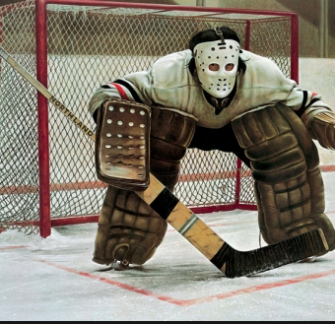
SKILLS DEVELOPMENT - GOALIES
Goalie Coordinator Role – Jason Krey, Greg Ruis
Sunday night skills at Rogers
Goalie specific sessions with Attitude coaching staff
Attitude will work to formalize a coaching plan for goalies for each team
Team will have named coach from staff responsible for goalie drills
Notes:
The goalie coordinators, Jason Krey (travel) and Greg Ruis (Mites) as well as the goalie training company Attitude Goaltending, who we are very happy to have back again this year.

Slide 33
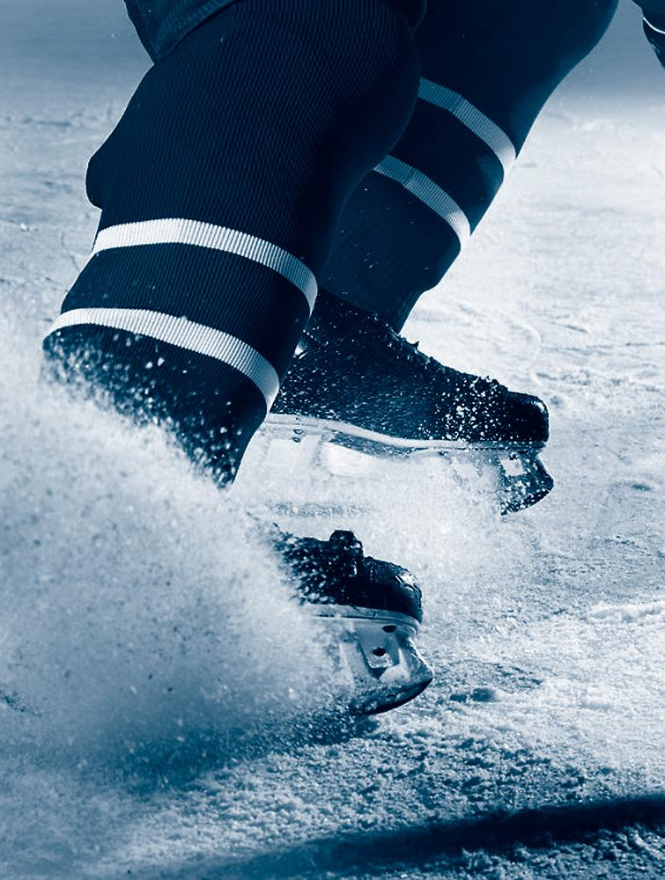
SKILLS DEVELOPMENT - SKATERS
Monday nights will consist of a more informal structure to ensure Ice touches and skill-centered practices run by team coaches in conjunction with Hockey development group input.
Notes:
Monday Night Skill night Will be utilized for PWA / U12 levels and down this year. 45 minutes skill sessions ran by the teams coaches in conjunction with Hockey Development group input. This will give teams more touches were needed and appropriate skill drills.

Slide 34

DRYLAND
Michael Blizel
Performance Executive, ETS
ETS has offered special discounted rates for RYHA members to continue in-season training.
Please reach out to Hank with any questions you may have or to get registered.
WWW.ETSPERFORMANCE.COM/RYHA
Notes:
Due to budgeting, RYHA will not be covering the cost of ETS this season. ETS and Hank have offered a special discount for RYHA players for this upcoming season if you wish to continue your in season training with ETS. Please reach out to Hank for registering.

Slide 35
TEAM DECLARATIONS
Squirts 7 teams
  A/B1/B1/B2/B2/C/C
  10U 2 Teams 10A & 10B2
Peewees 5 teams
  AA/A/B1/B2/C
  12U 2 Teams 12A & 12B1
Bantams 4 teams
  AA/A/B1/B2
  15U 2 teams 15A & 15B
(Number of teams/declarations may change depending on final registration numbers and total number of goalies)
Notes:
Read Slide………… Squirts 13 skaters on the A team and 12-11 skaters per other teams. Peewee’s 14 on AA team, 12-13 skaters per other teams. Bantam’s 15 -14 skaters per team.

Slide 36
BOYS TRYOUTS
Volunteers needed! Please see DIBS page on our website
Cannot volunteer for Bench/Locker Room/Clock etc for sessions you have a player participating
Goalie Skills Sessions
  Friday 9/26 5:00PM – 8:00PM
Squirt Skills Sessions
  Saturday 9/27 starting at 8AM
Squirts Scrimmages 9/27 – 9/29
Peewee Scrimmages 9/27 – 10/2
Bantam Scrimmages 9/27 – 10/3
*Check Website for your child’s times
Notes:
All tryout times and days are listed on the RYHA web page. Please check back frequently during tryouts for your son’s tryout times as groups change. Squirt teams are picked Monday the 29th - Peewee Teams Thursday the 2nd and Bantam teams Friday the 3rd. Our tryout partner this season will be Elk River. Peewees and Bantams will scrimmage in Rogers and Elk River.

Slide 37
GIRLS TRYOUTS
Volunteers needed! Please see DIBS page on our website
Cannot volunteer for Bench/Locker Room/Clock etc for sessions you have a player participating
Goalie Skills Sessions
  Saturday 10/4 3:00PM – 4:00PM
10U Skills Sessions
  Sunday 10/5 starting at 9AM
10U Scrimmages 10/5 – 10/9
12U Scrimmages 10/5 – 10/10
15U Scrimmages 10/5 – 10/9
*Check Website for your child’s times
Notes:
All tryout times and days are listed on the RYHA web page. Please check back frequently during tryouts for your son’s tryout times as groups change. U10 teams are picked 9th – U12 teams are picked 10th and U15 teams 9^{th.}

Slide 38
General Information
General Information
Bill Zacher will be our tryout manager. Bill has 11 years of experience with the RYHA board and the tryout process. He will oversee the tryout processes, procedures, and scoring.
Tryouts will be closed
Parents are not allowed in the arena during any sessions unless they are volunteering. We will have people helping out with skates and equipment.
Each player will receive a reversible jersey the player must wear, which they will be responsible for bringing to all sessions. DO NOT FORGET!
Please check the website for all session times and player assignments
Notes:
Bill Zacher will be our Tryout Manager. Bill has 11 of experience with the RYHA board and knows the tryout process inside and out.

Slide 39
General Information Continued:
Cell phone rule is in effect for all tryout sessions. RYHA will provide a phone drop/pickup station to ensure kids have their phone in a secure location during sessions
Players need to bring their own water
Ice time may not be equal / Timed Shifts / Coaches will be moving players around / Playing with and against different players.
Tape on sticks must be black or white
Players must remove all non-Rogers helmet stickers (No AAA, Tier 1/2 or HP stickers, no # stickers, no cancer ribbons etc).
Rogers Socks (Black, White or Blue) must be worn and must match
Tape on socks must be clear, white or black
Black breezers, gloves and helmet
Skate laces must be black or white
Notes:
General Information – No cell Phones in the locker room for the kids. If you have a cell phone you will be asked to put it in a drop box before entering the locker room. Please bring your own water bottles! Ice time during tryouts may not be equal but we will do our best to get it as close as we can so each player has the chance to show their ability. All stickers on gear especially helmets will need to be removed prior to taking the ice. Socks must match and be white, Blue or black. Laces must be black or white. Tape on sticks must be black or white, shin pad tape should be clear, white or black. Breezers, gloves and helment must be black as well.

Slide 40
INJURY / SICKNESS POLICY
Please call the level director immediately if a player is sick or is injured
Injured player must have a doctors note
If injury is approved, the following information will be used for board discretion:
  Input from previous coaches
  Review past tryout results
  Current scoring (if applicable)
  Past teams made
  Potential extended tryout for player
Notes:
Please notify me or the travel director if your player is sick or injured. An injured player must have a doctor’s note. We do have a protocol for injured players.

Slide 41
EVALUATORS
Outside Evaluators will be used for both skaters and goalies at the Squirt, Peewee and Bantam levels
  Evaluators are not tied to RYHA and will be provided a scoresheet with jersey numbers for evaluation
Goalie evaluators are from Attitude Goaltending and will score both skills and scrimmages.
Evaluator qualifications
  Previous evaluation experience
  Previous coaching experience
  Hockey playing history
  Currently, evaluate other associations
All Scoring is done by Outside Evaluators
  If a coach is chosen prior to last weekend or round of scrimmages they may be part of last round of scrimmages for coach selection picks.
Notes:
Outside Evaluators will be our judges again. They are not tired to RYHA and must meet the criteria to be an evaluator. All have high-level hockey playing experience and or coaching experience at high levels.

Slide 42

SCRIMMAGE SESSION GROUPING AND SCORING
Initial groups will be determined based on last years teams
  Returning A / B1 / B2 players will be divided up into different teams
  Players will be placed in groups using “snake draft style) – 1,2,3,4,4,3,2,1,…..
Scrimmage scoring
  Scrimmages will be used at all levels and will use a 9 point scoring scale (1-9)
  Three evaluators will each provide 3 scores for each player, resulting in 9 total scores per scrimmage
  Players are being scored on their play for each session.
*Due to numbers, 10U, 12U and 15U may not have upper/lower intersquad scrimmages. Additionally, girls scrimmage partners may vary.
Notes:
Read Slide….Initial mix groups are separated evenly based on last year’s scores for returners and coach rankings for 1st-year players coming from Mites. Scoring is on a 9-point scale, and 4 evaluators will give each kid 3 separate scores for each ice time.

Slide 43
SCORING - GOALIES
Skills
  The 9/26 (boys) and 10/4 (girls) sessions for goalies is a skills evaluation
  Goalies will be taken through specific drills for the evaluators to grade each goaltender based on a predetermined set of criteria for each drill
  Skills account for the following % of score:
    Squirts/10U – 60%
    Peewees/12U – 50%
    Bantams/15U – 40%
Scrimmages
  Goalies will be evaluated on skills that are created through game situations and scores will be compiled with skill session scores for ranking purposes
  Outside evaluators will be in communication with tryout manager, goalie director and level director to walk through scoring for final placement
Notes:
Goalie Skill night will be 9/26 boys and 10/4 girls. During scrimmages, goalies will rotate in and out of the net every 5 minutes when multiple goalies are on the ice.

Slide 44
SCORING – SQUIRTS/10U SKILLS
Skills Sessions
Skills Notes
Players will get to practice each station prior to being evaluated
Players will get 3-4 opportunities per station for their final score
Players are not measured on drill accuracy
Falling down is OK
Speed is important
Passing – not penalized for bad pass from coach
Shooting – not concerned with goals
  9 point scale evaluating:
    Forward/backward skating
    Edges
    Starting and Stopping
    Cross-overs
    Shooting
    Passing
Notes:
Squirt Skill sessions, each squirt skater will get a skills session on Saturday morning. Scoring topics are listed here. Each skater will get 1 test run at the drill before the judges start scoring.

Slide 45
SQUIRTS/10U TRYOUT STRUCTURE
SKILLS
Two even groups based on last year teams
Three skill stations
Each station is led by highest returning player to provide evaluators with baseline
3. UPPER/LOWER SCRIMMAGES
Intra-squad scrimmages
Groups are split into upper/lower based on skill and scrimmage scores
4. TEAM FORMATION AND COACH ANNOUNCEMENT
2. MIXED GROUP SCRIMMAGES
Intra-squad scrimmages
Groups are created equal based on skill scores
Notes:
The Squirt Tryout structure is listed here. Squirts/10U start with a Skill Session then go into 2 Mixed scrimmages, then onto upper / lower scrimmages based on skill and scrimmage scores.

Slide 46
PEEWEE/12U SCRIMMAGE STRUCTURE
1. INTRA-SQUAD SCRIMMAGES - MIXED
Even groups split up based on last year teams
3. OUTSIDE SCRIMMAGES WITH ELK RIVER 9/30
Three groups are formed to scrimmage on Wednesday, 10/1 (Lower/Mid/Upper)
2. INTRA-SQUAD SCRIMMAGES – UPPER/LOWER
Groups split into upper/lower based on scores from 1)
AA Pool will be formed after 3rd Scrimmage
Remaining players will be placed in lower pool
Lower group will not be eligible for AA
Upper group will have AA coach led practice
4. OUTSIDE SCRIMMAGES WITH ELK RIVER 10/2
Two groups are formed to scrimmage on Thursday, 10/3 (AA/A and A/B1/B2)
5. FINAL SCORING AND TEAM PLACEMENT
Notes:
The Peewee/12U tryout structure is just scrimmages. Starting with a mixed scrimmage then upper / lower groups. The upper group will have a coach practice mid-tryout, the last 2 scrimmages will be against Elk River.

Slide 47
BANTAM/15U SCRIMMAGE STRUCTURE
1. INTRA-SQUAD SCRIMMAGES - MIXED
Even groups split up based on last year teams
3. OUTSIDE SCRIMMAGES WITH ELK RIVER 10/1
Three groups are formed to scrimmage on Wednesday, 10/1 (Lower/Mid/Upper)
2. INTRA-SQUAD SCRIMMAGES – UPPER/LOWER
Groups split into upper/lower based on scores from 1)
AA Pool will be formed after 3rd Scrimmage
Remaining players will be placed in lower pool
Lower group will not be eligible for AA
Upper group will have AA coach led practice
4. OUTSIDE SCRIMMAGES WITH ELK RIVER 10/3
Two groups are formed to scrimmage on Friday, 10/3 (AA/A and A/B1/B2)
5. FINAL SCORING AND TEAM PLACEMENT
Notes:
Bantam/15U scrimmages will be the same as the peewees/12U. Mixed group scrimmage to start then moving to upper lower based on scores, Last two scrimmages will be against Elk River.

Slide 48
SCORING – TRACKING / INTEGRITY
RYHA uses a system called Skill Shark to store the scores (once score are entered by elevators they are locked)
Access to sheets are limited to subset of board members
  Checks and balances are in place to validate the sheets have not changed from end of one day to beginning of another
  Board members who have children at a certain level will not have access to edit the score sheets
Scores will not be shared or presented after tryouts to parents
Notes:
Scoring has multiple checks and balances to ensure scores are not entered incorrectly or changed. Members with children at a specific level are not allowed to have access to edit any score sheets.

Slide 49
FINAL ROSTER SELECTION PROCESS
Committee including Level Director / Tryout Manager / Development Director / President / Vice President / Coach will be present when selecting the team (Unless child is at that level)
Committee will follow the policy manual guidelines and validate scoring
Deviations from ranked order will need to be justified by coach
Locked players per level, based on final scoring are:
  Squirts – 85%
  Peewees – 75%
  Bantams – 50%
Notes:
The tryout manager, level director, development director, president, and vice president will be present when selecting the teams. Policy manual guidelines will be followed. Locks are 85% at squirts, 75% at peewees and 50% at Bantams.

Slide 50
FINAL ROSTER POSTING
All rosters will be posted to RYHA website as soon as they are finalized
Parent coaches should have phones available at the conclusion of their child’s level so they can be part of team selection
Any issues or concerns with tryout results should be addressed with an email requesting a meeting with Nate Moen to schedule with the appropriate individuals
  Do not call the coach
  Do not call the level director
  Please adhere to the 24-hour rule
No abusive or confrontational behavior will be tolerated
ZERO TOLERANCE POLICY
Notes:
Read the slide.

Slide 51
Misc - Dirty / Cheapshots will not be tolerated
Tryouts are to compete and play hard, we will not tolerate any cheap or intentional dirty play by any player.
If your player injures another player we will review the play with the Referee/Bench Coaches and Evaluators to determine if that player should be removed from the tryout for that day. If the injured player is unable to play or can’t finish tryouts the player that caused the injury will also miss the same time. This is only if it was an intent-to-injure situation.
We hope this is not an issue, but we want to ensure you are aware of how this would be handled.
Notes:
Work hard, play fair and keep it clean! If a player injures another player we will review the play with the referee/bench coaches and evaluators to determine if that player should be removed. If the play is considered to be intent to injure the player causing the injury will miss the same time as the injured player.

Slide 52
CONCLUSION
Tryouts can be stressful we want your players to be relaxed, ready to play and compete, but understand each child is different and as a parent you know your child best, please encourage them and be supportive throughout the process.
Hockey is only a game! We all want this to go as smooth as possible.
Notes:
Read Slide

Slide 53
THANK YOU!
Lots of lifetime friendships are formed during these years and we ask that you represent Rogers in a positive manner at all times, but especially when we are visiting other cities for games and tournaments.
Have fun play hard and let’s make sure the memories that are going to be talked about 10 years from now are good ones about the hockey team and the kids and not something a parent or coach did.
Make Good Decisions!
Enjoy the ride - It goes fast so hang on and be proud of your child and your team!
Let’s have a great season!

Slide 54
AGENDA
Welcome
Board and Coordinator Roles
DIBS Information
Fundraising
President Updates
Hockey Development & Tryouts
Questions

Slide 55

QUESTIONS?

