Slide 1
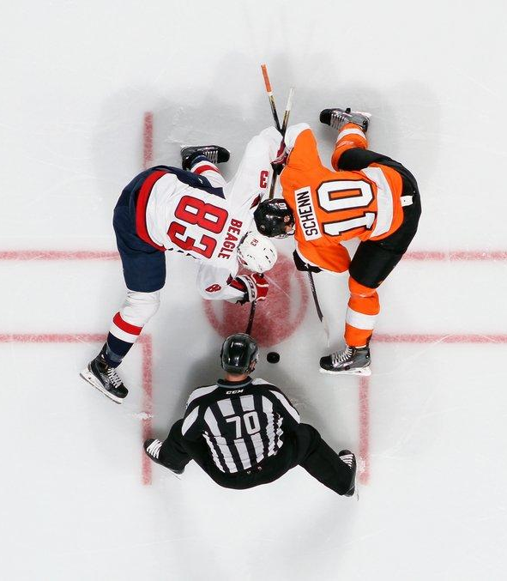
2025-2026
RYHA Mite Season
Nate Moen - RYHA President
John Groebner - Mite Director
Notes:
Bantam/PW:
https://us02web.zoom.us/j/85066777389?pwd=TUJMZzlybko4N1lGT2N1OUNKK1k0UT09

Slide 2

AGENDA
Welcome
Board and Coordinator Roles
DIBS Information
Fundraising
President Updates
Hockey Development & Tryouts

Slide 3
WELCOME
On behalf of RYHA, thank you for taking time to meet tonight. We want this to be a great experience for everybody, as this goes by quickly!

Slide 4
AGENDA
Welcome
Board and Coordinator Roles
DIBS Information
Fundraising
President Updates
Hockey Development & Tryouts

Slide 5

ASSOCIATION BOARD MEMBERS
Monthly Meeting every 3rd Monday of the Month - ALL ARE WELCOME!
Development Director – Ryan Johnson
Coaching Director – Dan Miller
Girls Director – Andy Pohl
Boys Director – Matt Kleinbrook
Mite Director – John Groebner
President – Nate Moen
Vice President – Dan Ritter
Secretary – Amanda Spilde
Treasurer – Christian Grams
Registration – Emily Barnacle
Ice Schedule – Tim Hanson
Gambling Manager – Mike Johnston
Fundraising – Zach Jans
Growth Director – Becky Chrisinger

Slide 6
ASSOCIATION COORDINATORS
U8 Coordinator
U10 Coordinator
U12 Coordinator
Mite Coordinator
Communications Coordinator
Tournament Coordinator
Manager Coordinator
S.K.A.T.E Coordinator
Hockey Fights Cancer
Volunteer Coordinator
Graphic Designers
Finance Manager
Goalie Coordinators
Dryland Coordinator - ETS Performance
Jr Gold Director
Growth Coordinators
Equipment Manager
SafeSport Coordinator

Slide 7

HOCKEY DEVELOPMENT TEAM
Ryan Johnson
Gino Guyer
John Groebner
Jeff Bredemus
Dan Ritter
Dan Miller
Matt Kleinbrook
Andy Pohl
Chad Vukich

Slide 8
BOARD POSITIONS
All Voting Positions are currently filled!
This has not been the case in the past, so we want to keep this momentum going and thank you for your support.
RYHA is growing and with growth comes the need for more opportunities to divide and conquer. We will be adding supporting roles in the future with coordinator positions.
Communication is Key – If you feel there are areas that seem to have gaps or could be improved, please communicate with your board members, remember this is a volunteer organization and there are over 500 kids in our association now!
Our goal is to make this experience a good one for your son/daughter and your family!

Slide 9
AGENDA
Welcome
Board and Coordinator Roles
DIBS Information
Fundraising
President Updates
Hockey Development & Training Camp

Slide 10
REGISTRATION / DIBS
Families are required to work ten (10) hours of volunteer time during the season regardless of the number of registered players. A minimum of three (3) hours must be completed at one of the RYHA hosted tournaments.
If the volunteer requirements are not fulfilled, you will be charged at a rate of $50 per hour, up to $500.00 (per family) against your payment method on file.
RYHA Mite Coaches (4 per team) and one Mite Team Manager per team will have their volunteer hours fulfilled.

Slide 11

TOURNAMENTS
3 HOME HOSTED TOURNAMENTS
NOVEMBER, JANUARY, MARCH
DIBS/Coordinators:
Time Clock
Scoresheet
Apparel/Baskets
ryhatournaments@rogershockey.com

Slide 12
Important Registration
Information
IF YOU HAVE A 1ST YEAR MITE OR U8 PLAYER OR ARE NEW TO RYHA PLEASE EMAIL A COPY/PICTURE OF YOUR CHILD'S BIRTH CERTIFICATE TO:
ryha.hockeyreg@gmail.com
YOUR CHILD CANNOT PLAY HOCKEY WITHOUT THEIR BIRTH CERTIFICATE ON FILE. THIS IS A USA HOCKEY REQUIREMENT.

Slide 13
AGENDA
Welcome
Board and Coordinator Roles
DIBS Information
Fundraising
President Updates
Hockey Development & Tryouts

Slide 14

FUNDRAISING
Zach Jans - Fundraising Director
Personal fundraising
  Not required
  Heggies Pizza
    Selling Pizza to help cover Personal Cost
    Great for family and friends

Slide 15
FUNDRAISING & SPONSORSHIPS
  Tiered “Packaged” Advertising Opportunities
  $1,000/$500
    Mite Team Sponsor/Sponsor Daughter or Sons team.
      Sponsorships for next year
      All sponsorships full this year
    Bar Down Classic Tournament Sponsor
Title Sponsor for Squirt-Pee Wee-Mite Jamboree
    Annual Golf Event Sponsor.
      Hole Sponsorship, Meal Sponsorship
Great way to showcase your brand name!
→ Most of my service providers are RYHA sponsors

Slide 16
FUNDRAISING & SPONSORSHIPS
Contact Zach Jans for any sponsorship details,
questions, or ideas!!
Email- ryhafundraising@rogershockey.com

Slide 17
AGENDA
Welcome
Board and Coordinator Roles
DIBS Information
Fundraising
President Updates
Hockey Development & Tryouts

Slide 18
PRESIDENT TOPICS
SafeSport
Cell Phone Policy
Association Apparel Guidelines
Budget
Ice
Pictures
New Updates – Crossbar, Neck Guards
Future Facility Updates

Slide 19
PRESIDENT TOPICS: SAFESPORT
All team coaches and volunteers must be current with SafeSport certification and the Background screening. These items are required.
Emphasis on electronic communication and locker rooms
Safe Sport Training: https://www.usahockey.com/safesporttraining
Background Check: https://www.minnesotahockey.org/page/show/96281-screening

Slide 20
PRESIDENT TOPICS: CELL PHONE POLICY
The use of cell phones in locker rooms is strictly forbidden. RYHA understands players may need to have a cell phone in their presence for personal reasons for rides and other communication purposes.
For this reason, RYHA will allow cell phones to be in an enclosed bag if the cell phone is confirmed to be powered off prior to entering the locker room.
Violations will be reported to D10 and the players family will be responsible for any fines.

Slide 21
PRESIDENT TOPICS: APPAREL
All teams will have the same warm-ups, which will be ordered from approved vendor.
Eliminates team specific looks
Uses approved RYHA Logo
2-year cycles
Teams can still purchase other items from approved vendor(s) with approved logo

Slide 22
PRESIDENT TOPICS: MISC
Budget
RYHA is in a strong financial position
Gambling continues to contribute
Planning for additional costs if/when additional rink is built
Pictures
Mite Pictures TBD

Slide 23
Team Managers
Each Mite team needs a manager to help coaches and parents stay informed and organized.
Manager Training is held for all Mite Teams once teams are formed (date TBD).
If you are interested in managing, reach out to the head coach once teams are formed.
Please prioritize this training session to ensure you get your season off to a great start.

Slide 24
PRESIDENT TOPICS: Updates
Equipment
Mouth Guards - Must be attached
Neck Guards – Must be worn
Crossbar
Used for registering, calendars, dibs, etc.
Each parent needs a login to receive updates
Future Facility
Progressing with City
New Capital Campaign
Updates

Slide 25
RYHA Rink Drive
Expand the RAC

Slide 26
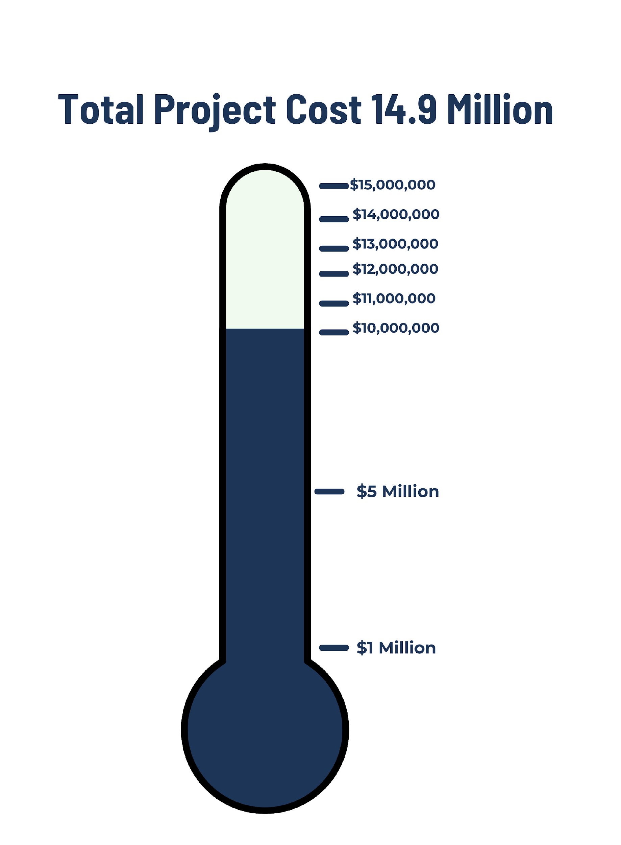
We have 9.9 million secured for the rink but just need 5 million more!

Slide 27
How are we doing this?
To make this vision a reality, we need support from large donors and the community.
RYHA is organizing a team of skilled salespeople, marketers, and grant writers.

Slide 28
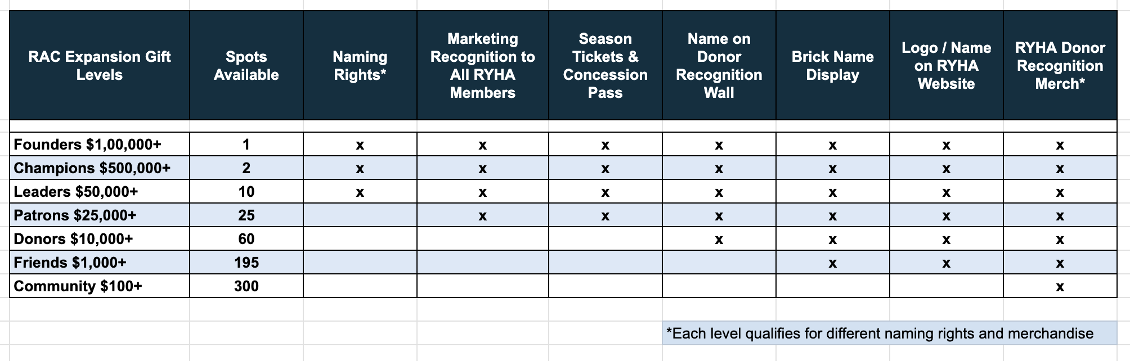
What are we offering large donor sponsors?
Donors contributing $10,000 and over will be honored on the Donor Recognition Wall inside the new rink. Donors choosing a naming opportunity will be recognized on both the Donor Recognition Wall and at the selected naming opportunity.
Contributions of $1,000 will receive a customizable brick for the donor brick wall.

Slide 29

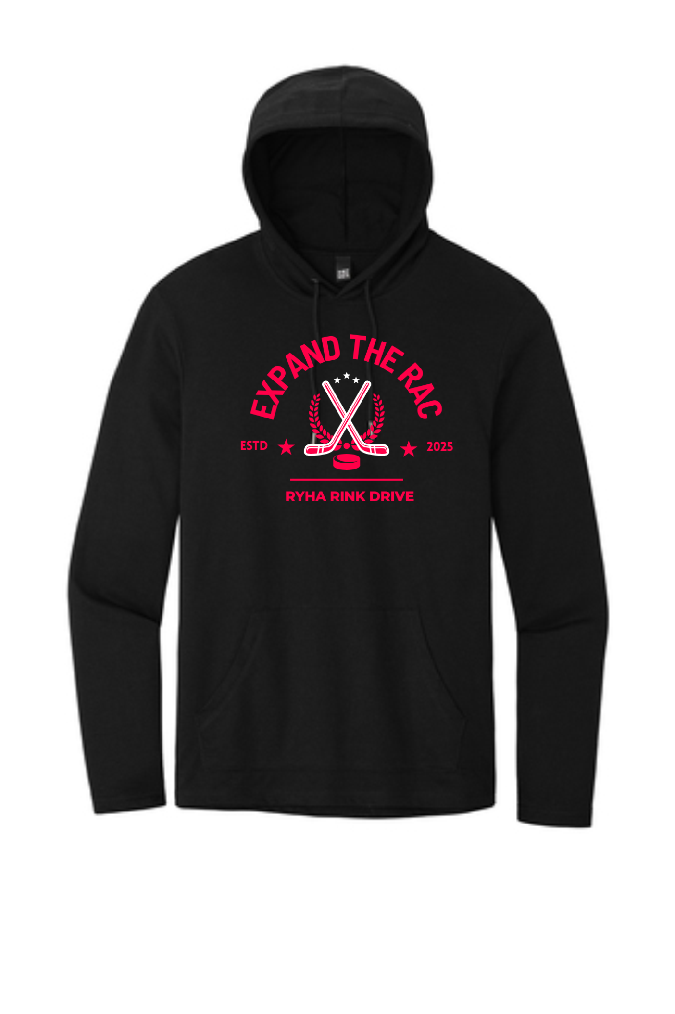

What are we offering RYHA members?
As a RYHA member you are important to the success of the new rink. We put together some exclusive members only packages.
With a $100 donation you get a free youth T-shirt and car badge to show support for the new rink.
A $200 donation will get you an adult sweatshirt and car badge.
Wear your T-shirt around Rogers to show local businesses how much hockey families contribute to our community and spread campaign awareness!
Simply driving your car around Rogers with the car badge helps us get our message out.

Slide 30
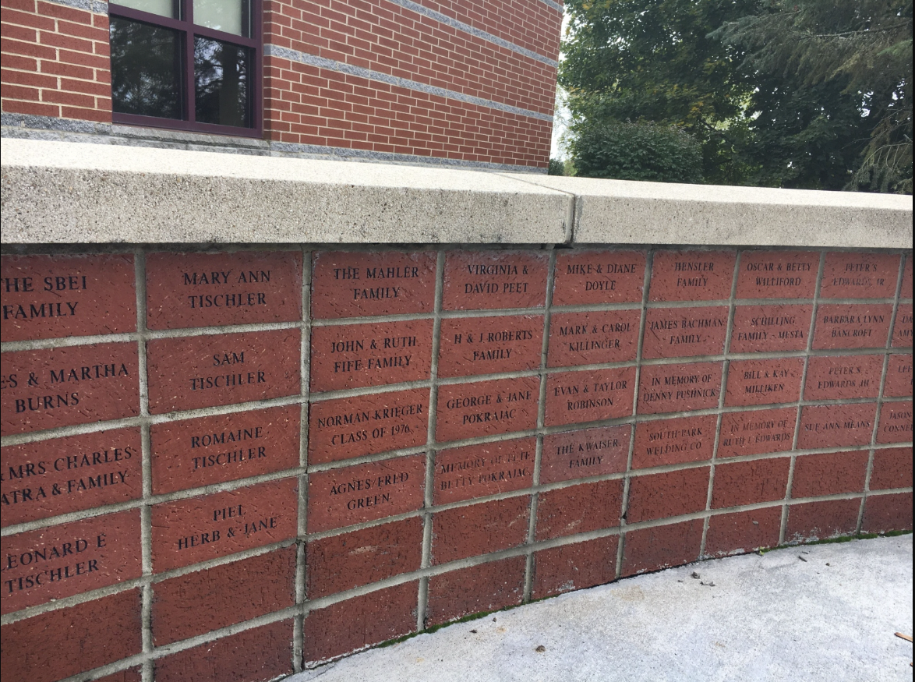
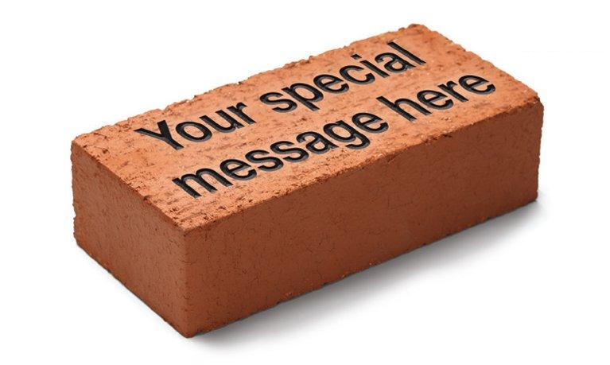
Brick Donations, $1,000 over 40 months
We need 200 donations of $1,000 to hit our goal
Get a brick to get your name, or a loved one's name in the rink forever
We have monthly payment options at $25 a month for 40 months
When RYHA members donate it shows the community just how much this rink matters to us

Slide 31
How can you help?
If you want to help e-mail rinkdrive@rogershockey.com
If you want to pledge money for the future, scan the “Pledge” QR code on the front tables
If you want to donate today, scan the “Donate Now” QR codes on the front tables

Slide 32
AGENDA
Welcome
Board and Coordinator Roles
DIBS Information
Fundraising
President Updates
Mite Program Focus and Development Plan

Slide 33

MITE PROGRAM & DEVELOPMENT 2025-2026
*All items are subject to change

Slide 34
Mite Program Focus
Passion for the game
Individual Skill Development through repetition
Skating, Puck Ability and Basic Hockey IQ
Player Retention

Slide 35
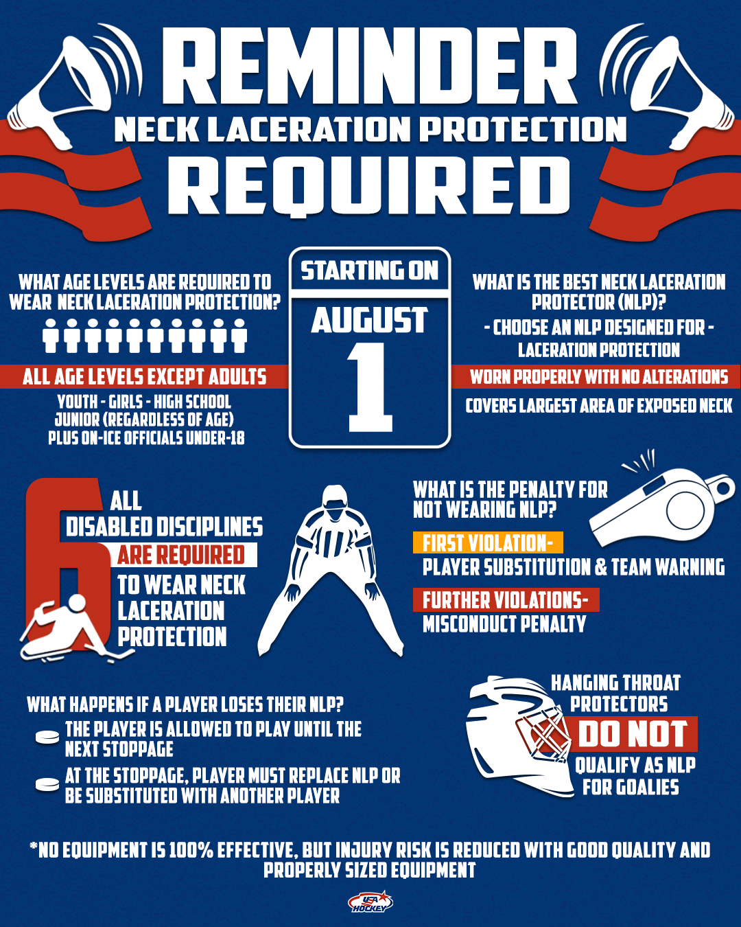

Slide 36
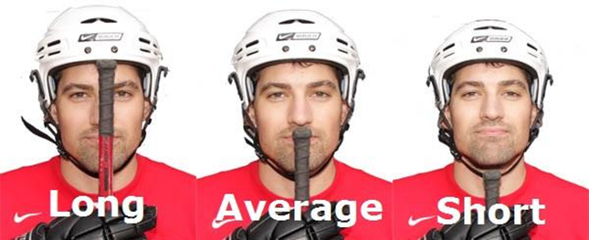
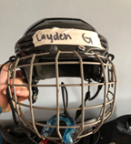
Season Prep
Equipment Necessities:
Name on Helmet
Mouth Guards - need to be attached
Helmet comfort
Neck Guard
Stick length (nose/chin)
Skates
  Proper sizing
  Tightening
Goalies (Mite & 8U A/B/C Levels)
  Everyone given an opportunity
  Goalie Introduction Training (Oct/Nov)
  In Season Mite Goalie Training (Jan/Feb)

Slide 37
Mite Season Structure
Early October - Mid November
  Players will be broken up into groups (5 tiers Mites, 1 tier 8U)
  Players will initially be separated by last years teams and a combination of skill and grade, adjustments will occur during this timeframe
Mid November- Mid March
  All players will be placed on Mite or 8U A-D
  3rd Grade-Mite or 8U A/B/C
  2nd Graders- Mite or 8U A/B/C/D
  1st and Kindergarten- Mite or 8U C or 6U
  Pre-K: Mite D
Some Exceptions may occur, however if an exception does occur the parental guardian will be contacted prior to placement

Slide 38

Training Camp Process
Players will be observed throughout this time to be placed in proper level for best development
Training Camp process will be continuous through the Tier Concept to place players on balanced teams at their level

Slide 39
Training Camp Structure
Group Information and Translation to Teams
Tier 1 - A/B - Mostly 3rd graders and some 2nd graders
Tier 2 - C - Mostly 2nd graders and 3rd graders
Tier 3 - C - Mostly 2nd graders and experienced 1st graders
Tier 4 - Upper mite D - Mostly 1st graders and 2nd year K, some 2nd
Tier 5 - Beginner mite D - Pre-K, K, 1st
8U Tier - Girls A/B

Slide 40
Practice Structure
All Practices are pre-planned and Coaches are expected to follow plan for that session
Practices are intended to support our initiatives around fun and skill development
ADM model will be used
Ice Time
  All sessions will be one hour
Our program is designed for individual development and puck touches. This philosophy and commitment can only be achieved by promoting small area games where we allow players the best opportunity to practice skills, while maximizing game skills.

Slide 41
Additional Practices
•Outdoor Ice:
Mite A/B/C & 8U Teams
South Community Park
More Information to come
Dryland
  No dryland facility
  Older Teams (A/B & 8U) may do some pre-practice Dryland work

Slide 42
Mite Coaches
We Need YOU!
  More help on the ice only helps the players
  Need a LEAD Coach for each Tier/Group
Each Mite Team will need: Dibs are available
  Head Coach
  Up to 4 Assistant Coaches
  Team Manager
Coaching Requirements:
  Register with USA Hockey and RYHA
  Have a Background Check
  Complete Safesport (to be on the ice, in locker room to work with the players)
Mite Coaches Meeting will be Later October

Slide 43
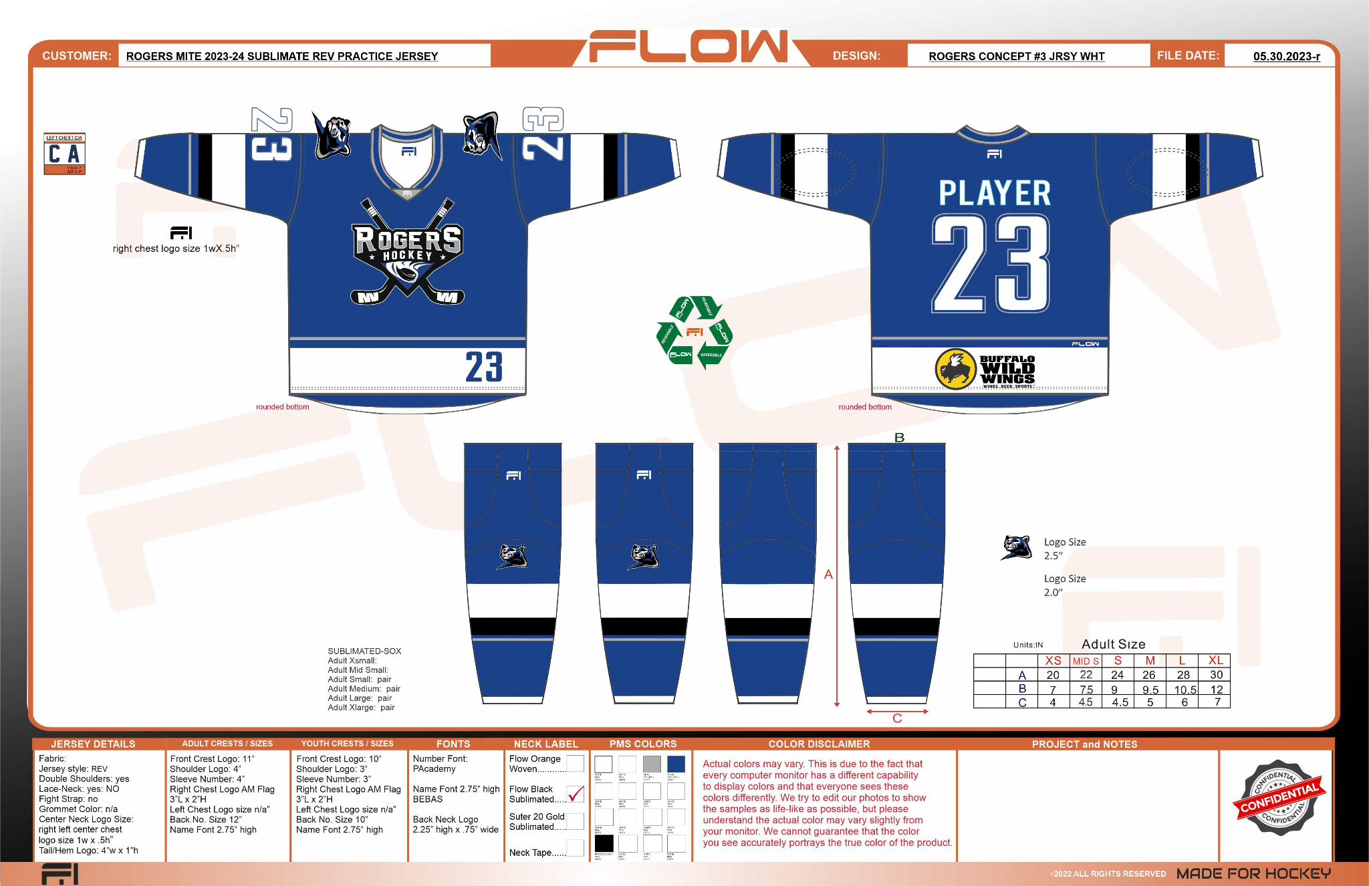
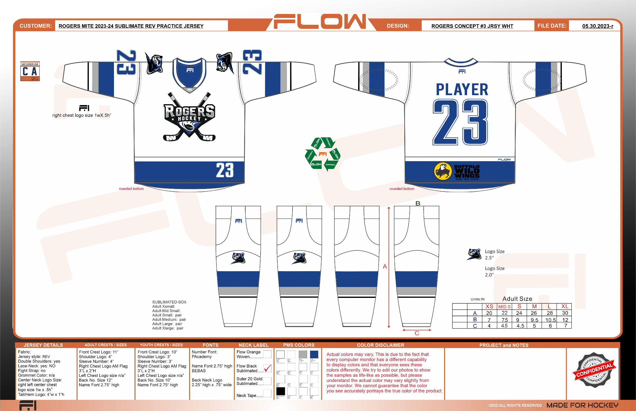
Team Information

Slide 44
Team Information
Regular Season
  Mite/8U - A/B
    Half ice games
    4 full ice D10 league games
    3 Jamborees
  Mite C
    Half ice and cross ice games
    3 Jamborees
  Mite D
    All cross ice games
Tier Sessions
  Mite/8U - A/B
    Half ice games will occur after 2nd week
  Mite C
    Cross ice and half ice games will occur after 2nd week
  Mite D
    Cross ice games will occur after 2nd week

Slide 45
Important Parent Information
No Scholarships will be given at this level, so let the kids have fun!
Bullying will not be tolerated, if it does occur please contact Level Director and there will be swift action
May play at other arenas other than Rogers. We have tried our best to get as much ice at Rogers as possible, but events will be scheduled at the Super Rink in Blaine, Anoka, and Brooklyn Park as well.

Slide 46

High School Partnership
Sara Weis - Booster Club President

Slide 47
Thank You!
We look forward to a fun season! Our association is growing and we strive to make this a great experience for you and your families. There are a lot of volunteer hours that go into a season during the season and throughout the summer.
Lots of lifetime friendships are formed during these years and we ask that you represent Rogers in a positive manner at all times, but especially when we are visiting other cities for games and tournaments.
Have fun play hard and let’s make sure the memories that are going to be talked about 10 years from now are good ones about the hockey team and the kids and not something a parent or coach did.
Make Good Decisions!
Enjoy the Ride - It goes fast so hang on and be proud of your child and your team! Let’s have a great Season

Slide 48

Questions?

