Slide 1
Baseball/Softball Infield Maintenance
Basic Practices to achieve the best infield Conditions

Slide 2
Infield Dragging
Clay Maintenance (Batter’s Boxes and Mound Clay)
Moisture Maintenance
High Traffic Areas
Grass Edge Maintenance
Topdressing
Rolling

Slide 3

Topdressing
How Much and What For
Moisture Management
Playability

Slide 4
Topdressing
Try to maintain 1/8” to ¼” of depth
Apply on an as needed basis
Many factors play a role in amount and frequency of topdressing
Types of recommended topdressings: Infield Conditioner Red, Calcined Clay Topdressing
NOT RECOMMENDED: Quick Dry

Slide 5
Infield Dragging
Drag Very Slow
Change Dragging Directions Daily
Stay away from the grass and fence edges
Pick drag up on the infield. Do not drag into the grass.

Slide 6
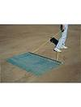
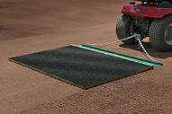
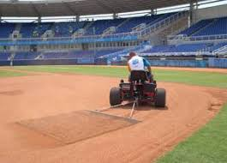
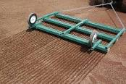

Slide 7
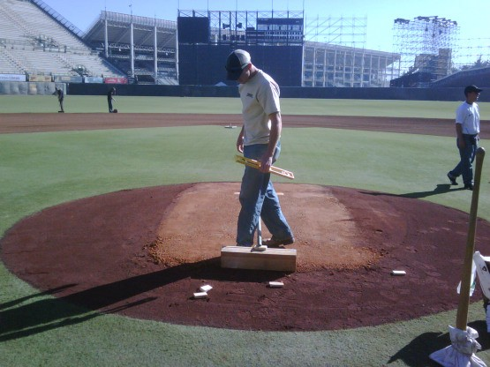
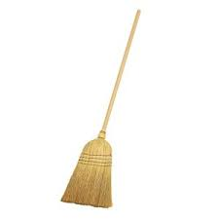
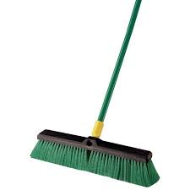
Clay Maintenance
(Batter’s Boxes and Mound Areas
Sweep all topdressing and infield mix away from the top of the clay.

Slide 8
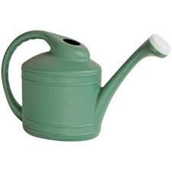
Clay Maintenance
Lightly water the clay to allow new clay to bond

Slide 9
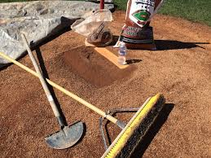
Clay Maintenance
Score the clay for best bond of the new clay to the existing

Slide 10
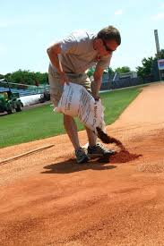
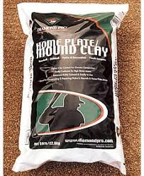
Clay Maintenance
Add the New Clay
Always use the same type of clay as the clay base
This gives it a much better bond

Slide 11
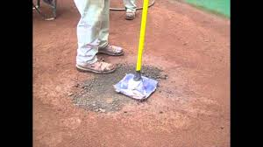
Clay Maintenance
Aggressively pack the clay with a tamp
Re-apply the topdressing over the clay to help hold moisture.

Slide 12
Moisture Maintenance
Moisture is a glue that holds dirt together.
Maintain the proper amount (especially in the clay areas)
Tarps
Topdressing
Water

Slide 13
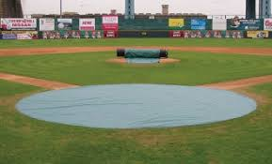
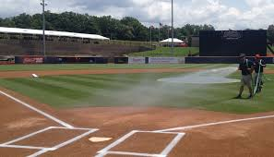
Moisture Maintenance

Slide 14
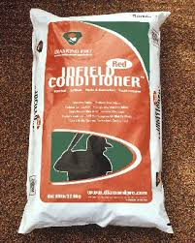
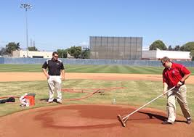
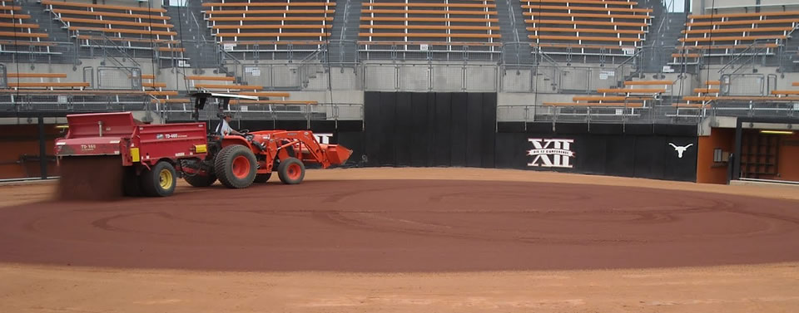
Moisture Maintenance
Topdressing Clay areas and infield skins

Slide 15
Grass Edge Maintenance
Causes of Lip Buildup
  Wind Erosion
  Water Erosion
  Natural Course of Play
  Dragging Too Fast
  Raking in the Wrong Direction

Slide 16


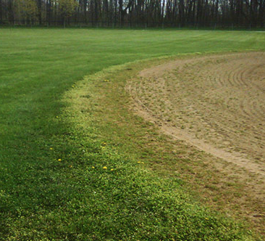



Grass Edge Maintenance

Slide 17
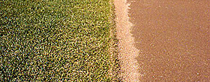
Grass Edge Maintenance

Slide 18
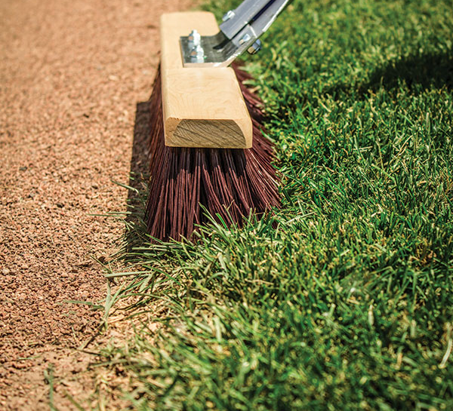
Grass Edge Maintenance

Slide 19
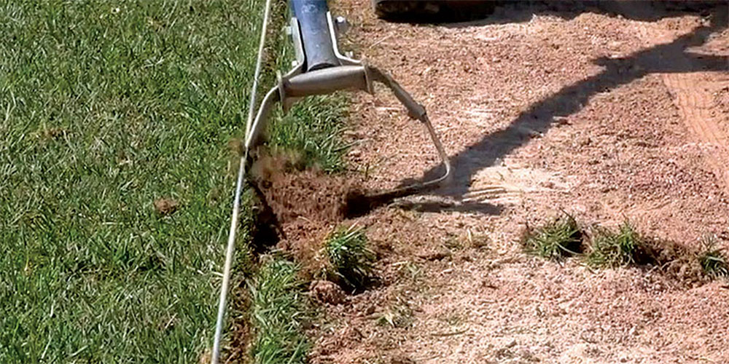
Grass Edge Maintenance

Slide 20
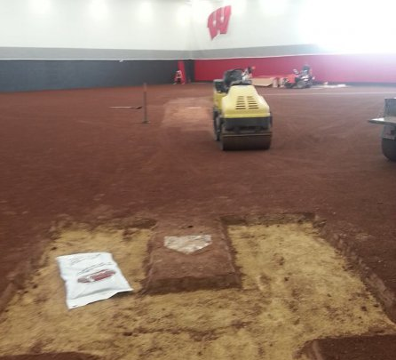
Rolling the Field

Slide 21
Rolling Benefits
Keeps Field Firm
Spring Rolling firms back up after frost puffs the field up
Footing and Ball Roll Consistency
Keeps compacted and doesn’t allow excess water to infiltrate.

Slide 22
Questions?

