Slide 1

Delano Area Youth Hockey Association – Welcome Packet
Last updated 8/2021

Slide 2

Welcome
Welcome to the Delano Area Youth Hockey Association. This handbook is intended to give you some insight into some of the basics around hockey for a new youth player. Whether it’s your first time or you have seen years of hockey games we welcome you as a guardian and parent into the DAYHA family.
Note that it is best to view this document on a computer/online as there are many active hyperlinks.

Slide 3
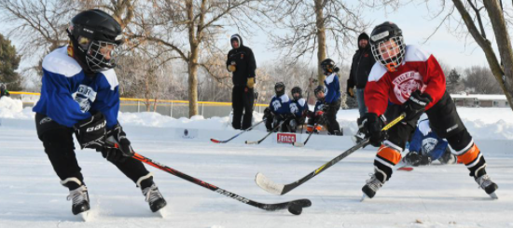
DAYHA – Delano Area Youth Hockey Association. We are a non –profit organization that promotes youth hockey in the cities of Delano, Loretto and Rockford. Our vision is to create a youth hockey experience that will enhance the individual skills and character of all who participate.
We are affiliated with District 3 (D3) of Minnesota Hockey which is an affiliation of USA Hockey. We have over 300 children in our program ranging from kindergarten to high school.
HDC – Hockey Development Committee. This is a group people who have a lot expertise about the actual game and the on ice experiences our kids receive. They help coordinate coaches and practice plans.
DASA – Delano Area Sports Arena. This is our rink. There is a separate board of directors that manages and owns the facility we practice in.

Slide 4
Our board serves as the governing body and main points of contact for the overall program. Your manager and coach will be your primary points of contact but there may be times when you need further support. See the link for who serves in each role and to learn more about what our board does.
DAYHA is a 501 (c ) (3) non-profit organization managed by a board of directions:
- elected by association members
Meets first Monday of each month
Meetings are open to members
Made of up volunteers
https://www.datigers.com/board

Slide 5
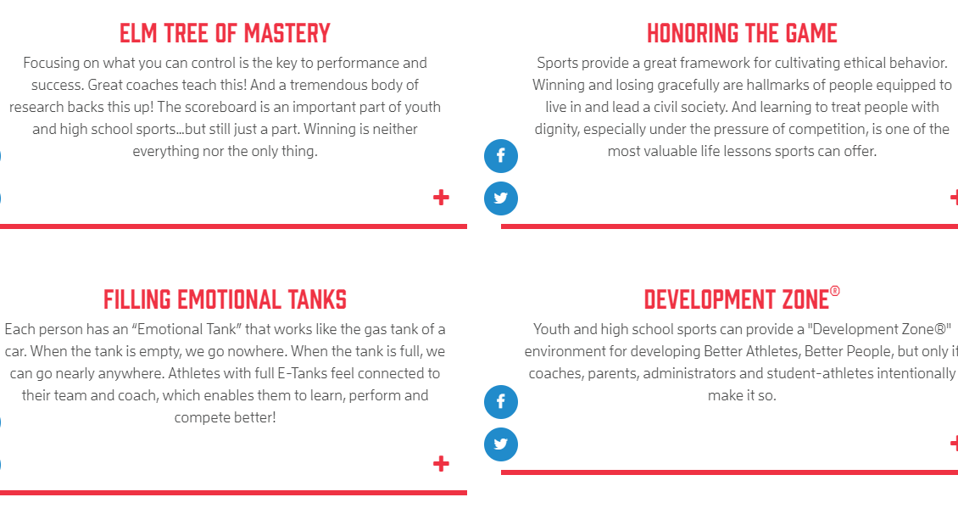
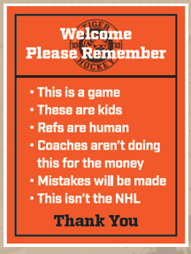

Tiger Hockey

Slide 6
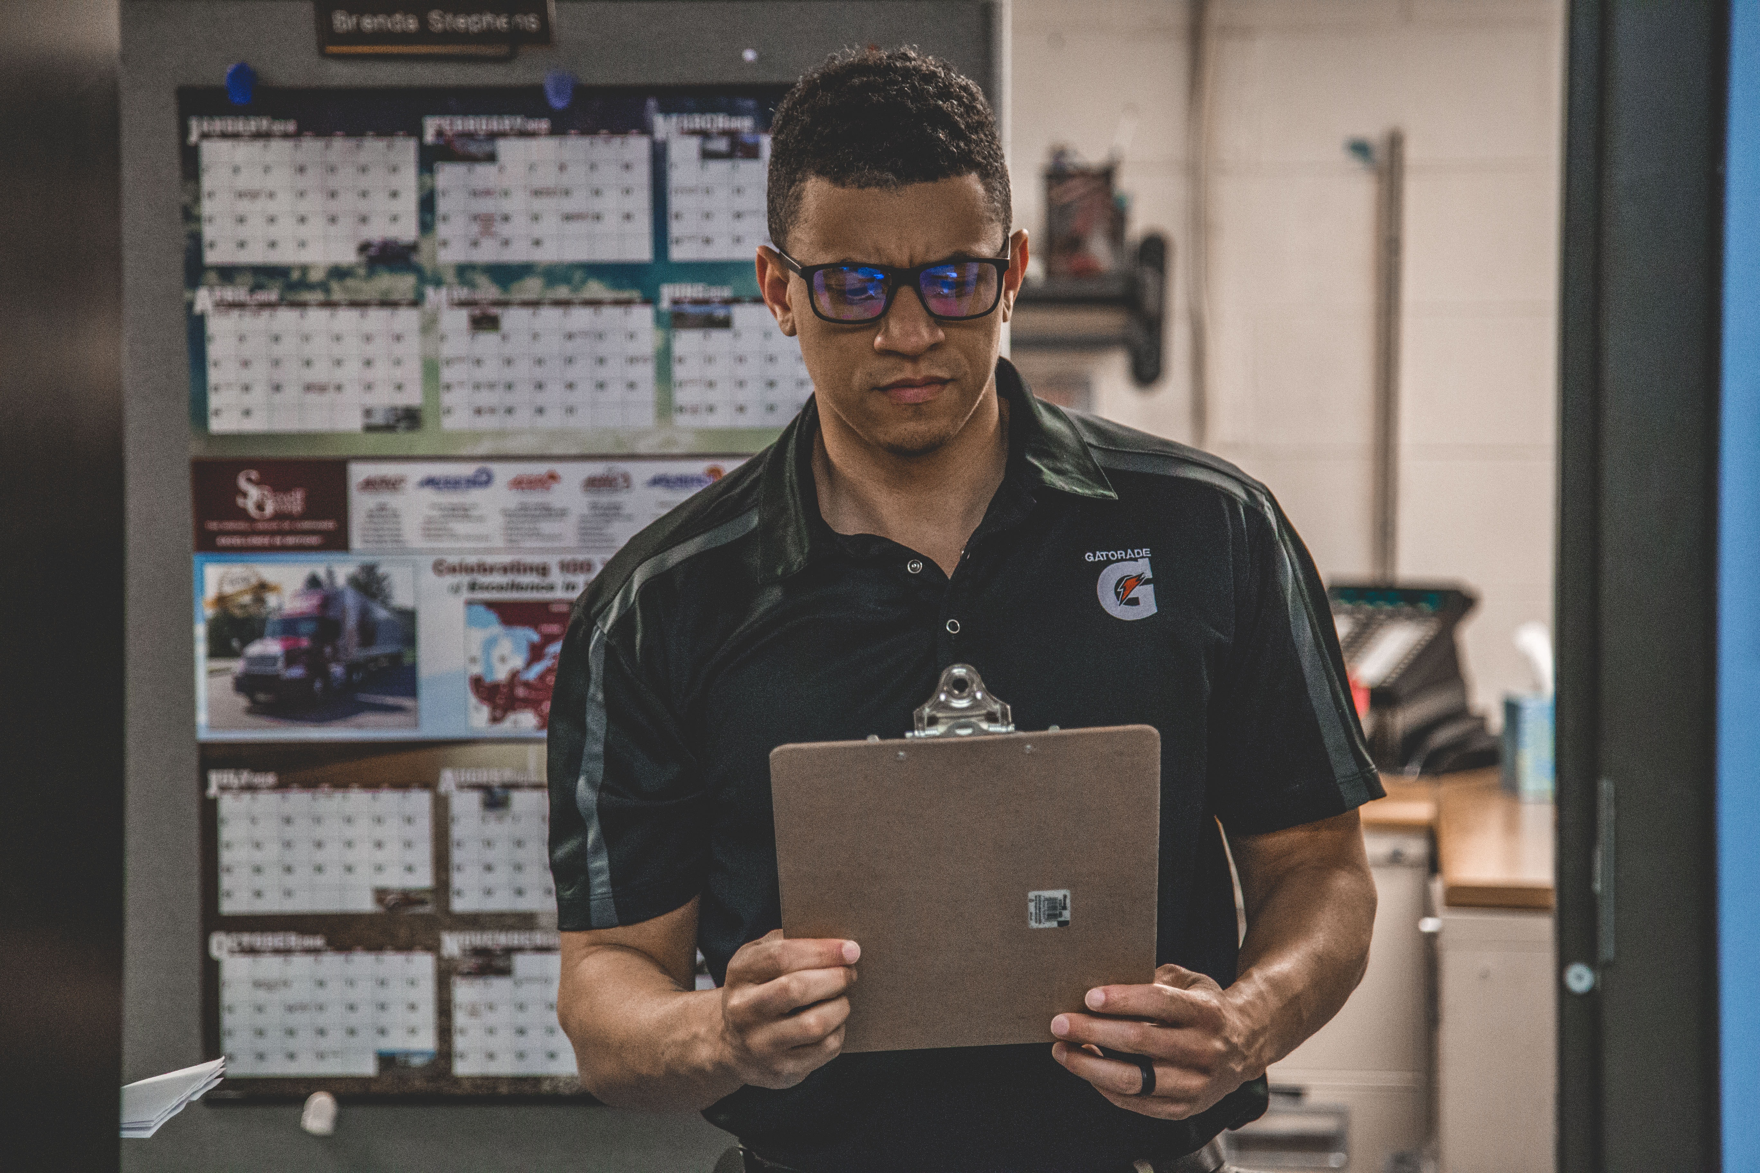
Team Manager & Coach Communications
Your team manager is a parent volunteer role that supports the entire team, coach and the parent group.
Your team manager will share with you how they prefer to communicate with the parents. It’s important that you check this format often, especially before a game, in case of changes or updates. Common examples of communication forums chosen by team managers are email, SportsEngine or GroupMe app.
Questions about logistics, timings, jersey colors, locations should all be directed to the team manager (not the coach)
Questions about your child’s development on the ice should be directed to the coach.

Slide 7
Tips for the Season
Don’t be shy! There is a lot to take in as you start this new adventure. You’ll find that people are more than helpful if you take the time to ask them.
Schedules – The practice schedules will change often and in many cases very last minute. While we know this can be very frustrating to work around your other family obligations, we make every attempt to get your player as much ice time as possible. Typically, the reasons for the change is not poor planning but some other last minute change (Like a HS game or practice cancelling) that creates an opportunity for more ice time.
Ice Time – we struggle in Delano to get as much as time as possible for all teams. We have more skaters and teams than we have ice. This leads to having less than ideal practice times. Never feel obligated to choose hockey over another event (like a family birthday or church) if that’s what you feel is best for your player and family.

Slide 8
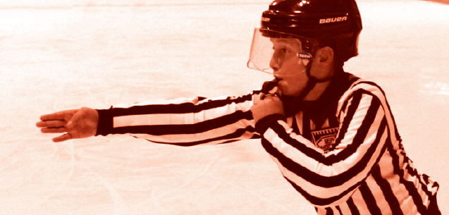
Rules of the game
If you want to know why that whistle is blowing or what those arm gestures the ref is doing mean… click on this link to learn more! USA Hockey Rule Book & Resources

Slide 9
What is required of a Hockey Family?
Mite/8U and Above: Background Screening is needed every 2 years for the parent of the same sex as the player.
Mite/8U and Above: SafeSport requirement for same sex parent as player.
Mite/8U and Above: Volunteer requirement per family is 10 hours for single player/15 for multiple players PLUS 1 tournament hour (See slide below about DIBS)
Squirts/10U and Above (Travel Teams): Penalty box/clock/scorekeeper/locker room monitor for games to be assigned by manager. This time is considered part of the team requirement and will not count towards volunteer hour requirements.
All Levels: optional opportunity to reduce registration fees by selling wreaths through our program, $5 off fees for each item sold.
Mite/8U and Above: Each family must sell or purchase $200 worth of raffle tickets. This is typically distributed in November.

Slide 10
Mite/8U Program Specific Q&A
Why do we play so few games?
We follow the USA Hockey ADM program, which focuses on skill development at this level.
How are practices organized?
A level leader (volunteer coach) sends out a practice plan to all coaches consisting of skill stations and small area games
Who are the coaches?
Parents volunteering their time to develop your child.
When do we play other towns?
There is a D3, 3 v 3 league for Mite/8U. Typically, there will be 8 scrimmages scheduled throughout the season. We will also play in a jamboree at the end of the year against other towns.
Who participates in the D3 3 v 3 league?
All mite and 8U skaters are divided into teams to participate in cross ice scrimmages against other D3 teams.
How are teams selected?
- At the mite/8U level, skaters are split evenly among ages and ability levels.

Slide 11
What are DIBS?
Volunteer hours!
DAYHA is a non-profit/non-school funded organization. Parent/Guardian volunteerism is a critical component to the success of the program.
Who volunteers: all parents and guardians are welcomed to volunteer. Volunteer hours are part of the way we keep costs down for our players and therefore a select number of hours are required for each player except those in (Termite and Intro to Hockey levels)
https://www.datigers.com/dib_sessions

Slide 12

Finding your team’s schedule
Schedule planning is important. DAYHA has made it easy for you to keep track of. Go here for the link to all calendars
https://www.datigers.com/page/show/8153-dayha-calendar
To view multiple teams and events, please click "SHOW TAG MENU" and scroll down to select your team(s) or or level clinic/tryout. Put a check next to multiple teams to generate a cumulative calendar. For association events - Please select the "Assoc. News & Events" Tag.
You should see all teams events that you selected for the month selected. Use the arrow keys next to the current calendar month identification to navigate from month to month.
Click on the Print Page tab at the bottom of the month's page to print.
CHECK BACK FREQUENTLY!!!! Schedules can change frequently and quickly.
How to link this Calendar with your smartphone
How to link this Calendar with your computer

Slide 13
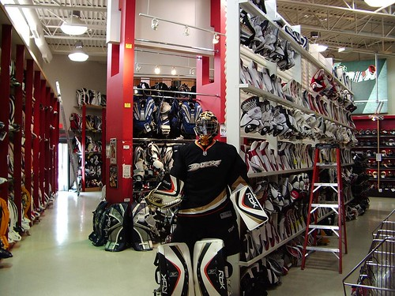
Equipment for your player
You will need to provide the equipment necessary for your child to play.
There are many places to buy great used hockey equipment. A few are, Play it Again Sports, Sideline Swap (online), Facebook Marketplace (online), NextDoor (online).
There are also lots of places to buy new equipment locally such as All Seasons Sports and Pure Hockey. There are too many to name them all!
Sizing for things like sticks and skates is unique to hockey. Be sure to ask someone in a store, an expert or watch a YouTube video to understand how to find the best fit.
Video on skate fit: How to Find Your Hockey Skate Size & Fit at Home – YouTube
Video on stick length: click here
Goalies- If your child is interested in trying out the role of Goalie- please let your coach know. Because of this unique role DAYHA will try to provide as much equipment as possible.
This Photo by Unknown Author is licensed under CC BY-NC-ND

Slide 14

Common Hockey Terms
An Assist: A player who passed the puck to the person who scored
Biscuit: the puck.
Breadbasket: term that describes the goalie’s chest. Typically used when describing that you put a shot right in the goalie’s logo.
Breakaway: A clear scoring opportunity where no defensive player is between the puck carrier and the goalie.
Celly: a celebration after a goal is scored. Depending on the score, stakes, and opponent, varying levels of cellying is acceptable.
Flow: great hockey hair, typically long that flows out of the helmet when the player skates.
Hat Trick: A player who scores three goals in one game achieves a "hat trick.“
Period: there are 3 periods in a game of hockey.
Power Play: Happens when a team has a one- or two-man advantage over the opposition due to penalties
Save: When a goalie prevents a shot from going into the net.
Shot on Goal: An attempt by the attacking team to score a goal by shooting the puck toward the net. This results in either a save or a goal.
Shorthanded: Happens to your team when the opposing team has a one- or two-man advantage due to penalties.
Slap Shot: A slap shot occurs when the player swings the stick back and then quickly forward, slapping the puck ahead with a forehand shot.
Stick-handling: A term for carrying the puck along the ice with the stick.
Turnover: Losing control of the puck to the opposing team.
Zamboni: The vehicle used to prepare the ice on the rink.

Slide 15
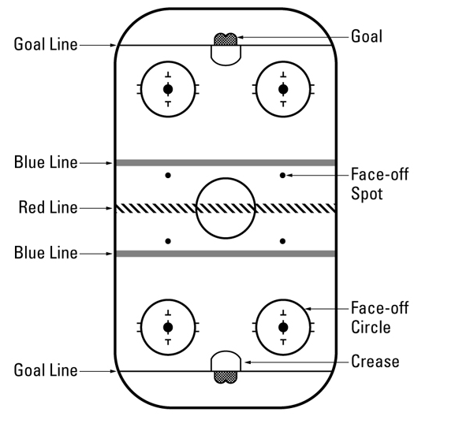
The Rink

Slide 16
Starting Parent Advice!
Here's a helpful list of things you can do to help your aspiring young hockey player and us!
Get Here Early! Ice is scarce and expensive, do your player a favor and give them plenty of time to go to the bathroom, get dressed so they can be on the ice, on time and not miss any instruction. Coaches expect all players to be ready to go on the ice at the designated time.
Bring a water bottle. All players should have a water bottle that is individually marked. All players should bring the water bottle with them on the ice and set it on the boards at the benches so they have access to it at all times without leaving the ice. Once a player is on the ice, there should be no reason for them to leave the ice until the session is over.
Double check gear. Make sure you have everything before you leave the house. There's a lot to remember, so do a quick look around before walking out the door to make sure your player has everything. Have your child help with this task so they get to know what’s needed.
Wear appropriate clothes. Clothing for underneath hockey gear should not be bulky (No jeans or sweatpants!). Gym shorts and spandex pants are encouraged as well as t-shirts or long sleeve shirts, either cotton or sweat wicking material will be sufficient for keeping your player warm while they work up a sweat on the ice.
Get dressed in a locker room. Locker room time is one of the most important aspects of playing hockey. Getting to know fellow players and teammates helps young players peak their interest. And helps develop the camaraderie necessary for playing as a team on the ice. Players should not be changing and dressing in public areas around the arena especially in the front lobby.
Tie skates tight! The ankle support that skates provide is crucial for players to learn how to skate properly and maintain their balance.
Protect their teeth. All players should have a mouth guard. It's a small equipment item but protects some very valuable teeth.
Don't leave clothing or personal items in public spaces. While we do our best to monitor our facility, getting dressed in the lobby or other public areas makes players and parents subject to lost items. Locker rooms are a safe place to leave bags and clothes, but we always recommend keeping valuables on your person.
Dry out your equipment. After each practice or game don’t leave everything zipped up in the bag or it will all STINK! Wash jersey’s/socks every couple times after use. Leave skates, pads, gloves out to dry in your garage, in the sun or a basement/mud room. This dry time will decrease smell incrementally!
Get involved- even though you may just be starting out, volunteer to your team manager or coach to help with small things they may need (just ask!) It’s a great way to meet others and support the team. This can be as simple as making an index card of all kids names and jersey numbers, to helping with treat bags after tournaments.
Have fun!!! We strive for two things every time we get on the ice with your player: Every player has learned something and is better at the end of the session than when they started; and every player had fun. The number one reason kids stop playing a sport is because it stops being fun. Please help us keep everything in perspective and reinforce this basic fundamental.

Slide 17

The “car ride home”
As for the car ride home, it can be an inclination to drill your child about the game but I welcome you to try out a few simple questions when your child is starting hockey :
“Did you have fun?”, “What are you most proud of?” & “What do you want to eat?”
Clearly, typically for most athletes and guardians, there will be more that they want to talk about. To truly help ease any awkwardness in the car ride home, the coach should have a group discussion with parents at the beginning of the year to specifically address this sensitive subject. The discussion should not be about how to parent, but about how parents can help support their player during the car ride home.
Here are three key points author Rick Traugott would like to stress to parents regarding that discussion with their child:
Don’t force a conversation about the game if your player isn’t interested in talking about it. Get a feel for their mental space. Maybe “Did you have fun?” is enough!
Ask what Coach said after the game. Not only will this give a parent a good indication of what a player might also think about the game; it allows for parents to help support the coach, as well as the development of the players and the team.
Don’t you or allow your child to blame others for a tough game. It’s not the goalie’s fault; it’s not the referee’s fault or another teammates fault. It’s a TEAM sport. Parents should focus on the things that your son or daughter can control and did well. Growth happens over time, not in one game!
Keep it light and fun and that will be their frame of mind going into the next practice or game.
Source: Rick Traugott
This Photo by Unknown Author is licensed under CC BY-NC-ND

Slide 18

Parent/Guardian Do’s & Don’ts
As a parent/guardian we know you want what’s best for your youth hocky player. Understanding some of these Do’s & Don’ts will give you good insight into where to start.
New Hockey Parent Do’s and Don’ts
So You’re Signing Your Kid Up for Hockey Eh? by JRiddall
Let Kids be Kids: A Letter to Parents
USA Hockey Parents: Helping Parents Enjoy Their Youth Hockey Experience
One Tank of Gas at a Time by Harry Thompson
10 Sanity Tips for Minor Hockey Parents by Jamie McKinven

Slide 19


Questions and Additional Resources
Contact your manager or coach with team specific questions
Visit the DAYHA page to find out more! https://www.datigers.com/page/show/8149-welcome-to-the-official-web-page-of-the-delano-area-tigers

