Slide 1

Newbury Park Track Club
Parent Orientation Meeting
January 15, 2026
6:30 PM

Slide 2
About
NPTC
Founded in 1968
Member of the Ventura County Youth Track Conference (VCYTC)
  Ventura Tigres
  Camarillo Cosmos
  Heritage Valley Blazers
  Ojai Road Runners
  Thousand Oaks Flyers
  Moorpark Striders
  Oxnard Stars
  Gold Coast
  Simi Valley Running Rebels
  United Track Club
100% run by volunteers
  Board of Directors
  Coaches
  Meet operations
  Miscellaneous administration

Slide 3
NPTC 2026 Board of Directors
Position | 2026 Representative
President | Don Klein
Vice President | Jon Duran
Treasurer | Steve Shearer
Secretary | Carolyn Bernardino
Conference Representative* | Brandi Williams
Head Coach Track + Field | Owen Healy
Head Coach Cross Country | Koby Reynolds
Director of Operations | Matt Greding
Director of Volunteers* | Lauren Muskat/Kari Joiner
Director of Registration | Lauren Muskat
Director of Records | Ron Clemen
Director of Communications/Publicity | Evan Mackay
*
open position in 2027
Board Members are afforded up to 2 comped registrations each season.

Slide 4
NPHS / NPTC
Partnership
Program
BYE WEEKEND – NO MEET
Youth Mentorship Program
  High school kids will be volunteering at youth practices as assistant coaches.
  Bring the high school and youth athletes together
  Still looking for more volunteers
    High school students
    Former youth athletes
    Current track athletes
  Talk to Izzy or Elizabeth for more details, or email nptcmentorship@gmail.com!

Slide 5
NPHS / NPTC
Partnership
Program
Newbury Park High School Track + Field Fundraisers
  Restaurant Nights
    January 20: The Habit (4-9pm, show code GIVEBACK or show flyer)
    February 11: Chipotle (5-9pm)
    March 4th & 5th: Sharkey’s (all day)
    March 4th & 5th: Baskin Robbins (all day)
  Cornhole Tournament
    Register by January 26th
    Saturday, January 31st
    Check-in 11:15; 12 noon start
    Silent auction
  Nearly $5000 raised in 2025!

Slide 6
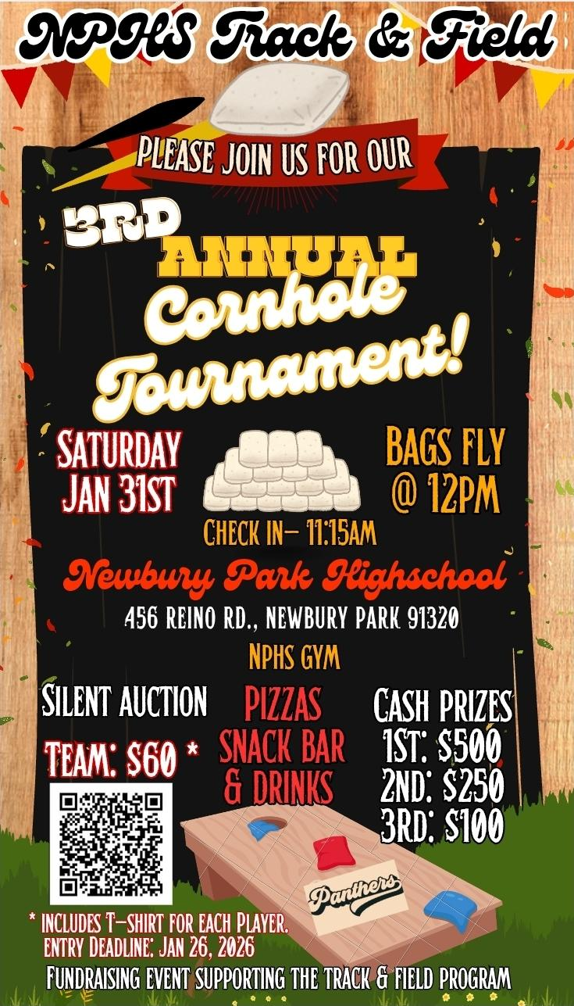
NPHS / NPTC
Partnership
Program
“We raised almost $5000 last year and it was all immediately put back into the program to fund coaches stipends, athlete equipment, tournaments/competitions, and other athlete expenses such as the banquet, awards, and scholarships.
Our goal is to set all of our coaches and athletes up for success in growth + development, mental, emotional + social balance, and to be successful in a competitive environment. We are working to provide better and safer equipment, fulfill coaches’ and athletes’ needs, and also have funds to create a positive experience and environment for all participants for years to come.”
- NPHS T+F Booster
Club President,
Nikki Mitchell

Slide 7
NPTC 2024 Coaches
Age Group |  | Coach
Gremlin; 8U Ages 7 – 8; 2018 – 2019 | Girls | *OPEN POSITION*
 | Boys | *OPEN POSITION*
Bantam; 10U Ages 9 – 10; 2016 – 2017 | Girls | Tish Pletcher, Heather Warme
 | Boys | Brett Miller
Mid; Junior; 12U Ages 11 – 12; 2014 – 2015 | Girls | Brandi Williams
 | Boys | Nate Hamilton
Youth/Intermediate; 14U/16U Ages 13 – 16; 2010 – 2013 | Girls | Sam Harris
 | Boys | *OPEN POSITION*
Specialty | Coach
High Jump | Mike Schuyler
Hurdles | Jon Duran
Shotput | Ryan Lockyer, Jason Zapatka
Long Jump | Lauren Schaffer
Distance | Koby Reynolds/Alavi Konkader
*If interested in coaching, please contact Owen Healy: Owen.Healy@avnetcom.
Notes:
Be sure to emphasize NEED to run this program! Coaches’ meeting next week, the 21st, 6:30, DV Center.

Slide 8
Volunteer Information
Volunteer Commitment
  3-shift obligation per family
    Failure to fulfill the requirement will result in a $250 fine charged at the end of the season
  2 options for meeting obligation
    Individual Shifts
      Approximately 2 – 3 hours each
      Read about volunteer opportunities and sign up
for shifts: Volunteer Sign-Ups
    Full-season Assignment
      Assistant Coaches for several age groups! The younger the age group, the more coaches needed.
      Net Team
      Snack Bar Manager
  Questions: volunteer.nptc@gmail.com

Slide 9
Code of Conduct + Etiquette
Code of Conduct
In order to ensure safety and a positive experience for all, parents, athletes & volunteers must adhere to the following:
  Demonstrate respect for teammates, opponents, coaches, and officials.
  Come prepared and on time for practice and meets,
  Respect all property and equipment.
  NPTC prohibits:
      Hitting, rough housing, or violation of personal space,
      Throwing objects,
      Climbing fences, bleachers, or equipment,
      Swearing,
      Alcoholic beverages and tobacco.
Only Newbury Park Track Club staff, coaches, and athletes are allowed on the track during practice!
Track Etiquette
  Only coaches, assistant coaches, and athletes are allowed on the field
  Safety considerations
  With the exception of water, food & drink are prohibited
  Overall cleanliness

Slide 10
Attire + Preparedness
Clothing and Shoes
  Practices
    Comfortable workout clothing and layers
    Running shoes or general purpose sneakers
      Local retailers: Big 5, Dick’s, Camarillo Outlets, or specialty stores, i.e. Road Runner Sports and Fleet Feet Road Runner Sports NPTC Fundraiser - see next slide
        Monday, January 19th- Sun, January 25
  Meets
    Uniforms
    3/16” pyramid (not needle) spikes are optional for 7-8 and older (parent supervision required); otherwise running shoes or general purpose sneakers
What else to bring?
  Labeled gear bag
  Labeled water bottle
  Sunscreen

Slide 11

Road Runner
Fundraiser

Slide 12
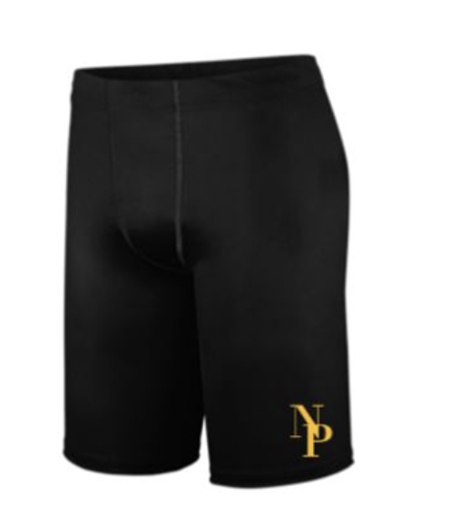
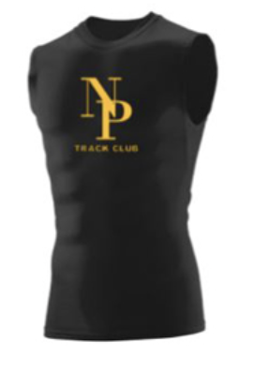

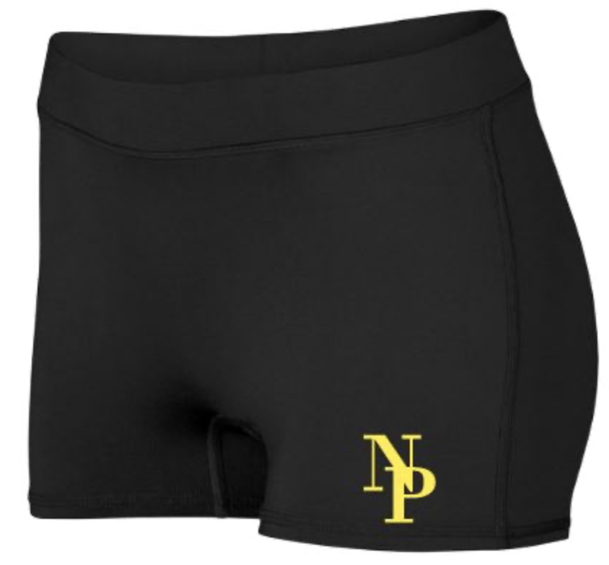



Uniforms
Uniforms are required to participate in meets. If you have a uniform that matches the styles shown below, you do not need to purchase a new one.
Options
  Compression - $28 per piece
  Loose-Fitting - $25 per piece
MEN
GIRLS
& WOMEN

Slide 13
Uniforms
How to purchase
  Online at: BK Sports NPTC Uniforms
Things to know
  Once purchased, uniforms cannot be returned or exchanged
  ORDER NO LATER THAN FEBRUARY 14th!!!
  To try on, visit BK Sports at 3773 Old Conejo Road in Newbury Park during open hours
    Mon – Fri: 10 AM – 6 PM
    Sat: 9 AM – 4 PM
    Sun: Closed
  Call with any questions: (805) 499-4244
Other apparel items
  Mitch Cohen with Relay Apparel – At all home meets!
  Annual Club T-Shirts
    3rd Annual T-Shirt Design Contest

Slide 14
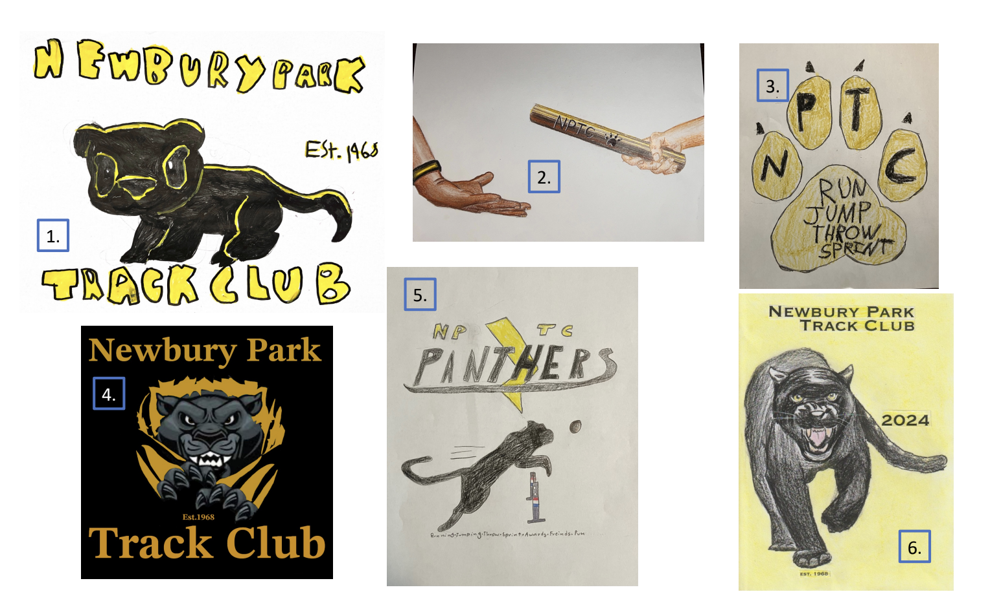
Club T-Shirts
Third Annual T-Shirt Design Contest
  Open to all NPTC athletes
  Designs should be limited to two colors + white
  All submissions should be in by Wednesday, February 18th (email to newburyparktrackclub@gmail.com)
  Winner to be announced Friday, February 20th

Slide 15
NPHS Track and Field Refurbishment
Three schools in our conference are getting their track and fields refurbished
  Refurb at Westlake HS and TO HS started per schedule on December 1, 2025.
  Refurbishment of NPHS was also scheduled to start on December 1 but slipped to December 15.
  The scheduled completion date for all three is still published as February 28th, 2025.
All teams that use the fields during these times are being relocated.
  The winter sports are most affected, i.e., NPHS Boys Soccer.
  All spring sports are also affected, Boys and Girls Lacrosse, T & F.
Mitigation
  NPTC first home meet is April 11, 2026.
  We have secured Moorpark College track for 3 practices (only).
  Offsite practices will be held.
Reminders
  Off site practice locations will be at a premium.
  The “curing” process for all-weather track material is highly sensitive. The track may look “done” but we may not be allowed on.

Slide 16
Practices
Location
  From February-March, at community fields designated by coaches
  Thursdays February 12, 19, 26 at Moorpark College
  In March and after, Newbury Park High School
  Enter at GATE 11 (large gate next to ticket booth) on Lesser Drive
    Plenty of parking on street and NPHS parking lot
Schedule
  Scheduled start date is February 3
  Practice times and places determined and communicated by age-group and distance coaches
Items to note
  Checking in with your coaches
  On-time drop off and pick up
  Checking for belongings
  Rainy day practices
  Lacrosse net

Slide 17
Meets
Schedule
Date | Match-Up | Location
March 7 | Simi Valley | @ Simi High School
March 14 | Oxnard, United | @ United, location TBD
March 21 | Moorpark | @ Moorpark High School
March 28 | Heritage Valley | @ Fillmore High School
April 4 | BYE WEEKEND – NO MEET
April 11 | Oxnard | @ NPHS
April 18 | Thousand Oaks | @ Thousand Oaks HS
April 25 | Ventura | @ NPHS
May 2 – JV East Meet | Gold Coast, Moorpark, Oxnard, Thousand Oaks, United | @ NPHS
May 9 – Varsity | All Clubs | @ Ventura High School

Slide 18
Meets
Running Events
  3200 (ages 11+)
  Hurdles (ages 11+)
  4x100 relay
  1600
  400
  100
  800
  200
  4x400 (ages 9+)
Field Events
  Long jump – open to all ages
  High jump – (ages 9+)
  Shot Put – (ages 9+)
  Discus – (youth only, if at all)
Event Limits
  8U – 14U: 4 events of which no more than 3 may be running
  15 – 16: 4 events of any variety
  Exception: 4x400 does not count towards limit total
  Over-eventing will result in a DQ in all events
Athletes are encouraged to try everything! Athletes who compete in all eligible events at least once throughout the season will be presented with a Warrior Award.

Slide 19
Meets
Meet-Day Schedule
  Meets start at 8:00 AM with first running event commencing at 8:30, unless otherwise noted
  Events are always in the same order, but times are not scheduled
  Calls for events
    Announced over PA
    1st, 2nd, 3rd and final call
  Running events take priority over field events
  Meets typically end between 1:00 and 3:00 PM

Slide 20
Post Season
JV Meet
  For all non-varsity athletes
  Must have competed in event at least once during regular season
  Event limits apply
Varsity Meet
  Based on results from regular-season meets
  Top 9 athletes for laned events
  Top 16 athlete for non-laned running events
    800, 1600, 3200; but must reach qualifying time
  Top 12 athletes for field events
  Top 9 teams for relays (4x100, 4x400)
  Event limits apply

Slide 21
Wrap Up
Key Dates
  Season starts – February 2
  Last day to drop and receive a refund – February 20
  Regular season meets – March 7
Things to remember
  NO COACHES, NO SEASON!
  Sign up to volunteer
  If you were on the waitlist, submit payment
  Order uniform(s)
Items of note
  Updates will be communicated via email through the website as well as in the Crossbar app
  Visit our website: nptrackclub.org or check Facebook: NP Track Club

